Slide 1

Engineering Mechanics Cables
Dr. Vishisht Bhaiya
Assistant Professor
Department of Civil Engineering
S. V. National Institute of Technology Surat
+

Slide 2
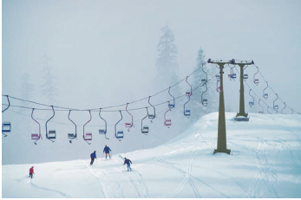
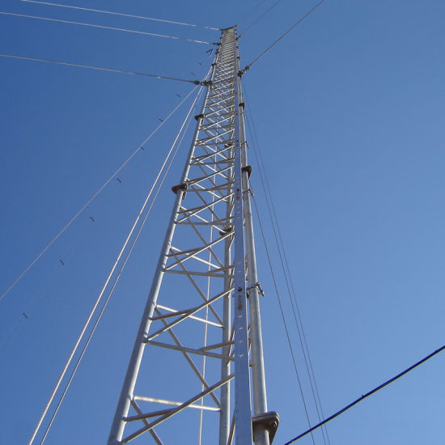
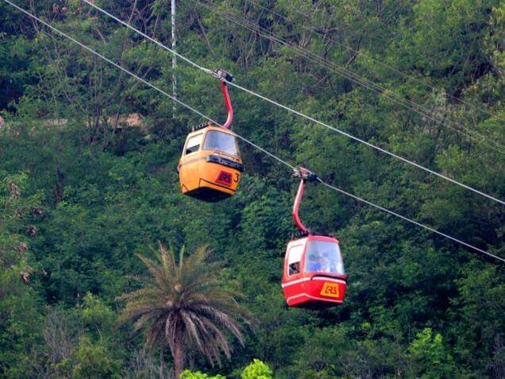
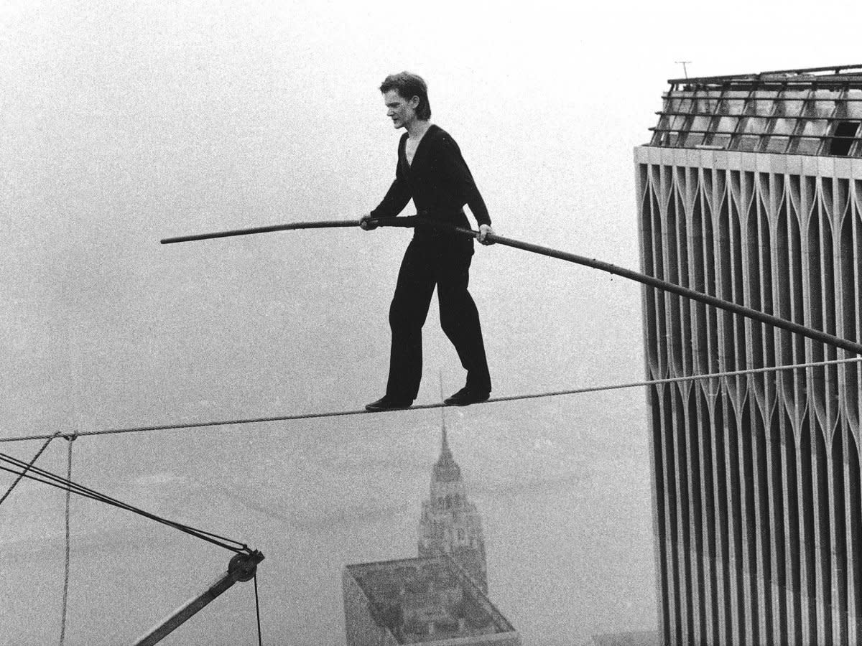
Aerial Tramways
Guy wires for
high towers

Slide 3
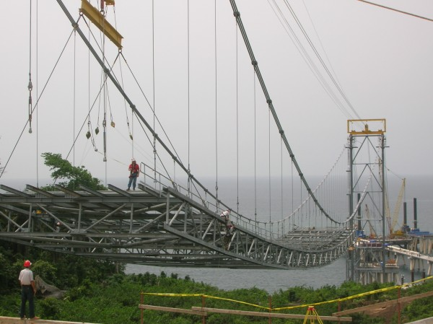

Slide 4
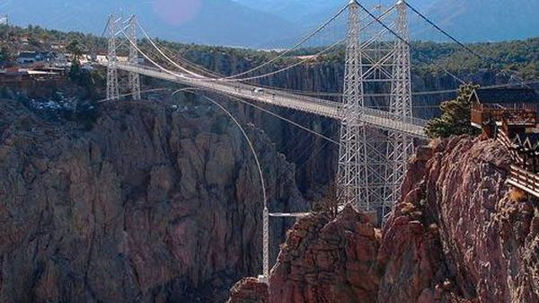
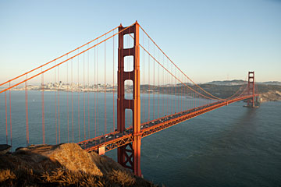
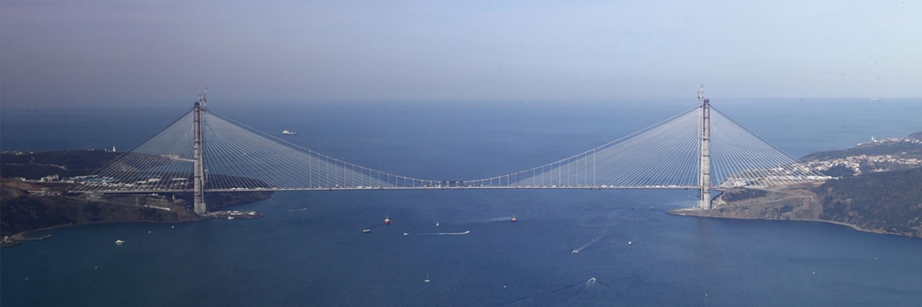
Suspension Bridges

Slide 5
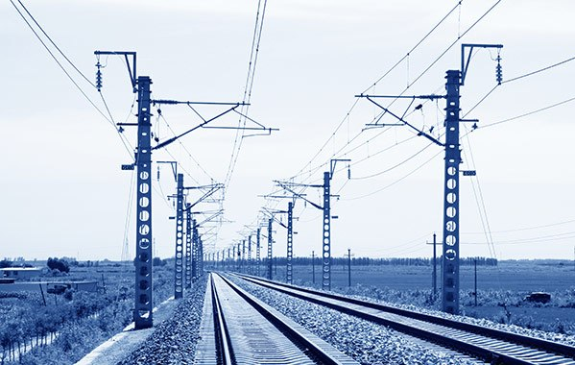
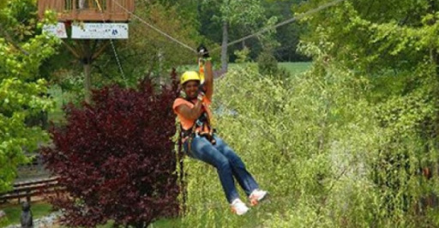
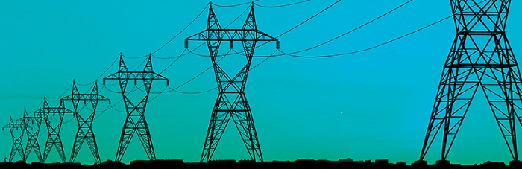
Power Transmission Lines & Sports

Slide 6
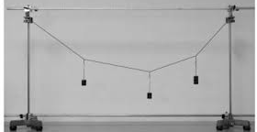
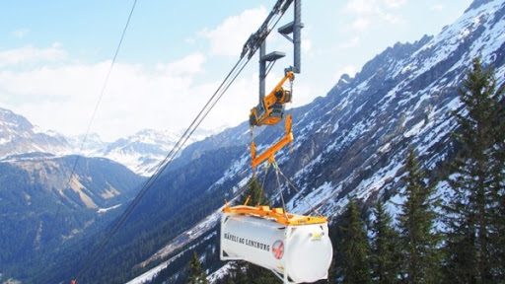
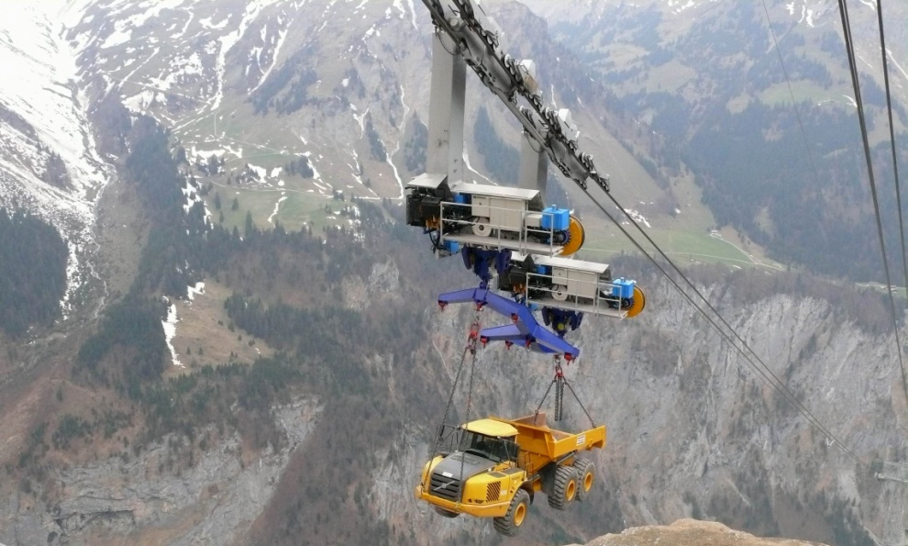
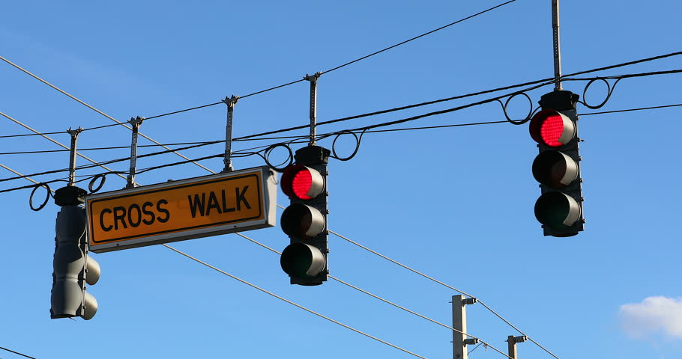
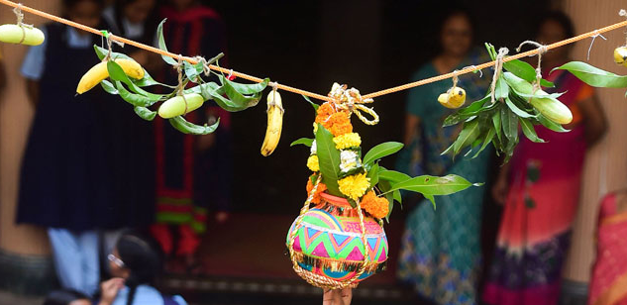
Few More Examples

Slide 7
Flexible Cables
Flexible cables are used in numerous engineering applications.
Common examples are power transmission lines and suspension bridges.
The term ﬂexible means that the cables are incapable of developing internal forces other than tension.
Cables may be divided into two categories, according to their loading:
Cables supporting concentrated loads,
Cables supporting distributed loads.

Slide 8
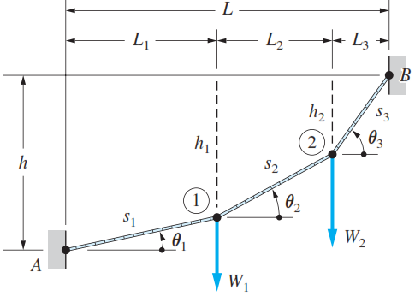
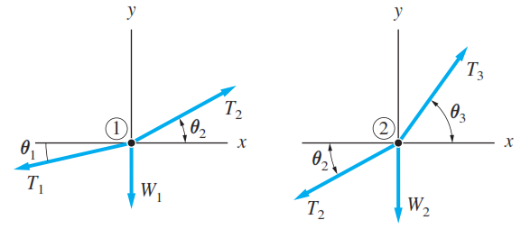
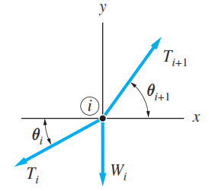

Cables under Concentrated Loads

Slide 9
Cables under Concentrated Loads
Since the weight of the cable of the chairlift shown is negligible compared to the weights of the chairs and skiers, the methods of this section can be used to determine the force at any point in the cable

Slide 10
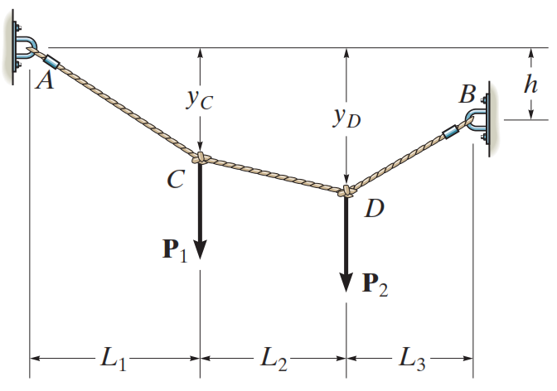
Cable Subjected to Concentrated Loads
When a cable of negligible weight supports several concentrated loads, the cable takes the form of several straight-line segments, each of which is subjected to a constant tensile force.
Nine unknowns
Tension in each of the three segments
Four components of reaction at A and B
Two sags y_{C} and y_{D} at points C and D .

Slide 11
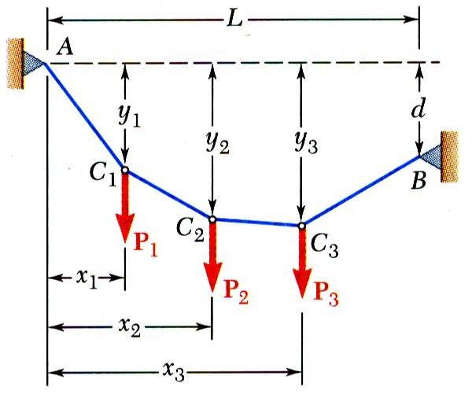
Cables With Concentrated Loads
Cables are applied as structural elements in suspension bridges, transmission lines, aerial tramways, guy wires for high towers, etc.
For analysis, assume:
concentrated vertical loads on given vertical lines,
weight of cable is negligible,
cable is flexible, i.e., resistance to bending is small,
portions of cable between successive loads may be treated as two force members
Wish to determine shape of cable, i.e., vertical distance from support A to each load point.

Slide 12
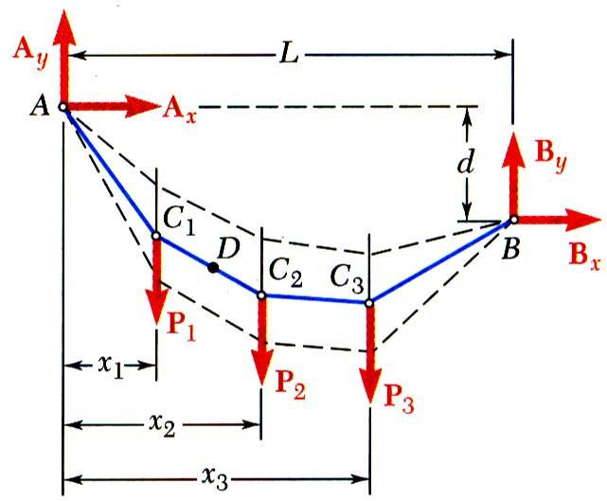
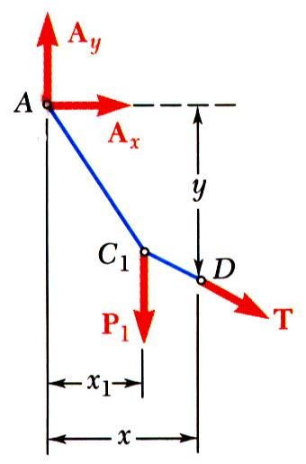
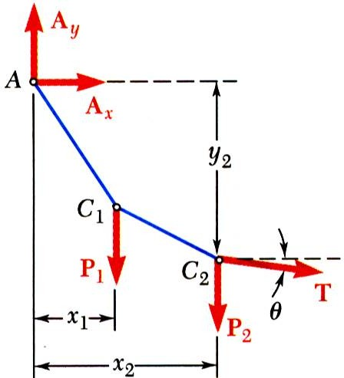
Cables With Concentrated Loads
Consider entire cable as free-body. Slopes of cable at A and B are not known - two reaction components required at each support.
Four unknowns are involved and three equations of equilibrium are not sufficient to determine the reactions.
Additional equation is obtained by considering equilibrium of portion of cable AD and assuming that coordinates of point D on the cable are known. The additional equation is ∑ M _{D} = 0.
For other points on cable,
∑ M_{C2} = 0
yields y₂
∑ F_{x} = 0, ∑ F_{y} = 0 yield T_{x} ,T_{y}
T_{x} = T cosθ = A_{x} = constant

Slide 13
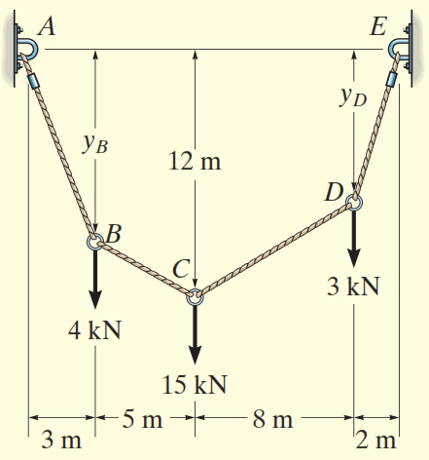
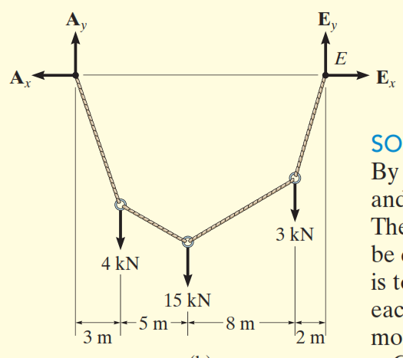
Problem 1
Determine the tension in each segment of the cable

Slide 14
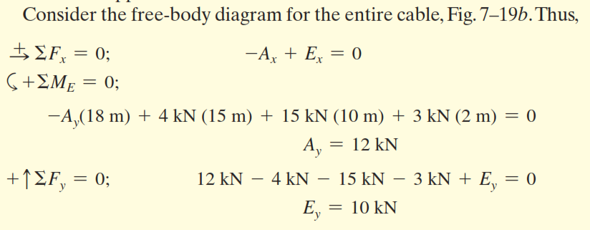

Slide 15
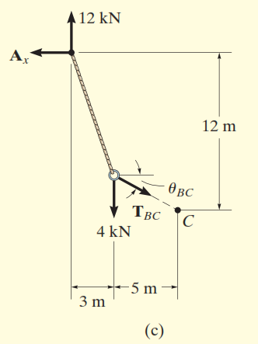
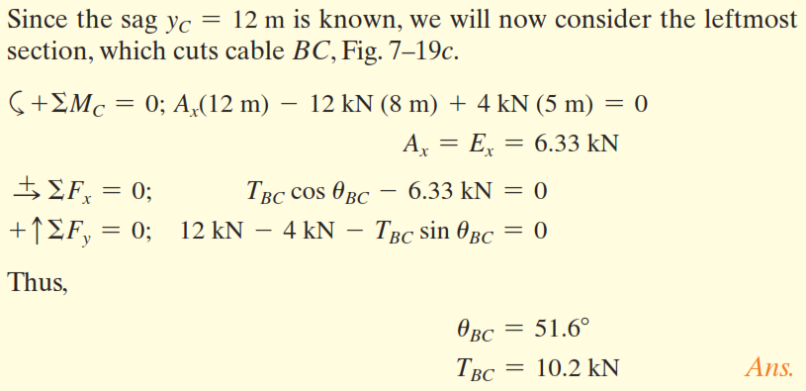

Slide 16
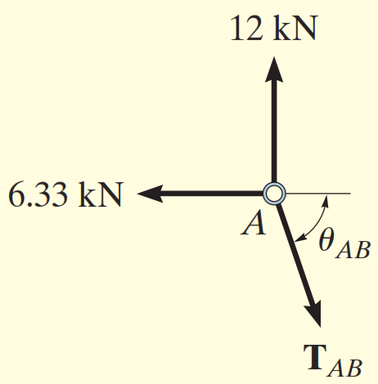
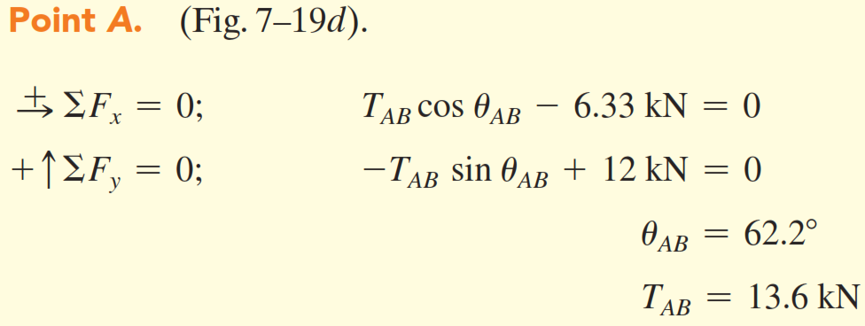

Slide 17
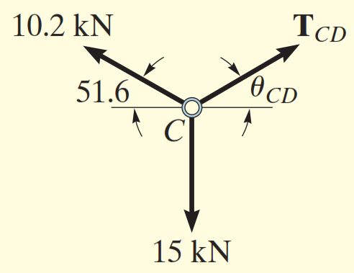
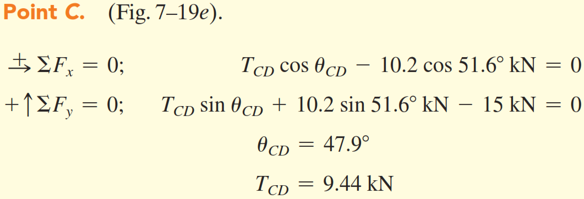

Slide 18
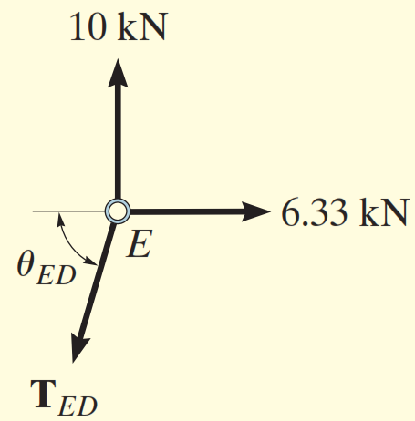
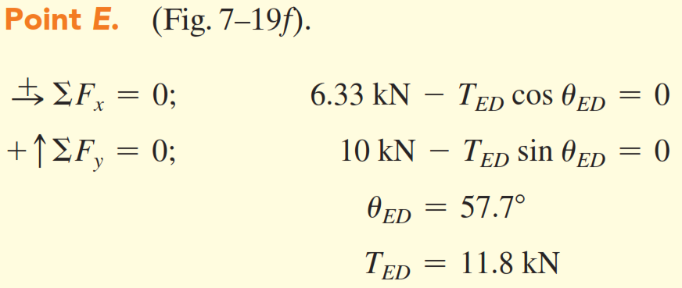

Slide 19
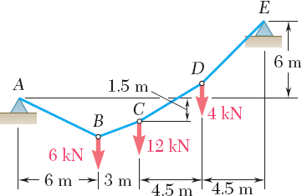
Problem 2
The cable AE supports three vertical loads from the points indicated. If point C is 1.5 m below the left support, determine the Reactions at the support.
SOLUTION:
Determine reaction force components at A from solution of two equations formed from taking entire cable as free-body and summing moments about E, and from taking cable portion ABC as a free- body and summing moments about C.
Calculate elevation of B by considering AB as a free-body and summing moments B. Similarly, calculate elevation of D using ABCD as a free- body.
Evaluate maximum slope and maximum tension which occur in DE.

Slide 20
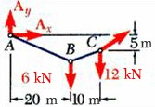
Ey
SOLUTION:
Determine two reaction force components at A from solution of two equations formed from taking entire cable as a free-body and summing moments about E
Ex
Ay
Ax
∑ ^{M} E
= 0 :
and from taking cable portion ABC as a free-body and summing moments about C.
∑ ^{M}C
= 0 :
− 1.5A_{x} − 9 A_{y} + 18 = 0
Solving simultaneously,
A_{x} = −18 kN A_{y} = 5 kN

Slide 21

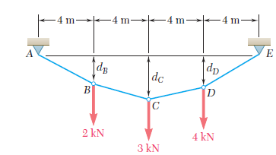
V_{E} =5 kN, H_{E} = 8 kN, F_{CD} = 9.43 kN

Slide 22

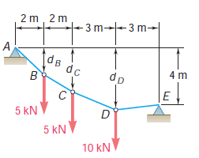

Slide 23
V_{A} =18.57 kN, H_{A} = 21.429 kN
V_{E} = 1.429 kN, H_{E} = 21.429 kN
d_{B} = 1.733 m, d_{D}= 4.20 m

Slide 24

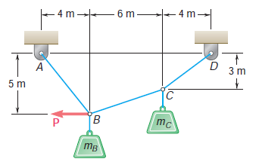
P = 196.2 N

Slide 25
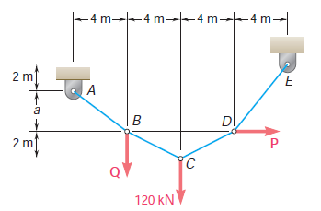
3 m
P = 72 kN, Q = 30 kN

