Slide 1
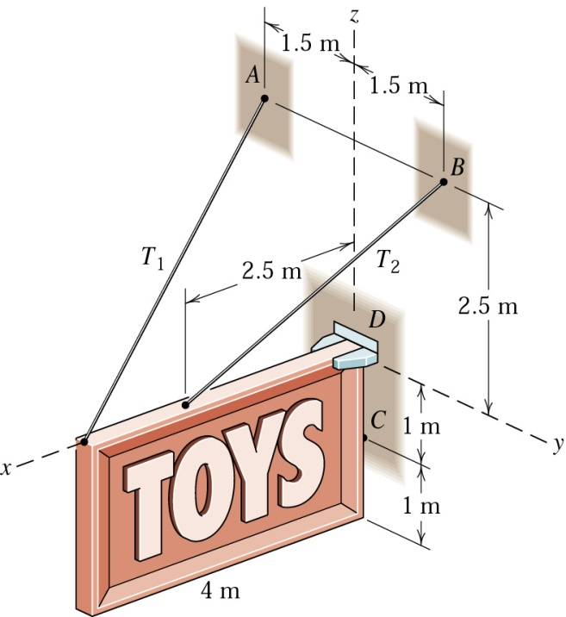


AM 108 Engineering Mechanics
D
O
K
C
A
B
Dr. Vishisht Bhaiya
Assistant Professor
Department of Civil Engineering
Email:- vishisht@amd.svnit.ac.in

Slide 2
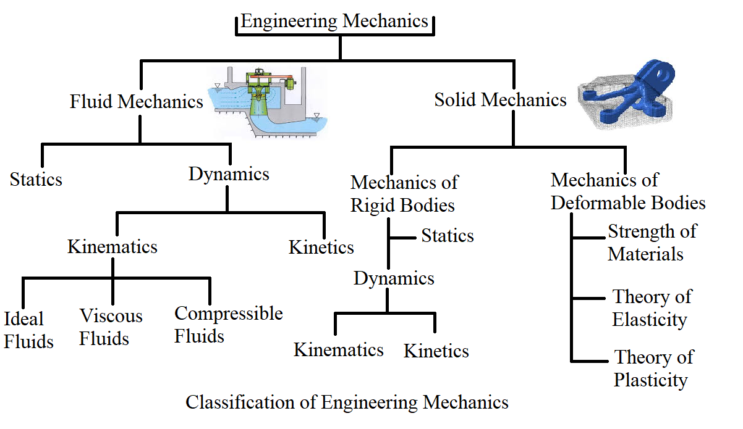
Classification of Mechanics
Study of geometry of motion without reference to the cause of motion
Study of geometry of motion with reference to the cause of motion

Slide 3
Kinetics
In this chapter we will be studying the relationship between forces on a body/particle and the accompanying motion
Newton’s Second law of motion:
F₁
a
Newton’s first and third law of motion were used extensively in the study of statics (the bodies at rest) whereas Newton’s second law of motion is used extensively in the study of the kinetics.
∑F_{x}
F₂
m
∑F_{x} = ma
“If the resultant force acting on a particle is not zero, the particle will have acceleration proportional to the magnitude of the resultant and in the direction of this resultant force”
“If the external unbalanced force acts on a body, the momentum of the body changes. The rate of change of momentum is directly proportional to the force and takes place in the direction of the motion”

Slide 4
Kinetics
The constant value obtained for the ratio of the magnitude of the force and acceleration is characteristic of the particle and is denoted by ‘m’. Where ‘m’ is mass of the particle
Since ‘m’ is a +ve scalar, the vectors of force ‘F’and acceleration ‘a’ have the same direction.

Slide 5
Kinetics
When the particle is subjected to several forces simultaneously, we have
Σ F = ma
Where Σ F represents the vector sum or resultant of all forces acting on the particle.
We observe that if the resultant of forces acting on the particle is zero (Σ F=0), the acceleration ‘a’ of the particle is zero.

Slide 6
Kinetics
u=Initial velocity of particle.
v= Velocity of particle at any instant of time.
If the particle is initially at rest (u= 0) , it will remain at rest (v=0). If originally moving with velocity u, the particle will maintain a constant velocity ‘u’ in a straight line. This is Newton’s First law and is a special case of Second law.
Units
Force in Newtons (N) 1 N = 1 Kgm/s²
Acceleration in m/s²

Slide 7

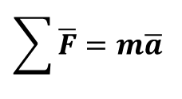
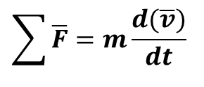

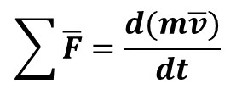

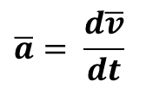
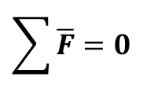

Kinetics
Linear Momentum and Rate of Change of Linear Momentum:
$$\overline{a}= \frac{d\overline{v}}{dt}$$
$$\sum{\overline{F}=m\frac{d(\overline{v})}{dt}}$$
$$\overline{v}$$
$$\sum{\overline{F}=m\overline{a}}$$
$$m\overline{v}$$
m
$$\sum{\overline{F}=\frac{d(m\overline{v})}{dt}}$$
$$m\overline{v}= \overline{L}=Linear Momentum$$
$$\dot{\overline{L}}=Rate of change of Linear Momentum$$
$$\sum{\overline{F}=0}$$
If $\dot{\overline{L}}=0$
m₁v₁ = m₂v₂
If the resultant force acting on the particle is zero, the linear momentum of the particle remain constant, both in magnitude and direction this is the “principle of conservation of linear momentum”.

Slide 8


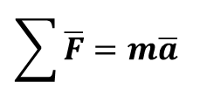






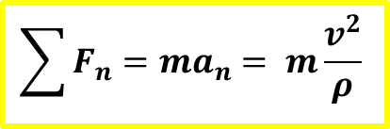

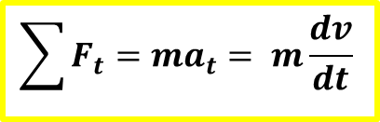
Kinetics
Rectilinear Motion (Rectangular components):
$a$_{y}
F₁
$$a$$
$$a$$
∑F_{x}
$a$_{x}
F₂
m
$$=$$
m
$$=$$
m
∑F
∑F
F₃
∑F_{y}
$$\sum{\overline{F}=m\overline{a}}$$
∑F_{x} = ma_{x}
∑F_{y} = ma_{y}
Curvilinear Motion (Tangential and Normal components):
(t) tangent
$$\sum{F_{t}=ma_{t}= m\frac{dv}{dt}}$$
$$\sum{F_{n}=ma_{n}= m\frac{v^{2}}{ρ}}$$
Path of Particle
$a$_{t}
$$v$$
The normal or radial acceleration is directed towards the center of rotation and is termed as Centripetal acceleration.
(ρ) Radius of Curvature
(n) normal
Particle
Centre
$a$_{n}

Slide 9
Kinetics
The forces along the normal and tangential directions., likewise may be termed centripetal and tangential forces respectively.
A force in the reverse direction to the centripetal acceleration is termed as the centrifugal force
It may be seen that whereas the centripetal acceleration is a reality, the centrifugal force is just hypothetical.
Centripetal acceleration =
Where r = radius of the path ,ω = angular velocity
v= linear speed .
Hence by definition, the corresponding inertial force,
Centrifugal force =
The centrifugal force is the outcome of the inertia of the mass resisting change of motion

Slide 10
Kinetics
Motion with a Constant speed in a Circular path
W
Velocity V
Radius= r
Centrifugal force =
Centripetal acceleration
Centrifugal force
Friction force
If the friction is not enough to negate the Centrifugal force, then the body tends to skid outwards. This friction causes a lot of wear and tear of tyre too. Therefore ‘Banking’ is provided to prevent skidding.

Slide 11
Kinetics
Newton’s second law may also be expressed by considering a force vector of magnitude ‘ma’ but of sense opposite to that of the acceleration. This vector is denoted by (ma)_{rev}. The subscript indicates that the sense of acceleration has been reversed and is called the inertia force vector.
It was pointed out by D’Alembert (Alembert, Jean le Rond d’ (1717-1783), French mathematician and philosopher) that problems of kinetics can be solved by using the principles of statics only (the equations of equilibrium) by considering an inertia force in a direction directly opposite to the acceleration in addition to the real forces acting on the system

Slide 12
Kinetics
D’Alembert’s Principle
EQUATION OF MOTION
(DYNAMIC EQUILIBRIUM)
Consider a particle of mass m acted upon by forces
F₁ and F₂.
By Newton’s Second law of motion we have the resultant force must be equal to the vector ‘m a’ .
Thus the given force must be equivalent to the vector ma.
R
m a
=
F₂
R= ma
F₁

Slide 13
Kinetics
If the inertia force vector is added to the forces acting on the particle we obtain a system of forces whose resultant is zero.
The particle may thus be considered to be in equilibrium. (THIS IS DYNAMIC EQUILIBRIUM)
F₂
R (resultant of F₁ and F₂)
F₁
ma(_{rev})

Slide 14
Kinetics
The problem under consideration may be solved by using the method developed earlier in statics. The particle is said to be in dynamic equilibrium.
If
ΣF_{x} = 0
ΣF_{y}= 0 including inertia force vector component
ΣF_{z} = 0
This principle is known as D’Alembert’s principle

Slide 15
Kinetics
D’Alembert’s principle states that
When different forces act on a system such that it is in motion with an acceleration in a particular direction, the vectorial sum of all the forces acting on the system including the inertia force (‘ma’ taken in the opposite direction to the direction of the acceleration) is zero.

Slide 16
Kinetics
In coplanar force system
y
Direction of motion
F₃
F₁
m
R
m a
m a_{y}
x
F₂
m
m a_{x}
m = mass of the body
a = acceleration of the mass
a_{y} = component of accn. in y direction
a_{x} = component of accn. in x direction
R – m a =0
OR
ΣF_{x} -ma_{x} = 0
ΣF_{y} -ma_{y} = 0

Slide 17
Kinetics
Work Energy Principle
(i) WORK:-
Work done by a force is the product of the force and the distance moved by the point of application in the direction of the force. It is a scalar quantity.
F
F
F
S
α
α
Force, Velocity,
Displacement
( + ) Work Done
A
B
F
S
s
( - ) Work Done
Work done = F × cosα × s
α = angle of inclination of force with the direction of motion
S = displacement of force from A to B
Unit: Nm ( Joule )

Slide 18
Kinetics
(ii) POWER:-
It is defined as the time rate of doing work.
Power = work done /Time= (force × distance) /Time
= force × velocity
Unit: (Nm)/s [watt]
(kN m)/s [kilo watt]
1 metric H.P=735.75 watts.
Energy:-
It is defined as the capacity to do work. It is a scalar quantity.
Unit :- N m (Joule)

Slide 19
Kinetics
Work-Energy relation for translation
From Newton’s second law of motion
∑ F =(W/g) × a -----------(1)
Also a = dv/dt =( dv/ds) ×( ds/dt) = v × dv/ds
sub in (1)
∑ F=( W/g ) × v × dv/ds
F × ds = (W/g ) × v × dv ------------------(2)
Let the initial velocity be u and the final velocity after it moves through a distance ‘ s’ be v

Slide 20
Kinetics
Integrating both sides, we get
s v
∑ F ∫ ds = (W/g) ∫ v dv
⁰ u
_{V}
∑ F × s = ( W/g ) v²/2 ]
u
∑ F × s = (W/2g) [v²-u²]
Therefore work done by a system of forces acting on a body while causing a displacement is equal to the change in kinetic energy of the body during the displacement.

Slide 21
Kinetics
Work done by a spring
s
F=k(s)
The force required to cause unit deformation of the spring is called the spring modulus denoted by the symbol k. The force required to deform a spring is given by F= ks. Work done by the force on a spring is the product of the average force and the deformation s.
W= -ks²/2. [ The negative sign indicates that whenever spring is deformed the force of spring is in the opposite direction of deformation.]

Slide 22
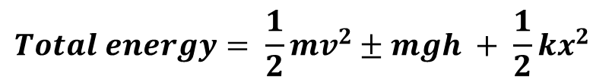
Kinetics
Conservative Force
If the work of a force in moving a particle between two positions is independent of the path followed by the particle and can be expressed as a change in its potential energy, then such forces is called as conservative force.
e.g Weight Force, Spring and elastic force
Non-Conservative Force
The force in which the work is dependent upon the path followed by the particles is known as non-conservative force.
e.g. Friction and viscous force
Principle of Conservation of Energy
When a particle is moving from position 1 to position 2 under the action of only conservative forces then by energy conservation principle we say that the total energy remains constant.
$$Total energy= \frac{1}{2}mv^{2}±mgh + \frac{1}{2}kx^{2}$$

Slide 23
Kinetics
1. A 200N block rests on a horizontal plane. Find the magnitude of the force required to give the block an acceleration of 1m/s² to the right. The coefficient of friction between the block and the plane is 0.25.
200N
30⁰
ma
N
F=0.25N₁
N₁

Slide 24
Kinetics
Solution 1:
Mass of Block m = 200/9.81 = 20.39 kg,
F= μN₁ , a= 1m/s
Σ Fy = 0; N₁ - Psin30 -200 = 0; N₁= 200 + P sin30
ΣF_{x} = m a_{x}.
Pcos 30 – 0.25N₁ = 20.39 ( 1)
Pcos30 -0.25(200+Psin30) = 20.39
[0.866-0.125] P -50 =20.39
P = 95 N

Slide 25
Kinetics
2. A body of weight 2kN is resting on a rough plane inclined at 12⁰ to the horizontal. It is pulled up the plane by means of a light flexible rope running parallel to the plane and passing over a light frictionless pulley at the top of the plane. The portion of the rope beyond the pulley hangs vertically down and carries a weight of 1kN at the end. If friction between the body and plane is 0.2 , find;
Tension in the rope
Acceleration with which the body moves up the plane
Distance moved by the body in 4 secs after starting from rest

Slide 26
Kinetics
2kN
T
A
T
12⁰
B
1kN
here, acceleration of block A is equal to acceleration of block B, hence a_{A}=a_{B}

Slide 27
Kinetics
y
2kN
a_{A}
ΣF_{x} =0
ma_{A}
-2 sin 12 +T-0.2N₁-(2/9.81)a_{A}=0
x
T
Σ F_{y}= 0
2 cos 12 – N₁=0
N₁=1.956 N
Substitute N₁ in eq. 1
-0.415 + T – 0.3912 -0.203 a_{A}=0
0.2 N₁
12⁰
N₁
FBD of A
t=4 s, u=0, and a=0.637 m/s²
Distance traveled s= (½) a t²
s=5.096 m
y
Σ F_{y}= 0
T
T – 1 + m_{B} a_{B}=0
T – 1 + (1/9.81)a_{B}=0
m_{B} a_{B}
B
a_{B}
Solving (1) (2) and (3)
T=0.935 kN
2. a_{A}=0.637 m/s² = a_{B}
FBD of B

Slide 28
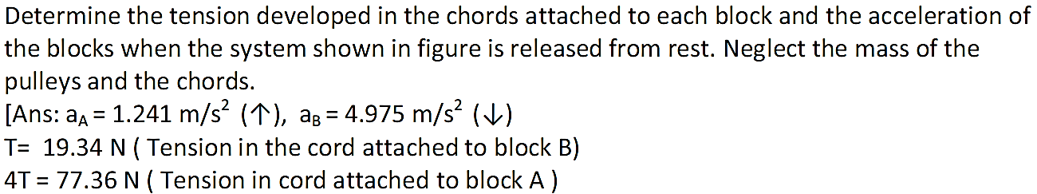
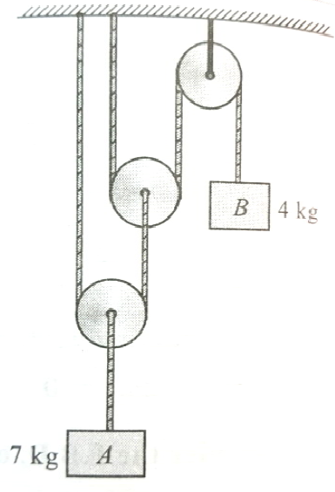
Kinetics
T
2T
1. Direction of motion
T
T
T
4T
T
T
∑F_{y} = ma_{y}
2T
a_{b}
(+) a_{a}
4T – (7 x 9.81) = 7a_{a}
2T
2T
T
7 x 9.81
4T
(+) a_{b}
4T
- T + (4 x 9.81) = 4a_{b}
a_{a}
2 eq^{n} 3 unknowns
4 x 9.81

Slide 29
Kinetics
3rd eq^{n} will be obtained by using kinematic relation
In present case one object (7 kg) is moving up and another object (4 kg) is moving down, Hence
Work done by internal forces = 0
4Tx_{a} – Tx_{b} = 0
4x_{a} – x_{b} = 0
T
Differentiating w.r.t. time (t)
4V_{a} – V_{b} = 0
m_{b}g
x_{b}
Differentiating w.r.t. time (t)
4a_{a} – a_{b} = 0 ---------------- (3)
4T – (7 x 9.81) = 7a_{a} -------------------- (1)
V_{b}
- T + (4 x 9.81) = 4a_{b} ------------------- (2)
V_{a}
Negative Work
4T
x_{a}
T = 19.34 N, 4T = 77.36 N
a_{a} = 1.241 m/s² , a_{b} = 4.975 m/s²
Positive
Work
m_{a}g

Slide 30
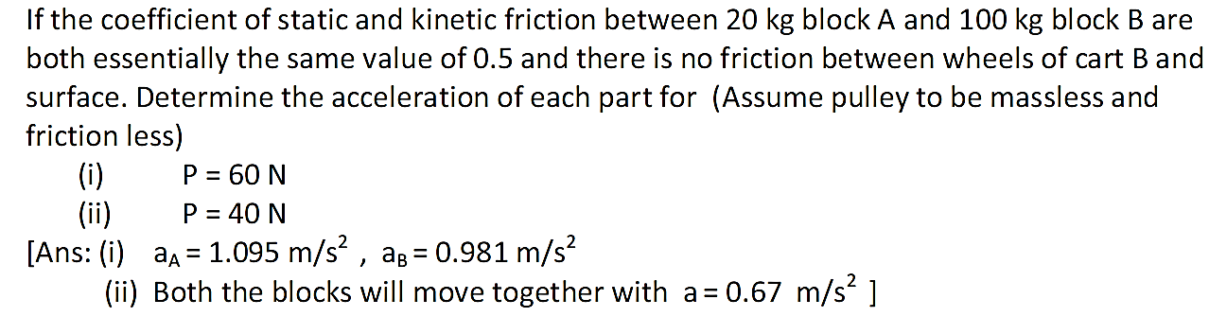
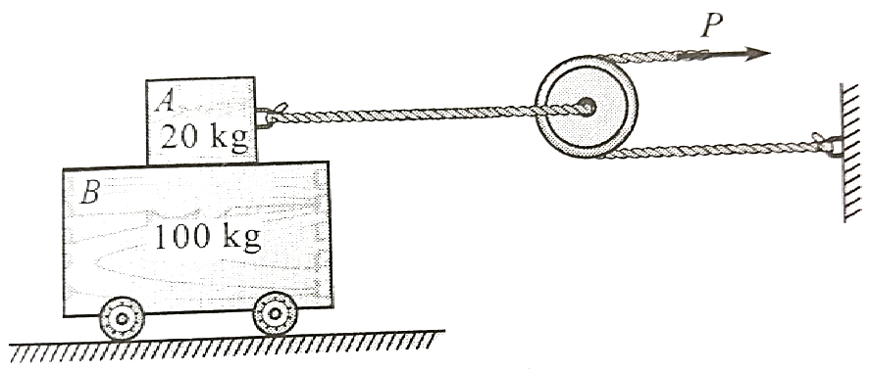
Kinetics
2P
2P
P

Slide 31
Kinetics
Static Analysis
∑F_{y} = 0
N_{A} – 20 x 9.81 = 0
N_{A} = 196.2 N
∑F_{x} = 0
120 – F_{A} = 0
F_{A} = 120 N
20 x 9.81
2P
FBD of A
F_{A}
N_{A}
For limiting equilibrium condition
F_{max} = μ_{s}N = 0.5 x 196.2 = 98.1 N
F_{A} is grater than F_{max}, Hence there is relative motion between block A and B
20 x 9.81
a_{A}
Kinetic Analysis
∑F_{y} = ma_{y} = ; a_{y} = 0
N_{A} – 20 x 9.81 = 0
N_{A} = 196.2 N
∑F_{x} = ma_{x}
120 – μ_{k}N_{A} = 20 x a_{A}
a_{A} = 1.095 m/s²
120
FBD of A
μ_{k}N_{A}
N_{A}

Slide 32
Kinetics
Kinetic Analysis
∑F_{x} = ma_{x}
μ_{k}N_{A} = 100 x a_{B} ;
a_{B} = 1.095 m/s²
FBD of B
100 x 9.81
a_{B}
μ_{k}N_{A}
Static Analysis (P = 40 N)
∑F_{y} = 0 ; N_{A} – 20 x 9.81 = 0 ; N_{A} = 196.2 N
∑F_{x} = 0 ; 80 – F_{A} = 0 ; F_{A} = 80 N
N_{B}
FBD of A
a_{A}
For limiting equilibrium condition
F_{max} = μ_{s}N = 0.5 x 196.2 = 98.1 N
20 x 9.81
120 x 9.81
2P =80
a
F_{A} < F_{max}, there is no relative motion between block A and B
2P =80
F_{A}
A
N_{A}
Kinetic Analysis
∑F_{x} = ma_{x}
80 = 120 x a
a = 0.67 m/s²
B
N_{B}

Slide 33
Kinetics
Block ‘A’ of weight 50 N is released from rest from the position shown in figure. Determine the maximum compression of the spring .The Modulus of spring is 800 N/m and μ between block and plane is 0.2. Also find the maximum velocity of the block.
0.8m
50N
30º

Slide 34
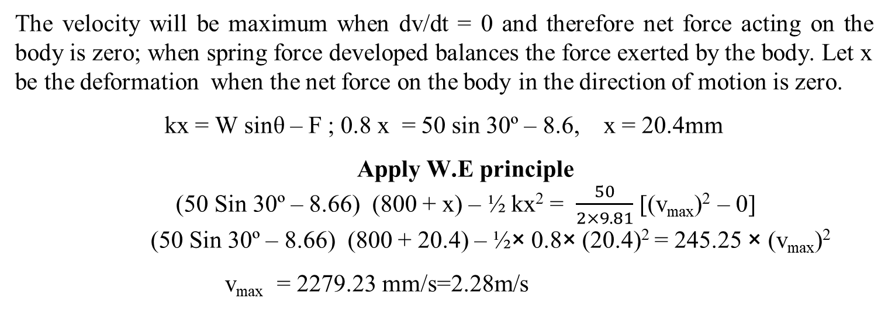
Kinetics
Solution : Let ‘s’ mm be the maximum compression. The body was at rest and again at rest when it moves a distance of (800 + s) mm
Apply W.E. principle
(50 sin 30º – 8.66) (800 + s) – ½×k×s² = 0
(50 sin 30º – 8.66) (800 + s) = ½ × 0.8 × s²
16.34 (800 + s) = 0.4× s²
13072 + 16.34 s = 0.4×s²
400s² – 16.34 s– 13072 = 0; s = 202.35mm
50×sin30º
800+s
F=0.2×43.3 =8.66N
30º
R_{N}=50×cos30º=43.3N
50N
The velocity will be maximum when dv/dt = 0 and therefore net force acting on the body is zero; when spring force developed balances the force exerted by the body. Let x be the deformation when the net force on the body in the direction of motion is zero.
kx = W sinθ – F ; 0.8 x = 50 sin 30º – 8.6, x = 20.4mm
Apply W.E principle
(50 Sin 30º – 8.66) (800 + x) – ½ kx² = $\frac{50}{2×9.81}$ [(v_{max})² – 0]
(50 Sin 30º – 8.66) (800 + 20.4) – ½× 0.8× (20.4)² = 245.25 × (v_{max})²
v_{max} = 2279.23 mm/s=2.28m/s

Slide 35
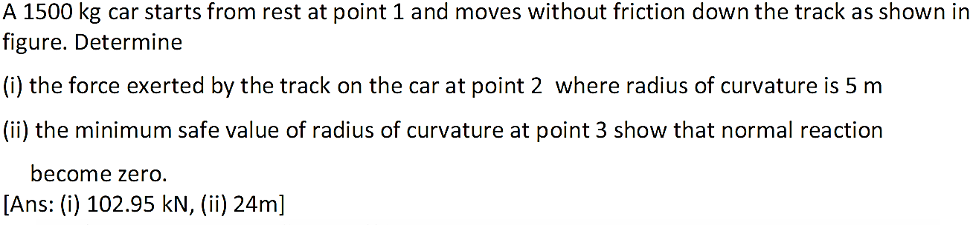
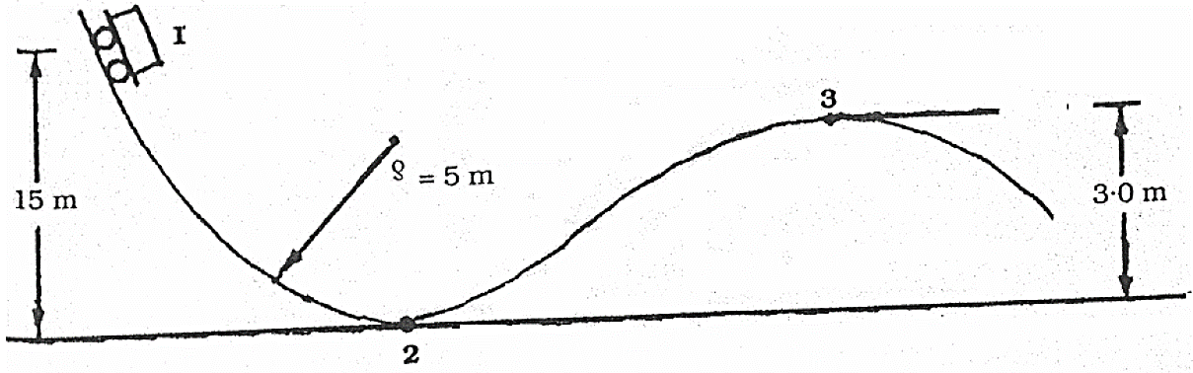
Kinetics
Initial Position
Velocity = 0
Mass = 1500 kg
P.E = mgh, K.E = 0
Position 3
Velocity = V₃
Mass = 1500 kg
Normal Reaction = 0
Position 2
Velocity = V₂
Mass = 1500 kg
P.E = 0, K.E = 0.5mv²
ρ = ?

Slide 36
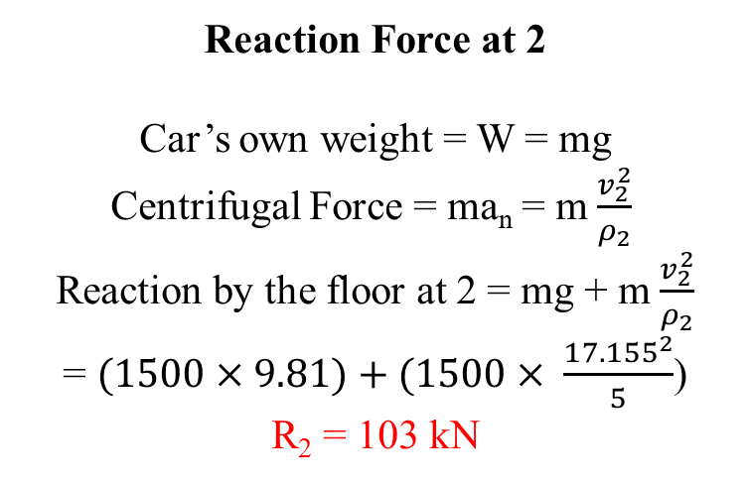
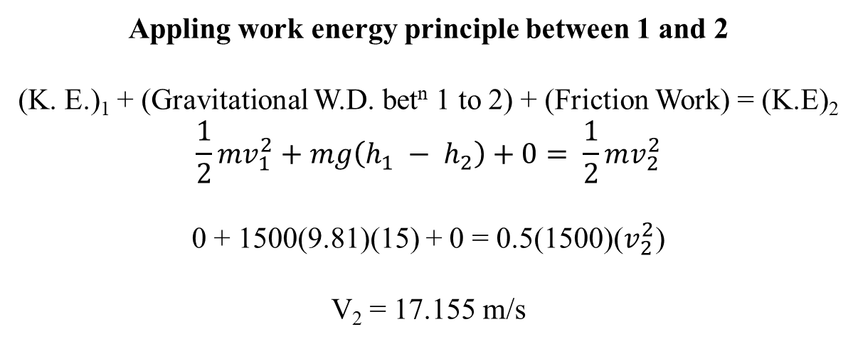
Kinetics
Appling work energy principle between 1 and 2
(K. E.)₁ + (Gravitational W.D. bet^{n} 1 to 2) + (Friction Work) = (K.E)₂
$$\frac{1}{2}mv_{1}^{2}+mg\left(h_{1} − h_{2}\right)+0= \frac{1}{2}mv_{2}^{2}$$
0 + 1500(9.81)(15) + 0 = 0.5(1500)($v_{2}^{2}$)
V₂ = 17.155 m/s
Reaction Force at 2
Car’s own weight = W = mg
Centrifugal Force = ma_{n} = m $\frac{v_{2}^{2}}{ρ_{2}}$
Reaction by the floor at 2 = mg + m $\frac{v_{2}^{2}}{ρ_{2}}$
= $(1500×9.81)+(1500× \frac{{17.155}^{2}}{5}$)
R₂ = 103 kN

Slide 37
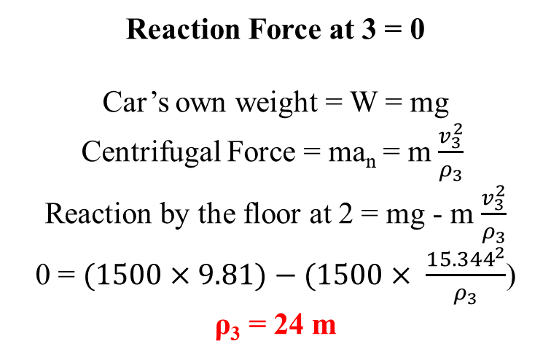
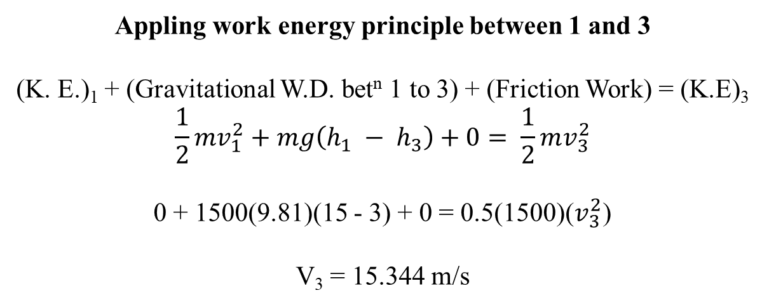
Kinetics
Appling work energy principle between 1 and 3
(K. E.)₁ + (Gravitational W.D. bet^{n} 1 to 3) + (Friction Work) = (K.E)₃
$$\frac{1}{2}mv_{1}^{2}+mg\left(h_{1} − h_{3}\right)+0= \frac{1}{2}mv_{3}^{2}$$
0 + 1500(9.81)(15 - 3) + 0 = 0.5(1500)($v_{3}^{2}$)
V₃ = 15.344 m/s
Reaction Force at 3 = 0
Car’s own weight = W = mg
Centrifugal Force = ma_{n} = m $\frac{v_{3}^{2}}{ρ_{3}}$
Reaction by the floor at 2 = mg - m $\frac{v_{3}^{2}}{ρ_{3}}$
0 = $(1500×9.81)−(1500× \frac{{15.344}^{2}}{ρ_{3}}$)
ρ₃ = 24 m

Slide 38
Kinetics
IMPULSE – MOMENTUM
Momentum:-
Quantity of motion possessed by a body is called momentum. It is the product of mass and velocity. It is a vector quantity.
Unit:- N s.
Force,
Time,
Velocity,
Impulse of a Force:-
It is defined as the product of force and the time over which it acts. It is a vector quantity.
Unit:- N s.

Slide 39

Kinetics
Impulse-momentum relationship
Force = Rate of change of momentum
F =( mv – mu) /t = Force causing impulse
F×t = mv₂ – mv₁
Impulse = final momentum – Initial momentum
The component of the resultant linear impulse along any direction is equal to change in the component of momentum in that direction.
F $=ma_{}= m\frac{dv}{dt}$
F.dt = m.dv
$$\int_{t1}^{t2}{F.dt}= \int_{v1}^{v2}{m.dv}$$
Law of Conservation of momentum
The law of conservation of momentum may be stated as , “momentum is conserved in a system in which resultant force is zero”. In other words, in a system if the resultant is zero, Initial momentum is equal to Final momentum
m₁u₁+m₂u₂ = m₁v₁+m₂v₂

Slide 40
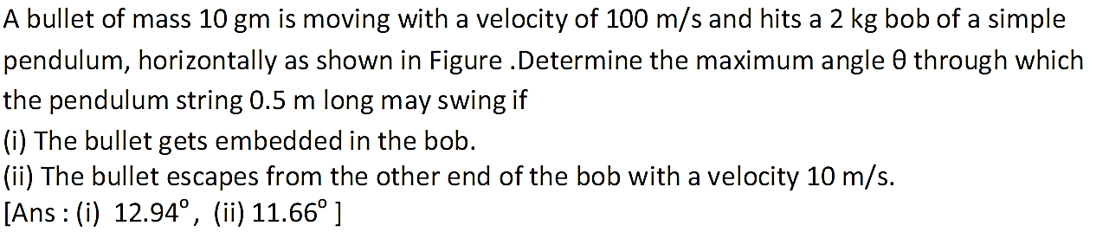
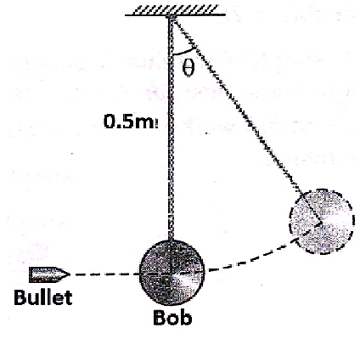
Kinetics

Slide 41
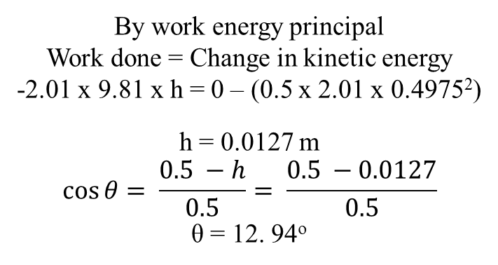
Kinetics
0.5 m
0.5 - h
v₂ = 0
m₁ = 0.01kg
u₁ = 100 m/s
(2)
h
(1)
v₁ = ?
2.01 x 9.81
m₂ = 2 kg
u₂ = 0 m/s
By law of conservation of momentum
m₁u₁ +m₂u₂ = (m₁ + m₂)v₁
(0.01x100) + (2x0) = (0.01 + 2) v₁
Velocity of bullet and bob together
v₁ = 0.4975 m/s
By work energy principal
Work done = Change in kinetic energy
-2.01 x 9.81 x h = 0 – (0.5 x 2.01 x 0.4975²)
h = 0.0127 m
$$\cos{θ= \frac{0.5 −h}{0.5}}= \frac{0.5 −0.0127}{0.5}$$
θ = 12. 94º

Slide 42
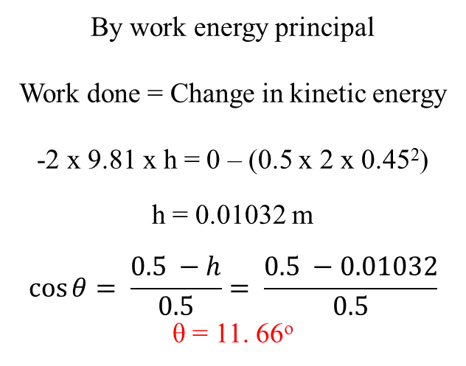
Kinetics
By law of conservation of momentum
m₁u₁ +m₂u₂ = m₁v₁ + m₂v₂
(0.01x100) + (2x0) = 0.01x10 + 2 v₂
Velocity of bullet and bob together
v₂ = 0.45 m/s
0.5 m
0.5 - h
m₁ = 0.01kg
u₁ = 100 m/s
v₁ = 10 m/s
v = 0
(2)
h
By work energy principal
Work done = Change in kinetic energy
-2 x 9.81 x h = 0 – (0.5 x 2 x 0.45²)
h = 0.01032 m
$$\cos{θ= \frac{0.5 −h}{0.5}}= \frac{0.5 −0.01032}{0.5}$$
θ = 11. 66º
v₂ = 0.45 m/s
(1)
2 x 9.81
m₂ = 2 kg
u₂ = 0 m/s
v₂ = ?

Slide 43
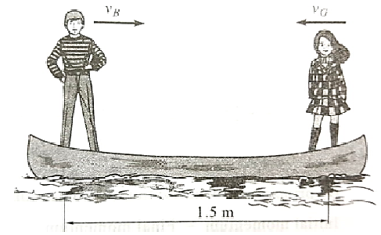
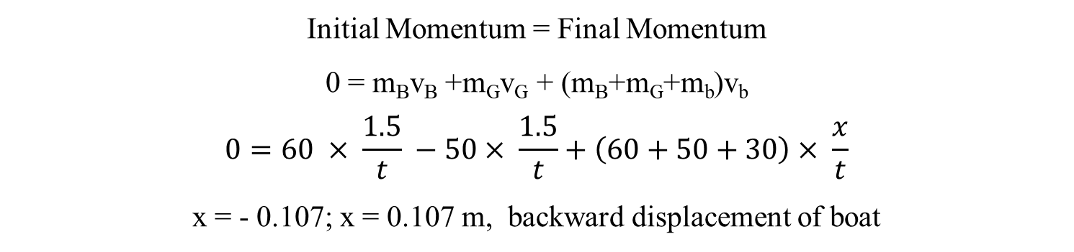
Kinetics
Initial Momentum = Final Momentum
0 = m_{B}v_{B} +m_{G}v_{G} + (m_{B}+m_{G}+m_{b})v_{b}
$$0=60 × \frac{1.5}{t} −50× \frac{1.5}{t}+\left(60+50+30\right)× \frac{x}{t}$$
x = - 0.107; x = 0.107 m, backward displacement of boat

