Slide 1
Wastewater Treatment
PRACTICAL - 4
SVNIT

Slide 2
What is wastewater treatment
Usually refer to sewage treatment, or domestic wastewater treatment
process of removing contaminants from wastewater, both runoff and domestic
SVNIT

Slide 3
Goals
To produce waste stream (effluent)
To produce solid waste (sludge)
To discharge or reuse them back into the environment
SVNIT

Slide 4
Where does wastewater come from?
Residences (kitchen, bathroom)
Commercial institution
Industrial institution (usually require specialized treatment process)
SVNIT

Slide 5
How can it be treated?
collected and transported via a network of pipes and pump stations to a municipal treatment plant
SVNIT

Slide 6
3 stages of water treatment
Primary
  solids are separated
Secondary
  dissolved biological matter is converted into a solid mass by using water-borne bacteria
  95% of the suspended molecules should be removed
Tertiary
  biological solids are neutralized then disposed, and treated water may be disinfected chemically or physically
SVNIT

Slide 7
Types of treatment
Mechanical treatment
  Influx (Influent)
  Removal of large objects
  Removal of sand and grit
  Primary Sedimentation
Biological treatment
  Trickling bed filter
  Activated sludge
Chemical treatment
  Disinfection
SVNIT

Slide 8
Preliminary treatment
Remove large objects
Ex: sticks, rags, toilet paper, tampons
Raked screen
Clog equipment in sewage treatment plant
SVNIT

Slide 9
Treatment stages - Primary treatment
typical materials that are removed during primary treatment include
  fats, oils, and greases (aka FOG)
  sand, gravels and rocks (aka grit)
  larger settleable solids including human waste, and
  floating materials
SVNIT

Slide 10
Methods used in primary treatment
Sand catcher
  Remove sand and grit
  Control wastewater velocity
    Sand grit and stone settle
    Keep suspended organic matter in water
  Damage equipments in the remaining treatment stage
  Landfill
SVNIT

Slide 11
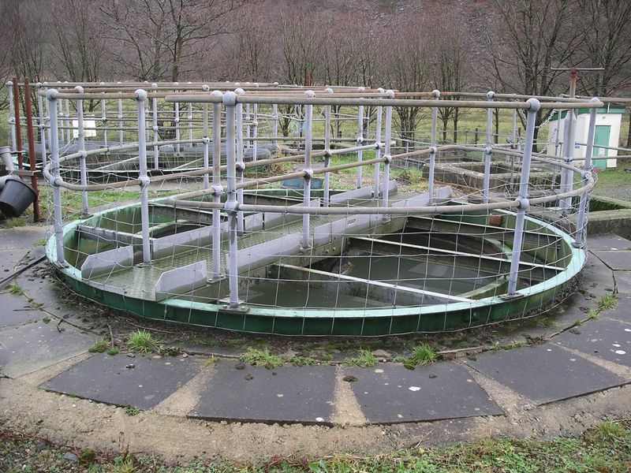
Primary Sedimentation Tank
  Remove grease, oil
  Fecal solid settle, floating material rise to the surface
  Produce a homologous liquid for later biological treatment
  Fecal sludge are pumped to sludge treatment plant
SVNIT

Slide 12
Treatment stages - Secondary treatment
Degrade biological content (dissolved organic matter) of the sewage
  Ex: human waste, food waste, soaps, detergent
Added bacteria and protozoa into sewage
3 different approaches
  Fixed film system
  Suspended film system
  Lagoon system
SVNIT

Slide 13
Three approaches
Fixed Film Systems
  grow microorganisms on substrates such as rocks, sand or plastic
  wastewater is spread over the substrate
  Ex: Trickling filters, rotating biological contactors
SVNIT

Slide 14
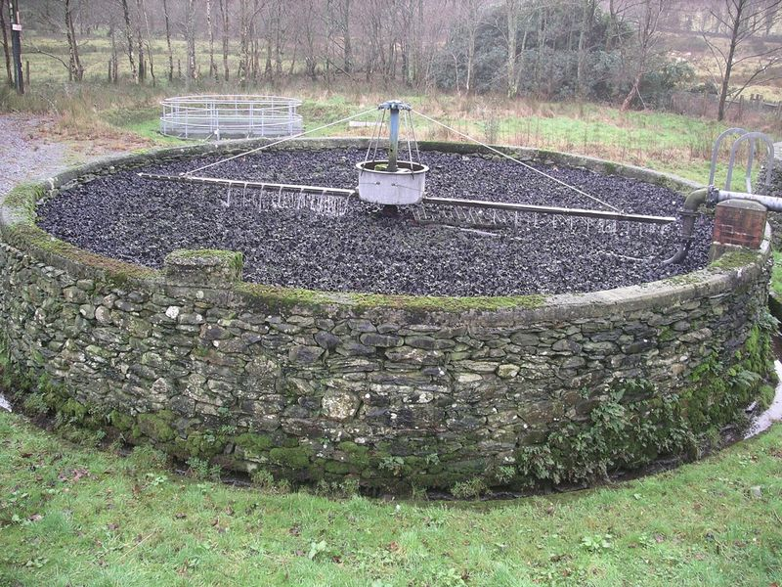
Trickling filters bed
Spread wastewater over microorganism
made of coke (carbonised coal), limestone chips or specially fabricated plastic media
Optimize their thickness by insect or worm grazing
SVNIT

Slide 15
Suspended Film Systems
  stir and suspend microorganisms in wastewater
  settled out as a sludge
  pumped back into the incoming wastewater
  Ex: Activated sludge, extended aeration
SVNIT

Slide 16
Activated sludge
mixed community of microorganisms
Both aerobic and anaerobic bacteria may exist
Biological floc is formed
SVNIT

Slide 17
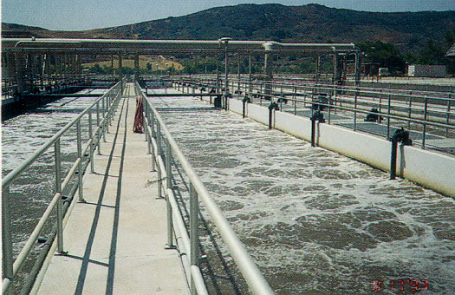
5 physical components of activated sludge process
aeration tank
  oxygen is introduced into the system
SVNIT

Slide 18
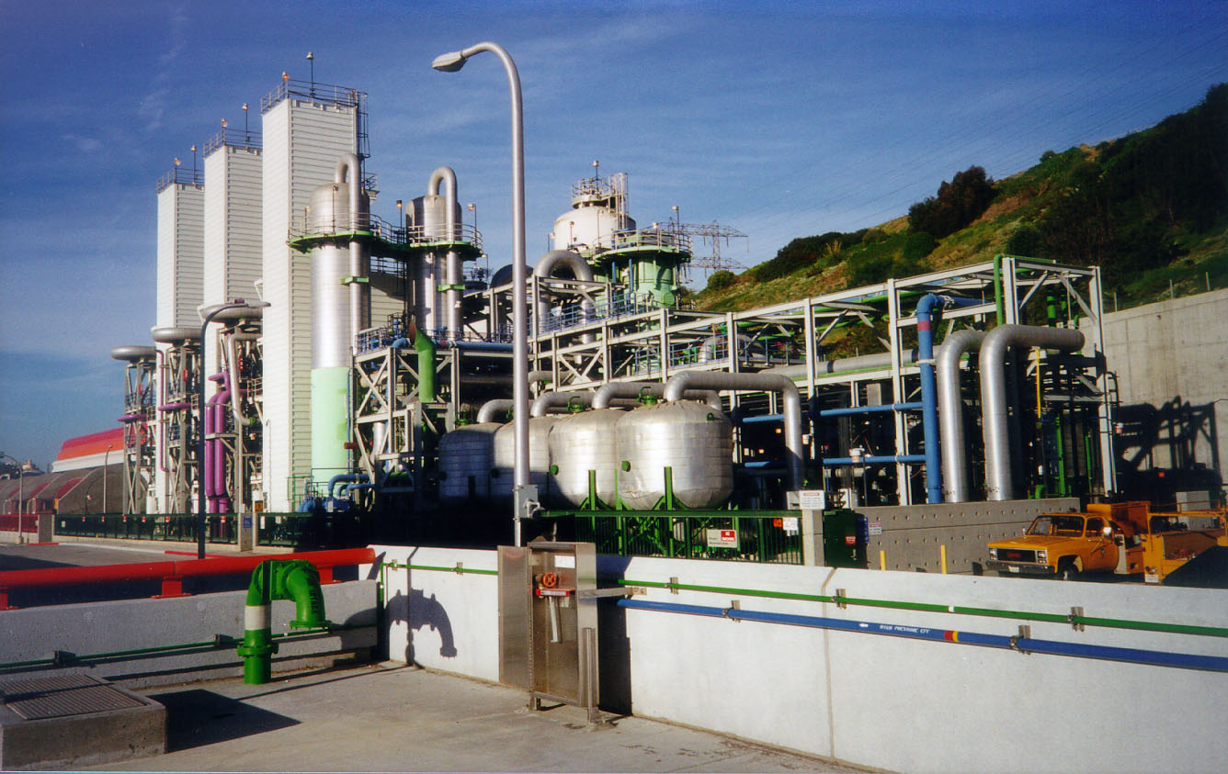
aeration source
  ensure that adequate oxygen is fed into the tank
  provided pure oxygen or compressed air
SVNIT

Slide 19
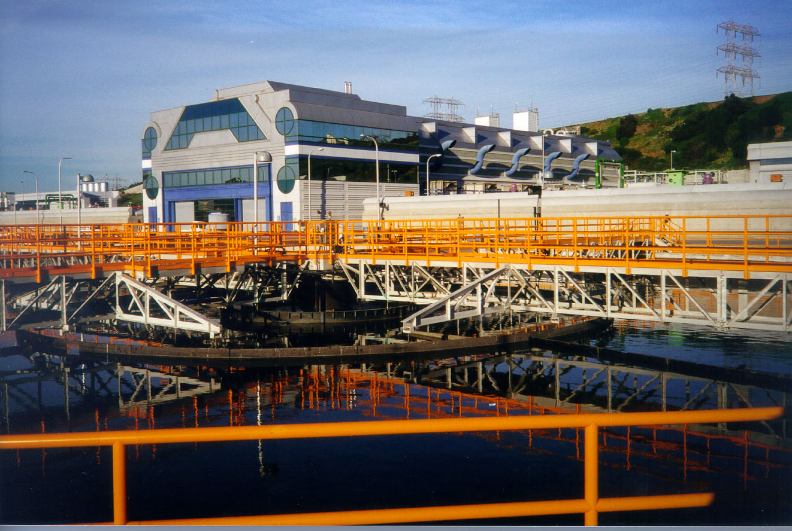
secondary clarifiers
  activated-sludge solids separate from the surrounding wastewater
SVNIT

Slide 20
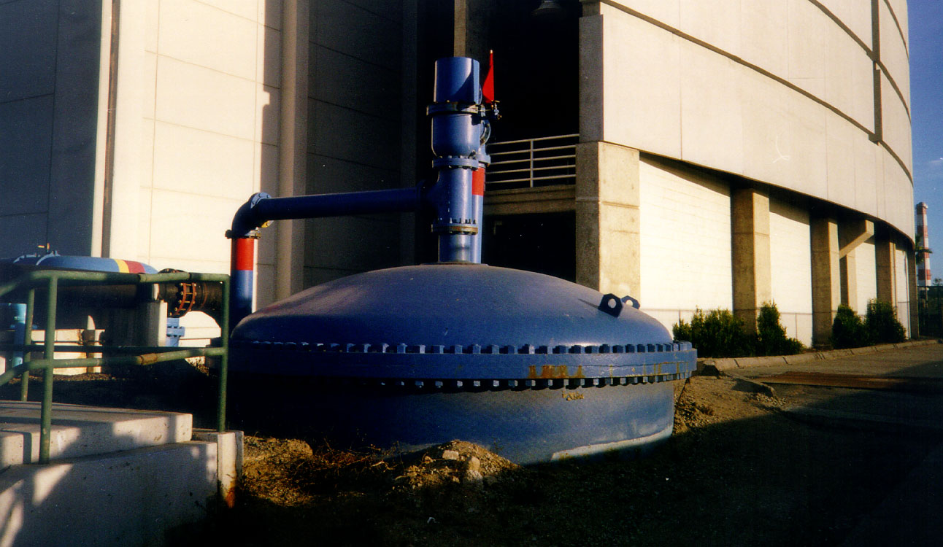
Activated sludge outflow line
  Pump activated sludge back to the aeration tank
Effluent outflow line
  discharged effluent into bay or tertiary treatment plant
SVNIT

Slide 21


SVNIT

Slide 22
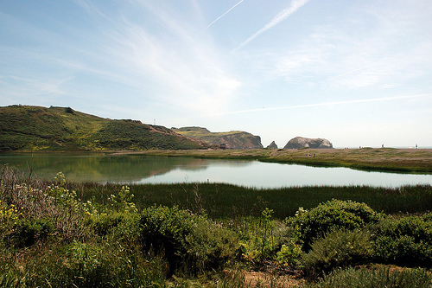
Lagoon Systems
  hold the waste-water for several months
  natural degradation of sewage
  Usually reeds are preferred
SVNIT

Slide 23
Treatment stages – Tertiary treatment
remove disease-causing organisms from wastewater
3 different disinfection process
  Chlorination
  UV light radiation
  Ozonation
SVNIT

Slide 24
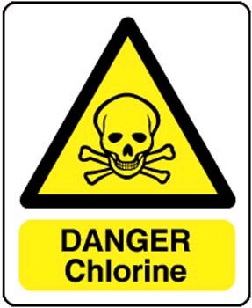
Chlorination
Most common
Advantages: low cost & effective
Disadvantages: chlorine residue could be harmful to environment
SVNIT

Slide 25
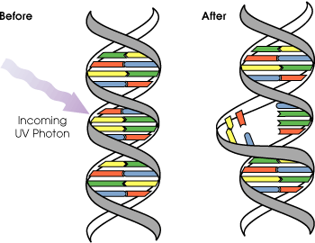
UV light radiation
Damage the genetic structure of bacteria, viruses and other pathogens.
Advantages: no chemicals are used
water taste more natural
Disadvantages: high maintenance of the UV-lamp
SVNIT

Slide 26
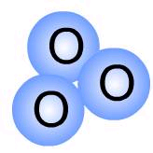
Ozonation
Oxidized most pathogenic microorganisms
Advantages: safer than chlorination
fewer disinfection by-product
Disadvantage: high cost
SVNIT

Slide 27
What can effluent use for?
discharged into a stream, river, bay, lagoon or wetland
used for the irrigation of a golf course, green way or park
If it’s sufficiently clean, it can be used for groundwater recharge
SVNIT

Slide 28
Advanced Treatment
Nitrogen removal
  Ammonia (NH₃) → nitrite (NO₂⁻)→ nitrate (NO₃⁻)
Phosphorous removal
  Precipitation with iron or aluminums salt
Lead to eutrophication
May cause algae bloom
SVNIT

Slide 29
Sludge treatment
Primary sludge usually have strong odors
Secondary sludge have high concentration of microorganism
Goals of treatments are:
  Reduce odors
  Remove water reduce volume
  Decompose organic matter
SVNIT

Slide 30
Untreated sludge are about 97 percent water
Settling can reduce about 92 to 96 percent of water
dried sludge is called a sludge cake
SVNIT

Slide 31
3 different sludge treatments
Aerobic digestion
Anaerobic digestion
composting
SVNIT

Slide 32
Aerobic digestion
Bacterial process
Need oxygen
Consume organic matter
Convert into carbon dioxide (CO₂)
SVNIT

Slide 33
Anaerobic digestion
Bacterial process
Do not require oxygen
Consume organic matter
Produce biogas, which can be used in generators for electricity
SVNIT

Slide 34
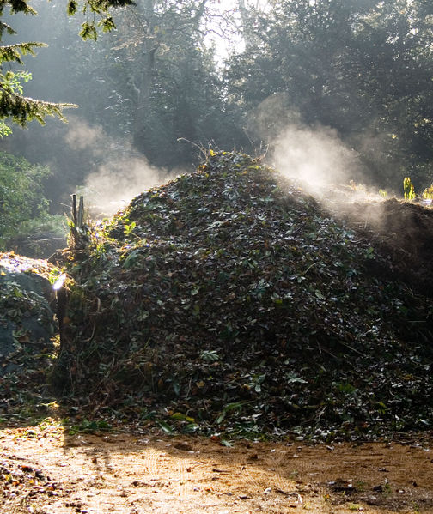
Composting
aerobic process
requires the correct mix of carbon, nitrogen, oxygen and water with sludge
Generate large amount of heat
SVNIT

Slide 35
Sludge disposal
Superheat sludge and convert into small granules that are rich in nitrogen
  Sell it to local farmer as fertilizer
Spread sludge cake on the field
Save landfill space
SVNIT

Slide 36
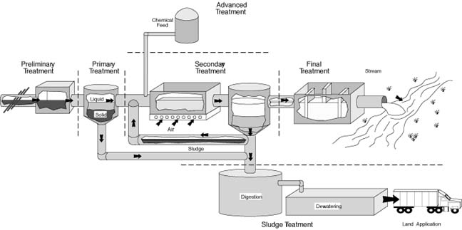
Summary
SVNIT

Slide 37
ACTIVITY
Divide in groups of 5
Preliminary, Primary, Secondary, Tertiary System.
Each group to take one system and explain all its components, its importance, working and significance.
SVNIT

