Slide 1

5. Kinetics of rectilinear motion
In this chapter we will be studying the relationship between forces on a body/particle and the accompanying motion
Newton’s Second law of motion:
Newton’s first and third law of motion were used extensively in the study of statics (the bodies at rest) whereas Newton’s second law of motion is used extensively in the study of the kinetics.

Slide 2
Work done by force:
Work done by a force is the product of the force and the distance moved by the point of application in the direction of the force. It is a scalar quantity.
F
F sinθ
F sinθ
F cosθ
F
F cosθ
α
α
A
B
s
Work done = (F cosα ) × s
X- component of force F moves through distance a S,
S = displacement of force from A to B
Unit: Nm ( Joule )

Slide 3
POWER:-
It is defined as the time rate of doing work.
Power = work done /Time= (force × distance) /Time
= force × velocity
Unit: (Nm)/s = [watt]
(kN m)/s = [kilo watt]
1 metric H.P=735.75 watts.

Slide 4
Energy:-
It is defined as the capacity to do work. It is a scalar quantity.
Unit :- N m (Joule)

Slide 5
Momentum:-
Quantity of motion possessed by a body is called momentum. It is the product of mass and velocity. It is a vector quantity.
Unit:- N s.
Impulse of a Force:-
It is defined as the product of force and the time over which it acts. It is a vector quantity.
Unit:- N s.

Slide 6
  Newton’s second law of motion.
  “If the resultant force acting on a particle is not zero , the particle will have an acceleration proportional to the magnitude of the resultant force and its direction is along that of the resultant force.”
    F α a
    F =Resultant of forces
a = Acceleration of the particle.
F = ma
m= mass of the particle.

Slide 7
The constant value obtained for the ratio of the magnitude of the force and acceleration is characteristic of the particle and is denoted by ‘m’. Where ‘m’ is mass of the particle
Since ‘m’ is a +ve scalar, the vectors of force ‘F’and acceleration ‘a’ have the same direction.
Units
Force in Newtons (N) N = 1 Kgm/s²
Acceleration in m/s²

Slide 8
Body will move in the direction of resultant
R = m a
F2
F1
F3
R = Resultant of forces F1,F2 and F₃

Slide 9
Using the rectangular coordinate system we have components along axes as,
ΣF_{x} = ma_{x}
ΣF_{y} = ma_{y}
ΣF_{z} = ma_{z}
where F_{x} ,F_{y} F_{z} and a_{x} , a_{y} ,a_{z} are rectangular components of resultant forces and accelerations respectively.

Slide 10
Newton’s second law may also be expressed by considering a force vector of magnitude ‘ma’ but of sense opposite to that of the acceleration. This vector is denoted by (ma)_{rev}. The subscript indicates that the sense of acceleration has been reversed and is called the inertia force vector.

Slide 11
Body will move in the direction of resultant
Inertia Force
R = m a
R = m a
F2
F2
F1
F1
F3
F3
R = Resultant of forces F1,F2 and F₃

Slide 12
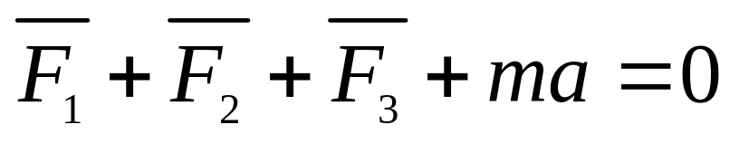
If the inertia force vector is added to the forces acting on the particle we obtain a system of forces whose resultant is zero.
F = R = m a
Inertia Force
F₂
F₁
F₃
Resultant of forces F₁,F₂, F₃ and Inertia force = 0
The particle may thus be considered to be in equilibrium. (THIS IS DYNAMIC EQUILIBRIUM)

Slide 13
It was pointed out by D’Alembert (Alembert, Jean le Rond d’ (1717-1783), French mathematician and philosopher) that problems of kinetics can be solved by using the principles of statics only (the equations of equilibrium) by considering an inertia force in a direction directly opposite to the acceleration in addition to the real forces acting on the system
D’Alembert’s principle states that
When different forces act on a system such that it is in motion with an acceleration in a particular direction, the vectorial sum of all the forces acting on the system including the inertia force (‘ma’ taken in the opposite direction to the direction of the acceleration) is zero.

Slide 14
The problem under consideration may be solved by using the method developed earlier in statics. The particle is said to be in dynamic equilibrium.
If
ΣF_{x} = 0
ΣF_{y}= 0 including inertia force vector
ΣF_{z} = 0
This principle is known as D’Alembert’s principle

Slide 15
Work-Energy relation for translation
From Newton’s second law of motion
∑ F = m × a = -----------(1)
Also a = dv/dt =( dv/dt) ×( ds/ds) = v × dv/ds
substituting in (1)
∑ F = m × v × dv/ds
ΣF × ds = m × v × dv ------------------(2)
Let the initial velocity be u and the final velocity after it moves through a distance ‘ s’ be v

Slide 16
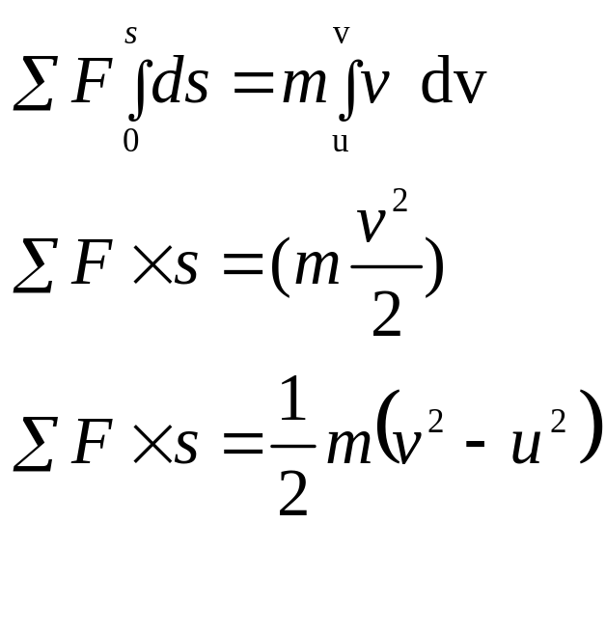
Integrating both sides, we get
v
u
Therefore work done by a system of forces acting on a body while causing a displacement is equal to the change in kinetic energy of the body during the displacement.

Slide 17
Impulse-momentum relationship
F = m × a
F = m × (v - u)/t = (mv – mu)/t
Force = Rate of change of momentum
F × t = mv – mu
Impulse = final momentum – Initial momentum
The component of the resultant linear impulse along any direction is equal to change in the component of momentum in that direction.

Slide 18
(Q 5.1)
A 200N block rests on a horizontal plane. If a 1000N force is applied, find whether the block will be at rest or move. If it moves then what is the acceleration with which the block start moving. The coefficient of friction between the block and the plane is 0.25.
1000N
30⁰
N

Slide 19
(Q 5.1)
1000N
1000 cos 30
Draw the free body diagram
200N
1000 sin 30
30⁰
N
F= μN₁
N₁
∑ Fy = 0
-1000Sin30 -200 +N₁ =0
N₁= 700 N μN₁ = 0.25 × 700 = 175 N

Slide 20
(Q 5.1)
∑ Fx ≠ 0 block is moving along x-direction
∑ Fx = R
1000N
1000 cos 30
200N
1000 sin 30
30⁰
motion
N
F= μN₁
N₁

Slide 21
(Q 5.1)
To find acceleration of the block
Apply Inertia Force (R= m×a) opposite to the direction of motion & bring the block to dynamic equilibrium
Including the inertia force, (m×a)
∑ Fx = 0
1000N
1000 cos 30
200N
1000 sin 30
30⁰
m.a
N
F= μN₁
N₁

Slide 22
(Q 5.1)
1000N
1000 cos 30
200N
1000 sin 30
30⁰
m×a
N
F= μN₁=175N
N₁
∑ Fx = 0 = +1000 cos30 – m×a – μN₁
a = 33.89 m/s²

Slide 23
(Q 5.1)
200N
1000N
a = 33.89 m/s²
30⁰
m×a
motion
N
F= μN₁=175N
N₁
note: the block start from rest with an acceleration, a = 33.89 m/s²
The velocity of the block and distance moved by the block after t seconds can be calculated by
V = u + a t
S = u t + (½) a t2
V² – u² = 2 a s

Slide 24
(Q 5.2)
A 200N block rests on a horizontal plane. If a 1000N force is applied, find the block velocity of the block after it moves a distance of 0.6 m. The coefficient of friction between the block and the plane is 0.25.
Use work-energy relation.
1000N
30⁰
N

Slide 25
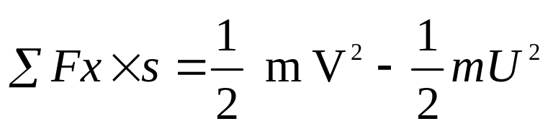
(Q 5.2)
1000N
1000 cos 30
Draw the free body diagram
200N
1000 sin 30
30⁰
Initial velocity
u = 0
N
F= μN₁
N₁
Work-energy relation
(1000 cos 30 – μ N₁) × s = (1/2) m (v² – u²)
v = 6.377 m/s

Slide 26
(Q 5.3)
A 200N block rests on a horizontal plane. If a 1000N force is applied, find the block velocity of the block after 0.188 seconds. The coefficient of friction between the block and the plane is 0.25.
Use Impulse-momentum relation.
1000N
30⁰
N

Slide 27
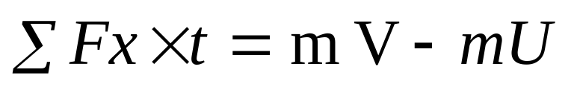
(Q 5.3)
1000N
1000 cos 30
Draw the free body diagram
200N
1000 sin 30
30⁰
Initial velocity
u = 0
N
F= μN₁
N₁
Impulse-momentum relation
(1000 cos 30 – μ N₁) × t = m v – m u
v = 6.377 m/s

Slide 28
(Q 5.4)
A 200N block rests on a horizontal plane. Find the magnitude of the force required to give the block an acceleration of 1m/s² to the right. The coefficient of friction between the block and the plane is 0.25.
200N
30⁰
ma
N
F=0.25N
N₁

Slide 29

(Q 5.4)
Solution 1:
Mass of Block m = 200/9.81 = 20.39 kg,
F= μN₁ , a= 1m/s
Σ Fy= 0
N₁ - Psin30 -200 = 0 ------------1
N₁= 200 + P sin30

Slide 30
(Q 5.4)
ΣF_{x} = m a_{x}.
Pcos 30 – 0.25N₁ = 20.39 ( 1) -----------2
From eq.2
Pcos30 -0.25(200+Psin30) = 20.39
[0.866-0.125] P -50 =20.39
P = 95 N

Slide 31
(Q 5.5)
A motorist traveling at a speed of 72kmph suddenly applies his brakes and comes to a stop after skidding 45m. Determine
Time required for the car to stop
The coefficient of friction between the tyres and the pavement.

Slide 32
(Q 5.5)
Solution
u= 20 m/s , v = 0, s= 45m
v² –u² = 2as
-(20)² = 2 a 45
a = - 4.44 m/s²
V = u + at, 0 = 20 – 4.44×t
t = 4.5 secs

Slide 33
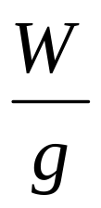
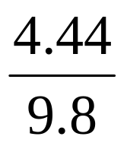
(Q 5.5)
+ ΣF_{Y} = 0
W = N₁ …………1
Σ F_{X} = 0
- μN₁ –m(-a) = 0
ma = μN₁ and from 1
.a = μ W
μ = = 0.453
Direction of motion
W
m a
μN₁
N₁

Slide 34
(Q 5.6)
A body of weight 2kN is resting on a rough plane inclined at 12⁰ to the horizontal. It is pulled up the plane by means of a light flexible rope running parallel to the plane and passing over a light frictionless pulley at the top of the plane. The portion of the rope beyond the pulley hangs vertically down and carries a weight of 1kN at the end. If friction between the body and plane is 0.2 , find;
Tension in the rope
Acceleration with which the body moves up the plane
Distance moved by the body in 4 sec. after starting from rest

Slide 35
(Q 5.6)
2kN
T_{A}
A
T_{B}
12⁰
B
1kN
Here, acceleration of block A is equal to acceleration of block B, hence
a_{A}= a_{B ,}
s_{A}= s_{B}
T_{A}= T_{B}

Slide 36
(Q 5.6)
Y
Draw the FBD of block A and B
2 kN sin 12
X
2 kN cos 12
T
A
T
12⁰
B
1kN
Here, acceleration of block A is equal to acceleration of block B, hence
a_{A}= a_{B and}
s_{A}= s_{B}

Slide 37
y
a_{A}
ma_{A}
x
(Q 5.6)
2 kN sin 12
2 kN cos 12
T
ΣF_{x} =0
- 2 sin 12 +T- 0.2N₁-(2/9.81)a_{A}=0
(1)
0.2 N₁
Σ F_{y}= 0
12⁰
2 cos 12 – N₁=0
N₁=1.956 N
Substitute N₁ in eq. 1
-0.415 + T – 0.3912 -0.203 a_{A}=0
N₁
FBD of A
(2)
y
T
Σ F_{y}= 0
T – 1 + m_{B} a_{B}=0
T – 1 + (1/9.81)a_{B}=0
m_{B} a_{B}
B
(3)
a_{B}
Solving (1) (2) and (3)
T=0.935 kN
2. a_{A}=0.637 m/s² = a_{B}
FBD of B

Slide 38
(Q 5.6)
t=4 s u=0 and a=0.637 m/s²
Distance traveled s= (½) a t²
s=5.096 m
Calculate the distance moved by the body using work-energy relation
& by using Impulse-momentum relation

Slide 39
Determine using work energy principle the velocity of block weighing 5000 N, shown in figure after it has moved 50m starting from rest. Assume μ = 0.2.
(Q 5.7)
4000N
30º
20º

Slide 40
Y
4000N
X
4kN sin 30
(Q 5.7)
4kN cos 30
5kN sin20
5kN cos20
30º
F=0.2×R_{N} =539.69N
20º
R_{N}
Solution:
R_{N} – 5000cos20º + 4000sin30º = 0
R_{N} = 2698.46N
from W.E. principle
Σ F×s=(W/2g) (v² – u²)
(4000cos30º – 539.69 – 5000sin20º)50 = 5000 ( v² – 0 )
2×9.81
v = 15.44 m/sec.
F.B.D

Slide 41
Determine the constant force P that will give the system of bodies shown in figure a velocity of 3m/s. after moving 4.5m from rest. The pulleys are frictionless and μ = 0.2. W_{A}=200N, W_{B}=1000N, W_{C}=500N.
(Q 5.8)
P
A
B
4
3
C

Slide 42
(Q 5.8)
200N
P
1000N
0.2×200=40N
R_{N}=200N
0.2×600=120N
53.13º
500N
=600N
R_{N}=1000×cos53.13º
53.13º
0.2×500=100N
R_{N}= 500N

Slide 43
(Q 5.8)
From W.E. principle
Σ F×s = [W/2g] (v²– u²)
[P – 40 – 120 – 1000 sin 53.13º – 100] 4.5
= 1700 [(3.0)² – 0 ]
2 ×9.81
P = 1233.29N
200N
P
0.2×200=40N
R_{N}=200N
0.2×600=120N
=600N
500N
R_{N}=1000×cos53.13º
53.13º
1000N
0.2×500=100N
R_{N}= 500N
16

Slide 44
(Q 5.9)
In what distance will block A attain a velocity of 3m/s starting from rest? Take μ = 0.2. W_{A} = 1500N, W_{B} = 2000N. Use work-energy relation.
A
3
4
B
4
3

Slide 45
NOTE: S_{A} = 2S_{B}, a_{A} = 2a_{B}, T_{A} = 0.5 T_{B}
Time taken by Block A = Time taken by block B
(Q 5.9)
T
T
2T = T_{B}
T
T
T
T
W_{B} cosθ₂
=1200
=1200
W_{A} cosθ₁
W_{A} sinθ₁
3
A
W_{B} sinθ₂
4
B
4
3
θ₁=53.13
36.87=θ₂

Slide 46
(Q 5.9)
F B D
A
F₁=0.2×900
=180N
B
R_{N1}= 1500×3/5=900N
R_{N2}=2000×4/5 =1600N
1500N
F₂=0.2×1600=320N
2000N

Slide 47
from W.E. principle
Σ F×S = W/2g (v²-u²)
(1500 × 4/5 -180) s_{A} + ( - 2000×3/5- 320) s_{A}/2= [1500/(2×9.81)](3)² +[2000/(2×9.81)](1.5)²
s_{A} = 3.53m.
(Q 5.9)
F B D
A
F₁=0.2×900
=180N
B
R_{N1}= 1500×3/5=900N
R_{N2}=2000×4/5 =1600N
1500N
F₂=0.2×1600=320N
2000N

Slide 48
(Q 5.10)
Determine the velocity of block B after moving for 5 sec. starting from (i) rest (ii) downward velocity of 2 m/s.
BLOCK A=450N
BLOCK B=650N
A
B

Slide 49
(Q 5.10)
FBD of B
FBD of A
2T
T
Case (i) Starting from rest:
From impulse momentum principle
Σ F×t = mv – mu
Block B
(2T – 650) 5 = 650 ( v_{B} – 0)
9.81
T – 325 = 6.63 v_{B} ---- (1)
Block A
(450 – T) 5 = 450 ( 2v_{B} – 0)
9.81
450 – T = 18.35 v_{B}--- (2)
Solving 1 and 2 v_{B} = 5 m/s.
u_{B}=0
v_{B}
u_{A}=0
v_{A}=2v_{B}
650N
450N

Slide 50
EXERCISE PROBLEMS
5. Kinetics
Q1. Blocks A and B of mass 10 kg and 30 kg respectively are connected by an inextensible cord passing over a smooth pulley as shown in Fig. Determine the velocity of the system 4 sec. after starting from rest. Assume coefficient of friction =0.3 for all surfaces in contact.
B
A
60º
30º
Ans: v=13.6m/s

Slide 51
EXERCISE PROBLEMS
5. Kinetics
Q2. A tram car weighs 150kN. The tractive resistance being 1% of the weight of car. What power will be required to move the car at uniform speed of 20 kmph
Up an incline 1 in 300
(ii) Down an incline 1 in 250. Take efficiency 75%.
Ans: Pull = 2 kN
a) Output power=11.12kW

Slide 52
EXERCISE PROBLEMS
5. Kinetics
Q3. Two masses of 5 kg and 3 kg rest on two smooth inclined plane, each of inclination 30º and are connected by a string passing over a common apex. Find the velocity of 3 kg mass after 2 sec when released from rest. Find the distance it will cover before changing direction of motion, if 5kg mass is cut off after two sec of its release from rest.
5kg
3kg
30º
30º
V = 4.45 m/s
s = 0.61 m

Slide 53
EXERCISE PROBLEMS
5. Kinetics
Q4. A locomotive weighing 900 kN pulls a train of 10 coaches each weighing 300 kN at 72 Kmph on a level track against a resistance of 7 N/kN. If the rear 4 coaches get snapped from the train, find the speed of the engine and the remaining coaches after 120 secs. Assume no change in resistance and draw bar pull. Find also distance traveled by detached coaches before coming to rest.
4x300=1200kN
6x300=1800kN
900kN
P
V = 23.66 m/s
s = 2.9 km

Slide 54
EXERCISE PROBLEMS
5. Kinetics
Q5. Find the tension in the cord supporting body C in Fig. below. The pulleys are frictionless and of negligible weight.
Assume all blocks moving either downward or upward and accordingly draw FBD
0=a_{A} +2a_{B} +c_{C}
A
C
150 kN
B
300 kN
450 kN
Ans : T=211.72 kN

Slide 55
EXERCISE PROBLEMS
5. Kinetics
Q6. Two blocks A and B are released from rest on a 30º inclined plane with horizontal, when they are 20m apart. The coefficient of friction under the upper block is 0.2 and that under lower block is 0.4. compute the time elapsed until the block touch. After they touch and move as a unit what will be the constant forces between them.
(Ans : t = 4.85 s, contact force=8.65 N)

Slide 56
EXERCISE PROBLEMS
5. Kinetics
Q7. An elevator cage of a mine shaft weighing 8kN when empty is lifted or lowered by means of rope. Once a man weighing 600N entered it and lowered at uniform acceleratin such that when a distance of 187.5 m was covered, the velocity of the cage was 25m/s. Determine the tension in the cable and force exerted by man on the floor of the cage.
(Ans: T=7139 N and R=498 N)

Slide 57
EXERCISE PROBLEMS
5. Kinetics
Q8. A small block starts from rest at point a and slides down the inclined plane. At what distance along the horizontal will it travel before coming to rest . Take µ_{k}=0.3 [Ans :s=6m ]
5m
A
3
4
B
C
s

Slide 58
EXERCISE PROBLEMS
5. Kinetics
Q9. The system starts from rest in the position shown . How much further will block ‘A’ move up the incline after block B hits the ground . assume the pulley to be frictionless and massless and µ is 0.2 .W_{A}=1000N, W_{B}=2000N. [ Answer s =1.27m]
A
B
3
4
3m

Slide 59
EXERCISE PROBLEMS
5. Kinetics
Q10. A 1500Kg automobile travels at a uniform rate of 50kmph to 75kmph . During the entire motion, the automobile is traveling on a level horizontal road and rolling resistance is 2 % of weight of automobile . Find (i) maximum power developed (ii) power required to maintain a constant speed of 75kmph.
[ ANSWER: power developed = 6.131KN]

Slide 60
EXERCISE PROBLEMS
5. Kinetics
Q11. Two bodies A and B weighing 2000N and 5200N are connected as shown in the figure . find the further distance moved by block a after the block B hits Wall. µ=0.2 .[ Answer s=1.34m]
A
5
B
12
3m

Slide 61
EXERCISE PROBLEMS
5. Kinetics
Q12. A spring is used to stop 60kg package which is sliding on a horizontal surface . the spring has a constant k = 20kN/m and is held by cable such that it is initially compressed at 120mm. knowing that the package has a velocity of 2.5m/s in position shown and maximum additional displacement of spring is 40mm . Determine the coefficient of kinetic friction between package and surface. (Answer µ_{k}=0.2)
2.5 m/s
60kg
600m

Slide 62
EXERCISE PROBLEMS
5. Kinetics
Q13. The system shown in figure has a rightward velocity of 4m/s, just before force P is applied. Determine the value of P that will give a leftward velocity of 6m/s in a time interval of 20sec. Take µ = 0.2 & assume ideal pulley. [Answer P=645.41N]
P
1000N
400N

Slide 63
EXERCISE PROBLEMS
5. Kinetics
Q14. A locomotive of weight 500kN pulls a train of weight of 2500kN. The tractive resistance, due to friction is 10N/kN. The train can go with a maximum speed of 27kmph on a grade of 1in100. Determine (a) Power of the locomotive. (b) Maximum speed it can attain on a straight level track with the tractive resistance remaining same. [Answer (a) Power= 450kN (b) v=15m/s]
Q15. A wagon weighing 400kN starts from rest, runs 30m down a 1% grade & strikes a post. If the rolling resistance of the track is 5N/kN, find the velocity of the wagon when it strikes the post.
If the impact is to be cushioned by means of one bumper string, which compresses 1mm per 20 kN weight, determine how much the bumper spring will be compressed. [Answer v=1.716m/s, x=77.5mm]

Slide 64
EXERCISE PROBLEMS
5. Kinetics
Q16. A train whose weight is 20kN moves at the rate of 60kmph. After brakes are applied, it is brought to rest in 500m. Find the force exerted, assuming it to be uniform
Use work-energy relation
Use D’Alemberts equation.
Ans: F = 5.663 kN

Slide 65
EXERCISE PROBLEMS
5. Kinetics
Q17. The blocks A and B having weights 100 N and 300 N start from rest. The horizontal plane and the pulleys are frictionless. Determine the acceleration and the tension in the string.
string
Frictionless pulley
A
string
Frictionless pulley
Ans: a_{A}=8.403m/s2
a_{B}=4.201 m/s2
T= 85.71 N
B

Slide 66
EXERCISE PROBLEMS
5. Kinetics
Q18. The blocks A and B having weights 100 N and 300 N start from rest. The horizontal plane and the pulleys are frictionless. Determine the velocity of block B after 0.5 seconds and the tension in the string.
string
Frictionless pulley
A
string
Frictionless pulley
B

Slide 67
EXERCISE PROBLEMS
5. Kinetics
Q19. The blocks A and B having weights 100 N and 300 N start from rest when a load of 100 N is applied on the block A as shown in the figure. The horizontal plane and the pulleys are frictionless. Determine the acceleration and the tension in the string.
string
100 N
Frictionless pulley
A
string
Frictionless pulley
B

Slide 68
EXERCISE PROBLEMS
5. Kinetics
Q20. The system of blocks shown in the figure is released from external force when the block A, moving towards left with a velocity of 1 m/s. The blocks A and B having weights 100 N and 300 N. The horizontal plane and the pulleys are frictionless. Determine the velocity of the block B after 2 seconds.
string
Frictionless pulley
A
string
Frictionless pulley
B

Slide 69
EXERCISE PROBLEMS
5. Kinetics
Q21. An engine weighing 500 kN drags carriages weighing 1500kN up an incline of 1 in 100 against a resistance of 5N/kN starting from rest. It attains a velocity of 36 kmph (10m/s) in 1 km distance with a constant draw bar pull supplied by the engine. What is the power required for the same ? What is the tension developed in the link connecting the engine and carriages?
500N
P
1500N
100
1
Ans:
Pull=40.19kN, power=401kW, T=30.15kN

Slide 70
EXERCISE PROBLEMS
5. Kinetics
Q22. what velocity the block A will attain after 2 seconds starting from rest? Take μ = 0.2. W_{A} = 1500N, W_{B} = 2000N. Use impulse-momentum relation.
A
3
4
B
4
3

