Slide 1
Unit: Software Security & Trusted Systems
B.Tech VIII
NETWORK AND SYSTEM SECURITY (CORE ELECTIVE - 5) (CS424)

Slide 2
Book :
Computer Security: Principles and Practice
By William Stallings
Chapter 10: Buffer Overflow
Chapter 11 Software Security
Chapter 12 Operating System Security
Chapter 13 Trusted Computing and Multilevel Security
EECS710: Information Security
Professor Hossein Saiedian
Fall 2014
Notes:
Lecture slides prepared by Dr Lawrie Brown (UNSW@ADFA) for “Computer Security: Principles and Practice”, 1/e, by William Stallings and Lawrie Brown, Chapter 11 “Buffer Overflow”.

Slide 3
Contents
Chapter 10: Buffer Overflow
  Buffer Overflow
  Stack Overflows
  Shellcode
  Various defenses against buffer overflow attacks
  A range of other types of buffer overflow attacks

Slide 4
Software Security
NIST Definition of Computer Security
“The protection afforded to an automated information system in order to attain the applicable objectives of preserving the integrity, availability and confidentiality of information system resources (includes hardware, software, firmware, information/data, and telecommunications)”

Slide 5
Software Security
Any compromise to integrity, authentication and availability makes a software unsecure.
Software systems can be attacked to steal information, monitor content, introduce vulnerabilities and damage the behavior of software.
Software security is the concept of implementing mechanisms in the construction of security to help it remain functional (or resistant) to attacks.
i.e. before a piece of software is released to the public, it is subjected to software security testing to determine its ability to withstand hacking attempts.

Slide 6
Software Security
The goal of software security is to create secure software from the start without requiring additional security components to add additional layers of protection.
Programmers and engineers in the development stage must put up time and effort to accomplish software security before software launched into the market.

Slide 7
Software Security vs. Application Security
The terms – software security and application security are very near to each other.
However, the distinction between them is :
  Software security vulnerabilities must be taken care of before the software is deployed and sent to the end-users. This requires effort and commitment from programmers and engineers in the development stage.
  Application security is the additional tools require to provide security to application once it is deployed to market.

Slide 8
Software Security – Some common attacks
Buffer overflow, stack overflow:
  Buffer and stack overflow attacks overwrite the contents of the heap or stack respectively by writing extra bytes.
Command injection:
  It can be achieved on the software code when system commands are used predominantly.
  New system commands are appended to existing commands by the malicious attack.
  Sometimes it may stop services and cause DoS.
SQL injection:
  It uses malicious SQL code to retrieve or modify important information from database servers.
  It can be used to bypass login credentials.
  It fetches important information from a database or delete all important data from a database.

Slide 9
Buffer Overflow
A buffer overflow, is also known as a buffer overrun or buffer overwrite.
NIST defines buffer overflow as
  “A condition at an interface under which more input can be placed into a buffer or data holding area than the capacity allocated, overwriting other information. Attackers exploit such a condition to crash a system or to insert specially crafted code that allows them to gain control of the system.”

Slide 10
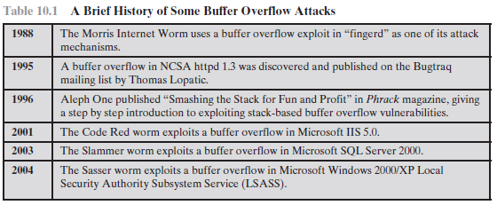
Buffer Overflow
A very common attack mechanism
  Started from 1988 Morris Worm to Code Red, Slammer, Sasser and many others..
  It is due to careless programming in applications.
Notes:
In this chapter we turn our attention specifically to buffer overflow attacks. This type of attack is one of the most common attacks seen, and results from careless programming in applications. This type of attack has been known since it was first widely used by the Morris Internet Worm in 1988, and techniques for preventing its occurrence are well known and documented. Unfortunately due to both a legacy of buggy code in widely deployed operating systems and applications, and continuing careless programming practices by programmers, it is still a major source of concern to security practitioners.

Slide 11
Buffer Overflow
A very common attack mechanism
  Started from 1988 Morris Worm to Code Red, Slammer, Sasser and many others..
  It is due to careless programming in applications.
Techniques for preventing buffer overflow occurrence are well known and documented.
Still of major concern to security practitioners due to
  Legacy of buggy code in widely deployed operating systems and applications.
  Continued careless programming techniques by programmers.
Notes:
In this chapter we turn our attention specifically to buffer overflow attacks. This type of attack is one of the most common attacks seen, and results from careless programming in applications. This type of attack has been known since it was first widely used by the Morris Internet Worm in 1988, and techniques for preventing its occurrence are well known and documented. Unfortunately due to both a legacy of buggy code in widely deployed operating systems and applications, and continuing careless programming practices by programmers, it is still a major source of concern to security practitioners.

Slide 12
Buffer Overflow Basics
Caused by programming error
When a process attempts to store data beyond the limits of a fixed-sized buffer, and consequently overwrites adjacent memory locations.
  Buffer can be on stack, heap, global data
Consequences of overwriting adjacent memory locations
  corruption of program data
  unexpected transfer of control
  memory access violation
  execution of code chosen by attacker
Notes:
A buffer overflow can occur as a result of a programming error when a process attempts to store data beyond the limits of a fixed-sized buffer, and consequently overwrites adjacent memory locations. These locations could hold other program variables or parameters, or program control flow data such as return addresses and pointers to previous stack frames. The buffer could be located on the stack, in the heap, or in the data section of the process. The consequences of this error include corruption of data used by the program, unexpected transfer of control in the program, possibly memory access violations, and very likely eventual program termination. When done deliberately as part of an attack on a system, the transfer of control could be to code of the attacker’s choosing, resulting in the ability to execute arbitrary code with the privileges of the attacked process.

Slide 13
Buffer Overflow Basics
Sometimes it is done deliberately
  To attack on a system
  To transfer the control of execution to the attacker’s chosen location of the code segment, resulting in the ability to execute arbitrary code with the privileges of the attacked process.
Notes:
A buffer overflow can occur as a result of a programming error when a process attempts to store data beyond the limits of a fixed-sized buffer, and consequently overwrites adjacent memory locations. These locations could hold other program variables or parameters, or program control flow data such as return addresses and pointers to previous stack frames. The buffer could be located on the stack, in the heap, or in the data section of the process. The consequences of this error include corruption of data used by the program, unexpected transfer of control in the program, possibly memory access violations, and very likely eventual program termination. When done deliberately as part of an attack on a system, the transfer of control could be to code of the attacker’s choosing, resulting in the ability to execute arbitrary code with the privileges of the attacked process.

Slide 14
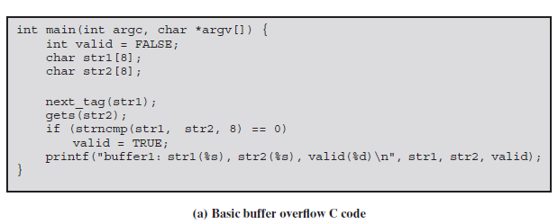
Buffer Overflow Example
C main function containing three variables
  valid, str1, and str2 – Assume these values will be saved in adjacent memory locations.
  next_tag(str1) - to copy some expected tag value(Assume “START”) into str1
Notes:
To illustrate the basic operation of a buffer overflow, consider the C main function given in Figure 11.1a. This contains three variables (valid, str1 and str2), whose values will typically be saved in adjacent memory locations. The purpose of the code fragment is to call the function next_tag(str1) to copy into str1 some expected tag value, eg “START”. It then reads the next line from the standard input for the program using the C library gets() function, and then compares the string read with the expected tag. If the next line did indeed contain just the string “START”, this comparison would succeed, and the variable valid would be set to TRUE. This case is shown in the first of the three example program runs in Figure 11.1b. Any other input tag would leave it with the value FALSE.
The problem with this code exists because the traditional C library gets() function does not include any checking on the amount of data copied. If more than 7 characters are present on the input line, when read in they will (along with the terminating NULL character) require more room than is available in the str2 buffer. Consequently the extra characters will proceed to overwrite the values of the adjacent variable, str1 in this case. For example, if the input line contained “EVILINPUTVALUE”, the result will be that str1 will be overwritten with the characters “TVALUE”, and str2 will use not only the 8 characters allocated to it, but 7 more from str1 as well. This can be seen in the second example run in Figure 11.1b. Knowing the structure of the code processing it, an attacker could arrange for the overwritten value to set the value in str1 equal to the value placed in str2, resulting in the subsequent comparison succeeding. For example, the input line could be the string “BADINPUTBADINPUT”. This results in the comparison succeeding, as shown in the third of the three example program runs.

Slide 15
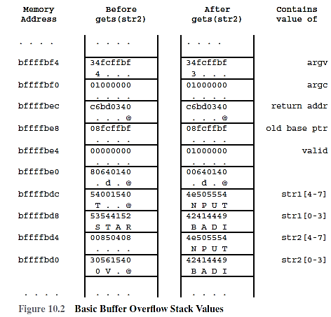
Buffer Overflow Example

Slide 16
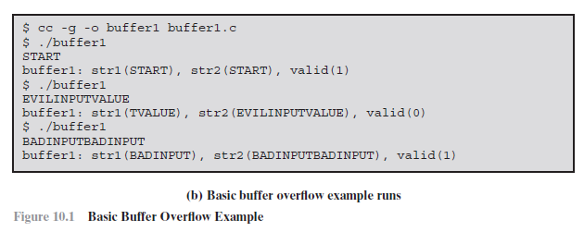
Buffer Overflow Example
Notes:
To illustrate the basic operation of a buffer overflow, consider the C main function given in Figure 11.1a. This contains three variables (valid, str1 and str2), whose values will typically be saved in adjacent memory locations. The purpose of the code fragment is to call the function next_tag(str1) to copy into str1 some expected tag value, eg “START”. It then reads the next line from the standard input for the program using the C library gets() function, and then compares the string read with the expected tag. If the next line did indeed contain just the string “START”, this comparison would succeed, and the variable valid would be set to TRUE. This case is shown in the first of the three example program runs in Figure 11.1b. Any other input tag would leave it with the value FALSE.
The problem with this code exists because the traditional C library gets() function does not include any checking on the amount of data copied. If more than 7 characters are present on the input line, when read in they will (along with the terminating NULL character) require more room than is available in the str2 buffer. Consequently the extra characters will proceed to overwrite the values of the adjacent variable, str1 in this case. For example, if the input line contained “EVILINPUTVALUE”, the result will be that str1 will be overwritten with the characters “TVALUE”, and str2 will use not only the 8 characters allocated to it, but 7 more from str1 as well. This can be seen in the second example run in Figure 11.1b. Knowing the structure of the code processing it, an attacker could arrange for the overwritten value to set the value in str1 equal to the value placed in str2, resulting in the subsequent comparison succeeding. For example, the input line could be the string “BADINPUTBADINPUT”. This results in the comparison succeeding, as shown in the third of the three example program runs.

Slide 17
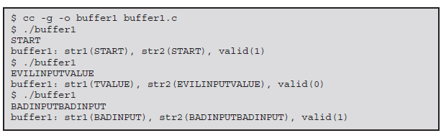
Buffer Overflow Example

Slide 18
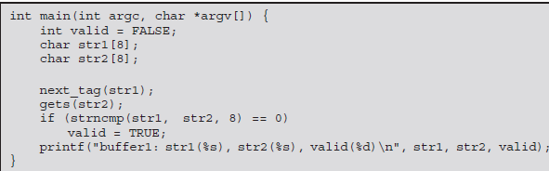
Buffer Overflow Example
What is the Problem with example?
C library gets() function does not include any checking on the amount of data copied.
If more than 7 characters are present on the input line, they require more room than is available in the str2 buffer.
Consequently the extra characters will proceed to overwrite the values of the adjacent variable, str1 in this case.
Notes:
To illustrate the basic operation of a buffer overflow, consider the C main function given in Figure 11.1a. This contains three variables (valid, str1 and str2), whose values will typically be saved in adjacent memory locations. The purpose of the code fragment is to call the function next_tag(str1) to copy into str1 some expected tag value, eg “START”. It then reads the next line from the standard input for the program using the C library gets() function, and then compares the string read with the expected tag. If the next line did indeed contain just the string “START”, this comparison would succeed, and the variable valid would be set to TRUE. This case is shown in the first of the three example program runs in Figure 11.1b. Any other input tag would leave it with the value FALSE.
The problem with this code exists because the traditional C library gets() function does not include any checking on the amount of data copied. If more than 7 characters are present on the input line, when read in they will (along with the terminating NULL character) require more room than is available in the str2 buffer. Consequently the extra characters will proceed to overwrite the values of the adjacent variable, str1 in this case. For example, if the input line contained “EVILINPUTVALUE”, the result will be that str1 will be overwritten with the characters “TVALUE”, and str2 will use not only the 8 characters allocated to it, but 7 more from str1 as well. This can be seen in the second example run in Figure 11.1b. Knowing the structure of the code processing it, an attacker could arrange for the overwritten value to set the value in str1 equal to the value placed in str2, resulting in the subsequent comparison succeeding. For example, the input line could be the string “BADINPUTBADINPUT”. This results in the comparison succeeding, as shown in the third of the three example program runs.

Slide 19
Buffer Overflow Example
What is the Problem with example?
C library gets() function does not include any checking on the amount of data copied.
If more than 7 characters are present on the input line, they require more room than is available in the str2 buffer.
Consequently the extra characters will proceed to overwrite the values of the adjacent variable, str1 in this case.
Notes:
To illustrate the basic operation of a buffer overflow, consider the C main function given in Figure 11.1a. This contains three variables (valid, str1 and str2), whose values will typically be saved in adjacent memory locations. The purpose of the code fragment is to call the function next_tag(str1) to copy into str1 some expected tag value, eg “START”. It then reads the next line from the standard input for the program using the C library gets() function, and then compares the string read with the expected tag. If the next line did indeed contain just the string “START”, this comparison would succeed, and the variable valid would be set to TRUE. This case is shown in the first of the three example program runs in Figure 11.1b. Any other input tag would leave it with the value FALSE.
The problem with this code exists because the traditional C library gets() function does not include any checking on the amount of data copied. If more than 7 characters are present on the input line, when read in they will (along with the terminating NULL character) require more room than is available in the str2 buffer. Consequently the extra characters will proceed to overwrite the values of the adjacent variable, str1 in this case. For example, if the input line contained “EVILINPUTVALUE”, the result will be that str1 will be overwritten with the characters “TVALUE”, and str2 will use not only the 8 characters allocated to it, but 7 more from str1 as well. This can be seen in the second example run in Figure 11.1b. Knowing the structure of the code processing it, an attacker could arrange for the overwritten value to set the value in str1 equal to the value placed in str2, resulting in the subsequent comparison succeeding. For example, the input line could be the string “BADINPUTBADINPUT”. This results in the comparison succeeding, as shown in the third of the three example program runs.

Slide 20
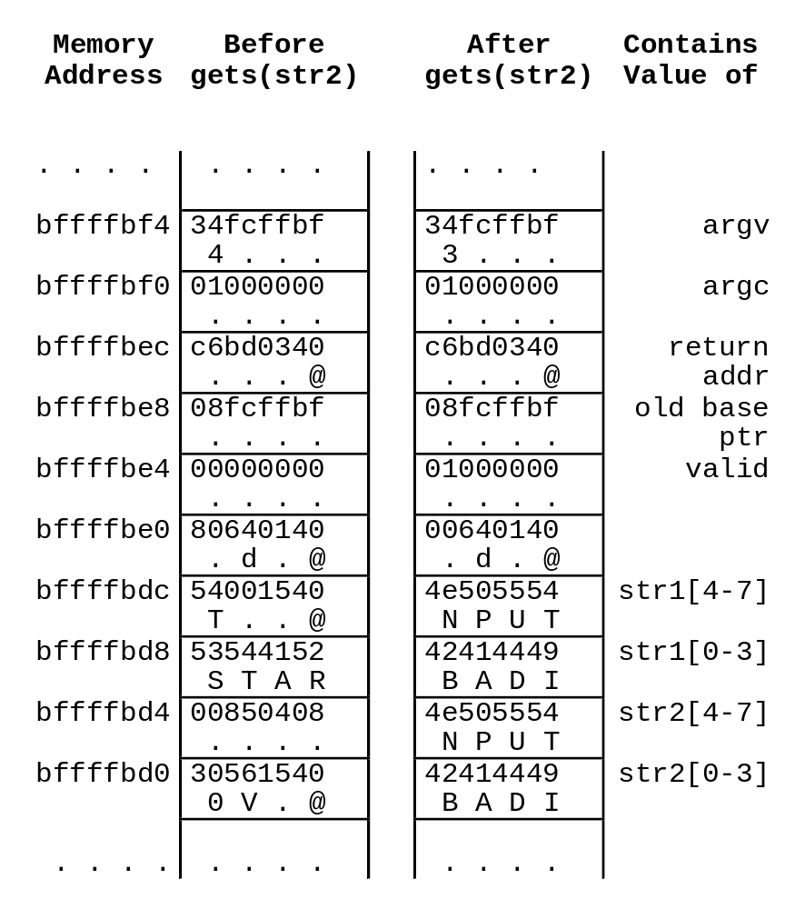
Buffer Overflow Example
Notes:
The order and location of the program variables will depend on the type of variable (local or global), the language and compiler used, and the target machine architecture. However, for the purpose of this example we will assume that they are saved in consecutive memory locations, from highest to lowest, as shown in Figure 11.2. The third example, of deliberate corruption of str1 to allow the comparison to succeed, as illustrated in Figure 11.2 with the values of the local variables before and after the call to gets(). Note also that the terminating NULL for the input string was written to the memory location following str1. This means the flow of control in the program will continue as if the expected tag was found, when in fact the tag read was something completely different. This will almost certainly result in program behavior that was not intended. How serious this is will depend very much on the logic in the attacked program. One dangerous possibility occurs if instead of being a tag, the values in these buffers were an expected and supplied password needed to access privileged features. If so, the buffer overflow provides the attacker with a means of accessing these features without actually knowing the correct password.

Slide 21
Buffer Overflow Example
How attack is possible ?
Assume that a valid password is stored in the str1 buffer, instead of “START” tag.
By supplying a long string an attacker performs buffer overflow and overwrites a valid password.
Strncmp() generates Valid=1 and so the attacker can access privileged features without knowing a valid password.
Notes:
To illustrate the basic operation of a buffer overflow, consider the C main function given in Figure 11.1a. This contains three variables (valid, str1 and str2), whose values will typically be saved in adjacent memory locations. The purpose of the code fragment is to call the function next_tag(str1) to copy into str1 some expected tag value, eg “START”. It then reads the next line from the standard input for the program using the C library gets() function, and then compares the string read with the expected tag. If the next line did indeed contain just the string “START”, this comparison would succeed, and the variable valid would be set to TRUE. This case is shown in the first of the three example program runs in Figure 11.1b. Any other input tag would leave it with the value FALSE.
The problem with this code exists because the traditional C library gets() function does not include any checking on the amount of data copied. If more than 7 characters are present on the input line, when read in they will (along with the terminating NULL character) require more room than is available in the str2 buffer. Consequently the extra characters will proceed to overwrite the values of the adjacent variable, str1 in this case. For example, if the input line contained “EVILINPUTVALUE”, the result will be that str1 will be overwritten with the characters “TVALUE”, and str2 will use not only the 8 characters allocated to it, but 7 more from str1 as well. This can be seen in the second example run in Figure 11.1b. Knowing the structure of the code processing it, an attacker could arrange for the overwritten value to set the value in str1 equal to the value placed in str2, resulting in the subsequent comparison succeeding. For example, the input line could be the string “BADINPUTBADINPUT”. This results in the comparison succeeding, as shown in the third of the three example program runs.

Slide 22
Buffer Overflow Attacks
To exploit a buffer overflow an attacker
  must identify a buffer overflow vulnerability in some program
    inspection, tracing execution, fuzzing tools
  understand how buffer is stored in memory and determine potential for corruption
Notes:
To exploit any type of buffer overflow, such as those we have illustrated here, the attacker needs to identify both:
a buffer overflow vulnerability in some program that can be triggered using externally sourced data under the attackers control, and
2. to understand how that buffer will be stored in the processes memory, and hence the potential for corrupting adjacent memory locations and potentially altering the flow of execution of the program.
Identifying vulnerable programs may be done by inspection of program source, tracing the execution of programs as they process oversized input, or using tools such as “fuzzing”. What the attacker does with the resulting corruption of memory varies considerably, depending on what values are being overwritten.

Slide 23
A Little Programming Language History
At machine level all data an array of bytes
  interpretation depends on instructions used
Modern high-level languages have a strong notion of type and valid operations
  not vulnerable to buffer overflows
  does incur overhead, some limits on use
C and related languages have high-level control structures, but allow direct access to memory
  hence are vulnerable to buffer overflow
  have a large legacy of widely used, unsafe, and hence vulnerable code
Notes:
Before exploring buffer overflows further, it is worth considering just how the potential for their occurance developed, and why programs are not necessarily protected from such errors. To understand this, we need to briefly consider the history of programming languages, and the fundamental operation of computer systems. At the basic machine level, all of the data manipulated by machine instructions executed by the computer processor are stored in either the processor’s registers or in memory. The data are simply arrays of bytes. Their interpretation is entirely determined by the function of the instructions accessing them.
At the other end of the abstraction spectrum, modern high-level programming languages like Java, ADA, Python, and many others, have a very strong notion of the type of variables, and what constitutes permissible operations on them. Such languages do not suffer from buffer overflows. But this flexibility and safety comes at a cost in resource use, both at compile time, and in additional code that must executed at run-time to impose checks such as that on buffer limits. The distance from the underlying machine language and architecture also means that access to some instructions and hardware resources is lost.
In between these extremes are languages such as C and its derivatives, which have many modern high-level control structures and data type abstractions, but which still provide the ability to access and manipulate memory data directly. Unfortunately, this means the language is susceptible to inappropriate use of memory contents. As has occurred in a number of common standard library functions. There is a large legacy body of code using unsafe functions, which are thus potentially vulnerable to buffer overflows.

Slide 24
Function Calls and Stack Frames
Some important Concepts
  When one function calls another, it needs to save the return address at some safe place so the called function can return control when it finishes.
  It also needs locations to save the parameters to be passed in to the called function, and also possibly to save register values that it wishes to continue using when the called function returns.
  All of this data is usually saved on the stack in a structure known as a stack frame.
  Also there is need of chaining these frames together.
Notes:
A stack buffer overflow occurs when the targeted buffer is located on the stack, usually as a local variable in a function’s stack frame. This form of attack is also referred to as stack smashing. Stack buffer overflow attacks have been exploited since first being seen in the wild in the Morris Internet Worm in 1988. The publication by Aleph One (Elias Levy) of details of the attack and how to exploit it [LEVY96] hastened further use of this technique, which is still widely exploited.
Because the local variables are placed below the saved frame pointer and return address, the possibility exists of exploiting a local buffer variable overflow vulnerability to overwrite the values of one or both of these key function linkage values. This possibility of overwriting the saved frame pointer and return address forms the core of a stack overflow attack. The attacker can overwrite the return address with any desired value, not just the address of the targeted function. It could be the address of any function, or indeed of any sequence of machine instructions present in the program or its associated system libraries. However, the approach used in the original attacks was to include the desired machine code in the buffer being overflowed.

Slide 25
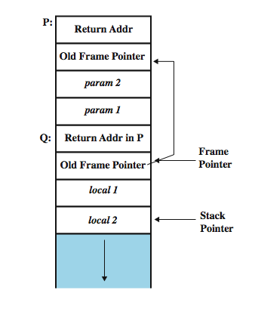
Function Calls and Stack Frames
Assume a function P calls Q
Stack frame: two frames
Calling function P: needs a data
structure to store the “return”
address and parameters to be
Passed.
Called function Q: needs a place
to store its local variables
somewhere different for every call.
Notes:
To better understand how buffer overflows work, we first take a brief digression into the mechanisms used by program functions to manage their local state on each call. When one function calls another, at the very least it needs somewhere to save the return address so the called function can return control when it finishes. Aside from that, it also needs locations to save the parameters to be passed in to the called function, and also possibly to save register values that it wishes to continue using when the called function returns. All of this data is usually saved on the stack in a structure known as a stack frame. One further piece of information then needed is some means of chaining these frames together. Figure 11.3 illustrates such a stack frame structure. See details in text of steps performed when one function calls another. As has been indicated before, the precise implementation of these steps is language, compiler and processor architecture dependent. However, something similar will usually be found in most cases.

Slide 26
Stack Buffer Overflow
Occurs when buffer is located on stack
  also referred to as stack smashing
  used by Morris Worm
  “Smashing the Stack” paper popularized it
Have local variables below saved frame pointer and return address
  hence overflow of a local buffer can potentially overwrite these key control items
Attacker overwrites return address with address of desired code
  program, system library or loaded in buffer
Notes:
A stack buffer overflow occurs when the targeted buffer is located on the stack, usually as a local variable in a function’s stack frame. This form of attack is also referred to as stack smashing. Stack buffer overflow attacks have been exploited since first being seen in the wild in the Morris Internet Worm in 1988. The publication by Aleph One (Elias Levy) of details of the attack and how to exploit it [LEVY96] hastened further use of this technique, which is still widely exploited.
Because the local variables are placed below the saved frame pointer and return address, the possibility exists of exploiting a local buffer variable overflow vulnerability to overwrite the values of one or both of these key function linkage values. This possibility of overwriting the saved frame pointer and return address forms the core of a stack overflow attack. The attacker can overwrite the return address with any desired value, not just the address of the targeted function. It could be the address of any function, or indeed of any sequence of machine instructions present in the program or its associated system libraries. However, the approach used in the original attacks was to include the desired machine code in the buffer being overflowed.

Slide 27
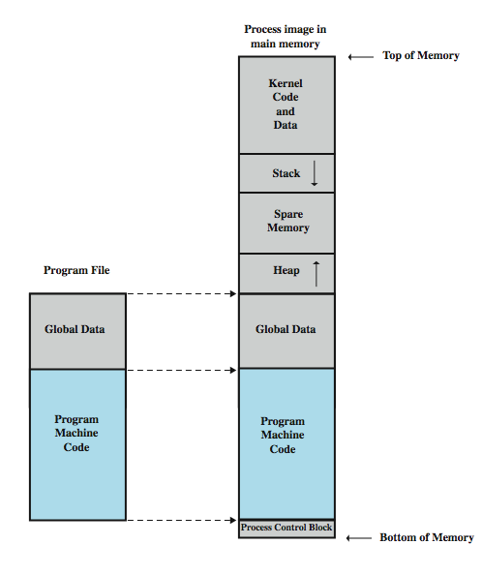
Programs and Processes
Notes:
At this point, it is useful to step back and take a somewhat wider view of a running program, and the placement of key regions such as the program code, global data, heap and stack. When a program is run, the operating system typically creates a new process for it. The process is given its own virtual address space, with a general structure as shown in Figure 11.4. This consists of the contents of the executable program file (including global data, relocation table, and actual program code segments) near the bottom of this address space, space for the program heap to then grow upwards from above the code, and room for the stack to grow down from near the middle (if room is reserved for kernel space in the upper half) or top. The stack frames we discussed are hence placed one below another in the stack area, as the stack grows downwards through memory.

Slide 28
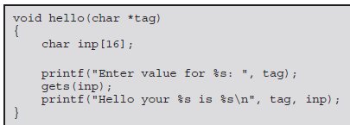
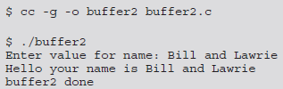
Stack Buffer Overflow Example
Consider an example
It contains a single local variable, the buffer “inp”.
Output for input “Bill and Lawrie” where length <=16.
Notes:
To illustrate the operation of a classic stack overflow, consider the C function given in Figure 11.5a. It contains a single local variable, the buffer inp. This hello function (a version of the classic Hello World program), prompts for a name, which it then reads into the buffer inp using the unsafe gets() library routine. It then displays the value read using the printf() library routine. As long as a small value is read in there will be no problems and the program calling this function will run successfully, as shown in the first of the example program runs in Figure 11.5b. However, if too much data is input, as shown in the second of the example program runs in Figure 11.5b, then the data extends beyond the end of the buffer and ends up overwriting the saved frame pointer and return address with garbage values (corresponding to the binary representation of the characters supplied). Then, when the function attempts to transfer control to the return address, it typically jumps to an illegal memory location, resulting in a “Segmentation Fault” and the abnormal termination of the program, as shown. Of more interest to the attacker, rather than immediately crashing the program, is to have it transfer control to a location and code of the attacker’s choosing. We can illustrate this process using this function, to start re-executing the hello function, rather then returning to the calling main routine. To do this we need to find the address at which the hello function will be loaded. . The easiest way to determine this is to run a debugger on the target program, and disassemble the target function. When done it is found at address 0x08048394. For the purpose of this demonstration I used a simple one-line Perl program, whose pack() function can be easily used to convert a hexadecimal string into its binary equivalent, as can be seen in the third of the example program runs in Figure 11.5b

Slide 29

Stack Buffer Overflow Example
Consider an example
It contains a single local variable, the buffer “inp”.
Output for input “XXXXXX……………..” where length >16.
It generates ‘segmentation fault’ as it overwrites the saved frame pointer and return address with garbage values
Notes:
To illustrate the operation of a classic stack overflow, consider the C function given in Figure 11.5a. It contains a single local variable, the buffer inp. This hello function (a version of the classic Hello World program), prompts for a name, which it then reads into the buffer inp using the unsafe gets() library routine. It then displays the value read using the printf() library routine. As long as a small value is read in there will be no problems and the program calling this function will run successfully, as shown in the first of the example program runs in Figure 11.5b. However, if too much data is input, as shown in the second of the example program runs in Figure 11.5b, then the data extends beyond the end of the buffer and ends up overwriting the saved frame pointer and return address with garbage values (corresponding to the binary representation of the characters supplied). Then, when the function attempts to transfer control to the return address, it typically jumps to an illegal memory location, resulting in a “Segmentation Fault” and the abnormal termination of the program, as shown. Of more interest to the attacker, rather than immediately crashing the program, is to have it transfer control to a location and code of the attacker’s choosing. We can illustrate this process using this function, to start re-executing the hello function, rather then returning to the calling main routine. To do this we need to find the address at which the hello function will be loaded. . The easiest way to determine this is to run a debugger on the target program, and disassemble the target function. When done it is found at address 0x08048394. For the purpose of this demonstration I used a simple one-line Perl program, whose pack() function can be easily used to convert a hexadecimal string into its binary equivalent, as can be seen in the third of the example program runs in Figure 11.5b

Slide 30
Stack Buffer Overflow Example
Consider an example
It contains a single local variable, the buffer “inp”.
Rather than this, the attacker could be interested in transfer control to a location and code of the attacker’s choosing, rather than immediately crashing the program.
The simplest way of doing this is for the input causing the buffer overflow to contain the desired target address at the point where it will overwrite the saved return address in the stack frame.
Then when the attacked function finishes and executes the return instruction, instead of returning to the calling function, it will jump to the supplied address instead and execute instructions from there.
Notes:
To illustrate the operation of a classic stack overflow, consider the C function given in Figure 11.5a. It contains a single local variable, the buffer inp. This hello function (a version of the classic Hello World program), prompts for a name, which it then reads into the buffer inp using the unsafe gets() library routine. It then displays the value read using the printf() library routine. As long as a small value is read in there will be no problems and the program calling this function will run successfully, as shown in the first of the example program runs in Figure 11.5b. However, if too much data is input, as shown in the second of the example program runs in Figure 11.5b, then the data extends beyond the end of the buffer and ends up overwriting the saved frame pointer and return address with garbage values (corresponding to the binary representation of the characters supplied). Then, when the function attempts to transfer control to the return address, it typically jumps to an illegal memory location, resulting in a “Segmentation Fault” and the abnormal termination of the program, as shown. Of more interest to the attacker, rather than immediately crashing the program, is to have it transfer control to a location and code of the attacker’s choosing. We can illustrate this process using this function, to start re-executing the hello function, rather then returning to the calling main routine. To do this we need to find the address at which the hello function will be loaded. . The easiest way to determine this is to run a debugger on the target program, and disassemble the target function. When done it is found at address 0x08048394. For the purpose of this demonstration I used a simple one-line Perl program, whose pack() function can be easily used to convert a hexadecimal string into its binary equivalent, as can be seen in the third of the example program runs in Figure 11.5b

Slide 31
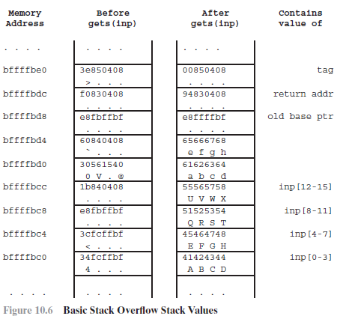
Stack Buffer Overflow Example
Consider an example
It contains a single local variable, the buffer “inp”.
Here, return address is
“0x08048394”
Notes:
To illustrate the operation of a classic stack overflow, consider the C function given in Figure 11.5a. It contains a single local variable, the buffer inp. This hello function (a version of the classic Hello World program), prompts for a name, which it then reads into the buffer inp using the unsafe gets() library routine. It then displays the value read using the printf() library routine. As long as a small value is read in there will be no problems and the program calling this function will run successfully, as shown in the first of the example program runs in Figure 11.5b. However, if too much data is input, as shown in the second of the example program runs in Figure 11.5b, then the data extends beyond the end of the buffer and ends up overwriting the saved frame pointer and return address with garbage values (corresponding to the binary representation of the characters supplied). Then, when the function attempts to transfer control to the return address, it typically jumps to an illegal memory location, resulting in a “Segmentation Fault” and the abnormal termination of the program, as shown. Of more interest to the attacker, rather than immediately crashing the program, is to have it transfer control to a location and code of the attacker’s choosing. We can illustrate this process using this function, to start re-executing the hello function, rather then returning to the calling main routine. To do this we need to find the address at which the hello function will be loaded. . The easiest way to determine this is to run a debugger on the target program, and disassemble the target function. When done it is found at address 0x08048394. For the purpose of this demonstration I used a simple one-line Perl program, whose pack() function can be easily used to convert a hexadecimal string into its binary equivalent, as can be seen in the third of the example program runs in Figure 11.5b

Slide 32
Stack Buffer Overflow Example
Consider an example
It contains a single local variable, the buffer “inp”.
Now consider the input of size 24 “ABCDEFGHQRSTUVWXabcdefgyuy” for value of “inp” buffer.
To overwrite the return address, frame ptr is also need to be overwritten wit some valid address. Suppose that valid address is “0x8fcffbf”.
Because the aim of this attack is to cause the hello function to be called again, a second line of input is included for it to read on the second run, namely the string NNNN, along with newline characters at the end of each line.
Notes:
To illustrate the operation of a classic stack overflow, consider the C function given in Figure 11.5a. It contains a single local variable, the buffer inp. This hello function (a version of the classic Hello World program), prompts for a name, which it then reads into the buffer inp using the unsafe gets() library routine. It then displays the value read using the printf() library routine. As long as a small value is read in there will be no problems and the program calling this function will run successfully, as shown in the first of the example program runs in Figure 11.5b. However, if too much data is input, as shown in the second of the example program runs in Figure 11.5b, then the data extends beyond the end of the buffer and ends up overwriting the saved frame pointer and return address with garbage values (corresponding to the binary representation of the characters supplied). Then, when the function attempts to transfer control to the return address, it typically jumps to an illegal memory location, resulting in a “Segmentation Fault” and the abnormal termination of the program, as shown. Of more interest to the attacker, rather than immediately crashing the program, is to have it transfer control to a location and code of the attacker’s choosing. We can illustrate this process using this function, to start re-executing the hello function, rather then returning to the calling main routine. To do this we need to find the address at which the hello function will be loaded. . The easiest way to determine this is to run a debugger on the target program, and disassemble the target function. When done it is found at address 0x08048394. For the purpose of this demonstration I used a simple one-line Perl program, whose pack() function can be easily used to convert a hexadecimal string into its binary equivalent, as can be seen in the third of the example program runs in Figure 11.5b

Slide 33
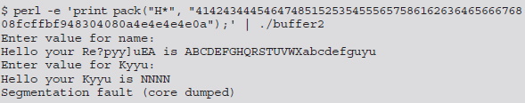
Stack Buffer Overflow Example
Consider an example
Here, the example of perl command is used where pack() function is used to convert a hexadecimal string into its binary equivalent. This output is then piped into the targeted buffer2 program.
Notes:
To illustrate the operation of a classic stack overflow, consider the C function given in Figure 11.5a. It contains a single local variable, the buffer inp. This hello function (a version of the classic Hello World program), prompts for a name, which it then reads into the buffer inp using the unsafe gets() library routine. It then displays the value read using the printf() library routine. As long as a small value is read in there will be no problems and the program calling this function will run successfully, as shown in the first of the example program runs in Figure 11.5b. However, if too much data is input, as shown in the second of the example program runs in Figure 11.5b, then the data extends beyond the end of the buffer and ends up overwriting the saved frame pointer and return address with garbage values (corresponding to the binary representation of the characters supplied). Then, when the function attempts to transfer control to the return address, it typically jumps to an illegal memory location, resulting in a “Segmentation Fault” and the abnormal termination of the program, as shown. Of more interest to the attacker, rather than immediately crashing the program, is to have it transfer control to a location and code of the attacker’s choosing. We can illustrate this process using this function, to start re-executing the hello function, rather then returning to the calling main routine. To do this we need to find the address at which the hello function will be loaded. . The easiest way to determine this is to run a debugger on the target program, and disassemble the target function. When done it is found at address 0x08048394. For the purpose of this demonstration I used a simple one-line Perl program, whose pack() function can be easily used to convert a hexadecimal string into its binary equivalent, as can be seen in the third of the example program runs in Figure 11.5b

Slide 34
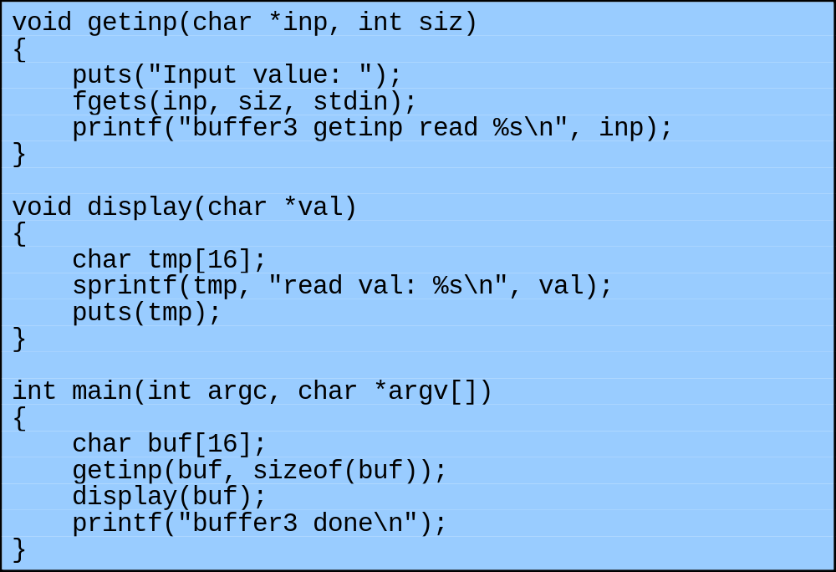
Another Stack Overflow
Safe input function; output
may still overwrite part of the
stack frame (sprintf creates
formatted value for a var)
Notes:
In all the examples used so far, the buffer overflow has occurred when the input was read. The possibility also exists that a program can safely read and save input, pass it around the program, and then at some later time in another function unsafely copy it, resulting in a buffer overflow. Figure 11.7a shows an example program illustrating this behavior. The main() function includes the buffer buf. This is passed along with its size to the function getinp() which safely reads a value using fgets(). The getinp()function then returns to main(), which then calls the function display() with the value in buf. This function constructs a response string in a second local buffer called tmp and then displays this. Unfortunately, the sprintf() library routine is another common, unsafe C library routine. Note in this program that the buffers are both the same size. The problem that may result occurs when data is being merged into a buffer that includes the contents of another buffer, such that the space needed exceeds the space available.

Slide 35
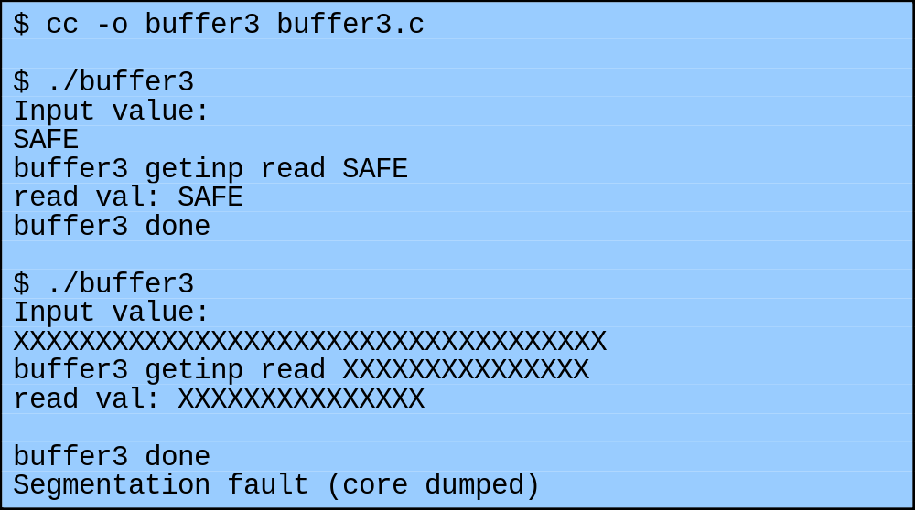
Another Stack Overflow
Safe input function; output
may still overwrite part of the
stack frame
Notes:
Look at the example runs of this program shown in Figure 11.7b. For the first run, the value read is small enough that the merged response didn’t corrupt the stack frame. For the second run, the supplied input was much too large. However, because a safe input function was used, only 15 characters were read, as shown in the following line. When this was then merged with the response string, the result was larger than the space available in the destination buffer. In fact, it overwrote the saved frame pointer, but not the return address. So the function returned, as shown by the message printed by the main() function. But when main() tried to return, because its stack frame had been corrupted and was now some random value, the program jumped to an illegal address and crashed. In this case the combined result was not long enough to reach the return address, but this would be possible if a larger buffer size had been used.

Slide 36
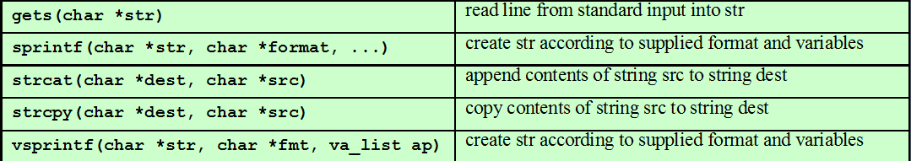
Common Unsafe C Functions

Slide 37
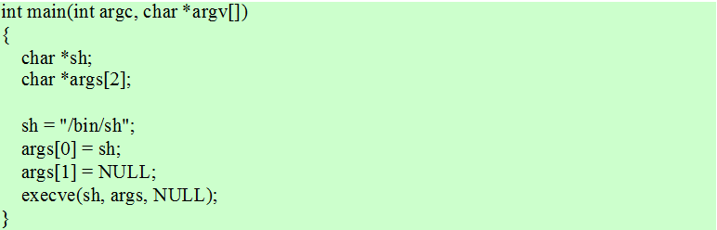
Unix Shellcode
In Windows terms: command.exe

Slide 38
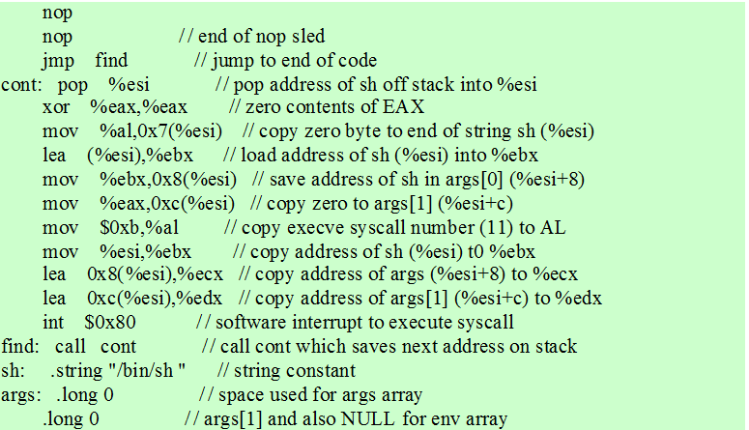
Unix Shellcode

Slide 39
Shellcode
code supplied by attacker
  often saved in buffer being overflowed
  traditionally transferred control to a shell
machine code
  specific to processor and operating system
  traditionally needed good assembly language skills to create
  more recently have automated sites/tools
Notes:
An essential component of many buffer overflow attacks is the transfer of execution to code supplied by the attacker, and often saved in the buffer being overflowed. This code is known as shellcode, because traditionally its function was to transfer control to a user command-line interpreter, or shell. Shellcode is machine code, a series of binary values corresponding to the machine instructions and data values that implement the attacker’s desired functionality. This means shellcode is specific to a particular processor architecture, and indeed usually to a specific operating system (O/S). Writing it traditionally required a good understanding of the assembly language and operation of the targeted system. However, more recently a number of sites and tools have been developed which automate this process, thus making the development of shellcode exploits available to a much larger potential audience. e.g. the Metasploit Project site.

Slide 40
Buffer Overflow Defenses
Buffer overflows are widely exploited
Large amount of vulnerable code in use
  despite cause and countermeasures known
Two broad defense approaches
  compile-time - harden new programs
  run-time - handle attacks on existing programs
Notes:
We have seen that finding and exploiting a stack buffer overflow is not that difficult. The large number of exploits over the previous couple of decades clearly illustrates this. There is consequently a need to defend systems against such attacks by either preventing them occurring at all, or at least detecting and aborting such attacks. This section discusses possible approaches to implementing such protections. These can be broadly classified into two categories:
• compile-time defenses which aim to harden programs to resist attacks in new programs
• run-time defenses which aim to detect and abort attacks in existing programs
Whilst suitable defenses have been known for a couple of decades, the very large existing base of vulnerable software and systems hinders their deployment. Hence the interest in run-time defenses which can be deployed as operating systems updates and provide some protection for existing vulnerable programs.

Slide 41
Compile-Time Defenses:
Programming Language
Use a modern high-level languages with strong typing
  not vulnerable to buffer overflow
  compiler enforces range checks and permissible operations on variables
Do have cost in resource use
And restrictions on access to hardware
  so still need some code in C like languages
Notes:
Compile-time defenses aim to prevent or detect buffer overflows by instrumenting programs when they are compiled. One possibility, is a to write the program using a modern high-level programming language which has a strong notion of variable type and what constitutes permissible operations on them. Such languages are not vulnerable to buffer overflow attacks, because their compilers include additional code to enforce range checks automatically, removing the need for the programmer to explicitly code them. The flexibility and safety provided by these languages does come at a cost in resource use, both at compile time, and also in additional code that must executed at run-time to impose checks such as that on buffer limits. These disadvantages are much less significant than they used to be, due to the rapid increase in processor performance. Also, the distance from the underlying machine language and architecture also means that access to some instructions and hardware resources is lost. This limits their usefulness in writing code, such as device drivers, that must interact with such resources. For these reasons, there is still likely to be at least some code written in less safe languages such as C.

Slide 42
Compile-Time Defenses:
Safe Coding Techniques
If using potentially unsafe languages eg C
Programmer must explicitly write safe code
  by design with new code
  extensive after code review of existing code, (e.g., OpenBSD)
Buffer overflow safety a subset of general safe coding techniques
Allow for graceful failure (know how things may go wrong)
  check for sufficient space in any buffer
Notes:
If languages such as C are being used, then programmers need to be aware that their ability to manipulate pointer addresses and access memory directly comes at a cost. In order to harden these systems, the programmer needs to inspect the code and rewrite any unsafe coding constructs in a safe manner. Given the rapid uptake of buffer overflow exploits, this process has begun in some cases. A good example is the OpenBSD project, which has undertaken an extensive audit of the existing code base including the operating system, standard libraries and common utilities.
With regard to programmers working on code for their own programs, the discipline required to ensure that buffer overflows are not allowed to occur is a subset of the various safe programming techniques see Chapter 12. Most specifically, it means a mindset that codes not just for success, or for the expected, but is constantly aware of how things might go wrong, and coding for “graceful failure”, always doing something sensible when the unexpected occurs. More specifically in the case of preventing buffer overflows, it means always ensuring that any code that writes to a buffer must first check to ensure sufficient space is available. Should emphasize both the need to always verify the amount of space being used, and the fact that problems can occur both with plain C code, as well as from calling standard library routines.

Slide 43
Compile-Time Defenses:
Language Extension, Safe Libraries
Proposals for safety extensions (library replacements) to C
  performance penalties
  must compile programs with special compiler
Several safer standard library variants
  new functions, e.g. strlcpy()
  safer re-implementation of standard functions as a dynamic library, e.g. Libsafe
Notes:
Given the problems that can occur in C with unsafe array and pointer references, there have been a number of proposals to augment compilers to automatically insert range checks on such references. Whilst this is fairly easy for statically allocated arrays, handling dynamically allocated memory is more problematic, and requires an extension to the semantics of a pointer to include bounds information, and the use of library routines to ensure these values are set correctly. Several such approaches exist. However, there is generally a performance penalty with the use of such techniques that may or may not be acceptable. It also requires all programs and libraries that require these safety features to be re-compiled with the modified compiler.
A common concern with C comes from the use of unsafe standard library routines, especially some of the string manipulation routines. One approach to improving the safety of systems has been to replace these with safer variants, eg. strlcpy() which requires rewriting the source to conform to the new safer semantics. Alternatively, it involves replacement of the standard string library with a safer variant. “Libsafe” is a well-known example of this. It implements the standard semantics, but includes additional checks to ensure that the copy operations do not extend beyond the local variable space in the stack frame. This library is implemented as a dynamic library, arranged to load before the existing standard libraries, and can thus provide protection for existing programs without requiring them to be recompiled.

Slide 44
Compile-Time Defenses:
Stack Protection
Stackgaurd: add function entry and exit code to check stack for signs of corruption
  Use random canary
  e.g. Stackguard, Win/GS, GCC
  check for overwrite between local variables and saved frame pointer and return address
  abort program if change found
  issues: recompilation, debugger support
Or save/check safe copy of return address (in a safe, non-corruptible memory area), e.g. Stackshield, RAD
Notes:
An effective method for protecting programs against classic stack overflow attacks is to instrument the function entry and exit code to setup and then check its stack frame for any evidence of corruption. If any modification is found, the program is aborted rather than allowing the attack to proceed. The Stackguard GCC compiler extension is one of the best known. The added function entry code writes a canary value below the old frame pointer address, before the allocation of space for local variables. The added function exit code checks that the canary value has not changed, before continuing with the usual function exit operations. Any attempt at a classic stack buffer overflow would have to alter this value in order to change the old frame pointer and return addresses, and would thus be detected, resulting in the program being aborted. It is critical that the canary value be unpredictable, usually random. If this were not the case, the attacker would simply ensure the shellcode included the correct canary value in the required location. There are some issues with using this approach. Firstly it requires that all programs needing protection be recompiled. Secondly, because the structure of the stack frame has changed, it can cause problems with programs, such as debuggers, which analyze stack frames. Similar functionality is available for Windows programs using Microsoft’s /GS Visual C++ compiler option.
Another variant is used by Stackshield and Return Address Defender (RAD) GCC extension. These extensions do not alter the structure of the stack frame. Instead, on function entry the added code writes a copy of the return address to a “safe” region of memory that would be very difficult to corrupt. On function exit the added code checks the return address in the stack frame against the saved copy, and if any change is found, aborts the program.

Slide 45
Run-Time Defenses:
Non Executable Address Space
Many BO attacks copy machine code into buffer and xfer ctrl to it
Use virtual memory support to make some regions of memory non-executable (to avoid exec of attacker’s code)
  e.g. stack, heap, global data
  need h/w support in MMU
  long existed on SPARC/Solaris systems
  recent on x86 Linux/Unix/Windows systems
Issues: support for executable stack code
Notes:
Have interest in run-time defenses that can be deployed as operating systems updates to provide some protection for existing vulnerable programs. These defenses involve changes to the memory management of the virtual address space of processes.
Many of the buffer overflow attacks involve copying machine code into the targeted buffer, and then transferring execution to it. A possible defense is to block the execution of code on the stack/heap/global data, assuming that executable code should only be found elsewhere in the processes address space. To support this feature efficiently requires support from the processor’s memory management unit (MMU) to tag pages of virtual memory as being non-executable. Some processor’s, such as the SPARC used by Solaris, have had support for this for some time. Enabling its use in Solaris requires a simple kernel parameter change. Other processor’s such as the x86 family have not had this support until recently, with the relatively recent addition of the no-execute bit in its MMU. Extensions have been made available to Linux, BSD and other Unix style systems to support the use of this feature. Support for enabling no-execute protection is also included in recent Windows systems.
Making the stack (and heap) non-executable provides a high degree of protection against many types of buffer overflow attacks for existing programs. However, one issue is support for programs that do need to place executable code on the stack, such as with the Java Runtime system. Executable code on the stack is also used to implement nested functions in C, and also Linux signal handlers. Special provisions are needed to support these requirements. Nonetheless, this is regarded as one of the best methods for protecting existing programs and hardening systems against some attacks.

Slide 46
Run-Time Defenses:
Address Space Randomization
Manipulate location of key data structures
  stack, heap, global data: change address by 1 MB
  using random shift for each process
  have large address range on modern systems means wasting some has negligible impact
Randomize location of heap buffers and location of standard library functions
Notes:
Another runtime technique that can be used to thwart attacks involves manipulation of the location of key data structures (stack, heap, global data) in a processes address space. The attacker needs to be able to predict the approximate location of the targeted buffer in one of these areas to determine a suitable return address to use in the attack to transfer control to the shellcode. One technique to greatly increase the difficulty of this prediction is to change the address at which the stack is located in a random manner for each process. The range of addresses available on modern processors is large (32-bits), and most programs only need a small fraction of that. So moving the stack memory region around has minimal impact on most programs, but makes predicting the targeted buffer’s address almost impossible.
Related to this, randomizing the allocation of memory on the heap makes the possibility of predicting the address of targeted buffers extremely difficult, thus thwarting the successful execution of some heap overflow attacks. Also can randomizes the order of loading standard libraries by a program, and their virtual memory address locations. This makes the address of any specific function sufficiently unpredictable as to render the chance of a given attack correctly predicting its address, very low.

Slide 47
Run-Time Defenses:
Guard Pages
Place guard pages between critical regions of memory (or between stack frames)
  flagged in MMU (mem mgmt unit) as illegal addresses
  any access aborts process
Can even place between stack frames and heap buffers
  at execution time and space cost
Notes:
A final runtime technique that can be used places guard pages between critical regions of memory in a processes address space. Gaps are placed between the ranges of addresses used for each of the components of the address space. These gaps, or guard pages, are flagged in the MMU as illegal addresses, and any attempt to access them results in the process being aborted. This can prevent buffer overflow attacks, typically of global data, which attempt to overwrite adjacent regions in the processes address space, such as the global offset table.
A further extension places guard pages between stack frames, or between different allocations on the heap. This can provide further protection against stack and heap over flow attacks, but at cost in execution time supporting the large number of page mappings necessary.

Slide 48
Other Overflow Attacks
have a range of other attack variants
  stack overflow variants
  heap overflow
  global data overflow
  format string overflow
  integer overflow
more likely to be discovered in future
some cannot be prevented except by coding to prevent originally
Notes:
There are a range of other buffer overflow attacks that have been exploited, and discuss possible defenses. These include variations on stack overflows, such as return to system call, overflows of data saved in the program heap, and overflow of data saved in the processes global data section. We review these next. Beyond the types of buffer vulnerabilities we have discussed here, there are still more variants including format string overflows and integer overflows. It is likely that even more will be discovered in future. The important message is that if programs are not correctly coded in the first place to protect their data structures, then attacks on them are possible. Whilst the defenses we’ve discussed can block many such attacks, some like the original example in Figure 11.1, corrupting an adjacent variable value in a manner that altered the behavior of the attacked program, simply cannot be blocked except by coding to prevent them occurring in the first place.

Slide 49
Replacement Stack Frame
stack overflow variant just rewrites buffer and saved frame pointer
  so return occurs but to dummy frame
  return of calling function controlled by attacker
  used when have limited buffer overflow
  e.g. off by one
limitations
  must know exact address of buffer
  calling function executes with dummy frame
Notes:
A variant on the classic stack buffer overflow attack overwrites just the buffer and saved frame pointer address. The saved frame pointer value is changed to refer to a location near the top of the overwritten buffer, where a “dummy” stack frame has been created with a return address pointing to the shellcode lower in the buffer. Following this change, the current function returns to its calling function as normal, since its return address has not been changed. However, that calling function is now using the replacement “dummy” frame, and when it returns, control is transferred to the shellcode in the overwritten buffer. This may seem a rather indirect attack, but it could be used when only a limited buffer overflow is possible, one that permits a change to the saved frame pointer, but not the return address. There are some additional limitations on this attack since the attacker must know the buffer address precisely, as the exact address of the “dummy” stack frame has to be used when overwriting the old frame pointer value. This can significantly reduce its chance of success. Another problem occurs after control has returned to the calling function. Because it is now using the “dummy” stack frame, any local variables it was using are now invalid, and use of them could cause the program to crash before this function finishes and returns into the shellcode. However, this is a risk with most stack overwriting attacks. Defenses against this type of attack include any of the stack protection mechanisms to detect modifications to the stack frame or return address by function exit code. Also using non-executable stacks blocks the execution of the shellcode, as does randomization of the stack in memory, and of system libraries.

Slide 50
Return to System Call
stack overflow variant replaces return address with standard library function
  response to non-executable stack defences
  attacker constructs suitable parameters on stack above return address
  function returns and library function executes
    e.g. system(“shell commands”)
  attacker may need exact buffer address
  can even chain two library calls
Notes:
Given the introduction of non-executable stacks as a defense against buffer overflows, attackers have turned to a variant attack in which the return address is changed to jump to existing code on the system, most commonly the address of a standard library function, such as the system() function. The attacker specifies an overflow that fills the buffer, replaces the saved frame pointer with a suitable address, replaces the return address with the address of the desired library function, writes a placeholder value that the library function will believe is a return address, and then writes the values of one (or more) parameters to this library function. When the attacked function returns, it restores the (modified) frame pointer, then pops and transfers control to the return address, which causes the code in the library function to start executing. Because the function believes it has been called, it treats the value currently on the top of the stack (the placeholder) as a return address, with its parameters above that. In turn it will construct a new frame below this location and run. Depending on the type of parameters and their interpretation by the library function, the attacker may need to know precisely their address (typically within the overwritten buffer). Another variant chains two library calls one after the other. Defenses against this include any of the stack protection mechanisms to detect modifications to the stack frame or return address by the function exit code, or randomization of the stack in memory, and of system libraries.

Slide 51
Heap Overflow
also attack buffer located in heap
  typically located above program code
  memory requested by programs to use in dynamic data structures, e.g. linked lists
no return address
  hence no easy transfer of control
  may have function pointers can exploit
  or manipulate management data structures
defenses: non executable or random heap
Notes:
Attackers also exploit overflows in buffers located elsewhere in the process address space, such as a buffer located in memory dynamically allocated from the heap. The heap is typically located above the program code and global data and grows up in memory (whilst the stack grows down towards it). Memory is requested from the heap by programs for use in dynamic data structures, such as linked lists of records. If such a record contains a buffer vulnerable to overflow, the memory following it can be corrupted. Unlike the stack, there will not be “return addresses” here to easily cause a transfer of control. However, if the allocated space includes a pointer to a function, which the code then subsequently calls, an attacker can arrange for this address to be modified to point to shellcode in the overwritten buffer. Alternatively can attack management data structures used by the memory allocation and deallocation library routines. Defenses against heap overflows include making the heap also non-executable. This will block the execution of code written into the heap. However, a variant of the return-to-system call is still possible. Randomizing the allocation of memory on the heap makes the possibility of predicting the address of targeted buffers extremely difficult, thus thwarting the successful execution of some heap overflow attacks. Additionally, if the memory allocator and deallocator include checks for corruption of the management data, they could detect and abort any attempts to overflow outside an allocated area of memory.

Slide 52
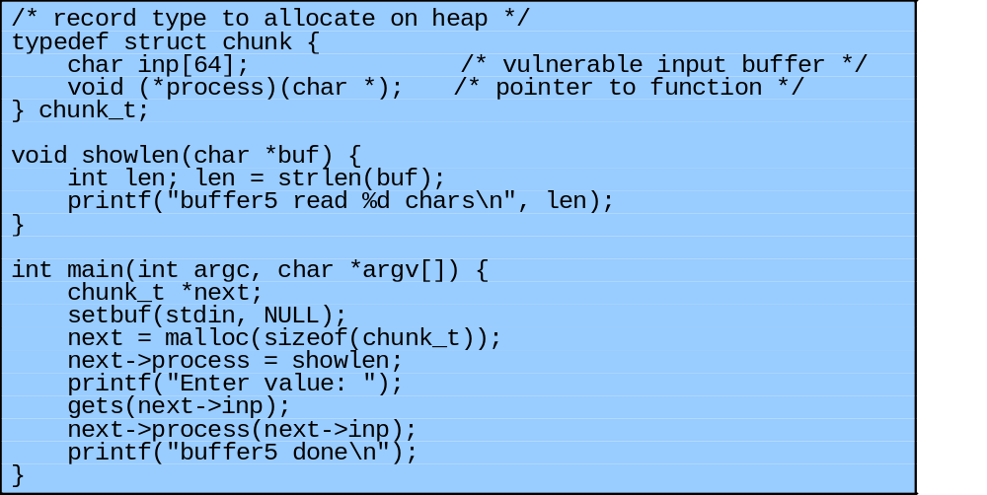
Heap Overflow Example
Notes:
As an example, consider the program code shown in Figure 11.11a. This declares a structure containing a buffer and a function pointer. Consider the lines of code shown in the main() routine. This uses the standard malloc() library function to allocate space for a new instance of the structure on the heap, and then places a reference to the function showlen() in its function pointer to process the buffer. Again, the unsafe gets() library routine is used to illustrate an unsafe buffer copy. Following this, the function pointer is invoked to process the buffer. An attacker, having identified a program containing such a heap overflow vulnerability, would construct an attack sequence as follows. Examining the program when it runs would identify that it is typically located at address 0x080497a8, and that the structure contains just the 64-byte buffer, and then the function pointer. Assume the attacker will use the shellcode we designed earlier, shown in Figure 11.8. The attacker would pad this shellcode to exactly 64-bytes by extending the NOP sled at the front, and then append a suitable target address in the buffer to overwrite the function pointer. This could be 0x080497b8 (with bytes reversed because x86 is little-endian as discussed before).

Slide 53
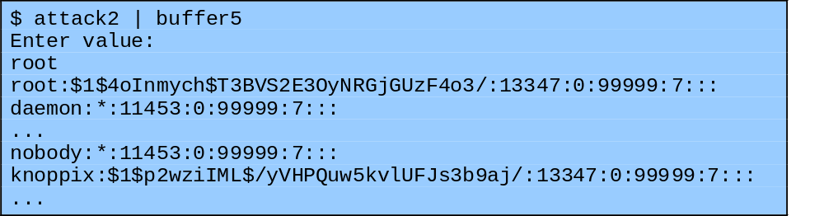
Heap Overflow Example
Notes:
Figure 11.11b shows the contents of the resulting attack script, and the result of it being directed against the vulnerable program (again assumed to be setuid root), with the successful execution of the desired, privileged shell commands.

Slide 54
Global Data Overflow
can attack buffer located in global data
  may be located above program code
  if has function pointer and vulnerable buffer
  or adjacent process management tables
  aim to overwrite function pointer later called
defenses: non executable or random global data region, move function pointers, guard pages
Notes:
A final category of buffer overflows we consider involves buffers located in the program’s global (or static) data area. Figure 11.4 showed that this is loaded from the program file, and located in memory above the program code. Again, if unsafe buffer operations are used, data may overflow a global buffer and change adjacent memory locations, including perhaps one with a function pointer, which is then subsequently called. More complex variations of this attack exploit the fact that the process address space may contain other management tables in regions adjacent to the global data area. Such tables can include references to “destructor” functions (a GCC C and C++ extension), a global-offsets-table (used to resolve function references to dynamic libraries once they have been loaded), and other structures. Again, the aim of the attack is to overwrite some function pointer that the attacker believes will then be called later by the attacked program, transferring control to shellcode of their choice. Defenses against such attacks include making the global data area non-executable, arranging function pointers to be located below any other types of data, and using guard pages between the global data area and any other management areas.

Slide 55
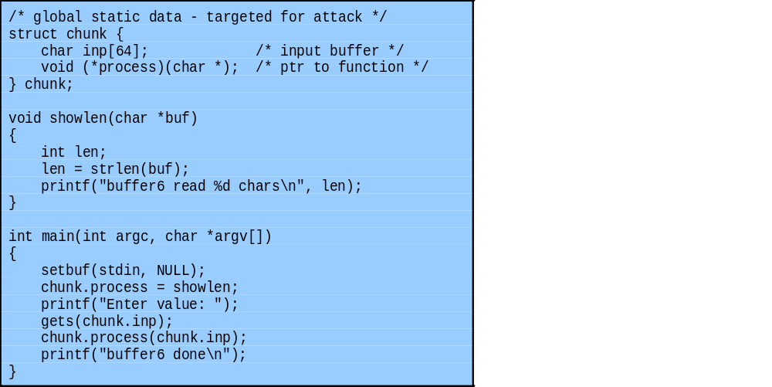
Global Data Overflow Example
Notes:
Figure 11.12a illustrates such a vulnerable program (which shares many similarities with Figure 11.11a, except that the structure is declared as a global variable). The design of the attack is very similar, indeed only the target address changes. The global structure was found to be at address 0x08049740, which was used as the target address in the attack. Note that global variables do not usually change location, as their addresses are used directly in the program code. The attack script and result of successfully executing it are shown in the text in Figure 11.12b.

Slide 56
Summary
Introduced basic buffer overflow attacks
Stack buffer overflow details
Shellcode
Defenses
  compile-time, run-time
Other related forms of attack (not covered)
  replacement stack frame, return to system call, heap overflow, global data overflow
Notes:
Chapter 11 summary.

