Slide 1
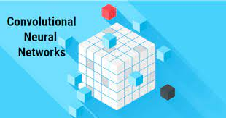
Dr. Amit Sinhal
Professor
Department of Computer Science & Engineering

Slide 2
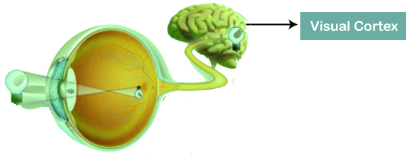
Convolutional Neural Networks are a special type of feed-forward artificial neural network in which the connectivity pattern between its neuron is inspired by the visual cortex.

Slide 3
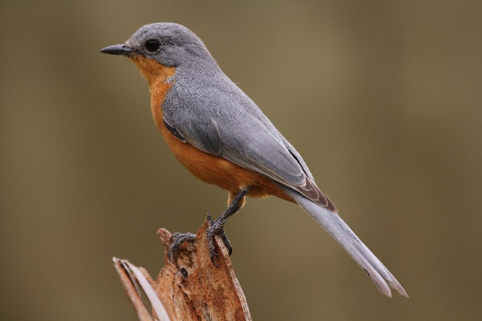
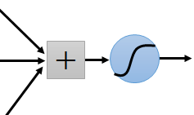
Consider learning an image:
Some patterns are much smaller than the whole image
Can represent a small region with fewer parameters
“beak” detector

Slide 4
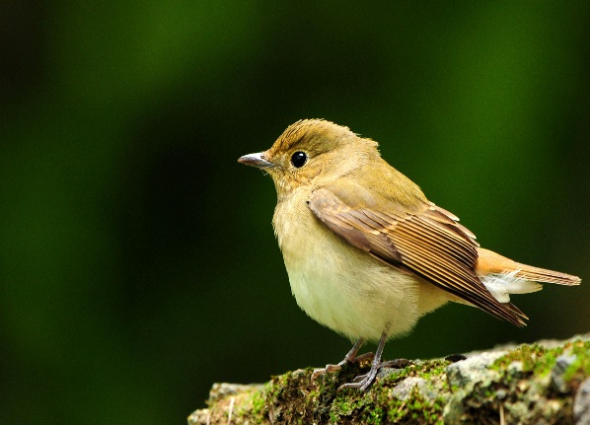
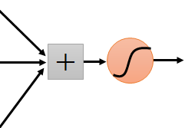
Same pattern appears in different places: They can be compressed! What about training a lot of such “small” detectors and each detector must “move around”.
“upper-left beak” detector
They can be compressed
to the same parameters.
“middle beak” detector

Slide 5
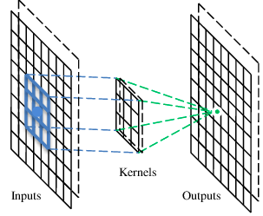
Convolutional Neural Networks (CNN)
A convolutional layer has a number of filters that does convolutional operation.
Beak detector
A filter
Aim is to reduce the images into a form that is easier to process, without losing features that are critical for getting a good prediction.

Slide 6
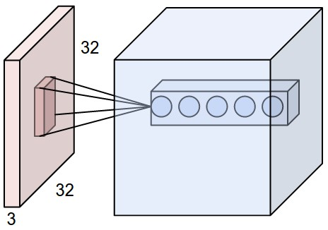
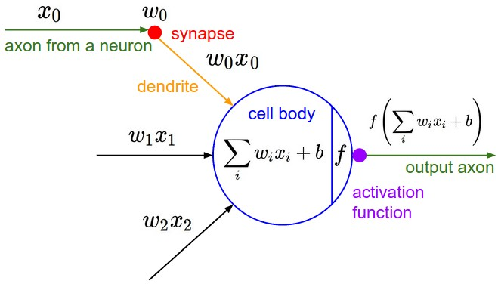
Convolutional Neural Networks (CNN)
A CNN is a neural network with some convolutional layers (and some other layers).

Slide 7
Convolutional Neural Networks (CNN)
Generally, a Convolutional Neural Network has three layers, which are as follows;
Input: If the image consists of 32 widths, 32 height encompassing three R, G, B channels, then it will hold the raw pixel([32x32x3]) values of an image.
Convolution: It computes the output of those neurons, which are associated with input's local regions, such that each neuron will calculate a dot product in between weights and a small region to which they are actually linked to in the input volume. For example, if we choose to incorporate 12 filters, then it will result in a volume of [32x32x12].
ReLU Layer: It is specially used to apply an activation function element wise, like as max (0, x) thresholding at zero. It results in ([32x32x12]), which relates to an unchanged size of the volume.
Pooling: This layer is used to perform a down sampling operation along the spatial dimensions (width, height) that results in [16x16x12] volume.

Slide 8
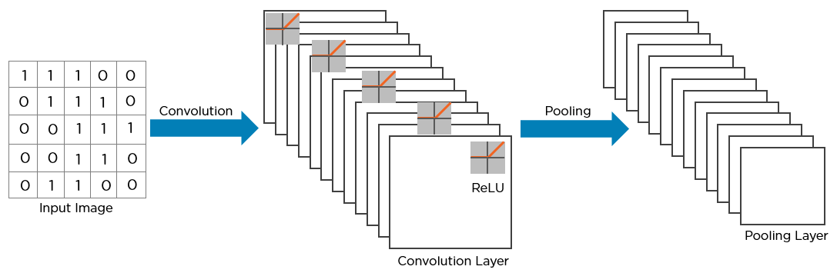
Convolutional Neural Networks (CNN)
The structure of the convolution neural network:

Slide 9
Convolution
In mathematics convolution is a mathematical operation on two functions that produces a third function that expresses how the shape of one is modified by the other.
1 | -1 | -1
-1 | 1 | -1
-1 | -1 | 1
1 | 0 | 0 | 0 | 0 | 1
0 | 1 | 0 | 0 | 1 | 0
0 | 0 | 1 | 1 | 0 | 0
1 | 0 | 0 | 0 | 1 | 0
0 | 1 | 0 | 0 | 1 | 0
0 | 0 | 1 | 0 | 1 | 0
Filter 1
-1 | 1 | -1
-1 | 1 | -1
-1 | 1 | -1
Filter 2
……
6 x 6 image
Each filter detects a small pattern (3 x 3).

Slide 10
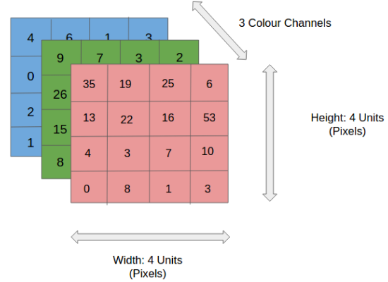
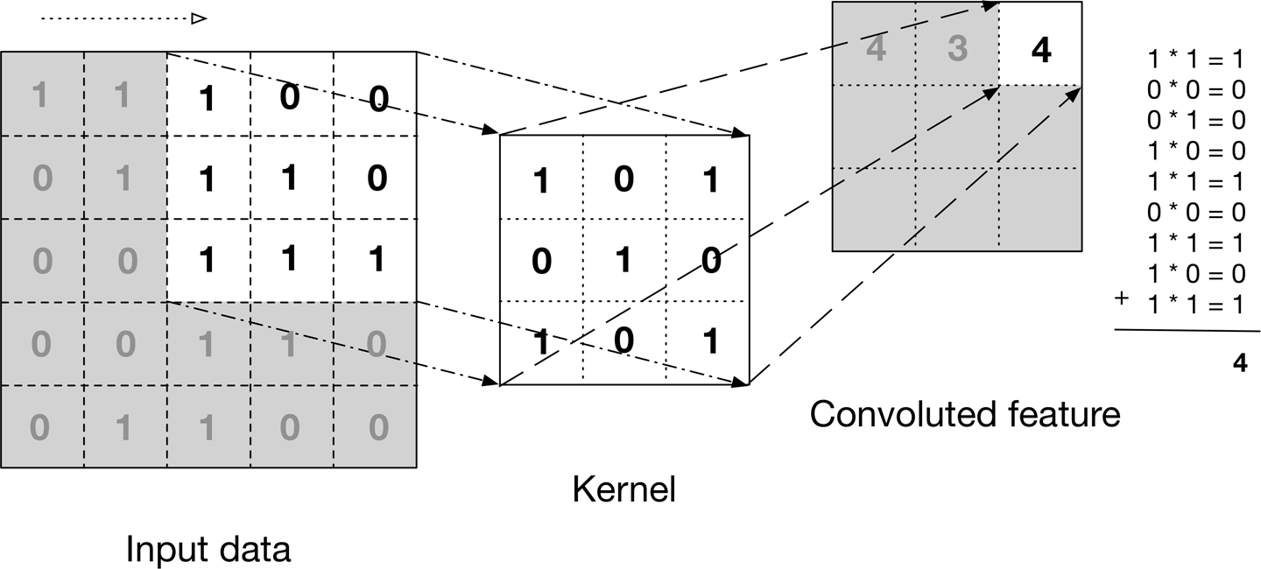

Slide 11
Convolutional Layer

Slide 12
Convolutional Layer

Slide 13
Pooling Layer
Similar to the Convolutional Layer, the Pooling layer is responsible for reducing the spatial size of the Convolved Feature.
This is to decrease the computational power required to process the data through dimensionality reduction.
Furthermore, it is useful for extracting dominant features which are rotational and positional invariant, thus maintaining the process of effectively training the model.

Slide 14
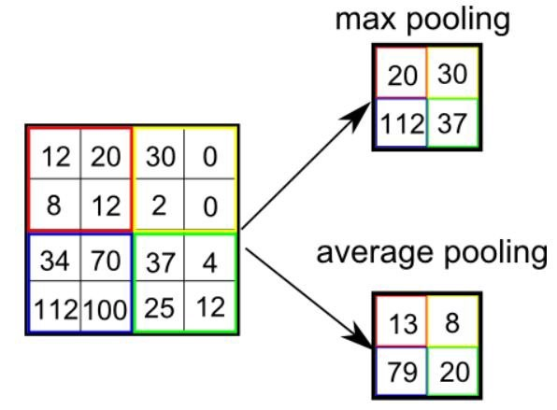
Pooling Layer
Max Pooling also performs as a Noise Suppressant. It discards the noisy activations altogether and also performs de-noising along with dimensionality reduction.
On the other hand, Average Pooling simply performs dimensionality reduction as a noise-suppressing mechanism.
Hence, generally Max Pooling performs a lot better than Average Pooling.

Slide 15
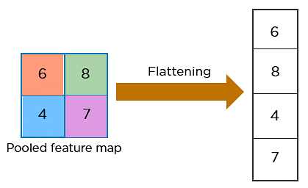
flattening
The next step in the process is called flattening. Flattening is used to convert all the resultant 2-Dimensional arrays from pooled feature maps into a single long continuous linear vector.

Slide 16
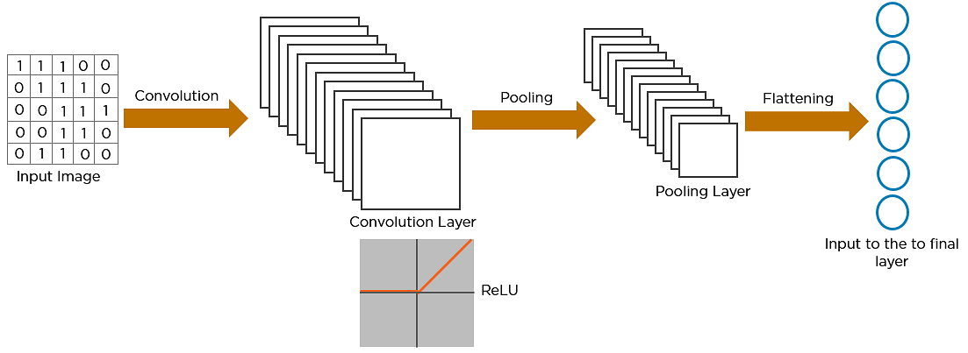
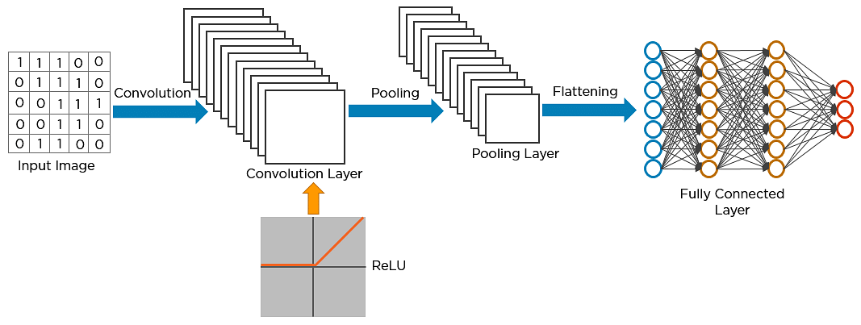
The flattened matrix is fed as input to the fully connected layer to classify the image.

Slide 17
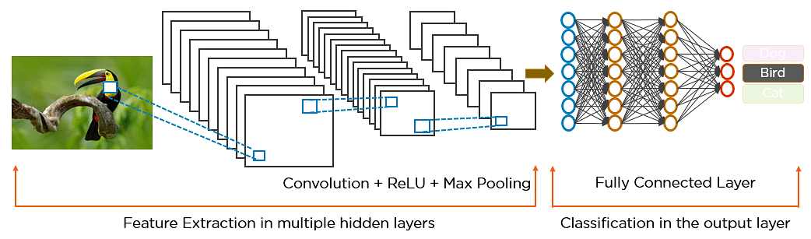
How Exactly CNN Recognizes
The pixels from the image are fed to the convolutional layer that performs the convolution operation
It results in a convolved map
The convolved map is applied to a ReLU function to generate a rectified feature map
The image is processed with multiple convolutions and ReLU layers for locating the features
Different pooling layers with various filters are used to identify specific parts of the image
The pooled feature map is flattened and fed to a fully connected layer to get the final output

Slide 18
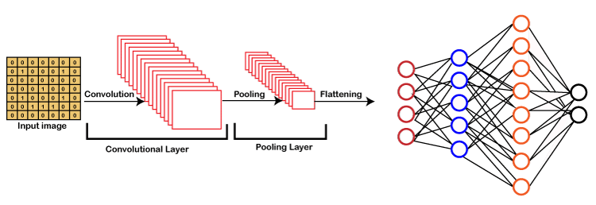
A CNN compresses a fully connected network in two ways:
Reducing number of connections
Shared weights on the edges
Max pooling further reduces the complexity

Slide 19
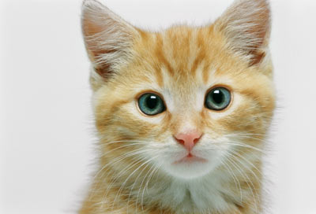
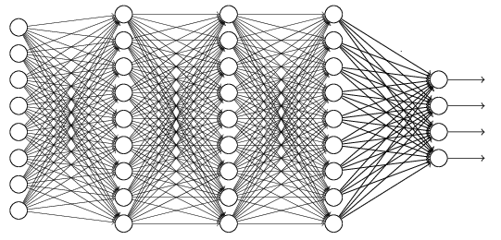
The whole CNN
cat dog ……
Convolution
Max Pooling
Can repeat many times
Fully Connected Feed- forward network
Convolution
Max Pooling
Flattened

Slide 20
Advantages of Convolutional Neural Networks (CNNs):
Good at detecting patterns and features in images, videos and audio signals.
Robust to translation, rotation and scaling invariance.
End-to-end training, no need for manual feature extraction.
Can handle large amounts of data and achieve high accuracy.
Disadvantages of Convolutional Neural Networks (CNNs):
Computationally expensive to train and require a lot of memory.
Can be prone to overfitting if not enough data or proper regularization is used.
Requires large amount of labeled data.
Interpretability is limited, it’s hard to understand what the network has learned.

