Slide 1
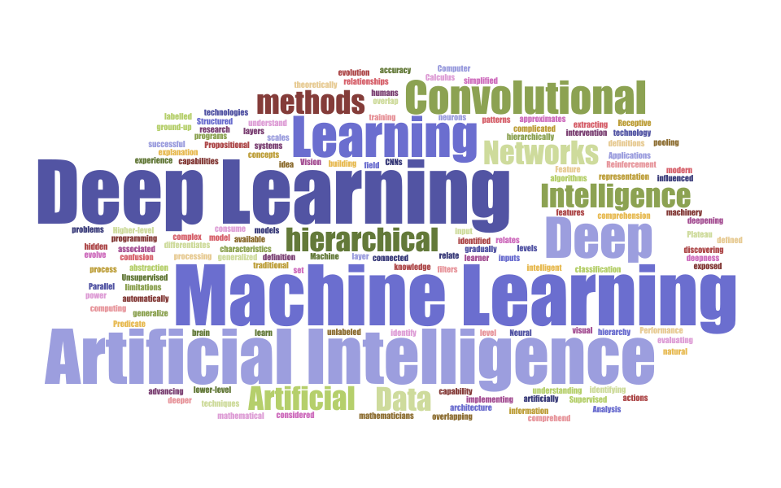
DEEP LEARNING (CS436 )
Dr. Amit Sinhal
Professor,
Department of Computer Science & Engineering
IET, JK Lakshmipat University, Jaipur

Slide 2
DEEP LEARNING (CS436 ) 3 Credits
Introduction of the Course
Course Outcomes:
CO1 : Understand fundamental principles, theory and approaches for learning with deep neural networks.
CO2 : Learn different types of Neural Network and Deep Neural Networks.
CO3 : Apply NN and DNN for various learning tasks in different domains.
C04 : Evaluate various NN and DNN by performing complex statistical analysis for DL techniques.
C05 : Design DL algorithms for real-world problems.

Slide 3
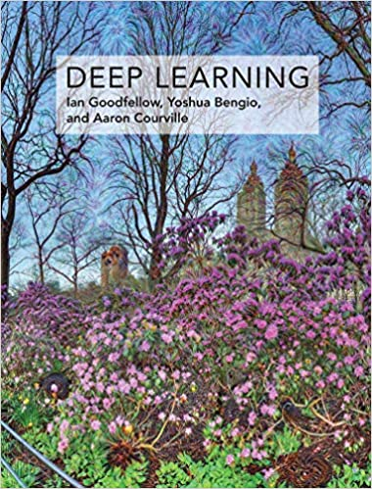
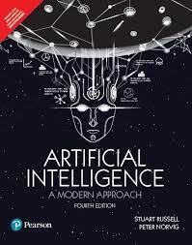
DEEP LEARNING (CS436 )
Topics
INTRODUCTION TO DEEP LEARNING
NEURAL NETWORKS BASICS
DEEP NEURAL NETWORKS
RECENT TRENDS
APPLICATIONS
Reference Books

Slide 4
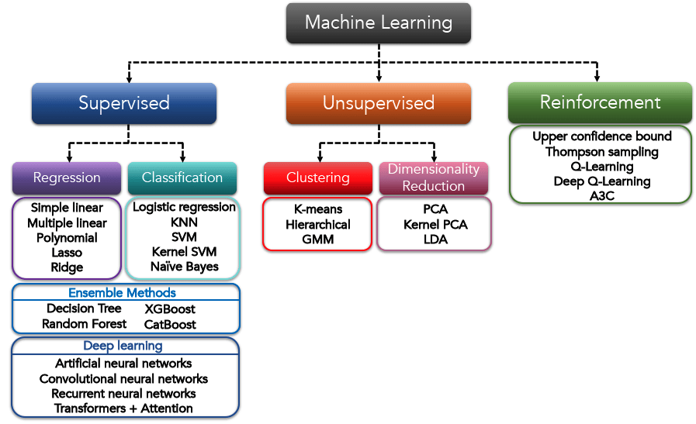

Slide 5
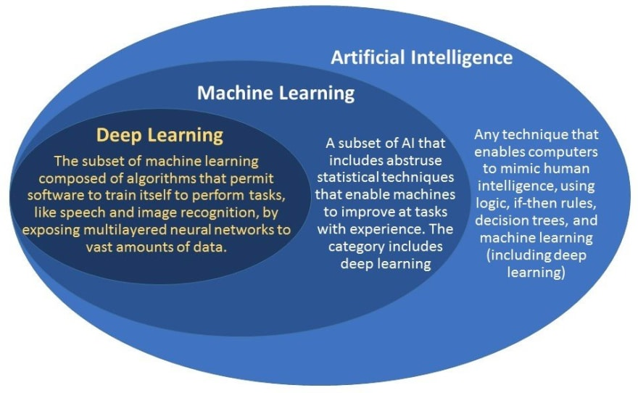
Introduction to Deep Learning

Slide 6
Deep Learning
Core idea: instead of hand-crafting complex features, use increased computing.
capacity and build a deep computation graph that will try to learn feature representations on its own.
End-to-end learning rather than a cascade of apps.
Works best with lots of homogeneous, spatially related features (image pixels, character sequences, audio signal measurements).
State-of-the-art and/or superhuman performance on many tasks.
Typically requires massive amounts of data and training resources.

Slide 7
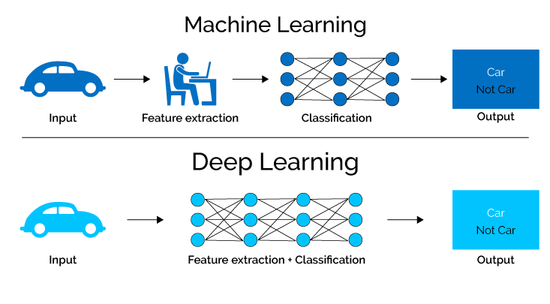
Machine Learning vs Deep Learning

Slide 8
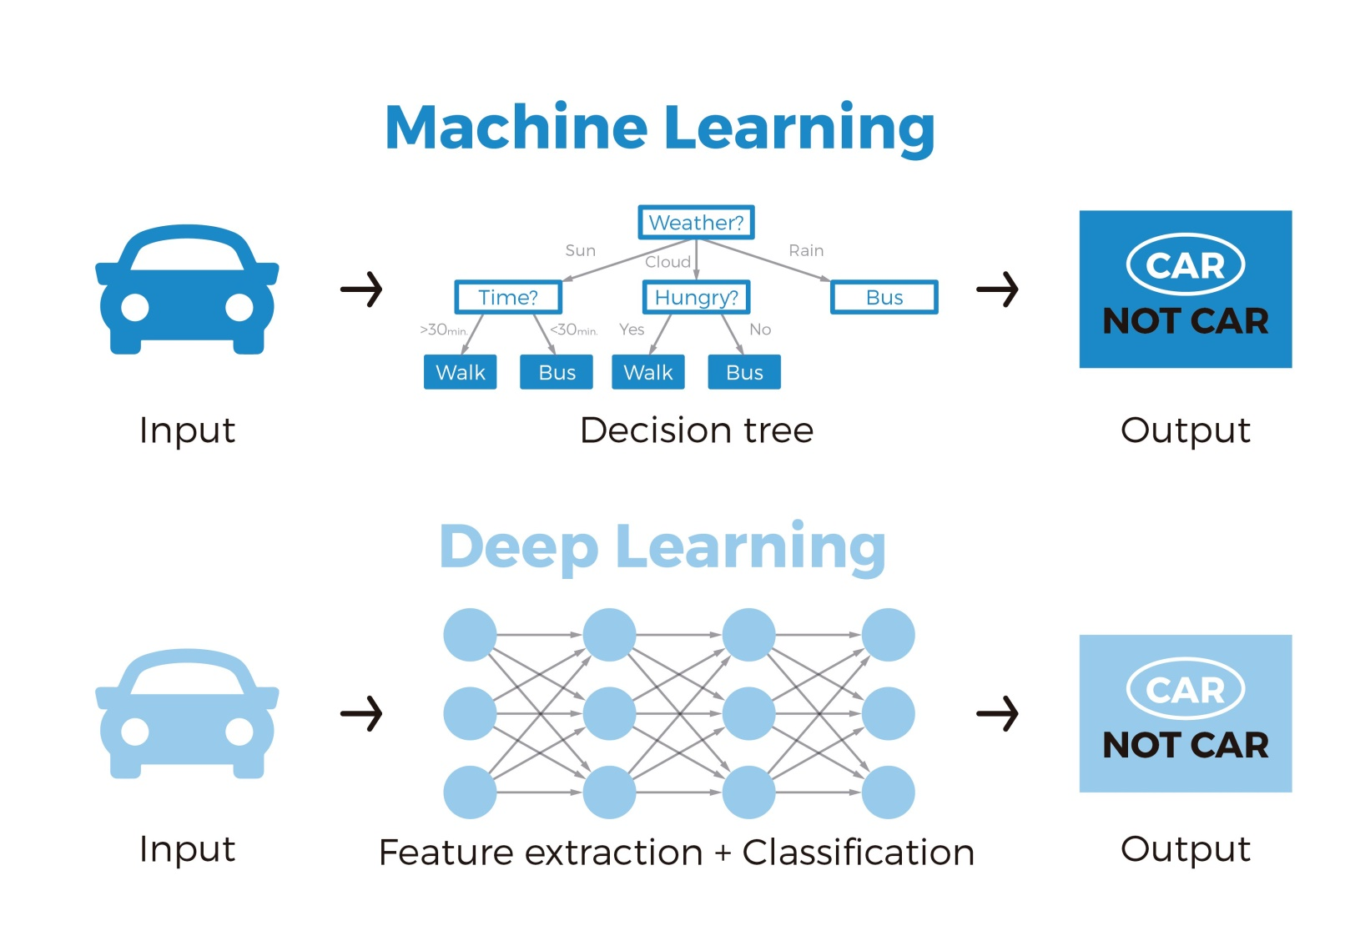
Machine Learning vs Deep Learning

Slide 9
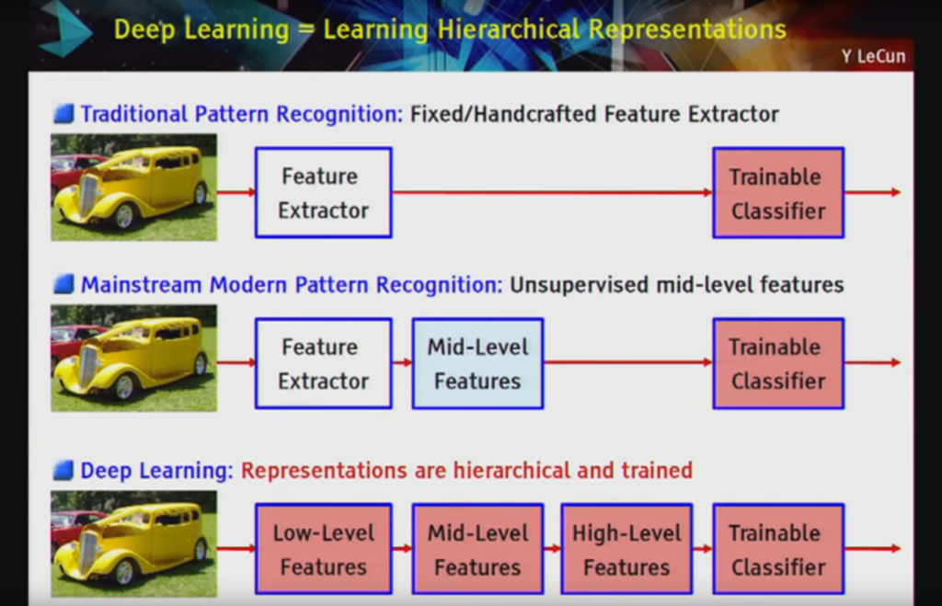

Slide 10
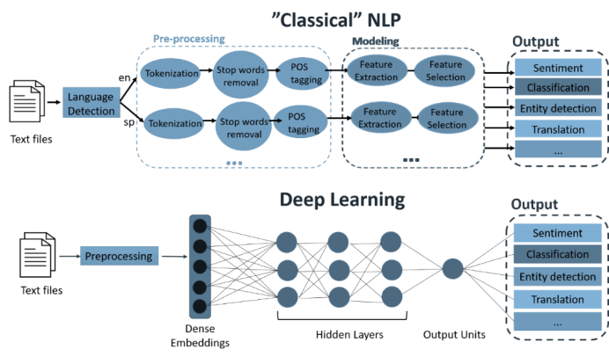

Slide 11
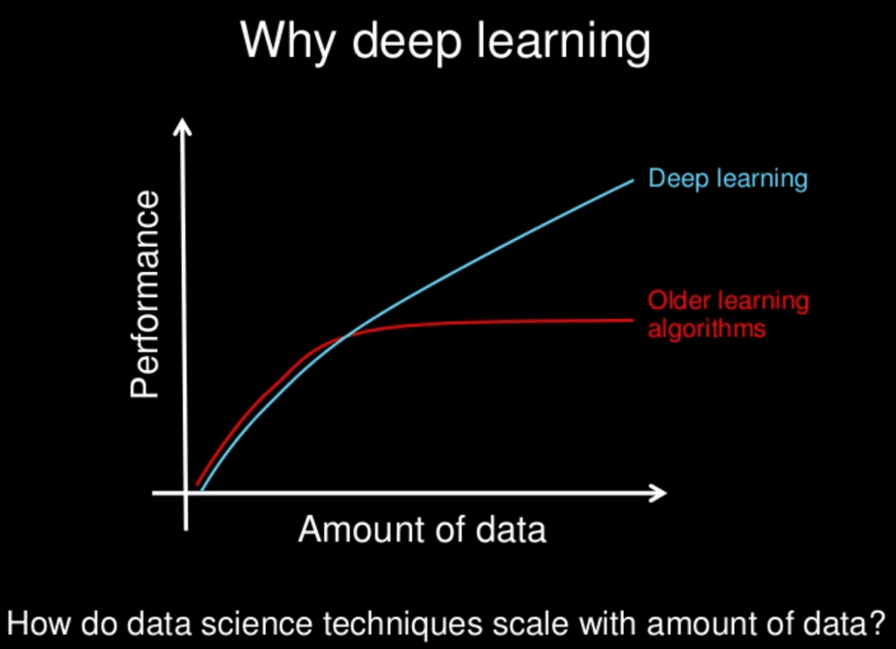

Slide 12
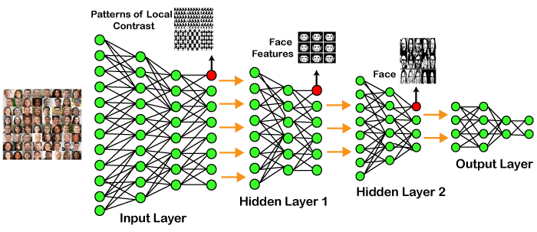
Examples of Deep Learning
ChatGPT (Generative Pre-trained Transformer)
A chatbot launched by OpenAI on November 30, 2022. It is built on top of OpenAI's GPT-3 family of large language models, and is fine-tuned (an approach to transfer learning) with both supervised and reinforcement learning techniques.

Slide 13
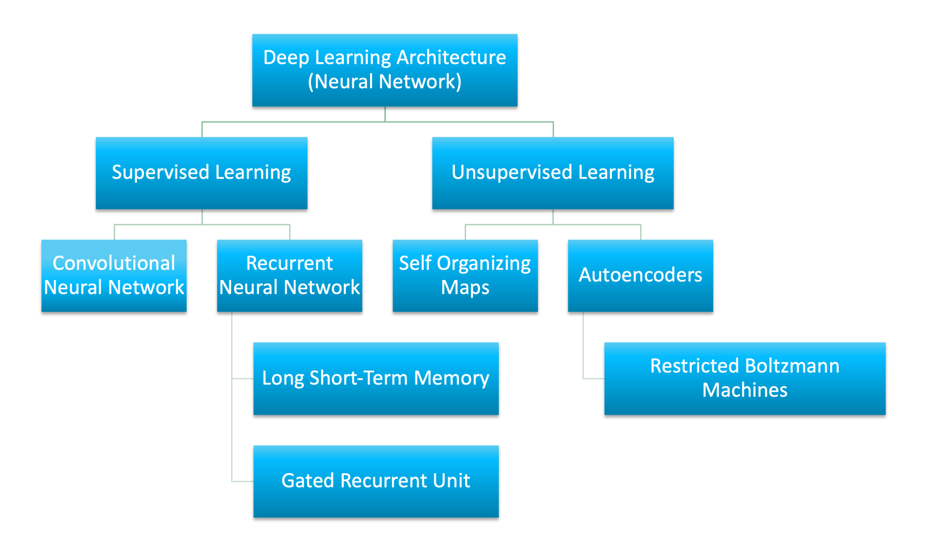

Slide 14
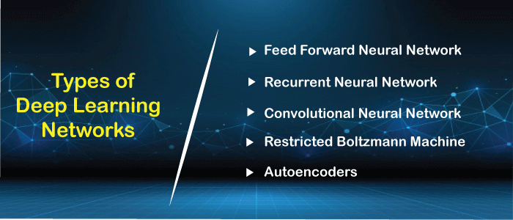

Slide 15
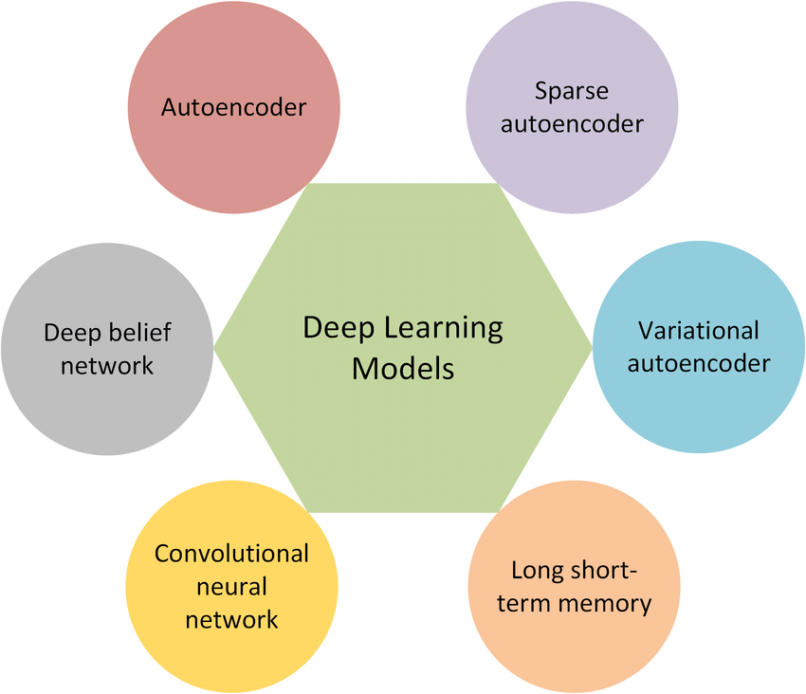

Slide 16
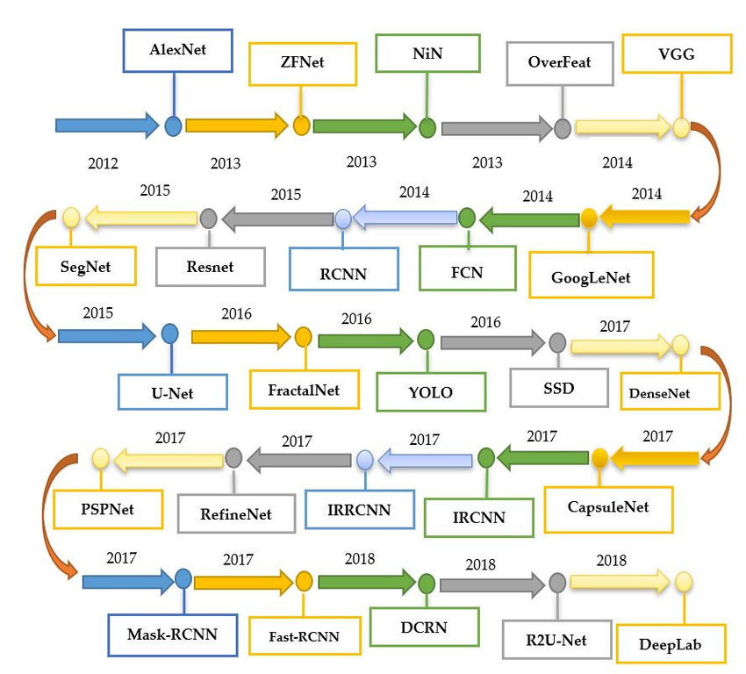
Evolution of Deep Learning

Slide 17
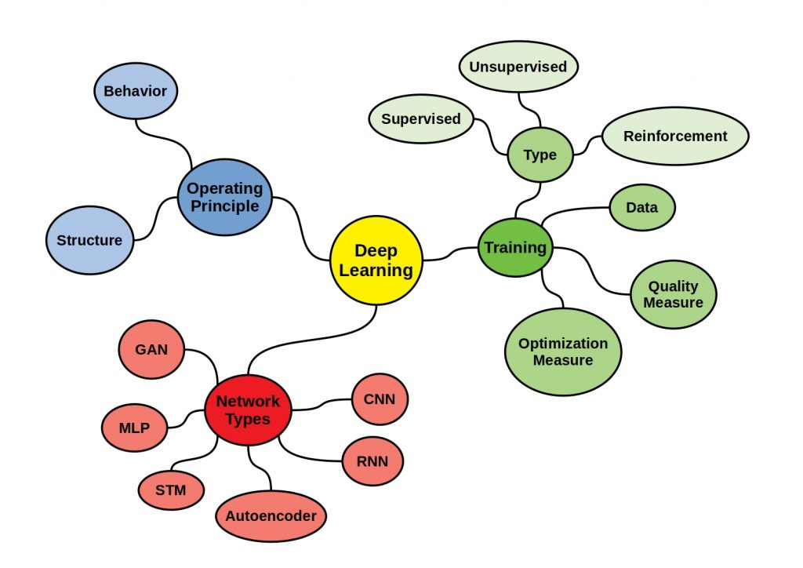

Slide 18
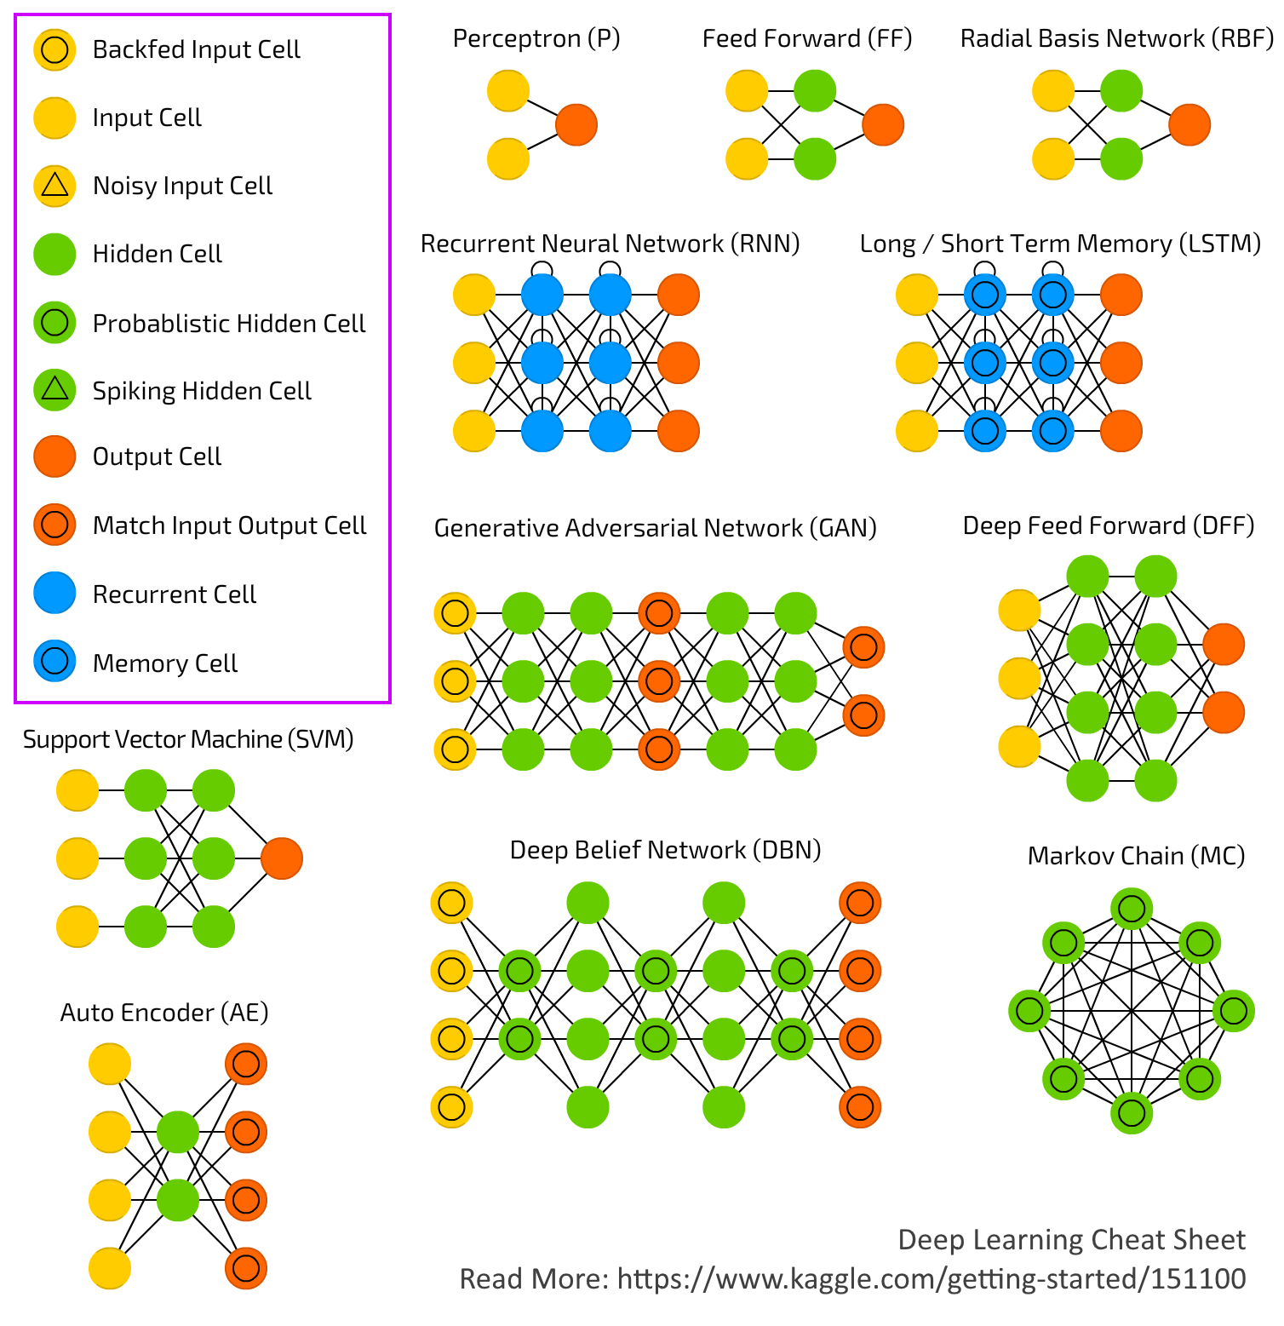

Slide 19
