Slide 1
Face Detection & Recognition
Literature Survey
U19CS012
U19CS077
U19CS123

Slide 2
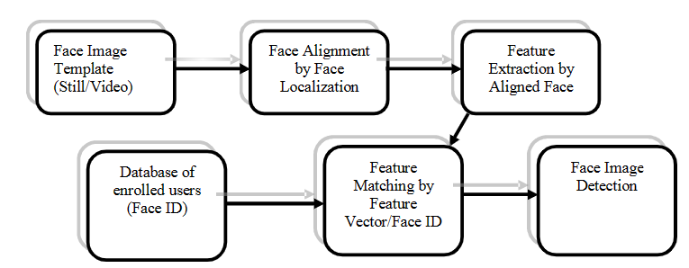
Steps for Facial Recognition
2D face recognition
Step 1 : To detect face
Step 2 : Face alignment
Step 3 : Feature extraction
Step 4 : Feature matching from database of enrolled users to recognize face

Slide 3
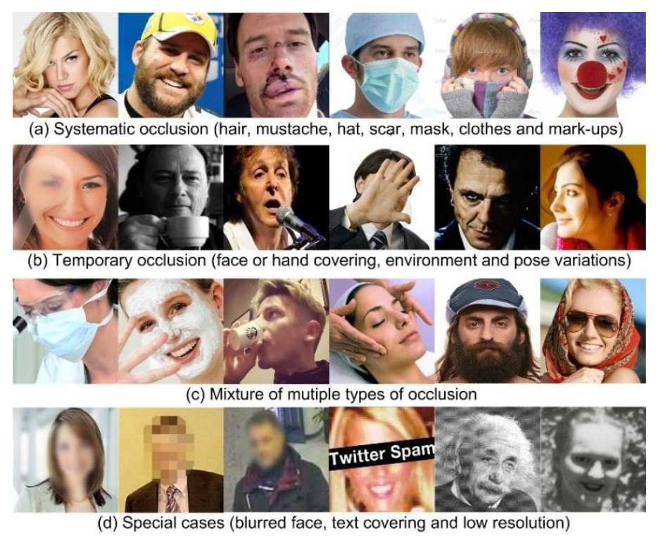
Challenges Faced
Facial expression
Illumination
Poses variations image orientation
Occlusion in face recognition
Rate and performance is dependent on:
Image capture conditions
Image quality
Lighting conditions
Partial occlusion
Facial expressions

Slide 4
Literature Survey
S.N. | Year of Publication | Authors | Title | DataSet Used | Model Applied | PCC | Note
1 | 1994 | A. Pentland, B. Moghaddam, and T. Starner | View-Based and modular eigenspaces for face recognition | The Facial Recognition Technology (FERET) | Eigenfeatures | 95% | This method would be less sensitive to appearance changes than standard eigenface method. The DB contained 7,562 images of approximately 3,000 individuals.
2 | 1996 | L. Wiskott and C. von der Malsburg | Recognizing faces by dynamic link matching | The Facial Recognition Technology (FERET) | Graph matching | 86.5% and 66.4% | For the matching tests of 111 faces of 15 degree rotation and 110 faces of 30 degree rotation to a gallery of 112 neutral frontal views
3 | 2003 | O. Deniz, M. Castrillon, M. Hernandez | Face recognition using independent component analysis and support vector machines | Yale Face Database. | SVM+PCA | 99.39% | DB contained 165 images of 15 individuals. The DB divided into 90 images
4 | 1997 | S.H. Lin, S.Y. Kung, and L.J. Lin | Face recognition/detection by probabilistic decision-based neural network | ORL Database of Faces | PDBNN | 96% | PDBNN face recognizing up to 200 people in approximately 1 second and the training time is 20 minutes.

Slide 5
Literature Survey
S.N. | Year of Publication | Authors | Title | DataSet Used | Model Applied | PCC | Note
5 | 2014 | Y. Taigman, M. Yang, M. Ranzato, and L. Wolf. Deepface | Deepface: Closing the gap to human-level performance in face verification. | LFW- People | DeepFace | 97.35%
6 | 2000 | A.S. Tolba, and A.N. Abu-Rezq | Combined classifiers for invariant face recognition | LFW- People | RBFNN | 99.50% | A new face synthesis method is implemented for reducing the false acceptance rate and enhancing the rejection capability of the classifier. The system is capable of recognizing a face in less than one second.
7 | 2022 | Yaoyao Zhong, Weihong Deng, Jiani Hu, Dongyue Zhao, Xian Li, Dongchao Wen | SFace: Sigmoid-Constrained Hypersphere Loss for Robust Face Recognition | LFW- People | SFace | 99.60%

Slide 6
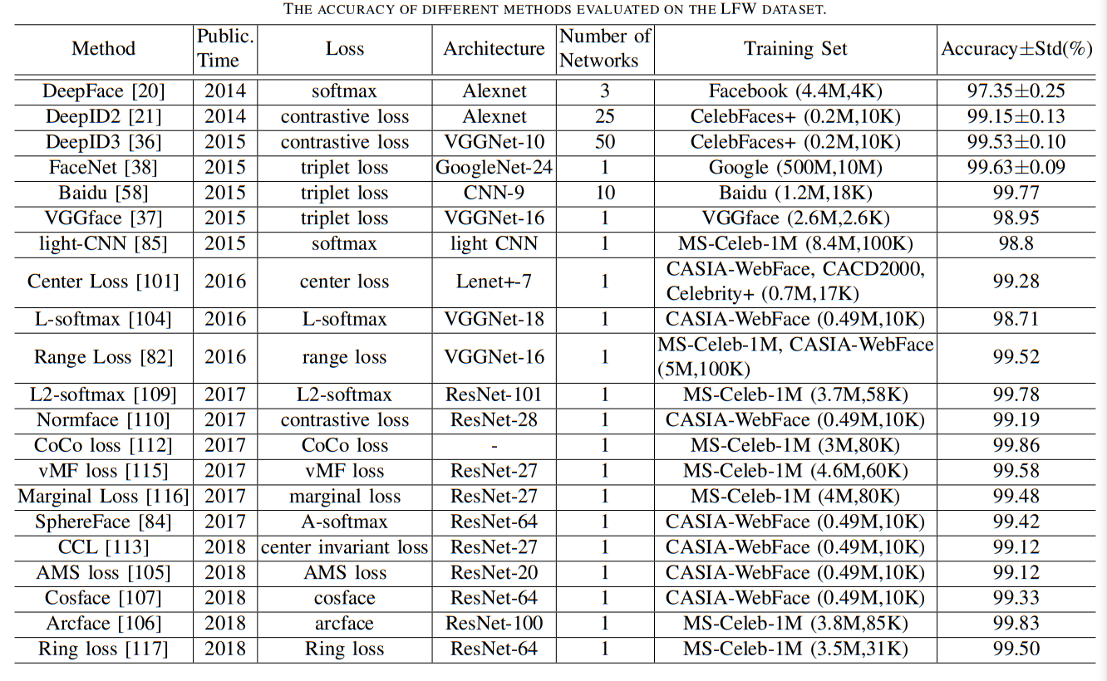
Literature Survey (LFW – People)

Slide 7


