Slide 1



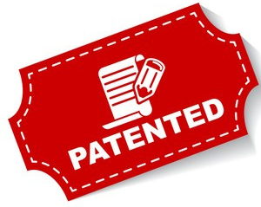





Intellectual Property Rights

Slide 2
Reasons why India need IPR
India is WTO nation and all 149 WTO nations have agreed for the IPR protection by including Trade Related Intellectual Property Rights (TRIPS). IPR has proved to be helpful and useful in various economies
Indian competitiveness is based more on the cheap labour and raw material but it can be a Knowledge based economy for that there is a need of IPR to convince and protect the originators about their work. This will boost the motivation to bring knowledge to the country.

Slide 3
Over the past two decades, intellectual property rights have grown to a stature from where it plays a major role in the development of global economy. Intellectual property is everywhere, • i.e., the music you listen to, the technology that makes your phone work, the design of your favourite bike, the logo on your chocolate, etc.
It exists in all the things you can see — all are the products of human creativity and skill, such as inventions, books, paintings, songs, symbols, names, images, or designs used in business, etc.

Slide 4
Intellectual Property (IP)
The property, which is created with intellect such as inventions, books, paintings, songs, names, images, or designs used in business, etc
Intellectual property right (IPR)
Exclusive rights given to person over the creation of their minds for certain periods of time.

Slide 5
Major laws for the protection of Intellectual Property in India
Copyrights act 1957
Trademark Act 1999
The Patents act 1970
Design act 2000
Amend by the copyright (Amendment) acts, 1994, 1999 & 2012
Amend by the patents (Amendment) act, 1999,2002, 2005 & 2006

Slide 6
Major laws for the protection of Intellectual Property in India
The semiconductor integrated circuits layout designs act, 2000
The geographical indication of goods (Registration and protection) act 1999
The protection of plan varieties and farmers rights act, 2000

Slide 7
PROPERTY
Intangible
Tangible
Intellectual Property
Movable
Eg. Car
Immovable
Eg. Building
Industrial property related
Copyright related
Patents, Designs, Trademarks, GIs

Slide 8
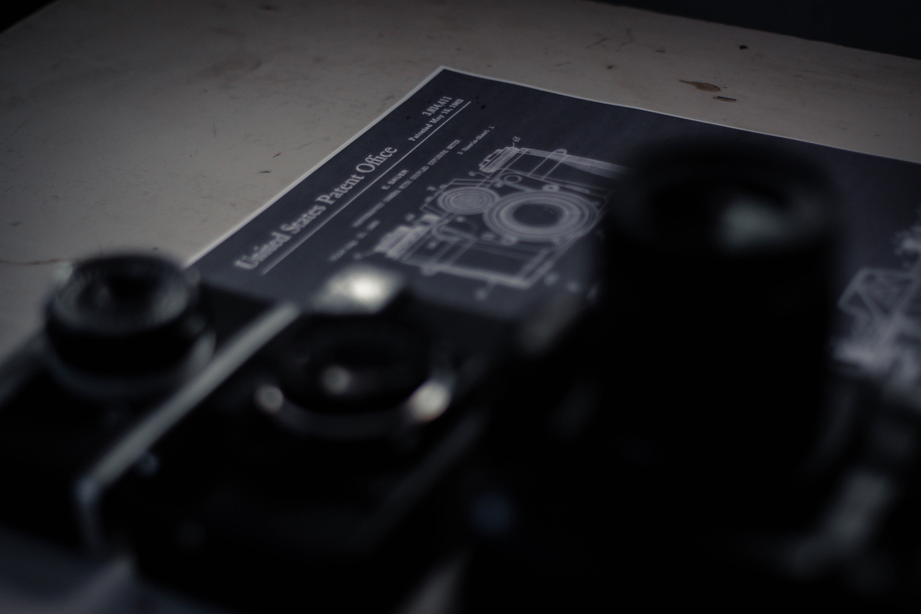
Monopolistic rights
Patent
A grant made by the government to an inventor, conveying and securing to him the exclusive right to make, use, and sell his invention for a term of years.
A Patent gives monopolistic rights to its owner to exclude others, from making, using, selling, offering for sale or importing the product or the process for producing the product without his consent.
The term of every patent in India is twenty years from the date of filing the Patent application.

Slide 9
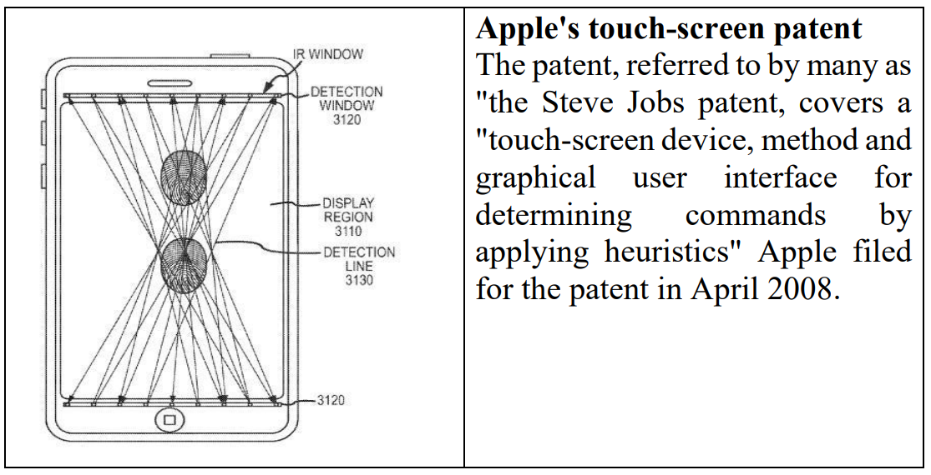

Slide 10
The Indian Patent act, 1970 has classified the patentable inventions as follows:
Process: According to the law, process means new methods of production, research, testing analysis or the technological process that can be validated as new or unique. These are not the physical objects are in documented form.
Machines: In the patent law, machines are physical objects. It can be any product, instrument, or any other physical item that is new or useful.
Manufacture: According to the patent law, manufacture means any physical item has been made up by a new and unique way or materials.
Composition of matter: Composition of matter in a patent law refers to the mixture of the chemical compounds, medicines and botanical compositions which are new , unique and are useful and do not exist in the nature in that particular state.

Slide 11
Patentability Criteria
a) Novelty: Novelty means the matter disclosed in the specification is neither published in India nor anywhere else where before the date of filing of patent application in India. The invention must be novel, meaning thereby that the Invention must not be in existence.
b) Non-obvious: the Invention must be non- obvious, i.e. the Invention must be a significant improvement to the previous one; mere change in technology will not give the right of the patent to the inventor. Example: Camera + Phone
c) Utility: Industrially applicable means the invention should possess utility, so that it can be made or used in an industry..
Some famous example of patent:
A) The entire Mach 3 system of Gillette protected by 35 patents, costs $35 billion just to bring to market.
B) Tata Motors had file up 34 patents for Tata Nano to make it cheapest car of the world.

Slide 12
How patent is Important in our Industrial practice?
Patents provide incentives to the individuals. In particular, the inventors deserve recognition for their creativity and material reward for their marketable inventions.
The incentives encourage innovation, which ensures that the quality of human life is enhanced.
Protection stimulates research, which results in technological development.
It enables the inventor (s) to recoup their investment for the money and time spent developing the ideas in Research and Development.

Slide 13
Trade mark
A trade mark (popularly known as brand name) in layman’s language is a visual symbol which may be a word signature, name, device, label, numerals or combination of colours used by one undertaking on goods or services or other articles of commerce to distinguish it from other similar goods or services originating from a different undertaking.
The trademark owner will have monopoly over the usage of that symbol. It includes Brands, Logos, Service marks, Trade name etc.

Slide 14
TRADEMARKS
Any sign that individualizes the goods of a given enterprise and distinguishes them from the goods of its competitors
Term of registration of a trademark is ten years, which may be renewed for a further period of ten years on payment of prescribed renewal fees.

Slide 15
Types of Trademark can be registered
There are many forms of trademark, which can be registered
Any name (including personal or surname of the applicant or predecessor in business or the signature of the person), which is not unusual for trade to adopt as a mark.
An invented word or any arbitrary dictionary word or words, not being directly • descriptive of the character or quality of the goods/service.
Letters or numerals or any combination there of.
The right to proprietorship of a trade mark may be acquired by either registration under the Act or by use in relation to particular goods or service.
Devices, including fancy devices or symbols
Monograms
Combination of colors or even a single color in combination with a word or device
Shape of goods or their packaging
Marks constituting a 3- dimensional sign.
Sound marks when represented in conventional notation or described in words by being graphically represented.

Slide 16
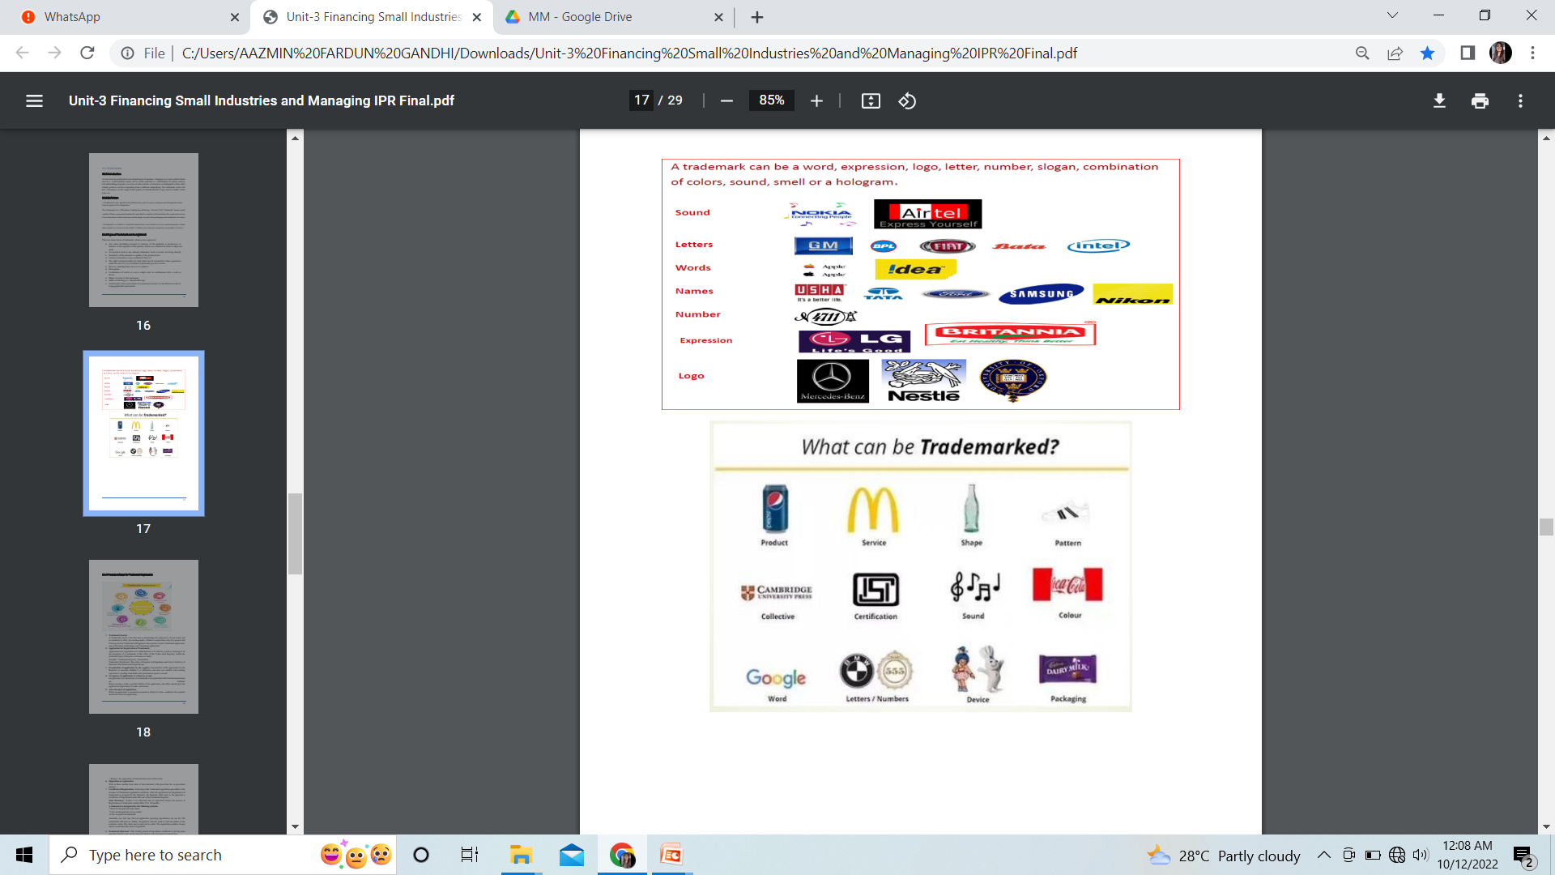

Slide 17
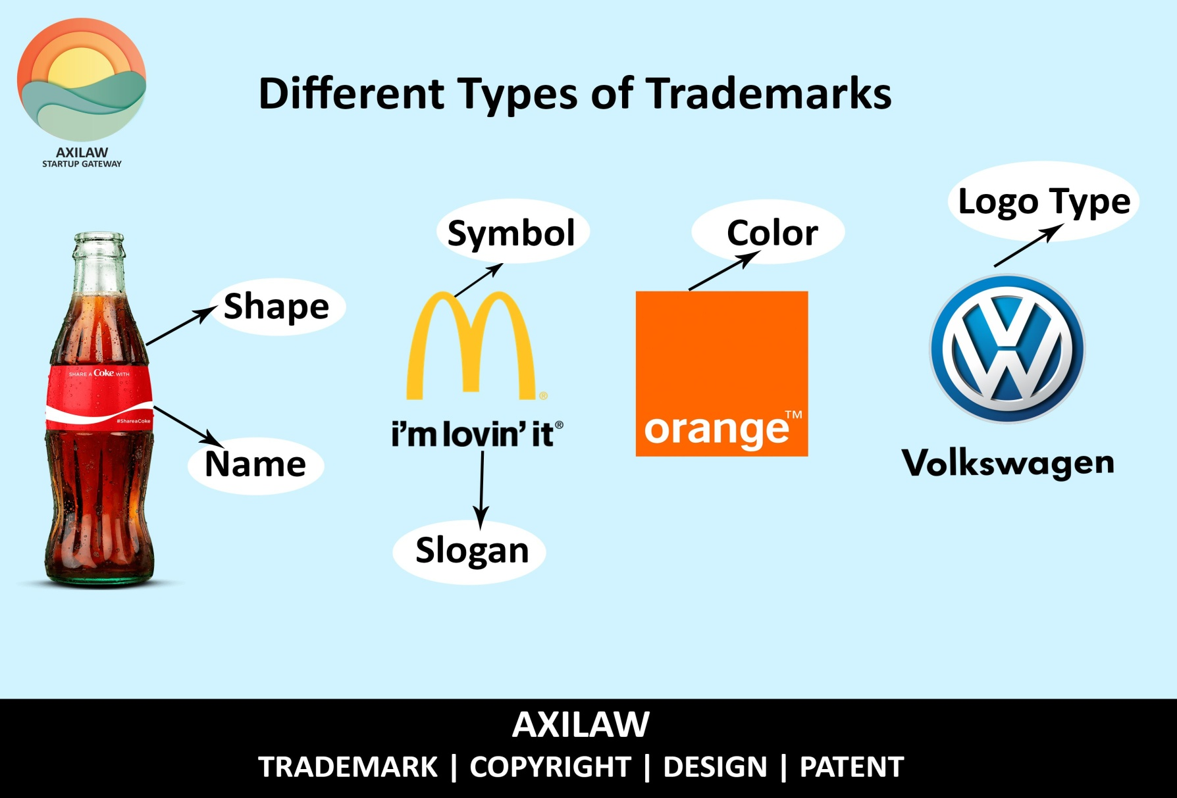

Slide 18
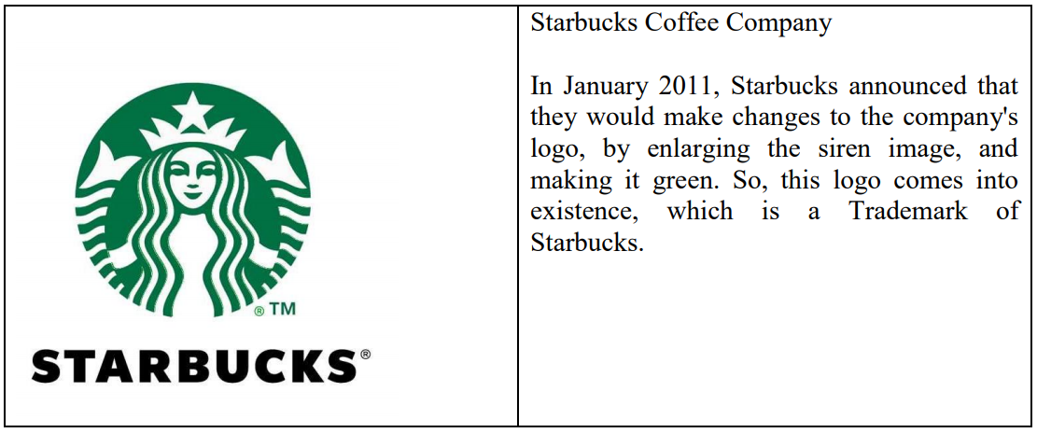

Slide 19
Procedure/steps for trademark registration
Trademark search
Application for registration of trademark
Examination of application by the registry
Acceptance of application or refusal to accept(only if formal requirements are fulfilled)
Advertisement of application (Purpose: for oppositions of interested persons with in time)
Opposition to registration (With in three months from date of advertisement with prescribed fee in prescribed manner)
Certificate of Registration (Time Duration: If there is no objection and /or opposition raised, the process of Registration of Trademark usually takes 15 to 18 months)

Slide 20
A trademark is designated by the following symbols:
™(for an unregistered trade mark)
℠ (for an unregistered service mark)
® (for a registered trademark)
Generally, one who has filed an application (pending registration) can use the TM (trademark) SM (Service Mark) designation with the mark to alert the public of his exclusive claim.
The claim may or may not be valid. The registration symbol, ®,may only be used when the mark is registered.
8. Trademark Renewal : The validity period of registration certificate is for ten years and after that the same can be renewed subject to the payment of renewal fees.

Slide 21
Why registration of trademark is important
Exclusive legal right on your business name
Protects your business name and gives remedy in the court in case of any infringement.
A sound name in the market in the eye of a general public
Creates a face value among competitors
Gives a legal recognition to your business
‘Monopoly’ business name or brand name

Slide 22
COPYRIGHT
The word copyright is a mixture of two words – ‘copy’ and ‘right’. To be more precise copyright means ‘right to copy’, wherein only the creator or his authorized person has a right to reproduce a work.
In simple words, a legal right which is possessed by the owner of Intellectual property is a copyright. “Copyright is a right given by the law to creators of literary, dramatic, musical and artistic works and producers of cinematograph films and sound recordings.
Section 13 of Copyright Act, 1957 states that the copyright can be given only for the original work. Copyright is usually provided for 60 years.

Slide 23

“original works of authorship”
“a tangible form of expression.”
COPYRIGHT
An exclusive legal right granted to the creators of intellectual work.
Copyright owner has rights to reproduce, translate, adapt, perform, distribute and publicly display the work, etc.

Slide 24
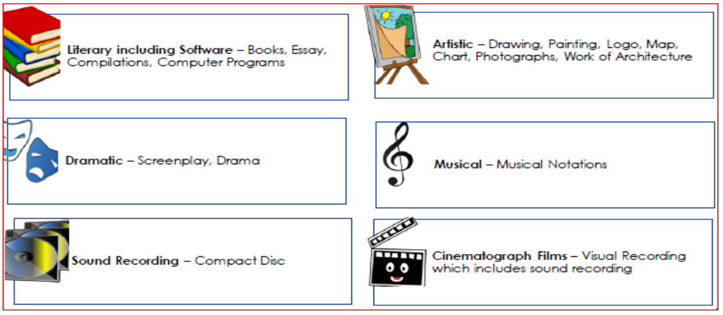

Slide 25
