Slide 1
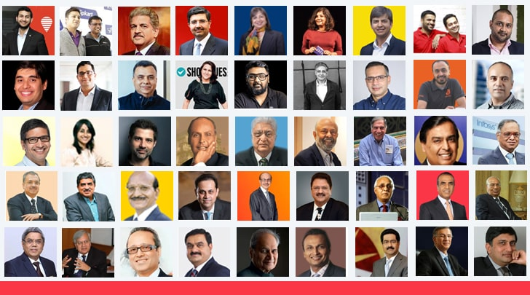

Slide 2

If You have confidence on own strength then you become entrepreneur,
But other have confidence on your strength then you become CEO.

Slide 3

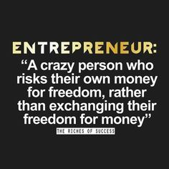

Slide 4
Concept
Enterprise
is an already formed business organization that propose some goods or services, etc.
Entrepreneur
is a person who establishes and manages the enterprise. He/she is often the founder and owner of the business.
Entrepreneurship
is the process of establishing new business enterprise along with the capacity to identify the opportunities and threats and to undertake all the risks to gain profits in results.

Slide 5
CONCEPT
It was the beginning of 18th Century when the word was used to refer to economic aspect
Richard Cantillon is the first one who introduced the term Entrepreneur with some economical aspect
According to him - “Entrepreneur as an agent who buy factors of production at certain price in order to combine them to produce product with a view to selling it in uncertain price in the future” (FARMER)
According to Knight - “Entrepreneur is the economic functionary who undertakes such responsibility of uncertainty which is not insured nor capitalized nor salaried”

Slide 6
THE CONCEPT OF ENTREPRENEUR
According to New Encyclopedia Britannica
“An entrepreneur is an individual who bear the risk of operating business in face of uncertainty about future condition”
According to Peter Drucker
“An entrepreneur is one who always searches for change, respond to it and exploit it as an opportunity. Innovation is a specific tools of an entrepreneur by which they can exploit change as an opportunity for different business and service”

Slide 7
DEFINITION

Slide 8
An individual who bears the risk of operating a business in the face of uncertainty about the future conditions. | Encyclopedia Britannica
He is the one who innovates, and introduces something new in the economy. | Joseph A. Schumpeter
He shifts economic resources out of an area of lower and into an area of higher productivity and greater yield. | J. B. Say (French economist)
He searches for change, responds to it and exploits opportunities. Innovation is the specific tool of an entrepreneur. | Peter F. Drucker
He is the one who is endowed with more than average capacities in the task of organising and coordinating the various factors of production. He is a pioneer and captain of industry. | Francis A. Walker
He is a critical factor in economic development and an integral part of economic transformation. | William Diamond
He is a person who is able to look at the environment, identify opportunities to improve the environment, marshall resources, and implement action to maximise those opportunities. | Robert E. Nelson

Slide 9
Why Should You Become an Entrepreneur?

Slide 10
You will be your own boss and boss to other people and make decisions that are crucial to the business’ success or failure.
You will have the chance to put your ideas into practice.
You will make money for yourself rather than for someone else.
You may participate in every aspect of running a business and learn and gain experience in a variety of disciplines.
You will have the chance to work directly with your customers.
You will have the personal satisfaction of creating and running a successful business.
You will be able to work in a field or area that you really enjoy.
You will have the chance to build retirement value (for example, by selling the business when you retire).

Slide 11
Scope of Entrepreneurship?

Slide 12
1. Contribution to GNP and per capita income:
Entrepreneurship contributes to economic stability by introducing new products
services in the market and encouraging effective resource mobilization.
This helps in increasing the gross national product as well as per capita income of the people in the country.
Economic stability leads to increased institutional investment for productive activities and is a sign of economic growth.
2. Employment generation:
Entrepreneurs are not only self-employed but also provide employment to others.
For example, when the information technology boom occurred in India, it led to several successful entrepreneurial ventures. This provided employment to many and also led to the launch of a number of engineering colleges, development of real-estate and hospitality ventures, and infrastructural facilities.

Slide 13
3. Balanced regional development:
The development of enterprises in less-developed regions promotes balanced regional development in the country.
Entrepreneurship stimulates the distribution of wealth and income to more and more individuals (such as stakeholders) and geographical areas, thus benefiting larger sections of society.
4. Promotion of export and trade:
Entrepreneurship promotes the country’s export trade and earns foreign exchange.
This earning can help combat the country’s import dues requirements. International trade brings economic strength and techno-economic reliance.
5. Improvement in the standard of living:
Entrepreneurs bring a wide variety of products and services into the market.
This increases competition in the market and makes it possible for people to avail of a better quality of products and services at lower and more competitive prices, resulting in an improvement of the country’s overall standard of living.

Slide 14
6. Increased innovation:
With the liberalization of the Indian economy, the increased competition in the domestic and international market has encouraged entrepreneurs to be more creative.
7. Overall development of the economy:
Entrepreneurs create new technologies, products, processes, and services that become the next wave of new industries, and these in turn drive the economy. Entrepreneurs are change agents in society. They create wealth and value, and generate employment in society. This naturally leads to social and economic growth.

Slide 15
Characteristics of an Entrepreneur

Slide 16
Mental ability
Clear objective
Business secrecy
Human relation ability
Communication ability
Technical knowledge
Motivator
Self-confidence
Long –term involvement
High energy level
Persistent problem solver
Initiative
Moderate risk-taker

Slide 17
Models of Entrepreneurship Development

Slide 18
Psychological Model
David McClelland’s theory
Hagen’s Theory of Withdrawal of Status Respect (1964)
Rotter- Internal–External Locus of Control Theory
Sociological Model
Max Weber’s Theory of Religious Beliefs
Hozelist’s Sociocultural Theory
Thomas Cochran’s Theory of Entrepreneurial Supply
Frank W. Young’s Theory of Group Level Pattern
Integrated Model

Slide 19
1. Psychological Models
The essence of psychological theory is an understanding of the difference in individuals’ attitudes.
According to this theory, the internal attitude and ability to judge and forecast any situation lead a person to become a successful entrepreneur.

Slide 20
David McClelland’s theory of Achievement motivation
In his theory, McClelland considers entrepreneurs as people who do things in a better way and make decisions in times of uncertainty.
Motivation is an important determinant for entrepreneurial growth.
Three motives for accomplishing things:
Need for Power (nP), or the drive to influence others and any given situation.
Need for Affiliation (nAff), or the drive for interpersonal relationship.
Need for Achievement (nAch), or the drive to excel, advance, and grow.
All of these needs may simultaneously act on an individuals.

Slide 21
Hagen’s Theory of Withdrawal of Status Respect (1964)
Everett Hagen’s concept of the entrepreneur is that of a “creative personality” interested in accelerating change and driven by a motivation to achieve.
According to Hagen, entrepreneurial growth has been very gradual and may or may not even occur in the same generation. In his theory of withdrawal of status respect,
Everett Hagen’s argument is that certain social changes may disrupt the stability of traditional society and cause psychological changes in a group or in an individual.

Slide 22
Rotter- Internal–External Locus of Control Theory
Professor J. D. Rotter of Ohio University introduced the Internal–External Locus of Control Theory, which highlights the self-confidence of a person, and the dependency on fortune and external environment for becoming an entrepreneur.
According to this theory, the internal locus of control comprises self-confidence, extreme belief in one’s own ability, and initiatives taken by an individual.
Locus of control determines whether a person perceives a potential goal to be attainable through one’s own actions (internal locus of control) or through uncontrollable external factors (external locus of control).

Slide 23
Psychological Model
David McClelland’s theory
Hagen’s Theory of Withdrawal of Status Respect (1964)
Rotter- Internal–External Locus of Control Theory
Sociological Model
Max Weber’s Theory of Religious Beliefs
Hozelist’s Sociocultural Theory
Thomas Cochran’s Theory of Entrepreneurial Supply
Frank W. Young’s Theory of Group Level Pattern

Slide 24
2. Sociological Model
Social cultures to be the driving force behind entrepreneurship.
The entrepreneur becomes a role performer in conformity with the role expectations of society.
Such role expectations are based on religious beliefs, taboos, and customs.

Slide 25
Max Weber’s Theory of Religious Beliefs
According to Max Weber, religious beliefs are the driving or restraining forces for entrepreneurial activity.
Religious beliefs play a crucial role in determining the attitude of the entrepreneur towards generating or limiting profits.
Weber took the position that entrepreneurial growth is dependent upon the ethical values (due to religion) of society.
Capitalism thrives under the Protestant work ethic that advocates hard work, honesty, and discipline. The spirit of capitalism, coupled with the motive of profit, results in the creation of a large number of successful business enterprises.
Weber distinguished between the “spirit of capitalism” and the “adventurous spirit.” The spirit of capitalism is influenced by a strict discipline, whereas the adventurous spirit comes from the free force of impulse.
Right combination of discipline and impulse defines the successful entrepreneur.

Slide 26
Hozelist’s Sociocultural Theory
According to Hozelist, a specific social culture leads to growth in entrepreneurship.
Social sanctions, cultural values, and role expectations are responsible for the emergence of entrepreneurship.
Entrepreneurship grows in societies that permit variability in choice of paths of life and non-standard socialization of individuals.

Slide 27
Thomas Cochran’s Theory of Entrepreneurial Supply
In agreement with Hozelist, believed that the environment in which an individual is brought up determines his entrepreneurial urge.
According to him, the supply of entrepreneurs in society needs to be seen with reference to prevailing child-rearing practices.
He stated that the performance of the entrepreneur might be seen in reference to his own attitudes towards an occupation.
Values and role expectations of the particular social group to which he belongs are the most important determinants in the performance of business entrepreneurial roles.

Slide 28
Frank W. Young’s Theory of Group Level Pattern
This is one of change based upon society’s incorporation of relative sub-groups within society.
Group can be reactive in two ways: if the group experiences low status recognition and denial of access to important social networks, other with the greater access.
A group without anything will compete with other groups and also try to acquire societal recognition.
Low status group will lead to entrepreneurial behaviour if the group has better institutional resources than others in that society level.
Young’s model of entrepreneurship suggests the creation of supporting institutions in society, such as the family, as the determinant of entrepreneurship.

Slide 29
Psychological Model
David McClelland’s theory
Hagen’s Theory of Withdrawal of Status Respect (1964)
Rotter- Internal–External Locus of Control Theory
Sociological Model
Max Weber’s Theory of Religious Beliefs
Hozelist’s Sociocultural Theory
Thomas Cochran’s Theory of Entrepreneurial Supply
Frank W. Young’s Theory of Group Level Pattern

Slide 30
3. Integrated Models
In search of an integrated approach, the behaviorists tried to synthesize psychology and sociology to explain entrepreneurship.
According to T.V. Raos, the optimal presence of the following factors, leads to the initiation of entrepreneurship.
Need for motive
Long term involvement in thought and action to achieve the goal in entrepreneurial activity.
Personal, social and material resources favorable to entrepreneurial activity.
Suitable sociopolitical System for the establishment, development, and expansion of an enterprise.

Slide 31
INTRODUCTION TO ENTREPRENEUR AND PROFESSIONAL MANAGERS

Slide 32
Functions of Entrepreneur and Manager in managing organization
Planning
Organizing
Staffing
Directing
Controlling

Slide 33
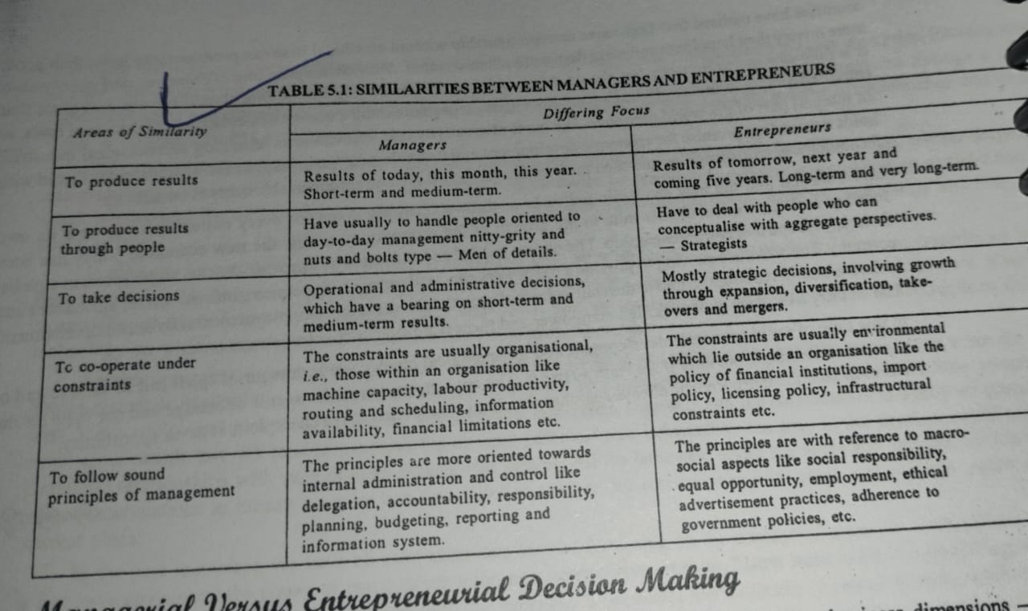

Slide 34
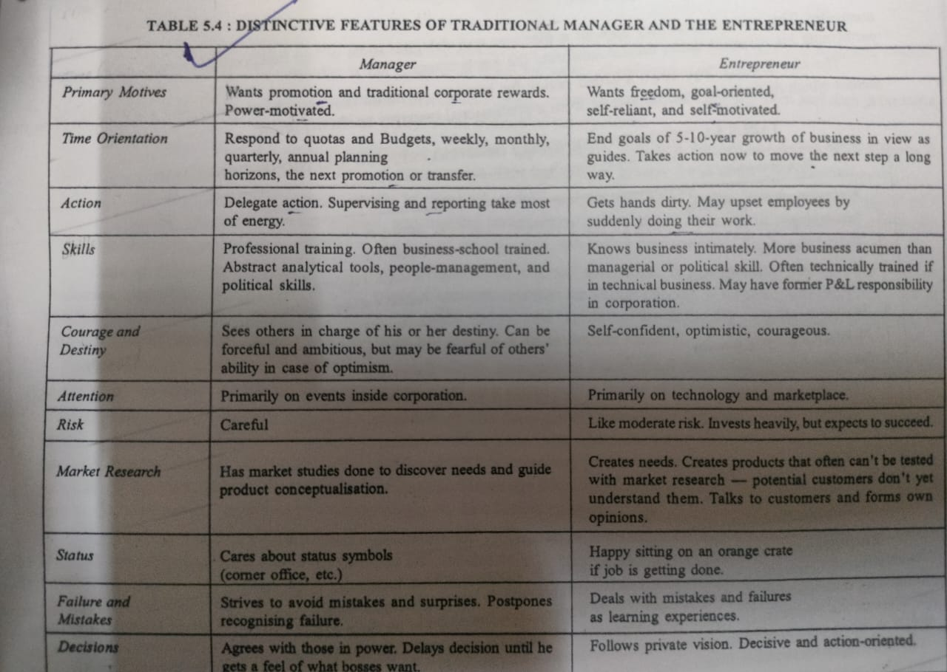

Slide 35
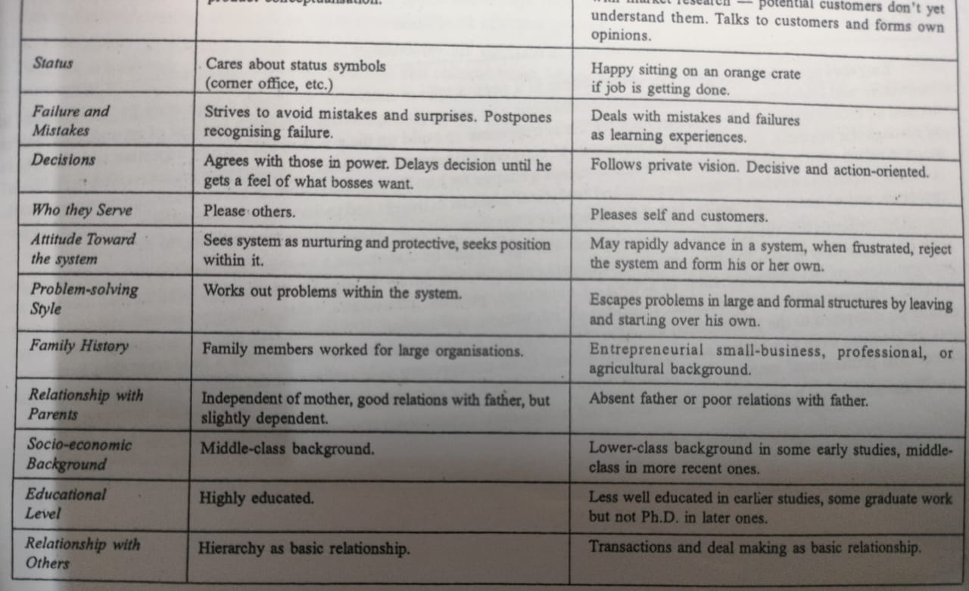

Slide 36
CLASSIFICATION OF ENTREPRENEURS

Slide 37
According to type of business
Business entrepreneur
Trading entrepreneur
Industrial entrepreneur
Corporate entrepreneur
Agricultural entrepreneur

Slide 38
According to use of technology
Technical entrepreneur
Non-technical entrepreneur
Professional entrepreneur

Slide 39
According to motivation
Pure entrepreneur
Induced entrepreneur
Motivated entrepreneur
Spontaneous entrepreneur

Slide 40
According to growth
Growth entrepreneur
Super-growth entrepreneur

Slide 41
According to stages of development
First-generation entrepreneur
Modern entrepreneur
Classical entrepreneur

Slide 42
According to functional characteristics
1. Innovative entrepreneur:
Entrepreneurs introduce new goods or new methods of production or discover new markets or reorganize their enterprises.
2. Imitative (Copied) or adoptive entrepreneur:
Entrepreneurs do not innovate themselves, but imitate techniques and technology innovated by others.
Suitable for underdeveloped economies as adoption saves costs of trial and error.
3. Fabian entrepreneur:
Entrepreneurs display great caution and skepticism (doubt) in experimenting with any change in their enterprise. They change only when there is an imminent threat to the very existence of their enterprise.
4. Drone entrepreneur:
Entrepreneurs are characterized by a die-hard conservatism and may even be prepared to suffer the loss of business.

