Slide 1
Entrepreneurship Environment

Slide 2
Entrepreneurship Environment
Environment - Sum total of external factors within which an enterprise operates.
Characteristics of environment:
Dynamic
Uncontrollable and external.
Poses threats and offers opportunities

Slide 3
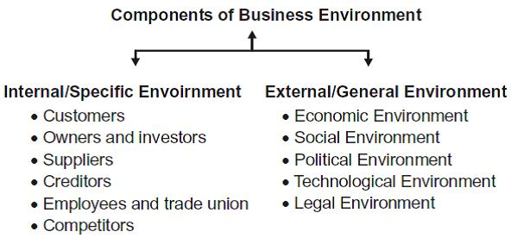
A PESTLE analysis is a simple tool that helps businesses succeed because it allows business owners to gain an understanding of the wider market in which they are operating in.

Slide 4
There are many companies the world over, that conduct PESTLE analysis on their brands in order to ascertain strategies for the future or else to understand the market before launching them. It is a fundamental tool of market planning and strategizing that must be carried out to comprehend market trends and the systematic risks involved.
PESTLE analysis gives you an overview of the whole situation your business might be in.

Slide 5
PESTEL ANALYSIS BY PEPSICO
PepsiCo is the largest selling beverage the world over, of course after its arch rival Coca Cola. It accounts for a 37% share of the global beverage market, and therefore they need to understand each and every country’s market in order to stay in line with their PESTEL situations.

Slide 6
Political
Pepsi is a non-alcoholic beverage and is therefore regulated by the FDA. So, they’re supposed to maintain a firm standard of the laws set out by the FDA with consistency. Also, many different markets across the world have different set of regulations that are either relaxed or are either stringent. There is competitive pricing by Pepsi’s competitors and that is one factor that Pepsi has to keep in mind at all times. The political scenario also matters greatly as there can be some civil unrest in certain markets or due to inflation the sales of the product can fall. Most importantly, cross border situations are starkly different therefore Pepsi has to stay in line with all those policies and changes so that they can adapt to all those changes accordingly.

Slide 7
Economic
As the recent economic downturn has plagued the economy, companies had to restructure their sales and marketing campaigns greatly. Also, with diminishing profits they had to undergo downsizing internally and re-think upon how to penetrate the market. Economic conditions have the highest influence on a business, regardless of what trade it is in. Though, in Pepsi’s favor, the economic downturn that started in 2008 resulted in increased sales of its beverages mainly as people were being laid off from jobs, they were spending time with friends and family or at home.

Slide 8
Social factors
Social factors greatly impact Pepsi, as it’s a non-alcoholic beverage it has to remain in line with the strict and stark differences of cultures the world over. Also, Pepsi has to communicate its image as a global brand so that the people can associate it with themselves as something that connects the world together. Usually, the social implications are seen in marketing campaigns for example certain countries have religious festivals, so Pepsi has to keep in line with all those festivals in order to understand the psyche of their market and how they can cash upon the opportunity.

Slide 9
Technological
With the advent of the new age in technology, companies have completely integrated themselves with all the recent changes that have taken place. To mention a recent trend that has greatly picked up and something that almost every business is turning toward is Social Media. The social media explosion has allowed for increasingly interactive engagement with the consumers with real time results so Pepsi has to stay ahead of all the developments that take place with keeping in view how the youth of today utilizes technology for their benefit and how can Pepsi reach them in order to keep on increasing brand recall and brand engagement.

Slide 10
Environmental
These factors can affect Pepsi, but not immensely alter its trade and profit generation as these factors affect agri-businesses much more directly.

Slide 11
Legal
There can be many legal implications upon the beverage industry. I would cite one very famous incident took place in India, where Pepsi was accused of using contaminated water, given a lab test that was done upon the water flowing into the Pepsi factory that was located nearby an industrial estate. A massive recall was issued for the products from shelves and then the product was tested costing the company many billions of dollars upon the tests as India is a very major market.

Slide 12
Class Activity
TAKE ANY INDUSTRY OF YOUR CHOICE AND DO PESTEL ANALYSIS.

