Slide 1
Marketing Management
Dr. Hemantkumar P. Bulsara
[B.Engg.(Production), MBA (Marketing, CIS & International Business), FDPM – IIM A, PhD (Management)]
Associate Professor – Management
Former Head
Applied Mathematics and Humanities Department
S V National Institute of Technology
Surat - India

Slide 2
Core Concepts of Marketing
Needs, Wants and Demands
Product
Value and Satisfaction
Exchange and Transaction
Relationship and Networks
Market
Marketers and Prospects
Competition
Marketing Environment
Supply Chain Management

Slide 3
Segmentation, Targeting and Positioning
Bases for Segmenting Consumer Markets:
Geographic: Region, City, Rural and Semi-urban areas
Demographic: Age, Family size, Gender, Income, Occupation, Education, Socio-Economic Classification (SEC)
Psychographic: Lifestyle, Personality
Behavioral: Occasions, Benefits, User status, Usage rate, Loyalty status, Readiness stage, Attitude towards product

Slide 4
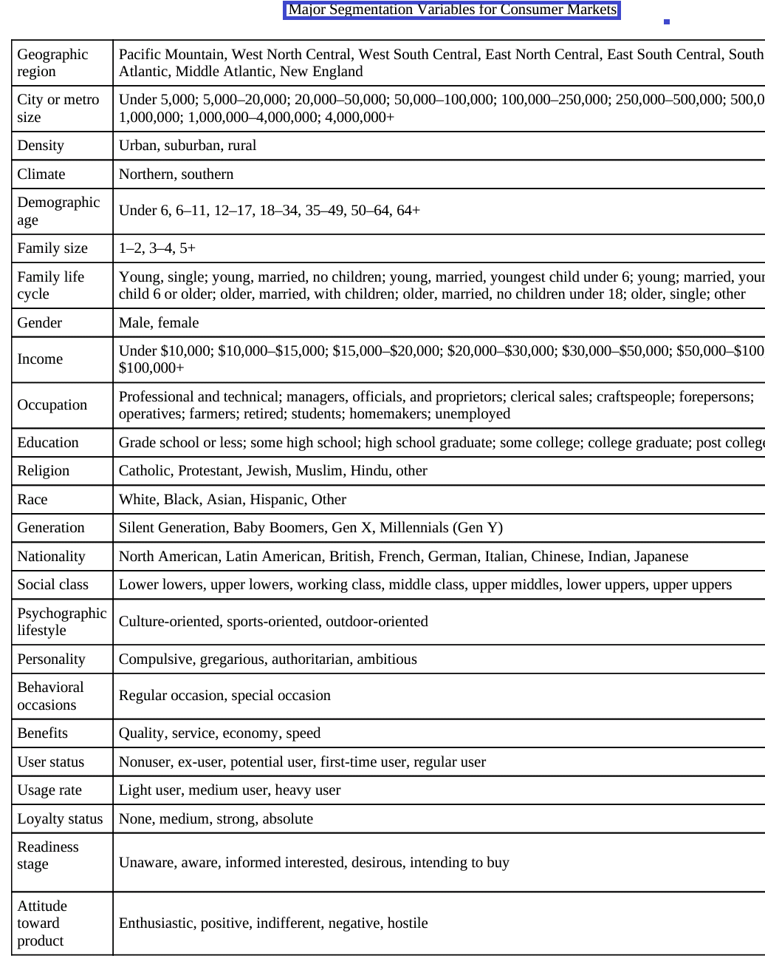

Slide 5
Bases for Segmenting Business market:
Industrial customers tend to be fewer in number and purchase larger quantities. Many of the consumer market segmentation variables can be applied to industrial markets. Industrial markets might be segmented on characteristics such as:
Location
Company type
Behavioral characteristics

Slide 6
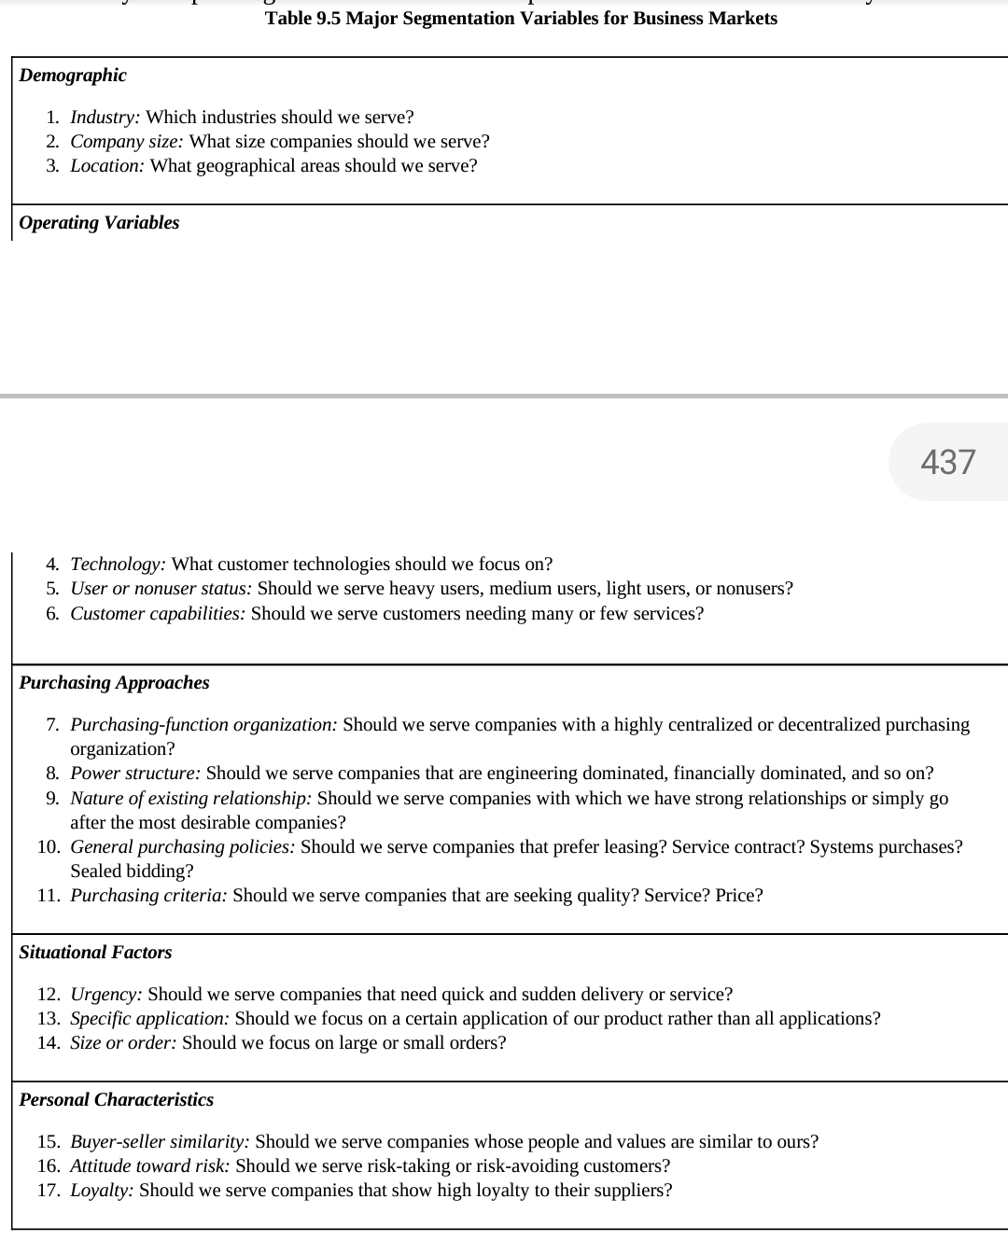
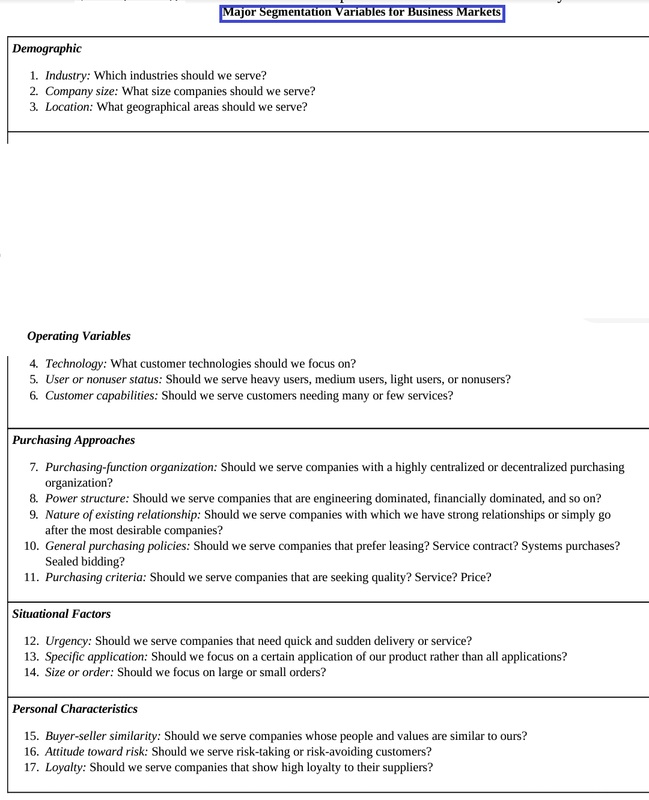

Slide 7
Targeting:
Target Marketing involves breaking a market into segments and then concentrating your marketing efforts on one or a few key segments. Target marketing can be the key to a small business’s success.
 | P1 | P2 | P3
M1
M2
M3

Slide 8
Target Market strategies:
Single segment concentrated strategy
Selective specialization
Product specialization
Market specialization
Full market coverage

Slide 9
Positioning:
The position of a product is the sum of those attributes normally ascribed to it by the consumers – its standing, its quality, the type of people who use it, its strengths, its weaknesses, any other unusual or memorable characteristics it may possess, its price and the value it represents.
Perception

Slide 10
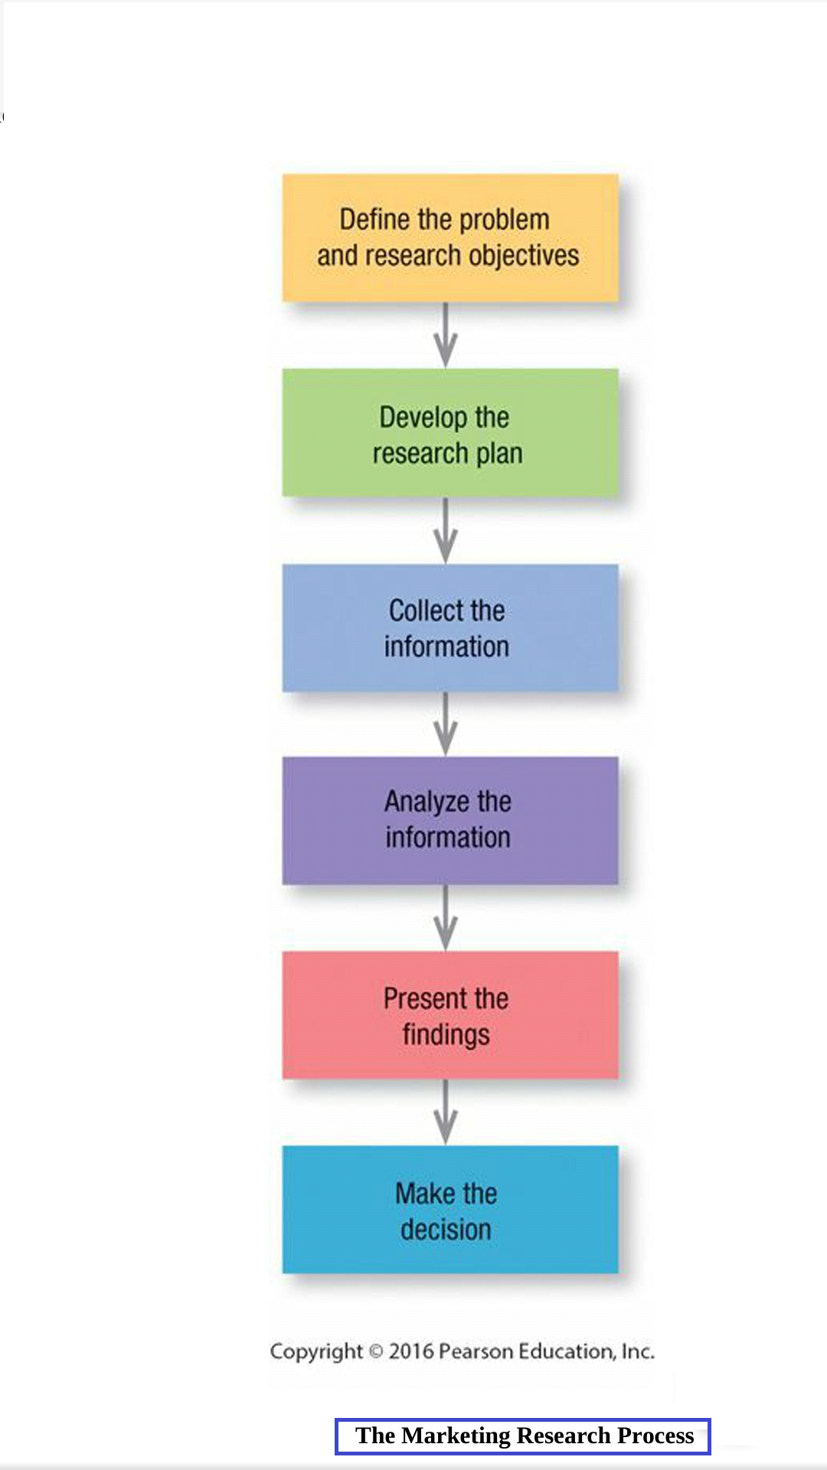
Marketing Research

Slide 11
Four Ps
Source: Philip Kotler et al, Marketing Management, 14th Edition, Page No. 23

Slide 12
Reference: Marketing Management by Philip Kotle el al. any latest edition.
Preferably - South Asian edition

Slide 13
Thank You
Dr. Hemantkumar P. Bulsara
[B.Engg.(Production), MBA (Marketing, CIS & International Business), FDPM – IIM A, PhD (Management)]
Associate Professor – Management
Former Head
Applied Mathematics and Humanities Department
S V National Institute of Technology
Surat - India
Email: hbulsara@amhd.svnit.ac.in
hemantbulsara@gmail.com

