Slide 1

The Math Behind Elliptic Curves
Blockchain Technology (CS467)
B.Tech. IV, Semester VII
Department of Computer Science and Technology
S. V. National Institute of Technology-Surat

Slide 2
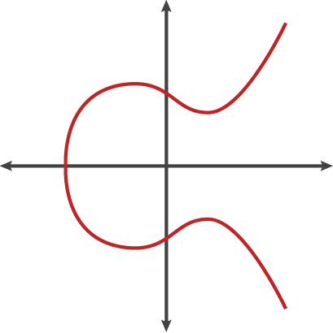
Elliptic Curves over Prime Field – GF(p)
y² = x³ + ax + b (weierstrass equation)

Slide 3
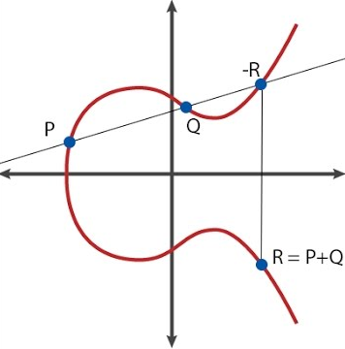
Addition Law

Slide 4
Points P and –R are on the blue line, they must satisfy the y = β x + μ equation
y = β x + μ
-R(x₃, -y₃)
P
y₁ = β.x₁ + μ
-R
-y₃ = β.x₃ + μ
μ = y₁ - β.x₁
-y₃ = β.x₃ + (y₁ - β.x₁)
Q(x₂, y₂)
y₃ = -β.x₃ - y₁ + β.x₁
y₃ = β.(x₁ - x₃) - y₁
P(x₁, y₁)
y₃ = β.(x₁ - x₃) - y₁
R(x₃, y₃)
β and x₃ are unknown

Slide 5
y² = x³ + ax + b y = β x + μ
y = β x + μ
(β x + μ)² = x³ + ax + b
β² x² + μ² + 2 βμx = x³ + ax + b
-R(x₃, -y₃)
x³ - β² x² + ax - 2 β μ x + b - μ² = 0
y² = x³ + ax + b
x³ - β² x² + (a - 2 β μ)x + (b - μ²) = 0
Q(x₂, y₂)
P(x₁, y₁)
R(x₃, y₃)

Slide 6
Polynomial Relation Rule
Sum of the roots have to be equal to negative coefficient of x²
Proof:
y² = x³ + ax + b has 3 distinct roots because it is cubic equation
Let’s say (a, b, c)
(x – a).(x – b).(x – c) = 0
[(x – a).(x – b)].(x – c) = 0
[x² - b x - a x + a b].(x – c) = 0
x³ - c x² - b x² +b c x - a x² + a c x – a b x + abc = 0
x³ – (a + b + c) x² – (ab + ac + bc)x + abc = 0

Slide 7
y² = x³ + ax + b
y = β x + μ
(β x + μ)² = x³ + ax + b
β² x² + μ² + 2 β x μ = x³ + ax + b
-R(x₃, -y₃)
x³ - β² x² + ax - 2 β μ x + b - μ² = 0
y² = x³ + ax + b
x³ - β² x² + (a - 2 β μ)x + (b - μ²) = 0
Q(x₂, y₂)
Polynomial relation rule states sum of roots equal to negative coefficient of x²
P(x₁, y₁)
-( -β² ) = x₁ + x₂ + x₃
β² = x₁ + x₂ + x₃
R(x₃, y₃)
x₃ = β² - x₁ - x₂
β is still unknown

Slide 8
y = β x + μ
-R(x₃, -y₃)
y² = x³ + ax + b
Q(x₂, y₂)
P(x₁, y₁)
R(x₃, y₃)

Slide 9
Just focus on the linear line
y = β x + μ
-R(x₃, -y₃)
Q(x₂, y₂)
β = tanα = (y₂ – y₁)/(x₂ – x₁)
y₂ – y₁
α
P(x₁, y₁)
x₂ – x₁

Slide 10
Doubling a point
y² = x³ + ax + b
Tangent line
2y.dy = (3x² + a).dx
P(x₁, y₁)
-2P(x₂, -y₂)
dy/dx = (3x² + a)/2y
β = (3x₁ ² + a)/2y₁
x₃ = β² - x₁ – x₂
y² = x³ + ax + b
y₃ = β.(x₁ - x₃) - y₁
2P(x₂, y₂)
P(x₁, y₁) + P(x₁, y₁) = 2P(x₂, y₂)

Slide 11
To sum up
P(x₁, y₁) + Q(x₂, y₂) = R(x₃, y₃)
P != Q
P = Q
β = (y₂ – y₁)/(x₂ – x₁)
β = (3 x₁ ² + a)/2 y₁
x₃ = β² - x₁ - x₂
y₃ = β.(x₁ - x₃) - y₁

Slide 12
Elliptic Curves
Weierstrass form : y² = x³ + ax + b

Slide 13
Summary
Over Prime Field
y² = x³ + ax + b
β = (y2 – y1)/(x2 – x1)
x3 = β² – x1 – x2
y3 = β(x1 – x3) – y1
β = (3x1² + a)/2y1
x3 = β² – 2x1
y3 = β(x1 – x3) – y1
Point
addition
Doubling

Slide 14
Addition
Group operation + Given Compute
Addition
Doubling

Slide 15
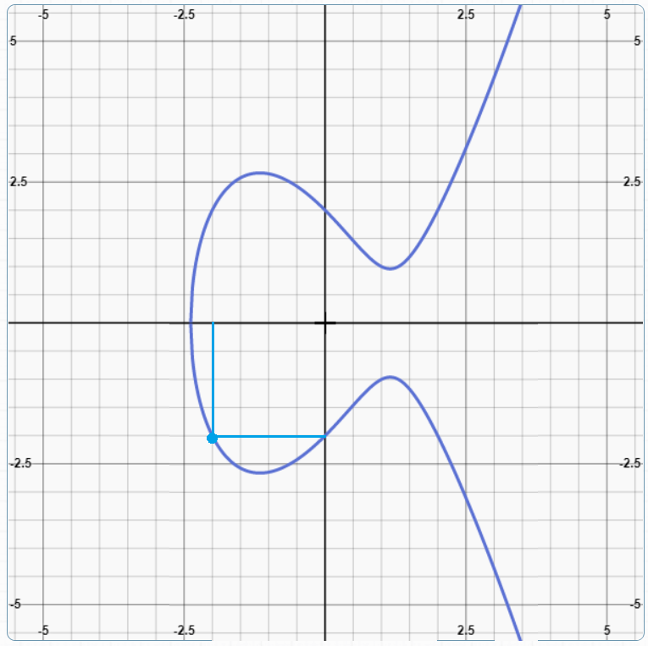
Calculation of kP (e.g. 1017P) – brute force
a = -4; b = 4
x1 = -2; y1 = -2
y² = x³ – 4x + 4
#Doubling (2P)
β = (3x1² + a)/2y1
x2 = β² – 2x1
y2 = β(x1 – x2) – y1
#Point addition
for i in range(1, 1017):
β = (y2 – y1)/(x2 – x1)
x3 = β² – x1 – x2
y3 = β(x1 – x3) – y1
P(-2, -2)
Requires 1017 steps. O(n) complexity is hard for really large integers.

Slide 16
Example
Example (addition): Given

Slide 17
Example
Example (addition): Given

Slide 18
Example
Example (doubling): Given

Slide 19
ECC
Scalar multiplication and cyclic subgroups
multiplication can be defined as:
nP = P + P + P+ ….. + P (n times)

Slide 20
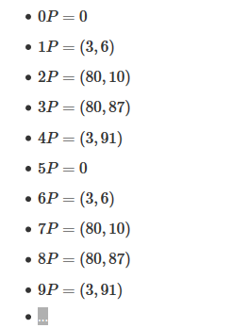
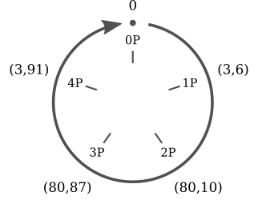
ECC
multiplication over points for elliptic curves in has an interesting property. Take the curve y² = x³+2x+3 (mod 97) and the point (3,6). Now calculate all the multiples of (3,6):
The multiples of (3,6) are just five distinct points

Slide 21
Comparable Key Sizes for Equivalent Security
Symmetric scheme (key size in bits) | ECC-based scheme (size of n in bits) | RSA/DSA (modulus size in bits)
56 | 112 | 512
80 | 160 | 1024
112 | 224 | 2048
128 | 256 | 3072
192 | 384 | 7680
256 | 512 | 15360

Slide 22
ECDSA
Parameter
CURVE | the elliptic curve field and equation used
G | elliptic curve base point, a point on the curve that generates a subgroup of large prime order n
n | integer order of G, means that n X G = O, where O is the identity element.
D | the private key (randomly selected)
Q | the public key D X G (calculated by elliptic curve)
m | the message to send

Slide 23
ECDSA
Signature Generation
Once we have the domain parameters and have decided on the keys to be used, the signature is generated by the following steps.
1. A random number k, 1 ≤ k ≤ n-1 is chosen
2. kG = (x₁,y₁) is computed. x₁ is converted to its corresponding integer x₁’
3. Next, r = x₁ mod n is computed
4. We then compute k⁻¹ mod q
5. e = HASH(m) where m is the message to be signed
6. s = k⁻¹(e + dr) mod n
where d is the private key of the sender.
We have the signature as (r,s)

Slide 24
ECDSA
Signature Verification
At the receiver’s end the signature is verified as follows:
1. Verify whether r and s belong to the interval [1, n-1] for the signature to be valid.
2. Compute e = HASH(m). The hash function should be the same as the one used for signature generation.
3. Compute w = s⁻¹ mod n.
4. Compute u₁ = ew mod n and u₂ = rw mod n.
5. Compute (x₁,y₁) = u₁G + u₂Q.
6. The signature is valid if r = x₁ mod n, invalid otherwise.
This is how we know that the verification works the way we want it to:
We have, s = k⁻¹(e + dr) mod n which we can rearrange to obtain, k = s⁻¹(e + dr) which is
s⁻¹e + s⁻¹rd
This is nothing but we + wrd = (u₁ + u₂d) (mod n)
We have u₁G + u₂Q = (u₁ + u₂d)G = kG which translates to v = r.

Slide 25
Elliptic Curve Pintsov Vanstone Signature (ECPVS)
Signature scheme using Elliptic Curves
More efficient than RSA as overhead is extremely low

Slide 26
ECPVS
Signature Generation
The plaintext message is split into two parts: part C representing the data elements requiring confidentiality and part V representing the data elements presented in plaintext. Both the parts are signed. The signature is generated as follows:
1. A random number k, 1 ≤ k ≤ n-1 is chosen.
2. Calculate the point R on the curve (R = kG).
3. Use point R and a symmetric encryption algorithm to get e = T_{R}(C).
4. Calculate a variable d such that d = HASH(e || I_{A} || V)
where I_{A} is the identity of the mailer terminal.
5. Now calculate the other part of the signature s as follows: s= ad + k(mod n); where a is the private key of the sender.
The signature pair (s,e) is transmitted together with the portion V of the plaintext.

Slide 27
ECPVS
Signature Verification
Retrieve Q_{A} (Q_{A} is mailer A’s public key)
Calculate the variable d = HASH(e || I_{A} || V) using the same HASH algorithm as the one used for generating the signature.
Compute U = sG – dQ_{A}.
Recover C = T_{u}⁻¹(e).
Run a redundancy test on C. If the test fails, discard the message. Else, the plaintext is recovered.
We have, s = ad + k. Multiply by base point G to obtain sG = adG + kG which is dQ_{A} + R
Therefore, R = sG – dQ_{A} which is U. Comparing the decrypted versions, m and m’ obtained using U and R, we ascertain the validity of the signature

Slide 28
Elliptic Curve Diffie-Hellman (ECDH)
Elliptic curve variant of the key exchange Diffie-Hellman protocol.
Decide on domain parameters and come up with a Public/Private key pair
To obtain the private key, the attacker needs to solve the discrete log problem

Slide 29
ECDH
How the key exchange takes place:
1. Alice and Bob publicly agree on an elliptic curve E over a large finite field F and a point P on that curve.
2. Alice and Bob each privately choose large random integers, denoted a and b
3. Using elliptic curve point-addition, Alice computes aP on E and sends it to Bob. Bob computes bP on E and sends it to Alice.
4. Both Alice and Bob can now compute the point abP Alice by multiplying the received value of bP by her secret number a and Bob vice-versa.
5. Alice and Bob agree that the x coordinate of this point will be their shared secret value.

Slide 30
Pros and Cons
Pros
Shorter Key Length
Same level of security as RSA achieved at a much shorter key length
Better Security
Secure because of the ECDLP
Higher security per key-bit than RSA
Higher Performance
Shorter key-length ensures lesser power requirement – suitable in wireless sensor applications and low power devices
More computation per bit but overall lesser computational expense or complexity due to lesser number of key bits

Slide 31
Pros and Cons
Cons
Relatively newer field
Idea prevails that all the aspects of the topic may not have been explored yet – possibly unknown vulnerabilities
Doesn’t have widespread usage
Not perfect
Attacks still exist that can solve ECC (112 bit key length has been publicly broken)
Well known attacks are the Pollard’s Rho attack (complexity O(√n) ), Pohlig’s attack, Baby Step,Giant Step etc

