Slide 1
Requirements Engineering
Slide Credits: Software Engineering by Ian Sommerville

Slide 2
Topics covered
Functional and non-functional requirements
Requirements engineering processes
Requirements elicitation
Requirements specification
Requirements validation
Requirements change

Slide 3
Requirements engineering
The process of establishing the services that a customer requires from a system and the constraints under which it operates and is developed.
The system requirements are the descriptions of the system services and constraints that are generated during the requirements engineering process.

Slide 4
What is a requirement?
It may range from a high-level abstract statement of a service or of a system constraint to a detailed mathematical functional specification.
This is inevitable as requirements may serve a dual function
May be the basis for a bid for a contract - therefore must be open to interpretation;
May be the basis for the contract itself - therefore must be defined in detail;
Both these statements may be called requirements.

Slide 5
Requirements abstraction (Davis)
“If a company wishes to let a contract for a large software development project, it must define its needs in a sufficiently abstract way that a solution is not pre-defined. The requirements must be written so that several contractors can bid for the contract, offering, perhaps, different ways of meeting the client organization’s needs. Once a contract has been awarded, the contractor must write a system definition for the client in more detail so that the client understands and can validate what the software will do. Both of these documents may be called the requirements document for the system.”

Slide 6
Types of requirement
User requirements
Statements in natural language plus diagrams of the services the system provides and its operational constraints. Written for customers.
System requirements
A structured document setting out detailed descriptions of the system’s functions, services and operational constraints. Defines what should be implemented so may be part of a contract between client and contractor.

Slide 7
Mentcare: A patient information system for mental health care
A patient information system to support mental health care is a medical information system that maintains information about patients suffering from mental health problems and the treatments that they have received.
Most mental health patients do not require dedicated hospital treatment but need to attend specialist clinics regularly where they can meet a doctor who has detailed knowledge of their problems.
To make it easier for patients to attend, these clinics are not just run in hospitals. They may also be held in local medical practices or community centres.

Slide 8
Mentcare
Mentcare is an information system that is intended for use in clinics.
It makes use of a centralized database of patient information but has also been designed to run on a PC, so that it may be accessed and used from sites that do not have secure network connectivity.
When the local systems have secure network access, they use patient information in the database but they can download and use local copies of patient records when they are disconnected.

Slide 9
Mentcare goals
To generate management information that allows health service managers to assess performance against local and government targets.
To provide medical staff with timely information to support the treatment of patients.

Slide 10
The organization of the Mentcare system

Slide 11
Key features of the Mentcare system
Individual care management
Clinicians can create records for patients, edit the information in the system, view patient history, etc. The system supports data summaries so that doctors can quickly learn about the key problems and treatments that have been prescribed.
Patient monitoring
The system monitors the records of patients that are involved in treatment and issues warnings if possible problems are detected.
Administrative reporting
The system generates monthly management reports showing the number of patients treated at each clinic, the number of patients who have entered and left the care system, number of patients sectioned, the drugs prescribed and their costs, etc.

Slide 12
Mentcare system concerns
Privacy
It is essential that patient information is confidential and is never disclosed to anyone apart from authorised medical staff and the patient themselves.
Safety
Some mental illnesses cause patients to become suicidal or a danger to other people. Wherever possible, the system should warn medical staff about potentially suicidal or dangerous patients.
The system must be available when needed otherwise safety may be compromised and it may be impossible to prescribe the correct medication to patients.

Slide 13
User and system requirements

Slide 14
Readers of different types of requirements specification

Slide 15
System stakeholders
Any person or organization who is affected by the system in some way and so who has a legitimate interest
Stakeholder types
End users
System managers
System owners
External stakeholders

Slide 16
Stakeholders in the Mentcare system
Patients whose information is recorded in the system.
Doctors who are responsible for assessing and treating patients.
Nurses who coordinate the consultations with doctors and administer some treatments.
Medical receptionists who manage patients’ appointments.
IT staff who are responsible for installing and maintaining the system.

Slide 17
Stakeholders in the Mentcare system
A medical ethics manager who must ensure that the system meets current ethical guidelines for patient care.
Health care managers who obtain management information from the system.
Medical records staff who are responsible for ensuring that system information can be maintained and preserved, and that record keeping procedures have been properly implemented.

Slide 18
Agile methods and requirements
Many agile methods argue that producing detailed system requirements is a waste of time as requirements change so quickly.
The requirements document is therefore always out of date.
Agile methods usually use incremental requirements engineering and may express requirements as ‘user stories’ (discussed in Chapter 3).
This is practical for business systems but problematic for systems that require pre-delivery analysis (e.g. critical systems) or systems developed by several teams.

Slide 19
Functional and non-functional requirements

Slide 20
Functional and non-functional requirements
Functional requirements
Statements of services the system should provide, how the system should react to particular inputs and how the system should behave in particular situations.
May state what the system should not do.
Non-functional requirements
Constraints on the services or functions offered by the system such as timing constraints, constraints on the development process, standards, etc.
Often apply to the system as a whole rather than individual features or services.
Domain requirements
Constraints on the system from the domain of operation

Slide 21
Functional requirements
Describe functionality or system services.
Depend on the type of software, expected users and the type of system where the software is used.
Functional user requirements may be high-level statements of what the system should do.
Functional system requirements should describe the system services in detail.

Slide 22
Mentcare system: functional requirements
A user shall be able to search the appointments lists for all clinics.
The system shall generate each day, for each clinic, a list of patients who are expected to attend appointments that day.
Each staff member using the system shall be uniquely identified by his or her 8-digit employee number.

Slide 23
Requirements imprecision
Problems arise when functional requirements are not precisely stated.
Ambiguous requirements may be interpreted in different ways by developers and users.
Consider the term ‘search’ in requirement 1
User intention – search for a patient name across all appointments in all clinics;
Developer interpretation – search for a patient name in an individual clinic. User chooses clinic then search.

Slide 24
Requirements completeness and consistency
In principle, requirements should be both complete and consistent.
Complete
They should include descriptions of all facilities required.
Consistent
There should be no conflicts or contradictions in the descriptions of the system facilities.
In practice, because of system and environmental complexity, it is impossible to produce a complete and consistent requirements document.

Slide 25
Non-functional requirements
These define system properties and constraints e.g. reliability, response time and storage requirements. Constraints are I/O device capability, system representations, etc.
Process requirements may also be specified mandating a particular IDE, programming language or development method.
Non-functional requirements may be more critical than functional requirements. If these are not met, the system may be useless.

Slide 26
Types of nonfunctional requirement

Slide 27
Non-functional requirements implementation
Non-functional requirements may affect the overall architecture of a system rather than the individual components.
For example, to ensure that performance requirements are met, you may have to organize the system to minimize communications between components.
A single non-functional requirement, such as a security requirement, may generate a number of related functional requirements that define system services that are required.
It may also generate requirements that restrict existing requirements.

Slide 28
Non-functional classifications
Product requirements
Requirements which specify that the delivered product must behave in a particular way e.g. execution speed, reliability, etc.
Organisational requirements
Requirements which are a consequence of organisational policies and procedures e.g. process standards used, implementation requirements, etc.
External requirements
Requirements which arise from factors which are external to the system and its development process e.g. interoperability requirements, legislative requirements, etc.

Slide 29
Examples of nonfunctional requirements in the Mentcare system
Product requirement The Mentcare system shall be available to all clinics during normal working hours (Mon–Fri, 0830–17.30). Downtime within normal working hours shall not exceed five seconds in any one day. Organizational requirement Users of the Mentcare system shall authenticate themselves using their health authority identity card. External requirement The system shall implement patient privacy provisions as set out in HStan-03-2006-priv.

Slide 30
Goals and requirements
Non-functional requirements may be very difficult to state precisely and imprecise requirements may be difficult to verify.
Goal
A general intention of the user such as ease of use.
Verifiable non-functional requirement
A statement using some measure that can be objectively tested.
Goals are helpful to developers as they convey the intentions of the system users.

Slide 31
Usability requirements
The system should be easy to use by medical staff and should be organized in such a way that user errors are minimized. (Goal)
Testable non-functional requirement
Medical staff shall be able to use all the system functions after four hours of training.
After this training, the average number of errors made by experienced users shall not exceed two per hour of system use.

Slide 32
Metrics for specifying nonfunctional requirements
Property | Measure
Speed | Processed transactions/second User/event response time Screen refresh time
Size | Mbytes Number of ROM chips
Ease of use | Training time Number of help frames
Reliability | Mean time to failure Probability of unavailability Rate of failure occurrence Availability
Robustness | Time to restart after failure Percentage of events causing failure Probability of data corruption on failure
Portability | Percentage of target dependent statements Number of target systems

Slide 33
Another Example: The LIBSYS system
A library system that provides a single interface to a number of databases of articles in different libraries.
Users can search for, download and print these articles for personal study.

Slide 34
Examples of functional requirements of LIBSYS
The user shall be able to search either all of the initial set of databases or select a subset from it.
The system shall provide appropriate viewers for the user to read documents in the document store.
Every order shall be allocated a unique identifier (ORDER_ID) which the user shall be able to copy to the account’s permanent storage area.

Slide 35
Requirements imprecision in LIBSYS
Ambiguity
Consider the term ‘appropriate viewers’
User intention - special purpose viewer for each different document type;
Developer interpretation - Provide a text viewer that shows the contents of the document.

Slide 36
Non-functional requirements LIBSYS
Product requirement
The user interface for LIBSYS shall be implemented as simple HTML without frames or Java applets.
Organisational requirement
The system development process and deliverable documents shall conform to the process and deliverables defined in XYZCo-SP-STAN-95.
External requirement
The system shall not disclose any personal information about customers apart from their name and reference number to the operators of the system.

Slide 37
Domain Requirements of LIBSYS
There shall be a standard user interface to all databases which shall be based on the Z39.50 standard.
Because of copyright restrictions, some documents must be deleted immediately on arrival. Depending on the user’s requirements, these documents will either be printed locally on the system server for manually forwarding to the user or routed to a network printer.

Slide 38
Requirements engineering processes

Slide 39
Requirements engineering processes
The processes used for RE vary widely depending on the application domain, the people involved and the organisation developing the requirements.
However, there are a number of generic activities common to all processes
Requirements elicitation;
Requirements analysis;
Requirements validation;
Requirements management.
In practice, RE is an iterative activity in which these processes are interleaved.

Slide 40
A spiral view of the requirements engineering process

Slide 41
Requirements specification

Slide 42
Requirements specification
The process of writing down the user and system requirements in a requirements document.
User requirements have to be understandable by end-users and customers who do not have a technical background.
System requirements are more detailed requirements and may include more technical information.
The requirements may be part of a contract for the system development
It is therefore important that these are as complete as possible.

Slide 43
Ways of writing a system requirements specification
Notation | Description
Natural language | The requirements are written using numbered sentences in natural language. Each sentence should express one requirement.
Structured natural language | The requirements are written in natural language on a standard form or template. Each field provides information about an aspect of the requirement.
Design description languages | This approach uses a language like a programming language, but with more abstract features to specify the requirements by defining an operational model of the system. This approach is now rarely used although it can be useful for interface specifications.
Graphical notations | Graphical models, supplemented by text annotations, are used to define the functional requirements for the system; UML use case and sequence diagrams are commonly used.
Mathematical specifications | These notations are based on mathematical concepts such as finite-state machines or sets. Although these unambiguous specifications can reduce the ambiguity in a requirements document, most customers don’t understand a formal specification. They cannot check that it represents what they want and are reluctant to accept it as a system contract

Slide 44
Requirements and design
In principle, requirements should state what the system should do and the design should describe how it does this.
In practice, requirements and design are inseparable
A system architecture may be designed to structure the requirements;
The system may inter-operate with other systems that generate design requirements;
The use of a specific architecture to satisfy non-functional requirements may be a domain requirement.
This may be the consequence of a regulatory requirement.

Slide 45
Natural language specification
Requirements are written as natural language sentences supplemented by diagrams and tables.
Used for writing requirements because it is expressive, intuitive and universal. This means that the requirements can be understood by users and customers.

Slide 46
Guidelines for writing requirements
Invent a standard format and use it for all requirements.
Use language in a consistent way. Use shall for mandatory requirements, should for desirable requirements.
Use text highlighting to identify key parts of the requirement.
Avoid the use of computer jargon.
Include an explanation (rationale) of why a requirement is necessary.

Slide 47
Problems with natural language
Lack of clarity
Precision is difficult without making the document difficult to read.
Requirements confusion
Functional and non-functional requirements tend to be mixed-up.
Requirements amalgamation
Several different requirements may be expressed together.

Slide 48
Insulin pump control system
Collects data from a blood sugar sensor and calculates the amount of insulin required to be injected.
Calculation based on the rate of change of blood sugar levels.
Sends signals to a micro-pump to deliver the correct dose of insulin.
Safety-critical system as low blood sugars can lead to brain malfunctioning, coma and death; high-blood sugar levels have long-term consequences such as eye and kidney damage.

Slide 49
Insulin pump hardware architecture

Slide 50
Activity model of the insulin pump

Slide 51
Essential high-level requirements
The system shall be available to deliver insulin when required.
The system shall perform reliably and deliver the correct amount of insulin to counteract the current level of blood sugar.
The system must therefore be designed and implemented to ensure that the system always meets these requirements.

Slide 52
Example requirements for the insulin pump software system
3.2 The system shall measure the blood sugar and deliver insulin, if required, every 10 minutes. (Changes in blood sugar are relatively slow so more frequent measurement is unnecessary; less frequent measurement could lead to unnecessarily high sugar levels.) 3.6 The system shall run a self-test routine every minute with the conditions to be tested and the associated actions defined in Table 1. (A self-test routine can discover hardware and software problems and alert the user to the fact the normal operation may be impossible.)

Slide 53
Structured specifications
An approach to writing requirements where the freedom of the requirements writer is limited and requirements are written in a standard way.
This works well for some types of requirements e.g. requirements for embedded control system but is sometimes too rigid for writing business system requirements.

Slide 54
Form-based specifications
Definition of the function or entity.
Description of inputs and where they come from.
Description of outputs and where they go to.
Information about the information needed for the computation and other entities used.
Description of the action to be taken.
Pre and post conditions (if appropriate).
The side effects (if any) of the function.

Slide 55
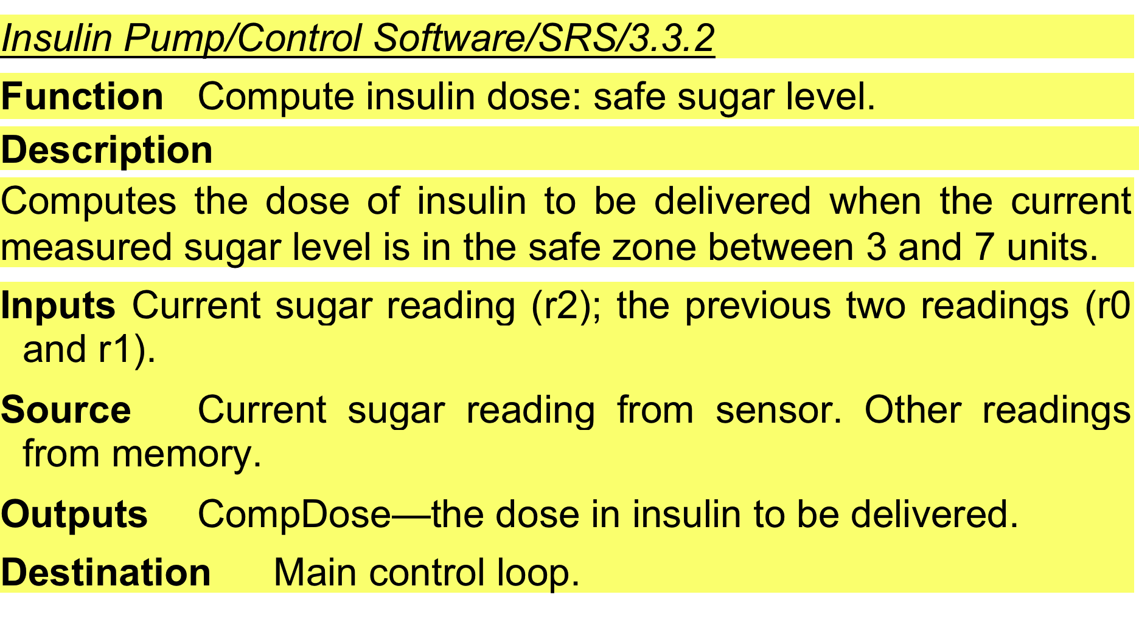
A structured specification of a requirement for an insulin pump

Slide 56
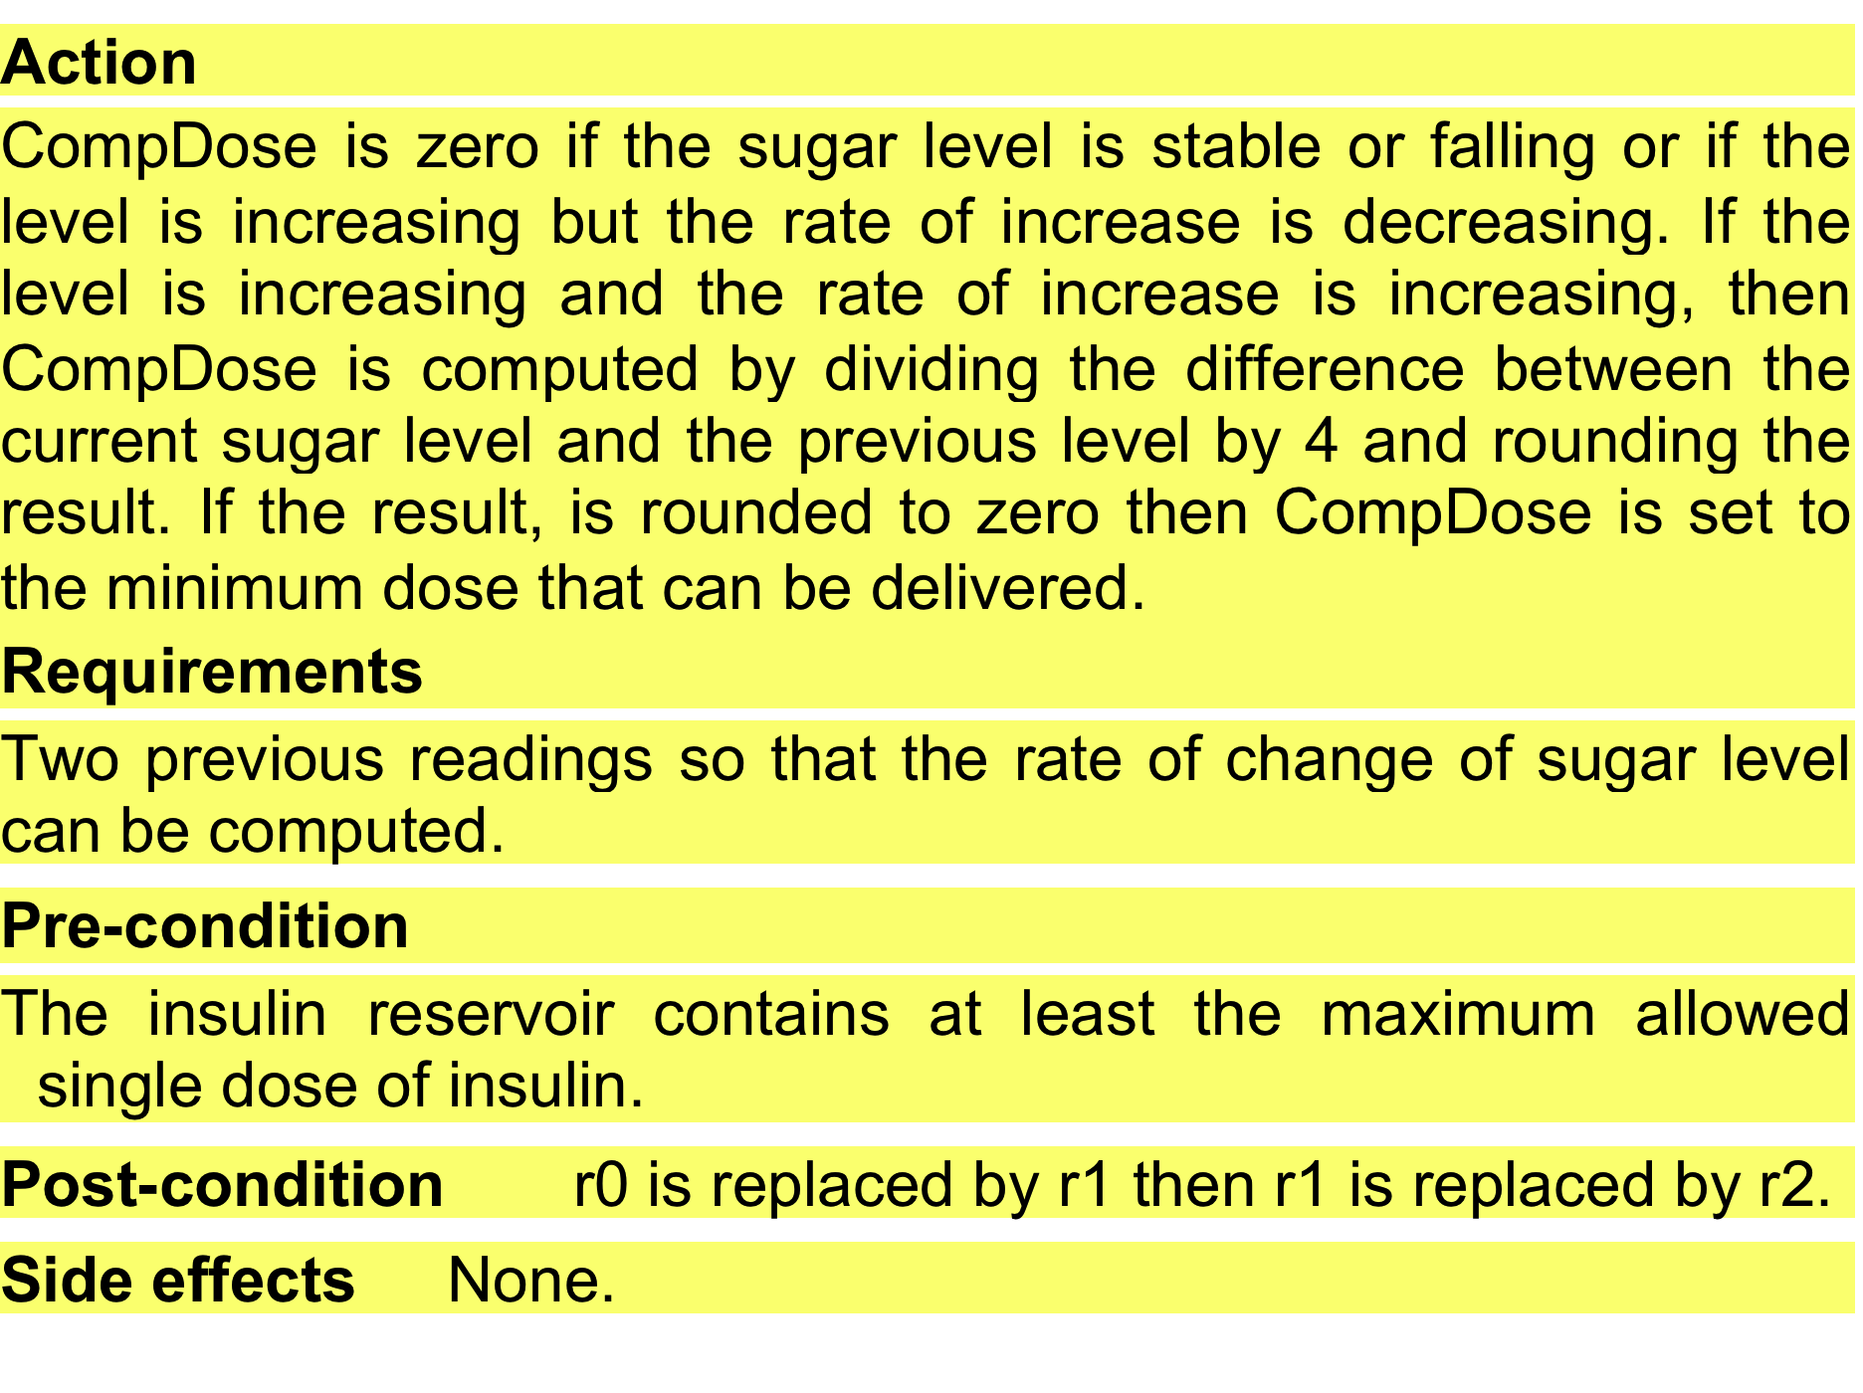
A structured specification of a requirement for an insulin pump

Slide 57
Tabular specification
Used to supplement natural language.
Particularly useful when you have to define a number of possible alternative courses of action.
For example, the insulin pump systems bases its computations on the rate of change of blood sugar level and the tabular specification explains how to calculate the insulin requirement for different scenarios.

Slide 58
Tabular specification of computation for an insulin pump
Condition | Action
Sugar level falling (r2 < r1) | CompDose = 0
Sugar level stable (r2 = r1) | CompDose = 0
Sugar level increasing and rate of increase decreasing ((r2 – r1) < (r1 – r0)) | CompDose = 0
Sugar level increasing and rate of increase stable or increasing ((r2 – r1) ≥ (r1 – r0)) | CompDose = round ((r2 – r1)/4) If rounded result = 0 then CompDose = MinimumDose

Slide 59
Use cases
Use-cases are a kind of scenario that are included in the UML.
Use cases identify the actors in an interaction and which describe the interaction itself.
A set of use cases should describe all possible interactions with the system.
High-level graphical model supplemented by more detailed tabular description (see Chapter 5).
UML sequence diagrams may be used to add detail to use-cases by showing the sequence of event processing in the system.

Slide 60
Use cases for the Mentcare system

Slide 61
The software requirements document
The software requirements document is the official statement of what is required of the system developers.
Should include both a definition of user requirements and a specification of the system requirements.
It is NOT a design document. As far as possible, it should state WHAT the system should do rather than HOW it should do it.

Slide 62
Users of a requirements document

Slide 63
Requirements document variability
Information in requirements document depends on type of system and the approach to development used.
Systems developed incrementally will, typically, have less detail in the requirements document.
Requirements documents standards have been designed e.g. IEEE standard. These are mostly applicable to the requirements for large systems engineering projects.

Slide 64
The structure of a requirements document
Chapter | Description
Preface | This should define the expected readership of the document and describe its version history, including a rationale for the creation of a new version and a summary of the changes made in each version.
Introduction | This should describe the need for the system. It should briefly describe the system’s functions and explain how it will work with other systems. It should also describe how the system fits into the overall business or strategic objectives of the organization commissioning the software.
Glossary | This should define the technical terms used in the document. You should not make assumptions about the experience or expertise of the reader.
User requirements definition | Here, you describe the services provided for the user. The nonfunctional system requirements should also be described in this section. This description may use natural language, diagrams, or other notations that are understandable to customers. Product and process standards that must be followed should be specified.
System architecture | This chapter should present a high-level overview of the anticipated system architecture, showing the distribution of functions across system modules. Architectural components that are reused should be highlighted.

Slide 65
The structure of a requirements document
Chapter | Description
System requirements specification | This should describe the functional and nonfunctional requirements in more detail. If necessary, further detail may also be added to the nonfunctional requirements. Interfaces to other systems may be defined.
System models | This might include graphical system models showing the relationships between the system components and the system and its environment. Examples of possible models are object models, data-flow models, or semantic data models.
System evolution | This should describe the fundamental assumptions on which the system is based, and any anticipated changes due to hardware evolution, changing user needs, and so on. This section is useful for system designers as it may help them avoid design decisions that would constrain likely future changes to the system.
Appendices | These should provide detailed, specific information that is related to the application being developed; for example, hardware and database descriptions. Hardware requirements define the minimal and optimal configurations for the system. Database requirements define the logical organization of the data used by the system and the relationships between data.
Index | Several indexes to the document may be included. As well as a normal alphabetic index, there may be an index of diagrams, an index of functions, and so on.

Slide 66
Requirements validation

Slide 67
Requirements validation
Concerned with demonstrating that the requirements define the system that the customer really wants.
Requirements error costs are high so validation is very important
Fixing a requirements error after delivery may cost up to 100 times the cost of fixing an implementation error.

Slide 68
Requirements checking
Validity. Does the system provide the functions which best support the customer’s needs?
Consistency. Are there any requirements conflicts?
Completeness. Are all functions required by the customer included?
Realism. Can the requirements be implemented given available budget and technology
Verifiability. Can the requirements be checked?

Slide 69
Requirements validation techniques
Requirements reviews
Systematic manual analysis of the requirements.
Prototyping
Using an executable model of the system to check requirements. Covered in Chapter 2.
Test-case generation
Developing tests for requirements to check testability.

