Slide 1
Software Engineering COMP 201
Lecturer: Sebastian Coope
Ashton Building, Room G.18
E-mail: coopes@liverpool.ac.uk
COMP 201 web-page:
http://www.csc.liv.ac.uk/~coopes/comp201
Lecture 17 – Concepts of Object Oriented Design

Slide 2
Object-Oriented
Object orientation means to organize the software as a collection of discrete objects that incorporate both data structure and behaviour
System functionality is expressed in terms of object services

Slide 3
Object Concepts
We continue to explore the question “what are good systems like?” by describing the object oriented paradigm.
We shall answer these questions:
What is an object?
How do objects communicate?
How is an object’s interface defined?
What have objects to do with components?
Finally we consider inheritance, polymorphism and dynamic binding.

Slide 4
Object Concepts
Don’t think of what an object holds – but what it will do for you
Consequently no public data members
Think only about the methods (the public interface)
Objects are potentially reusable components.
An object may represent something in the real world
But often not

Slide 5
What is an Object?
Conceptually, an object is a thing you can interact with:
you can send it various messages and
it will react
How it behaves depends on the current internal state of the object, which may change
For example: as part of the object’s reaction to receiving a message.
It matters which object you interact with, an object has an identity which distinguishes it from all other objects.

Slide 6
Again… What is an Object?
An object is a thing which has
behaviour,
state and
identity [Grady, Booch, 1991]
Advantages:
Shared data areas are eliminated. Objects communicate by message passing.
Objects are independent and encapsulate state and representation information. Their independence can lead to easier maintenance

Slide 7
State
The state of the object is all the data which it currently encapsulates
An object normally has a number of named attributes (or instance variables or data members) each of which has a value
Some attributes can be mutable (variable)
An attribute ADDRESS
other attributes may be immutable (constant)
Date of birth
Identifying number

Slide 8
Behaviour
The way an object acts and reacts, in terms of its state changes as message passing.
An object understands certain messages,
it can receive the message and act on them.
The set of messages that the object understands, like the set of attributes it has, is normally fixed.

Slide 9
Identity is more Tricky
The idea is that objects are not defined just by the current values of their attributes
An object has a continuous existence
For example the values of the object’s attributes could change, perhaps in response to a message, but it would still be the same object.

Slide 10
Example
Consider an object which we’ll call myClock, which understands the messages:
reportTime()
resetTimeTo(07:43), resetTimeTo(12:30) or indeed more generally resetTimeTo(newTime)
How does it implement this functionality?
The outside world doesn’t need to know – the information should be hidden – but perhaps it has an attribute time
Or perhaps it passes these messages on to some other object, which it knows about, and has the other object deal with messages

Slide 11
Messages
A message includes a selector; here we’ve seen the selectors
reportTime and resetTimeTo
A message may, but need not, include one or more arguments
Often, for a given selector there is a single “correct” number of arguments (Recall method overloading however..)

Slide 12
Examples
Person
Identity Seb_Coope
State Age, weight, height
Behaviour
setAge
Printer
State offline, online
Behaviour
printDocument Sends control signals to printer
Security login
State username, password
Validate
Hash password, load credentials from database, check password

Slide 13
Interfaces
The object’s public interface defines which messages it will accept
An object can also send to itself any message which it is capable of understanding (in either its public or private interface)
So typically an object has two interfaces:
The public interface (any part of the system can use)
The larger private interface (which the object itself and other privileged parts of the system can use)

Slide 14
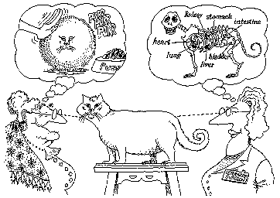
Object: Classification
It depends on the abstraction level and the point of view

Slide 15
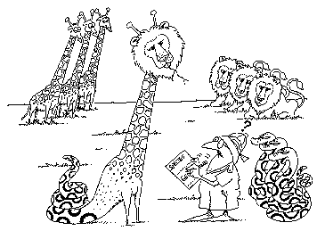
Object: Classification
objects with the same data structure (attributes) and behaviour (operations) are grouped into a class
each class defines a possibly infinite set of objects

Slide 16
Object: Classification
Each object is an instance of a class
Each object knows its class
Each instance has its own value for each attribute (state) but shares the attribute names and operations with other instances of the class
also “static” i.e. class variables
A class encapsulates data and behaviour, hiding the implementation details of an object

Slide 17
Object Interface Specification
Object interfaces have to be specified so that the objects and other components can be designed in parallel.
Objects may have several interfaces which are viewpoints on the methods provided.
Hiding information inside objects means that changes made to an object do not affect other objects in an unpredictable way.

Slide 18
Digression: Why have Classes?
Why not just have objects, which have state, behaviour and identity as we require?
Classes in object oriented languages serve two purposes:
Convenient way of describing a collection (a class) of objects which have the same properties
In most modern OO languages, classes are used in the same way that types are used in many other languages
To specify what values are acceptable

Slide 19
Classes and Types
Often, people think of classes and types as being the same thing (indeed it is sometimes convenient and not misleading to do so). It is not strictly correct however.
Remember that a class does not only define what messages an object understands!
It also defines what the object does in response to the messages.

Slide 20
What have Objects to do with Components?
The hype surrounding object orientation sometimes suggests that any class is automatically a reusable component.
This, of course, is not true!
The first factor is that the reusability of a component is not simply a property of the component itself, it also depends upon the context of development and proposed reuse.
Another important factor is that the class structure often turns out to be too fine grained for effective reuse.
In order to reuse a single class you have
To be writing in the same programming language and
using a compatible architecture

Slide 21
Object: Inheritance
Inheritance is the sharing of attributes and operations among classes based upon a hierarchical relationship
A class can be defined broadly and then refined into successively finer subclasses
Each subclass incorporates or inherits all of the properties of its super class and its own unique properties

Slide 22
Subclass ←→ Superclass
A subclass is an extended, specialized version of its superclass.
It includes the operations and attributes of the superclass, and possibly extra ones which extend the class.

Slide 23
Object: Inheritance
Vehicle
Person
Land Vehicle
Water Vehicle
Doctor
Nurse
Surgeon
Family
Doctor
Car
Amphibious Vehicle
Boat
single
multiple

Slide 24
Inheritance - Warning
One should not abuse inheritance
It is not just a way to be able to access some of the methods of the subclass
A subclass must inherit all the superclass
Composition is often “better” than inheritance
(!) An object class is coupled to its super-classes. Changes made to the attributes or operations in a super-class propagate to all sub-classes.

Slide 25
Object: Polymorphism
Polymorphism allows the programmer to use a subclass anywhere that a superclass is expected. E.g., if B is a subclass of type A then if an argument expects a variable of type A, it should also be able to take any variable of type B.
Polymorphism essentially reduces the amount of code duplication required. However, Object-Oriented Programming Languages also usually have a feature called “dynamic binding” which makes this idea even more useful..

Slide 26
Dynamic Binding
Dynamic Binding is when an object determines (possibly at run time) which code to execute as the result of a method call on a base type.
For example, imagine C is a subclass of B and both have a method named printName(). Then if we write:
B temp = new C(); // (This is allowed by polymorphism)
temp.printName();
we would invoke the printName() method of object C, not of object B, even though the type of temp is B.
This is dynamic binding. Let us consider another example..

Slide 27
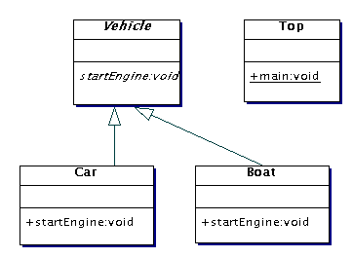
Dynamic Binding - Example
Vehicle v = null;
v = new Car();
v.startEngine();
v = new Boat();
v.startEngine();
Call Car startEngine() method
Call Boat startEngine() method

Slide 28
Unified Modelling Language(UML)
Unify notations
UML is a language for:
Specifying
Visualizing and
Documenting
the parts of a system under development
Authors (Booch, Rumbaugh and Jacobsen) agreed on notation but not able to agree on a single method
This is probably a “good thing”
UML has been adopted by the Object Management Group (OMG) as an Object-Oriented notation standard

Slide 29
UML – Other Influences
Meyer – pre and post conditions
Harel - statecharts
Wirfs-Brock - responsibilities
Coleman - message numbering scheme
Embley - singleton classes
Gamma - patterns, notes
Shlaer, Mellor - object lifecycles

Slide 30
UML – Some Notation
Object classes are rectangles with the name at the top, attributes in the middle section (“compartment”) and operations in the next compartment.
Relationships between object classes (known as associations) are shown as lines linking objects
Inheritance is referred to as generalisation.
It uses an open triangular arrow head

Slide 31
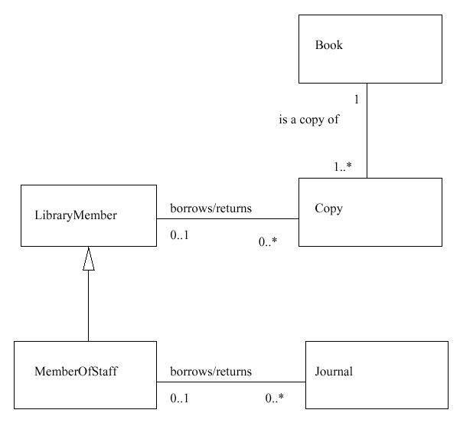
Library System UML Example
Note that if you avoid “Generalisation” you have a recognisable ER diagram

Slide 32
CASE Tools/Workbenches
Computer Aided Software Engineering (CASE)
A coherent set of tools to support a software engineering method
These workbenches may support a specific SE method or may provide support for creating several different types of system model.
There are also meta-CASE tools
A CASE tool to build CASE tools

Slide 33
CASE Tool Components
Diagram editors
Model analysis and checking tools
Repository and associated query language
Data dictionary
Report definition and generation tools
Forms definition tools
Code generation tools
Import/export translators

Slide 34
Key Points
Object Oriented Design is an approach to design so that design components have their own private state and operations.
Objects should have a constructor as well as inspection operations. They provide services to other objects.
Objects may be implemented sequentially or concurrently.

Slide 35
Key Points
Object interfaces should be defined precisely using e.g. a programming language like Java.
Object-oriented design potentially simplifies system evolution.
The Unified Modeling Language provides different notations for defining different object models.

