Slide 1
Software Engineering COMP 201
Lecturer: Sebastian Coope
Ashton Building, Room G.18
E-mail: coopes@liverpool.ac.uk
COMP 201 web-page:
http://www.csc.liv.ac.uk/~coopes/comp201
Lecture 19 – Essentials of Class Models

Slide 2
On Naming classes
NO PLURALS!
Person not Persons
Car not Cars
NO VERBS
Encrypt X
Not general process descriptors Encryption X
Encryptor or EncryptionHelper
Printer Good, Printing Bad

Slide 3
Class Models
In this lecture we will be studying Class Models which are a part of the Unified Modeling Language (UML).
Of the various models in UML, we have the categories:
Use case models – describing a system from the users’ point of view;
Static models – describing the elements of the system and their relationship; class models fall into this category;
Dynamic models – describing the behaviour of the system over time.

Slide 4
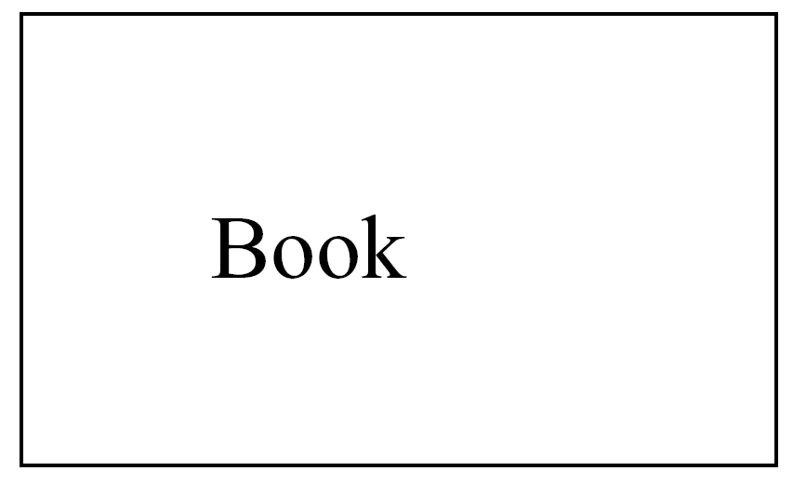
A Very Simple Class Model
In the Unified Modelling Language (UML), a class is shown in a class diagram as a rectangle giving its name:

Slide 5
What Makes a Good Class Model?
Ultimately, we have two objectives which we aim to meet:
Build, as quickly and cheaply as possible, a system which satisfies our current requirements;
Every piece of behaviour required of the system must be provided by the objects we choose
Build a system which will be easy to maintain and adapt to future requirements (Evolution)
Thus build a system composed of encapsulated modules with low coupling and high cohesion.

Slide 6
In Order to Meet the Objectives:
A good class model consists of classes which represent enduring classes domain objects, which don’t depend on the particular functionality required today
Remember that the names of classes are also important; use meaningful names for classes when possible and consider using a data dictionary to avoid conflicts

Slide 7
Deriving Classes
Recall that we previously mentioned the noun identification technique to find potential classes.
There are two main (extreme) techniques used to find classes in general:
Data-driven-design (DDD) – We identify all the data of the system and divide it into classes. We then assign particular responsibilities (methods) to these classes
Responsibility-driven-design (RDD) – We identify all the responsibilities of the system and divide them into classes. We then find the data each class requires.

Slide 8
Associations
In the same sense that classes correspond to nouns, associations correspond to verbs.
They express the relationship between classes.
There are instances of associations, just as there are instances of classes
Instances of a classes are called objects;
Instances of associations are called links in UML

Slide 9
Class A and B are Associated if
an object of class A sends a message to an object of class B
an object of class A creates an object of class B
an object of class A has an attribute whose values are objects of class B or collections of objects of class B
an object of class A receives a message with an object of class B as argument
In other words, if some object of class A has to know about some object of class B

Slide 10

Simple Association between Classes
One annotation which is often used early is the multiplicity of an association
This is so fundamental that we will spend some time thinking about it.

Slide 11

Example
Doctor is associated by has allocated with just one or more than one patient. We showed a 1 at the Doctor end of the association (alternately we can use 1..1)
On the other hand, there may be any number of patients for a given Doctor in our system. So the multiplicity on the Patient end is 1..* .

Slide 12
Multiplicity
We can specify:
an exact number simply by writing it, e.g. 1
a range of numbers using two dots between a pair of numbers, e.g., 1..10
an arbitrary, unspecified number using *
Loosely, you can think of UML’s * as an infinity sign, so the multiplicity 1 .. * expresses that number of copies can be anything between 1 and infinity.

Slide 13
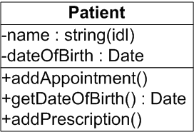
Attributes and Operations
The attributes of a class describe the data contained in an object of the class and their type
Most important are the operations of a class, which define the ways in which objects may interact.

Slide 14
Operation Signatures
The signature of an operation gives the selector, names and types of all formal parameters (arguments) and the return type. For example:
computeMean(List inputList): Float
Recall that the method called may depend upon a classes position within the inheritance hierarchy. There may be methods with the same name, do you remember the concept of dynamic binding?
Argument type
Return type
selector
Argument name

Slide 15
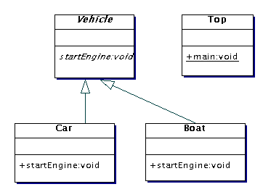
Dynamic Binding (recap)
Vehicle v = null;
v = new Car();
v.startEngine();
v = new Boat();
v.startEngine();
Call Car startEngine() method
Call Boat startEngine() method

Slide 16
Generalization
Important relationships which may exist between classes are called generalization. Conceptually this means that if class A is a generalization of class B, then the interface of class B must conform to the interface of class A.
Every attribute and operation of A will also be supported by B. In addition, B may contain some extra operations and data specific to its class.
Let’s see an example of this on the next slide…

Slide 17
Generalization
Animal
Age: Integer
getAge(): Integer
Cat
meow(): void
Dog
bark(): void
An object of a specialized class can be substituted for an object of a more general class in any context which expects a member of the more general class, but not the other way round

Slide 18
Generalization
Animal
Age: Integer
getAge(): Integer
Cat
meow(): void
Dog
bark(): void
Animal any = new Animal(12);
any.getAge();
any.meow();
any.bark();
Fine, returns 12
Error – No meow() method!
Error – No bark() method!

Slide 19
Generalization
Animal
Age: Integer
getAge(): Integer
Cat
meow(): void
Dog
bark(): void
Animal any = new Cat(8);
any.getAge();
any.meow();
any.bark();
Fine, returns 8
Fine, object “meows”
Error – No bark() method!

Slide 20
Inheritance versus Generalization
Generalization is a conceptual relationship between classes whereas inheritance is an implementation relationship.
Generalization obviously increases the coupling of a system and if a subclass is changed it usually necessitates a recompilation of the subclass also (this is a pragmatic issue).

Slide 21
CRC Cards
One common way of checking for a good design and guiding its refinement is to use CRC cards.
CRC stands for Classes, Responsibilities, Collaborations.
Although CRC is not part of UML, they add some very useful insights throughout a development.

Slide 22
Creating CRC Cards
The name of a class, at the top
The responsibilities of the class, on the left-hand side
The collaborators of the class, which help to carry out each responsibility, on the right-hand side of the card.
The responsibilities of the class describe at a high level the purpose of the class’s existence :
They are connected with the operations the class provides, but are more general than that might imply – i.e., they can be an abstraction of several operations.

Slide 23
CRC Cards
In general there should be one or two responsibilities per class and usually no more than four. Too many responsibilities often signals low cohesion (i.e., a bad level of abstraction) in the system.
Too many collaborators can signify high coupling in the system (the class is connected to too many other classes).
Since we aim to have systems with high cohesion and low coupling, we should aim to find a compromise between these values which is still conceptually sound.

Slide 24
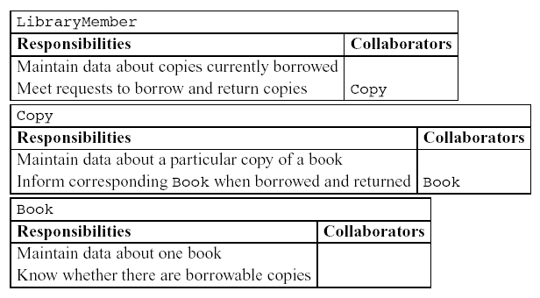
CRC Card Example
Questions: Do these three classes conform to our notion of a good design? What is their level or cohesion and coupling?

Slide 25
CRC Card of a Bad Object Class
Here is an example of a CRC card for a bad object class called Word_Processor_Object:
Word_Processor_Object
Responsibilities | Collaborators
Spellcheck the document Print the document Open a new document Save the document Email document | Dictionary Printer File I/O Networking API
Questions: Why is this a bad class according to the principals of good design we have identified? How can it be improved?

Slide 26
More about Associations
One of UML’s strengths is its expressiveness, and during this lecture we have seen a taste of that, covering most (but not quite all) features of class diagrams.

Slide 27
More on Class Models
Aggregation and composition
Roles
Navigability
Qualified association
Derived association
Constraints
Association classes
More about classes
We study these next lecture …

Slide 28
Lecture Key Points
During this lecture we introduced class diagrams which represent the static (as opposed to the dynamic) nature of the system to be built.
We discussed how classes and their associations can be found and the concept of multiplicity.
We also discussed class attributes and operations as well as looking at representations of generalization.
Finally we used the idea of CRC cards to validate a model.

