Slide 1
Software Engineering COMP 201
Lecturer: Sebastian Coope
Ashton Building, Room G.18
E-mail: coopes@liverpool.ac.uk
COMP 201 web-page:
http://www.csc.liv.ac.uk/~coopes/comp201
Software Cost Estimation

Slide 2
Software Cost Estimation
Software cost estimation involves predicting the resources required for a software development process

Slide 3
Fundamental Estimation Questions
How much effort is required to complete an activity?
How much calendar time is needed to complete an activity?
What is the total cost of an activity?
Project estimation and scheduling and interleaved management activities

Slide 4
Software Cost Components
Hardware and software costs
Travel and training costs
Effort costs (the dominant factor in most projects)
salaries of engineers involved in the project
Social and insurance costs
Effort costs must take overheads into account
costs of building, heating, lighting
costs of networking and communications
costs of shared facilities (e.g library, staff restaurant, etc.)

Slide 5
Costing and Pricing
Estimates are made to discover the cost, to the developer, of producing a software system
There is not a simple relationship between the development cost and the price charged to the customer
Broader organisational, economic, political and business considerations influence the price charged

Slide 6
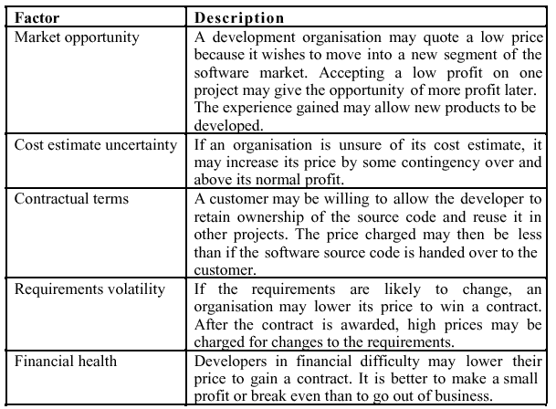
Software Pricing Factors

Slide 7
Programmer Productivity
A measure of the rate at which individual engineers involved in software development produce software and associated documentation
Not quality-oriented although quality assurance is a factor in productivity assessment
Essentially, we want to measure useful functionality produced per time unit

Slide 8
Productivity Measures
Size-related measures based on some output from the software process. This may be lines of delivered source code, object code instructions, etc.
Function-related measures based on an estimate of the functionality of the delivered software. Function-points are the best known of this type of measure

Slide 9
Measurement Problems
Estimating the size of the measure
Estimating the total number of programmer months which have elapsed
Estimating contractor productivity (e.g. documentation team) and incorporating this estimate in overall estimate

Slide 10
Lines of Code
What's a line of code?
The measure was first proposed when programs were typed on cards with one line per card
How does this correspond to statements as in Java which can span several lines or where there can be several statements on one line
What programs should be counted as part of the system?
Assumes linear relationship between system size and volume of documentation

Slide 11
Productivity Comparisons
The lower level the language, the more productive the programmer
The same functionality takes more code to implement in a lower-level language than in a high-level language

Slide 12
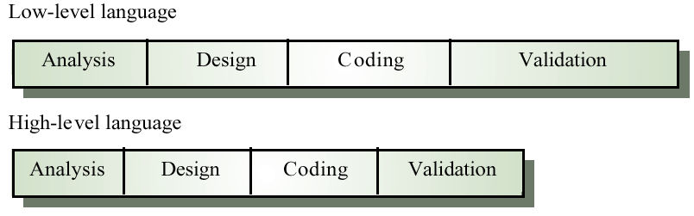
High and Low Level Languages

Slide 13
Function Points
Based on a combination of program characteristics
external inputs and outputs
user interactions
external interfaces
files used by the system
A weight is associated with each of these
The function point count is computed by multiplying each raw count by the weight and summing all values

Slide 14
Object Points
Object points are an alternative function-related measure to function points
Object points are NOT the same as object classes
The number of object points in a program is a weighted estimate of
The number of separate screens that are displayed
The number of reports that are produced by the system
The number of modules that must be developed

Slide 15
Productivity Estimates
Real-time embedded systems, 40-160 LOC/P-month
Systems programs , 150-400 LOC/P-month
Commercial applications, 200-800 LOC/P-month
In object points, productivity has been measured between 4 and 50 object points/month depending on type of application, tool support and developer capability

Slide 16
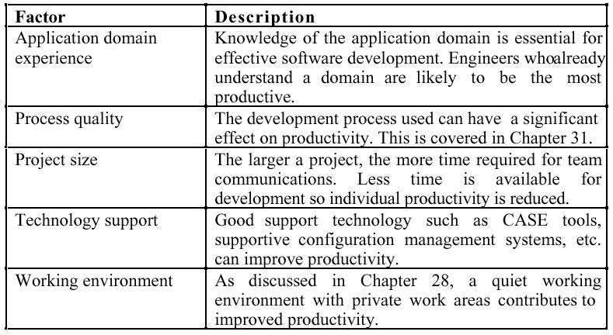
Factors Affecting Productivity

Slide 17
Quality and Productivity
It could be argued that all metrics based on volume/unit time are flawed because they do not take quality into account
Productivity may generally be increased at the cost of quality
It is not clear how productivity/quality metrics are related
If change is constant (simplifying and improving code for example) then an approach based on counting lines of code is not meaningful

Slide 18
Estimation Techniques
There is no simple way to make an accurate estimate of the effort required to develop a software system
Initial estimates are based on inadequate information in a user requirements definition
The software may run on unfamiliar computers or use new technology
The people in the project may be unknown
Project cost estimates may be self-fulfilling
The estimate defines the budget and the product is adjusted to meet the budget

Slide 19
Estimation Techniques
Algorithmic cost modelling
Expert judgement
Estimation by analogy
Parkinson's Law
Pricing to win

Slide 20
Algorithmic Code Modelling
A formulaic approach based on historical cost information and which is generally based on the size of the software
Discussed later …

Slide 21
Expert Judgement
One or more experts in both software development and the application domain use their experience to predict software costs. Process iterates until some consensus is reached.
Advantages: Relatively cheap estimation method. Can be accurate if experts have direct experience of similar systems
Disadvantages: Very inaccurate if there are no experts!

Slide 22
Estimation by Analogy
The cost of a project is computed by comparing the project to a similar project in the same application domain
Advantages: Accurate if project data available
Disadvantages: Impossible if no comparable project has been tackled. Needs systematically maintained cost database

Slide 23
Parkinson's Law
The project costs whatever resources are available
Advantages: No overspend
Disadvantages: System is usually unfinished
Parkinson’s Law states that work expands to fill the time available. The cost is determined by available resources rather than by objective statement.
Example: Project should be delivered in 12 months and 5 people are available. Effort = 60 p/m

Slide 24
Pricing to Win
The project costs whatever the customer has to spend on it
Advantages: You get the contract
Disadvantages: The probability that the customer gets the system he or she wants is small. Costs do not accurately reflect the work required

Slide 25
Top-Down and Bottom-Up Estimation
Any of these approaches may be used top-down or bottom-up
Top-down
Start at the system level and assess the overall system functionality and how this is delivered through sub-systems
Bottom-up
Start at the component level and estimate the effort required for each component. Add these efforts to reach a final estimate

Slide 26
Estimation Methods
Each method has strengths and weaknesses
Estimation should be based on several methods
If these do not return approximately the same result, there is insufficient information available
Some action should be taken to find out more in order to make more accurate estimates
Pricing to win is sometimes the only applicable method

Slide 27
Experience-Based Estimates
Estimating is primarily experience-based
However, new methods and technologies may make estimating based on experience inaccurate
Object-oriented rather than function-oriented development
Client-server systems rather than mainframe systems
Off the shelf components
Component-based software engineering
CASE tools and program generators

Slide 28
Pricing to Win
This approach may seem unethical and unbusinesslike?
However, when detailed information is lacking it may be the only appropriate strategy
The project cost is agreed on the basis of an outline proposal and the development is constrained by that cost
A detailed specification may be negotiated or an evolutionary approach used for system development

Slide 29
Algorithmic Cost Modelling
Cost is estimated as a mathematical function of product, project and process attributes whose values are estimated by project managers
Effort = A × Size^{B} × M
A is an organisation-dependent constant, B reflects the disproportionate effort for large projects and M is a multiplier reflecting product, process and people attributes
Most commonly used product attribute for cost estimation is code size
Most models are basically similar but with different values for A, B and M

Slide 30
Estimation Accuracy
The size of a software system can only be known accurately when it is finished
Several factors influence the final size
Use of COTS and components
Programming language
Distribution of system
As the development process progresses then the size estimate becomes more accurate

