Slide 1
Auto Encoders
Dr. Amit Sinhal
Professor
Department of Computer Science & Engineering

Slide 2
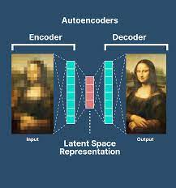
What is the Auto Encoders?
Autoencoders are a type of neural network architecture that are widely used for unsupervised learning tasks such as data compression, feature extraction, and denoising.
The basic idea behind autoencoders is to learn a compressed representation of the input data in a way that the output can be reconstructed from the compressed representation with minimal loss of information.

Slide 3
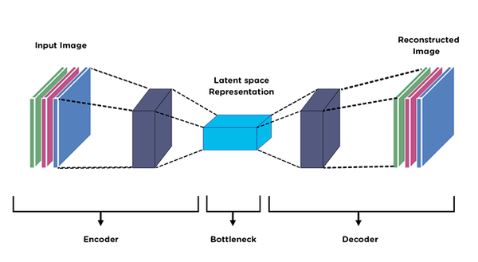
What is the Auto Encoders?
An autoencoder consists of two main parts: an encoder and a decoder.
The encoder takes the input data and maps it to a compressed representation (also known as the bottleneck or latent space), while the decoder takes the compressed representation and maps it back to the original input data.
The encoder and decoder are trained together in an end-to-end fashion to minimize the reconstruction error between the input and output data.

Slide 4
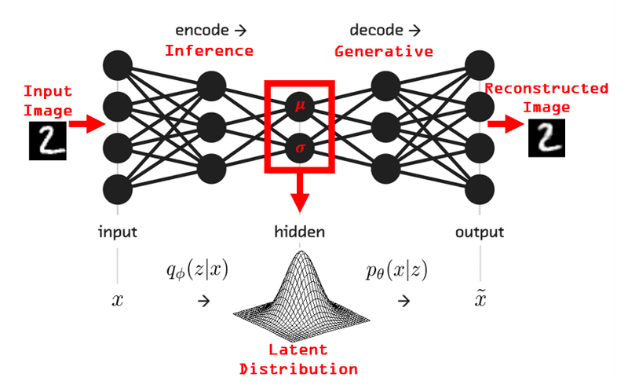
What is the Auto Encoders?
Autoencoders can be of different types such as simple autoencoders, convolutional autoencoders, denoising autoencoders, and variational autoencoders (VAEs), etc.
Simple autoencoders are commonly used for data compression tasks, whereas convolutional autoencoders are used for image data.
Denoising autoencoders are used to reconstruct the original signal from the noisy input, while VAEs are used for generating new samples from the learned distribution of the input data.

Slide 5
How Auto Encoder Works?
Autoencoders work by learning a compressed representation of the input data in a way that the output can be reconstructed from the compressed representation with minimal loss of information. The process can be broken down into the following steps:
Encoding: The input data is fed into the encoder, which maps it to a compressed representation (also known as the bottleneck or latent space). The encoder consists of one or more layers of neurons, and the output of each layer is a new representation of the input data that captures increasingly abstract features.
Bottleneck: The compressed representation obtained from the encoder is typically much smaller than the input data, and it contains a compressed representation of the most important features of the input.
Decoding: The compressed representation obtained from the encoder is fed into the decoder, which maps it back to the original input data. The decoder consists of one or more layers of neurons, and the output of each layer is a new representation of the input data that captures increasingly specific details.

Slide 6
How Auto Encoder Works?
Reconstruction: The output of the decoder is compared to the original input data, and the difference between the two is measured using a loss function. The loss function is used to optimize the weights and biases of the encoder and decoder such that the reconstruction error is minimized.
Testing: Once the autoencoder is trained, it can be used for testing by feeding it new input data and using the encoder to obtain a compressed representation of the data. The compressed representation can then be used for various tasks such as data compression, feature extraction, and denoising.

Slide 7
Types of Auto Encoders
Standard Autoencoder: This is the most basic type of autoencoder, consisting of an encoder and a decoder. The encoder maps the input data to a compressed representation, while the decoder maps the compressed representation back to the original data.
Denoising Autoencoder: This type of autoencoder is trained to reconstruct the original data from a noisy input. It is useful for denoising tasks in image and audio processing.
Convolutional Autoencoder: This type of autoencoder uses convolutional layers for the encoder and decoder, making it suitable for image processing tasks.
Variational Autoencoder: This type of autoencoder is designed to generate new data points by sampling from the compressed representation learned by the model. It is useful for tasks such as image generation and data augmentation.

Slide 8
Types of Auto Encoders
Recurrent Autoencoder: This type of autoencoder is designed for sequence data, such as time-series data or natural language processing. It uses recurrent layers in the encoder and decoder to capture temporal dependencies.
Sparse Autoencoder: This type of autoencoder is trained to learn a sparse representation of the input data, where most of the neurons in the compressed representation are inactive.
Contractive Autoencoder: This type of autoencoder is trained to learn a compressed representation of the input data that is robust to small perturbations in the input.
Adversarial Autoencoder: This type of autoencoder is designed to generate new data points that are similar to the input data. It consists of an encoder, a decoder, and a discriminator, which is trained to distinguish between the generated data and the real data.

Slide 9
Advantages of Auto Encoders
Unsupervised Learning: Autoencoders can be trained on unlabeled data, which makes them useful for unsupervised learning tasks. This makes them useful in situations where labeled data is scarce or expensive to obtain.
Data Compression: Autoencoders can be used for data compression tasks, where the input data can be compressed into a smaller size without significant loss of information.
Feature Extraction: Autoencoders can be used for feature extraction tasks, where the learned compressed representation of the data can be used for downstream tasks such as classification and clustering.
Denoising: Autoencoders can be used to reconstruct the original signal from the noisy input, making them useful for denoising tasks.
Versatile: Autoencoders can be adapted to a wide range of applications, including image and audio processing, natural language processing, and anomaly detection.

Slide 10
Disadvantages of Auto Encoders
Overfitting: Autoencoders can overfit the training data, which can result in poor generalization to new data.
Limited Capacity: Autoencoders may not have enough capacity to capture all the relevant information in the input data.
Slow Training: Autoencoders can be slow to train, especially for large datasets and complex architectures.
Lack of Interpretability: The learned compressed representation of the data may be difficult to interpret, which can make it challenging to understand how the model is making its predictions.
Sensitivity to Initialization: The performance of autoencoders can be sensitive to the choice of initialization parameters, which can make it difficult to train them effectively.

Slide 11
Applications of Auto Encoders
Data Compression: Autoencoders can be used for data compression tasks, where the input data can be compressed into a smaller size without significant loss of information. This is useful in situations where storage space is limited, such as in mobile devices or cloud storage.
Anomaly Detection: Autoencoders can be used for anomaly detection, where the model is trained on normal data and then used to identify unusual or abnormal data points.
Image Processing: Autoencoders can be used for various image processing tasks such as denoising, super-resolution, and image generation. They can also be used for feature extraction in image recognition tasks.
Natural Language Processing: Autoencoders can be used for natural language processing tasks such as text generation, sentiment analysis, and language translation.

Slide 12
Applications of Auto Encoders
Recommender Systems: Autoencoders can be used for personalized recommendation systems, where the model is trained on user preferences and used to make recommendations.
Finance: Autoencoders can be used for fraud detection in financial transactions by learning to identify unusual patterns in the data.
Robotics: Autoencoders can be used for feature extraction and motion planning in robotics.
Healthcare: Autoencoders can be used for medical image analysis and diagnosis, as well as predicting disease outcomes and drug discovery.
Audio Processing: Autoencoders can be used for various audio processing tasks such as noise reduction, speech recognition, and music recommendation.
Self-Driving Cars: Autoencoders can be used for feature extraction and decision-making in autonomous vehicles.

