Slide 1
Face
Detection

Slide 2
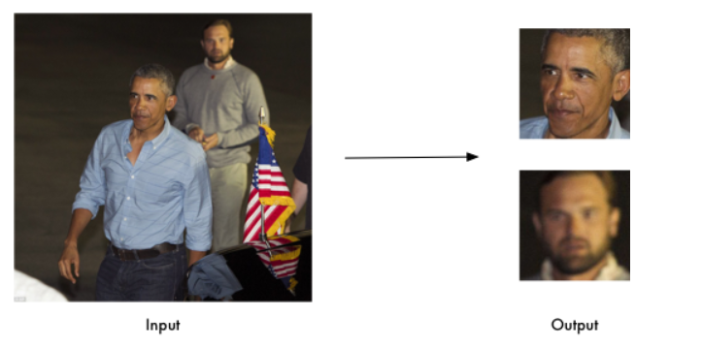
01
Problem Statement

Slide 3
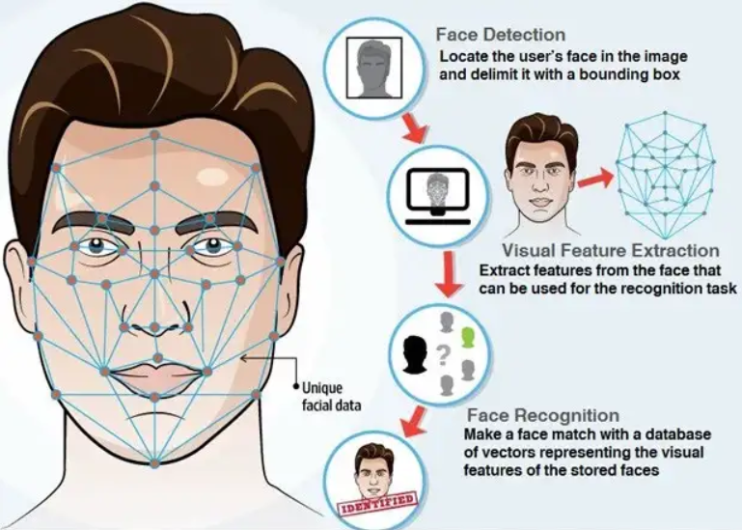

Slide 4
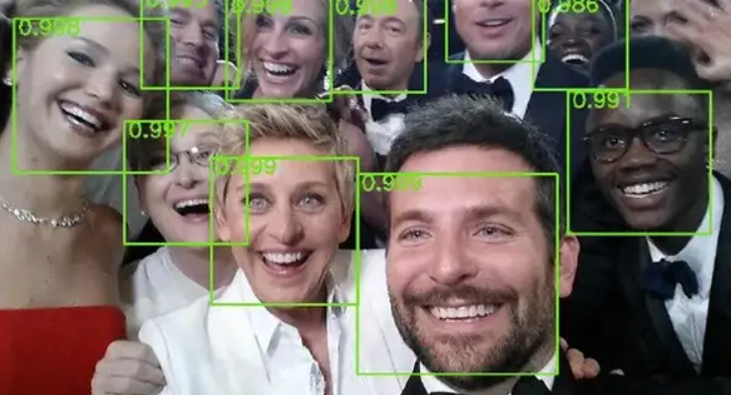
Step 1
Face Detection - Is an object recognition problem, which purpose is to locate the user’s face in the image and delimit it with a bounding box.

Slide 5

Step 2
2. Face Alignment. Normalize the face to be consistent with the database, such as geometry and photometric.

Slide 6
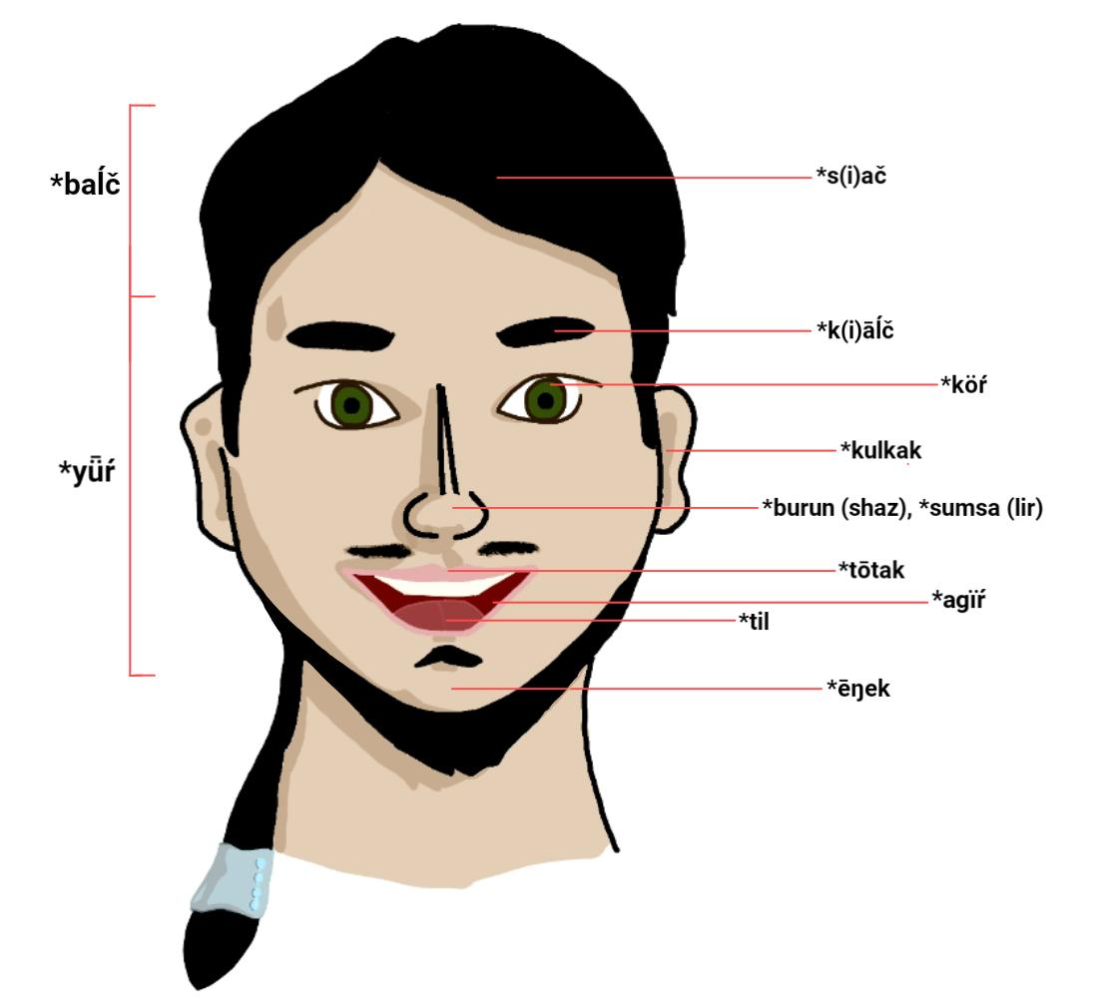
Step 3
3. Feature Extraction. Extract features from the face that can be used for the recognition task. it’s based on the convolutional network and autoencoders to shrink the feature vector. [Age, Gender, Emotion and Race]

Slide 7
Application
Face Verification "Is this the claimed person?" For example, at some airports, you can pass through customs by letting a system scan your passport and then verifying that you (the person carrying the passport) are the correct person. A mobile phone that unlocks using your face is also using face verification. This is a 1:1 matching problem.
Face Recognition "Who is this person?"
Real Life Problem - In Marriage Photography, All Photos will be Analyzed and Classified according to Different Faces Recognized.

