Slide 1


Digital Forensics
By,
Dr. Akash Thakar (C|EH, C|HFI, CEI)
Assistant Professor
Rashtriya Raksha University
+91 99090 39066
akash.thakar@rru.ac.in

Slide 2
CONTENTS :-
Definitions
Branches of Digital Forensics
Digital Evidence
Crime Scene Management
Windows Forensic Artifacts
Demonstration

Slide 3
DEFINITION :-
Cyber Crime :-
“Any Crime Committed By Using Computer, Internet Or Any Other Digital Medium As A Tool Or Target.”
Digital Forensics :-
“Cyber Forensics is the process of Identifying, Collecting, preserving, analyzing and presenting the digital evidence in such a manner that the evidence are legally accepted.”

Slide 4
BRANCHES OF DIGITAL FORENISCS :-
Computer Forensics
Mobile Device Forensics
Network Forensics
E-mail and Social Media Forensics
Database Forensics

Slide 5
DIGITAL EVIDENCE :-
What Is Digital Evidence :-
“Digital Evidence Is Any Information Or Data Related To The Case, That Is Stored On, Received By, Or Transmitted By An Electronic Device That May Be Relied In The Court Of Law.”

Slide 6
Properties of Digital Evidence :-
It can be duplicated exactly and a copy can be examined as if it were the original.
Examining a copy will avoid the risk of damaging the original.
With the right tools it is very easy to determine if digital evidence has been modified or tampered with by comparing it with the original.
It is relatively difficult to destroy.
Even if it is “deleted,” digital evidence can be recovered.
When criminals attempt to destroy digital evidence, copies can remain in places they were not aware of.

Slide 7
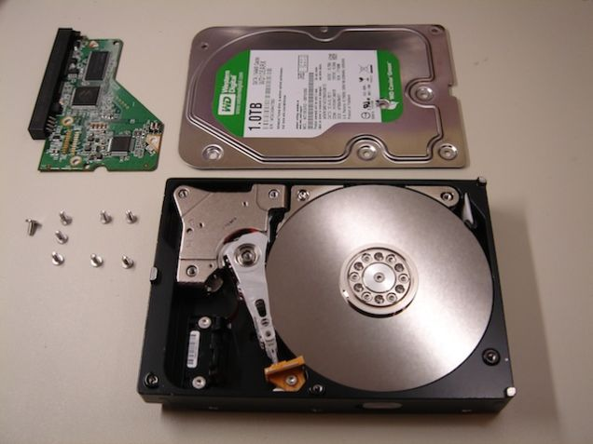
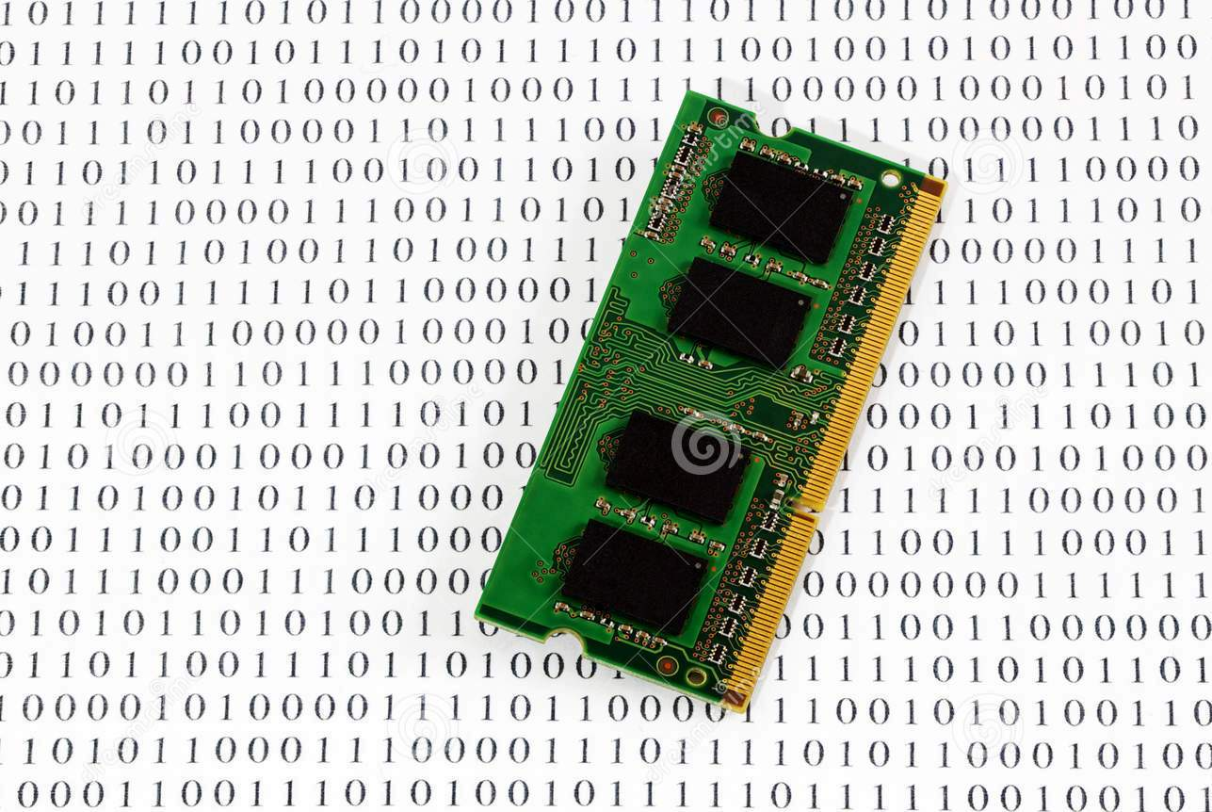
Types Of Digital Evidence :-
Persistent (Non-volatile) Data :-
It Means Data That Remains Intact When The Computer Is Turned Off.
E.G. Hard-disk, Flash-drives
2. Volatile Data :-
It Means Would Be Lost When The Computer Is Turned Off.
E.G. Temp. Files, Unsaved Open Files Etc.

Slide 8
Source Of Digital Evidence :-
Hard-Drive (Desktop, Laptop, External, Server)
Flash Drive
SD Cards
Floppy Disks
RAIDs
Optical Media (CD, DVD)
CCTV/DVR
Internal Storage of Mobile Device
GPS (Mobile/Car)
Call Site Track (Towers)
RAM

Slide 9
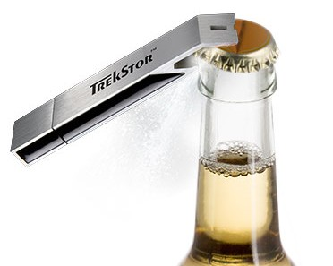
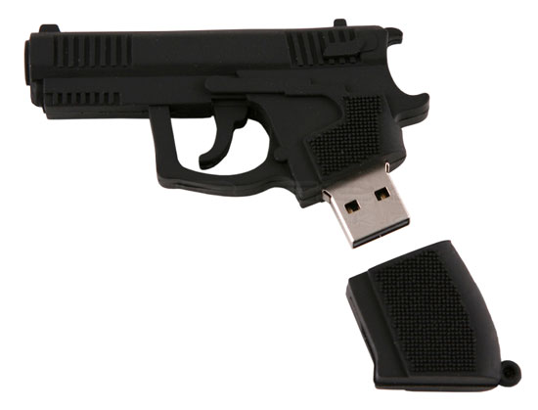
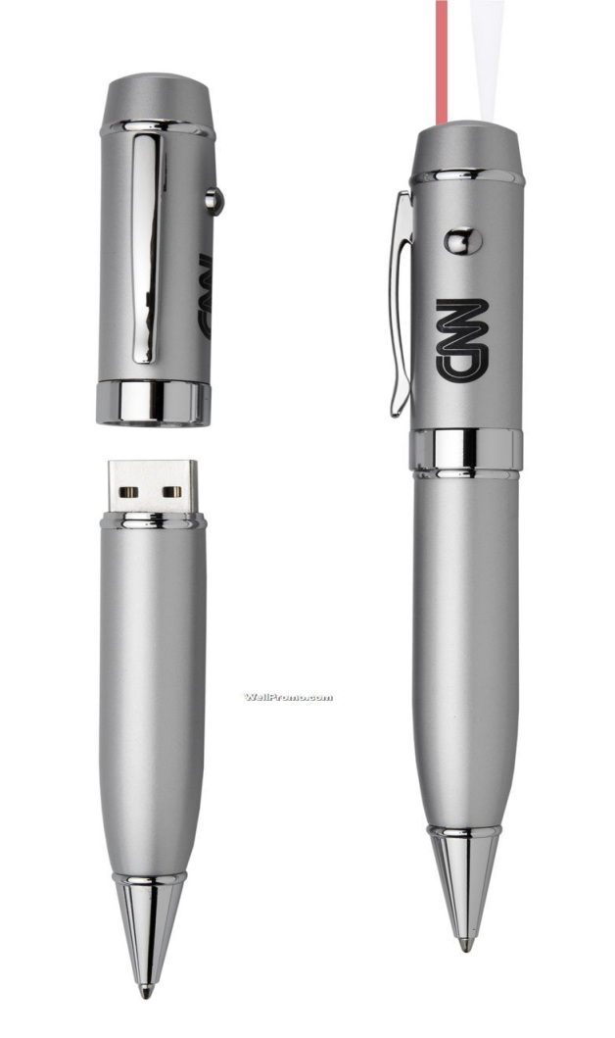

USB Bottle Opener
USB Gun
USB Comb
USB Pen

Slide 10
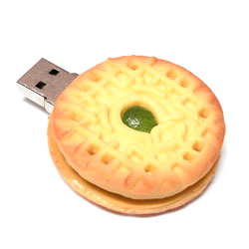
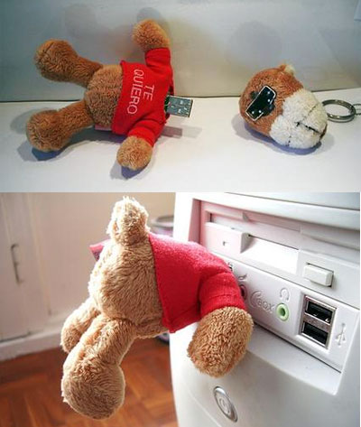
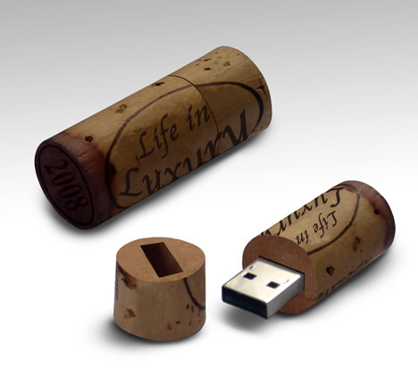
USB Teddy Bear
USB Cookies
USB Cork

Slide 11
DIGITAL FORENSIC PROCESS
Identifying the evidence
Preservation and Collection of evidence
Analysis and report generation

Slide 12
CRIME SCENE MANAGEMENT
Important steps at crime scene
Secure the Crime Scene
Documentation of the Crime Scene
Search for Digital Evidence
Identification of Digital Evidence
Evidence Collection in Forensically sound manner
Maintain Chain of Custody during transportation of Digital Evidence
Submit Digital Evidence in Forensic Science Laboratory

Slide 13
Investigative Tools and Equipment
Crime scene securing tapes
Digital Camera
Extra batteries
Video cameras
Note/sketch pads
Blank sterile storage media: Portable USB hard disks and pen drives
Write-Blocker device
Labels
Pens, permanent markers
Storage containers
Anti-static bags
Faraday bags
Toolkit containing screwdrivers (nonmagnetic), pliers, forceps, scissors, clips, pins, cutters etc.
Rubber gloves
Incident response toolkit (Software)
Converter / Adapter: USB, SATA, IDE, SCSI
Forensic Imaging software
Tools to collect volatile data (FTK Imager, Magnet Forensics Ram Capture)

Slide 14
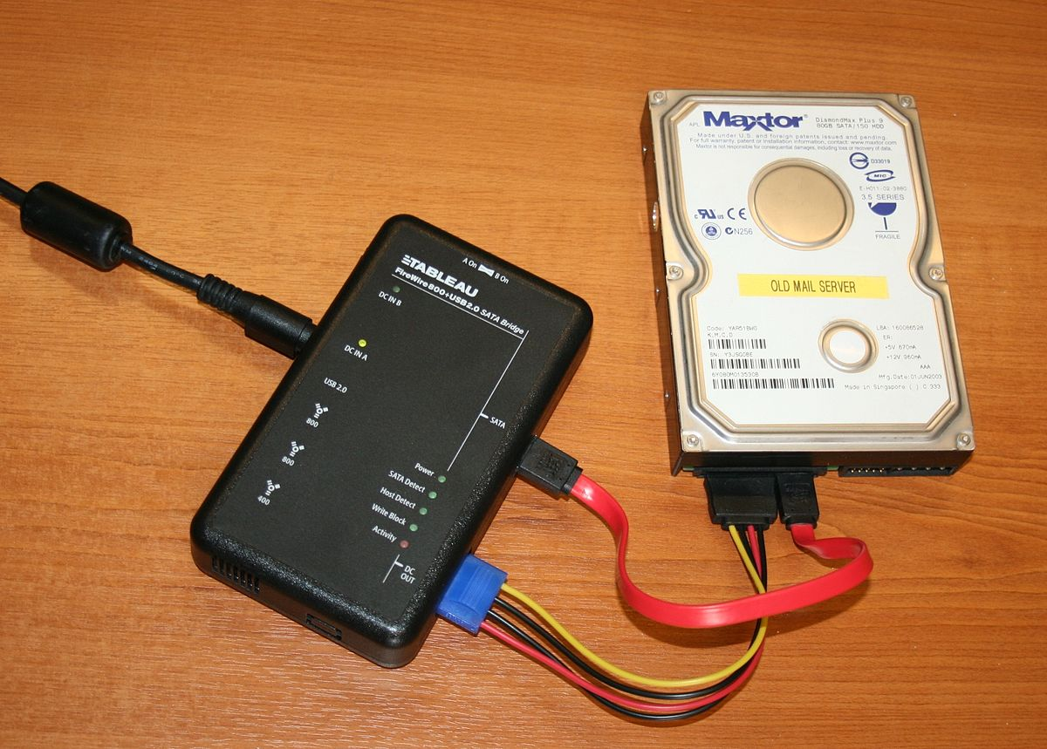
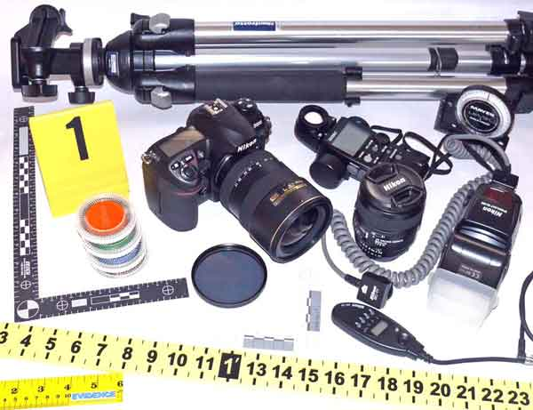
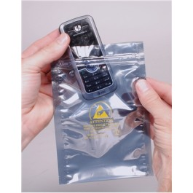
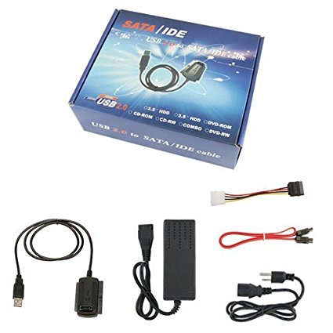

Slide 15
Non-electronic Evidence Collection
Recovery of non-electronic evidence can be crucial in the investigation of electronic crimes. Take proper care to ensure that such evidence is recovered and preserved. Items relevant to subsequent examination of electronic evidence may exist in other forms (written passwords and other handwritten notes, blank pads of paper with indented writing, hardware and software manuals, calendars, literature, text or graphical computer printouts, and photographs) and should be secured and preserved for future analysis.
These items are frequently in close proximity to the computer or related hardware items. All evidence should be identified, secured, and preserved in compliance with departmental procedures.

Slide 16
COPY, IMAGING AND CLONING
Disk cloning and disk imaging are two processes that accomplish the same goal: They copy all of a hard drive's contents. It's possible to clone a disk by using a disk image, but the two are distinctly different in the process they use to copy hard drives. Disk cloning creates a functional one-to-one copy of a hard drive, while disk imaging creates an archive of a hard drive that can be used to make a one-to-one copy.

Slide 17
COPY, IMAGING AND CLONING
Copy and Paste
Disk images and disk clones are different than just copying and pasting the entire contents of one hard drive to another. When you copy and paste files from one drive to another you're copying only the actual files and not the additional data the hard drive uses to locate and access those files. Things like the master boot record and the file allocation table are not copied to the new hard drive when you copy and paste. A copy and paste backup drive won't boot.

Slide 18
COPY, IMAGING AND CLONING
Disk Cloning
Disk cloning is the process of copying the entire contents of one hard drive to another including all the information that enables you to boot to the operating system from the drive. A cloning program enables you to make a one-to-one copy of one of your computer's hard drives on another hard drive. This second copy of the hard drive is fully operational and can be swapped with the computer's existing hard drive. If you boot to the cloned drive, its data will be identical to the source drive at the time it was created. A cloned drive can be used to replace its source drive in a computer in the event that something bad happens to the original drive.

Slide 19
COPY, IMAGING AND CLONING
Disk Imaging
Disk imaging is the process of making an archival or backup copy of the entire contents of a hard drive. A disk image is a storage file that contains all the data stored on the source hard drive and the necessary information to boot to the operating system. However, the disk image needs to be applied to the hard drive to work. You can't restore a hard drive by placing the disk image files on it; it needs to be opened and installed on the drive with an imaging program. Unlike cloned drives, a single hard drive can store several disk images on it. Disk images can also be stored on optical media and flash drives.

Slide 20
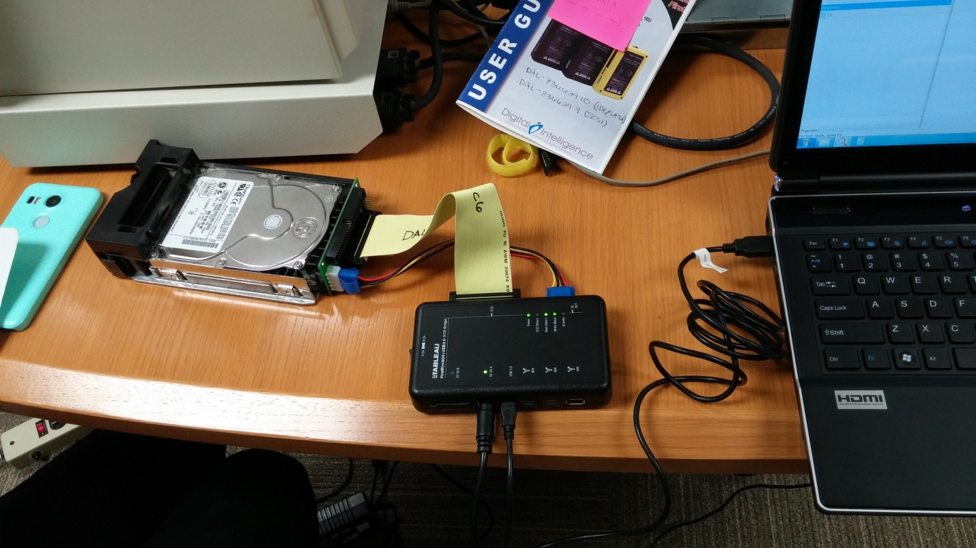
Write blocker
A write blocker is any tool that permits read-only access to data storage devices without compromising the integrity of the data. A write blocker, when used properly, can guarantee the protection of the data chain of custody.
There are both hardware and software write blockers. Some software write blockers are designed for a specific operating system. One designed for Windows will not work on Linux. Most hardware write blockers are software independent.

Slide 21
IMAGING PROCESS USING FTK IMAGER
Navigate to File | Create Disk Image. From the pop-up window, select one of the following source evidence types:
Physical disk: This is the whole hard drive, starting from the MBR to the last sector of the hard drive
Logical disk: This is one partition from the hard drive. Image file: This is if you need to convert an image from one format to another, that is, from the E01 format to a raw format

Slide 22
IMAGING PROCESS USING FTK IMAGER
RAW
This is simply a bit-to-bit copy of the hard drive without leaving or adding any single bit. This image format is usually accompanied by a separate file, containing meta information about the image file.
E01
This is the EnCase evidence file. It contains information that is related to the acquisition process, such as the investigator name, the timestamp, and the typed notes during the acquisition. It calculates the checksum for every 32 KB of data, and at the end of the image file, it adds the MD5 hash for the whole bit stream

Slide 23
IMAGING PROCESS USING FTK IMAGER
AFF
This is the Advanced Forensics Format, and it is used to store disk images and forensics images' metadata. This is not a proprietary but open format, which can be used with any tool for analysis and won't exclusively work with a single tool.

Slide 24
FORENSIC ARTIFACTS OF WINDOWS OPERATING SYSTEM
Registry
Prefetch
Browsing Artifacts
Shellbags
Volume Shadow Copy
USB devices
LNK files
Jump lists
Timestamp Analysis
$MFT (Master File Table)
Amcache
Shimcache

Slide 25
WINDOWS REGISTRY
The registry or Windows registry is a database of information, settings, options, and other values for software and hardware installed on all versions of Microsoft Windows operating systems.
Registry root keys (hive name)
When first opening the Windows Registry Editor, it displays root keys that contain all registry values. Below is a brief description about each of the most common root keys and the values contained in each of them.

Slide 26
WINDOWS REGISTRY
Root Key | Description
HKCR (HKEY_CLASSES_ROOT) | Describes file type, file extension, and OLE information. (Object Linking and Embedding)
HKCU (HKEY_CURRENT_USER) | Contains user who is currently logged into Windows and their settings.
HKLM (HKEY_LOCAL_MACHINE) | Contains computer-specific information about the hardware installed, software settings, and other information. The information is used for all users who log on to that computer. This key, and its subkeys, is one of the most frequently areas of the registry viewed and edited by users.
HKU (HKEY_USERS) | Contains information about all the users who log on to the computer, including both generic and user-specific information.
HKEY_CURRENT_CONFIG (HKCC) | The details about the current configuration of hardware attached to the computer.

Slide 27
WINDOWS REGISTRY
Registry is a giant database contains information regarding operating system functions. It also stores programs and settings for program.
Registry itself found in “c:\windows\system32\config”
DEFAULT, SAM, SECURITY, SOFTWARE and SYSTEM. These are the most common and important registry hives. All of the hives are found in same location. “c:\windows\system32\config” .Even auto backup of these hives is been stores by windows in Regback folder. In regedit, you will find these hives in HKLM (Hives Key Local Machine)
In every profile there is a file named as “NTUSER.DAT” Which means HKCU (Hives Key Current User) in registry. It is located in C:\users\username\NTUSER.DAT (Note: You have to uncheck system protected files from hidden menu)

Slide 28
WINDOWS REGISTRY
HKCU(ntuser.dat)\SOFTWARE\Microsoft\Windows\CurrentVersion\Explorer
\RecentDocs – Shows most recent open documents
\RunMRU – Shows MRU (Most Recent Used) run command
\TypedPaths – shows what was typed in path of directory
\UserAssist – Shows what program was executed and how many time it was executed by which user
“HKCU\SOFTWARE\Microsoft\Windows\CurrentVersion\Run”
Above Hive shows startup programs when computer is booting up. It can also be found in task manager.
“HKLM\SYSTEM\CurrentControlSet\Enum\USBSTOR”

Slide 29
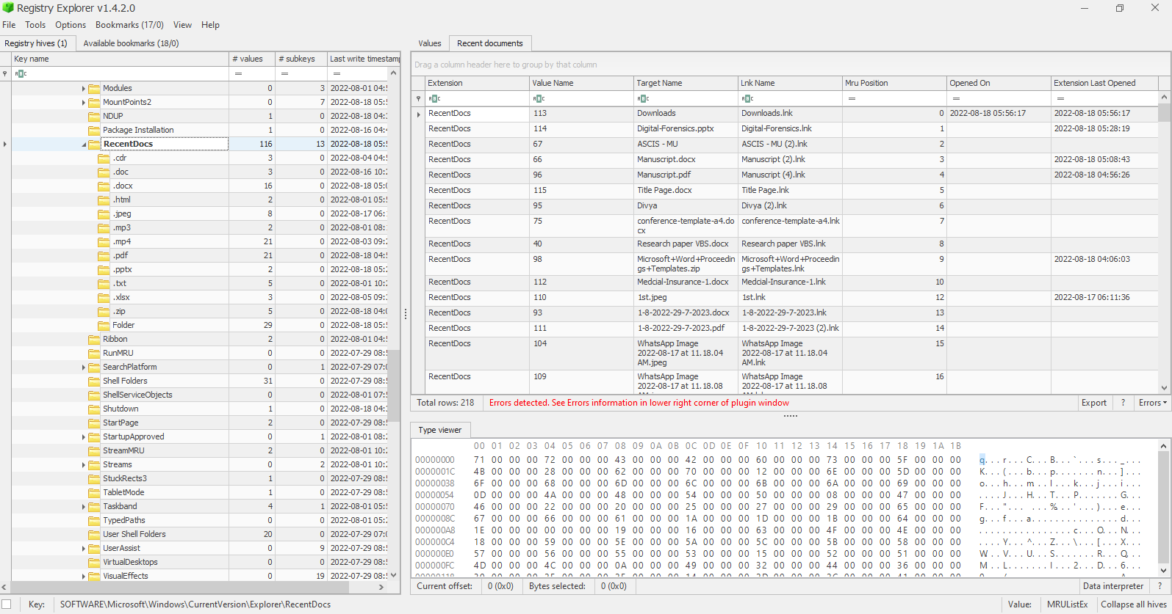

Slide 30
PREFETCH
Each time that you run an application in your system, a Prefetch file which contains information about the files loaded by the application is created by Windows operating system. The information in the Prefetch file is used for optimizing the loading time of the application in the next time that you run it.
Tool used for analysis is Winprefetchview by NirSoft

Slide 31
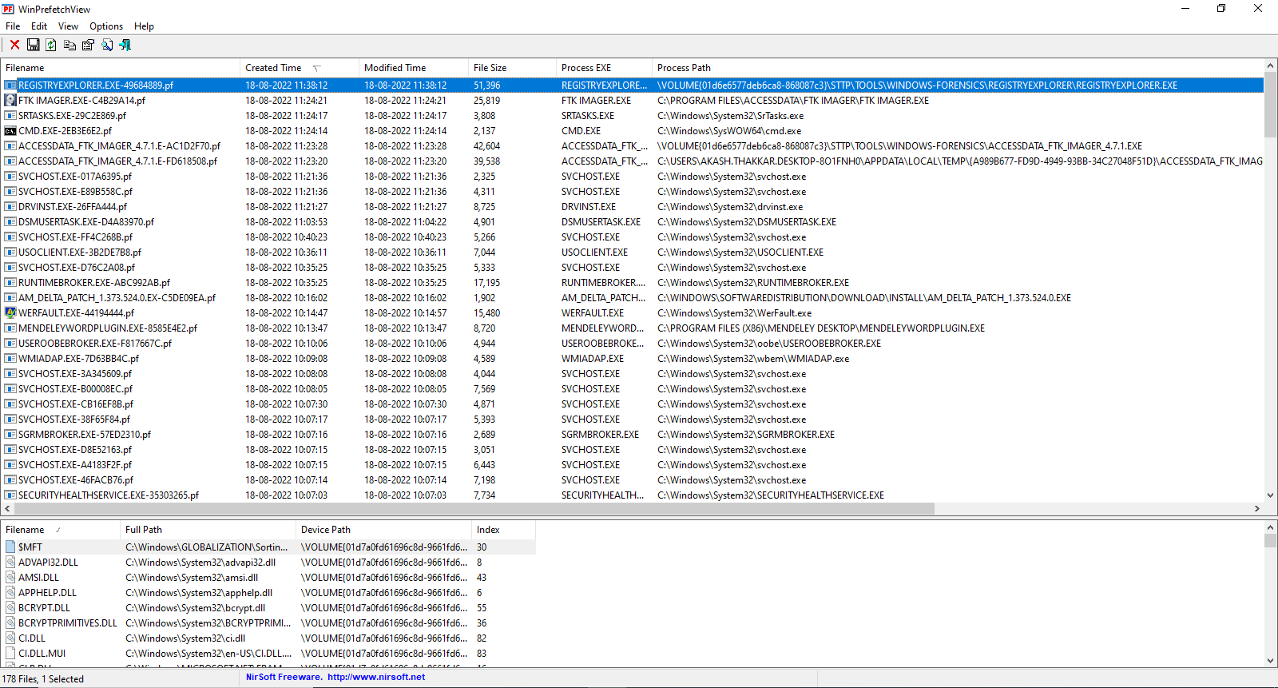

Slide 32
SHELLBAGS
Shellbags analysis is done by many automated tool like shellbags explorer. It stores data related to path opened on computer. In forensics it is important to identify some directories which is not available anywhere in computer. It shows at some point of time it was existing in a computer. It could be even in external drive also.
Tool used for analysis is Shellbag Explorer

Slide 33
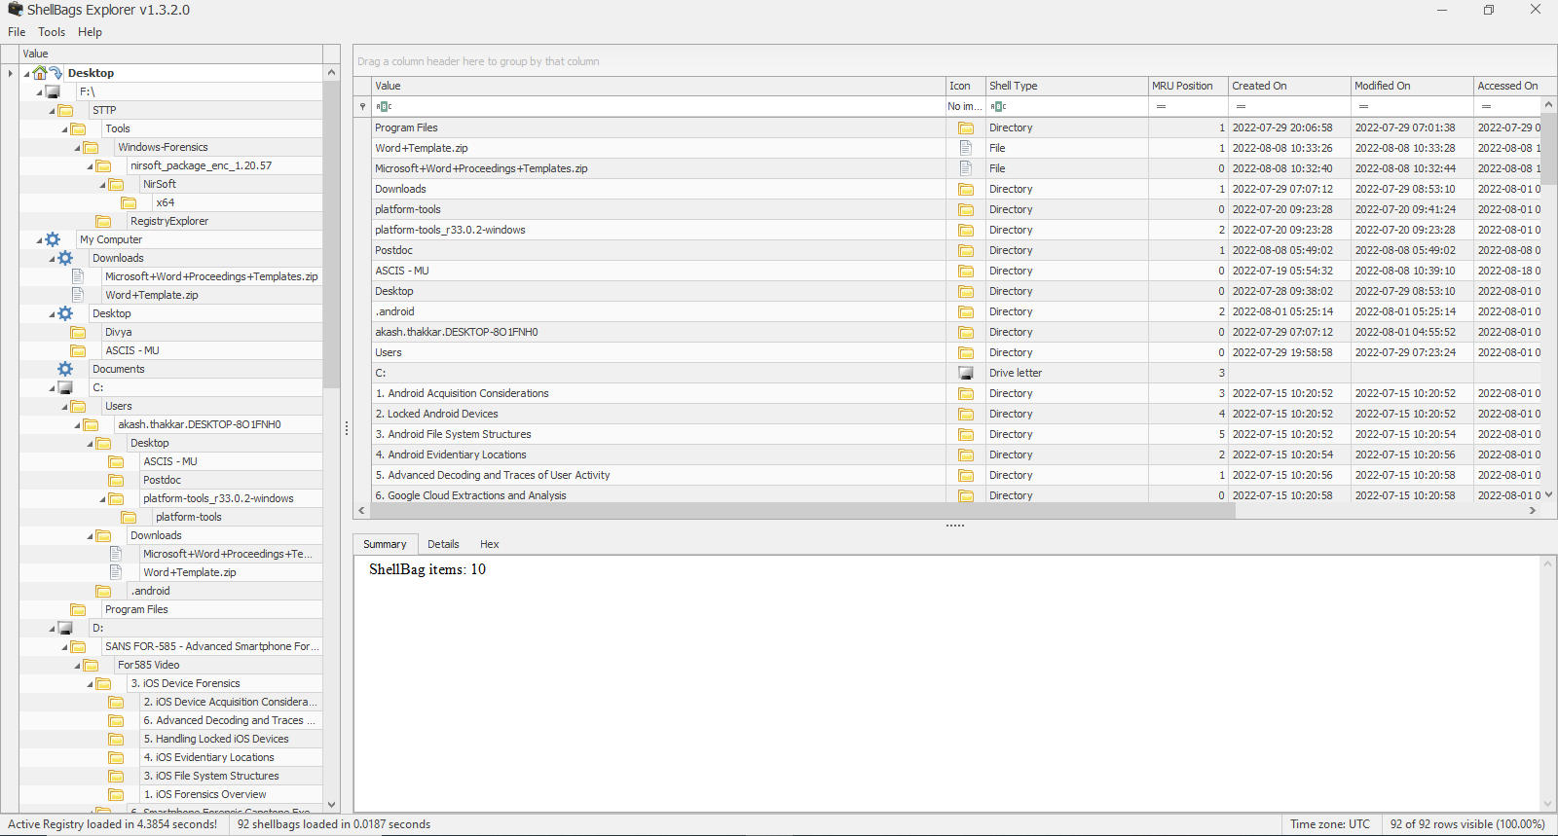

Slide 34
VOLUME SHADOW COPY
Windows has included the Volume Shadow Copy Service in it's releases since Windows XP.
Windows Shadow Copy is a service that either manually or automatically creates backup copies of disk volumes. These backups are automatically created when Windows performs either a scheduled backup or a system restore point. This happens before Windows Updates are installed, or when Windows determines that it is time to create a new system restore point
Windows Shadow Volumes are important to digital forensics because they can provide additional data that otherwise would not be available. They can allow a forensic investigator to recover deleted files, and to learn what was taking place on a system before he/she began the investigation.
Tool used for analysis is shadowcopyview

Slide 35
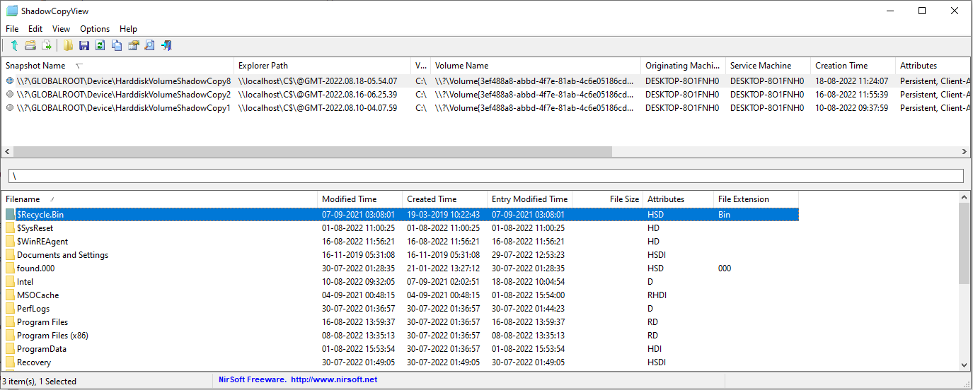

Slide 36
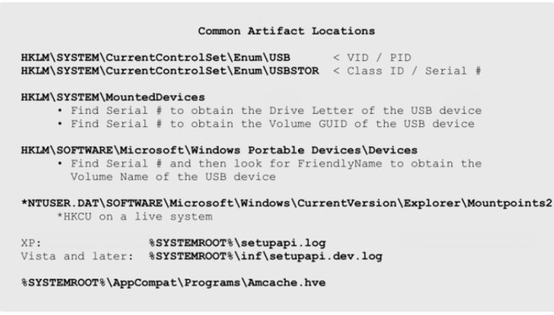
USB DEVICES

Slide 37
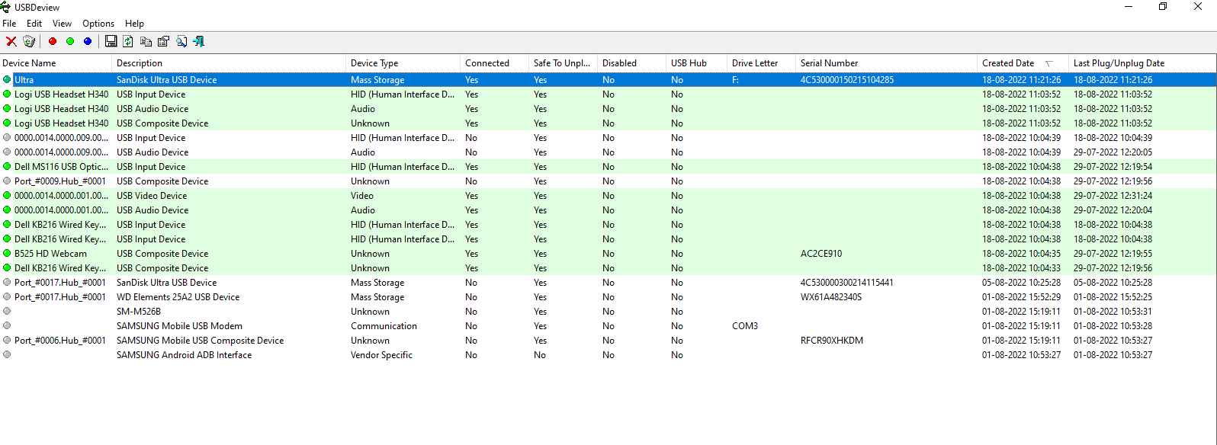

Slide 38
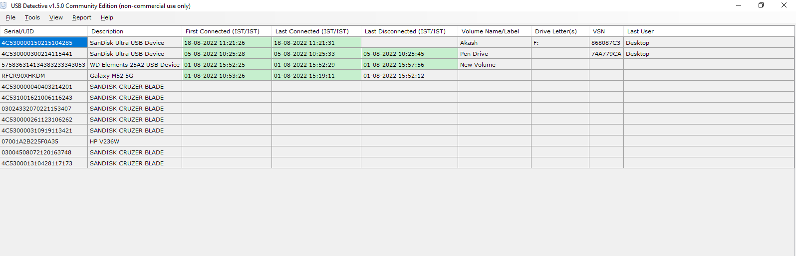

Slide 39
LNK FILES
The Windows Shortcut file has the extension .lnk. It basically is a metadata file, specific for the Microsoft Windows platform and is interpreted by the Windows Shell.
Details can be found from LNK files are as follow:
Original Path of target file
Timestamp for the target file and link file. (MAC)
Size of target file
Attribute associated with target file (read-only, hidden, system etc…)
System name, volume name, volume serial number and sometimes the MAC address of the system on which the link file is present
Whether the file resource is local or located on a remote system.
LNK files can be found at this path:
“C:\Users\Akash\AppData\Roaming\Microsoft\Windows\Recent (It will show recent items)”
• A tool named LNK Explorer (LECmd.exe) is command line utility written by Eric Zimmerman used for carving LNK files. To use that tool use this command: “LECmd.exe –d (Directory) c:\users\Akash\AppData\Roaming\Microsoft\Windows\Recent -q --csv .\”

Slide 40
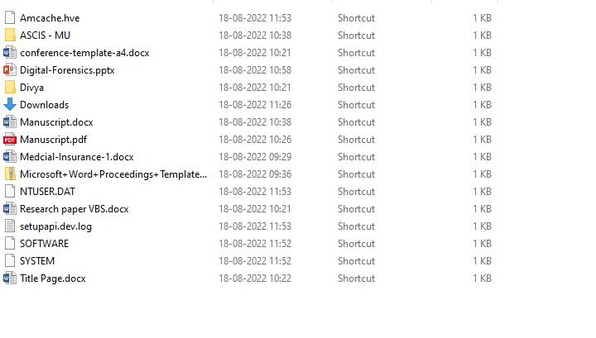

Slide 41
JUMP LISTS
Jump Lists are a new Windows 7 Taskbar feature that gives the user quick access to recently accessed application files and actions. Whenever you right click on icon of program shows in taskbar you will find jump lists.
It will show you recent files opened and commons tasks associated with that file.
Jumplists will be found at this path: “C:\Users\Akash\AppData\Roaming\Microsoft\Windows\Recent\AutomaticDestinations” (AutomaticDestinations folder will not be visible in windows explorer. It can be found under cmd)
With the jumplist analysis, you can get information like what was recently opened in respective application. For ex. In VLC media player, which files have been open, you can find out using jumplist.
Jump list Explorer is the tool used to parse this jumplist files. This tool is available in both GUI and CLI version. To use this tool follow this command: “JLECmd.exe -f C:\Users\Akash\AppData\Roaming\Microsoft\Windows\Recent\AutomaticDestinations\faef7def55a1d4b.automaticDestinations-ms (path of the file) --csv .\”
Another tool JumpListView from nirsoft can be used to see the jumplist data

Slide 42
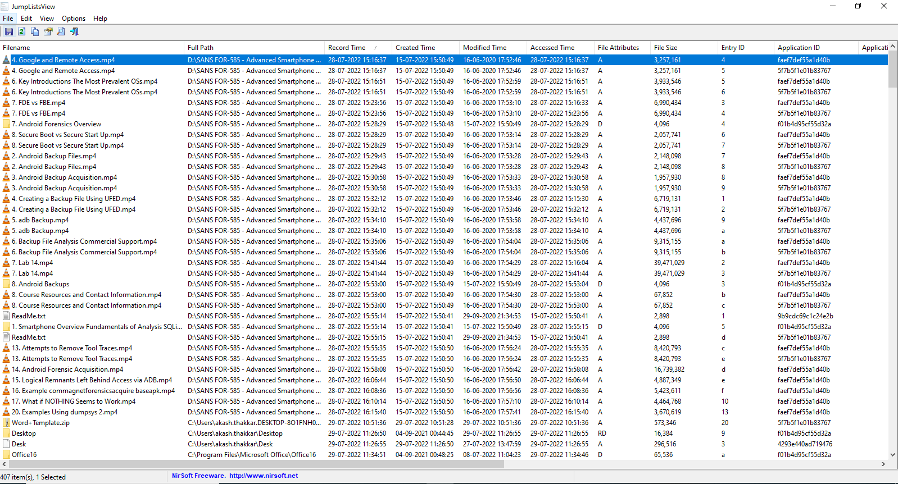

Slide 43
Timestamp Analysis
NTFS is the only file system stores record about birth or creation time of any file. In Linux there is no birth or creation time. There C stands for change in metadata not in the content.
Timestamp of any file is stored in $MFT file of NTFS file system.
In $MFT timestamp is stored in following manner:
o M – Modified
o A – Access
o C- Creation (B)
o E – Entry Date
In $MFT, timestamp of the file is stored in two different attributes. Whatever we are seeing in properties of file in windows explorer or in CMD is $STANDARD_INFORMATION ($SI) another copy of timestamp is stored under $FILE_NAME ($FN). $FN can only be modifiable by windows kernel.
Timestomp.exe is a common anti-forensic tool for timestamp changes. We can give any timestamp to any file. In all such anti-forensic tools, the common thing is they can change the entry in $SI attribute.
We can look for prefetch file to see that timestomp has been used or not. If you find any such activity, you can use any tool (ex. NirSoft - winprefetchviewer) to parse that prefetch file to know more details about number any last accessed date of timestomp.

Slide 44
$MFT
The master file table (MFT) is a database in which information about every file and directory on an NT File System (NTFS) volume is stored.
Detailed information about a file or directory such as the type, size, date/time of creation, date/time of most recent modification and author identity is either stored in MFT entries or in space external to the MFT but described by the MFT entries.
Tool used for analysis is MFT2CSV, MFTExplorer

Slide 45
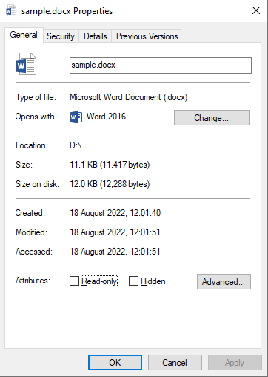
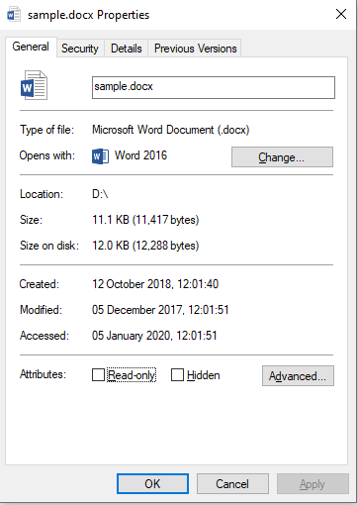
Original
Manipulated

Slide 46
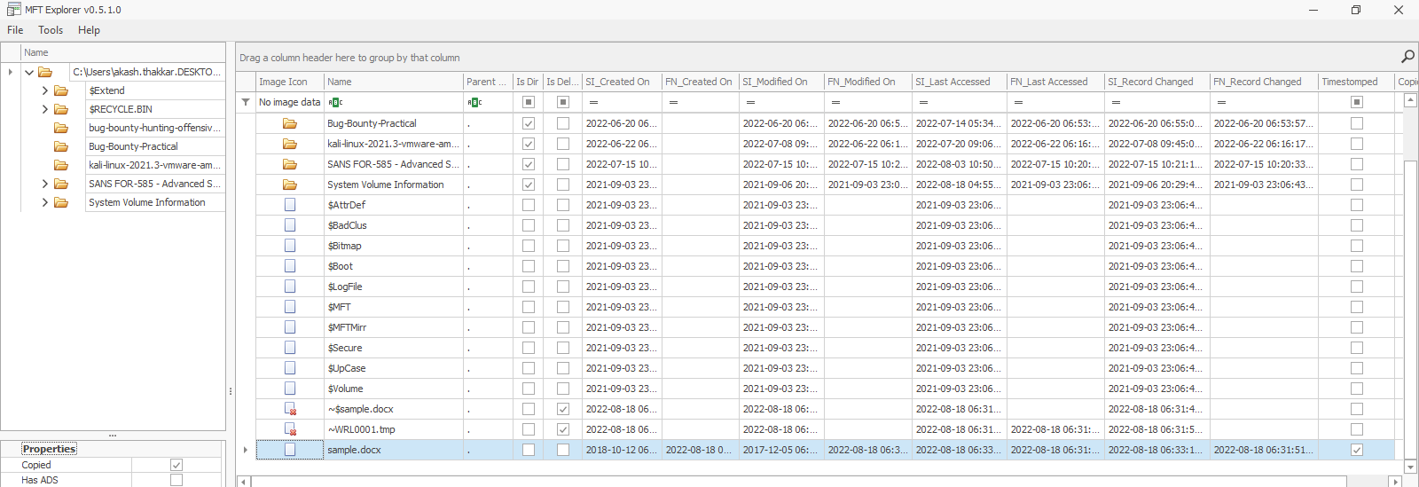

Slide 47
ANY QUESTIONS ???

