Slide 1
DIGITAL FORENSICS
By,
Dr. Akash Thakar (C|EH, C|HFI, CEI)
Assistant Professor
Rashtriya Raksha University
+91 99090 39066
akash.thakar@rru.ac.in

Slide 2
CONTENTS :-
Definitions
Branches of Digital Forensics
Digital Evidence
Types of Cybercrime
Crime Scene Management

Slide 3
DEFINITION :-
Cyber Crime :-
“Any Crime Committed By Using Computer, Internet Or Any Other Digital Medium As A Tool Or Target.”
Cyber Forensics :-
“Cyber Forensics is the process of Identifying, Collecting, preserving, analyzing and presenting the digital evidence in such a manner that the evidence are legally accepted.”

Slide 4
BRANCHES OF DIGITAL FORENISCS :-
Computer Forensics
Mobile Device Forensics
Network Forensics
E-mail and Social Media Forensics
Database Forensics

Slide 5
DIGITAL EVIDENCE :-
What Is Digital Evidence :-
“Digital Evidence Is Any Information Or Data Related To The Case, That Is Stored On, Received By, Or Transmitted By An Electronic Device That May Be Relied In The Court Of Law.”

Slide 6
Properties of Digital Evidence :-
It can be duplicated exactly and a copy can be examined as if it were the original.
Examining a copy will avoid the risk of damaging the original.
With the right tools it is very easy to determine if digital evidence has been modified or tampered with by comparing it with the original.
It is relatively difficult to destroy.
Even if it is “deleted,” digital evidence can be recovered.
When criminals attempt to destroy digital evidence, copies can remain in places they were not aware of.

Slide 7
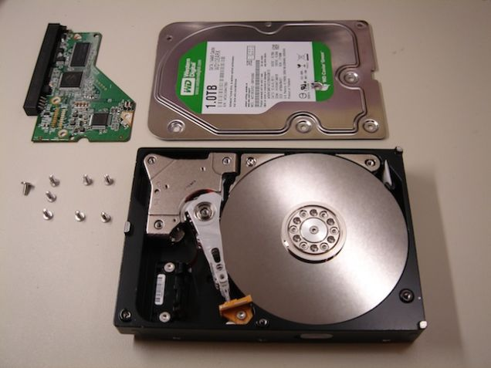
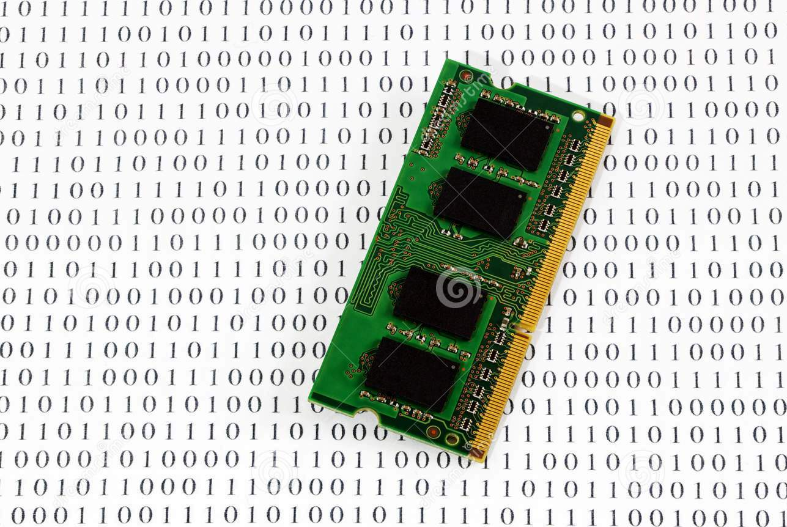
Types Of Digital Evidence :-
Persistent (Non-volatile) Data :-
It Means Data That Remains Intact When The Computer Is Turned Off.
E.G. Hard-disk, Flash-drives
2. Volatile Data :-
It Means Would Be Lost When The Computer Is Turned Off.
E.G. Temp. Files, Unsaved Open Files Etc.

Slide 8
Source Of Digital Evidence :-
Hard-Drive (Desktop, Laptop, External, Server)
Flash Drive
SD Cards
Floppy Disks
RAIDs
Optical Media (CD, DVD)
CCTV/DVR
Internal Storage of Mobile Device
GPS (Mobile/Car)
Call Site Track (Towers)
RAM

Slide 9

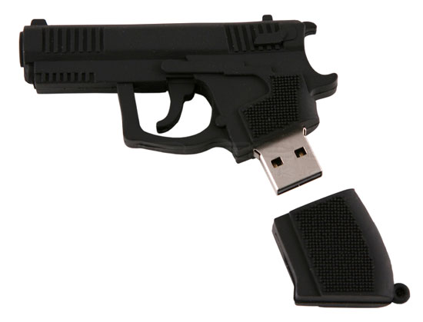
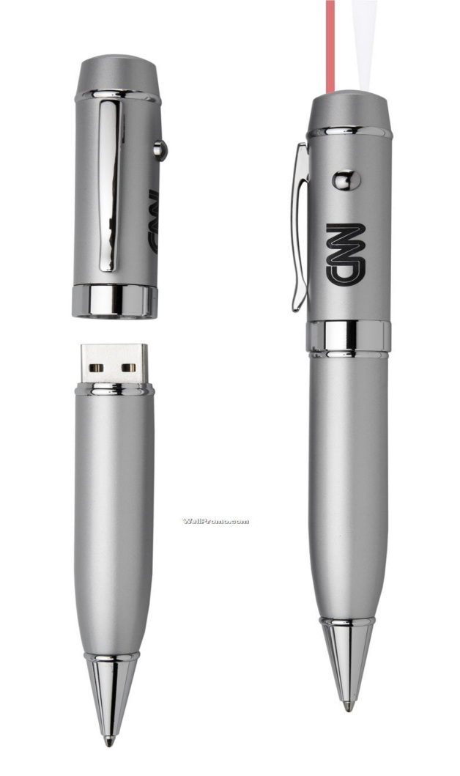

USB Bottle Opener
USB Gun
USB Comb
USB Pen

Slide 10
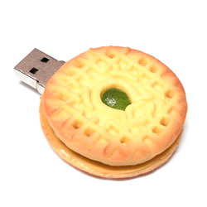
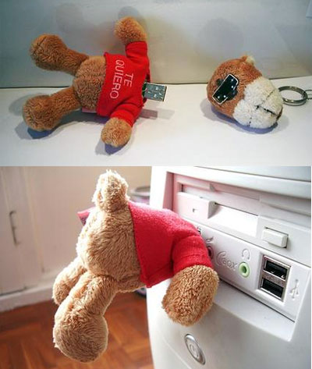
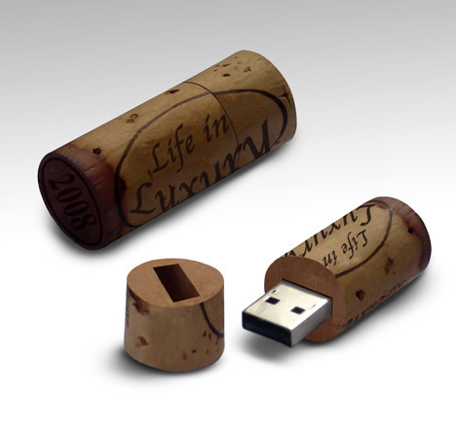
USB Teddy Bear
USB Cookies
USB Cork

Slide 11
Types Of Cyber Crime :-
Hacking
Phishing
Spoofing
Cyber Stalking
Cyber Terrorism
Data Theft
Social Engineering
Morphing
Skimming
Identity Theft
Malware Attack
Drug Trafficking
Spamming
Web Jacking
Child Pornography
Piracy
Piggy Banking
Online Fraud

Slide 12
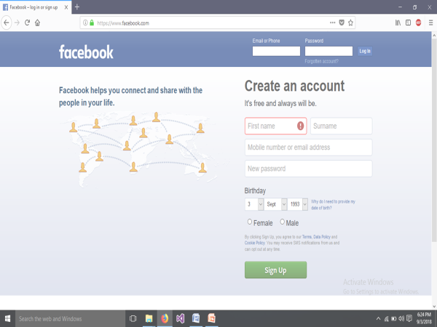

Slide 13


Slide 14
DIGITAL FORENSIC PROCESS
Identifying the evidence
Preservation and Collection of evidence
Analysis and report generation

Slide 15
CRIME SCENE MANAGEMENT
Important steps at crime scene
Secure the Crime Scene
Documentation of the Crime Scene
Search for Digital Evidence
Identification of Digital Evidence
Evidence Collection in Forensically sound manner
Maintain Chain of Custody during transportation of Digital Evidence
Submit Digital Evidence in Forensic Science Laboratory

Slide 16
Investigative Tools and Equipment
Crime scene securing tapes
Digital Camera
Extra batteries
Video cameras
Note/sketch pads
Blank sterile storage media: Portable USB hard disks and pen drives
Write-Blocker device
Labels
Pens, permanent markers
Storage containers
Anti-static bags
Faraday bags
Toolkit containing screwdrivers (nonmagnetic), pliers, forceps, scissors, clips, pins, cutters etc.
Rubber gloves
Incident response toolkit (Software)
Converter / Adapter: USB, SATA, IDE, SCSI
Forensic Imaging software
Tools to collect volatile data (FTK Imager, Magnet Forensics Ram Capture)

Slide 17
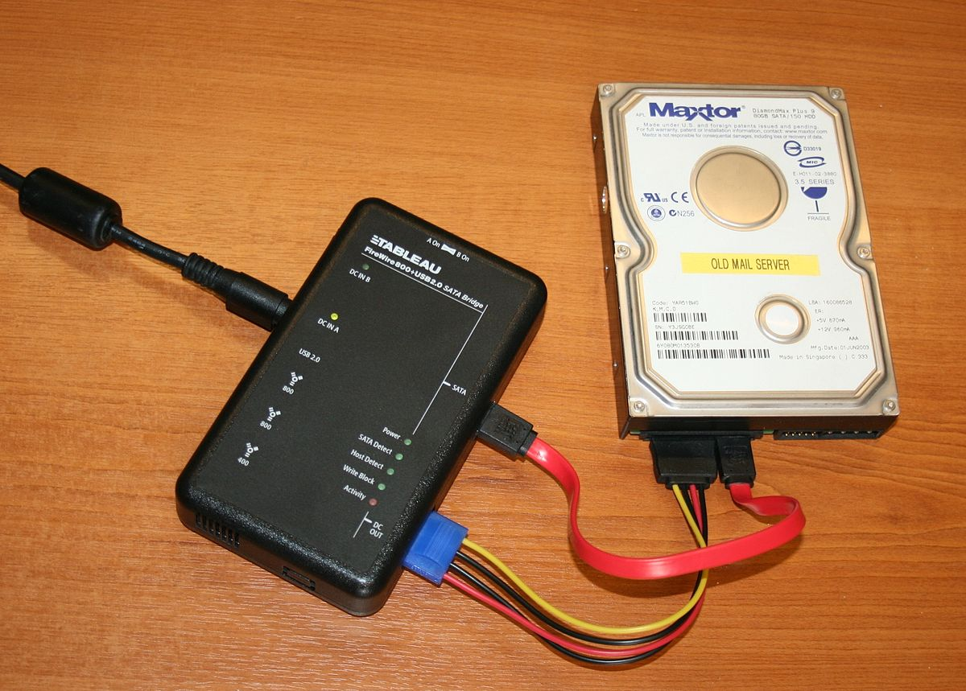
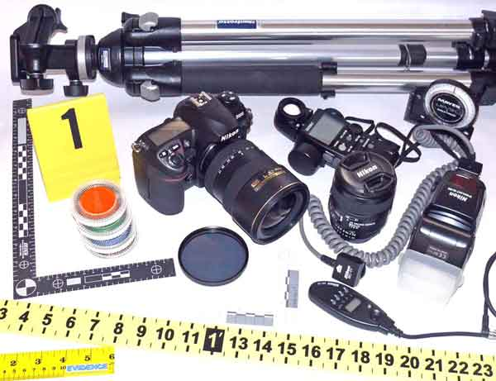
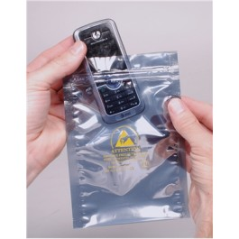


Slide 18
Non-electronic Evidence Collection
Recovery of non-electronic evidence can be crucial in the investigation of electronic crimes. Take proper care to ensure that such evidence is recovered and preserved. Items relevant to subsequent examination of electronic evidence may exist in other forms (written passwords and other handwritten notes, blank pads of paper with indented writing, hardware and software manuals, calendars, literature, text or graphical computer printouts, and photographs) and should be secured and preserved for future analysis.
These items are frequently in close proximity to the computer or related hardware items. All evidence should be identified, secured, and preserved in compliance with departmental procedures.

Slide 19

Digital Evidence Collection process from computer
Situation 1: The Monitor Is On And The Work Product and/or Desktop is Visible

Slide 20
Digital Evidence Collection process from computer
Situation 1: The Monitor Is On And The Work Product and/or Desktop are Visible
Photograph the screen and record the information displayed.
Collect volatile data using memory capturing tools.
Check for virtual drives. If yes, collect logical copies of mounted data.
Label all connections and ports.
Photograph them.
Disable network connectivity to prevent remote access.
Disconnect the power/shutdown.
Open CPU chassis to locate Hard disk and disconnect it.
Seize and package all evidence in Anti magnetic (Faraday) bags.
Transport evidence to forensic laboratory.
Maintain chain of custody.

Slide 21

Digital Evidence Collection process from computer
Situation 2: The Monitor Is On and The Screen Is Blank (Sleep Mode) Or The Screensaver (Picture) Is Visible

Slide 22
Digital Evidence Collection process from computer
Situation 2: The Monitor Is On and The Screen Is Blank (Sleep Mode) Or The Screensaver (Picture) Is Visible
Move the mouse slightly (without pushing buttons). The screen should change and show the work product or request a password.
Do not perform any other keystrokes or mouse operations if mouse movement does not cause a change in the screen.
Photograph the screen and record the information displayed.
Collect volatile data using memory capturing tools (Mind that always use write blocker to prevent any kind of manipulation during data collection).
Follow further steps as per situation 1.

Slide 23
DEMO FOR EVIDENCE COLLECTION

Slide 24
Digital Evidence Collection process from computer
Situation 3: The Monitor Is Off
Make a note of the “off” status.
Turn the monitor on, then determine if the monitor status is as described in either situation 1 or 2 above and follow those steps.
Check for outside connectivity (telephone modem, cable, integrated services digital network [ISDN], and digital subscriber line [DSL]). If a telephone connection is present, attempt to identify the telephone number.
Avoid damage to potential evidence by removing any floppy disks that are present, packaging the disk separately, and labeling the package. If available, insert either a seizure disk or a blank floppy disk. Do not remove CDs or touch the CD drive.
Place tape over all the drive slots and over the power connector.
Record the make, model, and serial numbers.

Slide 25
Digital Evidence Collection process from computer
Situation 3: The Monitor Is Off
Photograph and diagram the connections of the computer and the corresponding cables.
Label all connectors and cable ends (including connections to peripheral devices) to allow for exact reassembly at a later time. Label unused connection ports as “unused.” Identify laptop computer docking stations in an effort to identify other storage media.
Collect non-volatile data, i.e. storage media (Hard Disk, Pen drives, Optical Disks, Mobile phones, Memory card etc.)
Seize and package all evidence in anti-magnetic (Faraday) bags.
Tag/label each bag.
Transport evidence to forensic laboratory.
Maintain chain of custody.

Slide 26
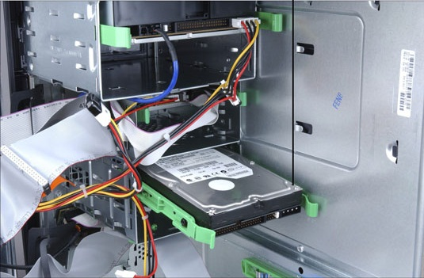
Digital Evidence Collection process from computer
Situation 3: The Monitor Is Off

Slide 27
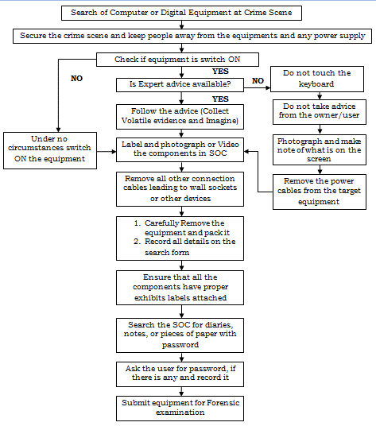

Slide 28
Complaint/FIR No. | Police Station:
Date: | Time: | Organization:
Examiner Name(s):
Location:
Method of evidence received (i.e. delivered, seized, discovered)
System Information
Date of Purchase
System Manufacturer
System Serial Number
System Name
System Model Number
System Date/Time
Other Identifying Date (i.e. damage, label etc.)
Processor
Memory
Network Card
SCSI Card
Modem
Keyboard
Monitor
Mouse
Floppy Disk Drive (s)
CD/DVD Drive (s)
Printer (s)
Other Cards
Other Devices and Drives
Size of Hard-drive
Hash Value if obtained

Slide 29
Evidence Packaging, Transporting, and Storing
Packaging
If multiple computer systems are collected, label each system so that it can be reassembled as found (system A: mouse, keyboard, monitor, and main base unit; system B: mouse, keyboard, monitor, and main base unit).
When packaging evidence at a crime scene—
Ensure that all collected electronic evidence is properly documented, labeled, and inventoried before packing.
Pay special attention to latent or trace evidence and take action to preserve it.
Pack magnetic media in antistatic packaging (paper or antistatic plastic bags). Avoid using materials that can produce static electricity, such as standard plastic bags (Faraday bags).
Avoid folding, bending, or scratching computer media, such as a diskette, compact disk-read only memory (CD-ROM), or tape.
Ensure that all containers used to hold evidence are properly labeled.

Slide 30
Evidence Packaging, Transporting, and Storing
Transporting
Ensure that computers and other components that are not packaged in containers are secured in the vehicle to avoid shock and excessive vibrations. For example, computers may be placed on the vehicle floor and monitors placed on the seat with the screen down and secured by a seat belt. When transporting evidence—
Keep all electronic evidence away from magnetic sources. Radio transmitters, speaker magnets, and heated seats are examples of items that can damage electronic evidence.
Avoid storing electronic evidence in vehicles for prolonged periods of time. Conditions of excessive heat, cold, or humidity can damage electronic evidence.
Maintain the chain of custody on all evidence transported.

Slide 31
Evidence Packaging, Transporting, and Storing
Storing
Store evidence in a secure area away from temperature and humidity extremes. Protect it from magnetic sources, moisture, dust, and other harmful particles or contaminants. Be aware that potential evidence, such as dates, times, and system configurations may be lost as a result of prolonged storage. Since batteries have a limited life, data could be lost if they fail. Therefore, appropriate personnel (such as the evidence custodian, laboratory chief and forensic examiner) should be informed that a device powered by batteries is in need of immediate attention.

Slide 32
ANY QUESTIONS ???

