Slide 1
Chapter 13 Trusted Computing and Multilevel Security
modified from slides of Lawrie Brown and Hesham El-Rewini
Notes:
This chapter deals with a number of interrelated topics having to do with the degree
of confidence users and implementers can have in security functions and services:
• Formal models for computer security:
• Multilevel security
• Trusted systems
• Mandatory access control
• Security evaluation

Slide 2
Computer Security Models
two fundamental computer security facts:
all complex software systems have eventually revealed flaws or bugs that need to be fixed
it is extraordinarily difficult to build computer hardware/software not vulnerable to security attacks
problems involved both design and implementation
led to development of formal security models
Notes:
Two historical facts highlight a fundamental problem that needs to be addressed in
the area of computer security. First, all complex software systems have eventually
revealed flaws or bugs that subsequently needed to be fixed. A good discussion of
this can be found in the classic The Mythical Man-Month [BROO95]. Second, it is
extraordinarily difficult, if not impossible, to build a computer hardware/ software
system that is not vulnerable to a variety of security attacks. An illustration of this
difficulty is the Windows NT operating system, introduced by Microsoft in the
early 1990s. Windows NT was promised to have a high degree of security and to be
far superior to previous OSs, including Microsoft’s Windows 3.0 and many other
personal computer, workstation, and server OSs. Sadly, Windows NT did not deliver
on this promise. This OS and its successor Windows versions have been chronically
plagued with a wide range of security vulnerabilities.
Problems to do with providing strong computer security involved both design
and implementation. It is difficult, in designing any hardware or software module,
to be assured that the design does in fact provide the level of security that was
intended. This difficulty results in many unanticipated security vulnerabilities. Even
if the design is in some sense correct, it is difficult, if not impossible, to implement
the design without errors or bugs, providing yet another host of vulnerabilities.
These problems have led to a desire to develop a method to prove, logically
or mathematically, that a particular design does satisfy a stated set of security
requirements and that the implementation of that design faithfully conforms to the
design specification. To this end, security researchers have attempted to develop
formal models of computer security that can be used to verify security designs and
implementations.
Initially, research in this area was funded by the U.S. Department of Defense
and considerable progress was made in developing models and in applying them
to prototype systems. That funding has greatly diminished as have attempts to
build formal models of complex systems. Nevertheless, such models have value in
providing a discipline and a uniformity in defining a design approach to security
requirements [BELL05]. In this section, we look at perhaps the most influential
computer security model, the Bell-LaPadula (BLP) model [BELL73, BELL75].
Several other models are examined in Section 13.2 .

Slide 3
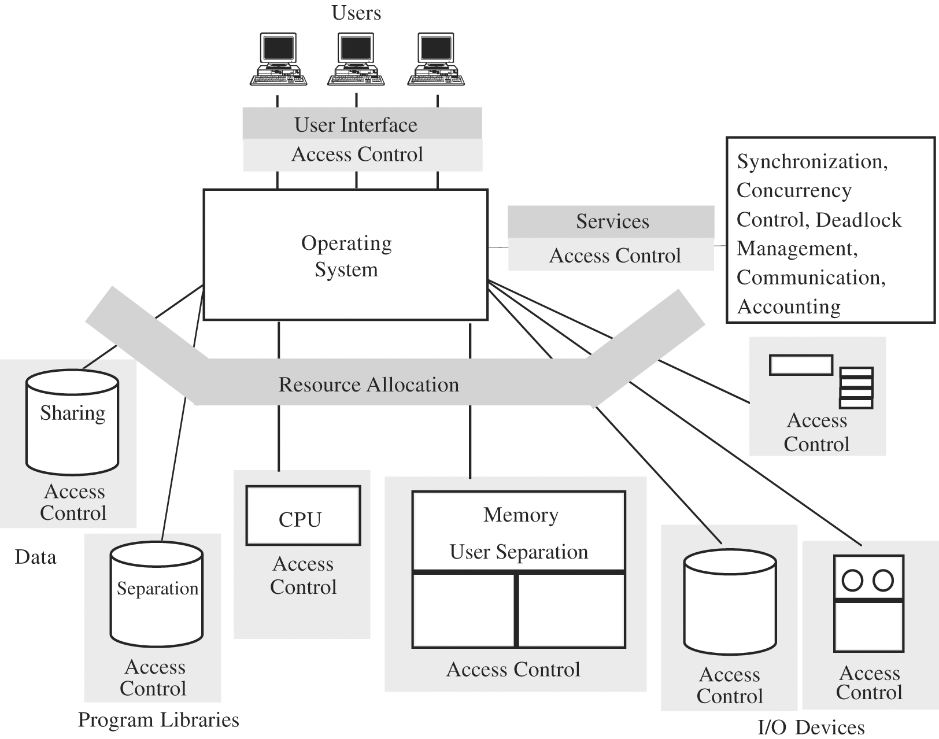
Trusted OS Functions

Slide 4
Bell-LaPadula (BLP) Model
formal model for access control
developed in 1970s
subjects and objects are assigned a security class
a subject has a security clearance
an object has a security classification
form a hierarchy and are referred to as security levels
top secret > secret > confidential > restricted >unclassified
security classes control the manner by which a subject may access an object
Notes:
The BLP model was developed in the 1970s as a formal model for access
control. The model relied on the access control concept described in Chapter 4
(e.g., Figure 4.4 ). In the model, each subject and each object is assigned a security
class . In the simplest formulation, security classes form a strict hierarchy and
are referred to as security levels . One example is the U.S. military classification
scheme:
top secret > secret > confidential > restricted > unclassified
It is possible to also add a set of categories or compartments to each security
level, so that a subject must be assigned both the appropriate level and category to
access an object. We ignore this refinement in the following discussion.
This concept is equally applicable in other areas, where information can be
organized into gross levels and categories and users can be granted clearances to
access certain categories of data. For example, the highest level of security might be
for strategic corporate planning documents and data, accessible by only corporate
officers and their staff; next might come sensitive financial and personnel data,
accessible only by administration personnel, corporate officers, and so on. This
suggests a classification scheme such as
strategic > sensitive > confidential > public
A subject is said to have a security clearance of a given level; an object is said to
have a security classification of a given level. The security classes control the manner
by which a subject may access an object.

Slide 5
BLP Model Access Modes
READ
the subject is allowed only read access to the object
APPEND
the subject is allowed only write access to the object
WRITE
the subject is allowed both read and write access to the object
EXECUTE
the subject is allowed neither read nor write access to the object but may invoke the object for execution
Notes:
The model defined four access modes,
although the authors pointed out that in specific implementation environments, a
different set of modes might be used. The modes are as follows:
• read: The subject is allowed only read access to the object.
• append: The subject is allowed only write access to the object.
• write: The subject is allowed both read and write access to the object.
• execute: The subject is allowed neither read nor write access to the object but
may invoke the object for execution.
When multiple categories or levels of data are defined, the requirement is
referred to as multilevel security . The general statement of the requirement for
confidentiality-centered multilevel security is that a subject at a high level may not
convey information to a subject at a lower level unless that flow accurately reflects
the will of an authorized user as revealed by an authorized declassification. For
implementation purposes, this requirement is in two parts and is simply stated.
A multilevel secure system for confidentiality must enforce the following:
• No read up: A subject can only read an object of less or equal security level.
This is referred to in the literature as the simple security property (ss-property) .
• No write down: A subject can only write into an object of greater or equal
security level. This is referred to in the literature as the *-property (pronounced
star property ).

Slide 6
BLP Formal Description
based on current state of system (b, M, f, H):
current access set b: triples of (s, o, a)
subject s has current access to object o in access mode a
access matrix M: matrix of M_{ij}
access modes of subject S_{i} to access object O_{j}
level function f: security level of subjects and objects
f_{o} ( O_{j} ) is the classification level of object O_{j}
f_{s} ( S_{i} ) is the security clearance of subject S_{i}
f_{c} ( S_{i} ) is the current security level of subject S_{i}
hierarchy H: a directed rooted tree of objects
Notes:
We use the notation presented in [BELL75]. The model is based on the concept of a
current state of the system. The state is described by the 4-tuple ( b , M , f , H ), defined
as follows:
• Current access set b : This is a set of triples of the form (subject, object, access-
mode). A triple ( s , o , a ) means that subject s has current access to o in access
mode a . Note that this does not simply mean that s has the access right a to o . The
triple means that s is currently exercising that access right; that is s is currently
accessing o by mode a .
Access matrix M : The access matrix has the structure indicated in Chapter 4 .
The matrix element M _{ij} records the access modes in which subject S _{i} is permitted
to access object O _{j} .
• Level function f : This function assigns a security level to each subject and
object. It consists of three mappings: f _{o} ( O _{j} ) is the classification level of object
O _{j} ; f _{s} ( S _{i} ) is the security clearance of subject S _{i} ; f _{c} ( S _{i} ) is the current security
level of subject S _{i} . The security clearance of a subject is the maximum security
level of the subject. The subject may operate at this level or at a lower level.
Thus, a user may log onto the system at a level lower than the user’s security
clearance. This is particularly useful in a role-based access control system.
• Hierarchy H : This is a directed rooted tree whose nodes correspond to objects
in the system. The model requires that the security level of an object must
dominate the security level of its parent. For our discussion, we may equate
this with the condition that the security level of an object must be greater than
or equal to its parent.

Slide 7
BLP Formal Description
three BLP properties:
ss-property: ∀ (S_{i}, O_{j}, read) has f_{c} (S_{i}) ≥ f_{o} (O_{j})
*-property: ∀ (S_{i}, O_{j}, append) has f_{c} (S_{i}) ≤ f_{o} (O_{j}) and
∀ (S_{i}, O_{j}, write) has f_{c} (S_{i}) = f_{o} (O_{j})
ds-property: current (S_{i}, O_{j}, A_{x}) implies A_{x} ∈ M[S_{i} O_{j}]
BLP gives formal theorems
theoretically possible to prove system is secure
in practice usually not possible
Notes:
We can now define the three BLP properties more formally. For every subject
S _{i} and every object O _{j} , the requirements can be stated as follows:
• ss-property: Every triple of the form ( S _{i} , O _{j} , read) in the current access set b
has the property f_{c}(S_{i}) ≥ f_{o}(O_{j}) .
• *-property: Every triple of the form ( S _{i} , O _{j} , append) in the current access set b
has the property f_{c}(S_{i}) ≤ f_{o}(O_{j}) . Every triple of the form ( S _{i} , O _{j} , write) in the
current access set b has the property f _{c} ( S _{i} ) f _{o} ( O _{j} ).
• ds-property: If ( S _{i} , O _{j} , A _{x} ) is a current access (is in b ), then access mode A _{x}
is recorded in the ( S _{i} , O _{j} ) element of M . That is, ( S _{i} , O _{j} , A _{x} ) implies that
A_{x} ∈ M[S_{i},O_{j}] .
These three properties can be used to define a confidentiality secure system.
In essence, a secure system is characterized by the following:
1. The current security state of the system ( b , M , f , H ) is secure if and only if
every element of b satisfies the three properties.
2. The security state of the system is changed by any operation that causes a
change any of the four components of the system, ( b , M , f , H ).
3. A secure system remains secure so long as any state change does not violate
the three properties.
[BELL75] shows how these three points can be expressed as theorems using the
formal model. Further, given an actual design or implementation, it is theoretically
possible to prove the system secure by proving that any action that affects the state
of the system satisfies the three properties. In practice, for a complex system, such
a proof has never been fully developed. However, as mentioned earlier, the formal
statement of requirements can lead to a more secure design and implementation.

Slide 8
Illustration
o₅
High
Write
Read
s₂
o₄
o₅
Object
Read
o₃
s₂
Subject
Write
Read
s₁
o₂
Read
o₁
Low

Slide 9
BLP Rules
1
release access
change object level
change current level
give access permission
create an object
delete a group of objects
get access
2
3
4
5
7
8
6
rescind access permission
Notes:
The BLP model includes a set of rules based on abstract operations that change the
state of the system. The rules are as follows:
1. Get access: Add a triple ( subject , object , access-mode ) to the current access set b .
Used by a subject to initiate access to an object in the requested mode.
2. Release access: Remove a triple ( subject , object , access-mode ) from the current
access set b . Used to release previously initiated access.
3. Change object level: Change the value of f _{o} ( O _{j} ) for some object O _{j} . Used by a
subject to alter the security level of an object.
4. Change current level: Change the value of f _{c} ( S _{i} ) for some subject S _{i} . Used by a
subject to alter the security level of a subject.
5. Give access permission: Add an access mode to some entry of the access
permission matrix M . Used by a subject to grant an access mode on a specified
object to another subject.
6. Rescind access permission: Delete an access mode from some entry of M .
Used by a subject to revoke an access previously granted.
7. Create an object: Attach an object to the current tree structure H as a leaf.
Used to create a new object or activate an object that has previously been
defined but is inactive because it has not been inserted into H .
8. Delete a group of objects: Detach from H an object and all other objects
beneath it in the hierarchy. This renders the group of objects inactive. This
operation may also modify the current access set b because all accesses to the
object are released.
Rules 1 and 2 alter the current access; rules 3 and 4 alter the level functions;
rules 5 and 6 alter access permission; and rules 7 and 8 alter the hierarchy. Each rule
is governed by the application of the three properties. For example, for get access
for a read, we must have f_{c}(S_{i}) ≥ f_{o}(O_{j}) and A, ε M[S_{i},O_{j}] .

Slide 10
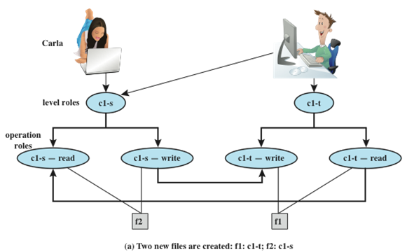
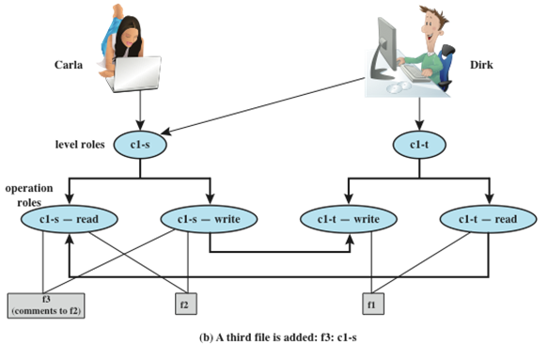
BLP Example
*-property
Notes:
An example, from [WEIP06] illustrates the operation of the BLP model and also
highlights a practical issue that must be addressed. We assume a role-based access
control system. Carla and Dirk are users of the system. Carla is a student (s) in
course c1. Dirk is a teacher (t) in course c1 but may also access the system as a
student; thus two roles are assigned to Dirk:
Carla: (c1-s)
Dirk: (c1-t), (c1-s)
The student role is assigned a lower security clearance and the teacher role a
higher security clearance. Let us look at some possible actions:
1. Dirk creates a new file f1 as c1-t; Carla creates file f2 as c1-s ( Figure 13.2a ).
Carla can read and write to f2, but cannot read f1, because it is at a higher
classification level (teacher level). In the c1-t role, Dirk can read and write f1
and can read f2 if Carla grants access to f2. However, in this role, Dirk cannot
write f2 because of the *-property; neither Dirk nor a Trojan horse on his
behalf can downgrade data from the teacher level to the student level. Only if
Dirk logs in as a student can he create a c1-s file or write to an existing c1-s file,
such as f2. In the student role, Dirk can also read f2.
2. Dirk reads f2 and wants to create a new file with comments to Carla as feedback.
Dirk must sign in student role c1-s to create f3 so that it can be accessed
by Carla ( Figure 13.2b ). In a teacher role, Dirk cannot create a file at a student
classification level.

Slide 11
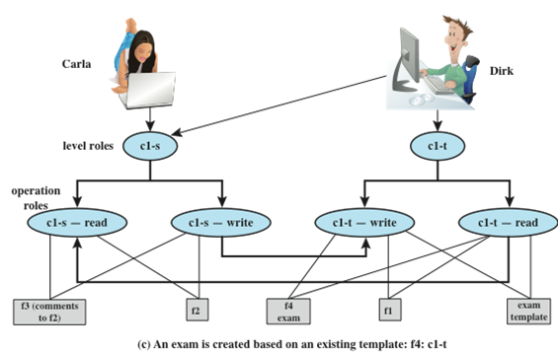
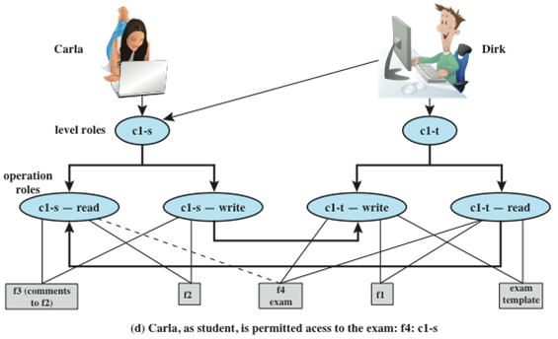
BLP Example
ss-property and *-property
Notes:
Dirk creates an exam based on an existing template file store at level c1-t.
Dirk must log in as c1-t to read the template and the file he creates (f4) must
also be at the teacher level ( Figure 13.2c ).
4. Dirk wants Carla to take the exam and so must provide her with read access.
However, such access would violate the ss-property. Dirk must downgrade
the classification of f4 from c1-t to c1-s. Dirk cannot do this in the c1-t role
because this would violate the *-property. Therefore, a security administrator
(possibly Dirk in this role) must have downgrade authority and must be able to perform the
downgrade outside the BLP model. The dotted line in
Figure 13.2d connecting f4 with c1-s-read indicates that this connection has
not been generated by the default BLP rules but by a system operation.

Slide 12
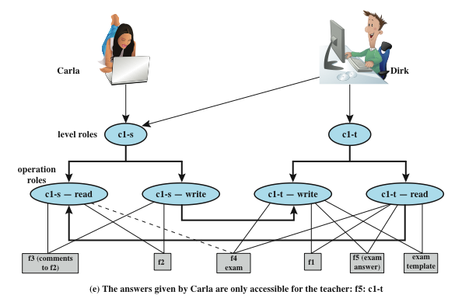
BLP Example
“downgrade” in a controlled and monitored manner
“classification creep”: information from a range of sources and levels
Confidentiality or Integrity
“covert channels”: (untrusted) low classified executable data
allowed to be executed by a high clearance (trusted) subject
Notes:
5. Carla writes the answers to the exam into a file f5. She creates the file at
level c1-t so that only Dirk can read the file. This is an example of writing up,
which is not forbidden by the BLP rules. Carla can still see her answers at her
workstation but cannot access f5 for reading.
This discussion illustrates some critical practical limitations of the BLP
model. First, as noted in step 4, the BLP model has no provision to manage the
“downgrade” of objects, even though the requirements for multilevel security
recognize that such a flow of information from a higher to a lower level may be
required, provided it reflects the will of an authorized user. Hence, any practical
implementation of a multilevel system has to support such a process in a controlled
and monitored manner. Related to this is another concern. A subject constrained
by the BLP model can only be “editing” (reading and writing) a file at one security
level while also viewing files at the same or lower levels. If the new document
consolidates information from a range of sources and levels, some of that information
is now classified at a higher level than it was originally. This is known as classification
creep and is a well-known concern when managing multilevel information.
Again, some process of managed downgrading of information is needed to restore
reasonable classification levels.

Slide 13
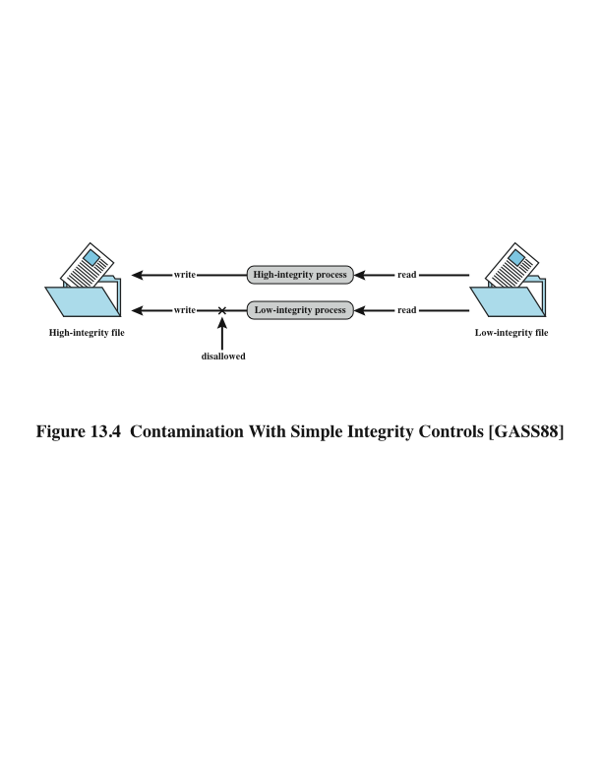
Biba Integrity Model
strict integrity policy:
Modify: To write or update information in an object
Observe: To read information in an object
Execute: To execute an object
Invoke: Communication from one subject to another
simple integrity: I(S) ≥ I(O)
integrity confinement: I(S) ≤ I(O)
invocation property: I(S1) ≥ I(S2)
Notes:
The BLP model deals with confidentiality and is concerned with unauthorized
disclosure of information. The Biba [BIBA77] models deals with integrity and is concerned
with the unauthorized modification of data. The Biba model is intended to
deal with the case in which there is data that must be visible to users at multiple or all
security levels but should only be modified in controlled ways by authorized agents.
The basic elements of the Biba model have the same structure as the BLP
model. As with BLP, the Biba model deals with subjects and objects. Each subject
and object is assigned an integrity level, denoted as I( S ) and I( O ) for subject S and
object O , respectively. A simple hierarchical classification can be used, in which there
is a strict ordering of levels from lowest to highest. As in the BLP model, it is also
possible to add a set of categories to the classification scheme; this we ignore here.
The model considers the following access modes:
• Modify: To write or update information in an object
• Observe: To read information in an object
• Execute: To execute an object
• Invoke: Communication from one subject to another
The first three modes are analogous to BLP access modes. The invoke mode is
new. Biba then proposes a number of alternative policies that can be imposed on this
model. The most relevant is the strict integrity policy, based on the following rules:
• Simple integrity: A subject can modify an object only if the integrity level of
the subject dominates the integrity level of the object: I( S ) ≥ I( O ).
• Integrity confinement: A subject can read an object only if the integrity level
of the subject is dominated by the integrity level of the object: I( S ) ≤ I( O ).
• Invocation property: A subject can invoke another subject only if the integrity
level of the first subject dominates the integrity level of the second subject:
I( S ₁ ) ≥ I( S ₂ ).
The first two rules are analogous to those of the BLP model but are concerned
with integrity and reverse the significance of read and write. The simple integrity rule
is the logical write-up restriction that prevents contamination of high-integrity data.
Figure 13.4 illustrates the need for the integrity confinement rule. A low-integrity
process may read low-integrity data but is prevented from contaminating a high integrity
file with that data by the simple integrity rule. If only this rule is in force, a
high-integrity process could conceivably copy low-integrity data into a high-integrity
file. Normally, one would trust a high-integrity process to not contaminate a high integrity
file, but either an error in the process code or a Trojan horse could result in
such contamination; hence the need for the integrity confinement rule.

Slide 14
Clark-Wilson Integrity Model
closely models commercial operations
Well-formed transactions
A user should not manipulate data arbitrarily
Separation of duty among users
A person who create or certify a well-formed transaction may not execute it
Notes:
A more elaborate and perhaps more practical integrity model was proposed by Clark
and Wilson [CLAR87]. The Clark-Wilson model (CWM) is aimed at commercial
rather than military applications and closely models real commercial operations. The
model is based on two concepts that are traditionally used to enforce commercial
security policies:
• Well-formed transactions: A user should not manipulate data arbitrarily, but
only in constrained ways that preserve or ensure the integrity of the data.
• Separation of duty among users: Any person permitted to create or certify a
well-formed transaction may not be permitted to execute it (at least against
production data).

Slide 15
Clark-Wilson Integrity Model
Principal components of the model
Constrained data items (CDIs)
Subject to strict integrity controls
Unconstrained data items (UDIs)
Unchecked data items
Integrity verification procedures (IVPs):
Intended to assure that all CDIs conform to some application-specific model of integrity and consistency
Transformation procedures (TPs):
System transactions that change the set of CDIs from one consistent state to another
Notes:
The model imposes integrity controls on data and the transactions that
manipulate the data. The principal components of the model are as follows:
• Constrained data items (CDIs): Subject to strict integrity controls.
• Unconstrained data items (UDIs): Unchecked data items. An example is a
simple text file.
• Integrity verification procedures (IVPs): Intended to assure that all CDIs
conform to some application-specific model of integrity and consistency.
• Transformation procedures (TPs): System transactions that change the set of
CDIs from one consistent state to another.

Slide 16
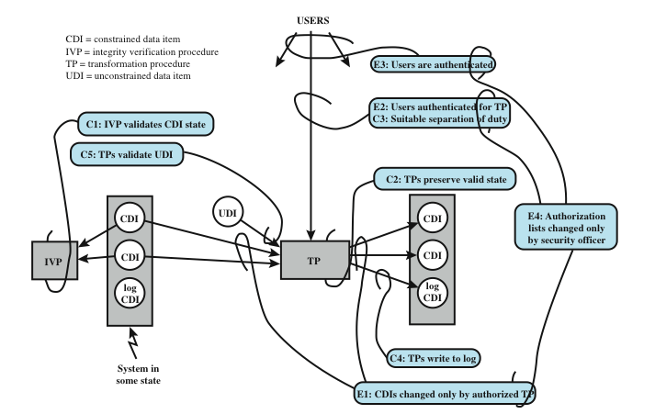
Clark-Wilson Integrity Model
Notes:
The CWM enforces integrity by means of certification and enforcement rules
on TPs. Certification rules are security policy restrictions on the behavior of IVPs
and TPs. Enforcement rules are built-in system security mechanisms that achieve
the objectives of the certification rules. The rules are as follows:
Cl: All IVPs must properly ensure that all CDIs are in a valid state at the time
the IVP is run.
C2: All TPs must be certified to be valid. That is, they must take a CDI to a valid
final state, given that it is in a valid state to begin with. For each TP, and
each set of CDIs that it may manipulate, the security officer must specify a
relation, which defines that execution. A relation is thus of the form (TPi,
(CDIa, CDIb, CDIc . . . )), where the list of CDIs defines a particular set of
arguments for which the TP has been certified.
El: The system must maintain the list of relations specified in rule C2 and
must ensure that the only manipulation of any CDI is by a TP, where the
TP is operating on the CDI as specified in some relation.
E2: The system must maintain a list of relations of the form (UserID, TPi,
(CDIa, CDIb, CDIc, . . . )), which relates a user, a TP, and the data objects
that TP may reference on behalf of that user. It must ensure that only
executions described in one of the relations are performed.
C3: The list of relations in E2 must be certified to meet the separation of duty
requirement.
E3: The system must authenticate the identity of each user attempting to
execute a TP.
C4: All TPs must be certified to write to an append-only CDI (the log) all information
necessary to permit the nature of the operation to be reconstructed.
C5: Any TP that takes a UDI as an input value must be certified to perform
only valid transformations, or else no transformations, for any possible
value of the UDI. The transformation should take the input from a UDI
to a CDI, or the UDI is rejected. Typically, this is an edit program.
E4: Only the agent permitted to certify entities may change the list of such
entities associated with other entities: specifically, the list of TPs associated
with a CDI and the list of users associated with a TP. An agent that can
certify an entity may not have any execute rights with respect to that entity.
Figure 13.5 illustrates the rules. The rules combine to form a two-part integrity
assurance facility, in which certification is done by a security officer with respect to
an integrity policy, and enforcement is done by the system.

Slide 17
Chinese Wall Model
integrity and confidentiality
use both discretionary and mandatory access
Subjects: Active entities that may wish to access protected objects
Information: Information organized into a hierarchy
Objects: Individual items of information, each concerning a single corporation
Dataset (DS): All objects that concern the same corporation
Conflict of interest (CI) class: All datasets whose corporations are in competition
Access rules: Rules for read and write access
Notes:
The Chinese Wall Model (CWM) takes a quite different approach to specifying
integrity and confidentiality than any of the approaches we have examined so far.
The model was developed for commercial applications in which conflicts of interest
can arise. The model makes use of both discretionary and mandatory access concepts.
The principal idea behind the CWM is a concept that is common in the financial
and legal professions, which is to use a what is referred to as a Chinese wall to prevent
a conflict of interest. An example from the financial world is that of a market analyst
working for a financial institution providing corporate business services. An analyst
cannot be allowed to provide advice to one company when the analyst has confidential
information (insider knowledge) about the plans or status of a competitor. However,
the analyst is free to advise multiple corporations that are not in competition with
each other and to draw on market information that is open to the public.
The elements of the model are the following:
• Subjects: Active entities that may wish to access protected objects; includes
users and processes
• Information: Corporate information organized into a hierarchy with three levels:
— Objects: Individual items of information, each concerning a single
corporation
— Dataset (DS): All objects that concern the same corporation
— Conflict of interest (CI) class: All datasets whose corporations are in
competition
• Access rules: Rules for read and write access

Slide 18
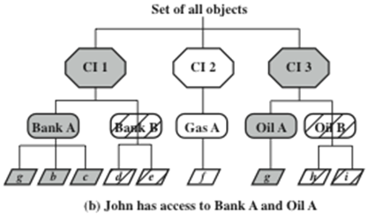
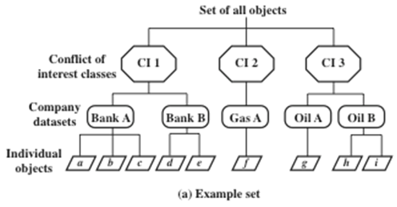
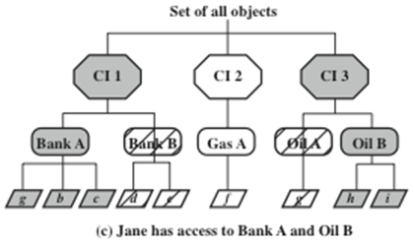
Chinese Wall Model
Simple security rule: A S can read O only if
• O is in the same DS as an object already accessed by S, OR
• O belongs to a CI from which S has not yet accessed any information
*-property rule: A S can write an O only if
• S can read O according to the simple security rule, AND
• All objects that S can read are in the same DS as O.
sanitized data
Notes:
Figure 13.6a gives an example. There are datasets representing banks, oil
companies, and gas companies. All bank datasets are in one CI, all oil company
datasets in another CI, and so forth.
In contrast to the models we have studies so far, the CWM does not assign security
levels to subjects and objects and is thus not a true multilevel secure model. Instead, the
history of a subject’s previous access determines access control. The basis of the Chinese
wall policy is that subjects are only allowed access to information that is not held to conflict
with any other information that they already possess. Once a subject accesses information
from one dataset, a wall is set up to protect information in other datasets in the same CI.
The subject can access information on one side of the wall but not the other side. Further,
information in other CIs is initially not considered to be on one side or the other of the
wall but out in the open. When additional accesses are made in other CIs by the same
subject, the shape of the wall changes to maintain the desired protection. Further, each
subject is controlled by his or her own wall—the walls for different subjects are different.
To enforce the Chinese wall policy, two rules are needed. To indicate the similarity
with the two BLP rules, the authors gave them the same names. The first rule
is the simple security rule:
Simple security rule: A subject S can read on object O only if
• O is in the same DS as an object already accessed by S, OR
• O belongs to a CI from which S has not yet accessed any information
Figures 13.6b and c illustrate the operation of this rule. Assume that at some
point, John has made his first read request to any object in this set for an object in
the Bank A DS. Because John has not previously accessed an object in any other
DS in CI 1, the access is granted. Further, the system must remember that access
has been granted so that any subsequent request for access to an object in the Bank
B DS will be denied. Any request for access to other objects in the Bank A DS is
granted. At a later time, John requests access to an object in the Oil A DS. Because
there is no conflict, this access is granted, but a wall is set up prohibiting subsequent
access to the Oil B DS. Similarly, Figure 13.6c reflects the access history of Jane.
The simple security rule does not prevent an indirect flow of information that
would cause a conflict of interest. In our example, John has access to Oil A DS and
Bank A DS; Jane has access to Oil B DS and Bank A DS. If John is allowed to read
from the Oil A DS and write into the Bank A DS, John may transfer information
about Oil A into the Bank A DS; this is indicated by changing the value of the first
object under the Bank A DS to g . The data can then subsequently be read by Jane.
Thus, Jane would have access to information about both Oil A and Oil B, creating
a conflict of interest. To prevent this, the CWM has a second rule:
*-property rule: A subject S can write an object O only if
• S can read O according to the simple security rule, AND
• All objects that S can read are in the same DS as O.
Put another way, either subject cannot write at all, or a subject’s access (both
read and write) is limited to a single dataset. Thus, in Figure 13.6 , neither John nor
Jane has write access to any objects in the overall universe of data.
The *-property rule is quite restrictive. However, in many cases, a user only
needs read access because the user is performing some analysis role.
To somewhat ease the write restriction, the model includes the concept
of sanitized data . In essence, sanitized data are data that may be derived from
corporate data but that cannot be used to discover the corporation’s identity. Any
DS consisting solely of sanitized data need not be protected by a wall; thus the two
CWM rules do not apply to such DSs.

Slide 19
Multilevel Security (MLS)
RFC 2828 defines multilevel security as follows:
“A class of system that has
system resources (particularly stored information) at more than one security level (i.e., has different types of sensitive resources) and
that permits concurrent access by users
who differ in security clearance and need-to-know,
but is able to prevent each user from accessing resources for which the user lacks authorization.”
Notes:
Multilevel security is of interest when there is a requirement to maintain
a resource, such as a file system or database in which multiple levels of data
sensitivity are defined. The hierarchy could be as simple as two levels (e.g., public
and proprietary) or could have many levels (e.g., the military unclassified,
restricted, confidential, secret, top secret). The preceding three sections have
introduced us to the essential elements of multilevel security. In this section, we
look at two applications areas where MLS concepts have been applied: role-based
access control system and database security.

Slide 20
Multi-Level Security
no read up
subject can only read an object of less or equal security level
referred to as the simple security property
ss-property
no write down
a subject can only write into an object of greater or equal security level
referred to as the *-property

Slide 21
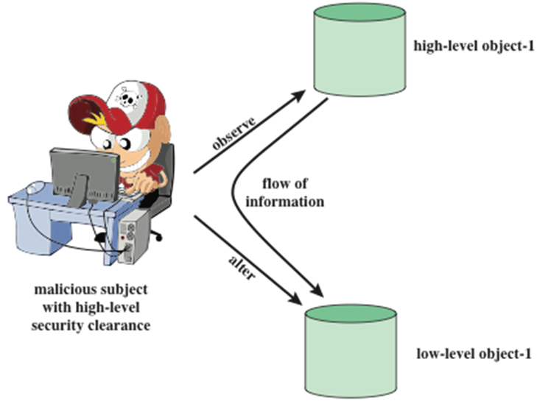
Multi-Level Security
Notes:
Figure 13.1 illustrates the need for the *-property. Here, a malicious subject
passes classified information along by putting it into an information container
labeled at a lower security classification than the information itself. This will allow a
subsequent read access to this information by a subject at the lower clearance level.
These two properties provide the confidentiality form of what is known as
mandatory access control (MAC). Under this MAC, no access is allowed that does
not satisfy these two properties. In addition, the BLP model makes a provision for
discretionary access control (DAC).

Slide 22
Multi-Level Security
ds-property : An individual (or role) may grant to another individual (or role) access to a document
based on the owner’s discretion,
constrained by the MAC rules
site policy overrides any discretionary access controls
Notes:
• ds-property : An individual (or role) may grant to another individual (or role)
access to a document based on the owner’s discretion, constrained by the MAC
rules. Thus, a subject can exercise only accesses for which it has the necessary
authorization and which satisfy the MAC rules.
The basic idea is that site policy overrides any discretionary access controls.
That is, a user cannot give away data to unauthorized persons.

Slide 23
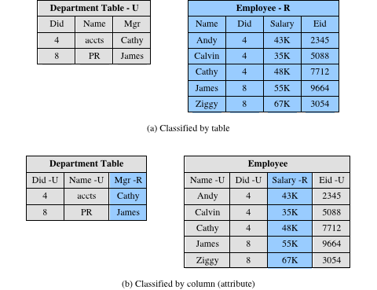
Database Security Classification (MLS Application)
Table
Column
Notes:
The addition of multilevel security to a database system increases the complexity of
the access control function and of the design of the database itself. One key issue
is the granularity of classification. The following are possible methods of imposing
multilevel security on a relational database, in terms of the granularity of classification
( Figure 13.10 ):
• Entire database: This simple approach is easily accomplished on an MLS
platform. An entire database, such as a financial or personnel database,
could be classified as confidential or restricted and maintained on a server
with other files.
• Individual tables (relations): For some applications, it is appropriate to assign
classification at the table level. In the example of Figure 13.10a , two levels of
classification are defined: unrestricted (U) and restricted (R). The Employee
table contains sensitive salary information and is classified restricted, while
the Department table is unrestricted. This level of granularity is relatively easy
to implement and enforce.
• Individual columns (attributes): A security administrator may choose to
determine classification on the basis of attributes, so that selected columns
are classified. In the example of Figure 13.10b , the administrator determines
that salary information and the identity of department managers is restricted
information.

Slide 24
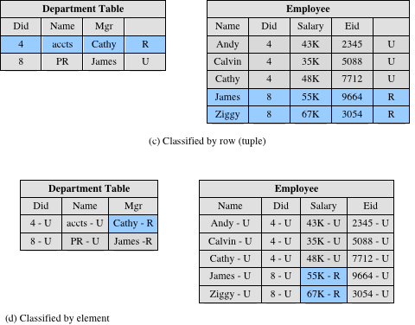
Database Classification
Row
Element
Notes:
Individual rows (tuples): In other circumstances, it may make sense to assign
classification levels on the basis of individual rows that match certain properties.
In the example of Figure 13.10c , all rows in the Department table that contain
information relating to the Accounts Department (Dept. ID 4), and all rows
in the Employee table for which the Salary is greater than 50K are restricted.
• Individual elements: The most difficult scheme to implement and manage is
one in which individual elements may be selectively classified. In the example
of Figure 13.10d , salary information and the identity of the manager of the
Accounts Department are restricted.
The granularity of the classification scheme affects the way in which access
control is enforced. In particular, efforts to prevent inference depend on the
granularity of the classification.

Slide 25

Database Security: Read Access
DBMS enforces simple security rule (no read up)
easy if granularity is entire database or at table level
inference problems if have column granularity
if can query on restricted data can infer its existence
SELECT Ename FROM Employee WHERE Salary > 50K
solution is to check access to all query data
also have problems if have row granularity
null response indicates restricted/empty result
no extra concerns if have element granularity
Notes:
For read access, a database system needs to enforce the simple
security rule (no read up). This is straightforward if the classification granularity
is the entire database or at the table level. Consider now a database classified by
column (attribute). For example, in Figure13.10b, suppose that a user with only
unrestricted clearance issues the following SQL query:
SELECT Ename
FROM Employee
WHERE Salary > 50K
This query returns only unrestricted data but reveals restricted information, namely
whether any employees have a salary greater than 50K and, if so, which employees.
This type of security violation can be addressed by considering not only the data
returned to the user but also any data that must be accessed to satisfy the query.
In this case, the query requires access to the Salary attribute, which is unauthorized
for this user; therefore, the query is rejected.
If classification is by row (tuple) rather than column, then the preceding query
does not pose an inference problem. Figure 13.10c shows that in the Employee table,
all rows corresponding to salaries greater than 50K are restricted. Because all such
records will be removed from the response to the preceding query, the inference
just discussed cannot occur. However, some information may be inferred, because a
null response indicates either that salaries above 50 are restricted, or no employee
has a salary greater than 50K.
The use of classification by rows instead of columns creates other inference
problems. For example, suppose we add a new Projects table to the database of
Figure13.10c consisting of attributes Eid, ProjectID, and ProjectName, where the
Eid field in the Employee and Projects tables can be joined. Suppose that all records
in the Projects table are unrestricted except for projects with ProjectID 500 through
599. Consider the following request:
SELECT Ename
WHERE Employee.Eid Projects.Eid
AND Projects.ProjectID 500
This request, if granted, returns information from the Employee table, which is
unrestricted, although it reveals restricted information, namely that the selected
employees are assigned to project 500. As before, the database system must consider
not just the data returned to the user but any data that must be accessed to satisfy
the query.
Classification by element does not introduce any new considerations. The
system must prevent not only a read up but also a query that must access higher
level elements in order to satisfy the query.
As a general comment, we can say that dealing with read access is far simpler
if the classification granularity is database or table. If the entire database has a
single classification, then no new inference issues are raised. The same is true of
classification by table. If some finer-grained classification seems desirable, it might
be possible to achieve the same effect by splitting tables.

Slide 26

Database Security: Write Access
enforce *-security rule (no write down)
have problem if a low clearance user wants to insert a row with a primary key that already exists in a higher level row:
can reject, but user knows row exists
can replace, compromises data integrity
polyinstantiation and insert multiple rows with same key, creates conflicting entries
same alternatives occur on update
avoid problem if use database/table granularity
Notes:
For write access, a database system needs to enforce the *-security
rule (no write down). But this is not as simple as it may seem. Consider the following
situation. Suppose the classification granularity is finer than the table level (i.e., by
column, by row, or by element) and that a user with a low clearance (unrestricted)
requests the insertion of a row with the same primary key as an existing row where
the row or one of its elements is at a higher level. The DBMS has essentially three
choices:
. Notify the user that a row with the same primary key already exists and reject
the insertions. This is undesirable because it informs the user of the existence
of a higher-level row with the specified primary key value.
2. Replace the existing row with the new row classified at the lower level. This is
undesirable because it would allow the user to overwrite data not visible to the
user, thus compromising data integrity.
3. Insert the new row at the lower level without modifying the existing row at the
higher level. This is known as polyinstantiation . This avoids the inference and
data integrity problems but creates a database with conflicting entries.
The same alternatives apply when a user attempts to update a row rather than
insert a row. To illustrate the effect of polyinstantiation, consider the following
query applied to Figure 13.10c by a user with a low clearance (U).
INSERT INTO Employee
VALUES (James,8,35K,9664,U)
The table already contains a row for James with a higher salary level, which
necessitates classifying the row as restricted. This new tuple would have an unrestricted
classification. The same effect would be produced by an update:
UPDATE Employee
SET Salary35K
WHERE Eid9664

Slide 27
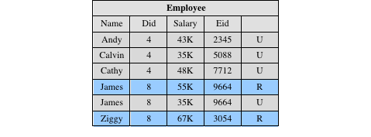
Example of Polyinstantiation
Notes:
The result is unsettling ( Figure 13.11 ). Clearly, James can only have one salary
and therefore one of the two rows is false. The motivation for this is to prevent
inference. If a unrestricted user queries the salary of James in the original database,
the user’s request is rejected and the user may infer that salary is greater than 50K.
The inclusion of the “false” row provides a form of cover for the true salary of James.
Although the approach may appear unsatisfactory, there have been a number of
designs and implementations of polyinstantiation [BERT95].
The problem can be avoided by using a classification granularity of database
or table, and in many applications, such granularity is all that is needed.

Slide 28
Terminology Related to Trust
Trust: The extent to which someone who relies on a system can have confidence that the system meets its specifications
i.e., that the system does what it claims to do and does not perform unwanted functions
Trusted system: A system believed to enforce a given set of attributes to a stated degree of assurance.
Trustworthiness: Assurance that a system deserves to be trusted, such that the trust can be guaranteed in some convincing way,
such as through formal analysis or code review.
Notes:
The models described in the preceding two sections are all aimed at enhancing
the trust that users and administrators have in the security of a computer
system. The concept of trust in the context of computer security goes back to
the early 1970s, spurred on by the U.S. Department of Defense initiative and
funding in this area. Early efforts were aimed to developing security models
and then designing and implementing hardware/software platforms to achieve
trust. Because of cost and performance issues, trusted systems did not gain a
serious foothold in the commercial market. More recently, the interest in trust
has reemerged, with the work on trusted computer platforms, a topic we explore
in Section 13.5 . In this section, we examine some basic concepts and implications
of trusted systems.
Some useful terminology related to trusted systems is listed in Table 13.1 .

Slide 29
Continued…
Trusted computer system: A system that employs sufficient hardware and software assurance measures to allow its use for simultaneous processing of a range of sensitive or classified information.
Trusted computing base (TCB): A portion of a system that enforces a particular policy
The TCB must be resistant to tampering and circumvention.
The TCB should be small enough to be analyzed systematically.
Assurance: A process that ensures a system is developed and operated as intended by the system's security policy.
Evaluation: Assessing whether the product has the security properties claimed for it.
Functionality: The security features provided by a product.

Slide 30
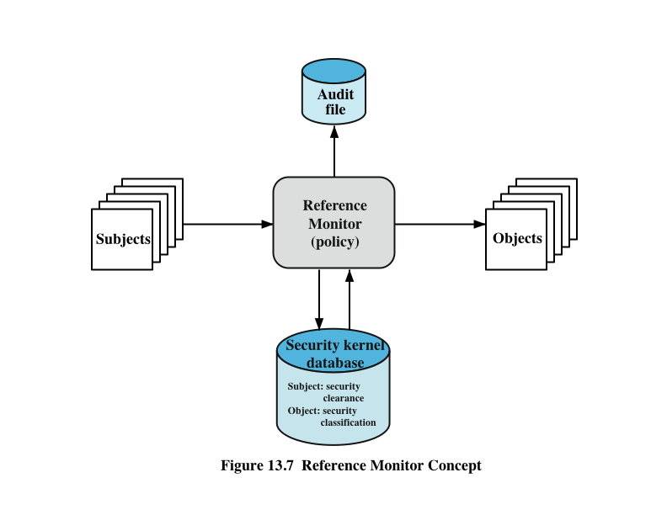
Reference Monitors
Properties
Complete mediation
Isolation
Verifiability
Trustworthy system
Notes:
Initial work on trusted computers and trusted operating systems was based on
the reference monitor concept, depicted in Figure 13.7 . The reference monitor is
a controlling element in the hardware and operating system of a computer that
regulates the access of subjects to objects on the basis of security parameters of
the subject and object. The reference monitor has access to a file, known as the
security kernel database , that lists the access privileges (security clearance) of
each subject and the protection attributes (classification level) of each object. The
reference monitor enforces the security rules (no read up, no write down) and has
the following properties:
• Complete mediation: The security rules are enforced on every access, not just,
for example, when a file is opened.
• Isolation: The reference monitor and database are protected from unauthorized
modification.
• Verifiability: The reference monitor’s correctness must be provable. That
is, it must be possible to demonstrate mathematically that the reference
monitor enforces the security rules and provides complete mediation and
isolation.
These are stiff requirements. The requirement for complete mediation means
that every access to data within main memory and on disk and tape must be mediated.
Pure software implementations impose too high a performance penalty to be practical;
the solution must be at least partly in hardware. The requirement for isolation means
that it must not be possible for an attacker, no matter how clever, to change the logic
of the reference monitor or the contents of the security kernel database. Finally, the
requirement for mathematical proof is formidable for something as complex as a
general-purpose computer. A system that can provide such verification is referred to
as a trustworthy system .
A final element illustrated in Figure 13.7 is an audit file. Important security
events, such as detected security violations and authorized changes to the security
kernel database, are stored in the audit file.
In an effort to meet its own needs and as a service to the public, the U.S.
Department of Defense in 1981 established the Computer Security Center within
the National Security Agency (NSA) with the goal of encouraging the widespread
availability of trusted computer systems. This goal is realized through the center’s
Commercial Product Evaluation Program. In essence, the center attempts to
evaluate commercially available products as meeting the security requirements
just outlined. The center classifies evaluated products according to the range of
security features that they provide. These evaluations are needed for Department
of Defense procurements but are published and freely available. Hence, they
can serve as guidance to commercial customers for the purchase of commercially
available, off-the-shelf equipment.

Slide 31
Trusted Platform Module (TPM)
concept from Trusted Computing Group
hardware module at heart of hardware/ software approach to trusted computing (TC)
uses a TPM chip
motherboard, smart card, processor
working with approved hardware/software
generating and using crypto keys
has three basic services:
authenticated boot, certification, encryption
Notes:
The trusted platform module (TPM) is a concept being standardized by an industry
consortium, the Trusted Computing Group. The TPM is a hardware module that
is at the heart of a hardware/software approach to trusted computing. Indeed, the
term trusted computing (TC) is now used in the industry to refer to this type of
hardware/software approach.
The TC approach employs a TPM chip in personal computer motherboard
or a smart card or integrated into the main processor, together with hardware and
software that in some sense has been approved or certified to work with the TPM.
We can briefly describe the TC approach as follows. The TPM generates keys that
it shares with vulnerable components that pass data around the system, such as
storage devices, memory components, and audio/visual hardware. The keys can be
used to encrypt the data that flow throughout the machine. The TPM also works
with TC-enabled software, including the OS and applications. The software can be
assured that the data it receives are trustworthy, and the system can be assured that
the software itself is trustworthy.
To achieve these features, TC provides three basic services: authenticated
boot, certification, and encryption.

Slide 32
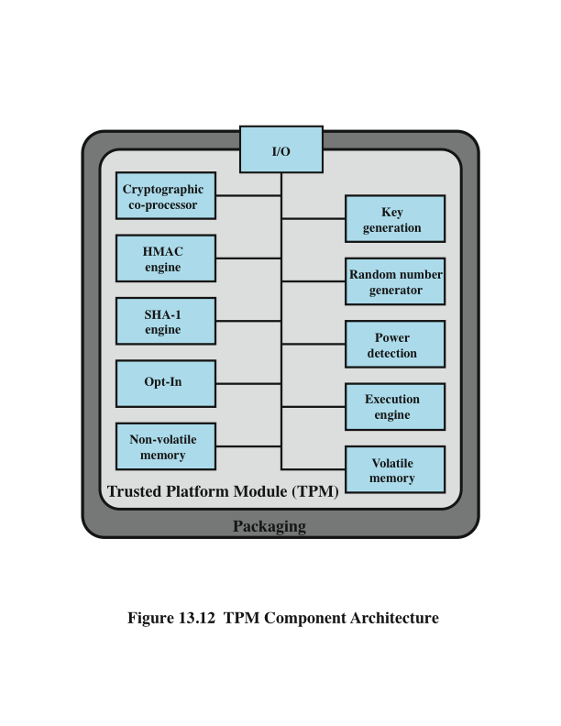
TPM Functions
Notes:
Figure 13.12 , based on the most recent TPM specification, is a block diagram of the
functional components of the TPM. These are as follows:
• I/O: All commands enter and exit through the I/O component, which provides
communication with the other TPM components.
• Cryptographic co-processor: Includes a processor that is specialized for
encryption and related processing. The specific cryptographic algorithms
implemented by this component include RSA encryption/decryption,
RSA-based digital signatures, and symmetric encryption.
• Key generation: Creates RSA public/private key pairs and symmetric keys.
• HMAC engine: This algorithm is used in various authentication protocols.
• Random number generator (RNG): This component produces random numbers
used in a variety of cryptographic algorithms, including key generation, random
values in digital signatures, and nonces. A nonce is a random number used once,
as in a challenge protocol. The RNG uses a hardware source of randomness
(manufacturer specific) and does not rely on a software algorithm that produces
pseudo random numbers.
SHA-1 engine: This component implements the SHA algorithm, which is used
in digital signatures and the HMAC algorithm.
• Power detection: Manages the TPM power states in conjunction with the
platform power states.
• Opt-in: Provides secure mechanisms to allow the TPM to be enabled or
disabled at the customer/user’s discretion.
• Execution engine: Runs program code to execute the TPM commands
received from the I/O port.
• Nonvolatile memory: Used to store persistent identity and state parameters
for this TPM.
• Volatile memory: Temporary storage for execution functions, plus storage
of volatile parameters, such as current TPM state, cryptographic keys, and
session information.

Slide 33
Authenticated Boot Service
responsible for booting entire OS in stages and ensuring each is valid and approved for use
at each stage digital signature associated with code is verified
TPM keeps a tamper-evident log of the loading process
log records versions of all code running
can then expand trust boundary to include additional hardware and application and utility software
confirms component is on the approved list, is digitally signed, and that serial number hasn’t been revoked
result is a configuration that is well-defined with approved components
Notes:
The authenticated boot service is responsible for booting the entire operating
system in stages and assuring that each portion of the OS, as it is loaded, is a
version that is approved for use. Typically, an OS boot begins with a small piece
of code in the Boot ROM. This piece brings in more code from the Boot Block
on the hard drive and transfers execution to that code. This process continues
with more and larger blocks of the OS code being brought in until the entire OS
boot procedure is complete and the resident OS is booted. At each stage, the
TC hardware checks that valid software has been brought in. This may be done
by verifying a digital signature associated with the software. The TPM keeps a
tamper-evident log of the loading process, using a cryptographic hash function to
detect any tampering with the log.
When the process is completed, the tamper-resistant log contains a record that
establishes exactly which version of the OS and its various modules are running. It
is now possible to expand the trust boundary to include additional hardware and
application and utility software. The TC-enabled system maintains an approved list
of hardware and software components. To configure a piece of hardware or load a
piece of software, the system checks whether the component is on the approved list,
whether it is digitally signed (where applicable), and that its serial number hasn’t
been revoked. The result is a configuration of hardware, system software, and
applications that is in a well-defined state with approved components.

Slide 34
Certification Service
once a configuration is achieved and logged the TPM can certify configuration to others
can produce a digital certificate
confidence that configuration is unaltered because:
TPM is considered trustworthy
only the TPM possesses this TPM’s private key
include challenge value in certificate to also ensure it is timely
provides a hierarchical certification approach
hardware/OS configuration
OS certifies application programs
user has confidence is application configuration
Notes:
Once a configuration is achieved and logged by the TPM, the TPM can certify the
configuration to other parties. The TPM can produce a digital certificate by signing
a formatted description of the configuration information using the TPM’s private
key. Thus, another user, either a local user or a remote system, can have confidence
that an unaltered configuration is in use because
1. The TPM is considered trustworthy. We do not need a further certification of
the TPM itself.
2. Only the TPM possesses this TPM’s private key. A recipient of the configuration
can use the TPM’s public key to verify the signature ( Figure 2.7b ).
To assure that the configuration is timely, a requester issues a “challenge” in
the form of a random number when requesting a signed certificate from the TPM.
The TPM signs a block of data consisting of the configuration information with
the random number appended to it. The requester therefore can verify that the
certificate is both valid and up to date.
The TC scheme provides for a hierarchical approach to certification. The
TPM certifies the hardware/OS configuration. Then the OS can certify the presence
and configuration of application programs. If a user trusts the TPM and trusts the
certified version of the OS, then the user can have confidence in the application’s
configuration.

Slide 35
Encryption Service
encrypts data so that it can only be decrypted by a machine with a certain configuration
TPM maintains a master secret key unique to machine
used to generate secret encryption key for every possible configuration of that machine
can extend scheme upward
provide encryption key to application so that decryption can only be done by desired version of application running on desired version of the desired OS
encrypted data can be stored locally or transmitted to a peer application on a remote machine
Notes:
The encryption service enables the encryption of data in such a way that the data
can be decrypted only by a certain machine and only if that machine is in a certain
configuration. There are several aspects of this service.
First, the TPM maintains a master secret key unique to this machine. From
this key, the TPM generates a secret encryption key for every possible configuration
of that machine. If data are encrypted while the machine is in one configuration, the
data can only be decrypted using that same configuration. If a different configuration
is created on the machine, the new configuration will not be able to decrypt the
data encrypted by a different configuration.
This scheme can be extended upward, as is done with certification. Thus, it is
possible to provide an encryption key to an application so that the application can
encrypt data, and decryption can only be done by the desired version of the desired
application running on the desired version of the desired OS. These encrypted data
can be stored locally, only retrievable by the application that stored them, or transmitted
to a peer application on a remote machine. The peer application would have
to be in the identical configuration to decrypt the data.
The encryption of a file proceeds in an analogous matter. In this latter case,
a process requests a symmetric key to encrypt the file. The TPM then provides an
encrypted version of the key to be stored with the file.

Slide 36
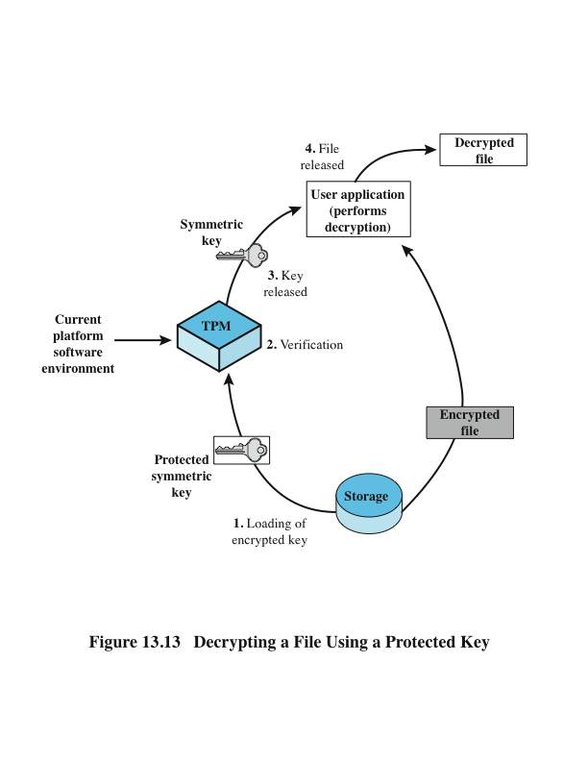
Protected Storage Function
Notes:
To give some feeling for the operation of a TC/TPM system, we look at the
protected storage function. The TPM generates and stores a number of encryption
keys in a trust hierarchy. At the root of the hierarchy is a storage root key generated
by the TPM and accessible only for the TPM’s use. From this key other keys
can be generated and protected by encryption with keys closer to the root of the
hierarchy.
An important feature of Trusted Platforms is that a TPM protected object can
be “sealed” to a particular software state in a platform. When the TPM protected
object is created, the creator indicates the software state that must exist if the secret
is to be revealed. When a TPM unwraps the TPM protected object (within the TPM
and hidden from view), the TPM checks that the current software state matches the
indicated software state. If they match, the TPM permits access to the secret. If they
don’t match, the TPM denies access to the secret.
Figure 13.13 provides an example of this protection. In this case, there is an
encrypted file on local storage that a user application wishes to access. The following
steps occur:
1. The symmetric key that was used to encrypt the file is stored with the file.
The key itself is encrypted with another key to which the TPM has access. The
protected key is submitted to the TPM with a request to reveal the key to the
application.
2. Associated with the protected key is a specification of the hardware/software
configuration that may have access to the key. The TPM verifies that the
current configuration matches the configuration required for revealing the key.
In addition, the requesting application must be specifically authorized to access
the key. The TPM uses an authorization protocol to verify authorization.
3. If the current configuration is permitted access to the protected key, then the
TPM decrypts the key and passes it on to the application.
4. The application uses the key to decrypt the file. The application is trusted to
then securely discard the key.

Slide 37
Summary
computer security models
Bell-Lapadula
Biba Integrity Model
Clark-Wilson Integrity Model
Chinese Wall Model
trusted systems
reference monitors
application of multilevel security
database security
trusted computing and the trusted platform module
authenticated boot service
certification service
encryption service
TPM functions
protected storage
Notes:
Chapter 13 summary.

