Slide 1
Fault Tolerance

Slide 2
Topics covered in this chapter
Introduction to faults
Failure models
Failure masking
Process Resilience
Agreement in Faulty system
Reliable Client server communication
Group communication
Distributed commit
Recovery

Slide 3
Fault Tolerance
A system or a component fails due to a fault
Fault tolerance means that the system continues to provide its services in presence of faults
A distributed system may experience and should recover also from partial failures
Includes:
- preventing faults and failures from affecting other components of the system,
- automatically recovering from partial failures, and doing so without seriously affecting performance

Slide 4
Basics Concepts
Dependability is the ability to avoid service failures that are more frequent. A key requirement of most systems is to provide some level of dependability. A dependable systems has the following properties.
• Availability: system is ready to be used immediately
• Reliability: system can run continuously without failure
• Safety: when a system (temporarily) fails to operate correctly, nothing catastrophic /dangerous happens
• Maintainability: how easily a failed system can be repaired

Slide 5
Basics Concepts
A system is said to “fail” when it cannot meet its promises.
A failure is brought about by the existence of “errors” in the system.
The cause of an error is a “fault”.

Slide 6
Types of Fault
There are three main types of ‘fault’:
1. Transient Fault – appears once, then disappears.
2. Intermittent Fault – occurs, vanishes, reappears; but: follows no real pattern (worst kind).
3. Permanent Fault – once it occurs, only the replacement/repair of a faulty component will allow the DS to function normally.

Slide 7
Failure Models
Type of failure | Description
Crash failure | A server halts, but was working correctly until it halts
Omission failure Receive omission Send omission | A server fails to respond to incoming requests A server fails to receive incoming messages A server fails to send messages
Timing failure | A server’s response lies outside the specified time interval
Response Value failure State transition | A server’s response is incorrect The value of the response is wrong The server deviates from the correct flow of control
Arbitrary failure | Any failure may occur, perhaps even unnoticed

Slide 8
Failure Masking by Redundancy
Strategy: hide the occurrence of failure from other processes using redundancy.
Three main types:
Information Redundancy – add extra bits to allow for error detection/recovery (e.g., Hamming codes and the like).
Time Redundancy – perform operation and, if needs be, perform it again. Think about how transactions work (BEGIN/END/COMMIT/ABORT).
Physical Redundancy – add extra (duplicate) hardware and/or software to the system

Slide 9
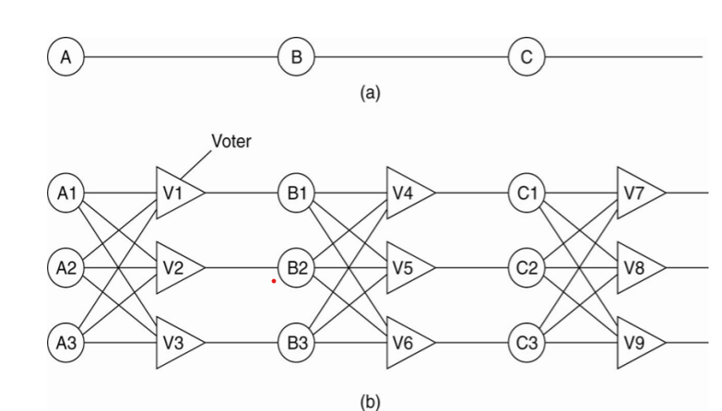
Failure Masking by Redundancy Triple modular redundancy

Slide 10
Process Resilience
Protection against process failures – achieved by replicating processes into groups
Groups:
– Organize identical processes into groups
– Process groups are dynamic
– Processes can be members of multiple groups
– Mechanisms are needed for managing groups and group membership

Slide 11
Process Resilience
Flat vs Hierarchical Groups:
– Flat group: all decisions made collectively
• There is no single point of failure
• Decision making is difficult
– Hierarchical group: coordinator makes decisions
• Decision making process is much simpler
• Single point of failure.

Slide 12
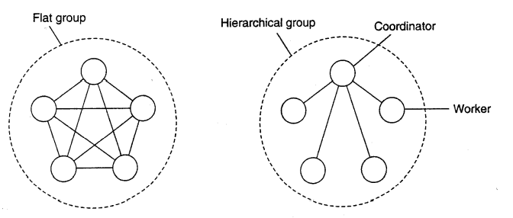
Process Resilience

Slide 13
Flat Groups versus Hierarchical Groups
Replicate processes and organize them into a group to replace a vulnerable process with a fault tolerant group
There are two ways to approach such replication:
1. Primary (backup) Protocols(kind of client-server arch.):
– primary coordinates all write operations.
– Its role can be taken over by one of the backup, if need be.
– When the primary crashes, the backups execute some election algorithm to choose a new primary
2. Replicated-Write Protocols :
– organizing identical processes into a flat group.
– No single point of failure.

Slide 14
Group Membership
When group communication is present, some method is needed for creating and deleting groups, as well as for allowing processes to join and leave groups.
-Group server
-Distributed method

Slide 15
Thank You

Slide 16
Agreement in faulty systems
Examples: Election, transaction commit/abort, dividing tasks among workers, mutual exclusion
– What happens when processes can fail?
– What happens when communication can fail?
– What happens when byzantine failures are possible
We want all non-faulty processes to reach and establish agreement (within a finite number of steps)

Slide 17
The Goal of Agreement Algorithms
“To have all non-faulty processes reach consensus on some issue (quickly).”
The two-army problem -with non-faulty processes, agreement between even two processes is not possible in the face of unreliable communication.
Byzantine generals problem – communication is perfect but the processes are not

Slide 18
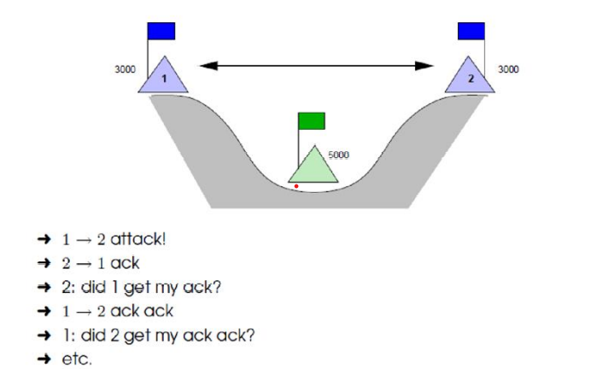
Tow Army Problem
Non-faulty processes but lossy communication.

Slide 19
Byzantine Generals Problem
Time: 330-1453 AD.
Place: Balkans and Modern Turkey.
Endless conspiracies, intrigue, and untruthfulness were alleged to be common practice in the ruling circles of the day (sounds strangely familiar … ).
That is: it was typical for intentionally wrong and malicious activity to occur among the ruling group. A similar occurrence can surface in a DS, and is known as ‘Byzantine failure’.
Question: how do we deal with such malicious group members within a distributed system?

Slide 20
Agreement in faulty systems
Recursive algorithm was devised by Lamport et. al in 1982
• Step 1: every general sends a (reliable) message to every other general announcing his troop strength
• Step 2: results of announcements of step 1 are collected together in the form of the vectors
• Step 3: every general passing vectors to other generals
• Step 4: each general examines the ith element of each of the newly received vectors. If no majority, corresponding element will be considered to be UNKNOWN

Slide 21
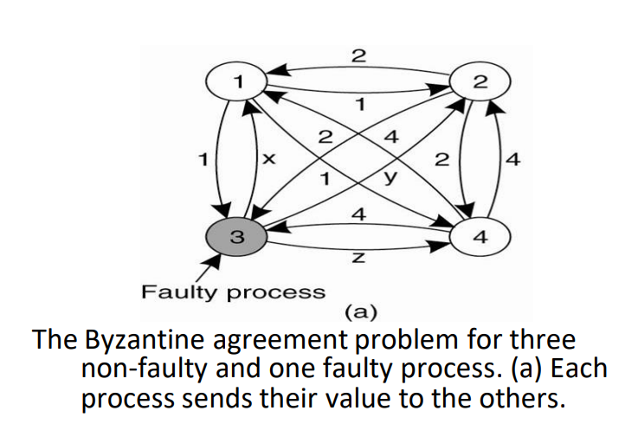
Agreement in faulty systems

Slide 22
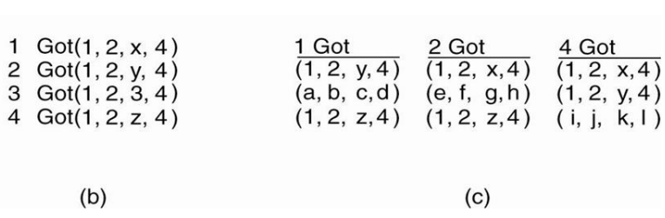
Agreement in faulty systems
(b) The vectors that each process assembles based on (a).
(c) The vectors that each process receives in step 3

Slide 23
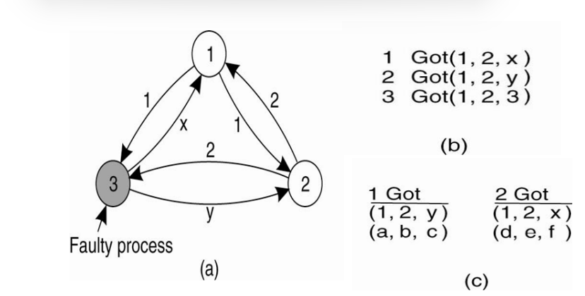
Agreement in faulty systems
The same as before, except now with two correct process and one faulty process

Slide 24
Agreement in faulty systems
• Lamport et.al proved that in a system with m faulty processes, agreement can be achieved only if 2m+1 correctly functioning processes are present, for a total of 3m+1 processes.
• Other way to say – agreement is possible only if more than two thirds of the processes are working properly.
• Fischer et.al(1985) proved that agreement becomes worse – slow processes are indistinguishable from crashed ones

Slide 25
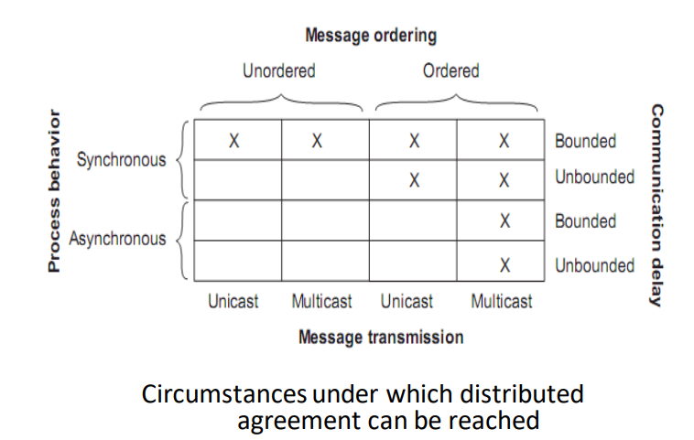
Agreement in faulty systems

Slide 26
Agreement in faulty systems
Agreement in Faulty Systems
Possible cases:
Synchronous (lock-step) versus asynchronous systems.
Communication delay is bounded (by globally and predetermined maximum time) or not.
Message delivery is ordered (in real-time) or not.
Message transmission is done through unicasting or multicasting.

Slide 27
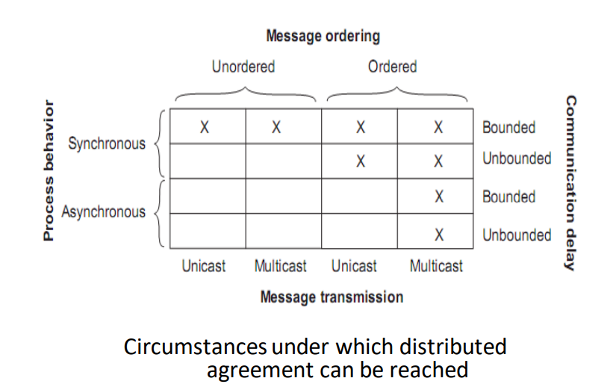
Agreement in faulty systems

Slide 28
Reliable Client/Server Communications
Communication channel may exhibit crash, omission, timing, and arbitrary failures
Focus is on masking crash and omission failures.
Example: In DS, reliable point-to-point communication is established using TCP which masks omission failures by guarding against lost messages using ACKs and retransmissions.
It performs poorly when a crash occurs (DS may try to mask a TCP crash by automatically re-establishing the lost connection).

Slide 29
Reliable Client/Server Communications
The RPC mechanism works well as long as both the client and server function perfectly.
Five classes of RPC failure can be identified:
The client cannot locate the server
The client’s request to the server is lost
The server crashes after receiving the request
The server’s reply is lost on its way to the client
The client crashes after sending its request

Slide 30
Reliable Client/Server Communications
Client cannot locate the server
An appropriate exception handling mechanism can deal with a missing server.
An appropriate exception handling mechanism can deal with a missing server.

Slide 31
Reliable Client/Server Communications
(2) Lost request message
• It can be dealt with easily using timeouts.
• If no ACK arrives in time, the message is resent.
• Server needs to be able to deal with the possibility of
duplicate requests

Slide 32
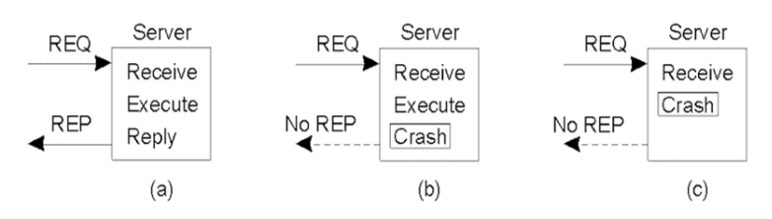
Reliable Client/Server Communications
(3) Server crashes
a) The normal case.
b) Crash after service execution.
c) Crash before service execution

Slide 33
Reliable Client/Server Communications
Server crashes are dealt with by implementing one of three possible implementation philosophies:
At least once semantics: keep trying until a reply is received. Guarantee is given that the RPC occurred at least once, but (also) possibly more that once.
At most once semantics: gives up immediately and reports back failure. Guarantee is given that the RPC occurred at most once, but possibly not at all.
No semantics: When a server crashes, client gets no indication. Nothing is guaranteed, and client and servers take their chances. Easy to implement
It has proved difficult to provide exactly once semantics

Slide 34
Reliable Client/Server Communications
Remote operation: print some text and (when done) send a completion message.
Three events that can happen at the server:
1. Send the completion message (M)
2. Print the text (P)
3. Crash (C)

Slide 35
Reliable Client/Server Communications
These three events can occur in six different orderings:
M →P →C: A crash occurs after sending the completion message and printing the text.
M →C (→P): A crash happens after sending the completion message, but before the text could be printed.
P →M →C: A crash occurs after sending the completion message and printing the text.
P→C(→M): The text printed, after which a crash occurs before the completion message could be sent.
C (→P →M): A crash happens before the server could do anything.
C (→M →P): A crash happens before the server could do anything. –
Parentheses indicate an event that can no longer happen because the server already crashed

Slide 36
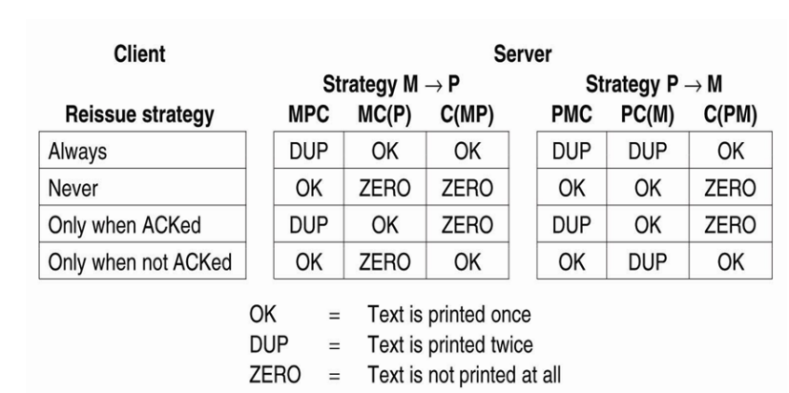
Reliable Client/Server Communications
Different combinations of client and server strategies in the presence of server crashes

Slide 37
Reliable Client/Server Communications
(4) Lost reply messages
• Why was there no reply? Is the server dead, slow, or did the reply just go missing?
• A request that can be repeated any number of times without any side-effects is said to be idempotent. (Example: a read of a static web-page is said to be idempotent)
• Nonidempotentrequests (for example, the electronic transfer of funds) are a little harder to deal with.
• A common solution is to employ unique sequence numbers. More work on server side and reply to clients..
• Another technique is the inclusion of additional bits in a retransmission to identify it as such to the server

Slide 38
Reliable Client/Server Communications
(5) Client crashes after request
• When an ‘old’ reply arrives, such a unwanted computation/reply is known as an orphan.
• Problems – waste CPU cycles, client reboot makes confusion with old replies…
• Four orphan solutions have been proposed by Nelson(1981):
1. extermination (the orphan is simply killed-off after checking log).
2. reincarnation (each client session has an epoch associated with it, making orphans easy to spot and obsolete).
3. gentle reincarnation (when a new epoch is identified, an attempt is made to locate a requests owner, otherwise the orphan is killed).
4. expiration (if the RPC cannot be completed within a standard amount of time, it is assumed to have expired).
• In practice, however, none of these methods are desirable for dealing with orphans. Orphans may have locks on files/data

Slide 39
Reliable Group Communication
Reliable multicast services guarantee that all messages are delivered to all members of a process
group.
But it is surprisingly tricky (as multicasting services tend to be inherently unreliable).
For a small group, multiple, reliable point-to-point channels will do the job, however, such a solution scales poorly as the group membership grows. Also:
– What happens if a process joins the group during communication?
– Worse: what happens if the sender of the multiple, reliable point-to- point channels crashes half way through sending the messages?

Slide 40
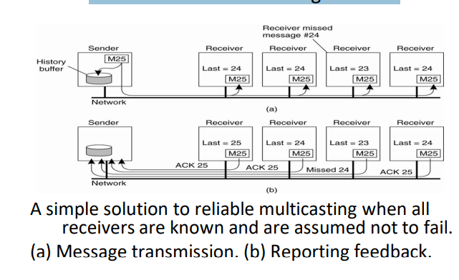
Basic Reliable-Multicasting Schemes

Slide 41
SRM: Scalable Reliable Multicasting
Based on feedback suppression
Receivers never acknowledge successful delivery.
Only missing messages are reported.
NACKs(negative ack) are multicast to all group members.
This allows other members to suppress their feedback, if necessary.
To avoid “retransmission clashes”, each member is required to wait a random delay prior to NACKing

Slide 42
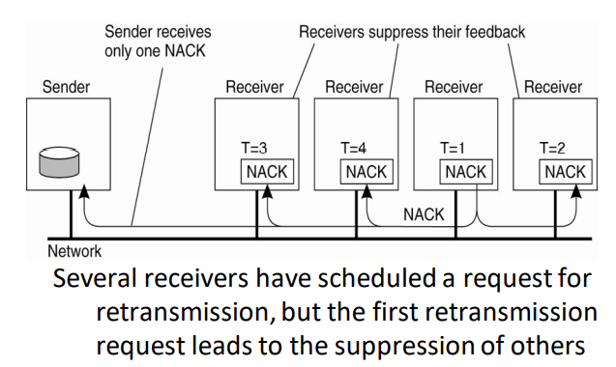
Non-hierarchical Feedback Control

Slide 43
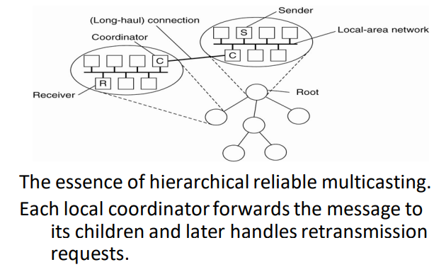
Hierarchical Feedback Control

Slide 44
Atomic Multicast
Reliable group communication in the face of
– possibly faulty processes, it is useful to look at the atomic multicast problem.
A message is delivered to either all processes, or none
Requires agreement about group membership
Process Group:
– Group view: view of the group (list of processes) sender had when message sent
– Each message uniquely associated with a group
– All processes in group have the same view

Slide 45
Distributed Commit
The atomic multicasting problem discussed in the previous section is an example of a more general problem, known as distributed commit
Coordinator tells all other processes that are also involved, called participants, whether or not to (locally) perform the operation in question

Slide 46
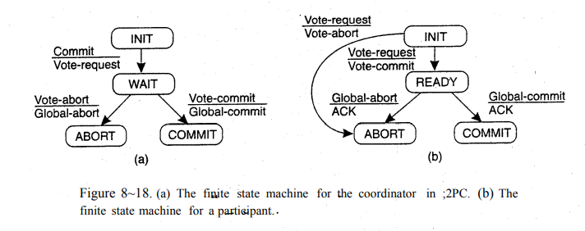
Two-Phase Commit

Slide 47
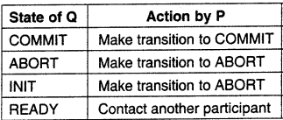
Two-Phase Commit

Slide 48
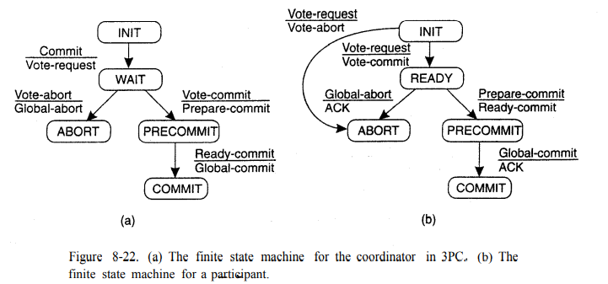
Three-Phase Commit

Slide 49
Failure Recovery
Recovery refers- to the process of restoring a (failed) system/process to a normal state of operation.
Recovery can apply – to the complete system (involving rebooting a failed computer) or – to a particular application (involving restarting of failed process(es)).
While restarting processes or computers is
– a relatively straightforward exercise in a centralized system,
– but it is significantly more complicated in a distributed system.
Restoring an erroneous state to an error free state

Slide 50
Failure Recovery
Issues:
Reclamation of resources: a process may hold resources, such as locks or buffers, on a remote node. Naively restarting the process or its host will lead to resource leaks and possibly deadlocks.
Consistency: Naively restarting one part of a distributed computation will lead to a local state that is inconsistent with the rest of the computation. In order to achieve consistency it is, in general, necessary to undo partially completed operations on other nodes prior to restarting.
Efficiency: One way to avoid the above problems would be to restart the complete computation whenever one part fails. However, this is obviously very inefficient, as a significant amount of work may be discarded unnecessarily

Slide 51
Forward vs. backward recovery
Forward error recovery :
• Correct erroneous state without moving back to a previous state.
• Example: erasure correction - missing packet reconstructed from successfully delivered packets.
– Here it is known that all communication has been lost,
– and if appropriate protocols are used (which, for example, buffer all outgoing messages),
– a forward recovery may be possible (e.g. by resending all buffered messages).
• Possible errors must be known in advance

Slide 52
Forward vs. backward recovery
Backward error recovery :
Correct erroneous state by moving to a previously correct state- restores the process or system state to a previous state known to be free from errors
Example: packet retransmission when packet is lost
– High overhead- due to the lost computation and the work required to restore the state.
– Error can reoccur
– Sometimes impossible to roll back (e.g. ATM has already delivered the money)

Slide 53
State-Based Recovery - Checkpointing
State-based recovery requires checkpoints to be performed during execution.
Shadow paging: make modifications to shadow page, after commit, make it to original one
Checkpointing :
Pessimistic and optimistic
Independent and coordinated
Synchronous and asynchronous

Slide 54
Recovery In Concurrent Systems
Failed process may have causally affected other processes
Upon recovery of failed process, must undo effects on other processes
Must roll back all affected processes
All processes must establish recovery points
Must roll back to a consistent global state

Slide 55
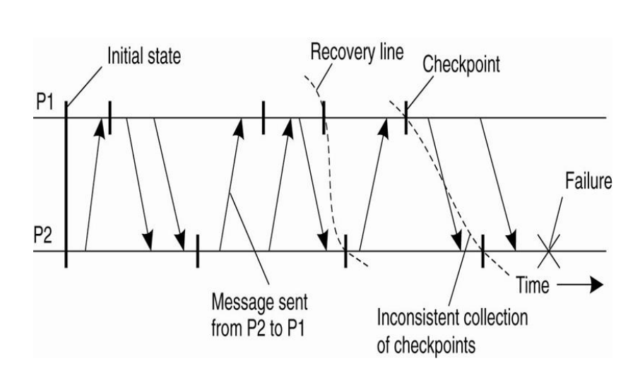
Recovery Line

Slide 56
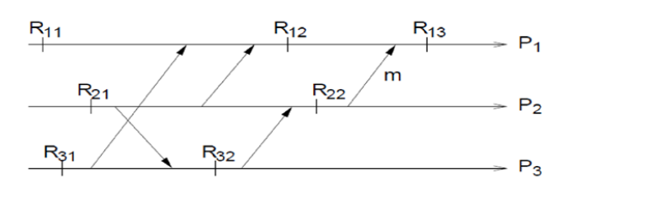
Independent Checkpointing- Domino effect

Slide 57
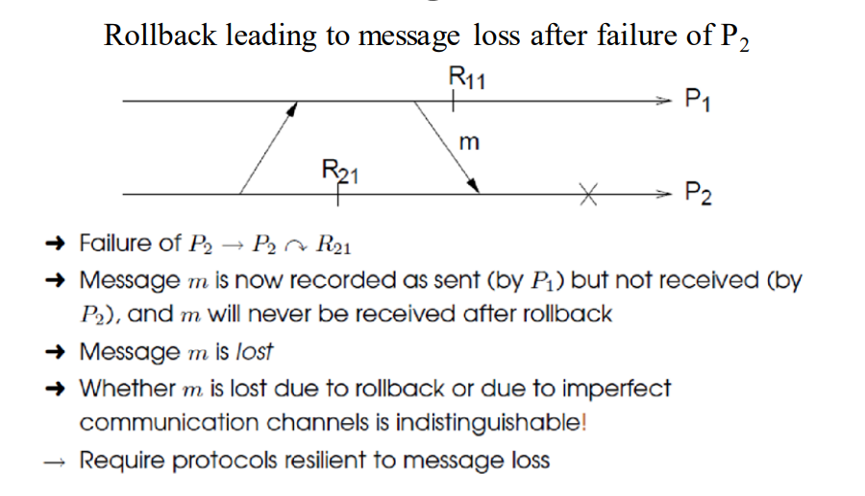
Message Loss

Slide 58
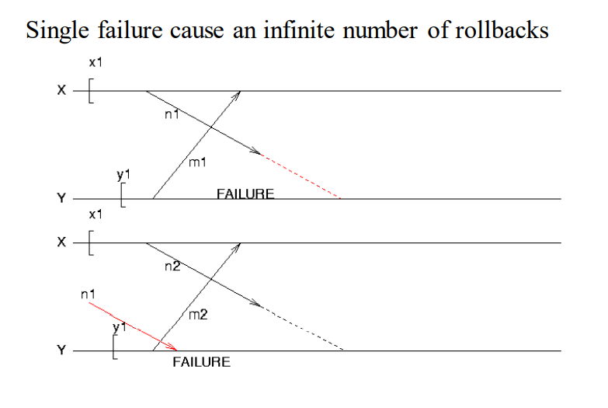
Live Lock

Slide 59
Coordinated Checkpointing
Coordinated checkpointing all processes synchronize to jointly write their state to local stable storage
A coordinator first multicasts a CHECKPOINT .-REQUEST message to all processes
The main advantage of coordinated checkpointing is that the saved state is automatically globally consistent, so that cascaded rollbacks leading to the domino effect are avoided

Slide 60
Message logging
the checkpointing is an expensive operation, especially concerning the operations involved in writing state to stable storage, techniques have been sought to reduce the number of checkpoints, but still enable recovery.
An important technique in distributed systems is logging messages
The basic idea underlying message logging is that if the transmission of messages can be replayed, we can still reach a globally consistent state but without having to restore that state from stable storage

Slide 61
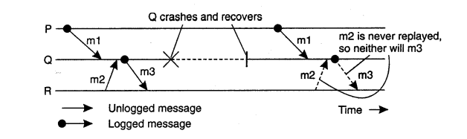
Characterizing Message- logging Schemes

Slide 62
Message Logging
Pessimistic Logging protocols
Optimistic logging protocol

Slide 63
Thank you

