Slide 1
Distributed Object-Based Systems

Slide 2
Introduction
The first paradigm consists of distributed objects. In distributed object based systems, the notion of an object plays a key role in establishing distribution transparency.
In principle, everything is treated as an object and clients are offered services and resources in the form of objects that they can invoke.
Distributed objects form an important paradigm because it is relatively easy to hide distribution aspects behind an object's interface.
Furthermore, because an object can be virtually anything, it is also a powerful paradigm for building systems
In this chapter, we will take a look at how the principles of distributed systems are applied to a number of well-known object-based systems.

Slide 3
Distributed Objects
The key feature of an object is that it encapsulates data called the state
The operations on those data, called the methods. Methods are made available through an interface
An object may implement multiple interfaces

Slide 4
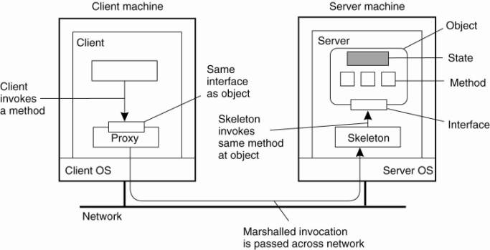
Distributed Objects

Slide 5
Compile Time versus Runtime Objects
The most obvious form is the one that is directly related to language-level objects such as those supported by Java, C++, or other object-oriented languages, which are referred to as compile-time objects
Using compile-time objects in distributed systems often makes it much easier to build distributed applications
For example , in Java:
An object can be fully defined by means of its class and the interfaces that the class implements.
Compiling the class definition results in code that allows it to instantiate Java objects.
The interfaces can be compiled into client-side and server-side stubs, allowing the Java objects to be invoked from a remote machine.
A Java developer can be largely unaware of the distribution of objects: he sees only Java programming code.

Slide 6
Compile Time versus Runtime Objects
An alternative way of constructing distributed objects is to do this explicitly during runtime.
A common approach is to use an object adapter, which acts as a wrapper around the implementation with the sole purpose to give it the appearance of an object

Slide 7
Persistent and Transient Objects
A persistent object continues to exist even if it is currently not contained in the address space of any server process
In contrast, a transient object is an object that exists only as long as the server that is hosting the object is.

Slide 8
Enterprise Java Beans (EJB)
An EJB is essentially a Java object that is hosted by a special server offering different ways for remote clients to invoke that object
Crucial is that this server provides the support to separate application functionality from systems-oriented functionality
The latter includes functions for looking up objects, storing objects, letting objects be part of a transaction, and so on
Typical services include those for remote method invocation (RMI), database access (JDBC), naming (JNDI), and messaging (JMS). Making use of these services is more or less automated

Slide 9
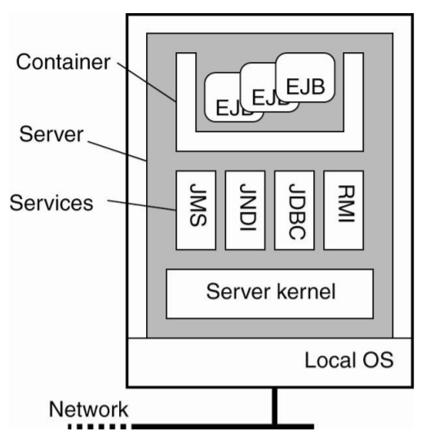
Enterprise Java Beans (EJB)

Slide 10
Enterprise Java Beans (EJB)
Stateless session beans are transient objects that are invoked once, does its work, after which it discards any information it maintains to perform the service it offered to a client.
Stateful session beans maintain client-related state.
Entity beans can be considered to be a long-lived persistent object. Such an entity bean will generally be stored in a database, and likewise, will also be part of distributed transactions.
Message-driven beans are used to program objects that should react to incoming messages (and likewise, be able to send messages). They cannot be invoked directly by a client, but rather fit into a publish-subscribe way of communication

Slide 11
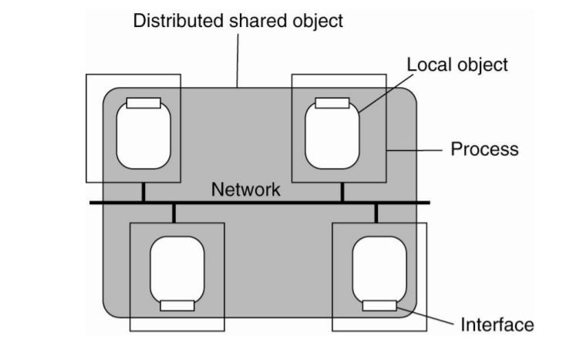
Global Distributed shared objects

Slide 12
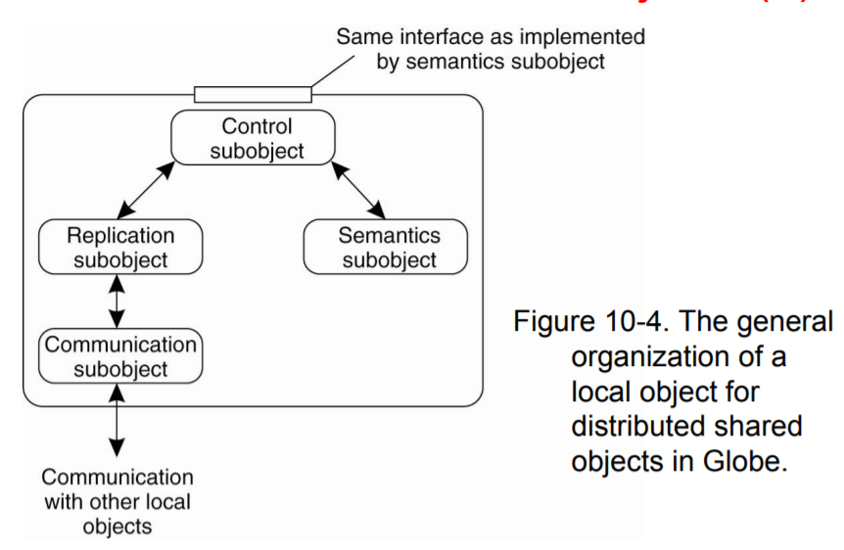
Global Distributed shared objects

Slide 13
Object servers
A key role in object-based distributed systems is played by object servers, that is, the server designed to host distributed objects.
The important difference between a general object server and other (more traditional) servers is that an object server by itself does not provide a specific service.
Specific services are implemented by the objects that reside in the server
An object server thus acts as a place where objects live

Slide 14
Object servers
An object consists of two parts: data representing its state and the code for executing its methods
Whether or not these parts are separated, or whether method implementations are shared by multiple objects, depends on the object server

Slide 15
Object Adapters
Decisions on how to invoke an object are commonly referred to as activation policies, to emphasize that in many cases the object itself must first be brought into the server's address space (i.e., activated) before it can actually be invoked.
What is needed then is a mechanism to group objects per policy. Such a mechanism is sometimes called an object adapter, or alternatively an object wrapper. An object adapter can best be thought of as software implementing a specific activation policy

Slide 16
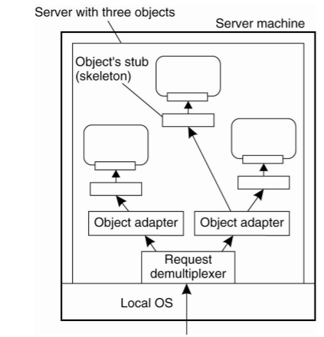
Object Adapters

Slide 17
Communication – Binding a Client to an Object
These systems generally offer the means for a remote client to invoke an object.
This mechanism is largely based on remote procedure calls (RPCs).
A difference between traditional RPC systems and distributed objects is that the latter generally provides system-wide object references.
Object references can be freely passed between processes on different machines, for example as parameters to method invocations

Slide 18
Communication – Binding a Client to an Object
By hiding the actual implementation of an object reference, distribution transparency is enhanced compared to traditional RPCs.
When a process holds an object reference, it must first bind to the referenced object before invoking any of its methods.
Binding results in a proxy being placed in the process's address space, implementing an interface containing the methods the process can invoke. In many cases, binding is done automatically.
When an object reference is given, it needs a way to locate the server that manages the actual object, and place a proxy in the client's address space.

Slide 19
Communication – Binding a Client to an Object
With implicit binding, the client is offered a simple mechanism that allows it to directly invoke methods using only a reference to an object.
In contrast, with explicit binding, the client should first call a special function to bind to the object before it can actually invoke its methods. Explicit binding generally returns a pointer to a proxy that is then become locally available

Slide 20
Implementation of Object References
An object reference must contain enough information to allow a client to bind to an object.

Slide 21
Implementation of Object References
Drawbacks
First: if the server's machine crashes and the server is assigned a different end point after recovery, all object references have become invalid.

Slide 22
Implementation of Object References
So far the client and server:
Have somehow already been configured to use the same protocol stack.
Not only does this mean that they use the same transport protocol, for example, TCP;
Furthermore, it means that they use the same protocol for marshaling and unmarshaling parameters.
They must also use the same protocol for setting up an initial connection, handle errors and flow control the same way, and so on.

Slide 23
Static versus Dynamic Remote Method Invocations
Static RMI: Static invocations require that the interfaces of an object are known when the client application is being developed. It also implies that if interfaces change, then the client application must be recompiled before it can make use of the new interfaces.
Dynamic RMI: The essential difference with static invocation is that an application selects at runtime which method it will invoke at a remote object. Dynamic invocation generally takes a form such as:
invoke(object, method, inputParameters, outputParameters);

Slide 24
Consistency and Replication
Entry Consistency
Data-centric consistency for distributed objects comes naturally in the form of entry consistency. Recall that in this case, the goal is to group operations on shared data using synchronization variables (e.g., in the form of locks).
Objects naturally combine data and the operations on that data, locking objects during an invocation serializes access and keeps them consistent

Slide 25
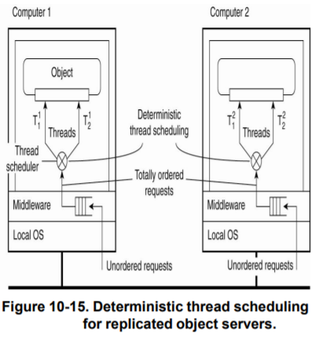
Entry Consistency

Slide 26
Replica Frameworks
An interesting aspect of most distributed object-based systems is that by nature of the object technology it is often possible to make a clean separation between devising functionality and handling extra functional issues such as replication. A powerful mechanism to accomplish this separation is formed by interceptors

Slide 27
Replica Frameworks
Babaoglu et al. (2004) describe a framework in which they use interceptors to replicate Java beans for J2EE servers. The idea is relatively simple: invocations to objects are intercepted at three different points
At the client side just before the invocation is passed to the stub.
Inside the client’s stub, where the interception forms part of the replication algorithm.
At the server side, just before the object is about to be invoked

Slide 28
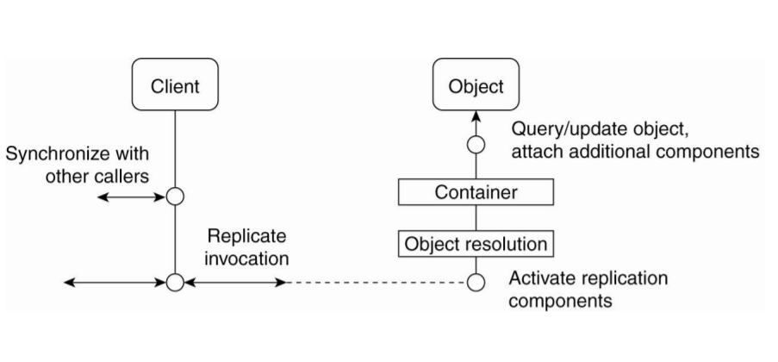
Replica Frameworks

Slide 29
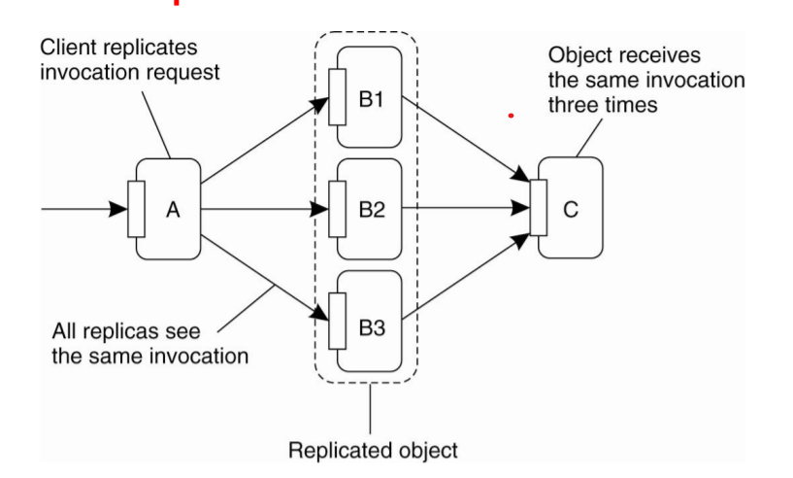
Replicated Invocation

Slide 30
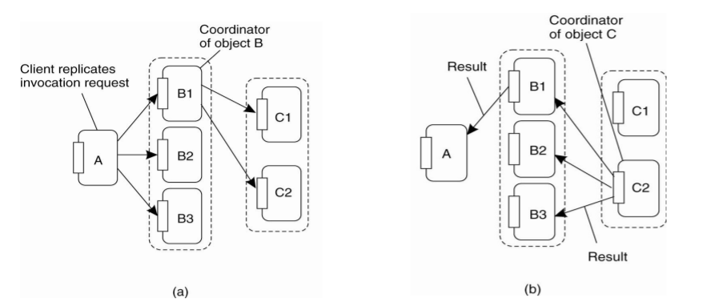
Replicated Invocation

Slide 31
Thank You

