Slide 1
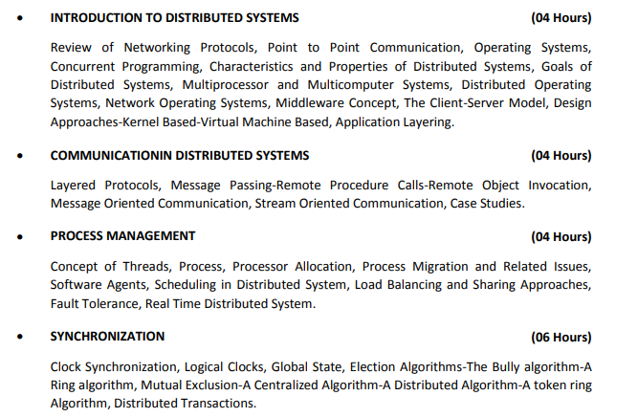
Syllabus

Slide 2
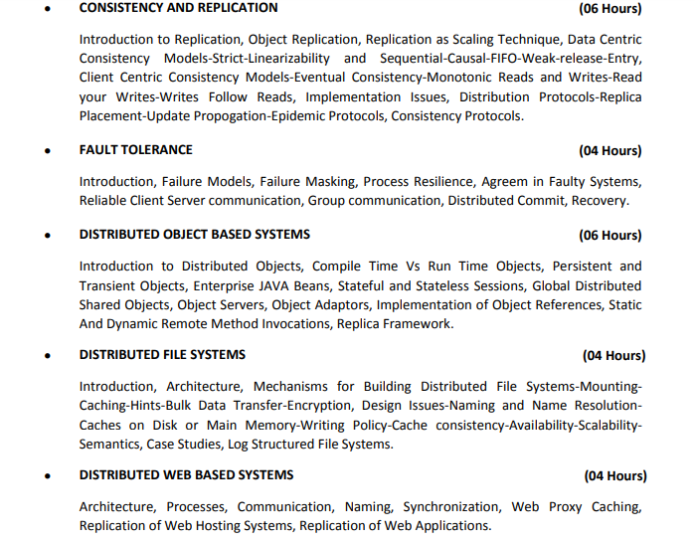
Syllabus

Slide 3
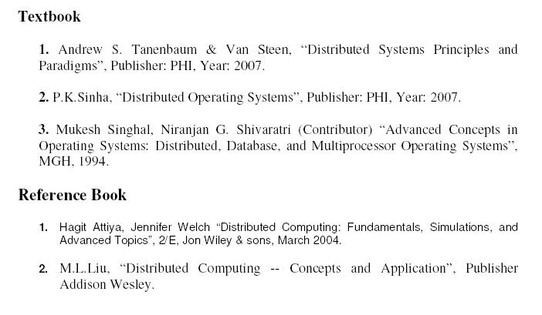

Slide 4
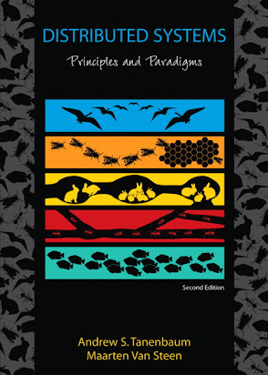
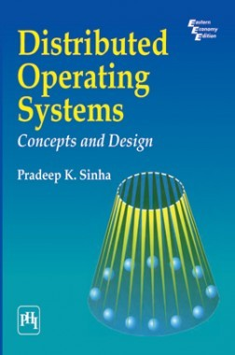
Reference Books
Distributed systems: principles and paradigms I Andrew S.Tanenbaum, Maarten Van Steen
Distributed Operating Systems Concepts and Design
By Pradeep K. Sinha, PHI

Slide 5
Unit-1 Introduction to Distributed System

Slide 6

Looping
Topics to be covered
Definition of a Distributed System
Goals of a Distributed System
Types of Distributed Systems
Challenges

Slide 7
Distributed system, distributed computing
Early computing was performed on a single processor. Uni-processor computing can be called centralized computing.
A distributed system is a collection of independent computers, interconnected via a network, capable of collaborating on a task.
Distributed computing is computing performed in a distributed system.

Slide 8
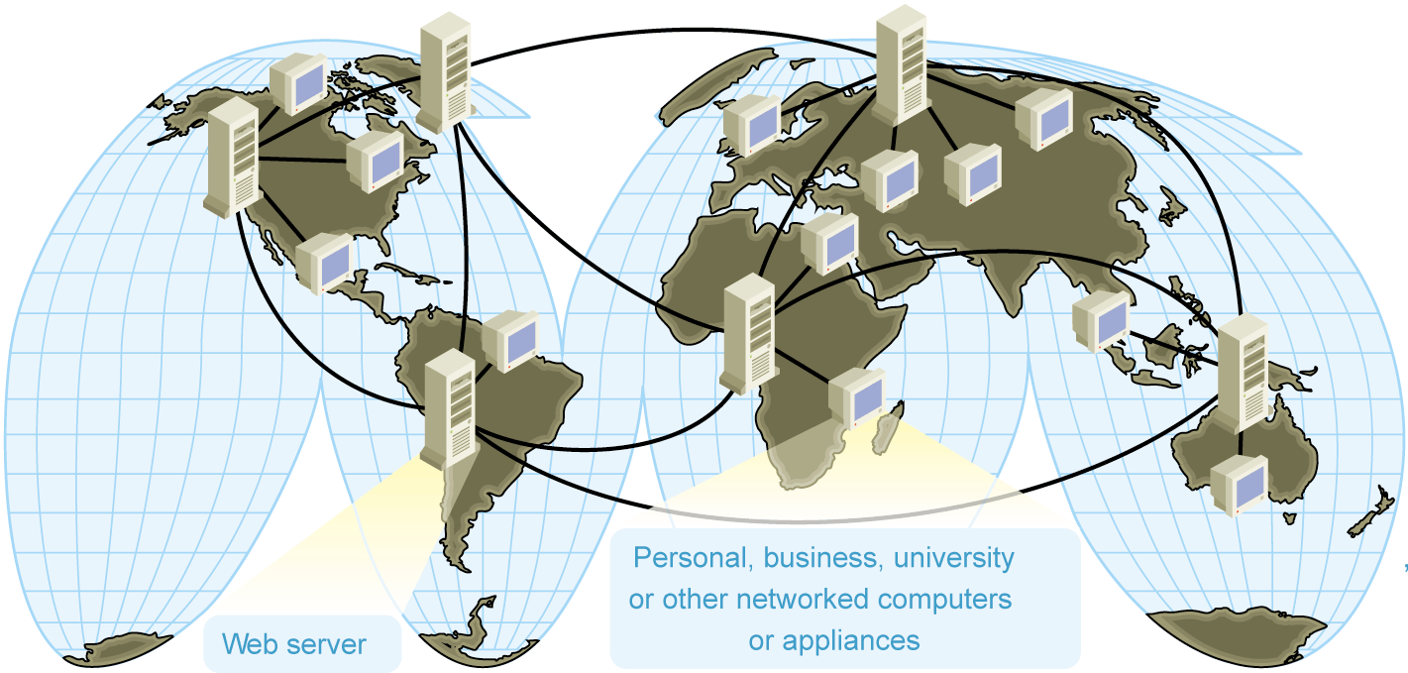
Distributed Operating System
Definition by Coulouris, Dollimore, Kindberg and Blair
“A distributed system is defined as one in which components at networked computers communicate and coordinate their actions only by passing messages.”
“A Distributed system is collection of independent computers which are connected through network.”
This system looks to its users like an ordinary centralized operating system but runs on multiple, independent central processing units (CPUs).

Slide 9
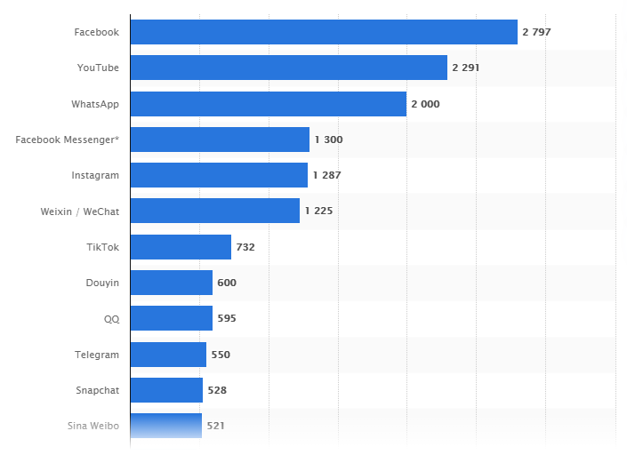
Most popular social networks worldwide as of April 2021
Number of active users monthly (in millions)

Slide 10
Why Distributed Operating System?
Facebook, currently, has 2.7 billion active monthly users.
Google performs at least 2 trillion searches per year.
About 500 hours of video is uploaded in Youtube every minute.
A single system would be unable to handle the processing. Thus, comes the need for Distributed Systems.
The main answer is to cope with the extremely higher demand of users in both processing power and data storage.
With this extremely demand, single system could not achieve it.
There are many reasons that make distributed systems is viable such as high availability, scalability, resistant to failure, etc.

Slide 11
Why Distributed?
Resource and Data Sharing
Printers, databases, multimedia servers etc.
Availability, Reliability
The loss of some instances can be hidden
Scalability, Extensibility
System grows with demands (e.g. extra servers)
Performance
Huge power (CPU, memory etc.) available
Horizontal distribution (same logical level is distr.)
Inherent distribution, communication
Organizational distribution, e-mail, video conference
Vertical distribution (corresponding to org. struct.)

Slide 12
Problems of Distribution
Concurrency, Security
Clients must not disturb each other
Partial failure
We often do not know, where is the error (e.g. RPC)
Location, Migration, Replication
Clients must be able to find their servers
Heterogeneity
Hardware, platforms, languages, management

Slide 13
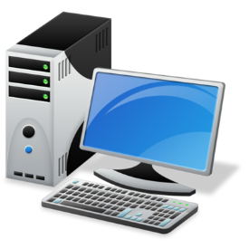
Advantages of Distributed Systems over Centralized Systems
Reliability: If one machine crashes, the system as a whole can still survive. Higher availability and improved reliability.
By having redundant components, the impact of hardware and software faults on users can be reduced.
Data sharing: Allow many users to access to a common database.
×
Load Transfer

Slide 14

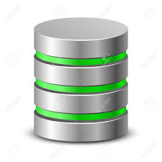
Advantages of Distributed Systems
Resource Sharing: Expensive peripherals such as color laser printers, photo-type setters and massive storage devices are also among the few things that should be sharable.
Communication: Enhance human-to-human communication, e.g., email, chat.
Flexibility: Spread the workload over the available machines

Slide 15
Advantages of Distributed Systems over Centralized Systems
Performance: By using the combined processing and storage capacity of many nodes, performance levels can be reached that is out of the scope of centralized machines.
Scalability: Resources such as processing and storage capacity can be increased incrementally.

Slide 16
Disadvantages Of Distributed Systems
Multiple Points of Failures: the failure of one or more participating computers, or one or more network links, can bring trouble.
Security Concerns: In a distributed system, there are more opportunities for unauthorized attack.
Possibility of security violation since the private data are visible to others over the network.
Software complexity: Distributed software is more complex and harder to develop than conventional software.
Distributed systems are hard to build and understand.

Slide 17
Examples of Distributed Systems
Distributed systems are all around us.
From the definition, Distributed Systems also looks the same as single system.
Let us say about Google Web Server, from users perspective while they submit the searched query, they assume google web server as a single system.
Just visit google.com, then search.
However Google builds a lot of servers even distributes in different geographical area to give you a search result within few seconds.
Amazon Platforms
Blockchain

Slide 18
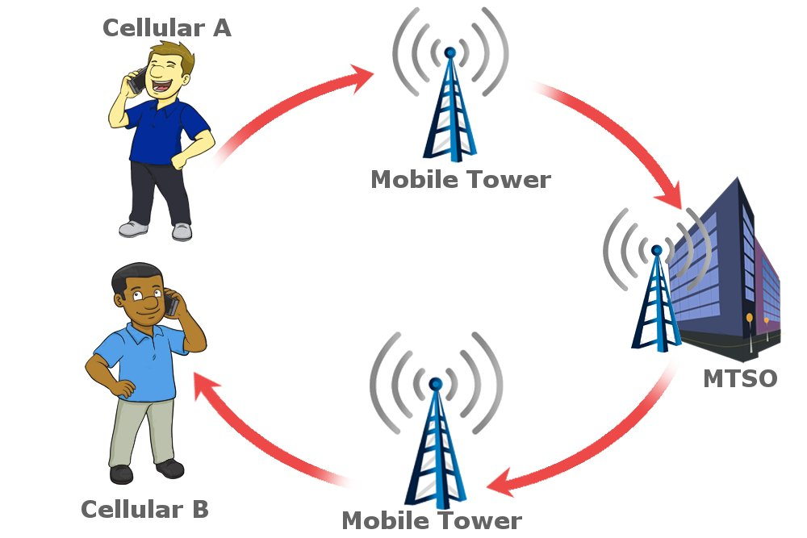
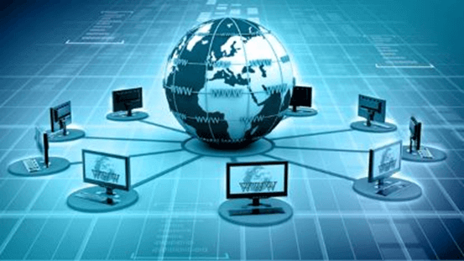
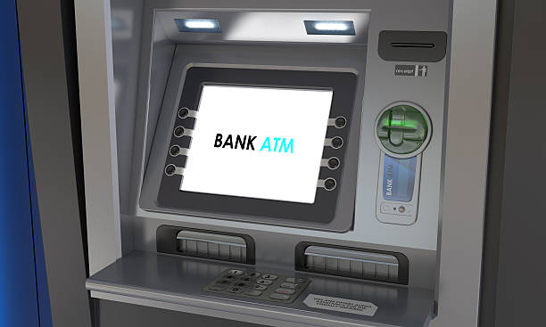
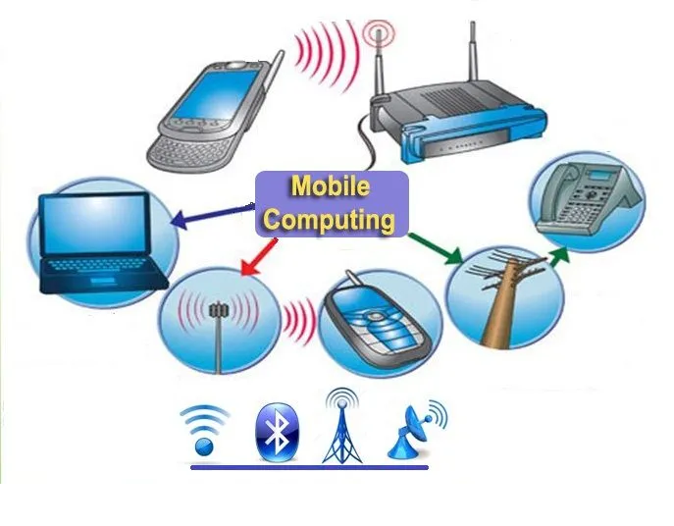
Examples of Distributed Systems
Telephone networks and cellular networks
Computer network such internet
ATM machines
Mobile Computing

Slide 19
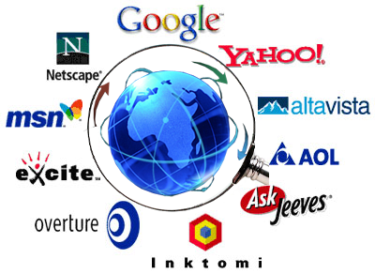
Examples of Distributed Systems
Web Search Engines:
Major growth industry in the last decade.
10 billion per month for global number of searches.
e.g. Google distributed infrastructure
Massively multiplayer online games:
Large number of people interact through the Internet with a virtual world.
Challenges include fast response time, real-time propagation of events.

Slide 20
Goals of Distributed Systems
Connect Users and Resources
Transparency
Openness
Be Scalable:
in size
geographically
administratively

Slide 21
Connect Users and Resources
The main goal of a distributed system is to make it easy for the users (and applications) to access remote resources, and to share them in a controlled and efficient way.
Resources can be just about anything, but typical examples include things like printers, computers, storage facilities, data, files, Web pages, and networks
There are many reasons for wanting to share resources.
One obvious reason is that of economics. For example, it is cheaper to let a printer be shared by several users in a office than having to buy and maintain a separate printer for each user.
Likewise, it makes economic sense to share costly resources such as supercomputers, high-performance storage systems, imagesetters,and other expensive peripherals.

Slide 22
Transparency
To hide the fact that its processes and resources are physically distributed across multiple computers.
A distributed system that is able to present itself to users and applications as if it were only a single computer system is said to be transparent.
Access transparency deals with hiding differences in data representation and the way that resources can be accessed by users.
For example, a distributed system may have computer systems that run different operating systems, each having their own file-naming conventions. Differences in naming conventions, as well as how files can be manipulated, should all be hidden from users and applications.

Slide 23
An important group of transparency types has to do with the location of a resource. Location transparency refers to the fact that users cannot tell where a resource is physically located in the system.
Distributed systems in which resources can be moved without affecting how those resources can be accessed are said to provide migration transparency.
The situation in which resources can be relocated while they are being accessed without the user or application noticing anything. In such cases, the system is said to support relocation transparency.
Resources may be replicated to increase availability or to improve performance by placing a copy close to the place where it is accessed. Replication transparency deals with hiding the fact that several copies of a resource exist.

Slide 24
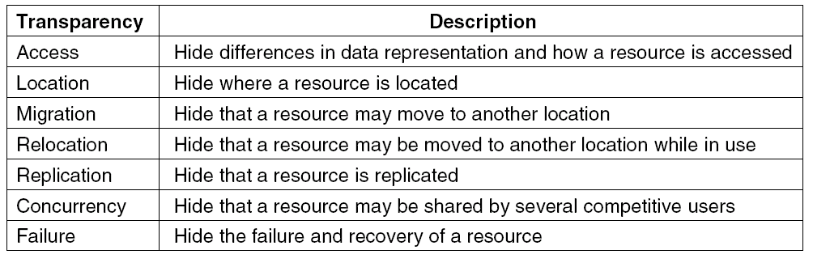
Transparency in a Distributed System
Different forms of transparency in a distributed system

Slide 25
Openness
An open distributed system is a system that offers services according to standard rules that describe syntax and semantics of the services.
In distributed system, services are generally specified through interfaces, which are often described in an Interface Definition Language (IDL).
Interface definitions written in an IDL nearly always capture only the syntax of services. In other words, they specify precisely the names of the functions that are available together with types of the parameters, return values, possible exceptions that can be raised.
It should be easy to configure the system out of different components.

Slide 26
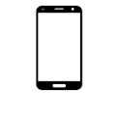





Distributed System Goals

Slide 27
Scalability
A system is said to be scalable if it can handle the addition of users and resources without suffering a noticeable loss of performance or increase in administrative complexity
Scale has three dimensions:
Size: number of users and resources . we can easily add more users and resources to the system.(problem: overloading)
Geography: In which the users and resources may lie far apart. (problem:
communication)
Administration:it can still be easy to manage even if it spans many independent administrative organizations. (problem: administrative mess)

Slide 28
DISTRIBUTED SYSTEM Concepts
Hardware Concepts | Software Concepts
Multicomputer | Uniprocessor OS
Multiprocessor | Multiprocessor OS
 | Network OS (NOS)
 | Distributed OS (DOS)
 | Middleware

Slide 29
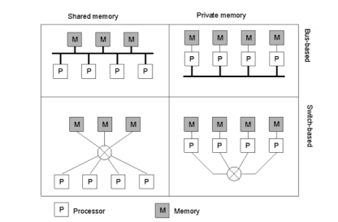
Multiprocessor and multicomputers
Computers that have shared memory is called Multiprocessors.
Those that do not share is called Multicomputers.
In Multiprocessor , if any CPU writes value 44 to address 100,any other CPU subsequently reading from its address 100 will get the value 44.
In Multicomputer…..

Slide 30
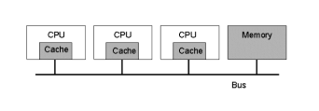
Multiprocessor
Coherent Memory
4-5 CPU will saturate the BUS
Add cache memory between the CPU and bus
Incoherent Memory

Slide 31
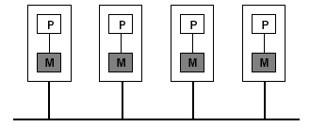
Multicomputer
Homogeneous (all nodes support same physical architecture)
Heterogeneous (does not support same physical architecture)
Computers that are part of the system may vary with respect to processor type, memory sizes and I/O bandwidth.

Slide 32
Software Concept
Mostly the software determines what a distributed system actually looks like
Distributed systems are very much like traditional operating systems.
Distributed systems act as a resource managers for the underlying hardware
Allowing multiple users and applications to share resources
Hide the heterogeneous nature of the underlying hardware.
By providing a virtual machine on which applications can be easily executed

Slide 33
Software Concept
Operating systems for distributed computers can be roughly divided into two categories:
Tightly coupled systems
The OS maintain a single, global view of the resources
Generally referred to as a distributed operating system (DOS)
Used for managing multiprocessors and homogeneous multicomputers.
Loosely-coupled systems
A collection of computers each running their own operating system.
However, these operating systems work together to make their own services and resources available to the others.
The loosely-coupled network operating system (NOS) is used for heterogeneous multicomputer systems.

Slide 34
Software Concept
Middleware
Enhancement to the services of the network operating system are needed so that better support for distribution transparency can be provided.
These enhancements leads to Middleware which lie at the heart of modern distributed system.

Slide 35
Software Concept
System | Description | Main Goal
DOS | Tightly-coupled operating system for multi-processors and homogeneous multicomputers | Hide and manage hardware resources
NOS | Loosely-coupled operating system for heterogeneous multicomputers (LAN and WAN) | Offer local services to remote clients
Middleware | Additional layer at top of NOS implementing general-purpose services | Provide distribution transparency

Slide 36
Distributed Operating System
Two types of distributed operating systems.
A multiprocessor operating system
Manages the resources of a multiprocessor.
A multicomputer operating system
An operating system that is developed for homogeneous multicomputers

Slide 37
Uniprocessor OS
To allow users and applications an easy way of sharing resources such as CPU,main memory, disks and peripheral devices.
Sharing resources means that different applications make use of same hardware in an isolated fashion.
To an application, it appears as if it has its own resources and that there may be several applications executing on same system at the same time each with their own set of resources.
Communication Primitives
Kernel Mode
User Mode

Slide 38
Multiprocessor Operating System
Multiprocessor- uses different system services to manage resources connected in a system and use system calls to communicate with the processor.
Multiple processors with shared memory
Support for multiple processors having access to a shared memory.
Problem: consistency
Solutions: synchronization
Semaphore
Monitor: programming-language concept since semaphore is error-prone

Slide 39
Distributed Operating System(DOS)
A tightly coupled operating system is generally referred to as a distributed operating system (DOS).
In distributed OS, a common set of services is shared among multiple processors in such a way that they are meant to execute a distributed application effectively and also provide services to separate independent computers connected in a network as shown in fig below
It communicates with all the computer using message passing interface(MPI).
It uses Data structure like queue to manages the messages and avoid message loss between sender and receiver computer.
Eg Automated banking system, railway reservation system etc.

Slide 40
Distributed Operating System(DOS)
Users not aware of multiplicity of machines
Access to remote resources similar to access to local resources
High degree of transparency (single system image)
Homogeneous hardware
Disadvantages:
It has a problem of scalability as it supports only limited number of independent computers with shared resources.
There is need to define message passing semantics prior to the execution of messages.

Slide 41
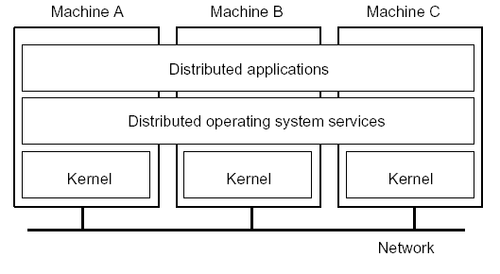
Distributed Operating System(DOS)
Each node has its own kernel containing modules for managing local resources.
Above each layer of kernel is a common layer of software that implements the operating system as virtual machine supporting parallel and concurrent execution of various tasks.
Apart form that is support distributed services (services may include, assignment of tasks to processors,masking hardware failure, transparent storage, interprocess communication, etc.)

Slide 42
Network Operating Systems
NOS does not assume underlying hardware is homogeneous and be managed as a single system
Different from distributed OS
NOS is constructed from a collection of uniprocessor systems, each with its own operating systems as shown in figure.
The machine and their os may be different but they are connected in a network.
Network operating system provides facilities to allow users to make use of the services available on a specific machine.
Example,
To allow a user to log into another machine remotely by using command rlogin machine.
Command to copy files from one machine to another machine.

Slide 43
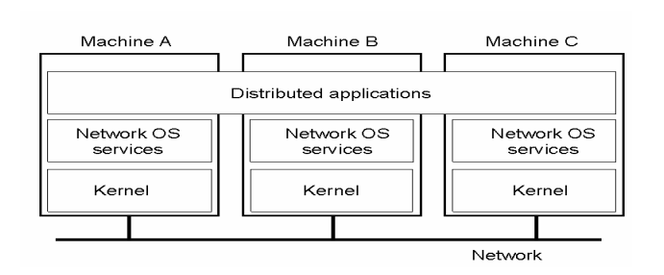
Network Operating Systems
Disadvantages
Management problem because all machine in nos are independent
Difference between NOS and DOS
DOS attempts to realize full transparency and provide a single-system view
Transparency is missing in NOS

Slide 44
Middleware
Neither a distributed operating system or a network operating system really qualifies as a distributed system according to the definition.
Distributed operating system is not intended to handle a collection of independent computers, while a network operating system does not provide a view of a single coherent system.
The question comes to mind whether it is possible to develop a distributed system that has the best of both words: the scalability of network operating systems and the transparency and related ease of use of distributed operating systems.
The solution is to be found in an additional layer of software that is used in network operating systems to more or less hide the heterogeneity of the collection of underlying platforms but also to improve distribution transparency.
Many modern distributed systems are constructed by means of such an additional layer of what is called middleware.

Slide 45
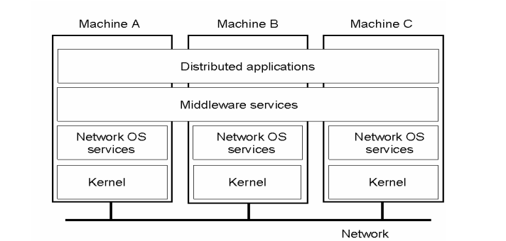
Middleware
It has a common set of services is provided for the local applications and independent set of services for the remote applications.
It provide the services such as locating the objects or interfaces by their names, finding the location of objects, maintaining the quality of services, handling the protocol information, synchronization, concurrency and security of the objects etc.

Slide 46
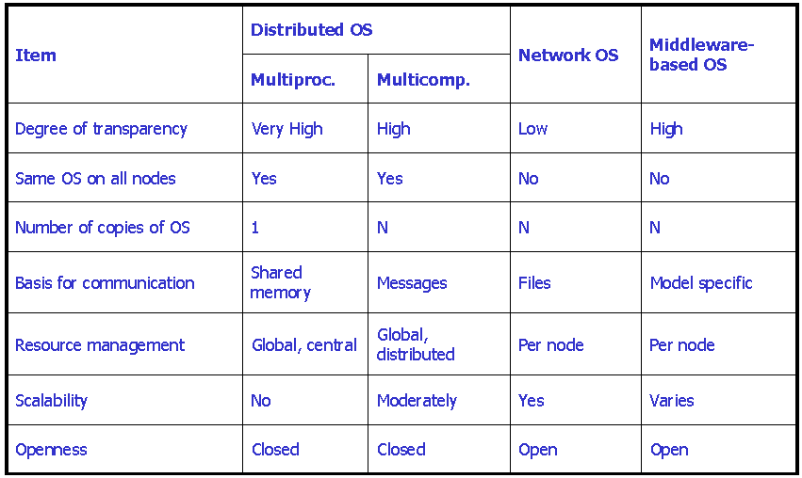
Comparison between systems

Slide 47
Architectural Styles
Distributed systems are often complex pieces of software of which the components are by definition dispersed across multiple machines.
To master their complexity, it is crucial that these systems are properly organized.
There are different ways on how to view the organization of a distributed system, but an obvious one is to make a distinction between the logical organization of the collection of software components and on the other hand the actual physical realization.
Software Architecture
System Architecture

Slide 48
Architectural Styles
An architectural style describes a particular way to configure a collection of components and connectors.
Component - a module with well-defined interfaces; reusable, replaceable
Connector – communication link between modules
RPC, Message Passing or streaming data
Important styles of software architecture for distributed systems:
Layered architectures
Object-based architectures
Data-centered architectures
Event-based architectures

Slide 49
Layered architectures
The Components are organized in a layered fashion where a component at layer Li is allowed to call components at the underlying layer Li-1, but not the other way around,
This model has been widely adopted by the networking community
An key observation is that control generally flows from layer to layer; requests go down the hierarchy whereas the results flow upward.
Layer N
Layer N-1
Request flow
Response flow
Layer 2
Layer 1

Slide 50
Object-based architectures
Each object corresponds a component
Components are connected through a (remote) procedure call mechanism.
The layered and object-based architectures still form the most important styles for large software systems
Object
Object
Object
Method call
Object
component = object connector = RPC or RMI
Object

Slide 51
Data-centered architectures
It evolve around the idea that processes communicate through a common (passive or active) repository.
It can be argued that for distributed systems these architectures are as important as the layered and object-based architectures
For example,
A wealth of networked applications have been developed that rely on a shared distributed file system in which virtually all communication takes place through files.
Web-based distributed systems are largely data-centric: processes communicate through the use of shared Web-based data services.
Component
Component
Data delivery
Publish
Shared (persistent) data space

Slide 52
Event-based architectures
Processes communicate through the propagation of events.
For distributed systems, event propagation has generally been associated with what are known as publish/subscribe systems.
Middleware
Advantage - processes are loosely coupled. In principle, they need not explicitly refer to each other.
Component
Component
Event delivery
Event bus
Publish
Component

Slide 53
System Architecture
There are three views toward system architectures:
Centralized Architectures
Decentralized architectures
Hybrid Architectures

Slide 54
Centralized Architectures
Manage distributed system complexity – think in terms of clients that request services from servers.
Processes are divided into two groups:
A server is a process implementing a specific service, for example, a file system service or a database service.
A client is a process that requests a service from a server by sending it a request and subsequently waiting for the server's reply.
wait for result
Client
Request
Reply
Server
Provide service
Time

Slide 55
Centralized Architectures
Communication - implemented using a connectionless protocol when the network is reliable e.g. local-area networks.
Client requests a service –sends a message for the server, identifying the service it wants, along with the necessary input data.
The Server will always wait for an incoming request, process it, and package the results in a reply message that is then sent to the client.

Slide 56
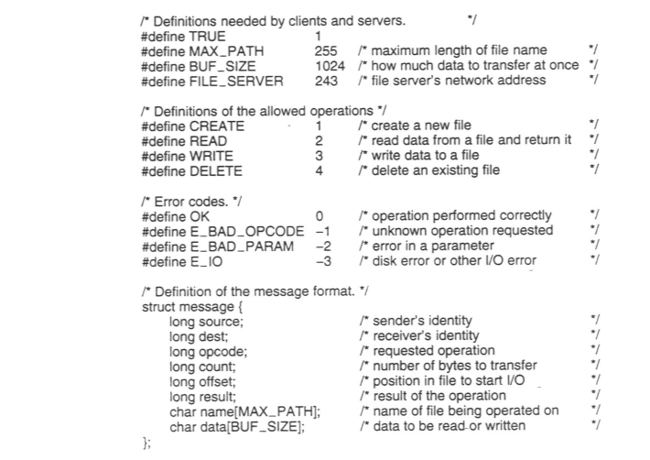
Client Server

Slide 57
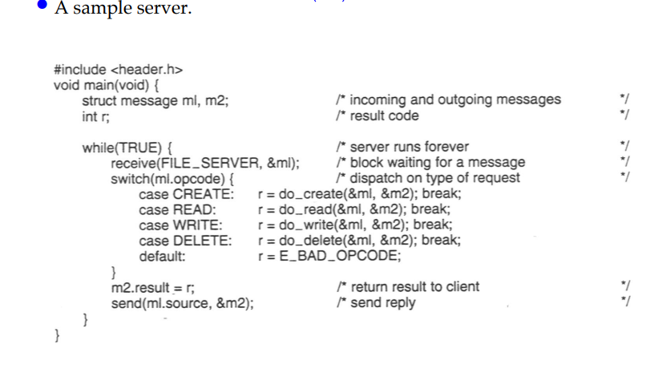

Slide 58
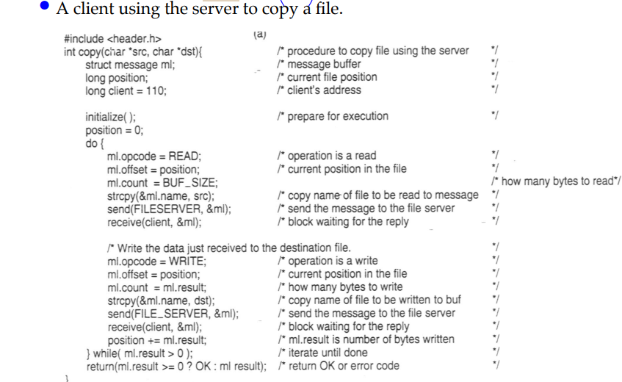

Slide 59
Application Layering
Traditional three-layered view:
The user-interface level
It contains units for an application’s user interface
Clients typically implement the user-interface level
Simple GUI
The processing level
It contains the functions of an application, i.e. without specific data
Middle part of hierarchy -> logically placed at the processing level
The data level
It contains the data that a client wants to manipulate through the application components
manages the actual data that is being acted on

Slide 60
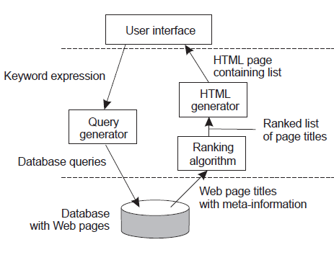
Internet search engine- An example of Application Layering
Traditional three-layered view:
User-interface level: a user types in a string of keywords and is subsequently presented with a list of titles of Web pages.
Data Level: huge database of Web pages that have been prefetched and indexed.
Processing level: search engine that transforms the user's string of keywords into one or more database queries.
Ranks the results into a list
Transforms that list into a series of HTML pages
User-interface level
Processing level
Data level

Slide 61
Multi-Tiered Architectures
Simplest organization - two types of machines:
A client machine containing only the programs implementing (part of) the user-interface level
A server machine containing the rest, that is the programs implementing the processing and data level
Single-tiered: dumb terminal/mainframe configuration
Two-tiered: client/single server configuration
Three-tiered: each layer on separate machine

Slide 62
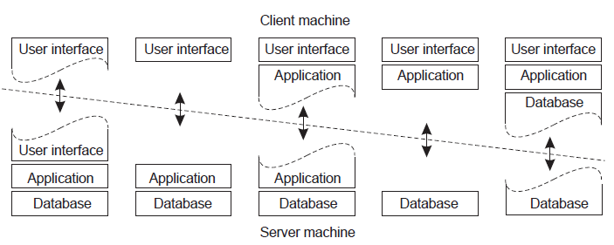
Two-tiered Architectures - Thin-client model and fat-client model
A
B
C
D
E
Case-A: Only the terminal-dependent part of the user interface
Case- B: Place the entire user-interface software on the client side
Case- C: Move part of the application to the front end

Slide 63
Two-tiered Architectures - Thin-client model and fat-client model
Thin
Client
Fat
Client
A
B
C
D
E
Case-D: Used where the client machine is a PC or workstation, connected through a network to a distributed file system or database. Banking Application
Case- E: Local disk

Slide 64
Thin client model
Used when legacy systems are migrated to client server architectures.
The legacy system acts as a server in its own right with a graphical interface implemented on a client.
A major disadvantage is that it places a heavy processing load on both the server and the network.
Fat Client Model
More processing is delegated to the client as the application processing is locally executed.
Most suitable for new C/S systems where the capabilities of the client system are known in advance.
More complex than a thin client model especially for management. New versions of the application have to be installed on all clients.

Slide 65
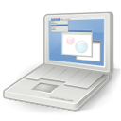

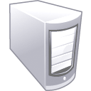


Multitiered Architectures (3-Tier Architecture)
Data Tier
(Back-End)
Middle Tier
(Business Tier)
Client Tier (Front-End)
Client
Machine
network
network
Mobile
Client
network
Database
Business
Logic
Desktop
Client
65

Slide 66
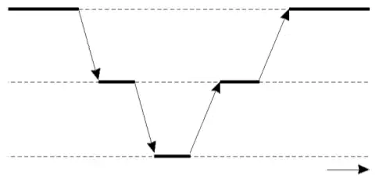
Multitiered Architectures (3-Tier Architecture)
The server tier in two-tiered architecture becomes more and more distributed
Distributed transaction processing
A single server is no longer adequate for modern information systems
This leads to three-tiered architecture
Server may acting as a client
Waiting for result
An example of a
server acting as client
User interface
(presentatio)
Request
operation
Return result
Application
server
Request data
Return data
Database
server
Time

Slide 67
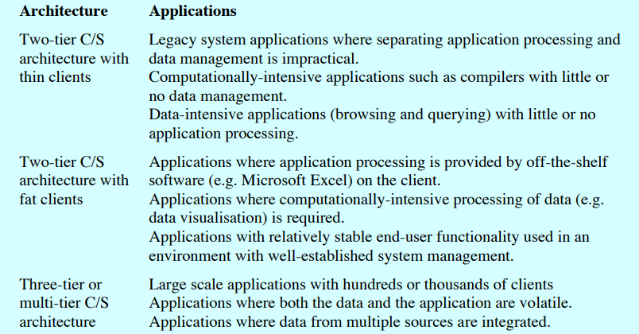

Slide 68
Decentralized Architectures
Multi-tiered architectures can be considered as vertical distribution
Placing logically different components on different machines
An alternative is horizontal distribution (peer-to-peer systems)
A collection of logically equivalent parts
Each part operates on its own share of the complete data set, balancing the load
Peer-to-peer architectures - how to organize the processes in an overlay network in which the nodes are formed by the processes and the links represent the possible communication channels (which are usually realized as TCP connections).
Decentralized Architectures Types
Structured P2P
Unstructured P2P

Slide 69
Structured P2P Architectures
There are links between any two nodes that know each other
Structured: the overlay network is constructed in a deterministic procedure
Most popular: distributed hash table (DHT)
DHT-based system
Data items are assigned a random key from a large identifier space, such as a 128-bit or 160-bit identifier.

Slide 70
Unstructured P2P Architectures
Largely relying on randomized algorithm to construct the overlay network
Each node has a list of neighbors
Many systems try to construct an overly network that resembles a random graph
Each node maintains a partial view, i.e., a set of live nodes randomly chosen from the current set of nodes constructed in a random way
An unstructured P2P network is formed when the overlay links are established arbitrarily.
Data items are randomly mapped to some node in the system & lookup is random.
In an unstructured P2P network, if a peer wants to find a desired piece of data in the network, the query has to be flooded through the network in order to find as many peers as possible that share the data..

Slide 71
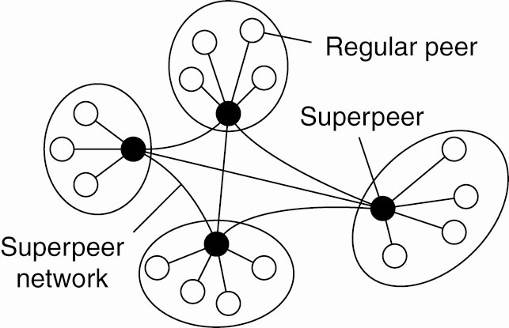
Superpeers
Used to address the following question
How to find data items in unstructured P2P systems
Flood the network with a search query?
An alternative is using superpeers
Nodes such as those maintaining an index are generally referred to as superpeers
They hold index of info. from its associated peers (i.e. selected representative of some of the peers)
Fixed association with superpeers
A hierarchical organization of nodes into a superpeer network

Slide 72
Hybrid Architectures
Many real distributed systems combine architectural features
combine client-server architecture (centralized) with peer-to-peer architecture (decentralized)
Two examples of hybrid architectures
Edge-server systems
Collaborative distributed systems

Slide 73
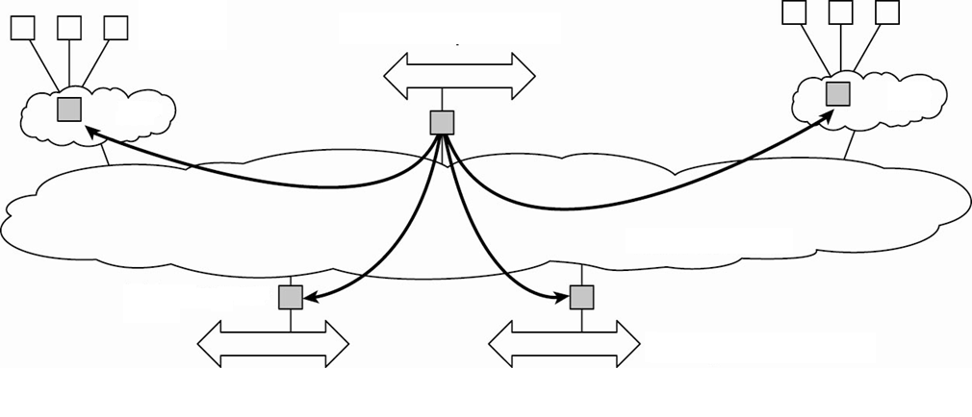
Edge-Server Systems
Deployed on the Internet where servers are “at the edge” of the network.
Each client connects to the Internet by means of an edge server.
Client
Content provider
ISP
ISP
Core Internet
Edge server
Enterprise network

Slide 74
Collaborative Distributed Systems
A hybrid distributed model that is based on mutual collaboration of various systems
Client-server scheme is deployed at the beginning
Fully decentralized scheme is used for collaboration after joining the system
Examples of Collaborative Distributed System:
BitTorrent: is a P2P File downloading system. It allows download of various chunks of a file from other users until the entire file is downloaded
Globule: A Collaborative content distribution network. It allows replication of web pages by various web servers

Slide 75
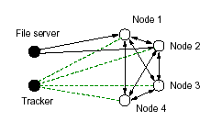
Collaborative Distributed Systems
In collaborative distributed systems, peers typically support each other to deliver content in a peer to peer like architecture, while they use a client server architecture for the initial setup of the network.
Nodes requesting to download a file from a server first contact the server to get the location of a tracker.
Tracker keeps track of active nodes that have chunks of file.
Using information from the tracker, clients can download the file in chunks from multiple sites in the network.
Nodes must then offer downloaded chunks to other nodes and are registered with the tracker, so that the other nodes can find them.

