Slide 1
Communication in a Distributed System
In a distributed system, processes run on different machines.
Processes can only exchange information through message passing.
Harder to program than shared memory communication
Successful distributed systems depend on communication models that hide or simplify message passing
Communication in distributed systems is always based on low-level message passing as offered by the underlying network.

Slide 2
Layered Network Communication Protocols
Physical layer:
Transmitting bits between sender and receiver
Functions of a Physical layer: Line Configuration, Data Transmission, Topology, Signals
Data link layer:
transmitting frames over a link, error detection and correction
Functions of a Datalink layer: Framing, Flow Control, Error Control, Access Control
Network layer:
Routing of packets between source host and destination host
Application protocol
Application
7
Presentation
Presentation protocol
6
Session
Session protocol
5
Transport protocol
Transport
4
Network
Network protocol
3
Data link protocol
Data link
2
Physical protocol
Physical
1
Network

Slide 3
Layered Network Communication Protocols
Transport layer:
Process‐to‐process communication
TCP and UDP ‐ Internet’s transport layer protocols
TCP: Connection‐oriented, Reliable communication
UDP: Connectionless, Unreliable communication
Session layer:
It establishes, manages, and terminates the connections between the local and remote application.
Functions of Session layer: Dialog control, Synchronization
Application protocol
Application
7
Presentation protocol
Presentation
6
Session
Session protocol
5
Transport protocol
Transport
4
Network
Network protocol
3
Data link protocol
Data link
2
Physical protocol
Physical
1
Network

Slide 4
Layered Network Communication Protocols
Presentation layer:
Transforms data to provide a standard interface for the Application layer.
Functions of Presentation layer:
MIME encoding
Data compression
Data encryption
Application layer:
Provides means for the user to access information on the network through an application
It serves as a window for users and application processes to access network service.
Application protocol
Application
7
Presentation
Presentation protocol
6
Session
Session protocol
5
Transport protocol
Transport
4
Network
Network protocol
3
Data link protocol
Data link
2
Physical protocol
Physical
1
Network

Slide 5
Middleware Layer
Middleware provides common services and protocols that can be used by many different applications
High‐level communication services, e.g., RPC, multicasting
Security protocols, e.g., authentication protocols, authorization protocols
Distributed locking protocols for mutual exclusion
Distributed commit protocols
Application protocol
Application
6
Middleware
Middleware protocol
5
Transport
Transport protocol
4
Network
Network protocol
3
Data link protocol
Data link
2
Physical protocol
Physical
1
Network

Slide 6
OSI Model
Application Layer
Application layer is used by Network applications.
Example: browsers
Data
Compression
Translation
Encryption
Presentation Layer
EDB12345AB
1010110010
10110100
01010101
Session Management – Securing multiple requests to a service from the same user.
Authentication - Who you are?
Authorization - Rules that determine who is allowed to do what.
Decryption
Session Layer
Segmentation: Received data divided into small data units called segments.
Flow control: It controls amount of data being transmitted.
Error Control: It is the process of detecting and correcting corrupted segments.
Transport Layer
Logical addressing
Routing
Path determination
Network Layer
Physical addressing
Media access control
Error correction
Data Link Layer
Physical Layer

Slide 7
OSI Model (Layers & Activities)
OSI Layers
Activities
Application
To allow access to network resources.
Presentation
To translate, compress, and encrypt/decrypt data.
Session
To establish, manage, and terminate session.
Transport
To provide reliable process-to-process
message delivery and error recovery.
Network
To move packets from source to destination;
To provide internetworking.
Data Link
To organize bits into frames;
To provide hop-to-hop delivery.
Physical
To transmit bits over a medium;
To provide mechanical and electrical specifications.

Slide 8
COMMUNICATION
In distributed system processes running on separate computers cannot directly access each other’s memory.
Two approaches to communication:
Shared memory-processes must have access to some form of shared memory (i.e., they must be threads, they must be processes that can share memory, or they must have access to a shared resource, such as a file)
Message passing- processes to communicate by sending each other messages

Slide 9
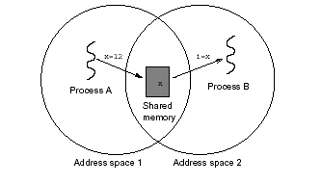
Shared Memory
Shared Memory:
There is no way to physically share memory
Distributed Shared Memory

Slide 10
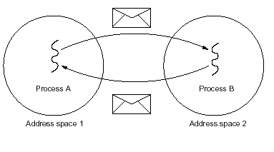
Message Passing
Message Passing:
Over the network
Introduces higher chances of failure
Heterogeneity introduces possible incompatibilities

Slide 11
Message Passing
It refers to means of communication between
Different thread with in a process .
Different processes running on same node.
Different processes running on different node.
In this a sender or a source process send a message to a non receiver or destination process.
Message has a predefined structure and message passing uses two system call: Send and Receive
send(name of destination process, message)
receive(name of source process, message)
P1
Send
P2
Receive
Sender
Receiver

Slide 12
Client Server Model
Following are different types of packets transmitted across the network.
REQ: Request packet is used to send the request from the client to the server.
Reply: This message is used to carry the result from the server to the client.
ACK: Acknowledgement packet is used to send the correct receipt of the packet to the sender.
Are You Alive (AYA)?: This packet is sent in case the server takes a long time to complete the client's request.
I am Alive (IAA): The server, if active, replies with this packet.

Slide 13
Client Server Model Interaction
Two processes in client-server model can interact in various ways:
Sockets
Remote Procedure Calls (RPC)
Socket
The process acting as server opens a socket using a well-known port and waits until some client request comes.
The second process acting as a client also opens a socket but instead of waiting for an incoming request, the client processes ‘requests first’.
Server Program
Client Program
Socket
Socket
Transport
Transport
Network
Network
Data link
Data link
Physical
Physical

Slide 14
Remote Procedure Call (RPC)
Low level message passing is based on send and receive primitives.
Remote Procedure Call (RPC) is a protocol that one program can use to request a service from a program located in another computer on a network without having to understand the network's details.
A procedure call is also sometimes known as a function call or a subroutine call.
More sophisticated is allowing programs to call procedures located on other machines.
RPC is a request–response protocol, i.e., it follows the client-server model
wait for result
Client
call remote procedure
return from call
Request
Reply
Server
call local procedure and return results
time

Slide 15
How RPC Works
An RPC is analogous to a function call. Like a function call, when an RPC is made, the calling arguments are passed to the remote procedure and the caller waits for a response to be returned from the remote procedure.
The client makes a procedure call that sends a request to the server and waits.
The thread is blocked from processing until either a reply is received, or it times out. When the request arrives, the server calls a local procedure that performs the requested service, and sends the reply to the client.
After the RPC call is completed, the client program continues. RPC specifically supports network applications.

Slide 16
one procedure (caller) calls another procedure (callee)
the caller waits for the result from the callee
the callee receives the request, computes the results, and then send them to the caller
the caller resumes upon receiving the results from the callee
How RPC Works
CALLER
arguments
CALLEE
invokes a procedure on the callee
receives the request
waits
computes the results
sends the results
results
resumes
RPC call between two networked systems

Slide 17
RPC Model
It is similar to commonly used procedure call model. It works in the following manner:
For making a procedure call, the caller places arguments to the procedure in some well specified location.
Control is then transferred to the sequence of instructions that constitutes the body of the procedure.
The procedure body is executed in a newly created execution environment that includes copies of the arguments given in the calling instruction.
After the procedure execution is over, control returns to the calling point, returning a result.

Slide 18
Functions of RPC Elements
The Client
It is user process which initiates a remote procedure call
The client makes a perfectly normal call that invokes a corresponding procedure in the client stub.
The Client stub
On receipt of a request it packs a requirements into a message and asks the local RPCRuntime to send it to the server stub.
On receipt of a result it unpacks the result and passes it to client.

Slide 19
Functions of RPC Elements
RPCRuntime
It handles transmission of messages between client and server.
It is responsible for
Retransmission
Acknowledgement
Routing and Encryption
The Server stub
It unpacks a call request and make a perfectly normal call to invoke the appropriate procedure in the server.
On receipt of a result of procedure execution it packs the result and asks to RPCRuntime to send.
The Server
It executes a appropriate procedure and returns the result from a server stub.

Slide 20
RPC Mechanism
Client Machine
Server Machine
Client
Server
Return
Call
Call
Execute
Return
Client Stub
Server Stub
Unpack
Pack
Unpack
Pack
RPCRuntime
RPCRuntime
Receive
Send
Receive
Send
Call Packet
Request Packet

Slide 21
RPC Mechanism
Client Machine
Client Machine
The client process call the server procedure.
Just like local procedure call, the client process sends the arguments required for the execution of the program.
As it happened the client system, the server stub packs the return value into a message, and sends it to the RPC runtime system.
The underlying layers of the communication system will then send the message back to the client system.
During the execution of a program, the client feels the need to call the server procedure.
The client process has passed the parameter for the server process, but server can only understand message, not parameters.
The client stub packs the arguments in the form of message.
It sends the message to the server system.
Sockets are used in the communication between the client and server.
It passes the message to the underlying communication layers.
The server stub unpack the parameters.
It calls the desired server routine using the regular procedure call mechanism.
The server stub and the client stub must share the same standards of encoding the parameters, else the parameters could be misread at the server end.
The client system captures the packets, parses and sends the message to the client stub.
Client stub unpacks the parameters and sends the return value to the client process.
The client process which was blocked till now, is activated and the process continues its execution.
The process running on the server recognizes the parameters and performs the required operations, and sends the return value to the server stub.
The server procedure feels that the caller process is the server stub, and has no idea about the client process.
Client
The receiver socket at the server end receives the packets from the client and recognized that it is a procedure call.
The message is then redirected to the server stub.
Server
Return
Call
Call
Execute
Return
Return
Client Stub
Server Stub
Unpack
Pack
Unpack
Pack
RPCRuntime
RPCRuntime
Receive
Wait
Send
Receive
Send
Call Packet
Request Packet

Slide 22
RPC Mechanism
Client procedure calls client stub.
Remote OS gives message to server stub.
Client stub builds message, and calls local OS.
Client’s OS sends message to remote OS.
Server stub unpacks parameters, calls server.
Client Machine
Server Machine
Client process
Server process
8 ← add(3, 5)
K=add(3, 5)
Implementation of add
Client stub (RPC library)
Server stub (RPC library)
proc: add | int: 3 | int: 5
proc: add | int: 3 | int: 5
Client OS
Server OS
proc: add | int: 3 | int: 5
proc: add | int: 3 | int: 5

Slide 23
RPC Mechanism
Server’s OS sends message to the client’s OS.
Server does work, returns result to the stub.
Stub unpacks result, returns to client.
Server stub packs it in message, calls local OS.
Client’s OS gives message to client stub.
Client Machine
Server Machine
Client process
Server process
8 ← add(3, 5)
K = 8
Implementation of add
K=add(3, 5)
Client stub (RPC library)
Server stub (RPC library)
Result | int: 8
Result | int: 8
Client OS
Server OS
Result | int: 8
Result | int: 8

Slide 24
Steps in a Remote Procedure Call
The client calls a local procedure, called the client stub.
Network messages are sent by the client stub to the remote system (via a system call to the local kernel using sockets interfaces).
Network messages are transferred by the kernel to the remote system via some protocol (either connectionless or connection-oriented).
A server stub, sometimes called the skeleton, receives the messages on the server. It unmarshals the arguments from the messages.
The server stub calls the server function, passing it the arguments that it received from the client.
When server function is finished, it returns to the server stub with its return values.
The server stub converts the return values, if necessary, and marshals them into one or more network messages to send to the client stub.

Slide 25
Steps in a Remote Procedure Call
Messages get sent back across the network to the client stub.
The client stub reads the messages from the local kernel.
The client stub then returns the results to the client function, converting them from the network representation to a local one if necessary.

Slide 26
Passing Value Parameters
Packing parameters into a message is called parameter marshaling.
Client and server machines may have different data representations (think of byte ordering)
Wrapping a parameter means transforming a value into a sequence of bytes
Client and server have to agree on the same encoding:
How are basic data values represented (integers, floats, characters)
How are complex data values represented (arrays, unions)
Client and server need to properly interpret messages, transforming them into machine-dependent representations.
Possible problems:
IBM mainframes use EBCDIC char code and IBM PC uses ASCII code
Integer: one’s complement and 2’s complement
Little endian and big endian

Slide 27
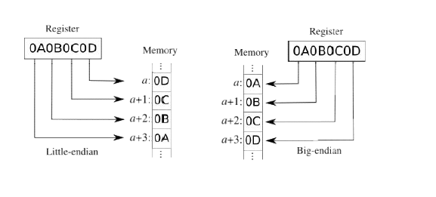

Slide 28
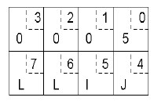
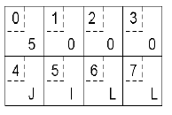
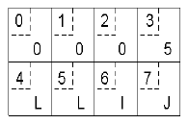
Passing Value Parameters
Original message on the Pentium
The message after receipt on the SPARC
The message after being inverted

Slide 29
Server Management
Stateful File Servers
A stateful server maintains client’s state information from one remote procedure call to the next.
These clients state information is subsequently used at the time of executing the second call.
To illustrate how a stateful file server works, let us consider a file server for byte-stream files that allows the following operations on files:
Open(filename, mode)
Read(fid, n, buffer)
Write(fid, n, buffer)
Seek(fid, position)
Close(fid)

Slide 30
Stateful File Server
After opening a file, if a client makes two subsequent Read (fid, 100, buf) requests, for the first request the first 100 bytes (bytes 0 to 99) will be read and for the second request the next 100 bytes (bytes 100 to 199) will be read.
Client Process
Open(filename, mode)
Server Process
File Table
Return(fid)
Fid | Mode | R/w Pointer
Read(fid, 100, buf)
Return (bytes 0 to 99)
Read(fid, 100, buf)
Return (bytes 100 to 199)

Slide 31
Stateless File Server
A stateless file server does not maintain any client state information.
Therefore every request from a client must be accompanied with all the necessary parameters to successfully carry out the desired operation.
Each request identifies the file and the position in the file for the read/write access.
Operations on files in Stateless File server:
Read(filename, position, n, buffer): On execution, the server returns n bytes of data of the file identified by filename.
Write(filename, position, n, buffer): On execution, it takes n bytes of data from the specified buffer and writes it into the file identified by filename.

Slide 32
Stateless File Server
Client Process
This file server does not keep track of any file state information resulting from a previous operation.
Therefore, if a client wishes to have similar effect as previous figure, the following two read operations must be carried out:
Read(filename, 0, 100, buffer)
Read(filename, 100, 100, buffer)
Server Process
File Table
Read(filename,0, 100, buf)
Fid | Mode | R/w Pointer
Return (bytes 0 to 99)
Read(filename,100, 100, buf)
Return (bytes 100 to 199)

Slide 33
Difference between Stateful & Stateless
Parameters | Stateful | Stateless
State | A Stateful server remember client data (state) from one request to the next. | A Stateless server does not remember state information.
Programming | Stateful server is harder to code. | Stateless server is straightforward to code.
Efficiency | More because clients do not have to provide full file information every time they perform an operation. | Less because information needs to be provided.
Crash recovery | Difficult due to loss of information. | Can easily recover from failure because there is no state that must be restored.
Information transfer | The client can send less data with each request. | The client must specify complete file names in each request.
Operations | Open, Read, Write, Seek, Close | Read, Write

Slide 34
Asynchronous RPC
A shortcoming of the original model: no need of blocking for the client in some cases.
There are two cases
If there is no result to be returned
If the result can be collected later

Slide 35
Asynchronous RPC
1. If there is no result to be returned
e.g., inserting records in a database, ...
The server immediately sends an ack promising that it will carryout the request
Client
wait for result
wait for acceptance
client
call remote procedure
return from call
call remote procedure
return from call
request
reply
request
accept request
Server
server
call local procedure and return results
call local procedure
time
time
The interconnection between client and server in a traditional RPC
The interaction using asynchronous RPC

Slide 36
Asynchronous RPC
1. If the result can be collected later
Example: prefetching network addresses of a set of hosts, ...
The server immediately sends an ACK promising that it will carryout the request
The client can now proceed without blocking
The server later sends the result
Wait for acceptance
Interrupt client
Client
Call remote procedure
Return from call
Return results
Acknowledge
Accept request
Request
Server
Call local procedure
Time
Call client with asynchronous RPC
A client and server interacting through two asynchronous RPCs

Slide 37
RPC Application Development
To develop an RPC application the following steps are needed:
Specify the protocol for client server communication
Develop the client program
Develop the server program
The programs will be compiled separately. The communication protocol is achieved by generated stubs and these stubs and rpc (and other libraries) will need to be linked in.

Slide 38
The rpcgen Protocol Compiler
The easiest way to define and generate the protocol is to use a protocol compiler such as rpcgen.
rpcgen provides programmers a simple and direct way to write distributed applications.
rpcgen is a compiler. It accepts a remote program interface definition written in a language, called RPC Language, which is similar to C.

Slide 39
It produces a C language output which includes stub versions of the client routines, a server skeleton, XDR filter routines for both parameters and results, and a header file that contains common definitions.
The client stubs interface with the RPC library and effectively hide the network from their callers.
The server stub similarly hides the network from the server procedures that are to be invoked by remote clients.

Slide 40
The output of rpcgen is:
A header file of definitions common to the server and the client
A set of XDR routines that translate each data type defined in the header file
A stub program for the server
A stub program for the client

Slide 41
RPC specification
A file with a ``.x'' suffix acts as a remote procedure specification file. It defines functions that will be remotely executed.
Multiple functions may be defined at once. They are numbered from one upward, and any of these may be remotely executed.
The specification defines a program that will run remotely.
The program has a name, a version number and a unique identifying number (chosen by you).

Slide 42
RPC versions and numbers
Each RPC procedure is uniquely identified by a program number, version number, and procedure number.
The program number identifies a group of related remote procedures, each of which has a different procedure number.
Program numbers are given out in groups of hexadecimal 20000000.
0 - 1fffffff defined by Sun,
20000000 - 3fffffff defined by user
Version numbers are incremented when functionality is changed in the remote program.
More than one version of a remote program can be defined and a version can have more than one procedure defined.

Slide 43
Writing protocol specification in RPC language to describe the remote version of calcu_pi.
/* pi.x: Remote pi calculation protocol */
program PIPROG {
version CALCU_PIVERS {
double CALCU_PI() = 1;
} = 1;
} = 0x39876543;
The program PIPROG is 0x39876543, Version number referred to symbolically as CALCU_PIVERS is 1.

Slide 44
In this example,
CALCU_PI procedure is declared to be:
the procedure 1,
in version 1 of the remote program
PIPROG, with the program number 0x39876543.
Notice that the program and procedure names are declared with all capital letters. This is not required, but is a good convention to follow.

Slide 45
To compile a .x file using
rpcgen –a –C pi.x
where:
option –a tells rpcgen to generate all of the supporting files
option –C indicates ANSI C is used

Slide 46
This will generate the files:
pi_clnt.c - the client stub - usually is not modified
pi_svc.c - the server stub - usually is not modified
pi.h - the header file that contains all of the XDR types generated from the specification
makefile.pi - makefile for compiling all of the client and server code
pi_client.c - client skeleton, need to be modified
pi_server.c – server skeleton, need to be modified
pi_xdr.c- Contains XDR filters needed by the client and server stubs – usually is not modified

Slide 47
rpcgen Files
pi_server.c
server files rpcgen common files client files
pi_svc.c
pi_xdr.c
pi.x
pi.h
makefile.pi
pi_clnt.c
pi_client.c

Slide 48
Make changes to pi_client.c file to give actual arguments to call(if required) and to display the output. then save the changes and run the following command.
Write the logic at the location indicated and save the changes. Now, run the last command.
make -f Makefile.add

Slide 49
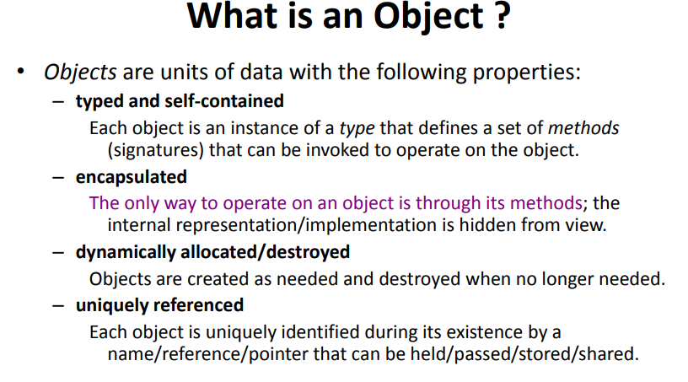

Slide 50
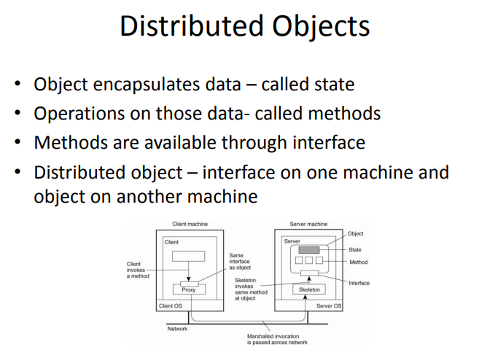

Slide 51
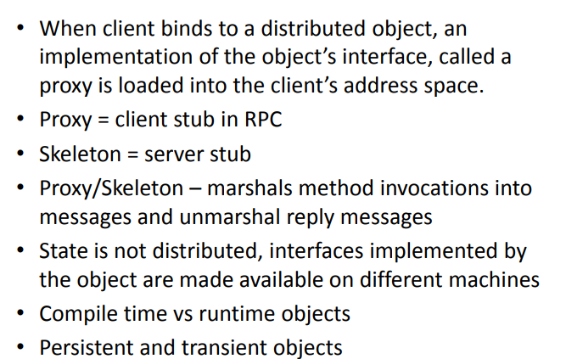

Slide 52
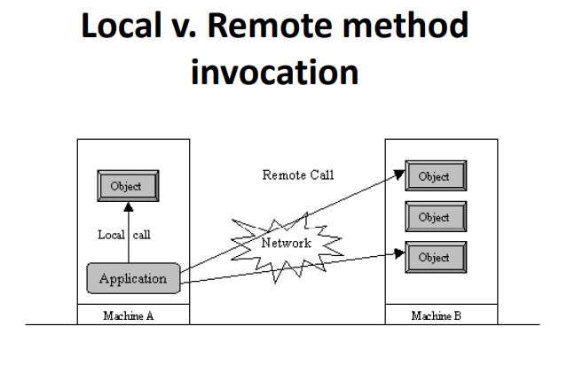

Slide 53
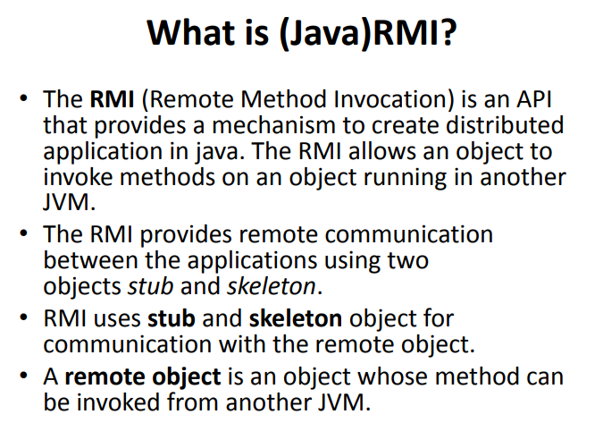

Slide 54
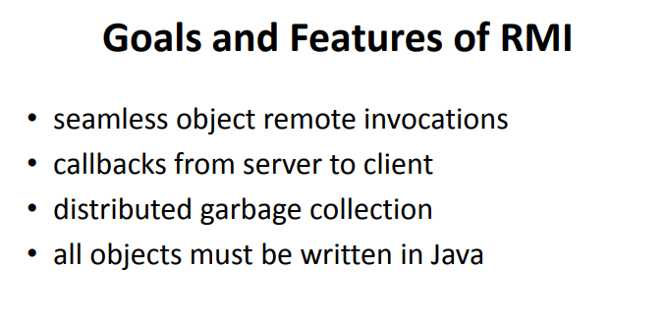

Slide 55
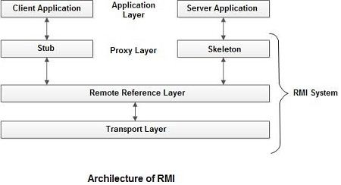
RMI Architecture
Built in three layers
Stub/Skeleton layer
Remote reference layer
Transport layer

Slide 56
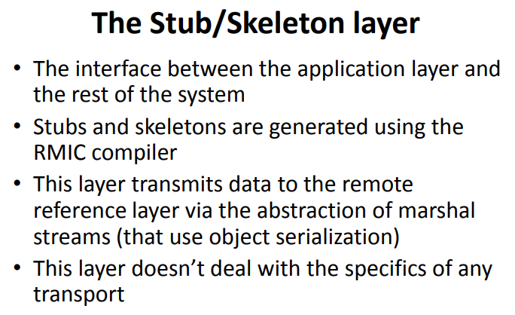

Slide 57
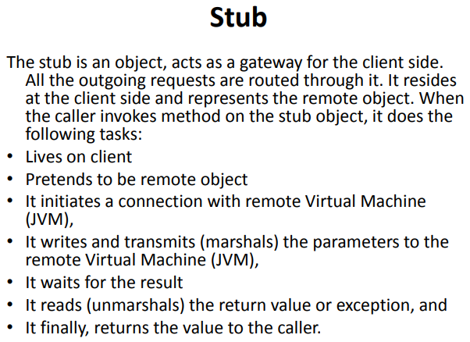

Slide 58
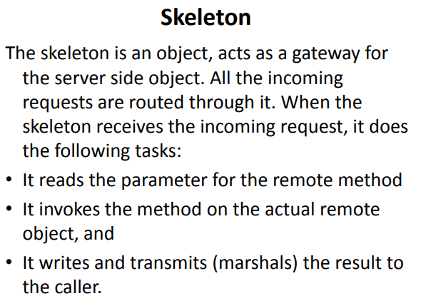

Slide 59
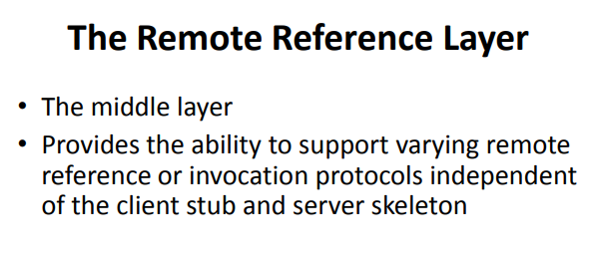

Slide 60
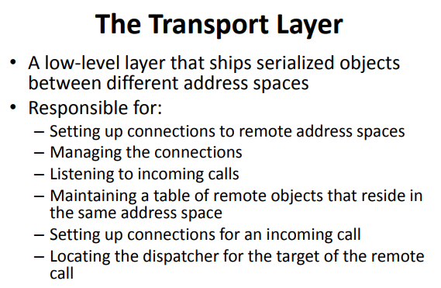

Slide 61
How does RMI work
Defining a remote interface
Implementing the remote interface
Creating Stub and Skeleton objects from the implementation class using rmic (RMI compiler)
Start the rmiregistry
Create and execute the server application program
Create and execute the client application program.

Slide 62
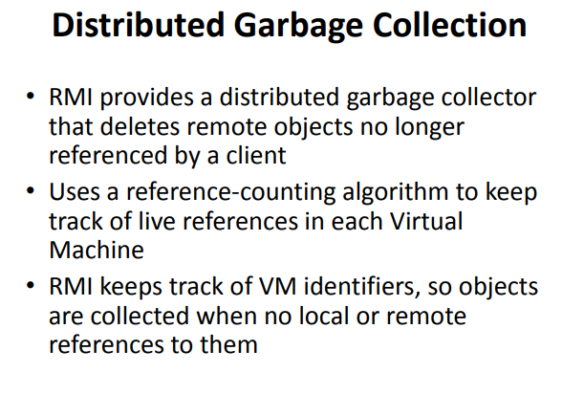

Slide 63
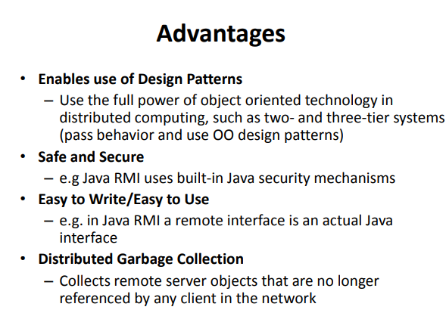

Slide 64
COMMUNICATION ABSTRACTIONS
Number of communication abstractions that make writing distributed applications easier.
Provided by higher level APIs:
Remote Procedure Call (RPC)
Remote Method Invocation (RMI)
Message-Oriented Communication
Group Communication
Streams
*
64

Slide 65
Types of Communication
Transient Vs. Persistent communication
Synchronous Vs. Asynchronous communication

Slide 66
Transient Vs. Persistent communication
Transient Communication
Here, Sender and receiver run at the same time based on request/response protocol, the message is expected otherwise it will be discarded.
Middleware discards a message if it cannot be delivered to receiver immediately
Messages exist only while the sender and receiver are running.
Communication errors or inactive receiver cause the message to be discarded.
Transport-level communication is transient
Persistent Communication
Messages are stored by middleware until receiver can accept it
Receiving application need not be executing when the message is submitted.
Example: Email

Slide 67
Synchronous Vs Asynchronous Communication
Synchronous Communication
Sender blocks until its request is known to be accepted
Sender and receiver must be active at the same time
Sender execution is continued only if the previous message is received and processed.
Asynchronous Communication
Sender continues execution immediately after sending a message
Message stored by middleware upon submission
Message may be processed later at receiver’s convenience

Slide 68
Message Oriented Communication
Persistent asynchronous communication.
Persistent synchronous communication.
Transient asynchronous communication.
Transient synchronous communication.
Receipt-based transient synchronous communication.
Delivery-based transient synchronous communication at message delivery.
Response-based transient synchronous communication.

Slide 69

Message Oriented Communication
A sends message and continues.
A stopped running.
A sends message and waits until accepted.
A stopped running.
A
A
Message is stored at B’s location for later delivery.
Accepted
Time →
Time →
B
B
B is not running
B starts and receives message.
B is not running
B starts and receives message.
Persistent synchronous communication
Persistent asynchronous communication

Slide 70
Message Oriented Communication
A sends message and continues.
A sends message and waits until received.
A
A
Message can be sent only if B is running.
Request is received.
ACK
Time →
Time →
B
B
B receives message.
B is running but doing something else.
B processes request.
Transient asynchronous communication
Receipt-based synchronous communication

Slide 71
Message Oriented Communication
A sends request and waits until accepted.
A sends request and waits for reply.
A
A
Request is received.
Accepted
Accepted
Time →
Request is received.
Time →
B
B
B is running but doing something else.
Process request
B is running but doing something else.
Process request
Delivery-based synchronous communication
Response-based synchronous communication

Slide 72
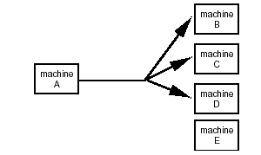
GROUP COMMUNICATION
Sender performs a single send()

Slide 73
GROUP COMMUNICATION
Two kinds of group communication:
Broadcast (messgae sent to everyone)
Multicast (message sent to specific group)
Used for:
Replication of services
Replication of data
Service discovery
Issues:
Reliability
Ordering
Example:
IP multicast

Slide 74
Strems
Support for Continuous Media
Between applications
Between devices
Data represented as single stream rather than discrete chunks

Slide 75
Continuous Media
All communication facilities discussed so far are essentially based on a discrete, that is time independent exchange of information
Continuous media: Characterized by the fact that values are time dependent:
Audio
Video
Animations
Sensor data (temperature, pressure, etc.)

Slide 76
Stream-Oriented Communication
RPC, RMI, message-oriented communication are based on the exchange of discrete messages
Timing might affect performance, but not correctness
In stream-oriented communication the message content must be delivered at a certain rate, as well as correctly.
e.g., music or video
Audio and video are time-dependent data streams – if the timing is off, the resulting “output” from the system will be incorrect.
Time-dependent information – known as “continuous media” communications.

Slide 77
Transmission Modes in Stream-Oriented Communication
Asynchronous transmission mode – the data stream(Sequence of data units) is transmitted in order, but there’s no timing constraints placed on the actual delivery (e.g., File Transfer). no restrictions with respect to when data is to be delivered.
Synchronous transmission mode – define a maximum end-to-end delay for individual data packets (but data can travel faster).
Isochronous transmission mode – data transferred “on time” – there’s a maximum and minimum end-to-end delay (known as “bounded jitter”).
Known as “streams” – isochronous transmission mode is very useful for multimedia systems.
e.g., audio & video

Slide 78
Types of Streams in Stream-Oriented Communication
Simple Streams – consists of a single flow of data, e.g., audio or video
Complex Streams – several sequences of data (substreams) that are “related” by time.
Think of a lip synchronized movie, with sound and pictures, together with sub-titles
This leads to data synchronization problems … which are not at all easy to deal with
multiple data flows, e.g., audio or combination audio/video

