Slide 1
Distributed Systems
Introduction
Chapter 1

Slide 2
Course/Slides Credits
Note: all course presentations are based on those developed by Andrew S. Tanenbaum and Maarten van Steen. They accompany their "Distributed Systems: Principles and Paradigms" textbook (1st & 2nd editions).
http://www.prenhall.com/divisions/esm/app/author_tanenbaum/custom/dist_sys_1e/index.html
And additions made by Paul Barry in course CW046-4: Distributed Systems
http://glasnost.itcarlow.ie/~barryp/net4.html

Slide 3
Definition of a Distributed System (1)
A distributed system is:
A collection of independent computers
that appears to its users
as a single coherent system

Slide 4
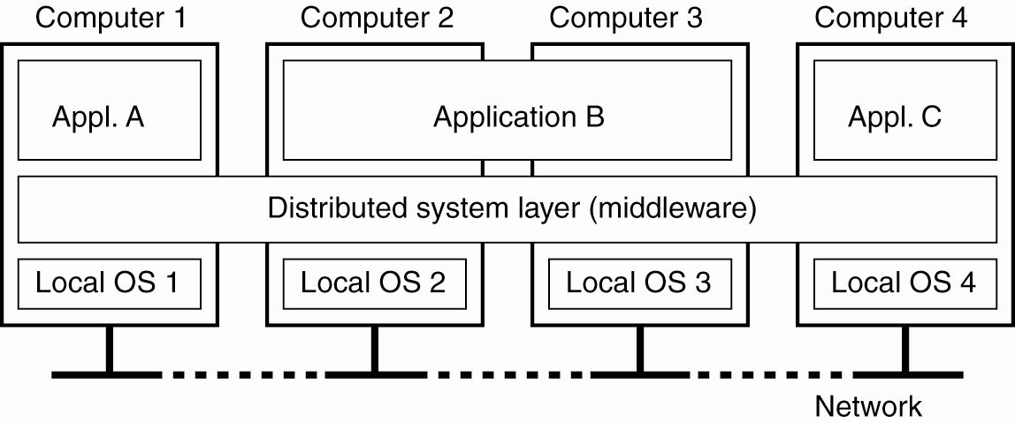
Definition of a Distributed System (2)
A distributed system organized as middleware.
The middleware layer extends over multiple machines,
and offers each application the same interface

Slide 5
Goals of Distributed Systems
Easily Connect Users/Resources
Exhibit Distribution Transparency
Support Openness
Be Scalable:
  in size
  geographically
  administratively
Looking at these goals helps use answer the question: “Is building a distributed system worth the effort?”

Slide 6
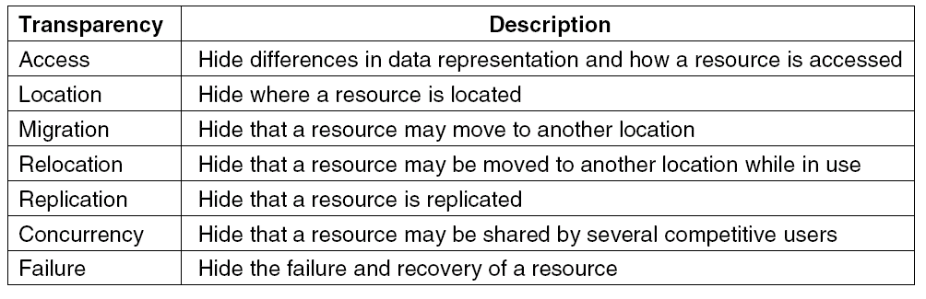
Transparency in a Distributed System
Different forms of transparency in a distributed system (ISO, 1995)

Slide 7
Scalability Limitations
Concept | Example
Centralized services | A single server for all users
Centralized data | A single on-line telephone book
Centralized algorithms | Doing routing based on complete information
Examples of scalability limitations

Slide 8
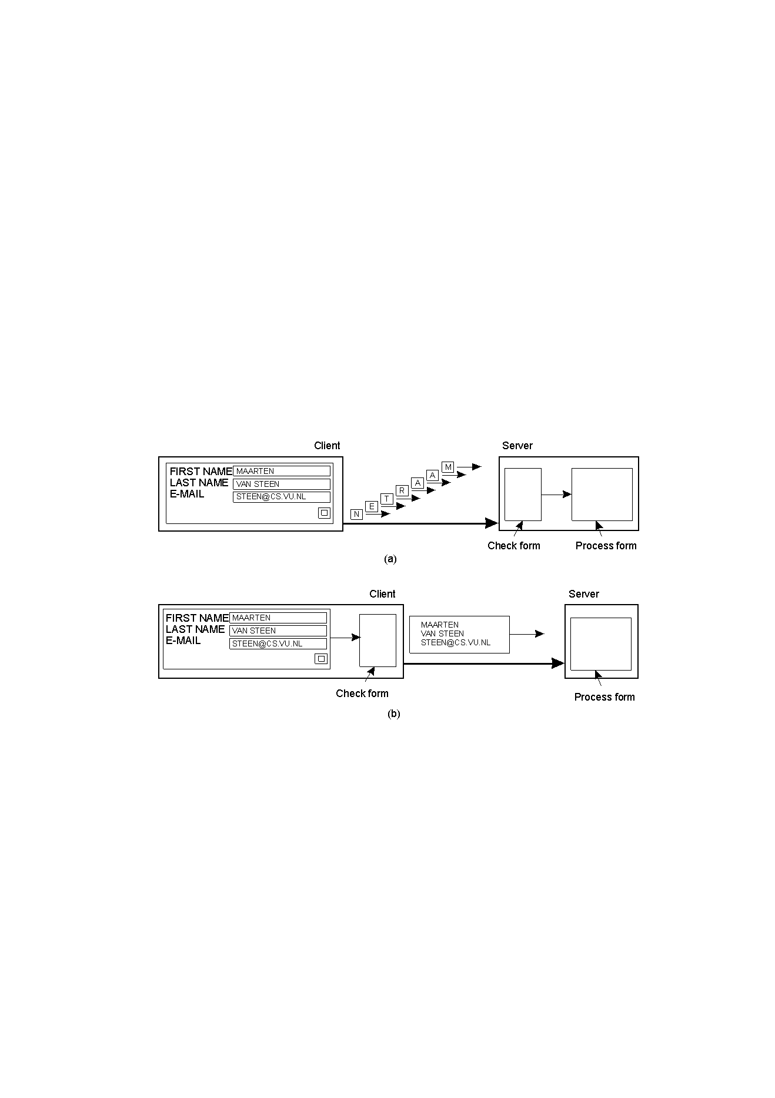
Scaling Techniques (1)
1.4
The difference between letting (a) a server
or (b) a client check forms as they are being filled

Slide 9
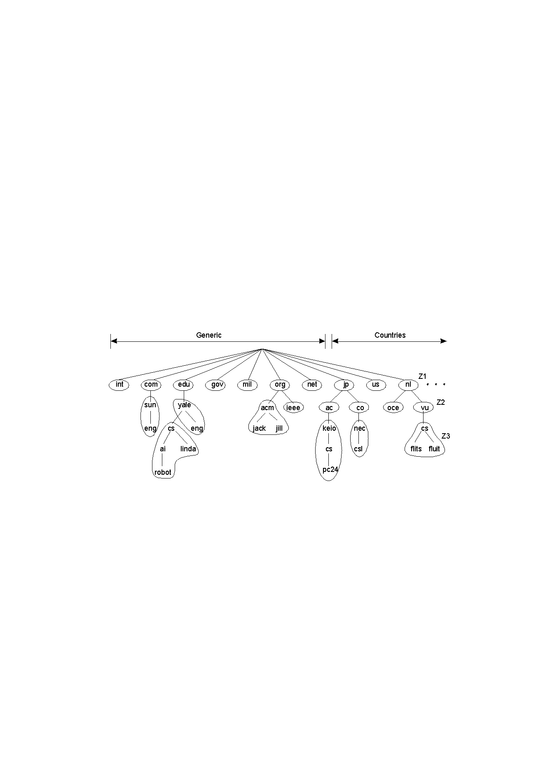
Scaling Techniques (2)
1.5
An example of dividing the DNS name space into zones

Slide 10
Characteristics of decentralized algorithms:
No machine has complete information about the system state.
Machines make decisions based only
on local information.
Failure of one machine does not ruin
the algorithm.
There is no implicit assumption that a global clock exists.

Slide 11
Pitfalls when Developing
Distributed Systems
The network is reliable
The network is secure
The network is homogeneous
The topology does not change
Latency is zero
Bandwidth is infinite
Transport cost is zero
There is one administrator

Slide 12
Types of Distributed Systems
• Distributed Computing Systems
  High Performance Computing (HPC)
• Distributed Information Systems
  Transaction Processing Systems (TPS)
  Enterprise Application Integration (EAI)
• Distributed Pervasive Systems
  Ubiquitous Systems

Slide 13
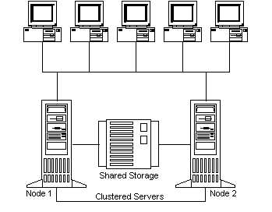
Clustered Systems Architecture
A. Frank - P. Weisberg

Slide 14
Cluster Computing Systems
Collection of similar workstations/PCs, closely connected by means of a high-speed LAN:
  Each node runs the same OS.
  Homogeneous environment
  Can serve as a supercomputer
  Excellent for parallel programming
Examples: Linux-based Beowulf clusters, MOSIX (from Hebrew University).

Slide 15
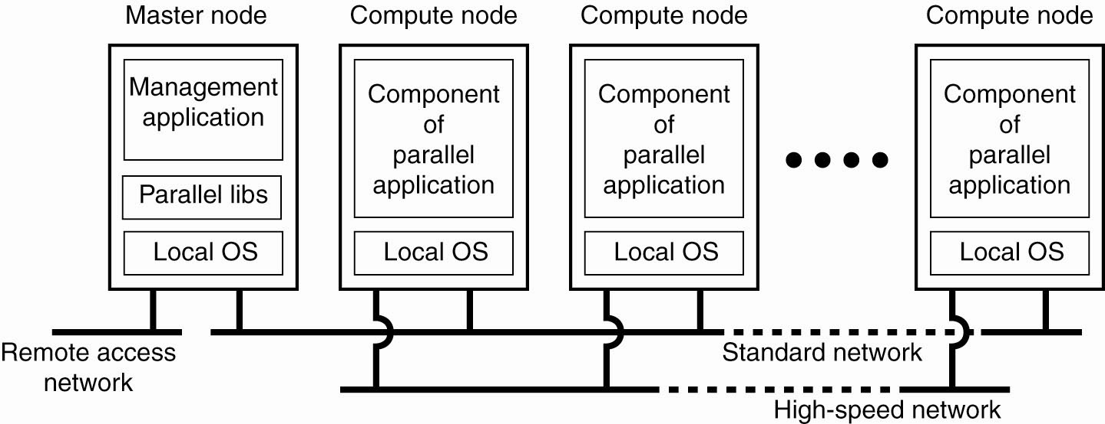
Architecture for Cluster Computing System

Slide 16
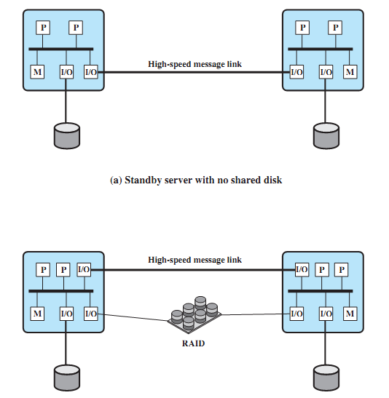
Cluster Configurations

Slide 17
Grid Computing Systems
Collection of computer resources, usually owned by multiple parties and in multiple locations, connected together such that users can share access to their combined power:
  Can easily span a wide-area network
  Heterogeneous environment
  Crosses administrative/geographic boundaries
  Supports Virtual Organizations (VOs)
Examples: EGEE - Enabling Grids for E-SciencE (Europe), Open Science Grid (USA).

Slide 18
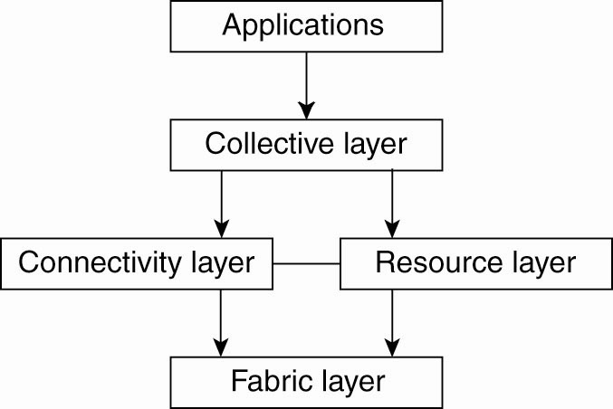
Architecture for Grid Computing Systems

Slide 19
Cloud Computing Systems (1)
Collection of computer resources, usually owned by a single entity, connected together such that users can lease access to a share of their combined power:
  Location independence: the user can access the desired service from anywhere in the world, using any device with any (supported) system.
  Cost-effectiveness: the whole infrastructure is owned by the provider and requires no capital outlay by the user.
  Reliability: enhanced by way of multiple redundant sites, though outages can occur, leaving users unable to remedy the situation.

Slide 20
Cloud Computing Systems (2)
  Scalability: user needs can be tailored to available resources as demand dictates – cost benefit is obvious.
  Security: low risk of data loss thanks to centralization, though problems with control over sensitive data need to be solved.
  Readily consumable: the user usually does not
  need to do much deployment or customization,
  as the provided services are easy to adopt and ready-to-use.
Examples: Amazon EC2 (Elastic Compute Cloud), Google App Engine, IBM Enterprise Data Center,
MS Windows Azure, SUN Cloud Computing.

Slide 21
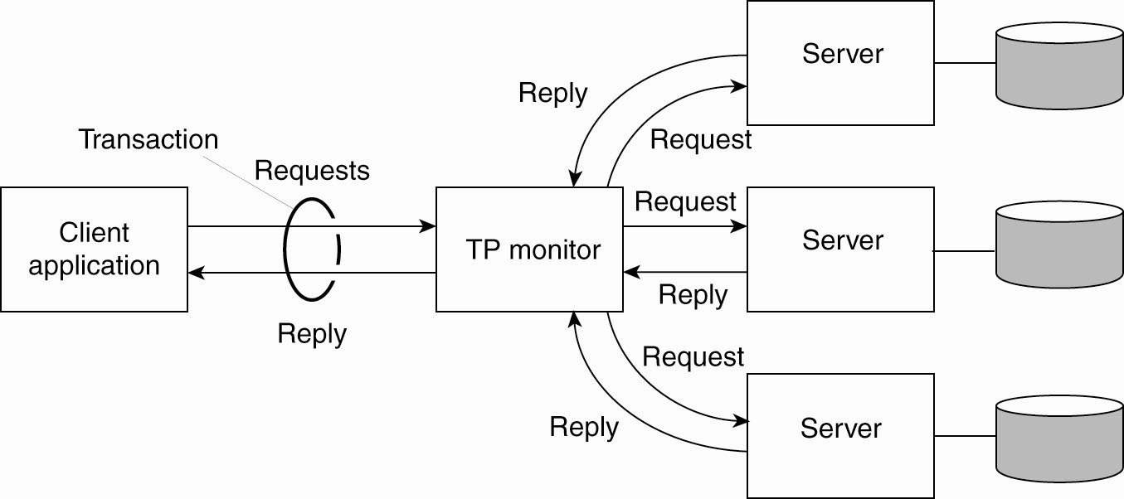
Transaction Processing Systems (TPS)
The role of a TP monitor in distributed systems

Slide 22
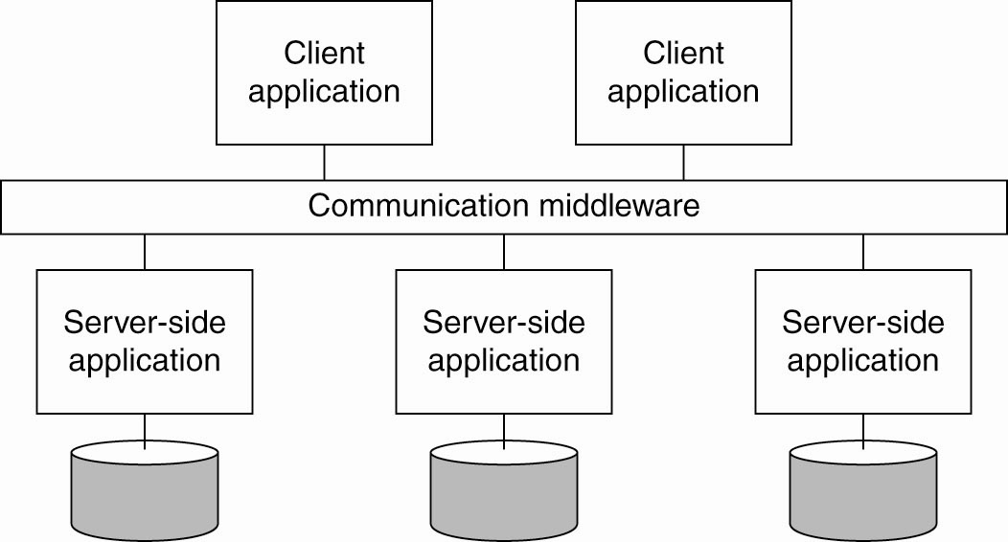
Enterprise Application Integration

Slide 23
Communication Middleware Models/Paradigm
Distributed File Systems
Remote Procedure Call (RPC)
Distributed Objects (RMI)
Distributed Documents

Slide 24
Distributed Pervasive Systems
Requirements for pervasive systems:
  Embrace contextual changes
  Encourage ad hoc composition
  Recognize sharing as the default
  Support distribution transparency

Slide 25
Electronic Health Care Systems (1)
Questions to be addressed for health care systems:
  Where and how should monitored data be stored?
  How can we prevent loss of crucial data?
  What infrastructure is needed to generate and propagate alerts?
  How can physicians provide online feedback?
  How can extreme robustness of the monitoring system be realized?
  What are the security issues and how can the proper policies be enforced?

Slide 26
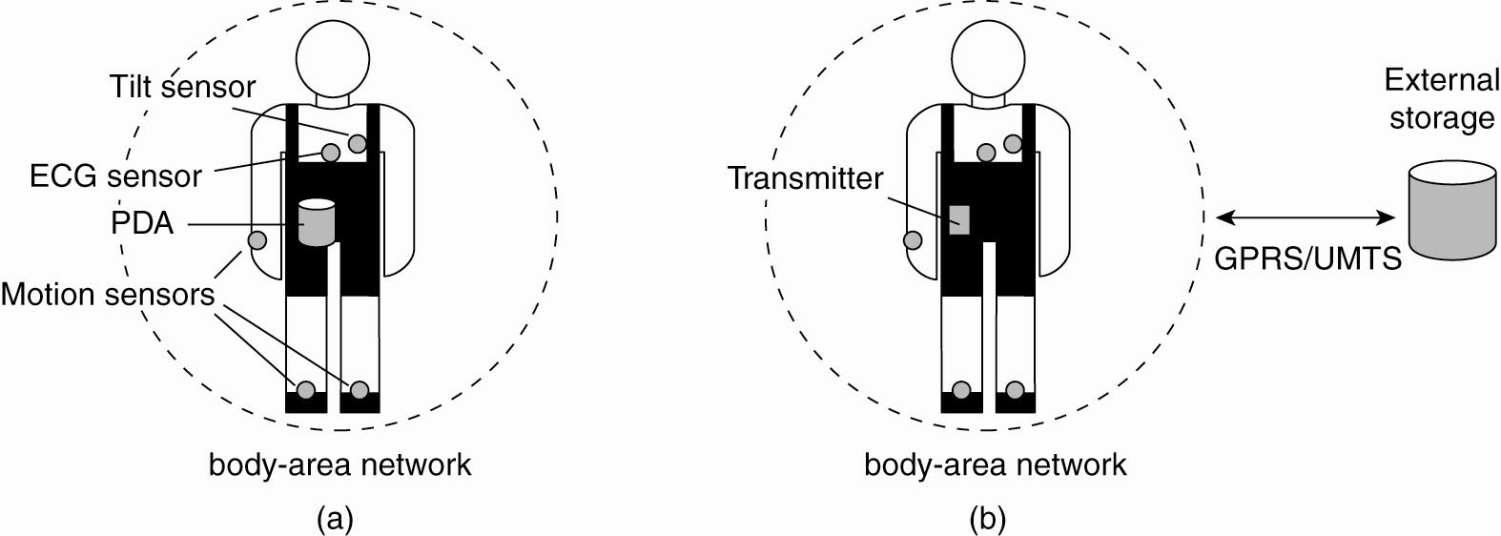
Electronic Health Care Systems (2)
Monitoring a person in a pervasive electronic health care system, using (a) a local hub
or (b) a continuous wireless connection

Slide 27
Sensor Networks (1)
The nodes to which sensors are attached are:
  Many (10s-1000s).
  Simple (i.e., hardly any memory, CPU power,
  or communication facilities).
  Often battery-powered (or even battery-less).
Questions concerning sensor networks:
  How do we (dynamically) set up an efficient tree in a sensor network?
  How does aggregation of results take place?
  Can it be controlled?
  What happens when network links fail?

Slide 28
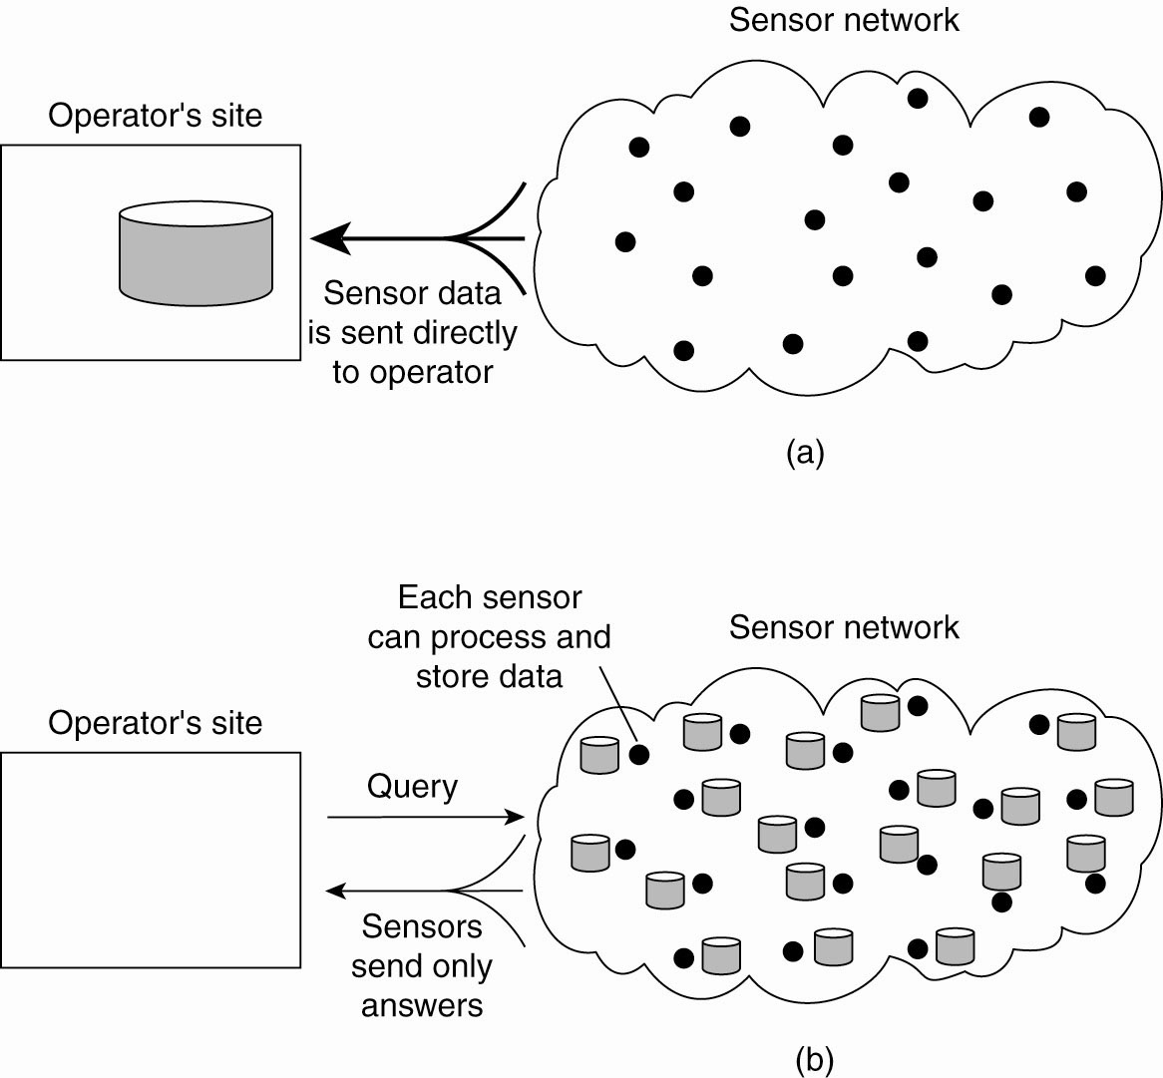
Sensor Networks (2)
Organizing a sensor network database, while storing and processing data (a) only at the operator’s site or …

Slide 29
Sensor Networks (3)
Organizing a sensor network database, while storing and processing data … or (b) only at the sensors

