Slide 1
Advanced Encryption Standard [Slide courtesy: Cryptography and network security by Behrouz Fourozan]
t

Slide 2
AES
Published by NIST (National Institute of Standards and Technology) in December 2001
First AES candidate conference
15 out of 21 algorithms selected
Second AES candidate conference
5 out of 15 selected as finalists
MARS, RC6, Rijndael, Serpent and Twofish
Third AES candidate conference
NIST announced Rijndael as the AES

Slide 3
AES…
The criteria defined by NIST for selecting AES fall into three areas:
Security
Cost
Implementation

Slide 4
AES…
AES is a non-Feistel cipher that encrypts and decrypts a data block of 128 bits.
It uses 10, 12, or 14 rounds.
The key size, which can be 128, 192, or 256 bits, depends on the number of rounds.
But the round keys are always 128 bits

Slide 5
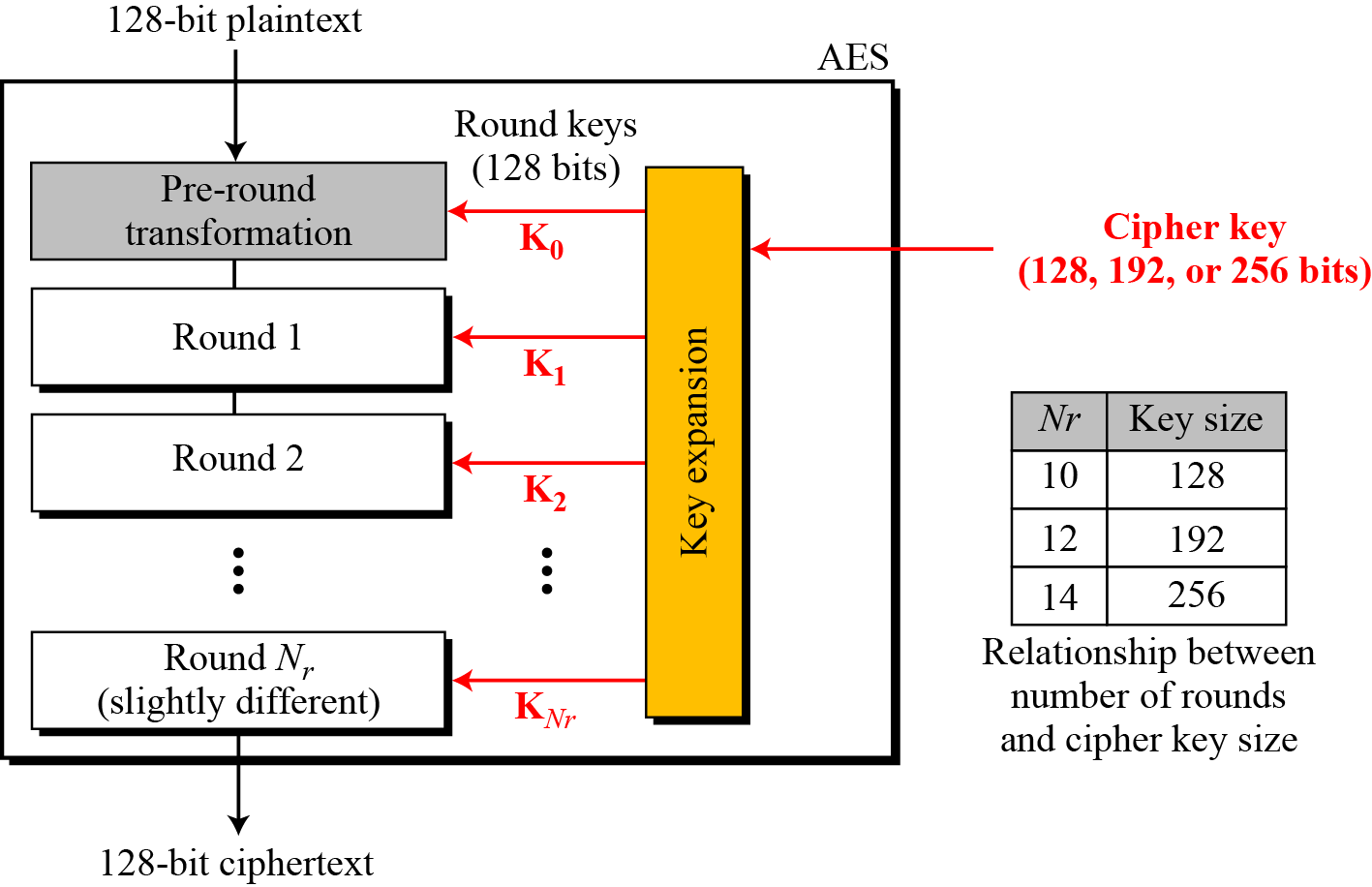
AES (General Design)…

Slide 6
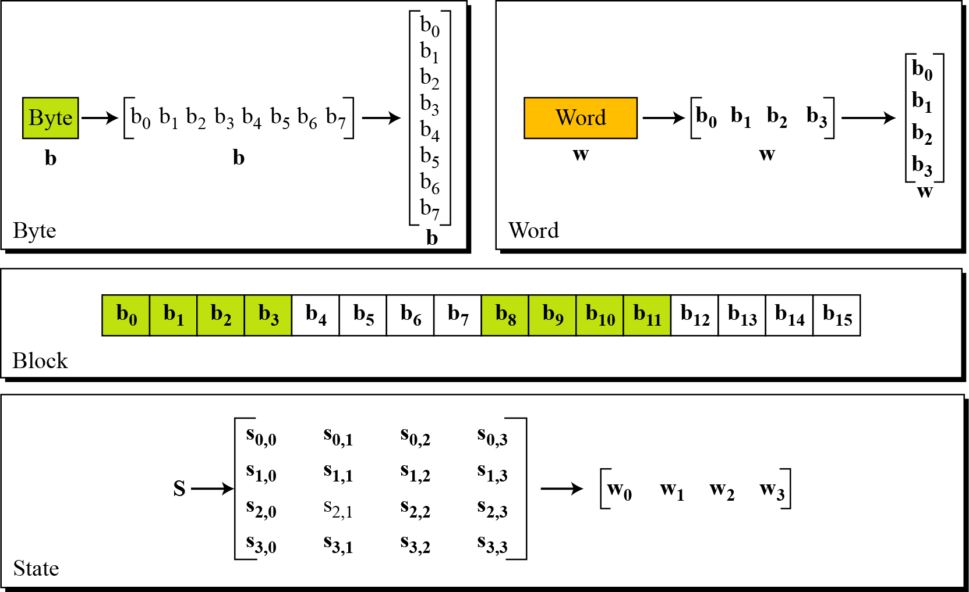
AES (Data Units)…

Slide 7
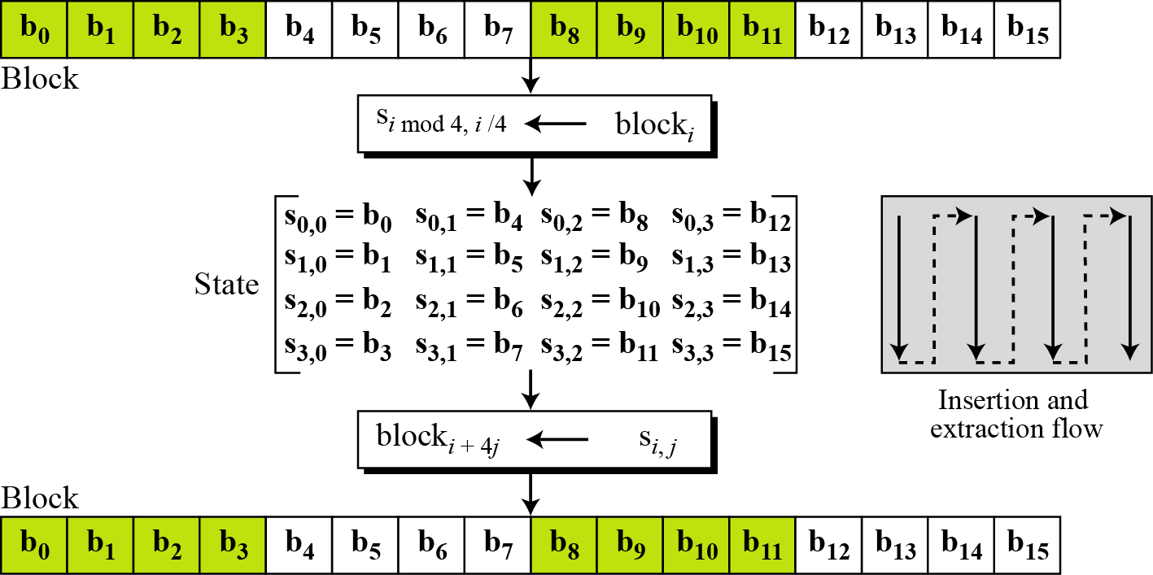
AES (Data Units)…

Slide 8
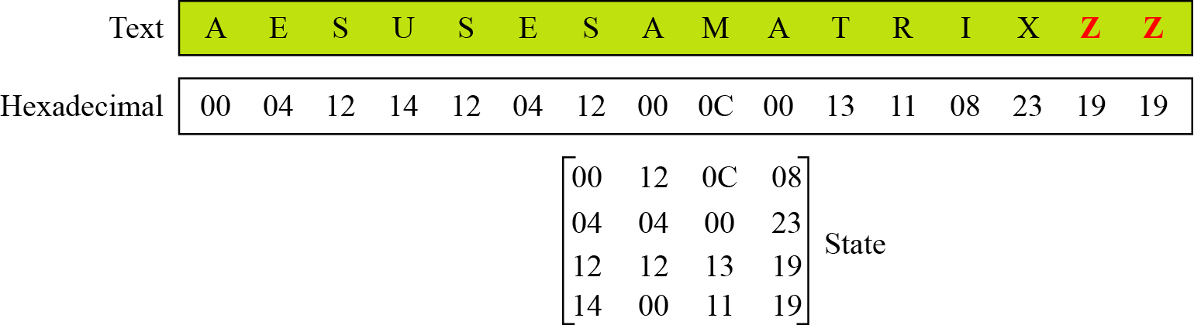
AES (Data Units)…
Changing plaintext to states

Slide 9
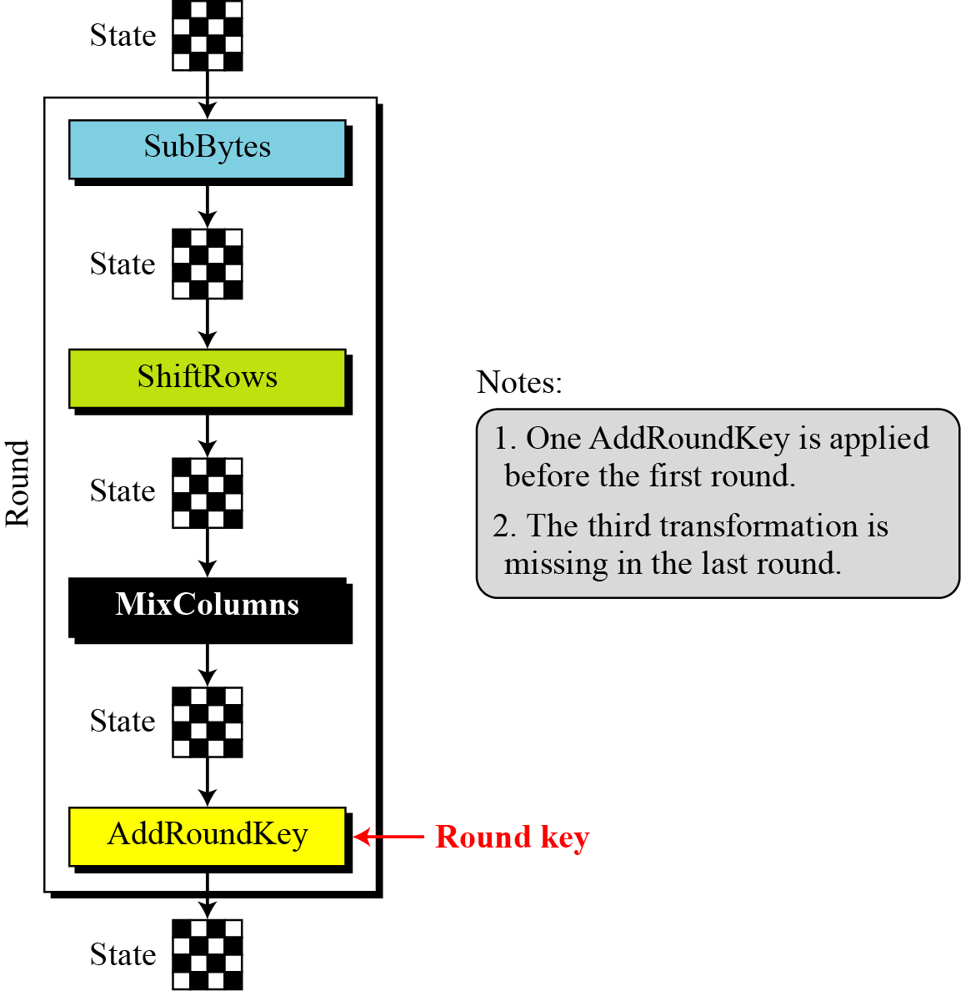
Structure of each round

Slide 10
AES Transformations
Four types
Substitution
Permutation
Mixing
Key-adding

Slide 11
Substitution
AES, like DES, uses substitution. AES uses two invertible transformations.
SubBytes
The first transformation, SubBytes, is used at the encryption site.
To substitute a byte, we interpret the byte as two hexadecimal digits.
The SubBytes operation involves 16 independent byte-to-byte transformations.

Slide 12
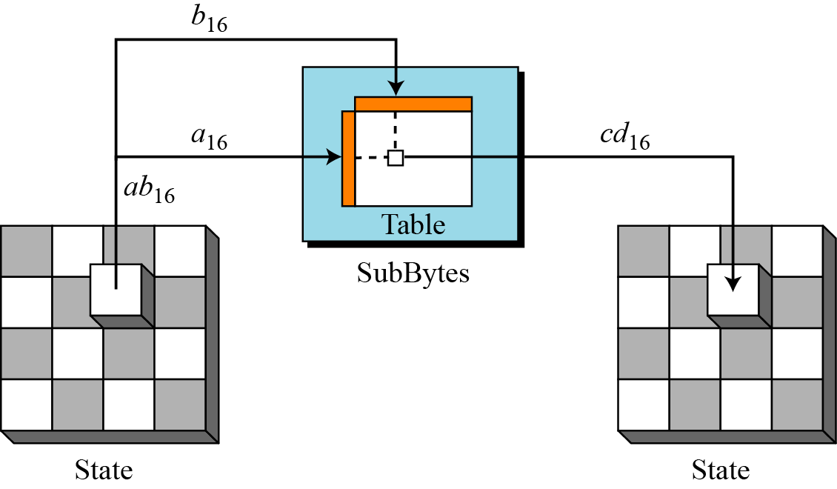
Substitution…

Slide 13
Substitution…

Slide 14
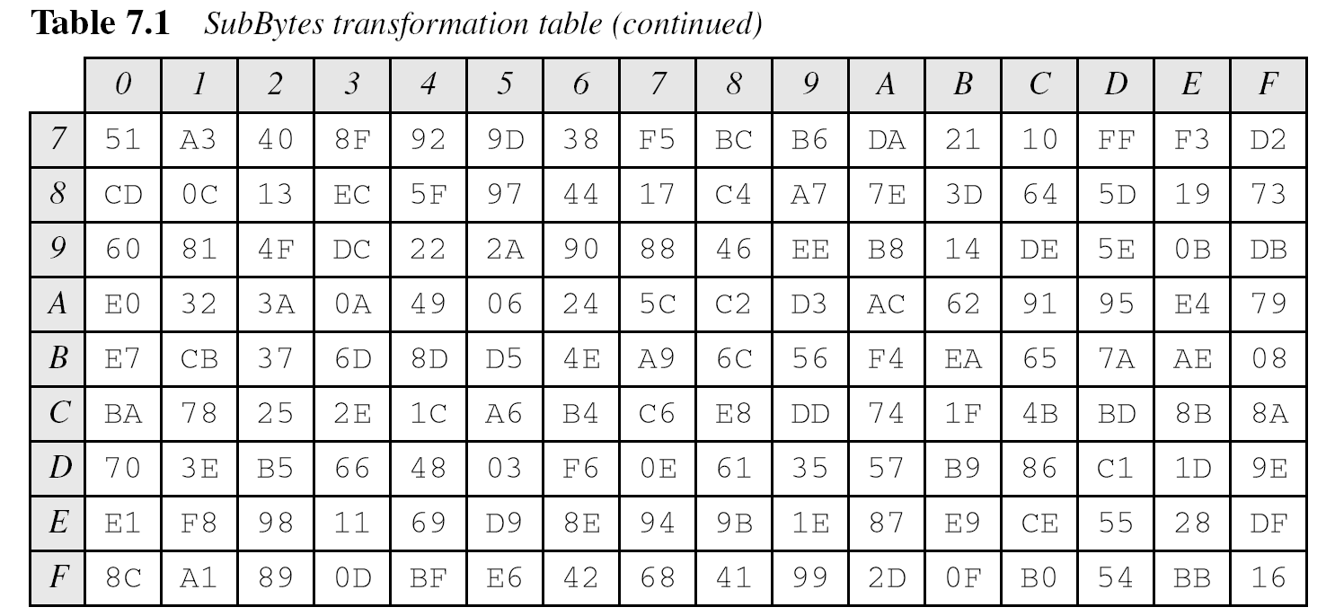
Substitution…

Slide 15
Substitution…

Slide 16
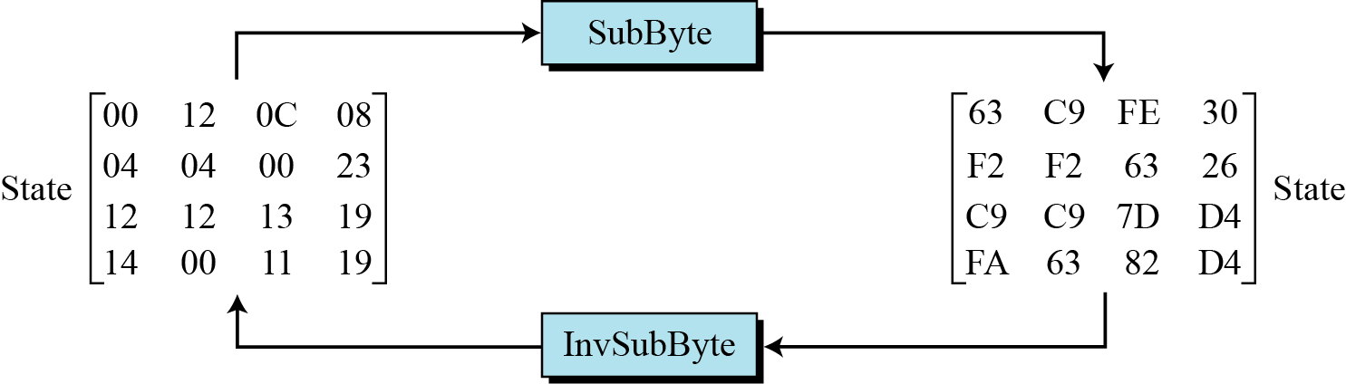
Substitution…
Example

Slide 17
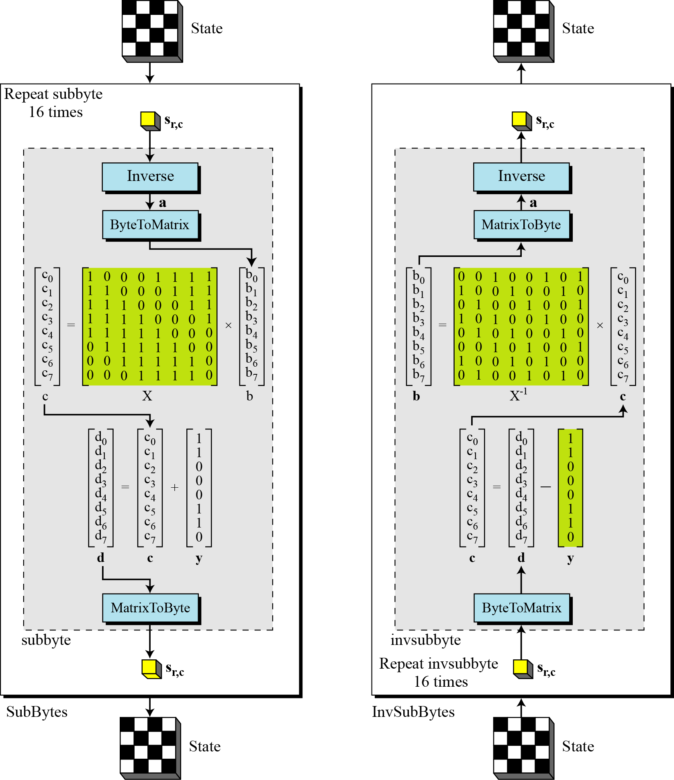
SubBytes and InvSubBytes processes

Slide 18
SubBytes and InvSubBytes processes…
Example
Let us show how the byte 0C is transformed to FE by subbyte routine and transformed back to 0C by the invsubbyte routine.

Slide 19
SubBytes and InvSubBytes processes…
Pseudo code

Slide 20
Substitution…
Exercise
Can you prove formally that the subbyte and invsubbyte are inverses of each other?
Can you prove that the subbyte transformation is nonlinear?

Slide 21
Substitution…
Exercise- solution
Can you prove formally that the subbyte and invsubbyte are inverses of each other?
It is the inverse operation, that makes the whole transformation nonlinear

Slide 22
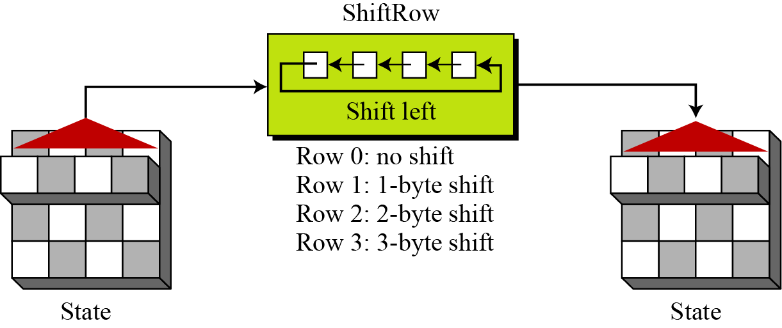
Permutation
ShiftRows
In the encryption, the transformation is called ShiftRows.

Slide 23
Permutation…
InvShiftRows
In the decryption, the transformation is called InvShiftRows and the shifting is to the right.

Slide 24
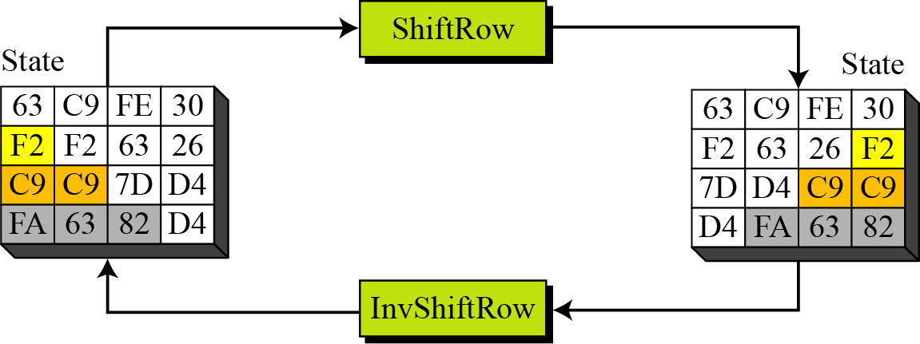
Permutation…
Example

Slide 25
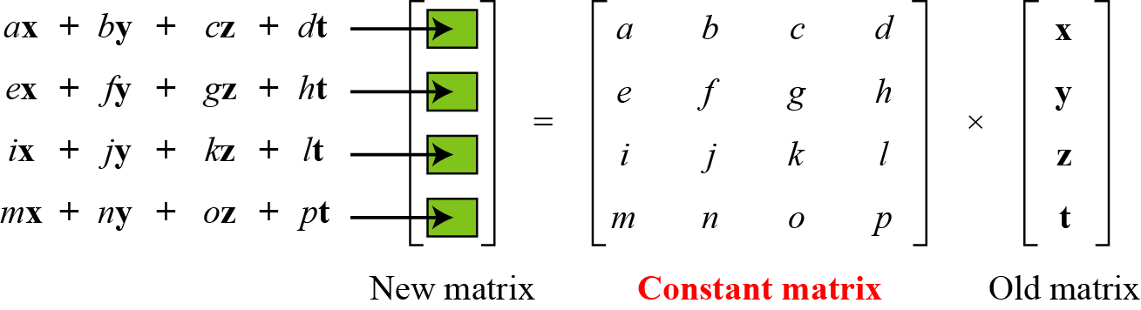
Mixing
An interbyte transformation that changes the bits inside a byte, based on the bits inside the neighboring bytes.
We need to mix bytes to provide diffusion at the bit level.

Slide 26
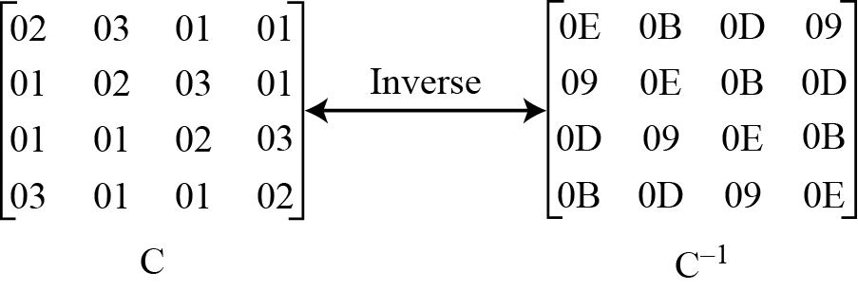
Mixing…
Constant matrices used by MixColumns and InvMixColumns

Slide 27
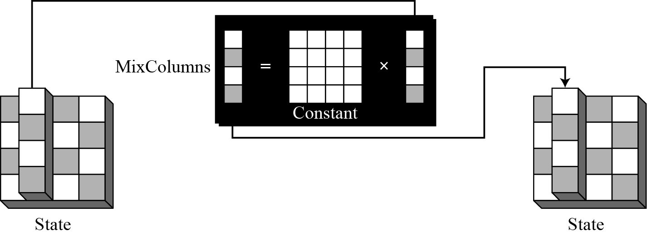
Mixing…
MixColumns
operates at the column level
transforms each column of the state to a new column.

Slide 28
Mixing…
InvMixColumns
basically the same as the MixColumns transformation but the inverse

Slide 29
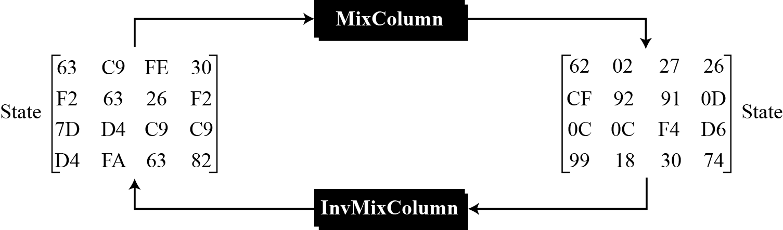
Mixing…
Example
how a state is transformed using the MixColumns transformation. The figure also shows that the InvMixColumns transformation creates the original one.

Slide 30
Key Adding
AddRoundKey
AddRoundKey proceeds one column at a time.
AddRoundKey adds a round key word with each state column matrix
the operation in AddRoundKey is matrix addition.

Slide 31
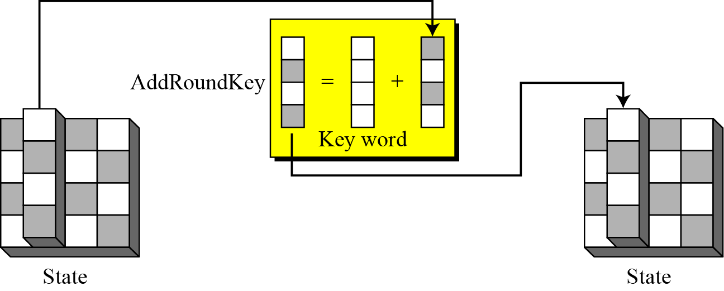
Key Adding…

Slide 32
Key Expansion
To create round keys for each round, AES uses a key-expansion process.
If the number of rounds is Nr , the key-expansion routine creates Nr + 1 128-bit round keys from one single 128-bit cipher key.

Slide 33
Key Expansion…

Slide 34
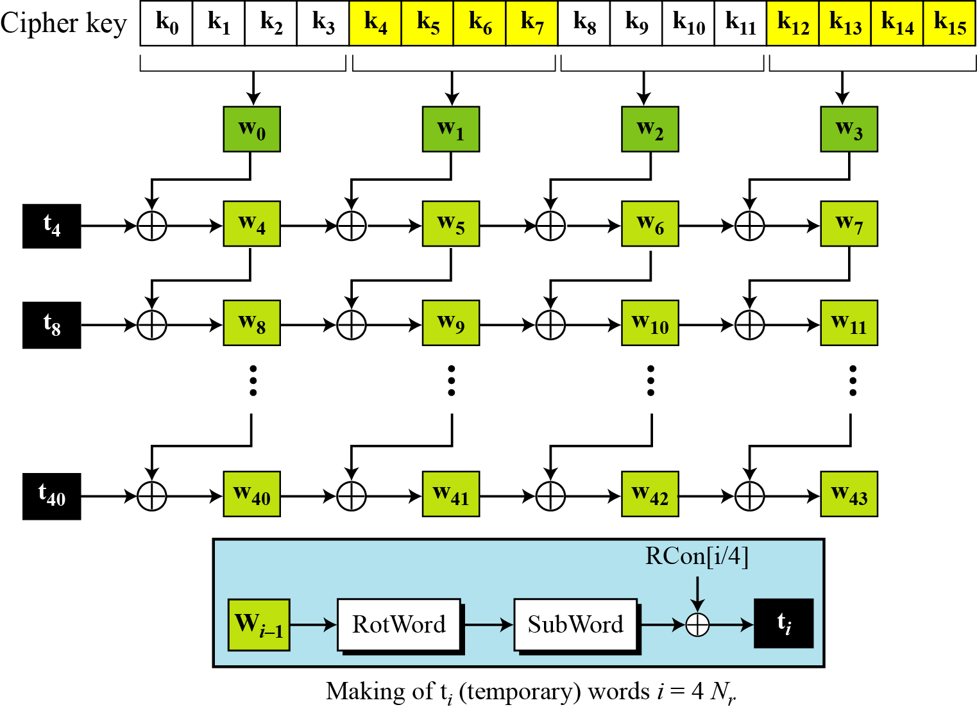
Key Expansion in AES-128…

Slide 35
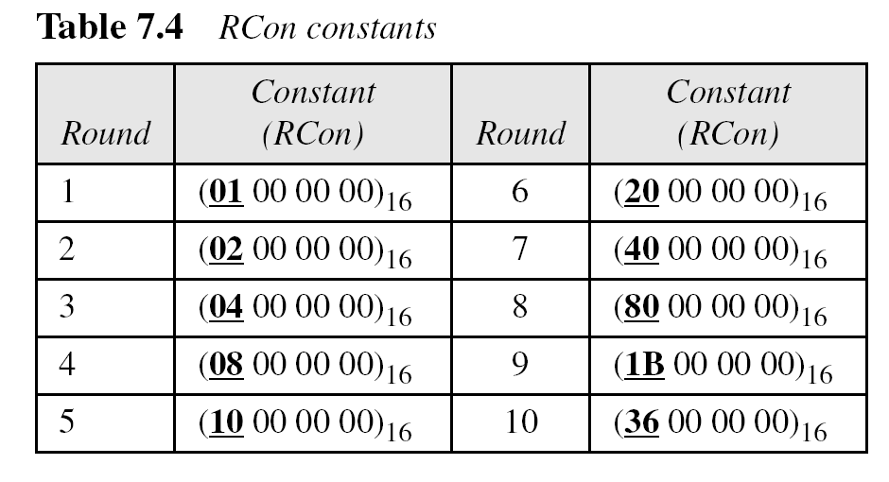
Key Expansion in AES-128…

Slide 36
Key Expansion in AES-128…
The key-expansion routine can either use the above table when calculating the words or use the GF(2⁸) field to calculate the leftmost byte dynamically, as shown below (prime is the irreducible polynomial):

Slide 37
Key Expansion in AES-128…
An illustration
how the keys for each round are calculated assuming that the 128-bit cipher key agreed upon by Alice and Bob is (24 75 A2 B3 34 75 56 88 31 E2 12 00 13 AA 54 87)₁₆.

Slide 38
Key Expansion in AES-128…
Each round key in AES depends on the previous round key.
The dependency, however, is nonlinear because of SubWord transformation.
The addition of the round constants also guarantees that each round key will be different from the previous one.
An illustration

Slide 39
Key Expansion in AES-128…

Slide 40
Key Expansion in AES-128…
What about weak keys for AES???

Slide 41
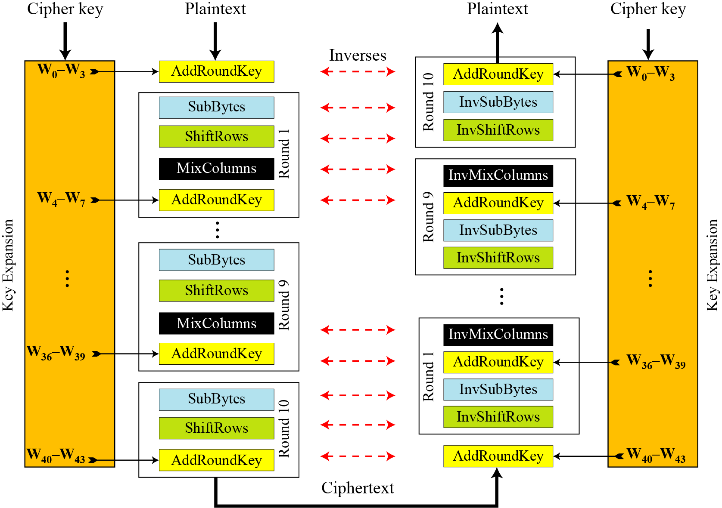
The cipher

Slide 42
Analysis
The result of encryption when the plaintext is made of all 0s.

Slide 43
Analysis…
The avalanche effect.

Slide 44
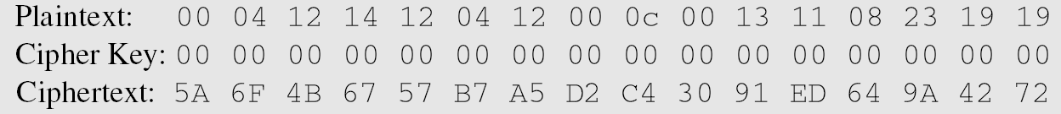
Analysis…
The effect of using a cipher key in which all bits are 0s.

Slide 45
Assignment-1
In a cipher, S-boxes can be either static or dynamic. The parameters in a static S-box do not depend on the key.
State some advantages and some disadvantages of static and dynamic S-boxes.
Are the S-boxes(substitution tables) in AES static or dynamic?

Slide 46
Assignment-2
AES has a larger block size than DES. Is this an advantage or disadvantage?
AES defines different implementation with three different numbers of rounds. DES defines only one implementation with 16 rounds. What are the advantages and disadvantages of AES over DES with respect to this difference?

Slide 47
Assignment-3
AES defines three different cipher-key sizes(128, 192 and 256); DES defines only one cipher key size(56). What are the advantages and disadvantages of AES with respect to this difference?

