Slide 1
Project Presentation of COOP-II
On
Devsphere
Bhagya Sharma
2210990210
Supervised By
Prof. Dr. Darpan Anand
Department of Computer Science and Engineering,
Chitkara University, Punjab

Slide 2
Problem Statement
Developers rely on multiple fragmented platforms such as GitHub, blogging sites, and deployment services to showcase their work
Lack of a unified system makes it difficult for recruiters and collaborators to evaluate a developer’s complete profile
Managing and maintaining consistency across platforms leads to inefficiencies and reduced visibility
No seamless integration exists between code repositories, technical content, and live application demonstrations
2

Slide 3
Proposed Solution – Devsphere
Devsphere introduces a centralized developer platform that integrates identity, content, and live project demonstrations Enables developers to showcase their complete professional presence within a single structured interface Combines authentication, blogging, project showcasing, and live previews into a unified ecosystem Simplifies evaluation, enhances discoverability, and improves overall developer visibility

Slide 4
Project Objectives
Implement secure authentication using GitHub OAuth for verified developer identity
Enable automatic extraction and display of developer profile data Provide a platform for creating and managing technical blog posts
Allow structured showcasing of projects with repository integration
Integrate live deployment previews to demonstrate real-time application functionality
Build a scalable and user-friendly system for centralized portfolio management

Slide 5
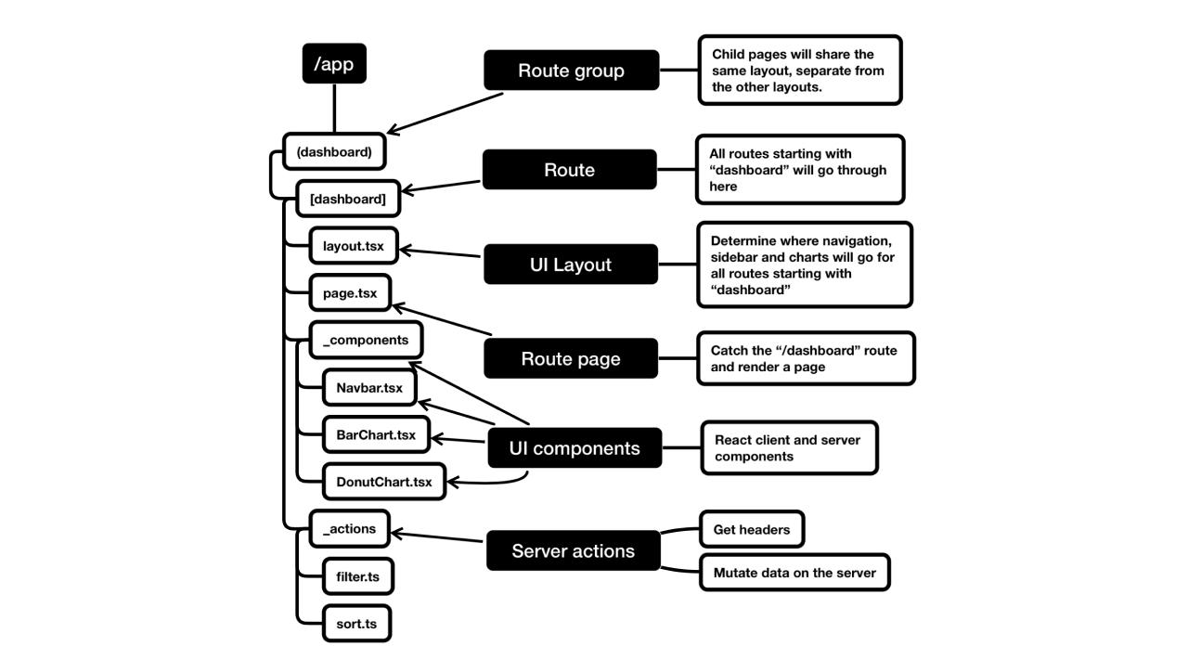
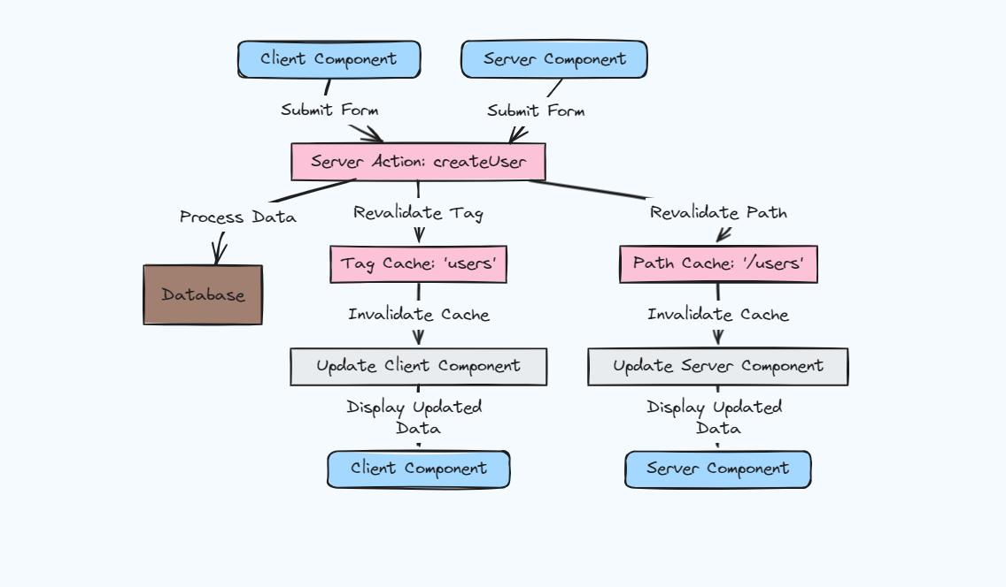
System Architecture

Slide 6
Technology Stack
The implementation of Devsphere involves multiple stages:
Setting up GitHub OAuth authentication using Auth.js
Fetching user profile and repository data via GitHub API
Designing database schemas for users, blogs, and projects
Implementing server-side logic for data handling
Building reusable UI components for frontend display
Integrating live preview functionality using iframe and Vercel URLs

Slide 7
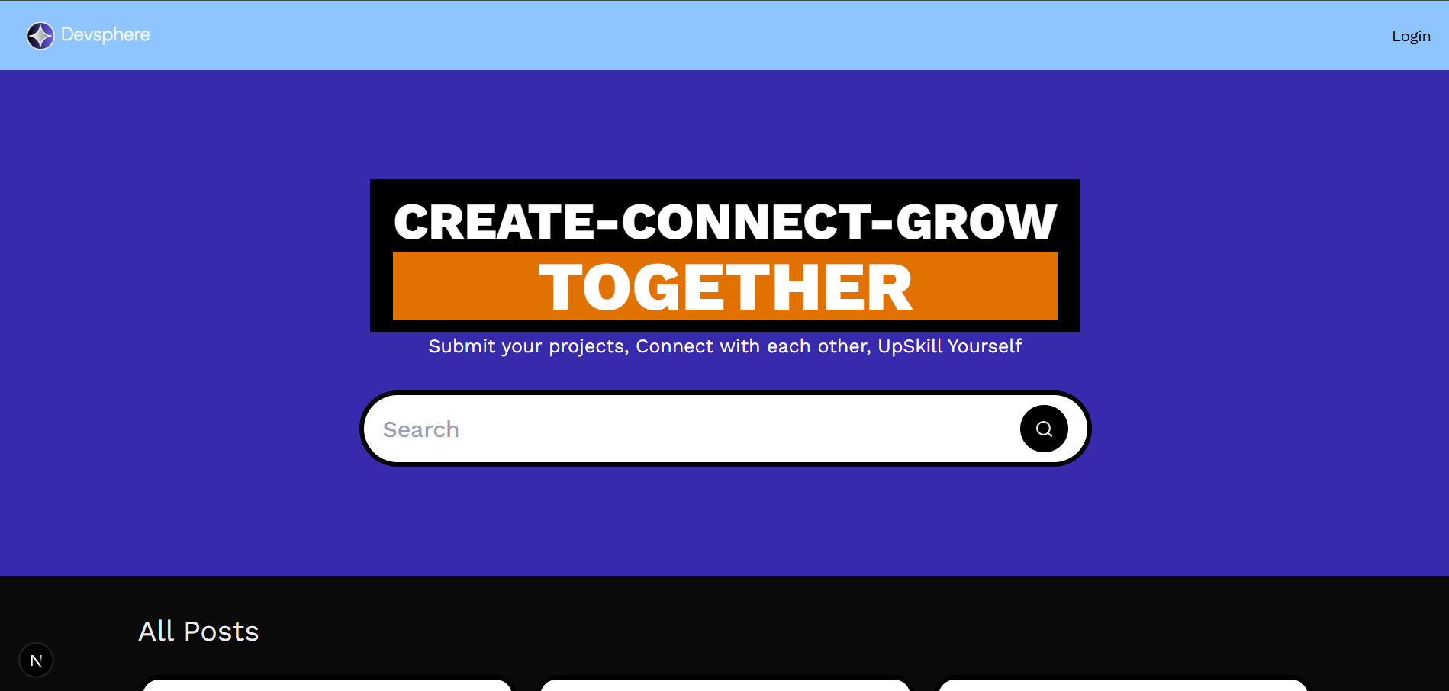
Result Screenshots

Slide 8
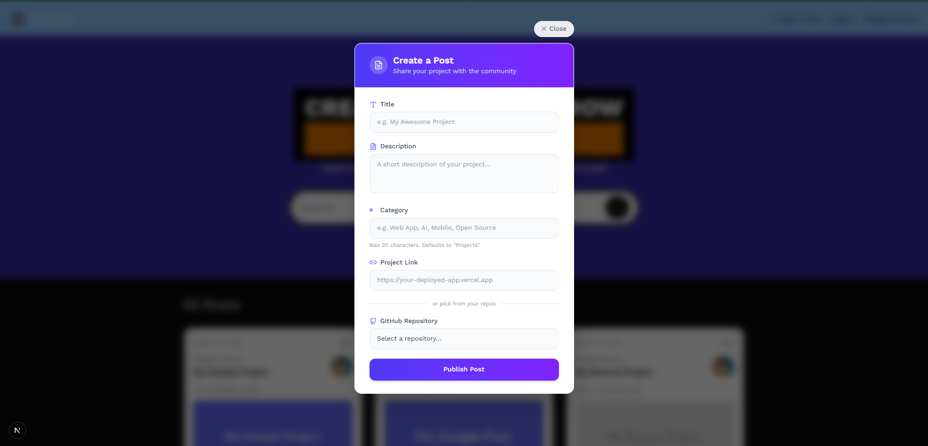

Slide 9
References
GitHub REST API Documentation – https://docs.github.com/en/rest
Vercel Documentation – https://vercel.com/docs
Next.js Official Documentation – https://nextjs.org/docs
React Official Documentation – https://react.dev
Auth.js (NextAuth) Documentation – https://authjs.dev
Prisma ORM Documentation – https://www.prisma.io/docs
Tailwind CSS Documentation – https://tailwindcss.com/docs
Sanity CMS Documentation – https://www.sanity.io/docs

Slide 10
Thank You
10

