Slide 1
FAKE NEWS DETECTION USING MACHINE LEARNING

Slide 2


Slide 3
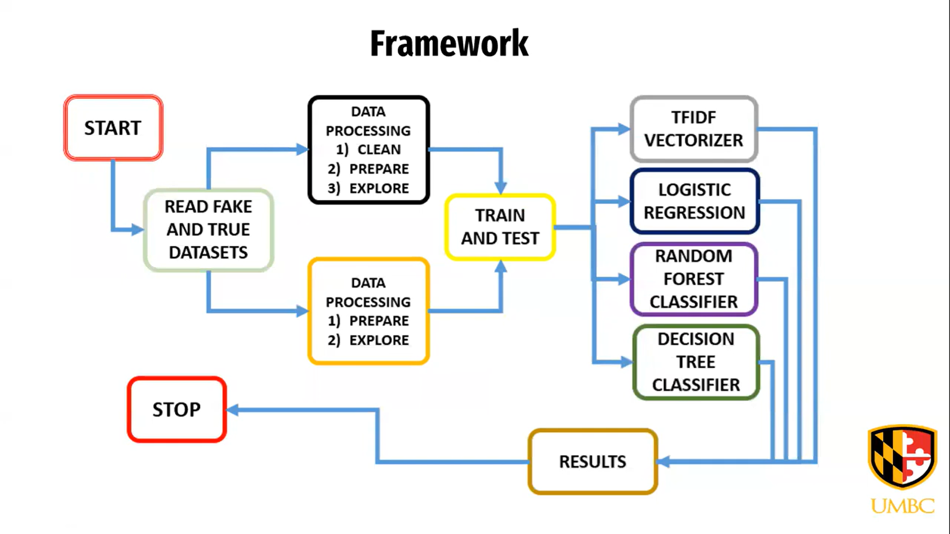
FRAMEWORK

Slide 4
Introduction Fake news detection is subtask of text classification and is often defined as the task of classifying news as real or fake. The term ‘fake news’ refers to the false or misleading information that appears as real news .

Slide 5
Problem statement
To detect fake news occurring on social media platforms in the form of articles, posts, etc.
The project aims to develop an automated system that can distinguish between real news and fake news using natural language processing and machine learning techniques. The system will analyse the text of the news article and determine the probability of it being true r false. This will help to prevent the spread of misinformation and protect the public from being misled.

Slide 6
TECHNIQUES
we used TF-IDF for feature extraction
We used machine learning algorithms.
We tested the efficiency of the classifier using accuracy

Slide 7
Dataset description the dataset was obtained from Kaggle. The true dataset contains 23481 posts, while the fake news contains 21417. Among the features are the title and text, as well as the subject,date,and label. There are several categories of new topics including political news, world news, government news, left news, us news etc.

Slide 8


Slide 9
MODEL COMPARISION
logistic regression
Decision tree
Random forest
Gda bosting
Accuracy =98.77%
Accuracy
=99.46%
Accuracy=
99.03%
Accuracy
=99.47%

Slide 10
CONCLUSION
With social media becoming more popular, more and more people are receive news from social media rather than traditional news media, social media ,however has also been used to disseminate fake news, which has strong negative effects on individual used and culture as a whole.in this paper, by reviewing existing literature in two phases, we discussed the false news problem; characterization and detection.
We introduced the basic concepts and principles of fake news in both traditional media and social media

Slide 11
THANK YOU

