Slide 1
Hexagon SDK

Slide 2
Hexagon SDK
The Hexagon SDK is a collection of code generation and performance analysis tools designed to help developers enhance the features and performance of audio, speech, video, imaging and computer vision software on devices powered by Snapdragon™ processors.
The Hexagon SDK is also designed to enable high computational burdens on the CPU to be off-loaded into a heterogeneous computing environment with the use of shared remote code objects.
Qualcomm's Hexagon SDK enables you to run your code on the Hexagon DSPs. This is achieved by Computation Offload.
Computational offload:
Define your own API, implement that API for the Hexagon DSP, and call it directly from the application processor. This is accomplished using a Remote Procedure Call mechanism called FastRPC and dynamic loading.

Slide 3
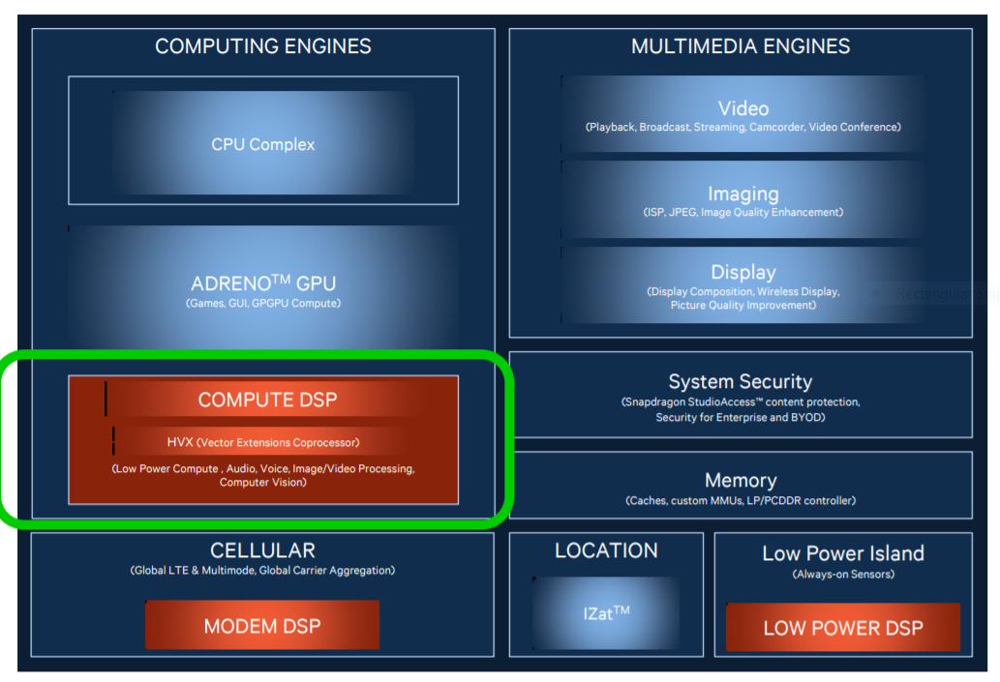
Hexagon DSPs in Snapdragon

Slide 4
What is CDSP?
CDSP intended for compute-intensive tasks such as image processing, computer vision, and camera streaming.
Compared to the host CPU, the DSP typically runs at a lower clock speed but provides more parallelism opportunities at the instruction level. This makes the DSP a better alternative to the CPU for power consumption. As a result, it is preferable to offload as many large compute-intensive tasks as possible onto the DSP to reduce the overall power consumption of the device.

Slide 5
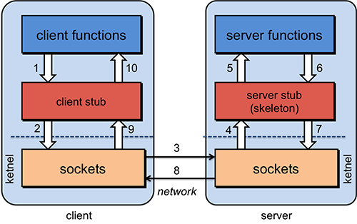
What is RPC?
Remote Procedure Call (RPC) is a protocol that one program can use to request a service from a program located in another computer on a network without having to understand the network's details.
RPC is used to call other processes on the remote systems like a local system. A procedure call is also sometimes known as a function call or a subroutine call.
RPC uses the client-server model. The requesting program is a client, and the service-providing program is the server.
fig: Remote Procedure Call

Slide 6
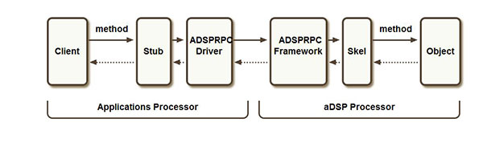
What is FastRPC?
The FastRPC framework allows for clients to transparently make remote method invocations between applications and DSP processors.
FastRPC architecture:
The below diagram depicts invocation of a single method where the client and object reside on different processors.

Slide 7
FastRPC
Client : User mode process that initiates the remote invocation
Stub : Auto generated code linked in with the user mode process that takes care of marshaling parameters
ADSPRPC Driver : ADSPRPC kernel driver that receives the remote invocation, queues them up and then waits for the response after signaling the remote side
ADSPRPC Framework : ADSPRPC framework dequeues the messages from the queue and dispatches them for processing
Skel : Auto generated code that takes care of unmarshaling parameters
Object : Method implementation. This is in the form of .so (shared object).

Slide 8
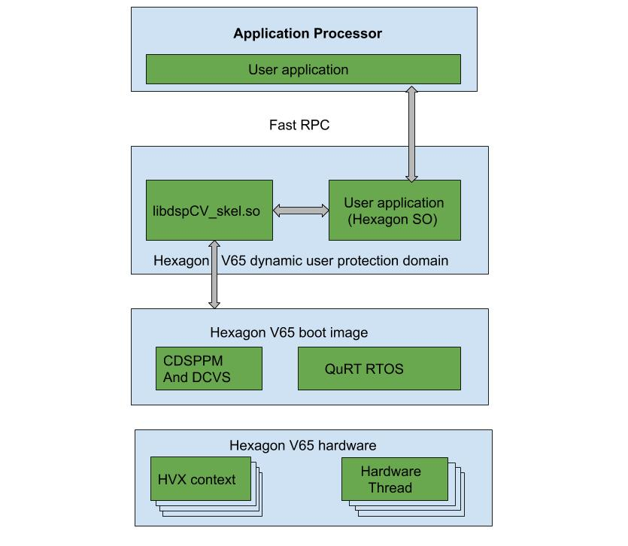
Architecture of Hexagon SDK

Slide 9
What is IDL file?
The interface definition language (IDL) -- the specification language used to describe a software component's application programming interface (API) -- is commonly used in Remote Procedure Call software.
In calculator Example
Calculator.idl
This file present in below path.
C:\Qualcomm\Hexagon_SDK\3.5.2\examples\common\calculator\inc
#include "AEEStdDef.idl"
interface calculator {
long sum(in sequence<long> vec, rout long long res);
};

Slide 10
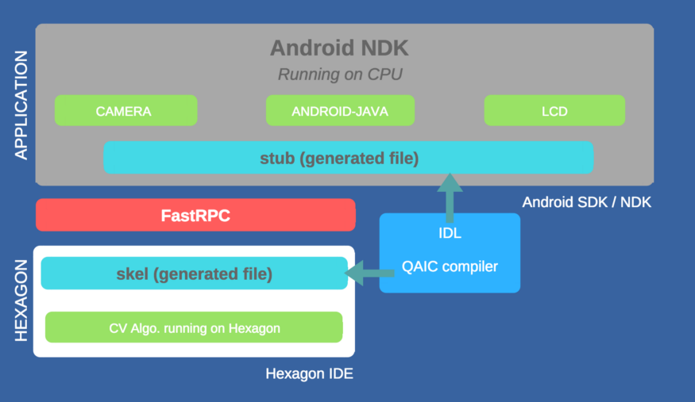
What is IDL file?

Slide 11
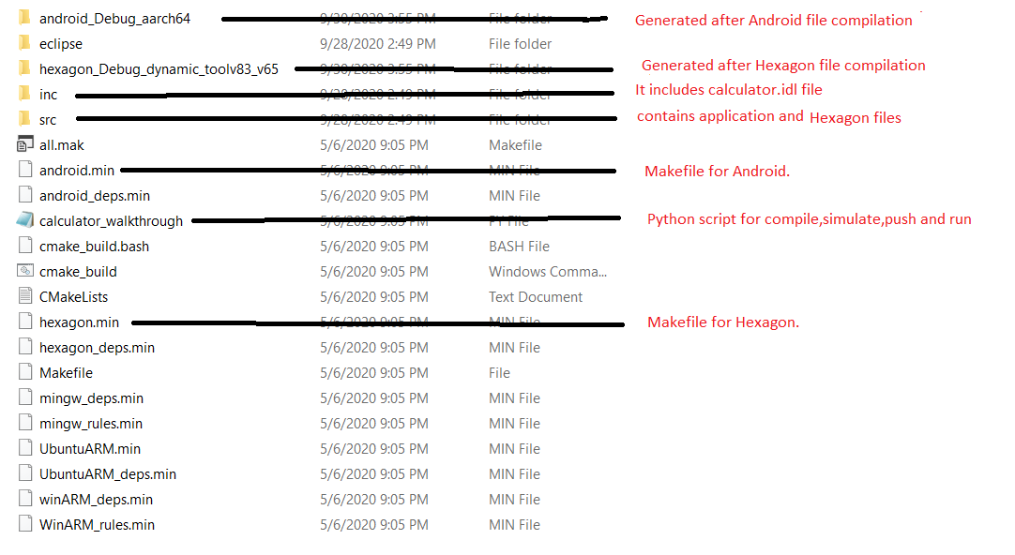
What is the folder structure in calculator example?

Slide 12
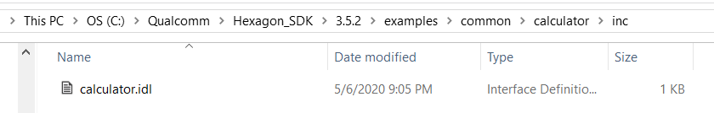
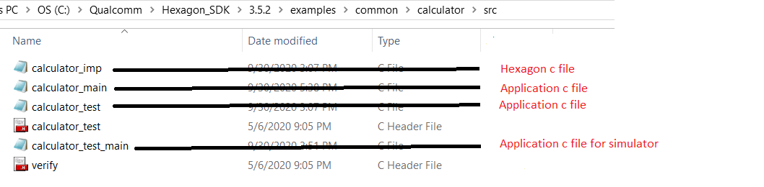
Where is IDL file & src files?
IDL file present in C:\Qualcomm\Hexagon_SDK\3.5.2\examples\common\calculator\inc
src files present in C:\Qualcomm\Hexagon_SDK\3.5.2\examples\common\calculator\src

Slide 13
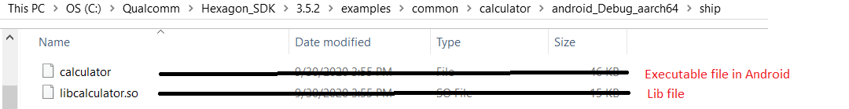
What are the libs/ executables generated? Where they generated?
In android.min
Generated library is: libcalculator.so
Generated Executable is: calculator
These are generated in C:\Qualcomm\Hexagon_SDK\3.5.2\examples\common\calculator\android_Debug_aarch64\ship

Slide 14
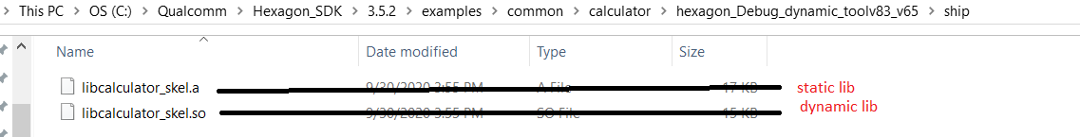
What are the libs/ executables generated? Where they generated?
In hexagon.min
Generated libraries are: libcalculator_skel.so , libcalculator_skel.a
Generated Executable is: calculator_q
These are generated in C:\Qualcomm\Hexagon_SDK\3.5.2\examples\common\calculator\hexagon_Debug_dynamic_toolv83_v65\ship

Slide 15
What is python walkthrough script? What it is doing? How to run?
walk-through script is a step by step guide to building, loading and executing the calculator example on Android.
Command for run python walk-through script is:
python calculator_walkthrough.py -T sdm845 -D cdsp
Walk-through script does:
1) Compile Application test app
2) Compile Hexagon Side library and
3) Run in simulator
4) Push the test app and libs into the device. into specific paths
App: vendor/bin/
Hexagon lib: /vendor/lib/rfsa/dsp/sdk/
5) Run the application

Slide 16
Explain individual commands ?
To setup sdk environment for windows candidate, you are required to execute the below command from your Hexagon SDK's root directory.
C:\Qualcomm\Hexagon_SDK\3.5.2>setup_sdk_env.cmd
1)compile Android test app:
Make clean for Android:
make tree_clean V=android_Debug_aarch64 CDSP_FLAG=1 VERBOSE=1
Make Android:
make tree V=android_Debug_aarch64 CDSP_FLAG=1 VERBOSE=1
2)Compile Hexagon Side library:
Make clean for Hexagon:
make tree_clean V=hexagon_Debug_dynamic_toolv83_v65 VERBOSE=1
Make Hexagon:
make tree V=hexagon_Debug_dynamic_toolv83_v65 VERBOSE=1

Slide 17
Explain individual commands ?
3)Simulaor command:
C:/Qualcomm/Hexagon_SDK/3.5.2/tools/HEXAGON_Tools/8.3.07/Tools/bin/hexagon-sim -mv65 --simulated_returnval --usefs hexagon_Debug_dynamic_toolv83_v65 --pmu_statsfile hexagon_Debug_dynamic_toolv83_v65/pmu_stats.txt --l2tcm_base 0xd800 hexagon_Debug_dynamic_toolv83_v65/calculator_q –

Slide 18
Explain individual commands ?
4) Push the libs into the device, into specific paths
---- Push Android components ----
Creating “/vendor/bin” in device and pushing calculator in “/vendor/bin” path.
adb shell mkdir -p /vendor/bin
adb push C:\Qualcomm\Hexagon_SDK\3.5.2/examples/common/calculator/android_Debug_aarch64/ship/calculator /vendor/bin
pushing libcalculator.so in “/vendor/lib64/” path
adb push C:\Qualcomm\Hexagon_SDK\3.5.2/examples/common/calculator/android_Debug_aarch64/ship/libcalculator.so /vendor/lib64/

Slide 19
Explain individual commands ?
---- Push Hexagon Components ----
Creating “/vendor/lib/rfsa/dsp/sdk/” path in device and pushing libcalculator_skel.so in ” /vendor/lib/rfsa/dsp/sdk/ ” path.
adb shell mkdir -p /vendor/lib/rfsa/dsp/sdk/
adb push C:\Qualcomm\Hexagon_SDK\3.5.2/examples/common/calculator/hexagon_Debug_dynamic_toolv83_v65/ship/libcalculator_skel.so /vendor/lib/rfsa/dsp/sdk/
---- Direct dsp messages to logcat ---
adb shell "echo 0x1f > /vendor/lib/rfsa/dsp/sdk/calculator.farf"

Slide 20
Explain individual commands ?
5) Run the application
---- Run Calculator Example Locally on Android ----
adb shell export LD_LIBRARY_PATH="/vendor/lib64/;" /vendor/bin/calculator 1 1000
---- Run Calculator Example on CDSP ----
adb shell export LD_LIBRARY_PATH=/vendor/lib64/:$LD_LIBRARY_PATH ADSP_LIBRARY_PATH="/vendor/lib/rfsa/dsp/sdk\;/vendor/lib/rfsa/dsp/testsig;" /vendor/bin/calculator 0 1000

Slide 21
Explain the logs?
calculator_imp.c:19:0x10ea:7: CDSP: =============== DSP: sum result 499500 ===============
This log is present in calculator_imp.c and it will display sum result of n numbers.
Where n is the input to command line arguments.
Output:
---Starting calculator test
---Allocate 4000 bytes from ION heap
---Creating sequence of numbers from 0 to 999
---Compute sum locally
Sum = 499500
---Success

Slide 22
Explain android.min (Android Makefile)?
ifeq ($(CDSP_FLAG), 1)
LIB_DSPRPC = libcdsprpc --->If CDSP is 1,we are taking lilibcdsprpc library
DEFINES += CDSP
else ifeq ($(MDSP_FLAG), 1)
LIB_DSPRPC = libmdsprpc
DEFINES += MDSP
else ifeq ($(SLPI_FLAG), 1)
LIB_DSPRPC = libsdsprpc
DEFINES += SLPI
else
LIB_DSPRPC = libadsprpc
DEFINES += ADSP
endif
$(info ************ LIB=$(LIB_DSPRPC) ************)
# stub library
BUILD_DLLS += libcalculator ---->Generating library name as libcalculator
libcalculator_QAICIDLS += inc/calculator ---->Including IDL files into libcalculator_QAICIDLS
libcalculator_C_SRCS += $V/calculator_stub ---->Including source files into libcalculator_C_SRCS
libcalculator_DLLS += $(LIB_DSPRPC) ---->Including CDSP lib to libcalculator_DLLS

Slide 23
Explain android.min (Android Makefile)?
# stand-alone calculator executable
BUILD_EXES += calculator --->Generating executable file as calculator
calculator_QAICIDLS += inc/calculator --->Including IDL files into calculator_QAICIDLS
calculator_C_SRCS += src/calculator_main src/calculator_test --->Including android source files into calculator_C_SRCS
calculator_LIBS += rpcmem --->Including rpcmem into calculator_LIBS
calculator_LD_FLAGS += -llog -ldl
calculator_DEFINES += VERIFY_PRINT_ERROR
# copy final build products to the ship directory
BUILD_COPIES = \
$(DLLS) \
$(EXES) \
$(LIBS) \
$(SHIP_DIR)/ ; ---->all generated build products will be in this path

Slide 24
Explain hexagon.min (Hexagon Makefile)?
# This builds the skel library
BUILD_LIBS += libcalculator_skel --->Generating static library name as libcalculator_skel
# only build the shared object if dynamic option specified in the variant
ifeq (1,$(V_dynamic))
BUILD_DLLS = libcalculator_skel --->Generating dynamic library name as libcalculator_skel
endif
libcalculator_skel_QAICIDLS = inc/calculator --->Including IDL files into libcalculator_skel_QAICIDLS
libcalculator_skel_C_SRCS += $V/calculator_skel --->Including source file into libcalculator_skel_C_SRCS
libcalculator_skel.C_SRCS = src/calculator_imp.c --->Including Hexagon source files into libcalculator_skel_C_SRCS

Slide 25
Explain hexagon.min (Hexagon Makefile)?
# quality test
BUILD_QEXES += calculator_q ---->Generaring executable file as calculator_q
calculator_q_C_SRCS = src/calculator_test_main src/calculator_test src/calculator_imp
--->Including Android & Hexagon source files to calculator_q_C_SRCS(simulator test)
calculator_q_LIBS = rtld rpcmem test_util atomic
# copy final build products to the ship directory
BUILD_COPIES = \
$(DLLS) \
$(EXES) \
$(LIBS) \
$(SHIP_DIR)/ ; ---->all generated build products will be in this path

Slide 26
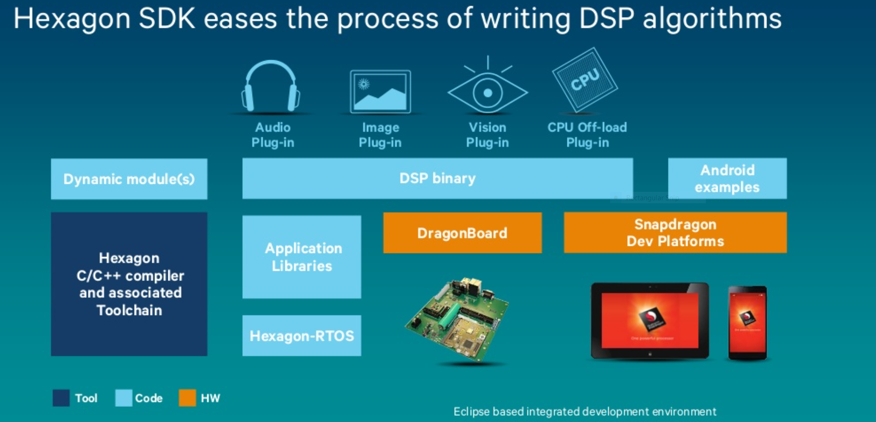

Slide 27
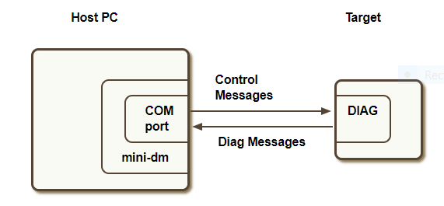
mini-dm
mini-dm.exe is the mini-diagnostic monitor provided by Qualcomm's Hexagon Access Program. It is a tool that displays diagnostic messages generated by the Hexagon DSP.
Diagnostic messages are generated by calling FARF on the DSP either from static or dynamic code
Connecting to a device:

Slide 28
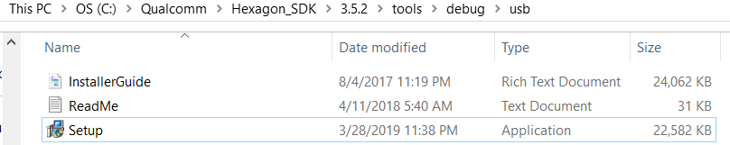
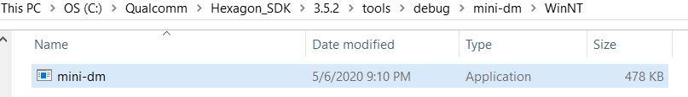
mini-dm
Hardware requirements
Target device
USB drivers ( For Windows: tools/debug/usb, For Linux: libusb is provided with SDK )
USB cable
Software requirements
mini-dm (tools/debug/mini-dm)

Slide 29

mini-dm
Steps to run mini-dm.exe
1)Install USB drivers (tools/debug/usb).
USB Driver Installation
For Windows:
USB drivers can be installed by running Setup.exe in tools/debug/usb directory
2)Power on the target device.
3)Connect the USB cable from the PC to the target device.
4)Open cmd promptand type:
5)Cd C:\Qualcomm\Hexagon_SDK\3.5.2\tools\debug\mini-dm\WinNT
6)mini-dm.exe —comport <port number>
Eg: mini-dm.exe —comport com3
Port number can be discovered by running the com_finder.py script.
Port number can also be discovered After pushing DSP split binaries on target and open Control Panel->Device manager-> Ports. The port number to consider is the one corresponding to the diagnostics port.
7)Play audio on the device or make a fastRPC call to generate messages
8)Diagnostic messages will start printing to console.

Slide 30
dspCV Library
Qualcomm's Hexagon SDK allows customers to develop DSP-accelerated Computer Vision applications on Hexagon V5 and later products via dynamic loading and FastRPC. The dspCV utility library abstracts the DSP runtime environment for any compute application (not necessarily just Computer Vision) to effectively use DSP resources. The FastCV library contains many image processing API's, optimized for the Hexagon DSP. This SDK includes several examples demonstrating usage of both of these libraries in the typical usage model shown below.
The dspCV library in ${HEXAGON_SDK_ROOT}/lib/fastcv/dspCV aims to abstract as much of the DSP runtime environment as possible, to reduce effort in offloading compute processing to the DSP. It offers API's to perform such functions as clock/power voting, multi-threaded callbacks, concurrency checking, and HVX resource management.

Slide 31
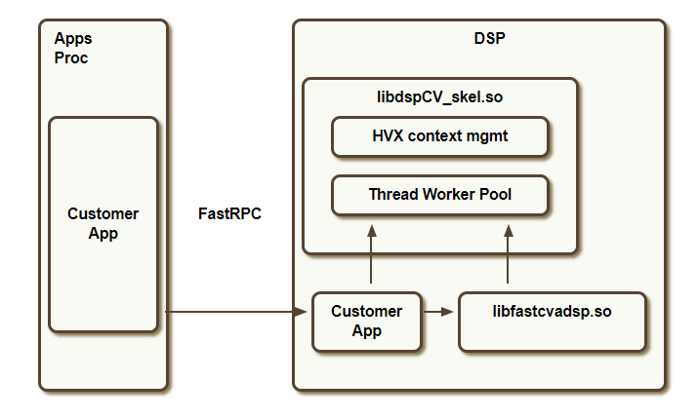
dspCV Library
fig: dspcv

Slide 32
DownscaleBy2
If scaling factor is = ½
i.e, downscaling an image from W × H to (W /2) × (H /2) .
Log analysis:
width=1920 and Height=1080
no of slipts=6
remaining rows=1080,900,720,540,360,180
rowsperjob =180
jobcount = 1,2,3,4,5,6
image srcstride :1920
image dstStride :1920
image srcHeight :180
total image size = 1920x1080
1 strip= 1920x180
2 same
3 same
|
|
6 same

