Slide 1
Hexagon SDK

Slide 2
Hexagon SDK
The Hexagon SDK is a collection of code generation and performance analysis tools designed to help developers enhance the features and performance of audio, speech, video, imaging and computer vision software on devices powered by Snapdragon™ processors.
The Hexagon SDK is also designed to enable high computational burdens on the CPU to be off-loaded into a heterogeneous computing environment with the use of shared remote code objects.
Qualcomm's Hexagon SDK enables you to run your code on the Hexagon DSPs. This is achieved by Computation Offload.
Computational offload:
Define your own API, implement that API for the Hexagon DSP, and call it directly from the application processor. This is accomplished using a Remote Procedure Call mechanism called FastRPC and dynamic loading.

Slide 3
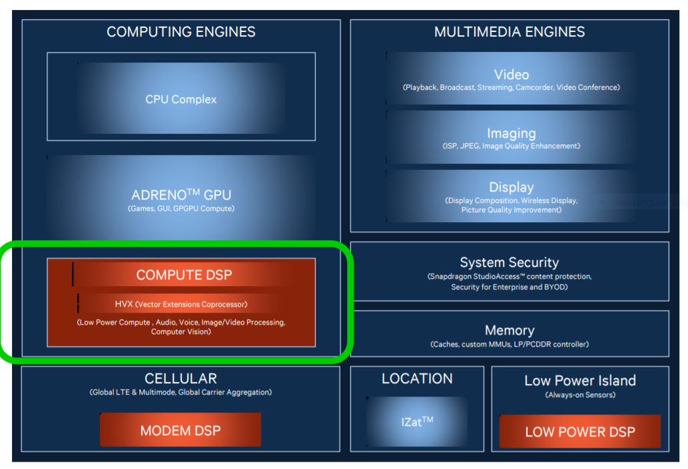
Hexagon DSPs in SnapdragonTM 820

Slide 4
What is CDSP?
CDSP intended for compute-intensive tasks such as image processing, computer vision, and camera streaming.
Compared to the host CPU, the DSP typically runs at a lower clock speed but provides more parallelism opportunities at the instruction level. This makes the DSP a better alternative to the CPU for power consumption. As a result, it is preferable to offload as many large compute-intensive tasks as possible onto the DSP to reduce the overall power consumption of the device.

Slide 5
What is RPC?
Remote Procedure Call (RPC) is a protocol that one program can use to request a service from a program located in another computer on a network without having to understand the network's details.
RPC is used to call other processes on the remote systems like a local system. A procedure call is also sometimes known as a function call or a subroutine call.
RPC uses the client-server model. The requesting program is a client, and the service-providing program is the server. Like a regular or local procedure call, an RPC is a synchronous operation requiring the requesting program to be suspended until the results of the remote procedure are returned.

Slide 6
What is FastRPC?
The FastRPC framework allows for clients to transparently make remote method invocations between applications and DSP processors.

Slide 7
What is IDL file?
The interface definition language (IDL) -- the specification language used to describe a software component's application programming interface (API) -- is commonly used in Remote Procedure Call software.
Calculator.idl
This file present in below path.
C:\Qualcomm\Hexagon_SDK\3.5.2\examples\common\calculator\inc
#include "AEEStdDef.idl"
interface calculator {
long sum(in sequence<long> vec, rout long long res);
};

Slide 8
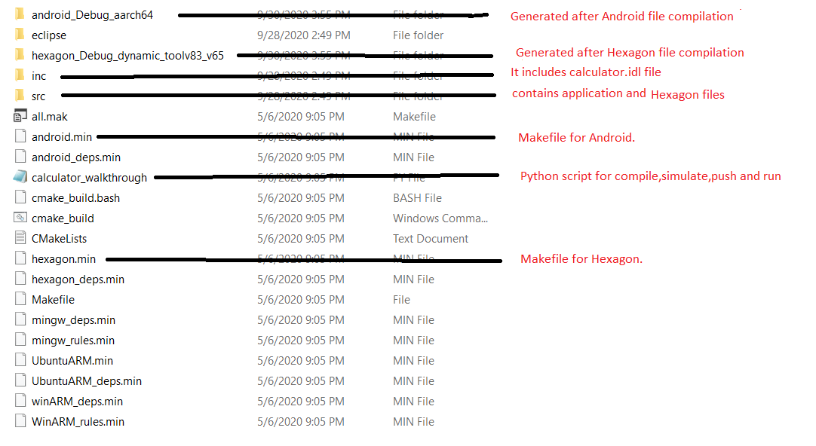
What is the folder structure in calculator example?

Slide 9
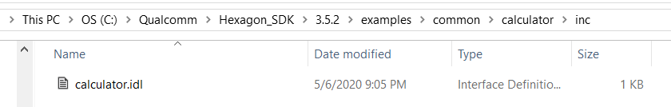
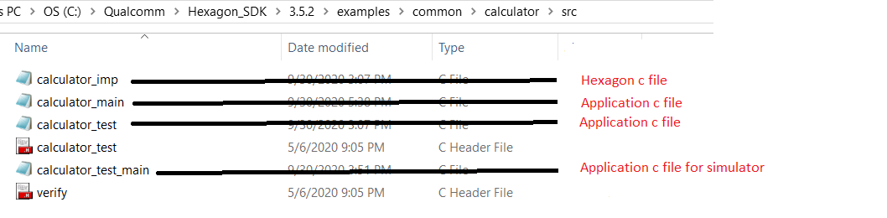
Where is IDL file & src files?
IDL file present in C:\Qualcomm\Hexagon_SDK\3.5.2\examples\common\calculator\inc
src files present in C:\Qualcomm\Hexagon_SDK\3.5.2\examples\common\calculator\src

Slide 10
What is python walkthrough script? What it is doing? How to run?
walk-through script is a step by step guide to building, loading and executing the calculator example on Android.
Command for run python walk-through script is:
python calculator_walkthrough.py -T sdm845 -D cdsp
Walk-through script does:
1) Compile Application test app
2) Compile Hexagon Side library and
3) Run in simulator
4) Push the test app and libs into the device. into specific paths
App: vendor/bin/
Hexagon lib: /vendor/lib/rfsa/dsp/sdk/
5) Run the application

Slide 11
Explain individual commands ?
1)compile Android test app:
Make clean for Android:
make tree_clean V=android_Debug_aarch64 CDSP_FLAG=1 VERBOSE=1
Make Android:
make tree V=android_Debug_aarch64 CDSP_FLAG=1 VERBOSE=1
2)Compile Hexagon Side library:
Make clean for Hexagon:
make tree_clean V=hexagon_Debug_dynamic_toolv83_v65 VERBOSE=1
Make Hexagon:
make tree V=hexagon_Debug_dynamic_toolv83_v65 VERBOSE=1

Slide 12
Explain individual commands ?
3)Simulaor command:
C:/Qualcomm/Hexagon_SDK/3.5.2/tools/HEXAGON_Tools/8.3.07/Tools/bin/hexagon-sim -mv65 --simulated_returnval --usefs hexagon_Debug_dynamic_toolv83_v65 --pmu_statsfile hexagon_Debug_dynamic_toolv83_v65/pmu_stats.txt --l2tcm_base 0xd800 hexagon_Debug_dynamic_toolv83_v65/calculator_q –

Slide 13
Explain individual commands ?
4) Push the libs into the device, into specific paths
---- Push Android components ----
Creating “/vendor/bin” in device and pushing calculator in “/vendor/bin” path.
adb shell mkdir -p /vendor/bin
adb push C:\Qualcomm\Hexagon_SDK\3.5.2/examples/common/calculator/android_Debug_aarch64/ship/calculator /vendor/bin
pushing libcalculator.so in “/vendor/lib64/” path
adb push C:\Qualcomm\Hexagon_SDK\3.5.2/examples/common/calculator/android_Debug_aarch64/ship/libcalculator.so /vendor/lib64/

Slide 14
Explain individual commands ?
---- Push Hexagon Components ----
Creating “/vendor/lib/rfsa/dsp/sdk/” path in device and pushing libcalculator_skel.so in ” /vendor/lib/rfsa/dsp/sdk/ ” path.
adb shell mkdir -p /vendor/lib/rfsa/dsp/sdk/
adb push C:\Qualcomm\Hexagon_SDK\3.5.2/examples/common/calculator/hexagon_Debug_dynamic_toolv83_v65/ship/libcalculator_skel.so /vendor/lib/rfsa/dsp/sdk/
---- Direct dsp messages to logcat ---
adb shell "echo 0x1f > /vendor/lib/rfsa/dsp/sdk/calculator.farf"

Slide 15
Explain individual commands ?
5) Run the application
---- Run Calculator Example Locally on Android ----
adb shell export LD_LIBRARY_PATH="/vendor/lib64/;" /vendor/bin/calculator 1 1000
---- Run Calculator Example on CDSP ----
adb shell export LD_LIBRARY_PATH=/vendor/lib64/:$LD_LIBRARY_PATH ADSP_LIBRARY_PATH="/vendor/lib/rfsa/dsp/sdk\;/vendor/lib/rfsa/dsp/testsig;" /vendor/bin/calculator 0 1000

Slide 16
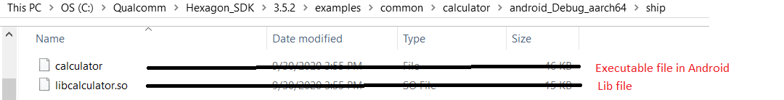
What are the libs/ executables generated? Where they generated?
In android.min
Generated library is: libcalculator.so
Generated Executable is: calculator
These are generated in C:\Qualcomm\Hexagon_SDK\3.5.2\examples\common\calculator\android_Debug_aarch64\ship

Slide 17
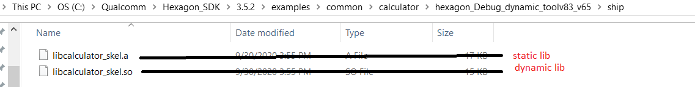
What are the libs/ executables generated? Where they generated?
In hexagon.min
Generated libraries are: libcalculator_skel.so , libcalculator_skel.a
Generated Executable is: calculator_q
These are generated in C:\Qualcomm\Hexagon_SDK\3.5.2\examples\common\calculator\hexagon_Debug_dynamic_toolv83_v65\ship

Slide 18
Explain the logs?
calculator_imp.c:19:0x10ea:7: CDSP: =============== DSP: sum result 499500 ===============
This log is present in calculator_imp.c and it will display sum result of n numbers.
Where n is the input to command line arguments.

Slide 19
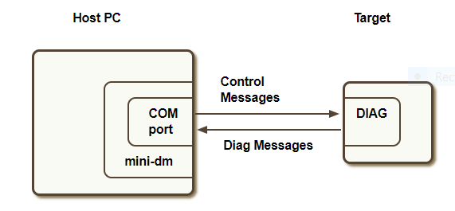
mini-dm
mini-dm.exe is the mini-diagnostic monitor provided by Qualcomm's Hexagon Access Program. It is a tool that displays diagnostic messages generated by the Hexagon DSP.
Diagnostic messages are generated by calling FARF on the DSP either from static or dynamic code
Connecting to a device:

Slide 20
mini-dm
Hardware requirements
Target device
USB drivers ( For Windows: tools/debug/usb, For Linux: libusb is provided with SDK )
USB cable
Software requirements
mini-dm (tools/debug/mini-dm)

Slide 21
mini-dm
Steps to run mini-dm.exe
1)Install USB drivers (tools/debug/usb).
USB Driver Installation
For Windows:
USB drivers can be installed by running Setup.exe in tools/debug/usb directory
2)Power on the target device.
3)Connect the USB cable from the PC to the target device.
4)Open cmd promptand type:
5)Cd C:\Qualcomm\Hexagon_SDK\3.5.2\tools\debug\mini-dm\WinNT
6)mini-dm.exe —comport <port number>
Eg: mini-dm.exe —comport com3
Port number can be discovered by running the com_finder.py script.
Port number can also be discovered After pushing DSP split binaries on target and open Control Panel->Device manager-> Ports. The port number to consider is the one corresponding to the diagnostics port.
7)Play audio on the device or make a fastRPC call to generate messages
8)Diagnostic messages will start printing to console.

Slide 22
dspCV Library
Qualcomm's Hexagon SDK allows customers to develop DSP-accelerated Computer Vision applications on Hexagon V5 and later products via dynamic loading and FastRPC. The dspCV utility library abstracts the DSP runtime environment for any compute application (not necessarily just Computer Vision) to effectively use DSP resources. The FastCV library contains many image processing API's, optimized for the Hexagon DSP. This SDK includes several examples demonstrating usage of both of these libraries in the typical usage model shown below.
The dspCV library in ${HEXAGON_SDK_ROOT}/lib/fastcv/dspCV aims to abstract as much of the DSP runtime environment as possible, to reduce effort in offloading compute processing to the DSP. It offers API's to perform such functions as clock/power voting, multi-threaded callbacks, concurrency checking, and HVX resource management.

Slide 23
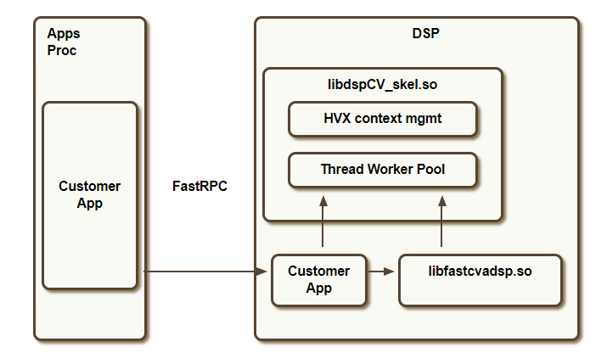
dspCV Library
fig: dspcv

