Slide 1
REAL ESTATE PRICE
EXPLORATION TOOL
KLH | DEPARTMENT OF CSE
Final Project Review | Department of CSE | KLH, KLEF
TEAM MEMBERS
2420030016 – YASHASWINI
2420030447 – SHAILAJA G
2420030700 – BHAGYALAXMI
Guide: Dr.N.Sunanda
Associate Professor
Academic Year: 2026–27
Notes:
Title slide. Replace all bracketed text. Use the full project title, list every team member with registration number, and name your guide. Insert the institution logo in the dashed box.

Slide 2
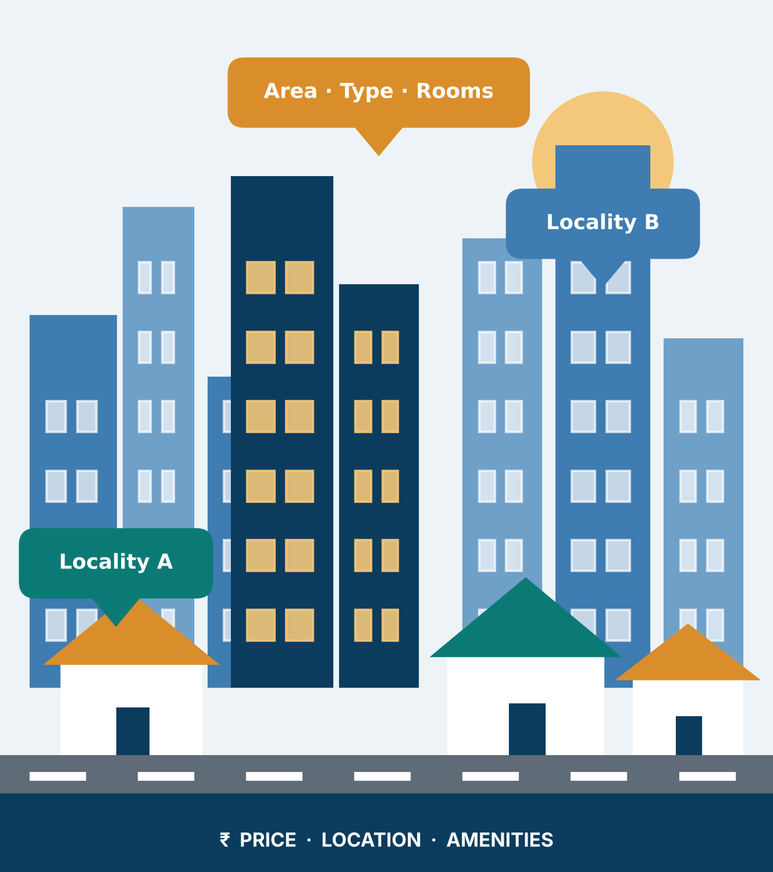



Introduction & Problem Statement
REAL-WORLD NEED
Compare localities • Explore price patterns • Understand price drivers
Background
Real estate prices vary across cities and localities. Location, property area, type, rooms and amenities can influence the selling price.
Problem Statement
Large property datasets are difficult to interpret manually. Users need a simple way to compare locations and understand the factors associated with property prices.
Motivation / Need
Buyers, sellers, investors and analysts need clear pricing insights. Without analysis, important patterns, unusual values and location-wise differences may be missed.
Notes:
State the domain, the exact problem and why it matters. Keep it to about 2 minutes. Add one real-world statistic if you can, with a citation.

Slide 3


Objectives & Scope
Objectives
1
Collect and prepare structured property data with relevant features and prices.
2
Identify missing values, duplicates, inconsistencies and outliers.
3
Analyze price patterns using EDA, statistics and visualizations.
4
Develop regression-based price estimation and an interactive dashboard.
Notes:
Objectives should be measurable and start with action verbs. The scope slide tells the panel what you did and did not attempt.

Slide 4

Literature Survey
S.No | Author(s) & Year | Method / Technique | Key Findings | Limitation / Gap
1 | Zulkifley et al. (2020) | Survey: SVR, ANN, XGBoost | ML methods can support house-price prediction. | Mainly prediction-focused; limited data-quality processing.
2 | Ja’afar et al. (2021) | Systematic review of ML valuation | Random Forest and other ML methods show promise. | No complete cleaning, quality-scoring and duplicate-detection pipeline.
3 | Soltani et al. (2022) | Spatial-temporal features with ML | Location and time influence housing prices. | Emphasis on prediction and spatial-temporal analysis.
4 | — | — | — | Only three related studies are detailed in the supplied review PPT.
Research Gap
Prior work often emphasizes prediction or spatial analysis. Our project combines data-quality checks, EDA, locality-wise comparison, predictive estimation and an interactive dashboard so users can explore why prices vary.
Notes:
Summarise four to six relevant papers or existing systems. End with the research gap, because that gap justifies your project.

Slide 5





Proposed System & Methodology
STEP 1
STEP 2
STEP 3
STEP 4
STEP 5
Define Problem
Collect Data
Design
Implement
Test & Evaluate
Define price-analysis goals and the features to explore.
Select a public real-estate dataset; confirm source, rows and columns.
Python analytics pipeline with regression models and Streamlit.
Preprocessing, EDA, model evaluation and dashboard modules.
Evaluate using MAE, MSE, RMSE and R²; test filters and outputs.
Key Novelty / Contribution
The project emphasizes understanding price-driving factors, not only producing a predicted price. It brings data cleaning, locality-wise exploration, model-based estimation and interactive visualization into one workflow.
Notes:
Walk through the five steps left to right. Rename the steps to match your project (for example, Requirement Analysis, Design, Coding, Testing, Deployment). End with your novelty.

Slide 6
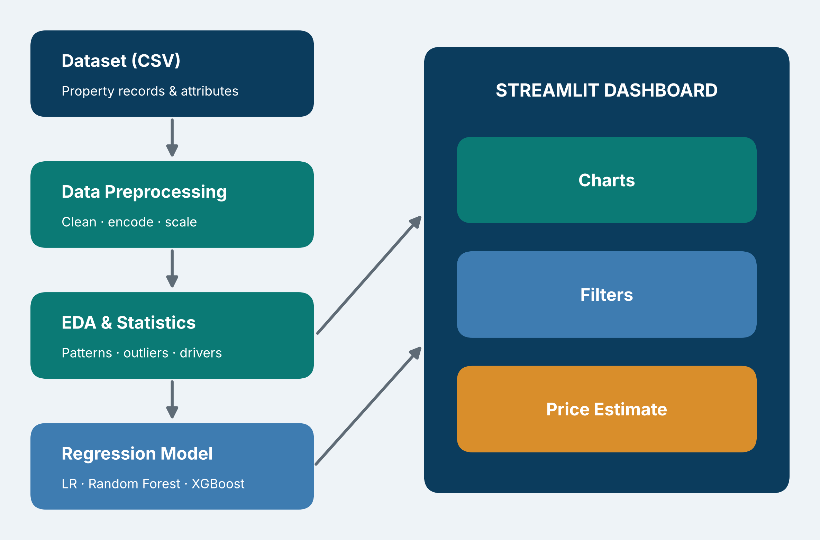
System Architecture
DATASET (CSV)
↓
DATA PREPROCESSING
↓
EDA & STATISTICAL ANALYSIS
↓
REGRESSION MODEL
↓
STREAMLIT DASHBOARD
(Charts • Filters • Price Estimate)
Components
1
Data Input
Loads property records and attributes.
2
Preprocessing & EDA
Cleans data and discovers patterns.
3
Prediction Engine
Trains and evaluates regression models.
4
Dashboard
Displays filters, comparisons and insights.
Notes:
Insert a clear block diagram: input, processing, storage, output. Number each block and explain them on the right. Redraw the figure yourself rather than copying it.

Slide 7


Hardware & Software Requirements
Hardware
Software & Tools
Libraries / Frameworks
Standard laptop / PC
Sufficient RAM for dataset processing
Local storage for CSV and code
Internet for dataset / documentation
Windows / Linux
Python
VS Code or Google Colab
Git / GitHub (if used)
Pandas, NumPy
Matplotlib, Plotly
Scikit-learn, Streamlit
CSV dataset; no database specified
Development / deployment: Local machine or Google Colab; Streamlit dashboard
Notes:
List only what you actually used, with versions. For a pure software project, shorten the hardware list and add cloud or deployment resources.

Slide 8
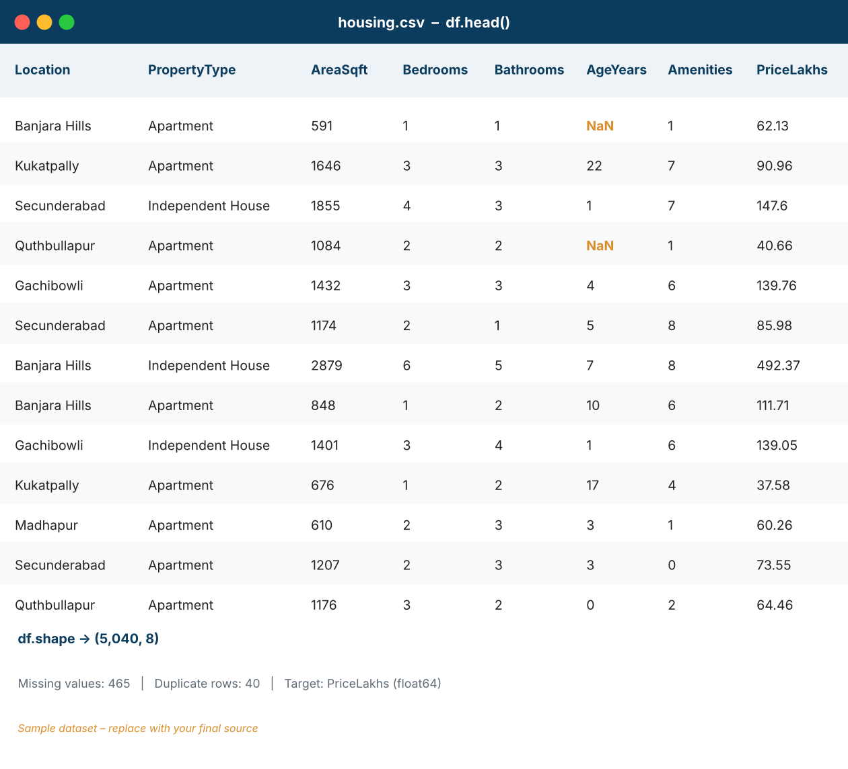
Dataset / Data Understanding
DATASET PREVIEW
Add the selected dataset's actual head() / info() screenshot here.
TBD
TBD
Records (rows)
Features (columns)
TBD
N/A
Missing values
Target classes
Source: Public real-estate / housing dataset (final source to be confirmed)
Features: Location, property type, area, bedrooms, bathrooms, amenities
Target: Selling price (continuous variable)
Quality: Missing values, duplicates and outliers will be assessed.
Notes:
Explain where the data came from and what it contains. Show a screenshot of the first rows or the info summary. For non-data projects, replace this slide with “Requirement Analysis” or “Input Specification”.

Slide 9
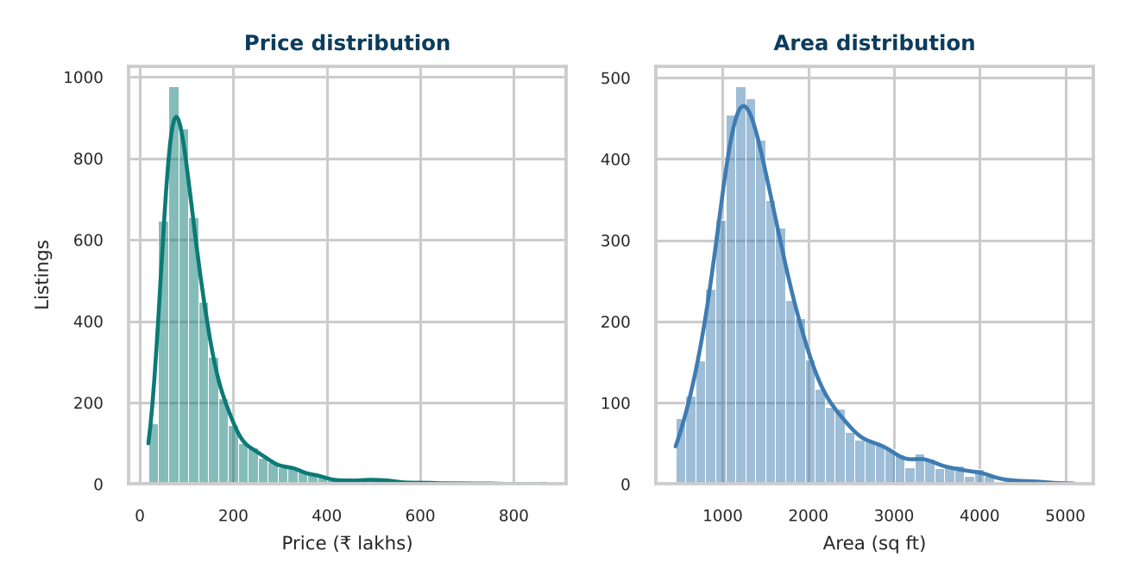
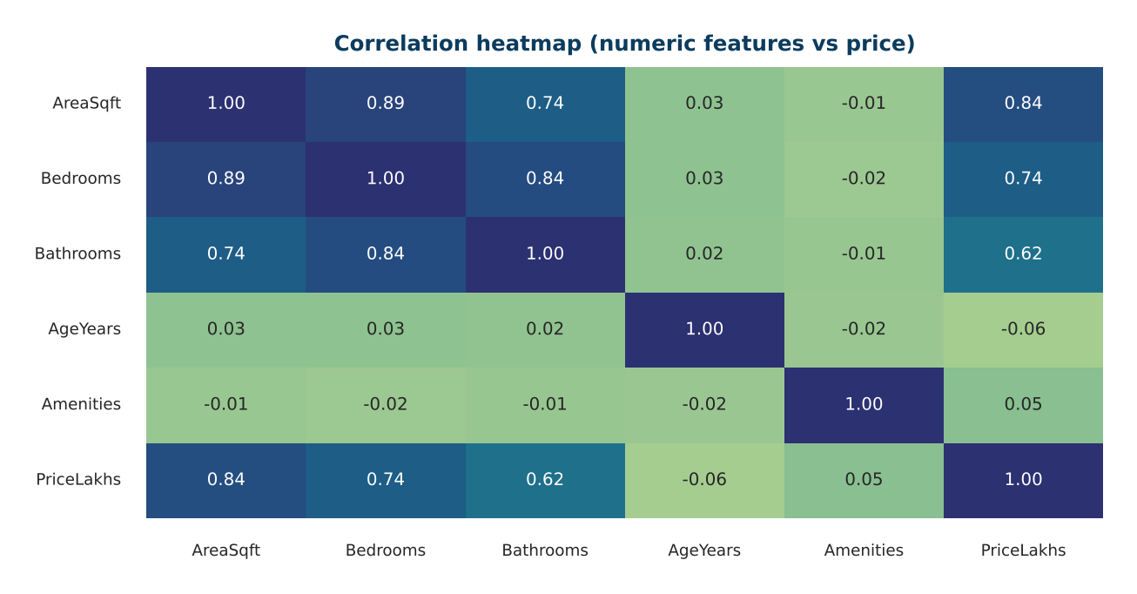



Data Preprocessing & Exploratory Analysis
EDA VISUAL 1
Price / area distributions
EDA VISUAL 2
Correlation / outlier analysis
Cleaning
Transformation
Feature Selection
Check completeness; remove true duplicates; standardize inconsistent values; inspect outliers before treatment.
Encode categorical fields; scale numerical features only when required by the selected model.
Use domain relevance and analysis to select useful attributes. Final feature count depends on the chosen dataset.
Notes:
Show two or three plots that tell a story: distributions, correlations, outliers. Explain what each plot told you and what you did about it.

Slide 10
Module-wise Description
1
Data Collection & Cleaning
2
Exploratory Data Analysis
Purpose: Enable user-driven exploration
Input → Output: Filters → charts, summaries and estimates
Developed by: Team allocation to be confirmed
Purpose: Enable user-driven exploration
Input → Output: Filters → charts, summaries and estimates
Developed by: Team allocation to be confirmed
3
Regression & Evaluation
4
Interactive Dashboard
Purpose: Enable user-driven exploration
Input → Output: Filters → charts, summaries and estimates
Developed by: Team allocation to be confirmed
Purpose: Enable user-driven exploration
Input → Output: Filters → charts, summaries and estimates
Developed by: Team allocation to be confirmed
Notes:
Divide the project into three to five modules. For each, state its purpose, inputs, outputs and who built it. Duplicate a card if you have more modules.

Slide 11

Algorithms & Technologies Used
Linear Regression
Random Forest Regression
XGBoost Regression
Why chosen
Boosted trees can model complex feature relationships
Key parameters
Learning rate, estimators and max depth
Why chosen
Boosted trees can model complex feature relationships
Key parameters
Learning rate, estimators and max depth
Why chosen
Boosted trees can model complex feature relationships
Key parameters
Learning rate, estimators and max depth
Selection criteria: Compare MAE, MSE, RMSE and R² on held-out test data; report the best measured model.
Notes:
Name each model, algorithm or technology, say why you chose it, and list the key settings. Then explain how you picked the final one.

Slide 12
Implementation / Model Building
Feature Selection
Code snippet / pseudocode
Location, area, property type, bedrooms, bathrooms and available amenities; final inputs depend on dataset columns.
ILLUSTRATIVE PIPELINE (update to match final code)
X_train, X_test, y_train, y_test = train_test_split(
X, y, test_size=0.2, random_state=42
)
pipeline = Pipeline([
("preprocess", preprocessor),
("model", Regressor())
])
pipeline.fit(X_train, y_train)
Preprocessing Pipeline
Load data → inspect → clean missing / duplicate / inconsistent records → encode categories → prepare features.
Data Splitting
Use a held-out test set; split ratio and record counts must be filled from the actual experiment.
Configuration
Regression task; tune model settings using validation results. Record final settings after training.
Notes:
Describe the build in the order you did it. Paste only the most important code or pseudocode, not entire files. For hardware projects, show the circuit or wiring summary instead.

Slide 13
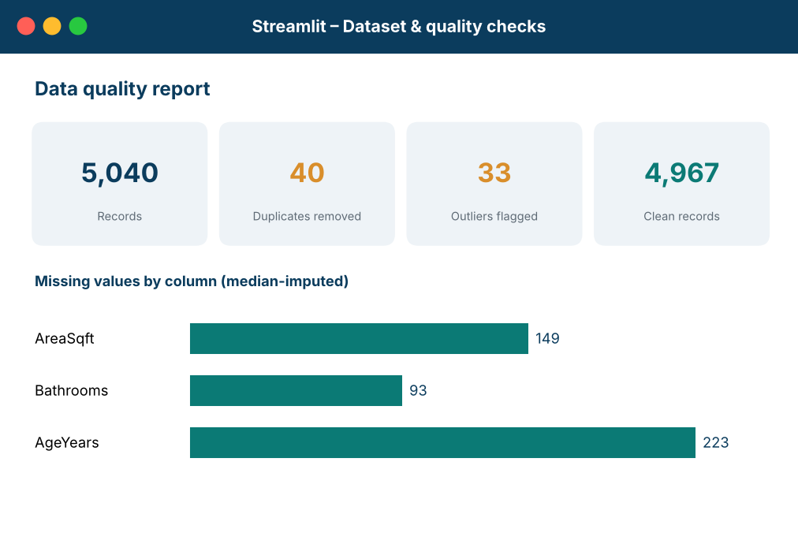
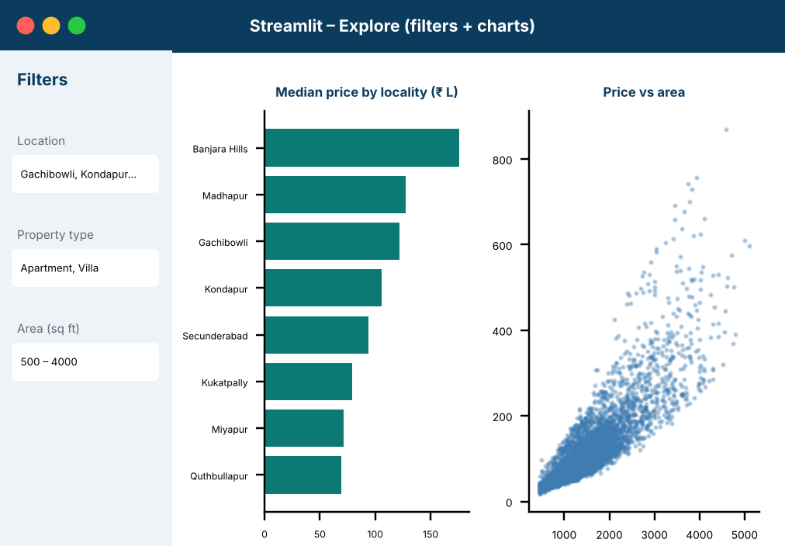
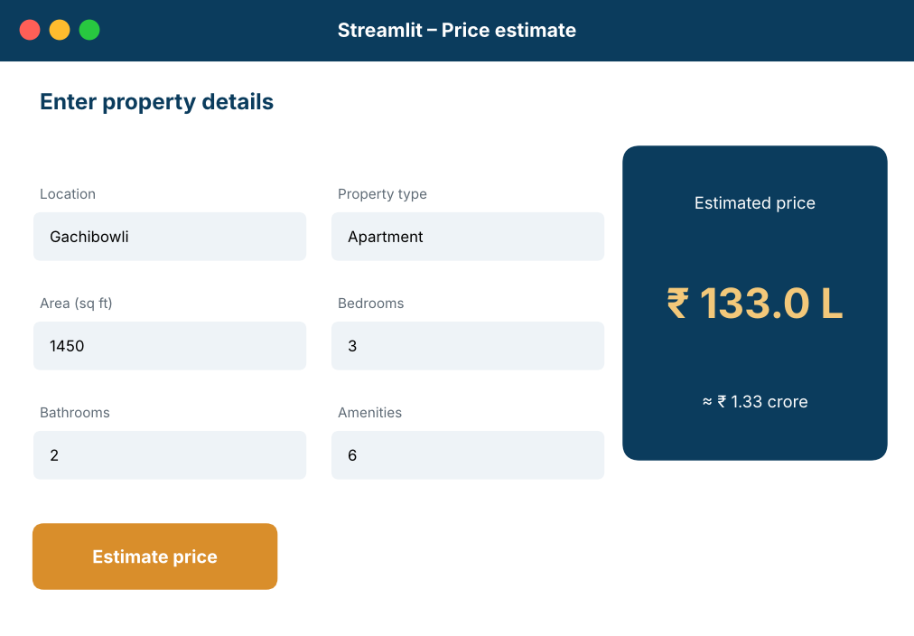
Working Prototype / Output Screens
SCREENSHOT 1
Dataset / preprocessing
SCREENSHOT 2
EDA dashboard
SCREENSHOT 3
Prediction view
Data preparation
Show cleaned dataset and quality checks.
Exploratory analysis
Show price distributions and locality comparisons.
Price estimation
Show user inputs and model prediction.
Notes:
Show real screenshots, photos of the hardware or a short demo video link. Caption each one with what the viewer should notice.

Slide 14
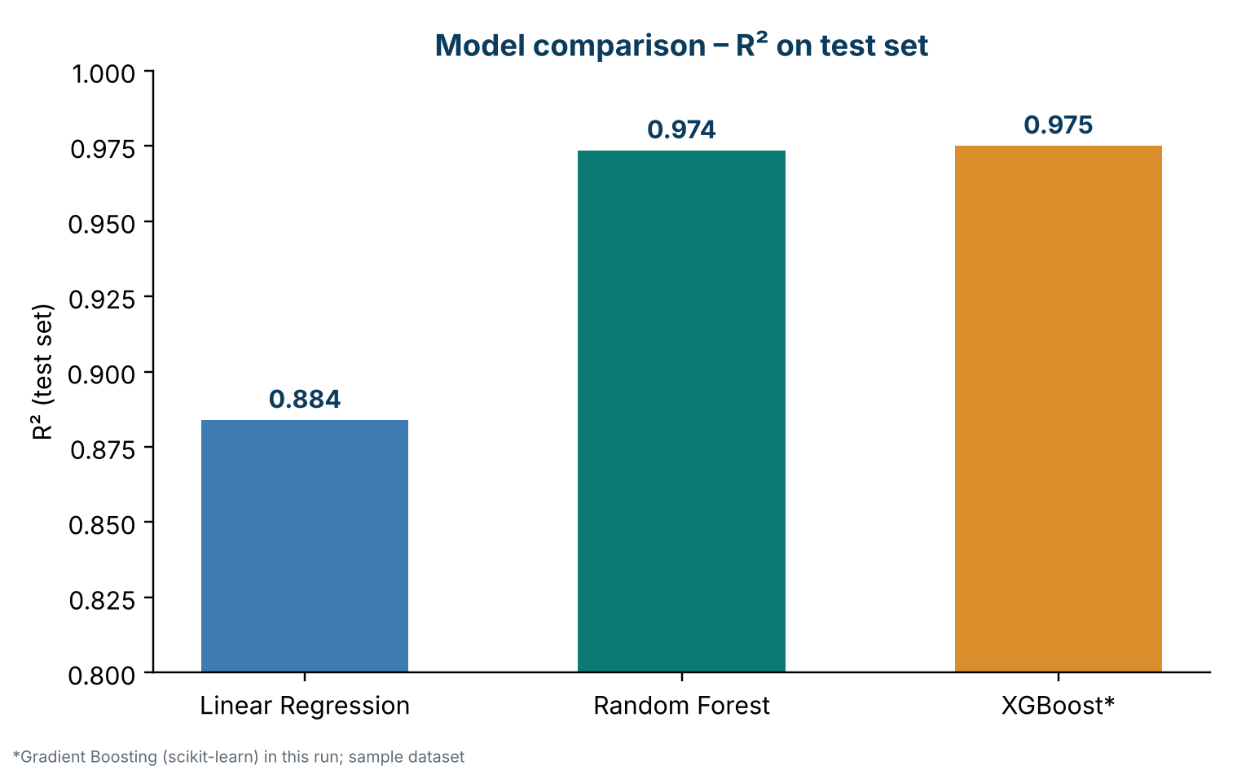
Results & Performance Comparison
REGRESSION MODEL COMPARISON
Linear Regression • Random Forest • XGBoost
Metrics: MAE | MSE | RMSE | R² | MAPE
Actual values will be added after model training and test evaluation.
Metric | Linear Regression | Random Forest | XGBoost
MAE | Pending | Pending | Pending
MSE | Pending | Pending | Pending
RMSE | Pending | Pending | Pending
R² | Pending | Pending | Pending
MAPE | Pending | Pending | Pending
Best model: To be identified after training and test evaluation.
No experimental metrics were supplied in the source documents. Enter actual MAE, MSE, RMSE and R² after evaluation.
Notes:
Right-click the chart and choose Edit Data to enter your real numbers. Replace the metrics with the ones that fit your project (accuracy, latency, power, throughput, user rating). State clearly which option performed best.

Slide 15
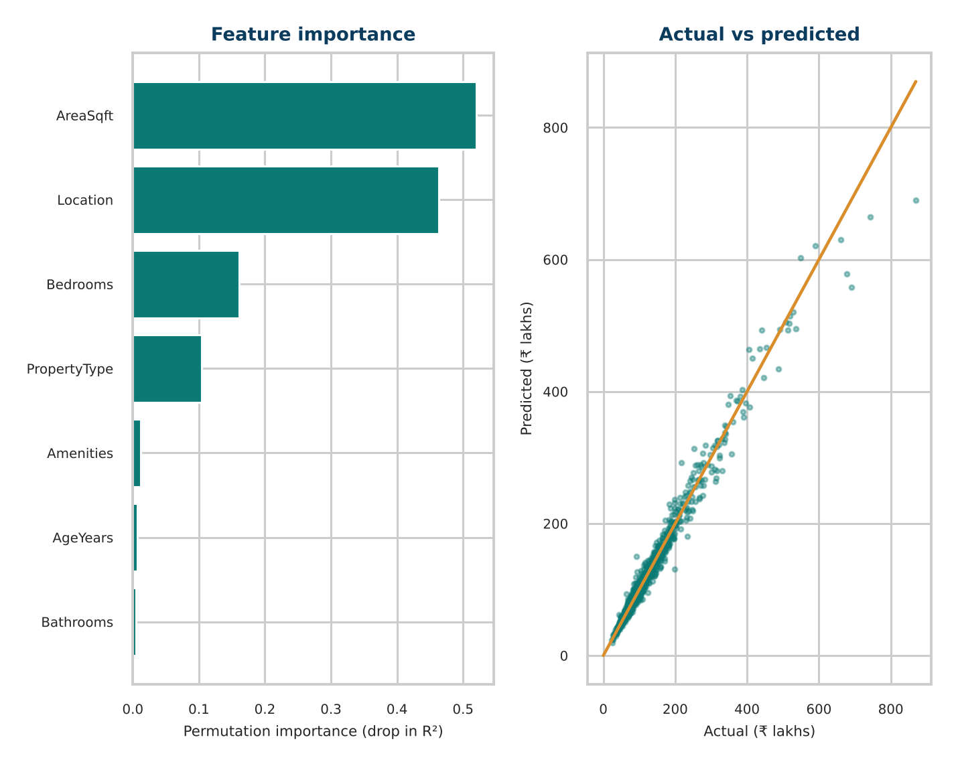
Analysis & Key Findings
ADD ACTUAL OUTPUT
Regression feature importance / actual-vs-predicted plot
TBD
Best test metric / model: pending evaluation
Interpretation: Report what the measured errors and R² indicate.
Error analysis: Inspect large residuals and unusual listings.
Key drivers: Location, area, property type and room / amenity attributes are candidate factors.
Notes:
Explain what the numbers mean. Use a confusion matrix, ROC curve, feature-importance chart or output comparison. Be honest about weak results; panels value that.

Slide 16

Testing & Validation
Test ID | Test Description | Expected Result | Actual Result | Status
TC-01 | Load dataset | CSV loads without error | To be recorded | Pending
TC-02 | Handle missing values | Selected cleaning applied | To be recorded | Pending
TC-03 | Apply dashboard filters | Charts reflect selected filters | To be recorded | Pending
TC-04 | Price estimate | Model returns numeric estimate | To be recorded | Pending
Functional Testing
Validation Method
Performance Testing
Check data loading, missing-value handling, filters, chart updates and prediction input validation.
Use a train/test hold-out; cross-validation may be added for model comparison. Record the method actually used.
Measure prediction errors with MAE, MSE, RMSE and R²; check dashboard responsiveness.
Notes:
List representative test cases with expected and actual outcomes. Name the validation methods you used. Delete rows you do not need.

Slide 17


Challenges & Limitations
Challenges Faced
Limitations
Missing / incomplete values → apply suitable imputation after inspection.
Inconsistent formats and duplicates → standardize fields and remove repeated records.
Extreme prices → inspect with plots / IQR; retain valid high-value properties.
Analysis quality depends on dataset completeness and reliability.
Market conditions change over time and by location.
A model trained on one region or period may not generalize to others.
Notes:
Be candid. Pair every challenge with how you solved it, and list limitations that the panel would otherwise spot themselves.

Slide 18

Conclusion
An integrated workflow for real-estate data preprocessing, EDA, regression-based estimation and an interactive Streamlit dashboard.
1
Final Outcome
Final model metrics and model comparison are pending completion of the implementation.
TBD
2
Headline achievement: Interactive exploration and price-analysis workflow
Objectives achieved: To be confirmed after implementation review
The tool is designed to turn raw property records into understandable insights for comparison and data-driven decisions.
3
Notes:
Revisit each objective and say whether you met it. Quote your headline result with numbers. Do not introduce new material here.

Slide 19



Future Scope & Applications
Improve Performance
Tune regression models and compare additional algorithms.
Applications
Property comparison across localities
Buyer / seller price exploration
Investment and market analysis
Potential users: buyers, sellers, investors and real-estate analysts
Expand Data / Features
Use larger, recent datasets and additional economic / location indicators.
Deploy & Build an Interface
Deploy the Streamlit dashboard and add map-based exploration.
Scale & Secure
Automate dataset updates and improve reliability.
Notes:
Give concrete next steps, ideally tied to the limitations. Then name two or three real-world uses.

Slide 20
Team Contribution
Reg. No. | Name | Contribution / Modules Handled
2420030016 | Yashaswini | Team project work; individual module allocation to be confirmed.
2420030447 | Shailaja G | Team project work; individual module allocation to be confirmed.
2420030700 | Bhagyalaxmi | Team project work; individual module allocation to be confirmed.
[Reg. No.] | [Member 4] | [Modules, tasks and report sections]
Notes:
Show that work was planned and shared. Every member should be able to explain their own module.

Slide 21

References
[1] Zulkifley et al., “House Price Prediction using a Machine Learning Model: A Survey of Literature,” 2020.
[2] Ja’afar et al., “Machine Learning for Property Price Prediction and Price Valuation: A Systematic Literature Review,” 2021.
[3] Soltani et al., “Housing Price Prediction Incorporating Spatio-Temporal Dependency into Machine Learning Algorithms,” 2022.
[4] L. Breiman, “Random forests,” Machine Learning, vol. 45, no. 1, pp. 5–32, 2001.
[5] F. Pedregosa et al., “Scikit-learn: Machine Learning in Python,” JMLR, vol. 12, pp. 2825–2830, 2011.
[6] W. McKinney, Python for Data Analysis, 3rd ed., O’Reilly, 2022.
[7] Plotly Technologies Inc., Plotly Python Graphing Library Documentation.
[8] Streamlit Inc., Streamlit Documentation.
Project Links
GitHub: Not provided
Dataset: Final dataset source / URL to be added
Demo video: To be added after prototype completion
Notes:
Use IEEE style, numbered in order of first citation in the deck. Include datasets, documentation and code repositories.

Slide 22
THANK YOU
Questions & Discussion
Guide: Dr. N. Sunanda
Assistant Professor, Department of CSE
KLH, Koneru Lakshmaiah Education Foundation
Notes:
Leave this slide up during questions. Make sure every team member can answer questions about their own module.

