Slide 1
Optimizing Sales Forecasting at XYZ Company: Leveraging SARIMA and Time-Series Analysis

Slide 2
Introduction to Sales Forecasting
Sales forecasting is crucial for strategic planning and resource allocation. At XYZ Company, we aim to enhance our forecasting accuracy using advanced techniques like SARIMA and time-series analysis . This presentation will explore how these methods can transform our sales predictions.

Slide 3



Understanding SARIMA
SARIMA, or
, is a powerful statistical model. It captures
and trends in time-series data. By incorporating seasonal effects, SARIMA can signiﬁcantly improve our sales forecasting accuracy at XYZ Company.

Slide 4
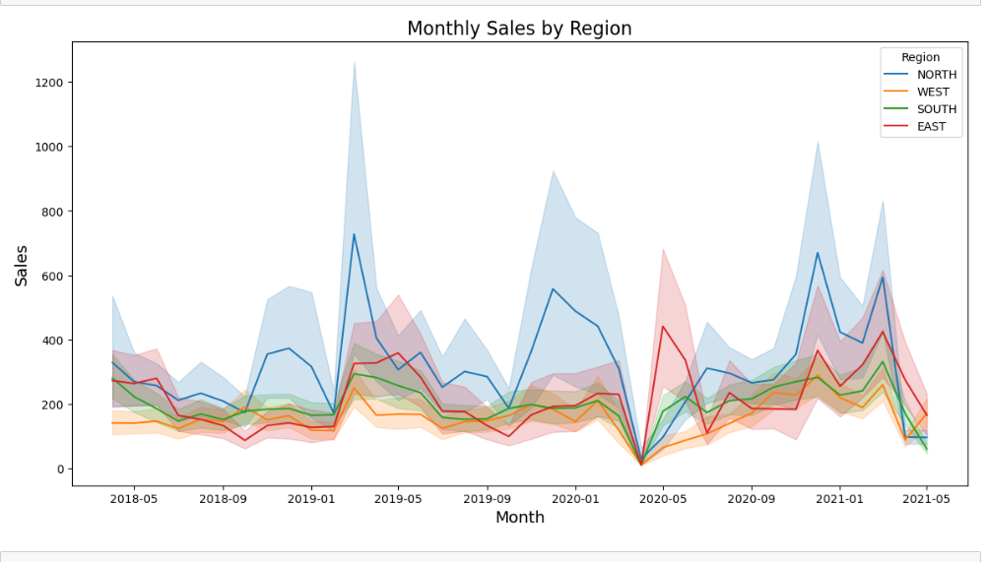

Slide 5
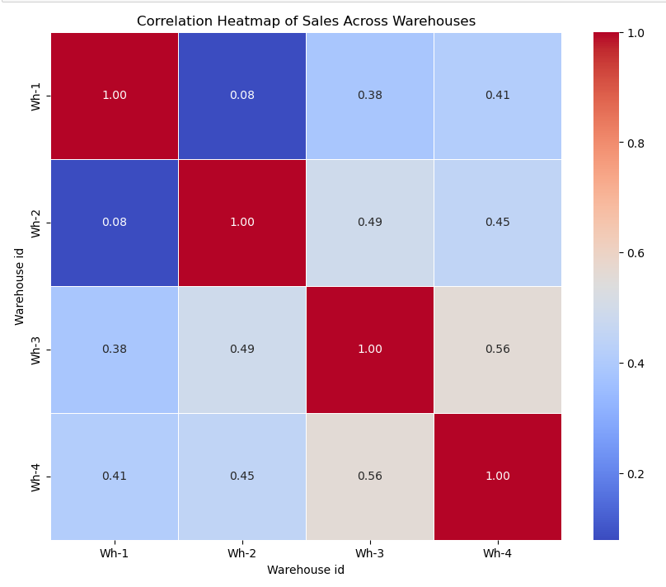

Slide 6
SARIMA workflow architecture
Preprocessing:
Transform the dataset to make it stationary (differencing, seasonal adjustments).
Conduct stationarity tests (ADF Test).
Model Identification:
Use tools like autocorrelation function (ACF) and partial autocorrelation function (PACF) plots to identify p,d,q,P,D,Q
Model Training:
Fit the SARIMA model on training data.
Validation:
Compare predicted vs. actual values on validation data.
Use error metrics like MAPE to evaluate performance.
Forecasting:
Use the trained SARIMA model to predict future values.

Slide 7
SARIMA workflow architecture
SARIMA Model Parameters
Non-Seasonal Components (ARIMA):
p: Order of non-seasonal AR terms.
d: Order of non-seasonal differencing.
q: Order of non-seasonal MA terms.
Seasonal Components:
P: Order of seasonal AR terms.
D: Order of seasonal differencing.
Q: Order of seasonal MA terms.
s: Length of the seasonality (e.g., s=12 for monthly data).
SARIMA Notation:
SARIMA(p,d,q)(P,D,Q,s)

Slide 8
RESULTS
RMSE (Root Mean Squared Error: 672.84)
Interpretation: RMSE represents the square root of the average squared differences between the actual and predicted values. A higher RMSE indicates larger errors in your predictions, meaning that your model's forecasted values deviate significantly from the actual values.
Possible reason for high RMSE: This could be due to large forecast errors on some individual predictions or a mismatch between the model and the data (e.g., underfitting, inappropriate model choice, or incorrect parameters).
MAE (Mean Absolute Error: 168.90)
Interpretation: MAE is the average of the absolute differences between the actual and predicted values. It's less sensitive to large outliers than RMSE but still shows how far, on average, your predictions are from the true values.
Possible reason for high MAE: Similar to RMSE, this suggests that the model's predictions are often far from the actual values.
Accuracy: 13.57%
Interpretation: Accuracy, as defined in your case (percentage of predictions within 10% of the actual values), is quite low. This suggests that most of your predictions are outside the acceptable tolerance range.
Possible reason for low accuracy: This could happen if the model is poorly tuned or if there is high variability in the data that the model is unable to capture.

Slide 9
FUTURE IMPROVEMENTS
1.Tuning SARIMA: Experiment with different SARIMA configurations (p, d, q, and seasonal parameters). Use tools like pmdarima for automated tuning.
2. Feature Engineering
Lag Features: Create lagged variables (e.g., sales from previous months) as predictors for XGBoost or other models.
Seasonal Indicators: Add explicit features like "month," "quarter," or "is_holiday" to capture seasonality and periodicity.
External Variables: Incorporate external variables such as promotions, weather data, or macroeconomic indicators, which may influence sales patterns.

Slide 10
Thanks!
Do you have any questions? youremail@email.com
+91 620 421 838
www.yourwebsite.com @yourusername

