Slide 1


Project(SQL+ PowerBI)

Slide 2
Data Columns
Date
2. Time
3. Booking_ID
4. Booking_Status
5. Customer_ID
6. Vehicle_Type
7. Pickup_Location
8. Drop_Location
9. V_TAT
10. C_TAT
11. cancelled_Rides_by_Customer
12. cancelled_Rides_by_Driver
13. Incomplete_Rides
14. Incomplete_Rides_Reason
15. Booking_Value
16. Payment_Method
17. Ride_Distance
18. Driver_Ratings
19. Customer_Rating

Slide 3
Power BI Questions:
Ride Volume Over Time
2. Booking Status Breakdown
3. Top 5 Vehicle Types by Ride Distance
4. Average Customer Ratings by Vehicle Type
5. cancelled Rides Reasons
6. Revenue by Payment Method
7. Top 5 Customers by Total Booking Value
8. Ride Distance Distribution Per Day
9. Driver Ratings Distribution
10. Customer vs. Driver Ratings

Slide 4
PowerBI Dashboard

Slide 5
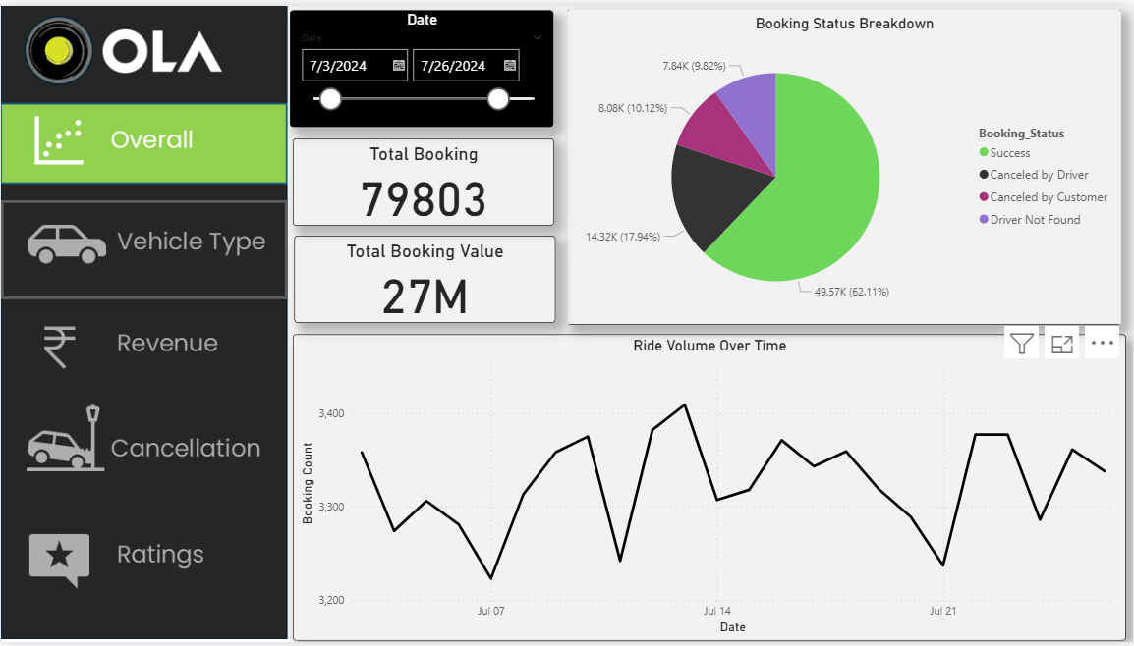

Slide 6
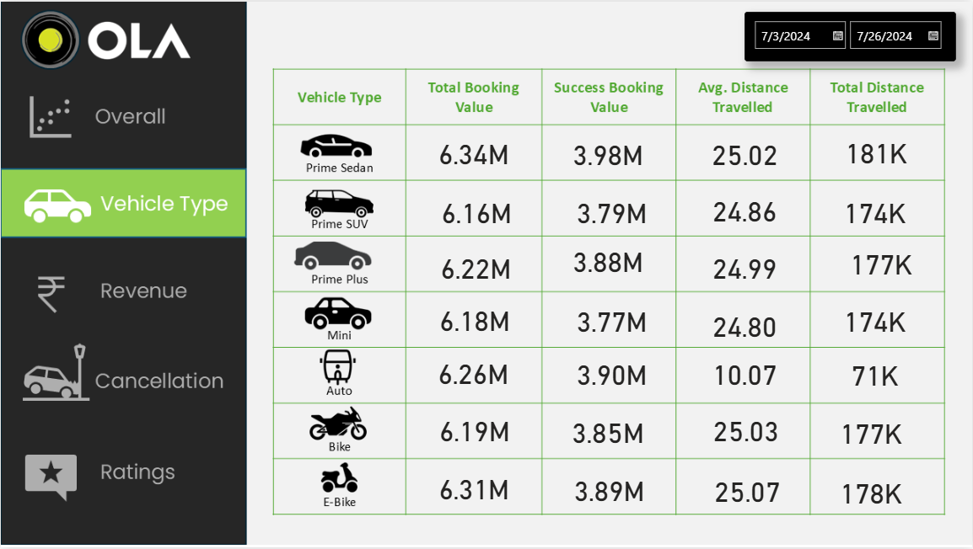

Slide 7
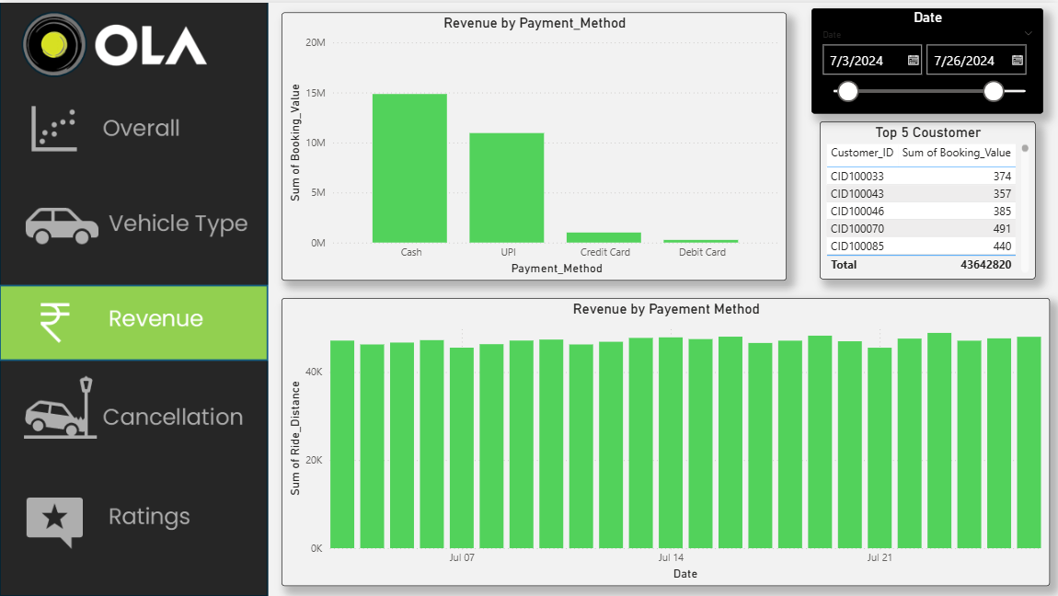

Slide 8
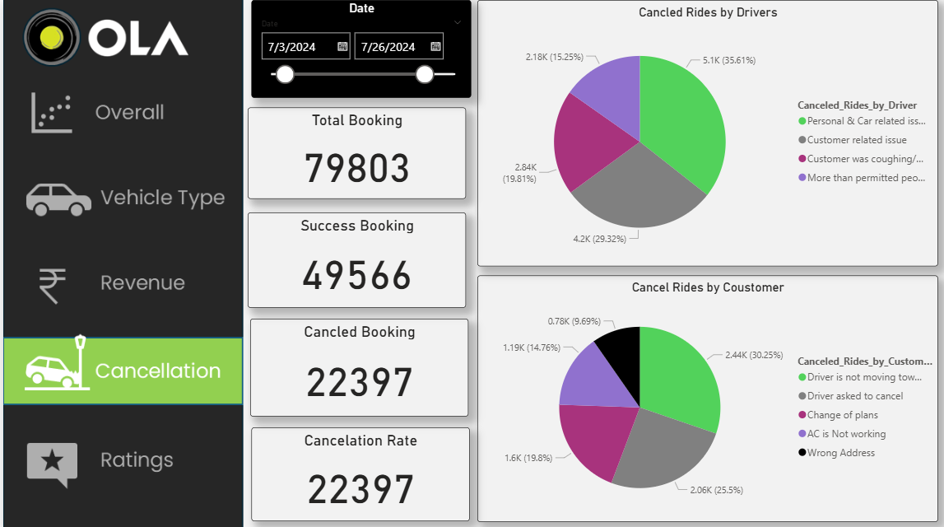

Slide 9
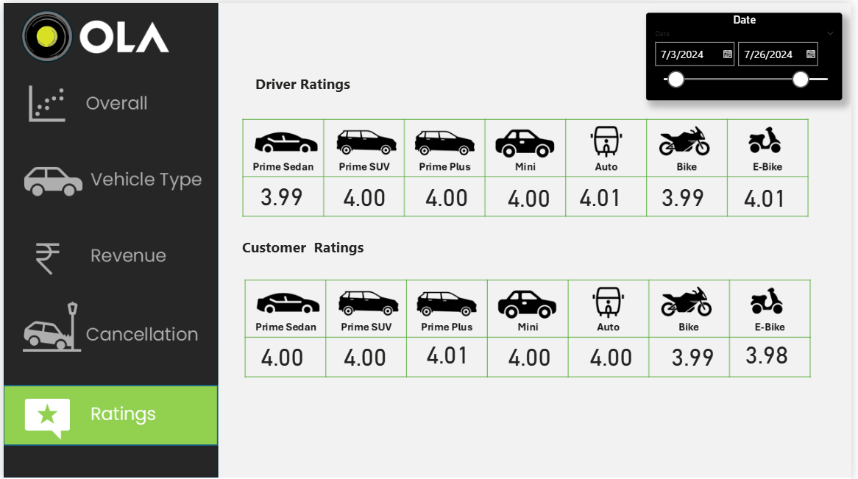

Slide 10
Power BI Answers:
Ride Volume Over Time: A time-series chart showing the number of rides per day/week.
2. Booking Status Breakdown: A pie or doughnut chart displaying the proportion of different booking statuses (success, cancelled by the customer, cancelled by the driver, etc.).
3. Top 5 Vehicle Types by Ride Distance: A bar chart ranking vehicle types based on the total distance covered.
4. Average Customer Ratings by Vehicle Type: A column chart showing the average customer ratings for different vehicle types.
5. cancelled Rides Reasons: A bar chart that highlights the common reasons for ride cancellations by customers and drivers.
6. Revenue by Payment Method: A stacked bar chart displaying total revenue based on payment methods (Cash, UPI, Credit Card, etc.).
7. Top 5 Customers by Total Booking Value: A leaderboard visual listing customers who have spent the most on bookings.
8. Ride Distance Distribution Per Day: A histogram or scatter plot showing the distribution of ride distances for different Dates. 9. Driver Rating Distribution: A box plot visualizing the spread of driver ratings for different vehicle types.
10. Customer vs. Driver Ratings: A scatter plot comparing customer and driver ratings for each completed ride, analyzing correlations

Slide 11
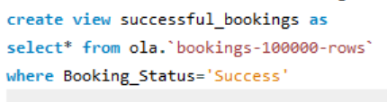
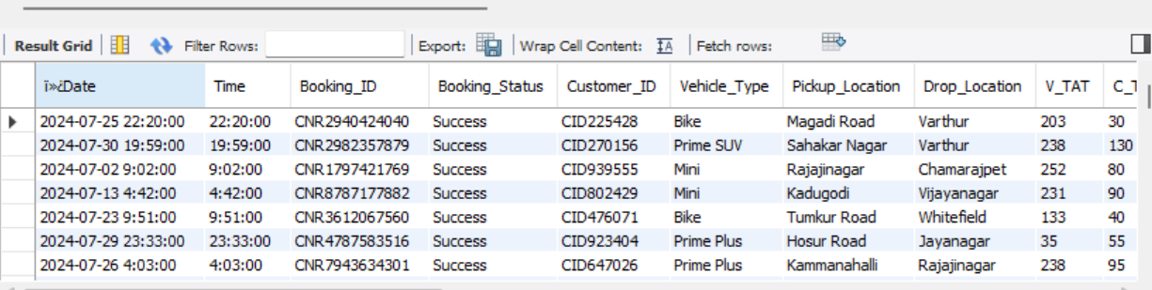
SQL Questions: OLA Data Analyst Project
1. Retrieve all successful bookings:

Slide 12
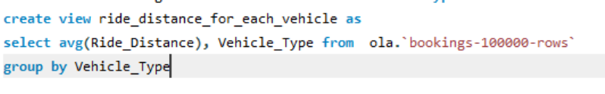
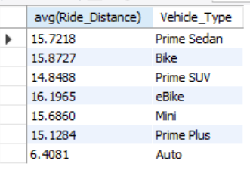
2. Find the average ride distance for each vehicle type:

Slide 13
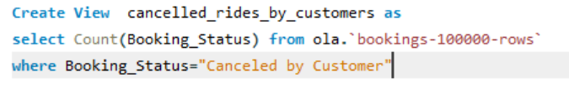
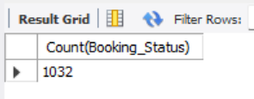
3. Get the total number of cancelled rides by customers:

Slide 14
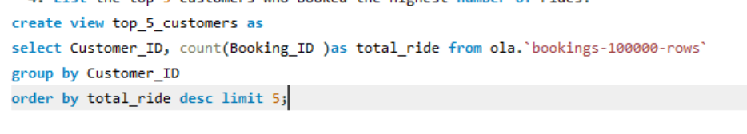
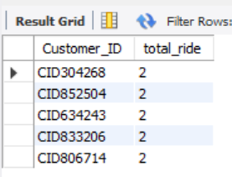
4. List the top 5 customers who booked the highest number of rides:

Slide 15
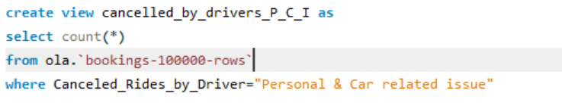
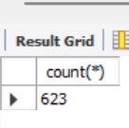
5. Get the number of rides cancelled by drivers due to personal and car-related issues:

Slide 16
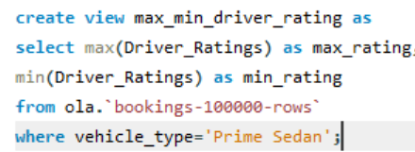

6. Find the maximum and minimum driver ratings for Prime Sedan bookings

Slide 17

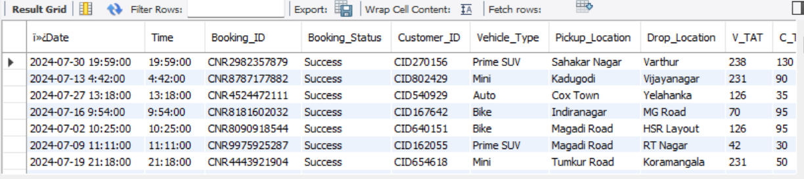
7. Retrieve all rides where payment was made using UPI

Slide 18
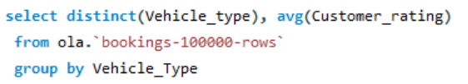
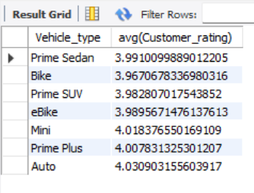
8. Find the average customer rating per vehicle type:

Slide 19


9. Calculate the total booking value of rides completed successfully:

Slide 20
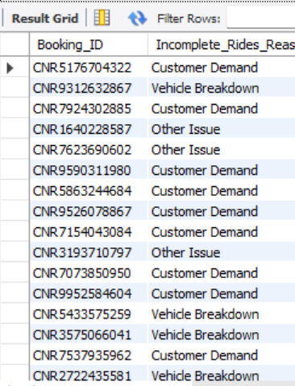

10. List all incomplete rides along with the reason

Slide 21
ChatGPT Prompt to Create Data
Please create a spreadsheet with 1 lac rows, for Bengaluru city. Give the following columns. The data will be for 1 month. use the following column
Date
2. Time
3. Booking ID
4. Booking Status
5. Customer ID
6. Vehicle Type- Auto- Prime Plus- Prime Sedan- Mini- Bike- eBike- Prime SUV
7. Pickup Location (Create dummy location points Take any 50 areas from Bangalore)
8. Drop Location (Take from dummy pickup locations)
9. AvgVTAT (Time taken to arrive at the vehicle)
10. Avg CTAT (Time taken to arrive the Customer)

Slide 22
11. Cancelled Rides by Customer
12. Reason for cancelling by Customer Driver is not moving towards pickup location---- Driver asked to cancel ACis not working (Only for 4-wheelers) Change of plans Wrong Address
13. Cancelled Rides by Driver Personal & Car related issues-- Customer related issue The customer was coughing/sick More than permitted people in there
14. Incomplete Rides
15. Incomplete Rides Reason Customer Demand-- Vehicle Breakdown Other Issue
16. Booking Value
17. Ride Distance
18. Driver Ratings
19. Customer Rating Keep the overall booking status success for this data at 62%.
If the booking status is successful, then only fare charge ratings, average VTAT, average CTAT, and other data will be there

Slide 23
Thankyou

