Slide 1
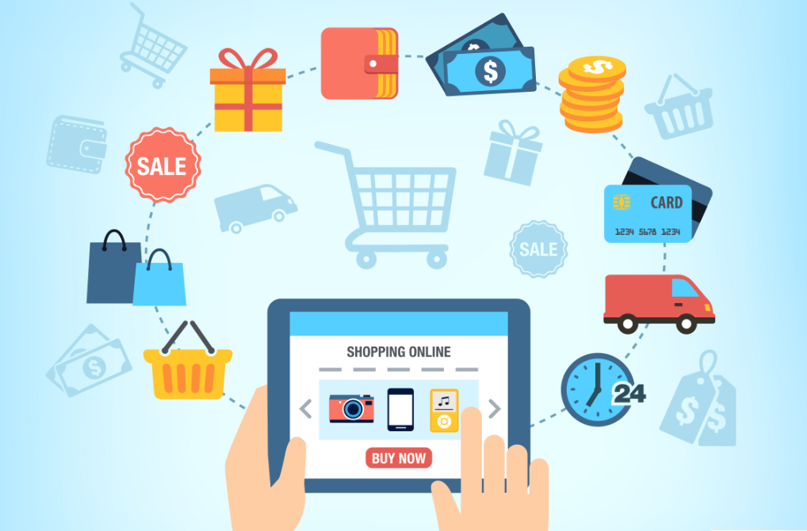
Ecommerce
Website Development
Represented by :
Miss. Shinde Bhagyashree Rajendra
Miss. Bhosale Sonam Ankush

Slide 2
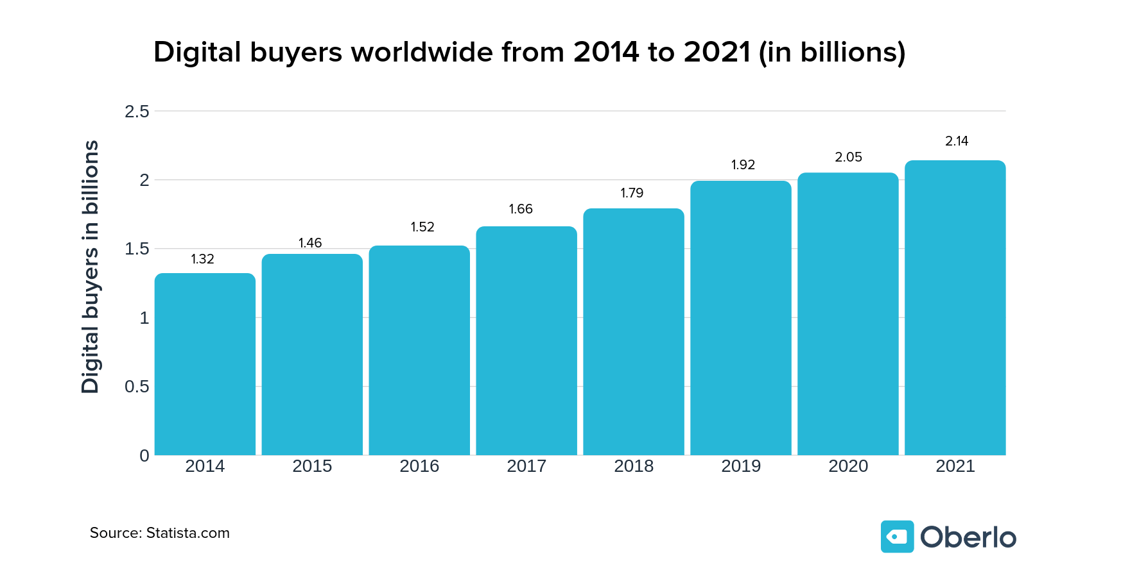
Reason of Ecommerce Website
Ecommerce is growing 3x faster than traditional retail. Overall, 51% of consumers prefer to shop online, while 49% would rather go to a store.
1. It can Save Time
2. It can Save Transportation Expenses
3. You can Shop at Any Time You Want
4. Products are Cheaper
5. You Don’t Need to Wait on Queues
6. You can Avoid Crowds
7. It is Easy to Search for What You Want

Slide 3
Problem Statement of Existing System
There are some problems occurs in existing system which are follows:
It is time consuming process.
End User can not give any feedback. It is difficult to update the data about the user and providing services.
There is a data loss if human error or any other functionality error occurs. Security is less.
There is no functionally to get the updated details at all time to the owners and managers from all the branches.
In existing system there are manual works , therefore, it is complex to save more data.
In existing system there are data are store in register, so the number of files are increased. Therefore, sometimes unauthorized person are access that important data.

Slide 4
Introduction
The objective of this website is to develop a general purpose online electronics store where multiple category of electronics devices(such as “Mobile”, “Laptop”, “Tablet” and “Television” etc.) can be bought from the comfort of home through the Internet.
Electrostore is a web based application where users can view various electronics devices along with their description. The project provides user with a flexible and attractive GUI and shows him a list of devices and carry out all the shopping activities online.
An online store is a virtual store on the Internet where customers can browse the category and select device of interest. The selected items may be collected in a shopping cart. At checkout time, the items in the shopping cart will be presented as an order. At that time, more information will be needed to complete the transaction.
This project is developed for users to have a brief look at the devices without actually visiting the store. The website displays different kinds of devices of different brands so that user can easily get their expected device.

Slide 5
TECHNOLOGY & TOOLS USED
Software Requirements:
Operating System : Windows XP / 7 / 10 and above, Linux
Front End : HTML, CSS, JavaScript
Back End : PHP 7.2, MySQL 5.7
Reporting Tool : HTML Report maker
Framework : CSS framework(Bootstrap)
Editor : Visual Studio Code, Notepad++
Web Server : XAMPP Server (Apache 2.4)

Slide 6
Main Goal
The main goals of this project are :
User friendly navigations to provide ease
Place an order in any time.
Maximize search options
1.by category's name 2.by Product’s name
In this system provide Door to Door service.
Help user by providing specification of products.
Full Security System.
Admin module can generate various types of category, products which includes the electronics devices with more description.
Our system provide all reports, document needed for admin without any delay.

Slide 7
Modules
Admin Module :-
Login –
Admin will login to this system using filling appropriate details.
Registration –
Admin will verify the service provider & accept the payment.
Display –
display information of services providers.
User Module :-
View Electronics Device details.
Search electronic devices based on category & product name.
Submit Feedback.

Slide 8
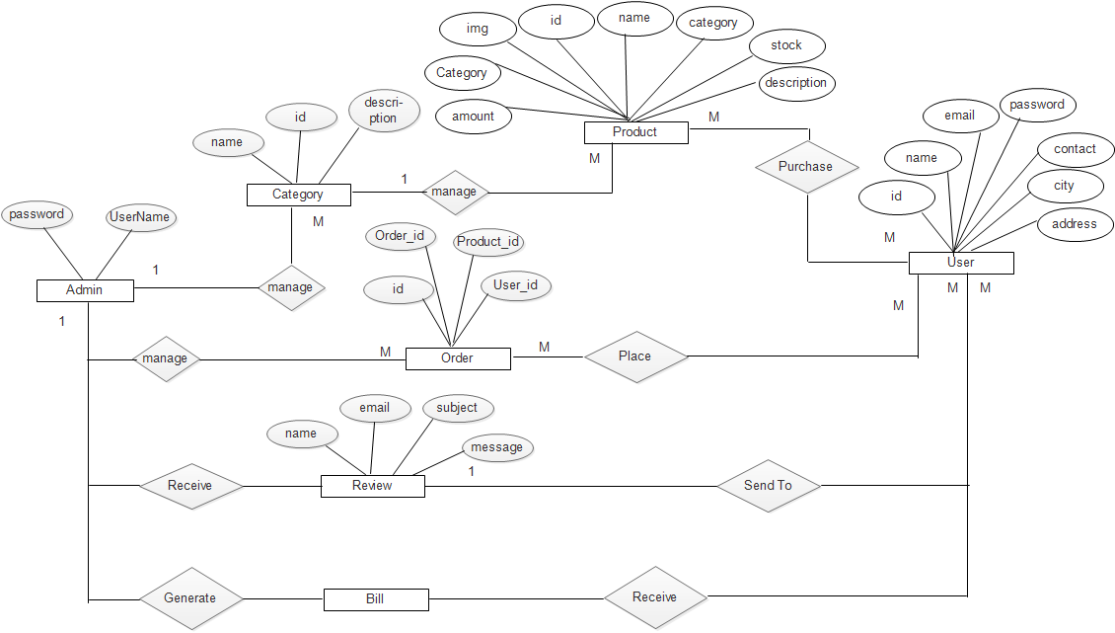
ER-Diagram

Slide 9
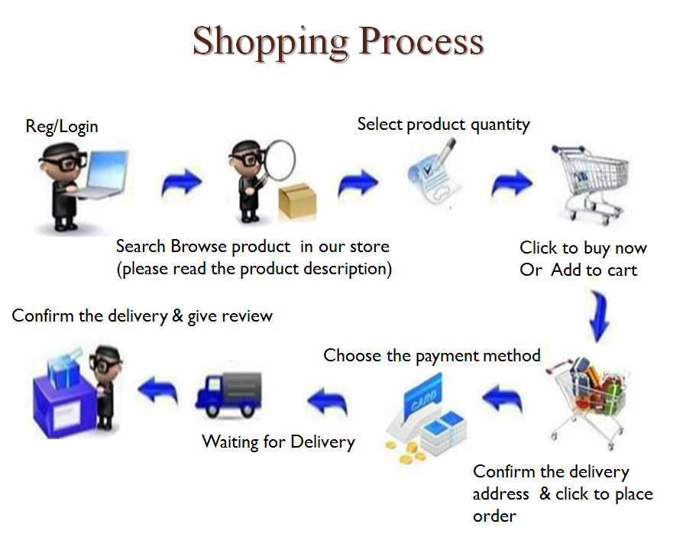

Slide 10
Demonstration of project

Slide 11
Thank you

