Slide 1


User Centric Pollution Alert System
8-credits

Slide 2


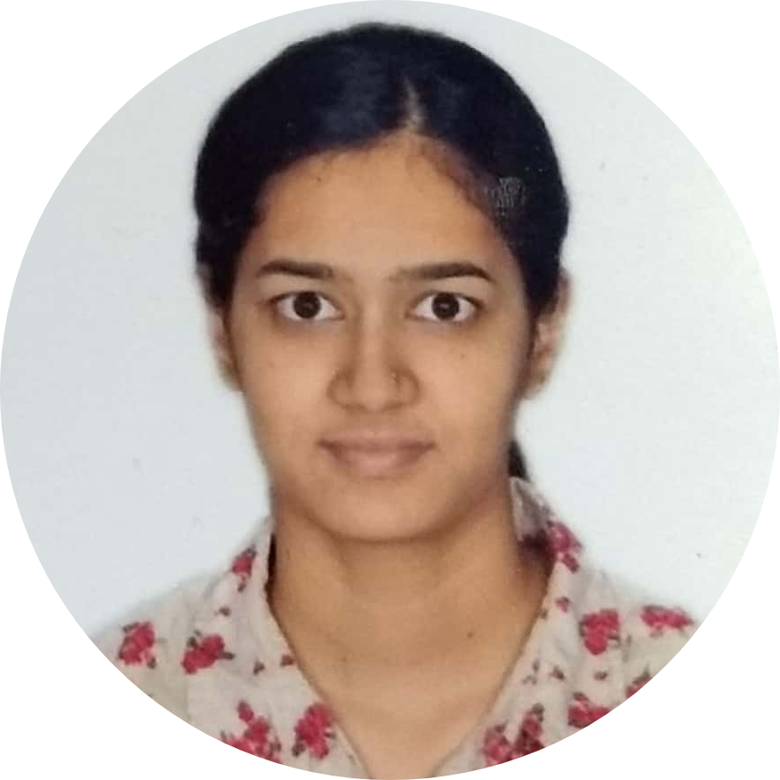
Our Team Id: 832
Team Member 1
Team Member 2
Team Member 3
Akshaya H N
01FB16EEC352
Akella Ramya
01FB16EEC025
Bhagyashree B R
01FB16EEC068

Slide 3

Project Guide
Prof. M Rajasekar
Associate Professor, ECE Dept
PES University

Slide 4
Contents
Introduction
Problem Statement
Overview
Block diagram
Literature Survey
Work carried out
Routing and Maps
Data and Visualization
Server Setup
Conclusion
References

Slide 5
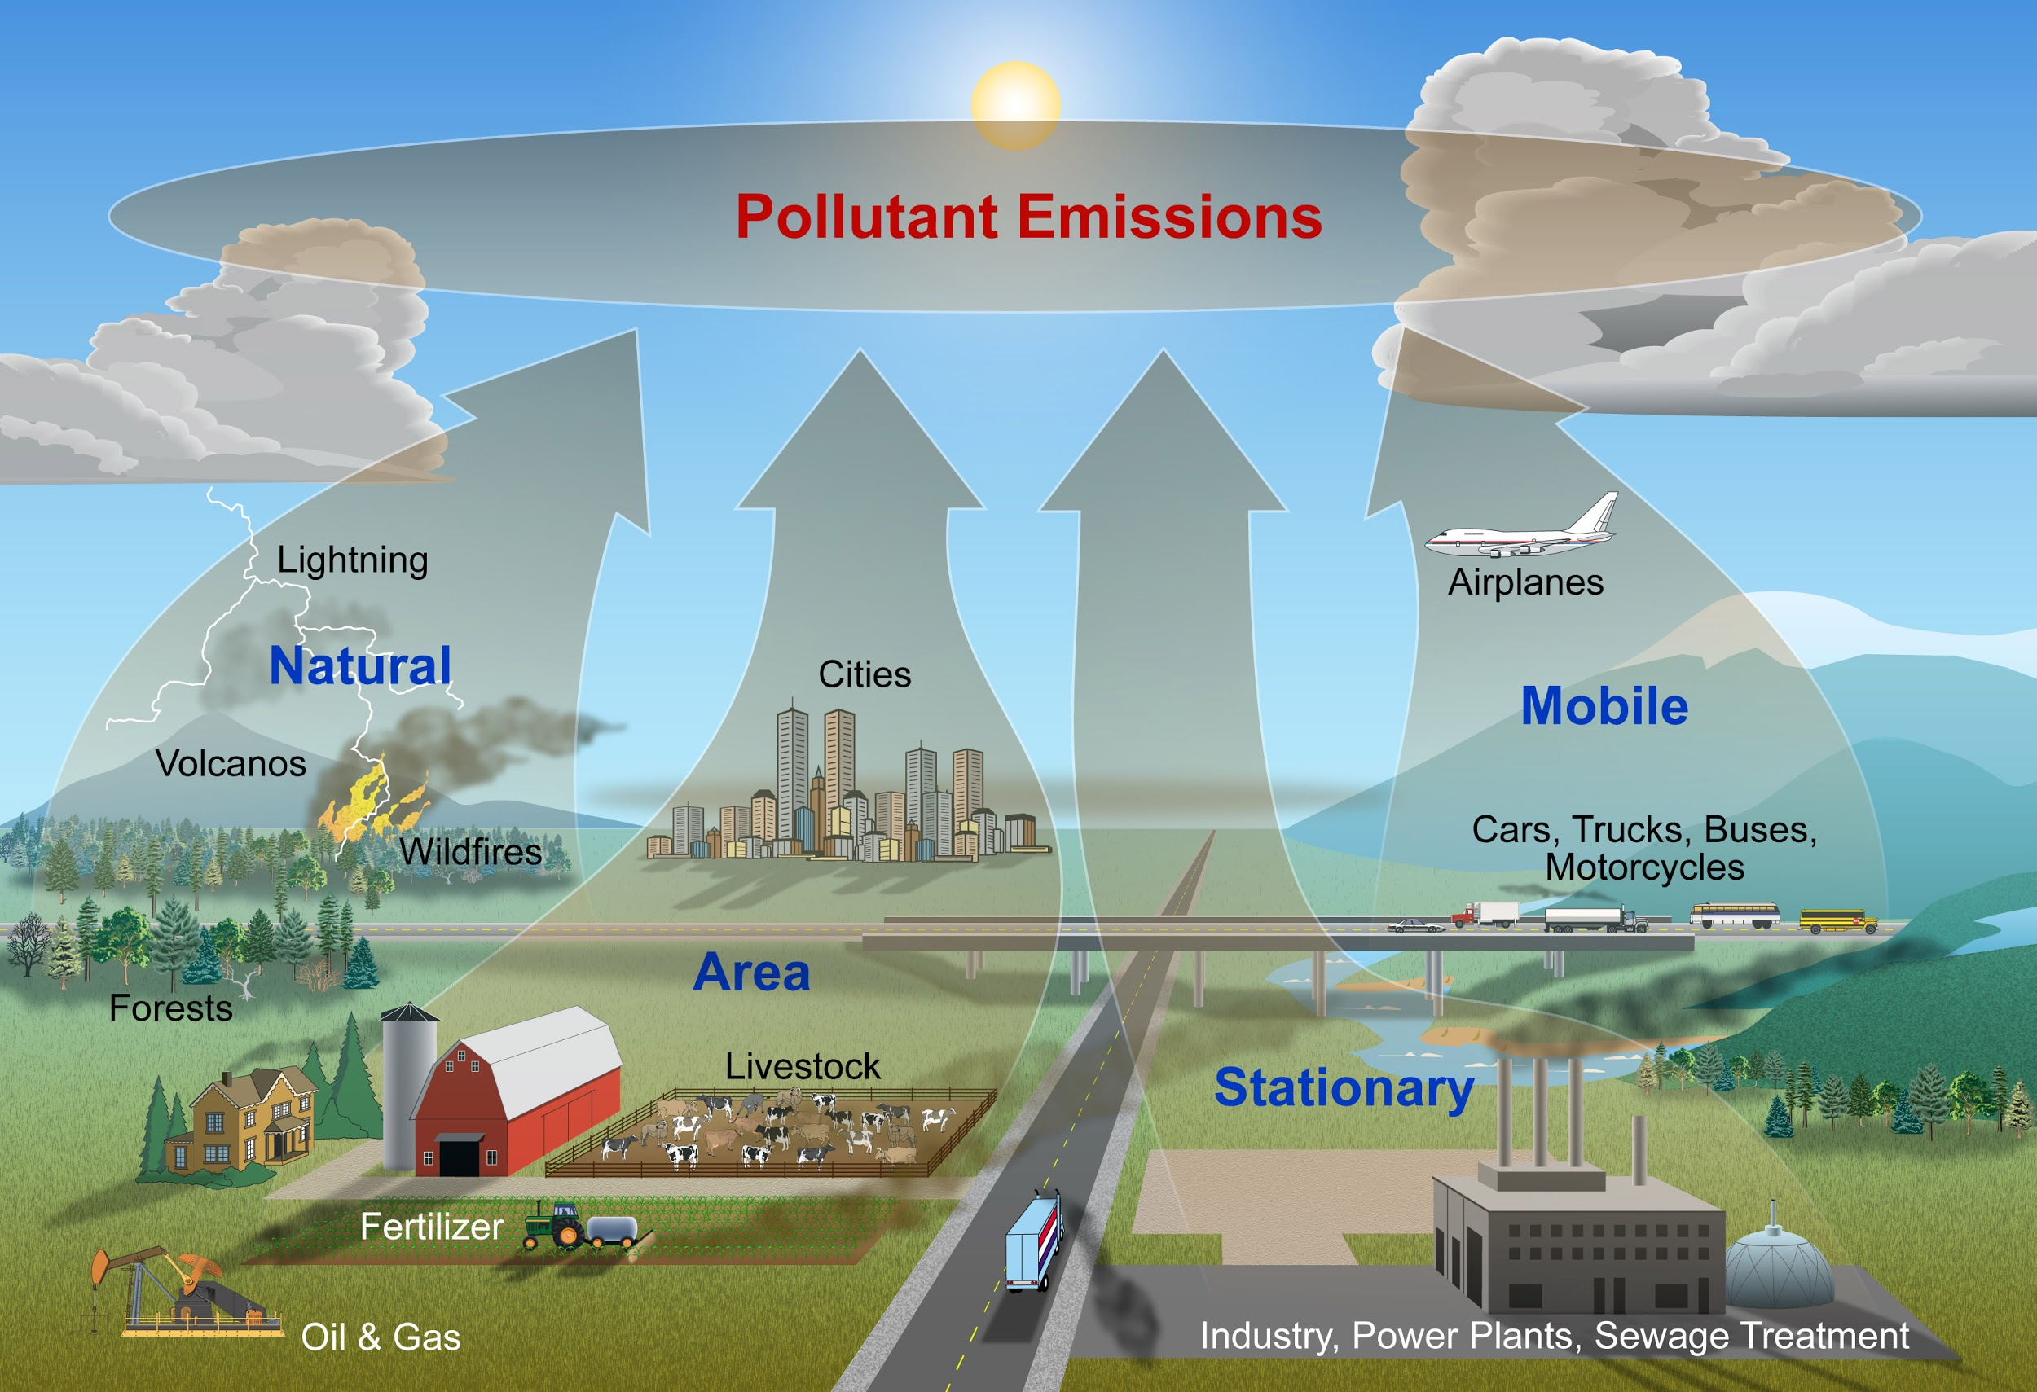
Introduction
In today’s world air is contaminated primarily due to vehicular emissions, factory chemical emissions, cigarettes, dust, pollen, natural activities like volcanic eruptions to name a few. From all these emissions there are 7 major constituents
PM 2.5
PM 10
Nitrogen dioxide
Ammonia
Carbon monoxide
Sulphur dioxide
Ozone

Slide 6




Problem Statement
A system to monitor pollution and guide users through routes based on the pollution density of the area, along with providing alerts about highly polluted areas.
Data Collection
Routes on Maps
Notifications

Slide 7





Overview
A system to collect pollution level data through wearable devices
Data stored in server
Inform user about highly polluted areas
Suggest routes with lesser pollution

Slide 8
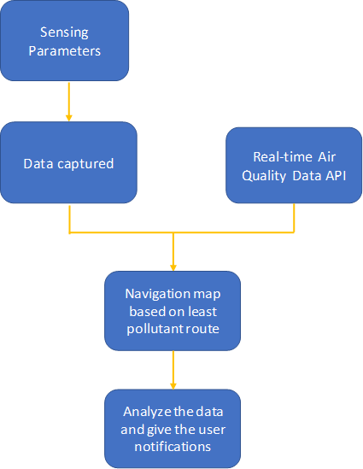
Block Diagram
Sensing Parameters: It consists of a network of sensor modules. These sensors measure the pollutant levels. It captures the data and stores them.
Real Time air quality API: The central and various state pollution control boards gather real time data of various pollutants concentration from various cities.
Navigation based on least pollutant route: When our app is used for navigation the route is shown based on AQI levels and the distance, giving the best possible route.
Analyze the data and notify the user: We use the data stored and give the user a personal notification of the pollution levels.

Slide 9
Literature Survey
Md Nazmul Hoq, Rakibul Alam, Ashraful Amin “Prediction of possible asthma attack from air pollutants: towards a high-density air pollution map for smart cities to improve living” Presented at 2019 International Conference on Electrical, Computer and Communication Engineering (ECCE), 7-9 February 2019
This paper proposed a pollution monitoring system to predict asthma attacks based on each person's pollution intake.They have designed a hardware system to constantly detect and monitor pollution levels in the user’s vicinity and developed a machine learning model to predict when the asthma attacks can occur. This helped in designing our own pollution alert app and routing algorithm.

Slide 10
Literature Survey
Sagar V Belavadi, Sreenidhi Rajagopal, Ranjani R, and Rajasekar Mohan , “Air Quality Forecasting using LSTM RNN and Wireless Sensor” presented at the 11th International Conference on Ambient Systems, Networks and Technologies, 2020.
The authors here, have created a model to predict the pollution levels (Air Quality Forecasting using LSTM RNN and Wireless Sensor Networks). A hardware device was used to measure the pollution levels across different locations, along with data from a few websites. Using this data, the model was trained to predict the pollution levels, a few hours ahead of time. Although our project focuses on pollution alerts and not prediction of pollution levels, this paper gave insights into the pollution monitoring hardware.

Slide 11
Literature Survey
Swati Dhingra, Rajasekhara Babu Madda, Amir H. Gandomi, Senior Member, IEEE, Rizwan Patan, Mahmoud Daneshmand, Life Member, IEEE “Internet of Things Mobile - Air Pollution Monitoring System (IoT-Mobair)”Presented at IEEE INTERNET OF THINGS JOURNAL 2019
This paper shows a systematic air quality monitoring system to identify the areas where pollution levels violate an ambient air quality standard. The authors have prepared an IOT kit with Arduino and gas sensors to monitor the pollution levels. They have also developed an Android application termed IoT-Mobair so that users can access relevant air quality data from the cloud. This system is analogous to Google Traffic or the Navigation application of Google Maps. Furthermore, air quality data can be used to predict future air quality index (AQI) levels. Whereas our project uses the Google maps API to show less polluted routes.

Slide 12
Routing and Maps

Slide 13
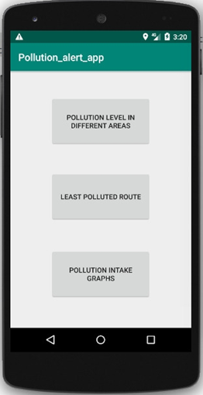

Notification based on the location
Once the App is launched, we get a login page showing the different options
Current location of the user is taken and the pollution level at that location is shown to the user

Slide 14
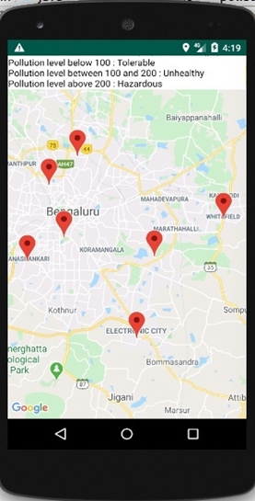
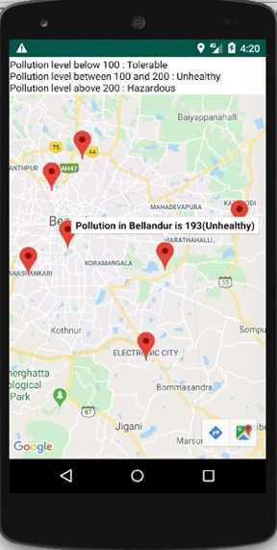
Pollution level in different areas
The first button directs to a map that shows the pollution levels of different areas in Bangalore.
By clicking on a locator we get the pollution in that area

Slide 15
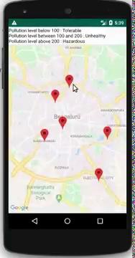
Demonstration

Slide 16




Call routing API to get directions for the given location
Algorithm to calculate the best route
Calculate the total pollution on all the routes and select the route with the minimum pollution
Suggest slight change in route if necessary
Using polylines of Google Maps API plot the route

Slide 17
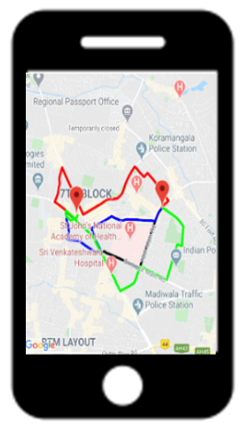
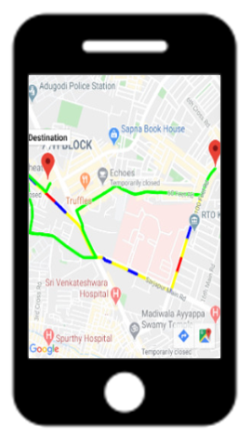
Best route suggestion based on our algorithm
Different routes possible from source to destination
Best route taken by algorithm

Slide 18
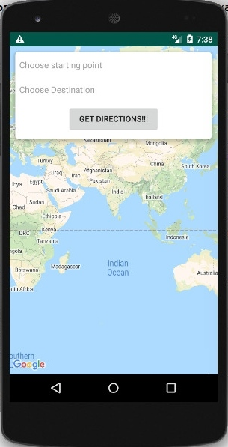
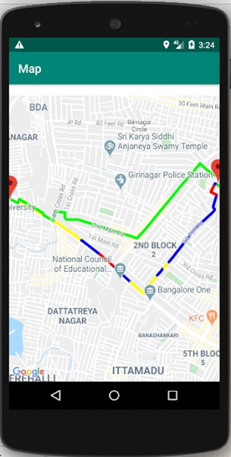
Best Route suggestion based on Time and Pollution
Different colors used to represent the different pollution levels across the area
Red: AQI levels above 200
Yellow: AQI levels between 100 to 200
Blue: AQI levels below 100
The route is visible on the map
AQI: Air Quality Index

Slide 19
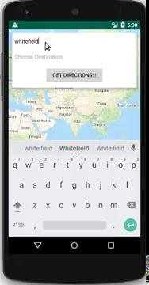
Demonstration

Slide 20
Data and Visualization

Slide 21


Steps used for scraping the data
Script that queries the Real-time air-quality data API made available on data.gov.in
To use this script, go to data.gov.in, sign up and generate an API key.
Once you have an API key replace the placeholder <API KEY> in the data url with your API key and run
Script used to check if the 2 files downloaded in an hour by
the scraper are same or not. You can delete the second fie if
they are the same

Slide 22
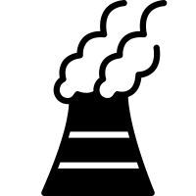
Restructuring the Data
India | Karnataka | Bengaluru | BTM Layout, Bengaluru - CPCB | ######## | PM2.5 | 31 | 352 | 202
India | Karnataka | Bengaluru | BTM Layout, Bengaluru - CPCB | ######## | NO2 | 13 | 65 | 26
India | Karnataka | Bengaluru | BTM Layout, Bengaluru - CPCB | ######## | SO2 | 1 | 7 | 1
India | Karnataka | Bengaluru | BTM Layout, Bengaluru - CPCB | ######## | CO | 8 | 119 | 67
India | Karnataka | Bengaluru | BTM Layout, Bengaluru - CPCB | ######## | OZONE | 28 | 90 | 33
India | Karnataka | Bengaluru | Bapuji Nagar, Bengaluru - KSPCB | ######## | PM2.5 | 65 | 95 | 76
India | Karnataka | Bengaluru | Bapuji Nagar, Bengaluru - KSPCB | ######## | PM10 | 78 | 122 | 96
PM2.5
PM10
NO2
NH3
SO2
CO
OZONE

Slide 23
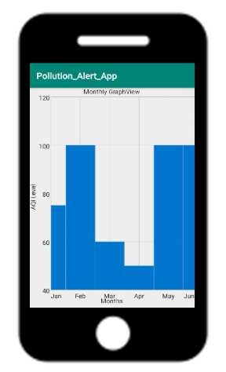
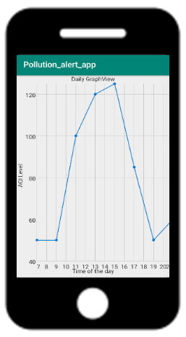

Data Visualization
Few visualizations are done the data used are for reference we will be linking the data with these maps.

Slide 24
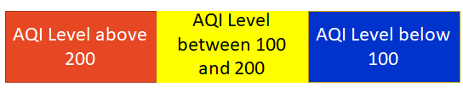
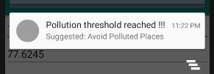
Notification
Notification based on the pollution levels

Slide 25

Demonstration

Slide 26
Server Setup

Slide 27
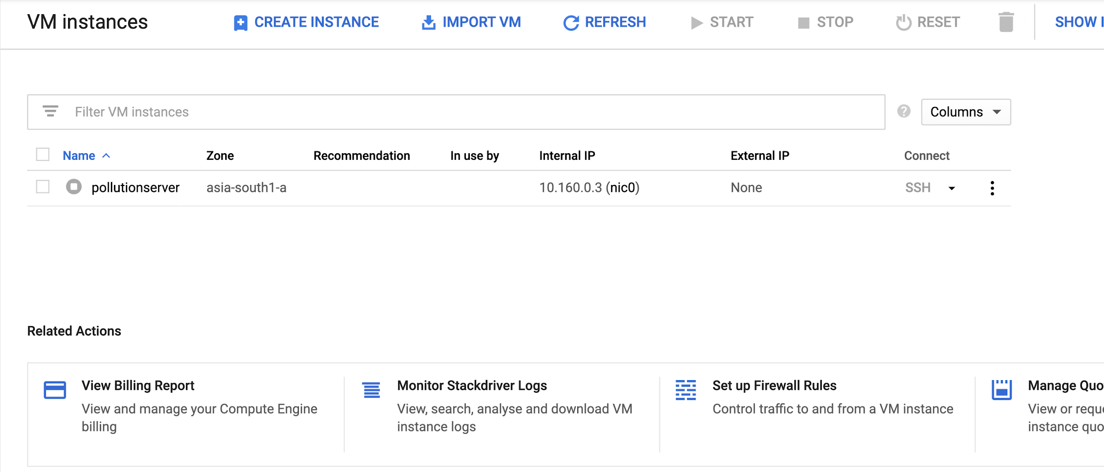
Server Creation
Created a Linux virtual machine instance in Google Compute Engine using the google cloud console.
Deployed a simple Apache web server on the virtual machine instance.
The server is set up and the required values were added

Slide 28
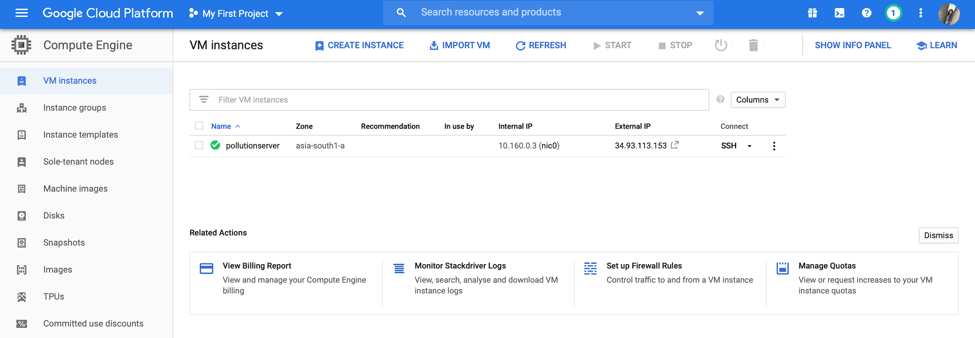
Further Steps
Once the server is started, we get the external IP through which we can access the server.
We connect to the virtual machine instance via the ssh.
We now interact with the virtual machine instance using the terminal window.

Slide 29
Data Stored in Server
Data is in the format latitude, longitude and pollution level
The server stores the values of pollution levels of various places and this information is made available to the app
The app calculates the least polluted route based on these values and suggests this route to the user.

Slide 30
Conclusion
Citizens commuting in the city can be aware of the levels of various pollutants in and around their routes
The data, over a long term, allows us to find patterns that help support air pollution control policy.
The pollution monitoring devices can be made more precise, reliable, durable and power-conserving in wearable forms
More features can be included in the app to make it more user friendly and efficient
Notes:
Pedestrians, motorcyclists and people in an open vehicle can use this app to check the pollution levels and choose their path accordingly
People with lung and breathing related issues can make use of this app to check the level of air pollution in their area.
Any huge variations in the pollution level values can be conveyed to the industries and necessary actions can be taken accordingly.
The data, over a long term, allows us to find patterns that help support air pollution control policy.
Based on this data the app can be customised for each user specifically, thereby making it more user-friendly and personalized. Users with respiratory disorders or such disorders that are sensitive to pollution levels can breathe a huge sigh of relief, by receiving notifications, alerts of potential and alarming levels in the regions of their travel or movement for avoiding or taking remedial measures. The pollution monitoring devices can be made more precise, reliable, durable and power-conserving in wearable forms.

Slide 31
References
[1] Md Nazmul Hoq, Rakibul Alam, Ashraful Amin “Prediction of possible asthma attack from air pollutants: towards a high-density air pollution map for smart cities to improve living” Presented at 2019 International Conference on Electrical, Computer and Communication Engineering (ECCE), 7-9 February 2019
[2] Sagar V Belavadi, Sreenidhi Rajagopal, Ranjani R, and Rajasekar Mohan , “Air Quality Forecasting using LSTM RNN and Wireless Sensor” presented at the 11th International Conference on Ambient Systems, Networks and Technologies, 2020.
[3] Swati Dhingra, Rajasekhara Babu Madda, Amir H. Gandomi, Senior Member, IEEE, Rizwan Patan, Mahmoud Daneshmand, Life Member, IEEE “Internet of Things Mobile - Air Pollution Monitoring System (IoT-Mobair)”Presented at IEEE INTERNET OF THINGS JOURNAL 2019
[4] David Hasenfratz, Olga Saukh, Silvan Sturzenegger, and Lothar Thiele Computer Engineering and Networks Laboratory ETH Zurich, Switzerland “Participatory Air Pollution Monitoring Using Smartphones”presented at the 2nd International Workshop on Mobile Sensing.

Slide 32
Thank You

