Slide 1
QR CODE GENERATOR

Slide 2
CONTENTS
Abstract
Introduction
Implementation
Results
Reference

Slide 3
ABSTRACT
Quick Response (QR) codes seem to appear everywhere these days. We can see them on posters, magazine ads, websites, product packaging and so on. Using the QR codes is one of the most intriguing ways of digitally connecting consumers to the internet via mobile phones since the mobile phones have become a basic necessity thing of everyone
In this paper, we present a methodology for creating QR codes by which the users enter text into a web browser and get the QR code generated.

Slide 4
INTRODUCTION
We all use QR code for multiple purposes like making payments, sharingWi-Fi, etc. Have you ever wished to generate such QR code on your own? We are here with a project for QR code generator using Python.
In this project, we will build a QR Code generator using Python Modules.
To generate QR Code in Python we will be using Tkinter and Qrcode modules in Python to build this project.
Then we generate the QR code from the above inputs and save in the given location using the qrcode module

Slide 5
IMPLEMENTATION
First we will import tkinter and all its sub-modules using the *. Then we will also import messagebox and pyqrcode. Tkinter module helps in creating GUI windows and apps where users can interact with events. We will generate object ws by assigning it with the Tk() constructor. Then we will give this application a title using the ws.title() method and pass "QR CODE GENERATOR" as its string. We can also configure the color of the app using the ws.config().
Then we create a user-defined function named generate_QR() where all our QR code logic will reside. The pyqrcode.create() generates the QR code as it fetches the string through user_input.get() method from the text box.

Slide 6
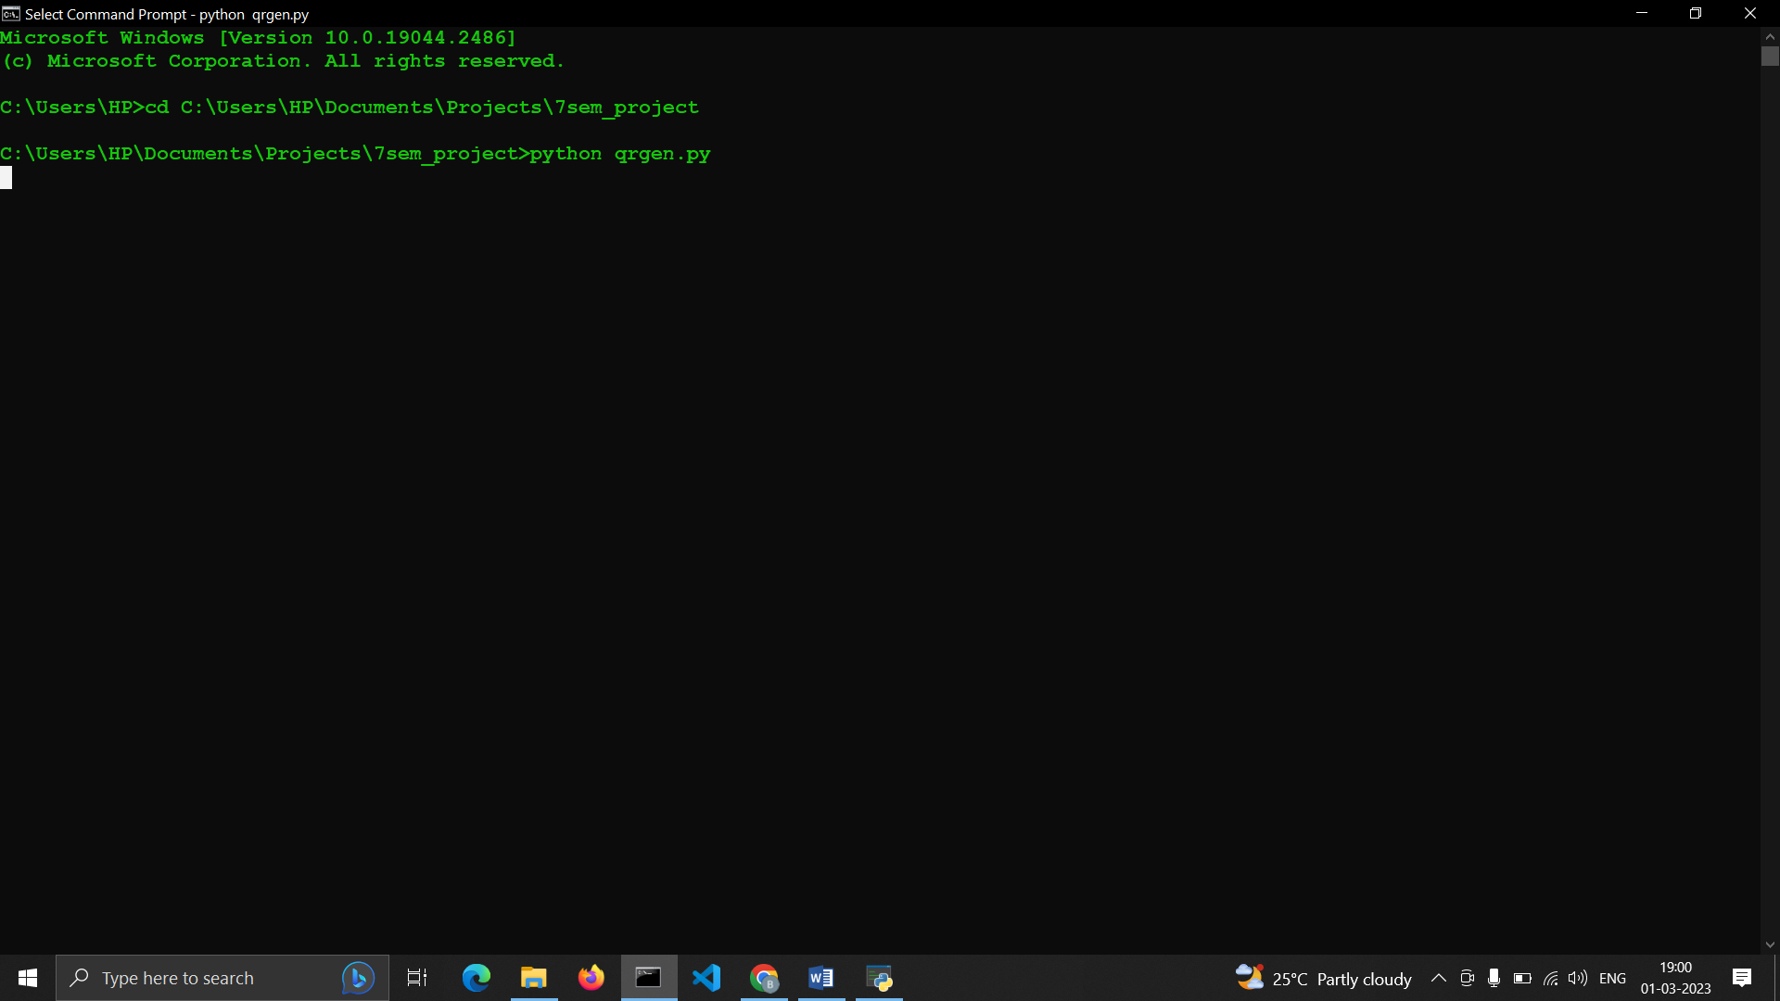
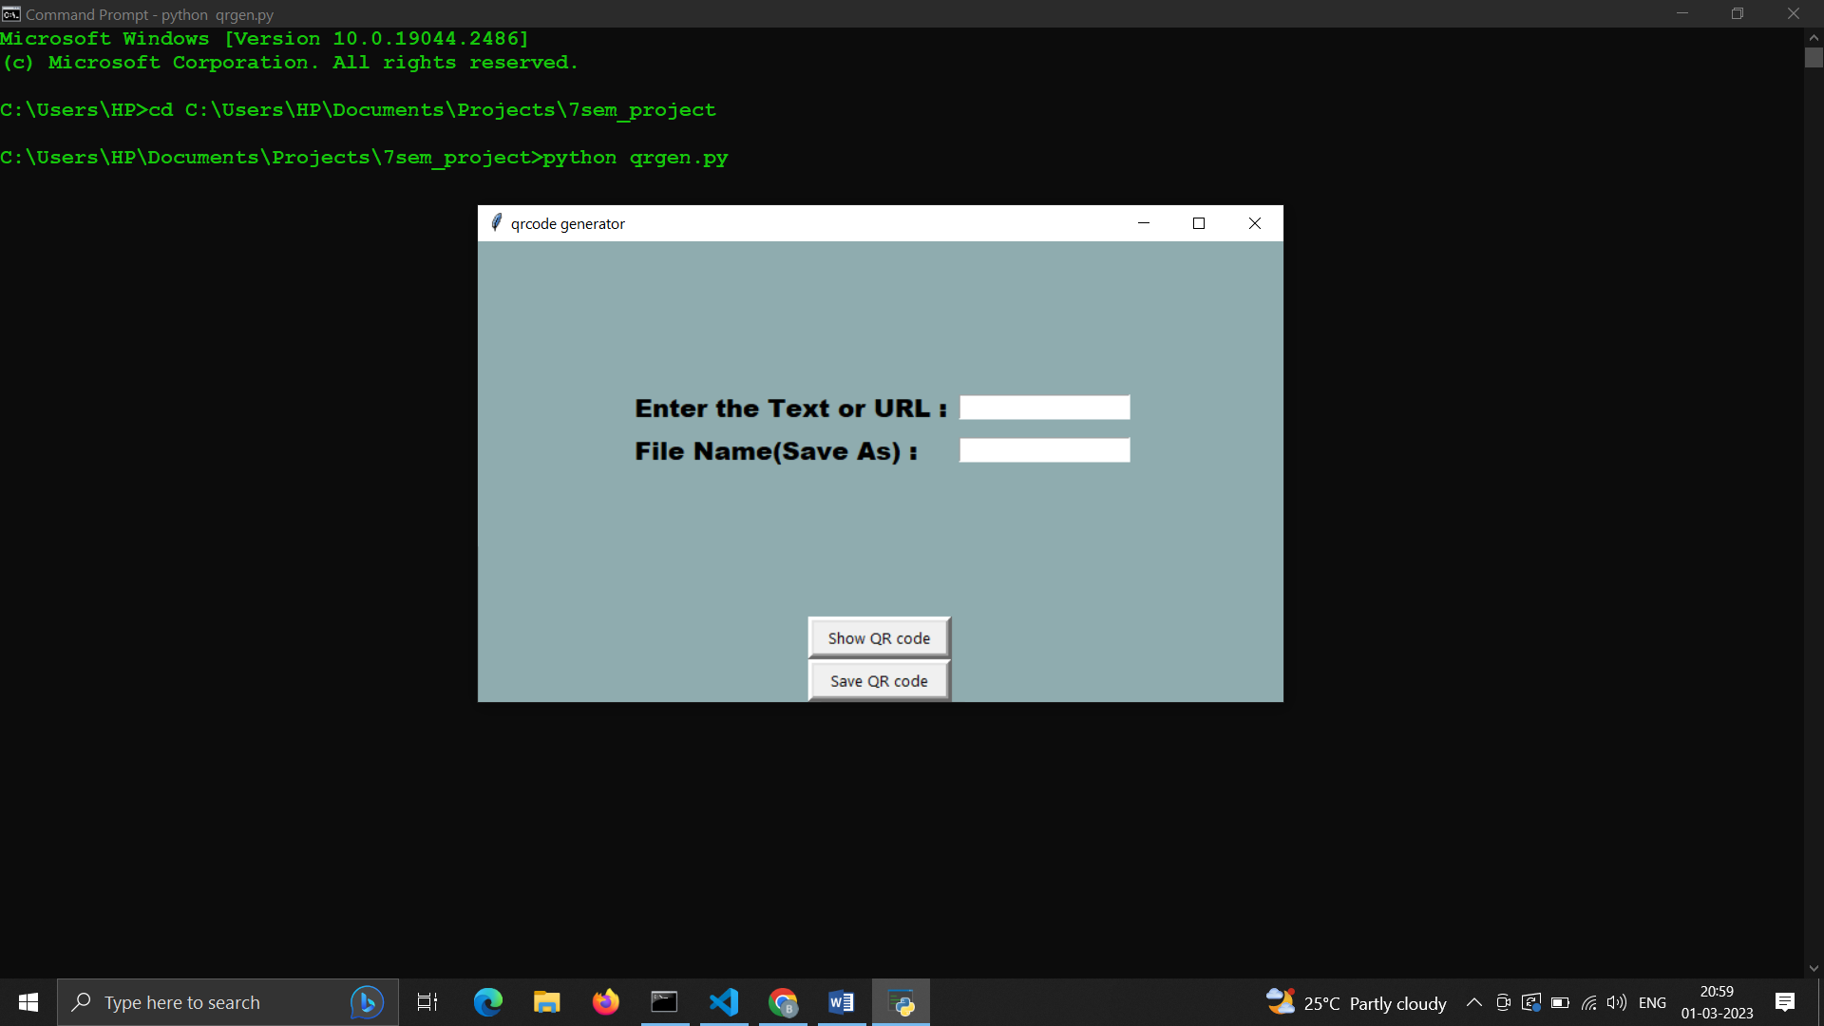
RESULTS

Slide 7
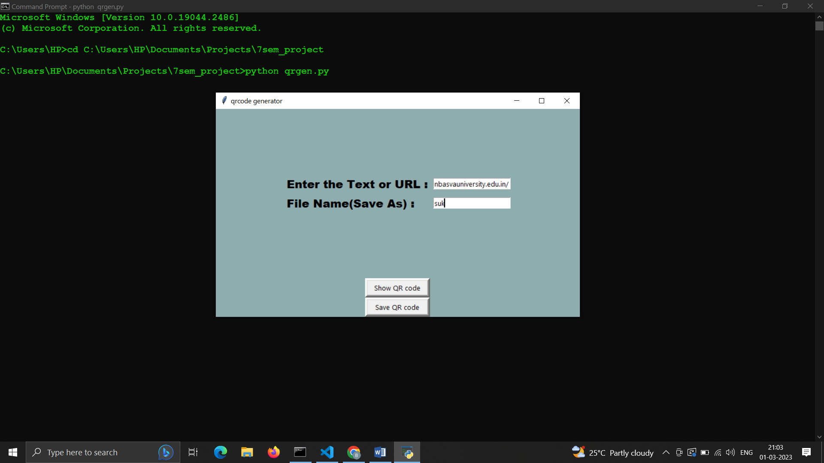
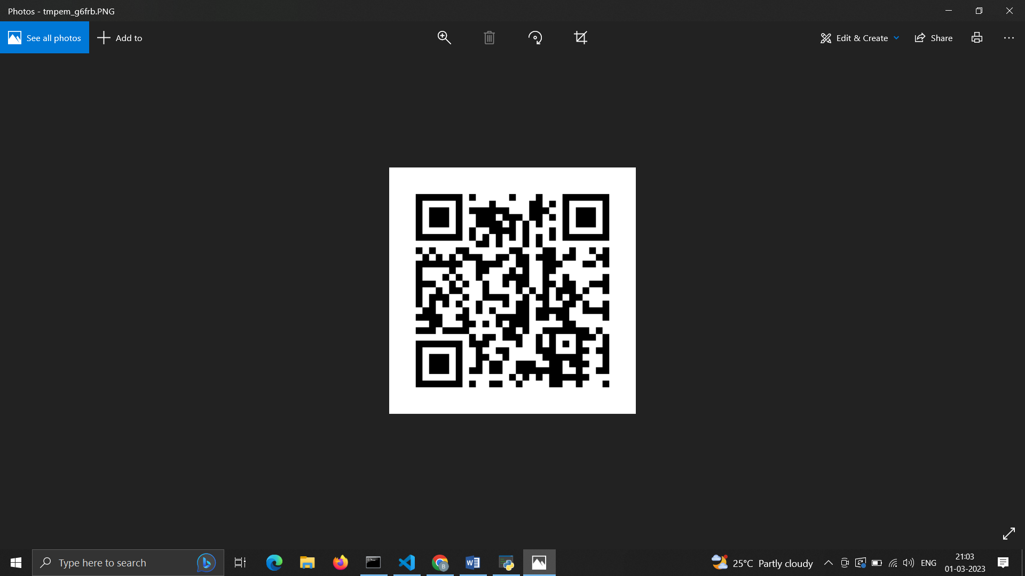

Slide 8
CONCLUSION
In the past decade or so, the application of QR codes in public domains like supermarkets and in educational purposes like book scanning or stationary scanning has been increased rapidly and it will continue to thrive in more fields as the awareness will increase.
The QR code technique is getting popular day by day and at the same time it is becoming increasingly secure as the technology is enhancing.
In near future, this technology will be used in wide public domains.

Slide 9
REFERENCES
[1]www.google.com
[2] www.Wikipedia.com
[3] https://docs.python.org/3/library/turtle.html
[4] www.w3schools.com

