Slide 1
CONTENTS
Abstract
Introduction
Implementation
Results
Reference

Slide 2
ABSTRACT
The final objective is to make a fully featured and functional turtle game. So weplan to start with small simple steps.We have decided to make the projectusing loops to draw a racetrack and create aracing turtle game.This project introduces for loops through a fun turtle race game. Loops are used todraw the racetrack and to make the turtles move a random number of steps eachturn. If you have a group of people to play the game, each person picks a turtle andthe one that gets the furthest is the winner.By making turtle race game, we will learn how to:
Write for loops in Python
Use random numbers in Python
Draw lines in different colours with Python Turtle

Slide 3
INTRODUCTION
There are 4 turtles with different colors placed before the Starting Line initially.
Every turtle will take a random number of steps to move forward on the race track continuously.
On the other end of the race track is the Finish Line.
The first one to reach the Finish Line is declared as the winner and the game stops.

Slide 4
IMPLEMENTATION
The 1st line of our Race the Turtles game will be to import the required modules- import random, turtle.
Next, let’s create the turtle screen using the Screen class of turtle module- myscreen= turtle.Screen()
Let’s do a quick setup of the screen by setting its background color to light blue (or any color of your choice) and setting its width and height to full size and giving a title to it-
myscreen.bgcolor('light blue') myscreen.setup(1.0,1.0) myscreen.title('Turtle Race Game')

Slide 5
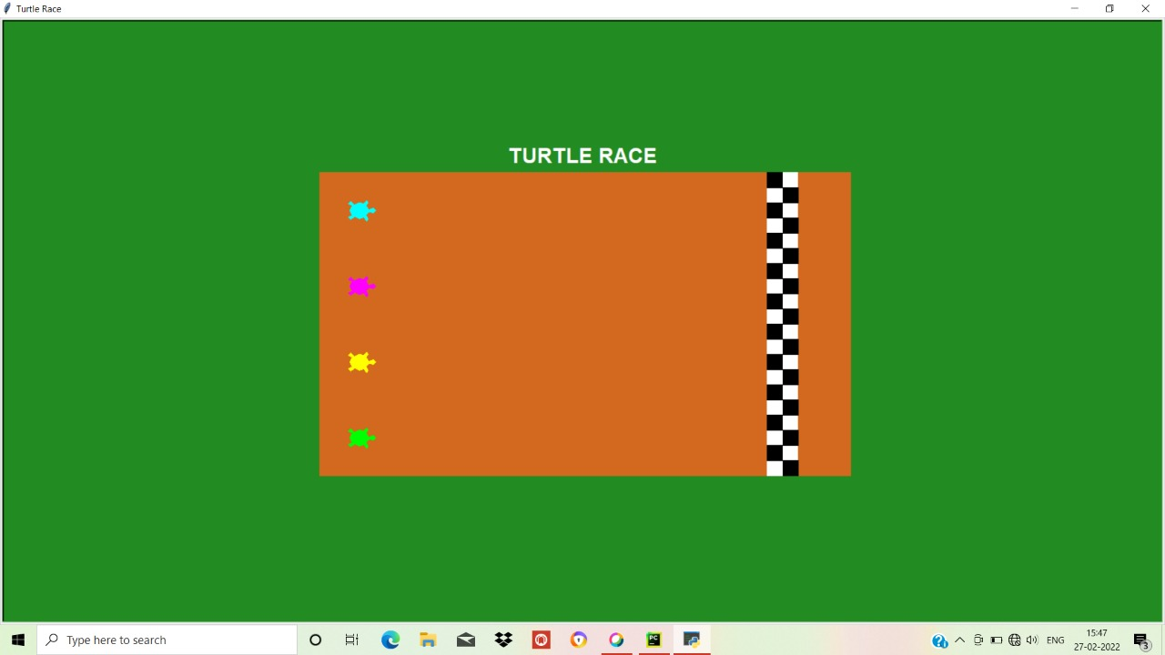
RESULTS

Slide 6


Slide 7
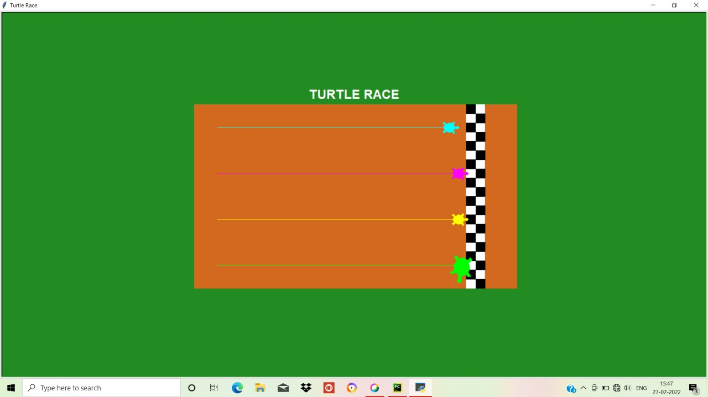

Slide 8
CONCLUSION
We have tried to implement the Turtle Race game using turtle package (Graphics). Which can perform basic operation of Python , providing simple implementation.
In future we would like to implement other type of games using the Python language.

Slide 9
REFERENCES
[1]www.google.com
[2] ww.wikipedia.com
[3] https://docs.python.org/3/library/turtle.html
[4] www.w3schools.com

