Slide 1
Graduate Admission Prediction Using Machine Learning
-Presented by
Group 1_Batch_13
(Ms. Bhagyashree Rajendra Atre
Mr. Narendra Singh Rathore
Ms. Vaibhavi Ganesh Rao)

Slide 2
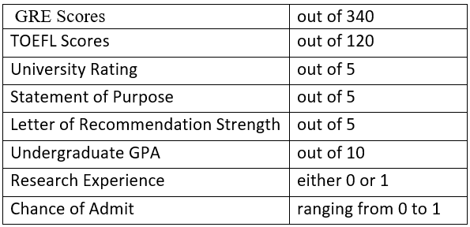
PROBLEM DESCRIPTION
We have been given dataset created for prediction of Graduate Admissions from an Indian perspective.
The dataset contains several parameters which are considered important during the application for Masters Programs.
The parameters included in dataset are :
Aim of the Project -
to predict the ‘Chance of Admit’ with minimum MSE and RMSE and
maximum R-Square score.

Slide 3
MULTIPLE LINEAR REGRESSION MODEL

Slide 4
Below are the main steps of deploying the MLR model:
1) Data Pre-processing Steps-
Importing libraries
Importing dataset
Checking for NULL values
EDA(Distplot)
Correlation matrix
Data Preparation
Splitting the dataset into training and testing
2) Fitting the MLR model to the training set
3) Model Evaluation-Using R2score and RMSE

Slide 5
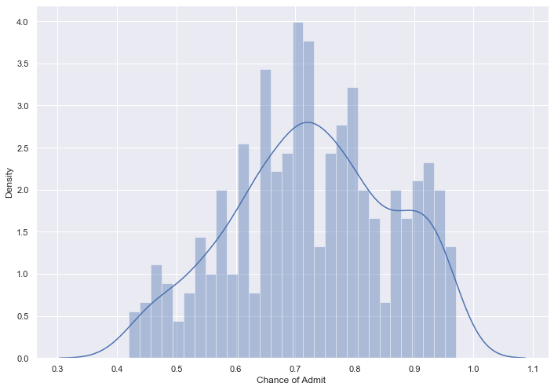
Data cleaning
EDA Distplot
Graph shows normal distribution of data

Slide 6
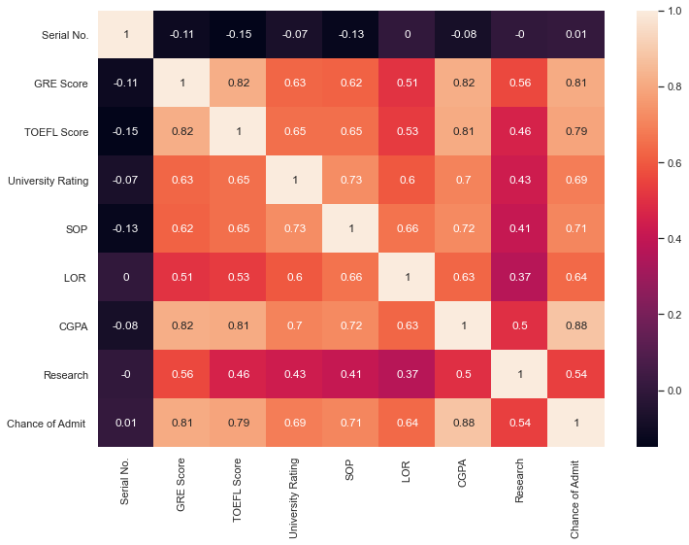
Correlation Matrix
To fit a linear regression model, we select those features which have a high correlation with our target variable Chance of Admit.
By looking at the correlation matrix we can see that CGPA has a strong positive correlation with Chance of Admit (0.88).
In this case we don't have any negative correlation with Chance of admit.
An important point in selecting features for a linear regression model is to check for multi-co-linearity.
The features GRE Score and TOFEL Score have a correlation of 0.82. These feature pairs are strongly correlated to each other.
The features GRE Score and CGPA have a correlation of 0.82. These feature pairs are strongly correlated to each other.
We should not select both these features together for training the model.
We will take GRE Score as feature in training model.

Slide 7
MODEL EVALUATION
Accuracy of given model is:
0.7504250805269773
The model performance for training set:
RMSE is 0.06838075795680312
R2 score is 0.74352634708665
The model performance for testing set:
RMSE is 0.06617830063761607
R2 score is 0.7504250805269773

Slide 8
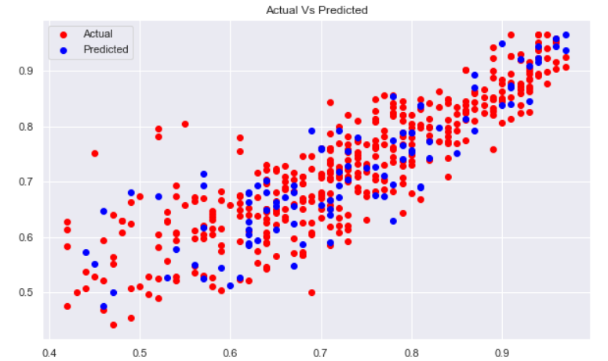
Plot For Actual Vs Predicted
It shows over fitting of the model to some extent

Slide 9
MULTIPLE LINEAR REGRESSION With PCA

Slide 10
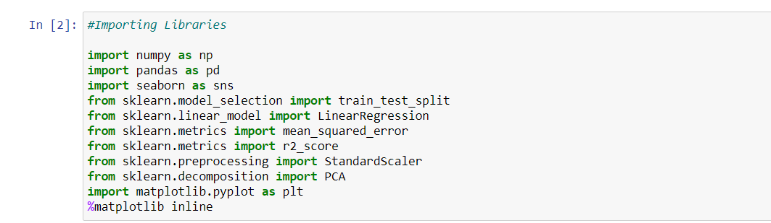
Below are the following steps to deploy a MLR model with PCA:
Importing all important libraries

Slide 11
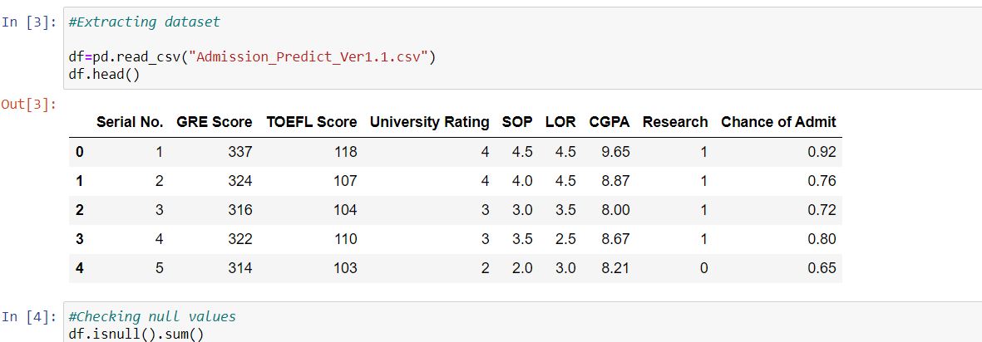
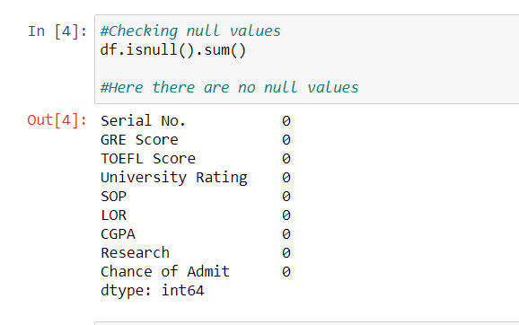
2. Importing the dataset and checking for the null values

Slide 12
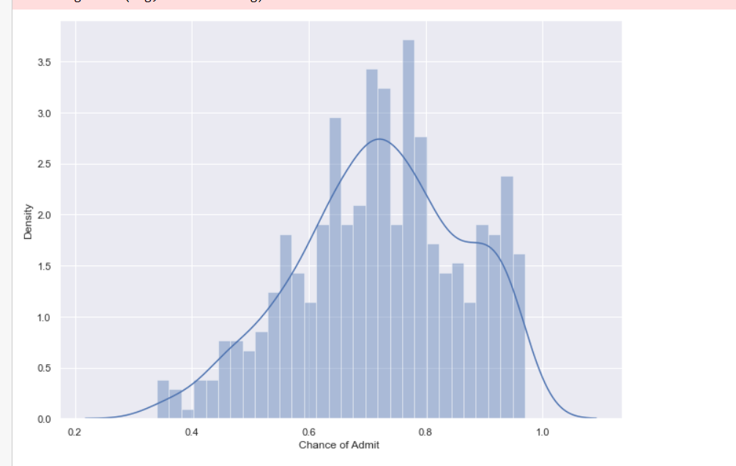
Performing Exploratory Data Analysis on given Dataset and Removing Outliers(if any)
Here, the distribution is normally distributed and has very few outliers.

Slide 13
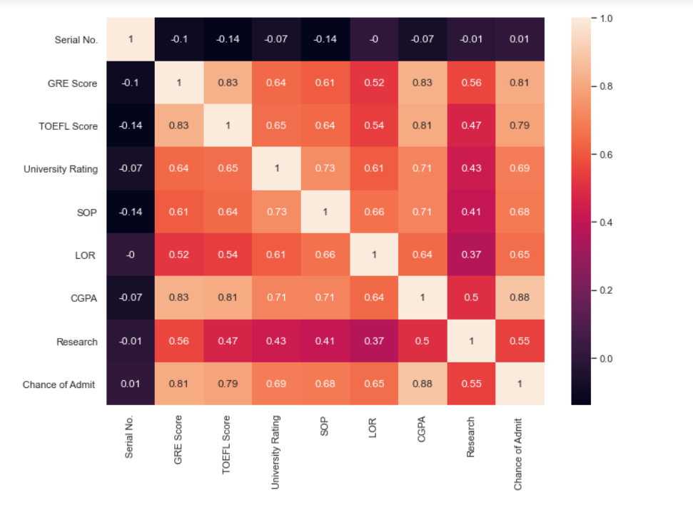
4. Plotting Correlation Matrix

Slide 14
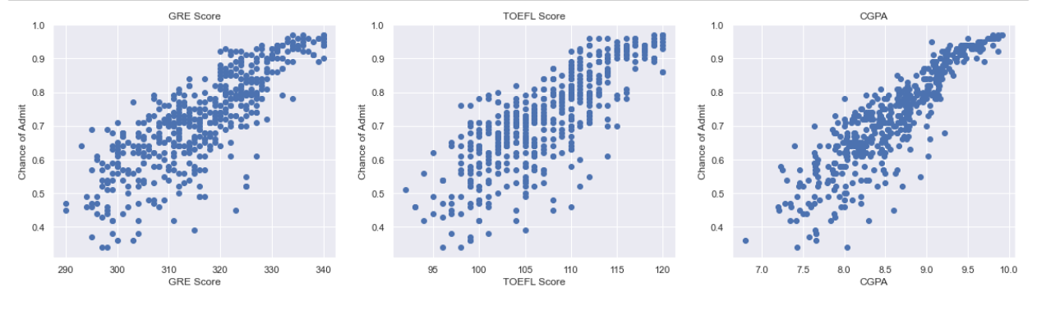
From the Correlation Matrix it is clear that the features are positively correlated with “Chance of Admit”.
CGPA has high correlation with “Chance of Admit” (0.88).
GRE Score has a correlation of 0.81 and TOEFL Score has a correlation of 0.79 .

Slide 15
5. Principal component analysis (PCA)
Given below the steps to follow :
Splitting the dataset into training and testing sets
Standardizing the features
Calculate the Variance
Determining principal components
Build the MLR model

Slide 16
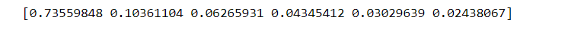
Variance Ratios :
By looking at the variance ratios, the value of “n_components” for PCA is selected as 2.
Model Evaluation :
The Model Performance for Training set:
RMSE is 0.06511602320008014
R2_Score is 0.7899652430779844
2. The Model Performance for Testing set:
RMSE is 0.059827430706322064
R2_Score is 0.8080241042508857
3. Accuracy of model is 0.8080241042508857

Slide 17
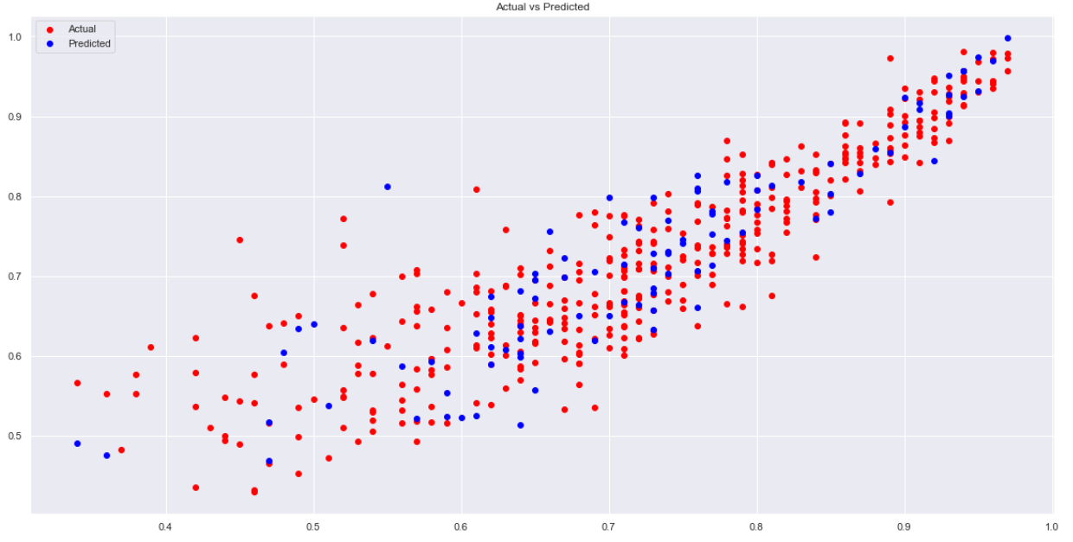
Plot For Actual Vs Predicted
It shows over fitting of the model to some extent

Slide 18
RANDOM FOREST REGRESSION

Slide 19
Steps Followed For Creating The Model
Importing important libraries
Importing the dataset
Data cleaning and Data pre-processing
Data visualization and modeling
Data evaluation

Slide 20
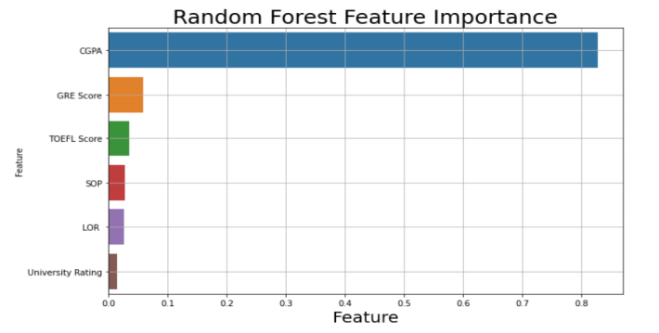
Data visualization
FEATURE SELECTION
Most important variable is CGPA-highest ranking.
Out of 7 features, 6 features are selected for model development and further analysis as per random forest regressor’s feature importance scores.

Slide 21
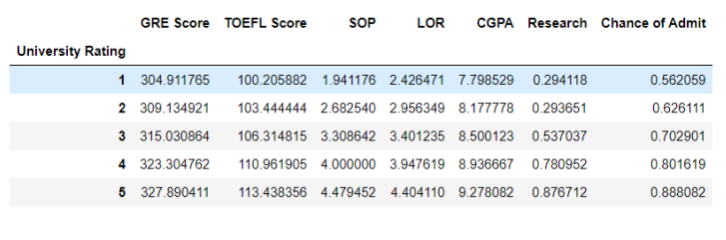
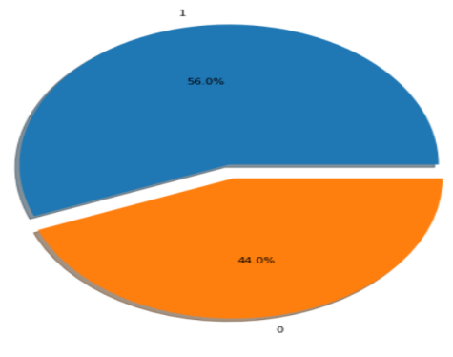
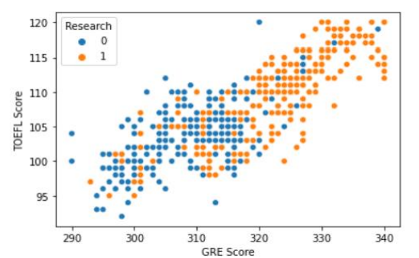
CORRELATION ANALYSIS
CGPA, TOEFL Score and GRE Score shows positive correlation.
University Rating Correlation Analysis
Importance of Research to get Admission

Slide 22
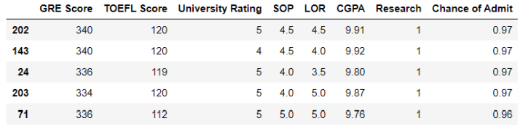
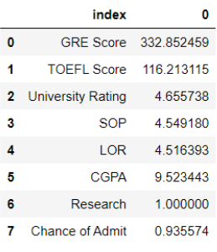
Score for 90% chance of admission
Finding maximum chance of admit
Finding the scores required for 90% chance of admit

Slide 23
Modeling
Splitting the dataset into training and testing sets
Standardizing the features
Build the Random forest regression model
Fitting the model to get maximum accuracy by determining the number of estimators. In this model the no. of estimators is 100.

Slide 24
Model evaluation
Accuracy of the model is 0.8243508760587057
RMSE is 0.40734138087029725
R2 score is for testing set is 0.8201016463327142
R2 score is for training set is 0.9679351816145866
MSE is 0.16592700056932058

Slide 25
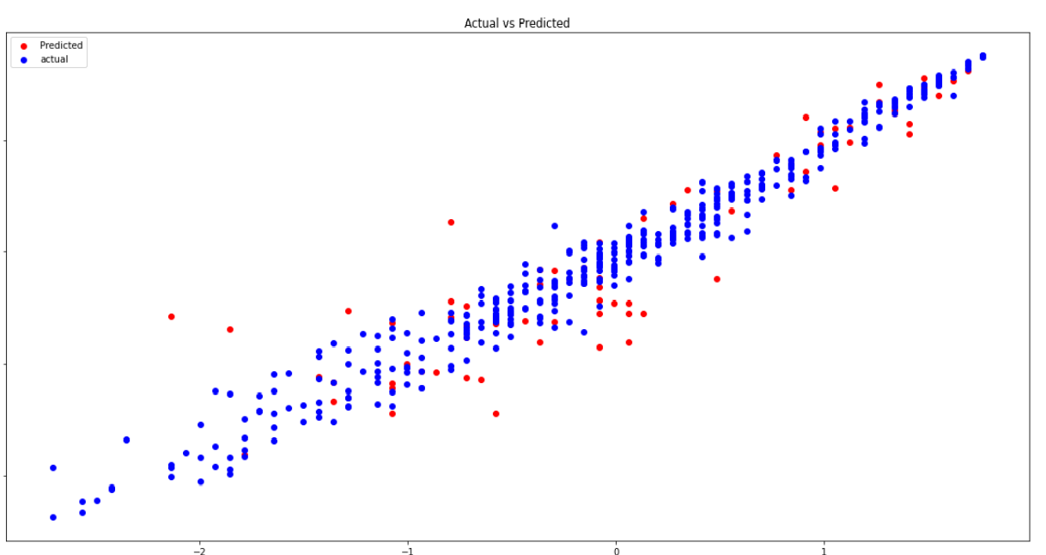
Plot For Actual Vs Predicted
It shows close to perfect fitting of the model.

Slide 26
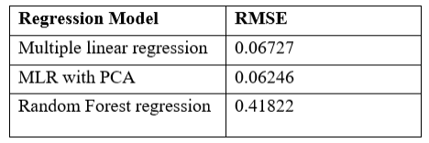
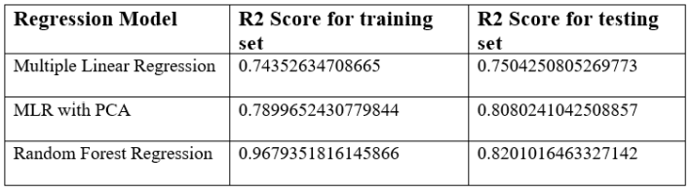
conclusion
Random forest model have good performance
The higher the score better the model performs
We can say that the random forest regression is good followed closely by MLR with PCA.

Slide 27
Limitations
The main limitation of this project is we developed models based solely on data from Indian Students.
We considered only few universities with different rankings.
More information relating to new colleges can be added in the future.
The system may also be modified to a web-based application by making node-red modifications.

Slide 28
Thank you

