Slide 1

MSPM’S Deogiri Institute of Engineering and Management Studies, Aurangabad Department of Computer Science and Engineering
Subject: Theory of Computation
Topic: Regular Expression to DFA
Submitted by Bhagyashree Tipare(36165)
Karuna Horshil (36166)
Under the Guidance of Prof. Sarika Chavan Asst.Prof.Department of CSE (Deogiri Institute Engineering and Management Studies) 2019-2020

Slide 2
Regular Expressions
Tokens are built from symbols of a finite vocabulary.
We use regular expressions to define structures of tokens
2

Slide 3
Definition of a Regular Expression
R is a regular expression if it is:
a for some a in the alphabet , standing for the language {a}
ε, standing for the language {ε}
Ø, standing for the empty language
R1+R2 where R1 and R2 are regular expressions, and + signifies union (sometimes | is used)
R1R2 where R1 and R2 are regular expressions and this signifies concatenation
R* where R is a regular expression and signifies closure
(R) where R is a regular expression, then a parenthesized R is
also a regular expression
3

Slide 4
Definition of a Regular Expression
This definition may seem circular, but 1-3 form the basis
Precedence: Parentheses have the highest precedence, followed by *, concatenation, and then union.

Slide 5
Regular Expressions
The sets of strings defined by regular expressions are termed regular sets
Definition of regular expressions
∅ is a regular expression denoting the empty set
λ is a regular expression denoting the set that contains only the empty string
A string s is a regular expression denoting a set containing only s

Slide 6
Regular Expressions
If A and B are regular expressions, so are
A | B (alternation)
The union (or disjunction) of two regular languages is a regular language:
å = { a, b, c} /ab|bc/ /ca|bb/
AB (concatenation)
A* (Kleene closure)
The Kleene closure (denoted by the Kleene star: *) of a regular language is a regular language:
å = { a, b, c} /a*/ /(ab|ca)*/

Slide 7
RE Examples
L(001) = {001}
L(0+10*) = { 0, 1, 10, 100, 1000, 10000, … }
L(0*10*) = {1, 01, 10, 010, 0010, …}i.e. {w | w has exactly a single 1}
L()* = {w | w is a string of even length}
L((0(0+1))*) = { ε, 00, 01, 0000, 0001, 0100, 0101, …}
L((0+ε)(1+ ε)) = {ε, 0, 1, 01}
L(1Ø) = Ø ; concatenating the empty set to any set yields the empty set.
Rε = R
R+Ø = R
7

Slide 8
Finite state automata
^{υ} Deterministic Finite Automata (DFA)
The machine can exist in only one state at any given time.
^{υ} Non-deterministic Finite Automata (NFA)
The machine can exist in multiple states at the same time.

Slide 9
DFA
A DFA is defined by the 5-tuple:{Q Σ q F δ }
A Deterministic Finite Automaton (DFA) consists of:
Q ==> a finite set of states
Σ ==> a finite set of input symbols (alphabet)
q0 ==> a start state
F ==> set of final states
δ ==> a transition function, which is a mapping between Q x Σ ==> Q

Slide 10
#Example
1) Build a DFA for the following language:
L = {w | w is a binary string that contains 01 as a substring}.
Steps for building a DFA to recognize L:
Σ = {0,1}
Decide on the states: Q
Designate start state and final state(s)
δ: Decide on the transitions:

Slide 11
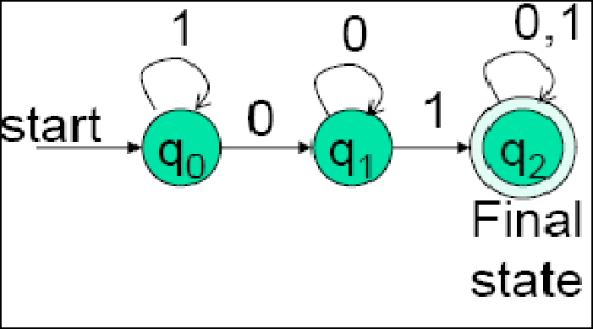
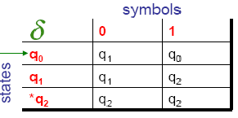
Regular expression: (0+1)*01(0+1)*
υ Q= {q0, q1, q2}
υ Σ={0,1}
υ start state = q0
υ F = {q2}
¬ DFA of R.E.
υ Transition table:

Slide 12
Application of DFA
Vending Machines
Traffic Lights
Video Games
Text Parsing
Regular Expression Matching
CPU Controllers
Protocol Analysis
Natural Language Processing
Speech Recognition

Slide 13
Conclusion

Slide 14
Thank You

