Slide 1

RELIABLE DATA TRANSFER SYSTEM FOR ONLINE BANKING
Brainware University
Course Code : BTD50112
Course Name : Computer Networks
Department Name : Computer Science & Engineering – CS & DS
Presented by
Bhagyashree Das (BWU/BTD/24/063)
Krishanu Das (BWU/BTD/24/137)
Debraj Mondal (BWU/BTD/24/139)
Sayantan Paul (BWU/BTD/24/144)

Slide 2
Objective :
Design a client-server banking network using Cisco Packet Tracer.
Use CRC (Cyclic Redundancy Check) to detect transmission errors.
Demonstrate receiver-side detection of a corrupted frame.
Recalculate and verify CRC at the receiver.
Decide whether the frame is ACCEPTED or REJECTED.
Explain retransmission/error-control as the recovery mechanism.

Slide 3
Real-Life Connection :
Online banking transactions require accurate delivery of transaction data.
A changed bit can alter the meaning of transmitted information.
CRC provides error detection by calculating a remainder at the sender and receiver.
CRC detects an error; it does not itself correct the corrupted data.
ARQ/retransmission can be used to recover from a rejected frame.
Encryption and authentication are future security enhancements in this academic model.

Slide 4
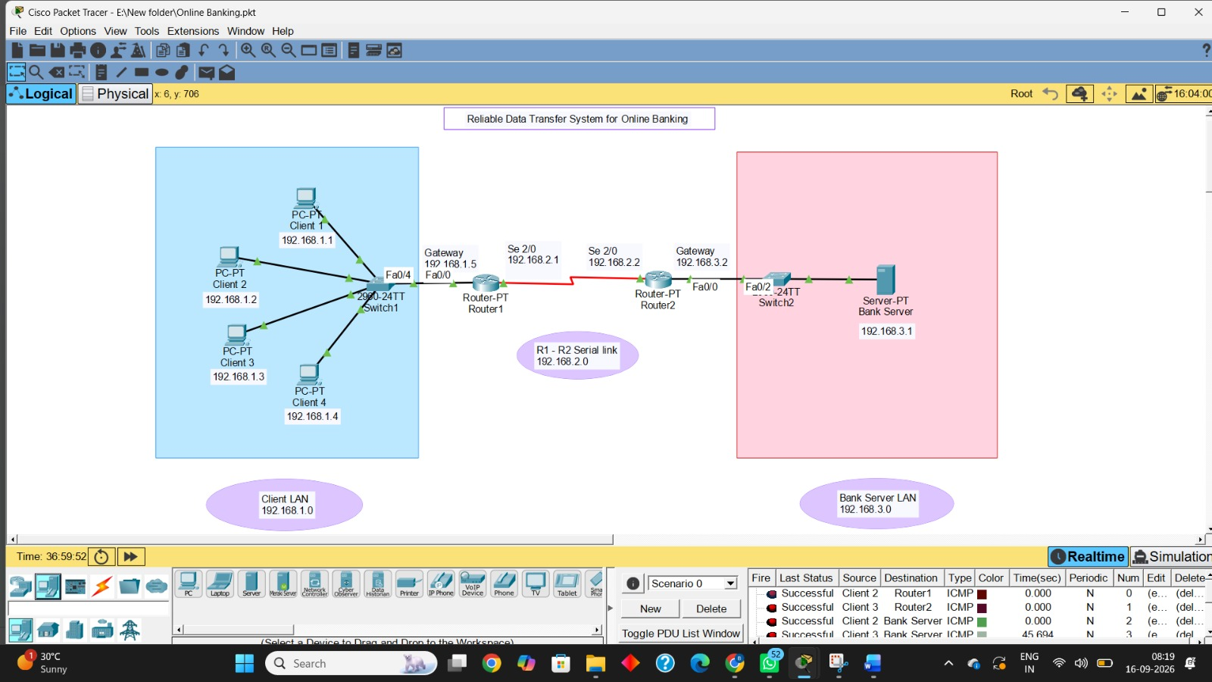
System Model – Cisco Packet Tracer :

Slide 5
IP Addressing :
Device | Interface | IP | Mask | Gateway
PC0 / Client 1 | FastEthernet0 | 192.168.1.1 | 255.255.255.0 | 192.168.1.5
PC1 / Client 2 | FastEthernet0 | 192.168.1.2 | 255.255.255.0 | 192.168.1.5
PC2 / Client 3 | FastEthernet0 | 192.168.1.3 | 255.255.255.0 | 192.168.1.5
PC3 / Client 4 | FastEthernet0 | 192.168.1.4 | 255.255.255.0 | 192.168.1.5
Router1 | FastEthernet0/0 | 192.168.1.5 | 255.255.255.0 | —
Router1 | Serial2/0 | 192.168.2.1 | 255.255.255.252 | —
Router2 | Serial2/0 | 192.168.2.2 | 255.255.255.252 | —
Router2 | FastEthernet0/0 | 192.168.3.2 | 255.255.255.0 | —
Server0 / Bank Server | FastEthernet0 | 192.168.3.1 | 255.255.255.0 | 192.168.3.2

Slide 6
Networks and Packet Path :
Network | Address | Purpose
Client LAN | 192.168.1.0/24 | PC0–PC3
R1–R2 Serial | 192.168.2.0/30 | Point-to-point router link
Bank Server LAN | 192.168.3.0/24 | Bank server network
Packet path: PC → Switch0 → R1 → Serial Link → R2 → Switch1 → Server
Client gateway: 192.168.1.5
Bank-server gateway: 192.168.3.2

Slide 7
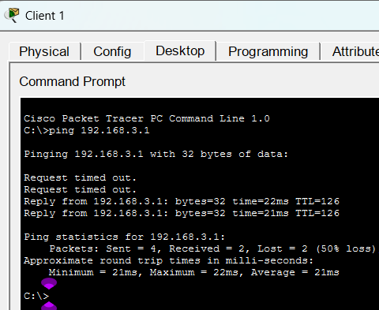
Connectivity Test :
End-to-end test: Client 1 → Bank Server
Command: ping 192.168.3.1
Successful ICMP replies confirm routed IP connectivity.
Packet Tracer Simulation Mode can be used to observe the packet path.
Recommended evidence: include screenshots from the actual .pkt file in the final submission.
Client 1 (192.168.1.1) → Bank Server (192.168.3.1)

Slide 8
Original data = 1101011011
CRC = 1110
Transmitted frame = 11010110111110
CRC Calculation :
Parameter | Value
Data | 1101011011
Generator | 10011
Generator degree | 4
Zeros appended | 4
Padded data | 11010110110000
CRC | 1110
Modulo-2 (XOR) division:
11010110110000 ÷ 10011
Remainder = 1110
CRC = 1110
Transmitted Frame
Original data = 1101011011
CRC = 1110
Transmitted frame = 11010110111110
1101011011 + 1110 = 11010110111110

Slide 9
Receiver Verification – Correct Frame :
Received frame = 11010110111110
Generator = 10011
Receiver divides the complete frame by the same generator.
CRC remainder = 0000
0000 → NO ERROR DETECTED → FRAME ACCEPTED

Slide 10
Acceptance / Rejection Rule :
CRC remainder | Meaning | Decision
0000 | No error detected by CRC | ACCEPT
Non-zero | Error detected | REJECT / retransmit
CRC is an error-detection mechanism.
ARQ/retransmission can provide recovery after rejection.
CRC does not itself correct the corrupted bit.

Slide 11
Results :
Test | CRC result | Decision
Correct frame: 11010110111110 | 0000 | ACCEPT
Corrupted frame: 01010110111110 | 0100 | REJECT
Packet Tracer topology provides the client-to-server communication path.
Successful ICMP communication demonstrates end-to-end IP connectivity.
CRC calculation and receiver verification demonstrate the requested error-detection logic.

Slide 12
Limitations :
Academic Packet Tracer model, not a production banking architecture.
CRC detects but does not correct errors.
Encryption and authentication are not implemented in the supplied topology.
ARQ/retransmission is described as the recovery mechanism, not implemented as a full application protocol.
ICMP verifies connectivity; it is not a complete banking transaction application.
Future Scope :
Implement ARQ-based automatic retransmission.
Compare CRC with checksum and Hamming code.
Add encryption and authentication.
Develop real-time banking functions such as balance inquiry and fund transfer.
Measure delay, packet loss, bandwidth and error rates.
Scale to multiple branches, redundant links and cloud infrastructure.

Slide 13
Conclusion :
The client LAN and bank-server LAN communicate through two routers and a /30 serial link.
For data 1101011011 with generator 10011, the CRC is 1110.
The transmitted frame is 11010110111110.
A receiver remainder of 0000 leads to acceptance.
A non-zero remainder, such as 0100 in the demonstrated corrupted frame, leads to rejection.
ARQ, encryption and authentication can extend the model toward a more complete reliable banking system.

Slide 14
References:
Cisco Networking Academy – Cisco Packet Tracer.
Forouzan, B. A. – Data Communications and Networking.
Kurose, J. F. & Ross, K. W. – Computer Networking: A Top-Down Approach.
Peterson, L. L. & Davie, B. S. – Computer Networks: A Systems Approach.
https://youtu.be/A9g6rTMblz4?si=OI3p8u3VZrWqdZy5
https://youtu.be/wQGwfBS3gpk?si=nygHb2e37kOr_6Le

