Slide 1

Project Title -
Seasonal Agriculture Performance Analysis
[ Student Name: Thakare Bhagyashri Vasudev
College Name: Government Engineering College ,Daman ]
AICTE STU ID : (STU6a646979ebc551784965497)

Slide 2

PROBLEM STATEMENT
Agricultural activities are influenced by seasonal variations in environmental conditions, farming practices, resource availability and market conditions. As a result, agricultural performance may differ from one season to another. However, raw agricultural data does not clearly explain how agricultural performance changes across seasons or what patterns can be observed in different seasonal conditions. The problem is to analyze the given agricultural dataset and investigate seasonal differences in agricultural performance by identifying meaningful patterns, trends, relationships and variations within the available data.

Slide 3
Project Description
The project Seasonal Agriculture Performance Analysis is a data analytics assignment focused on investigating how farming performance changes across different seasons, geographical areas, and environmental conditions.
Overview: The project uses a detailed dataset covering farming practices, weather conditions, crop yields, resource usage, and economic outcomes across seasons.
Core Problem: Raw agricultural data does not clearly reveal how farming outputs change from one season to another. The goal is to clean, analyze, and explore the dataset to uncover these hidden patterns and seasonal variations.
Key Tasks: Students need to clean the data, apply statistical and visualization techniques, compare performance metrics (such as crop output, resource usage, and revenue) across different seasons, and document their findings in a Jupyter Notebook.

Slide 4

WHO ARE THE END USERS?
Farmers & Local Agricultural Workers: Helps them understand seasonal trends so they can optimize planting schedules, manage resource consumption (like fertilizers and water), and select the best crops for each season.
Agricultural Planners & Government Policymakers: Assists decision-makers in formulating evidence-based agricultural policies, allocating emergency resources, and designing seasonal support programs for regional farming communities.
Agribusinesses & Supply Chain Managers: Provides valuable market and yield predictability, allowing seed suppliers, fertilizer manufacturers, and crop distributors to align their inventory with seasonal demand.
Agricultural Researchers & Data Analysts: Offers structured empirical findings to support broader climate, soil, and yield studies aimed at improving sustainable farming practices.

Slide 5

Technology Used
Jupyter Notebook: The primary software environment used to write code, analyze data, run calculations, and document the entire workflow.
Python: The main programming language used for processing and analyzing the dataset.
Key Software Libraries
Data Processing & Cleaning: Libraries like Pandas and NumPy are used to clean, inspect, filter, and structure the agricultural data.
Data Visualization: Tools like Matplotlib and Seaborn are used to create graphs, charts, and plots to easily spot seasonal trends and patterns.
Statistical Analysis: Math and statistics libraries (such as SciPy or Statsmodels) are used to run comparisons, calculate averages, and test relationships across different seasons.

Slide 6
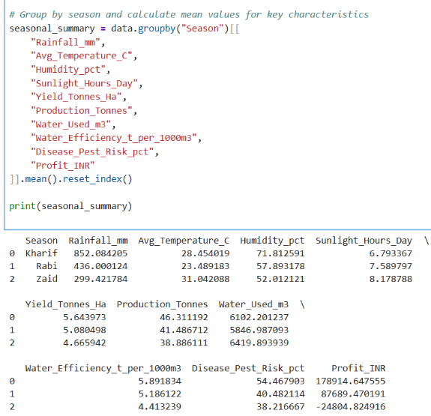
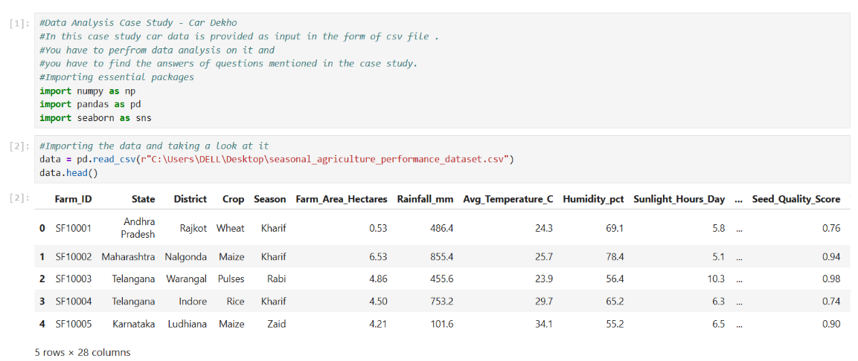
RESULTS
Characteristics that change between seasons
Rainfall (mm) – Different monsoon cycles (Kharif, Rabi, Zaid) bring varying rainfall levels.
Average Temperature (°C) – Seasonal temperature shifts affect crop growth.
Humidity (%) – Influences disease/pest risks and crop health.
Sunlight Hours/Day – Varies with season length and impacts photosynthesis.
Yield & Production (Tonnes/Ha, Tonnes) – Crop output fluctuates depending on seasonal conditions.
Water Usage & Efficiency – Irrigation needs differ across seasons.
Disease/Pest Risk (%) – Higher in humid/rainy seasons.

Slide 7
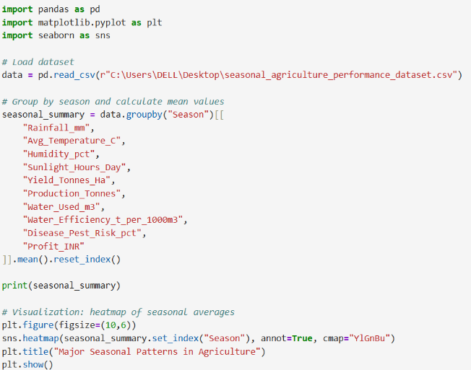
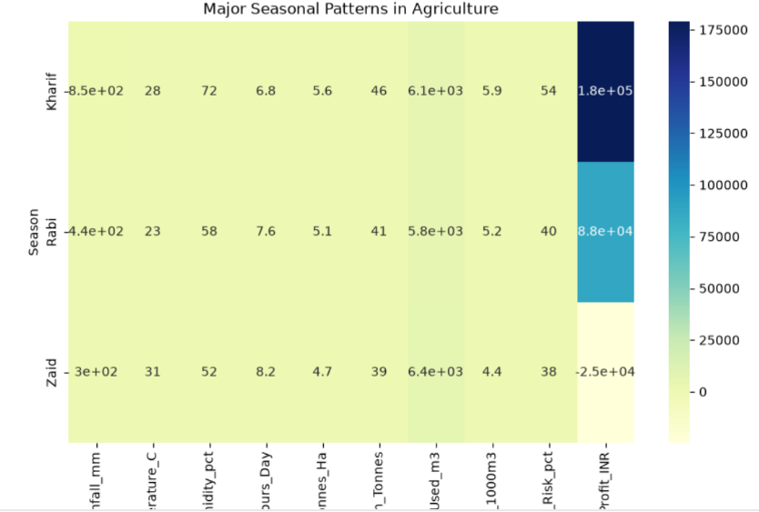
RESULTS
A summary table of average values per season.
A heatmap showing which factors rise or fall across Kharif, Rabi, and Zaid.

Slide 8
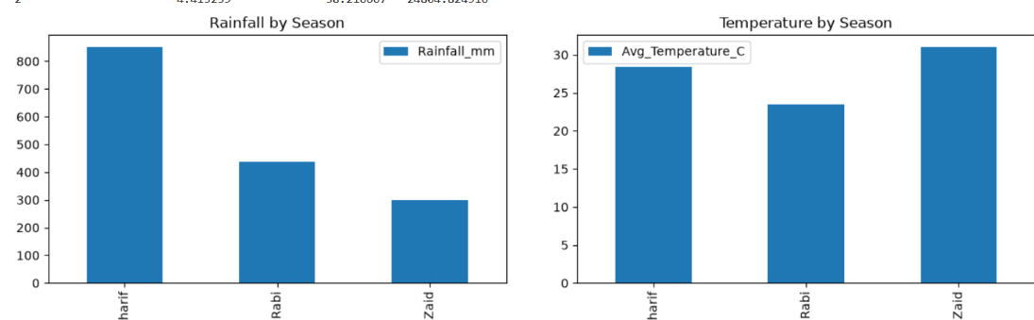
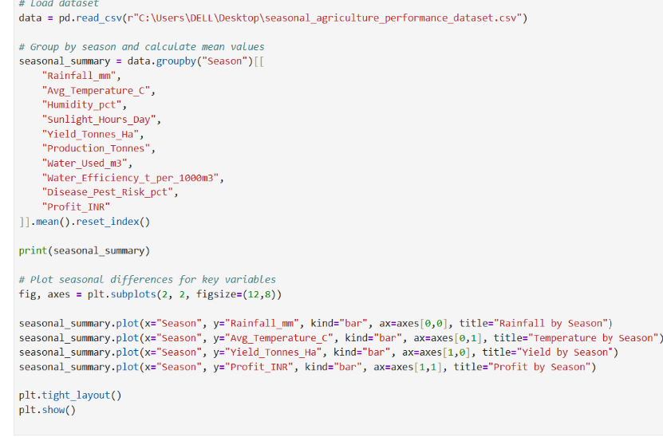
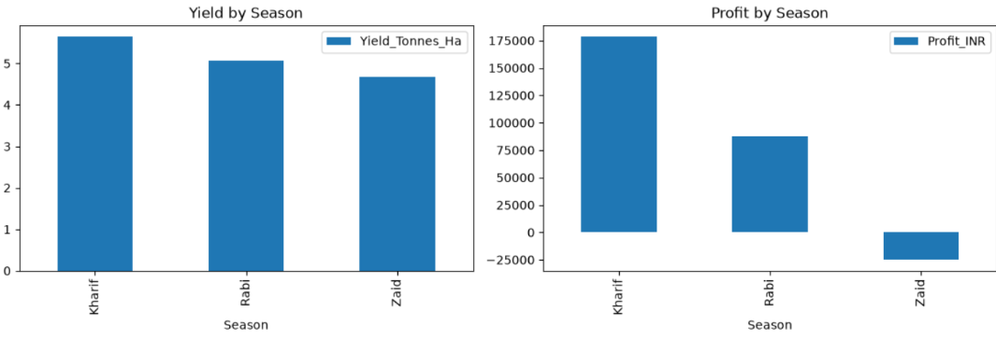
RESULTS
A summary table of average values per season.
Bar charts showing rainfall, temperature, yield, and profit differences across Kharif, Rabi, and Zaid.

Slide 9
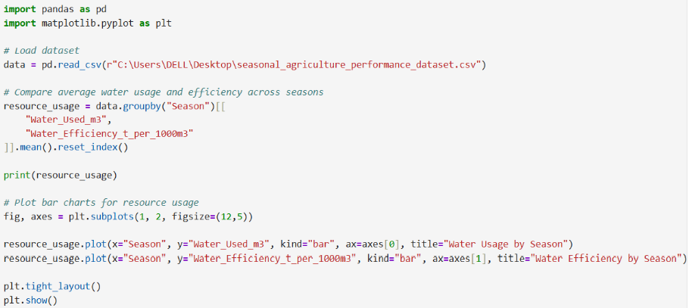
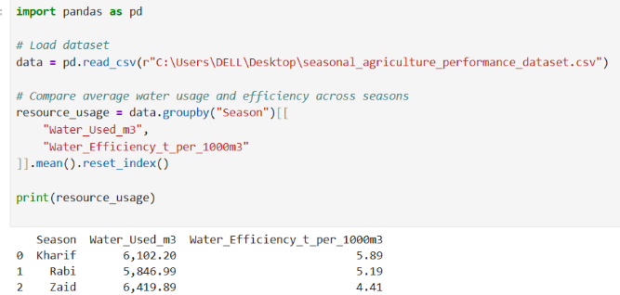
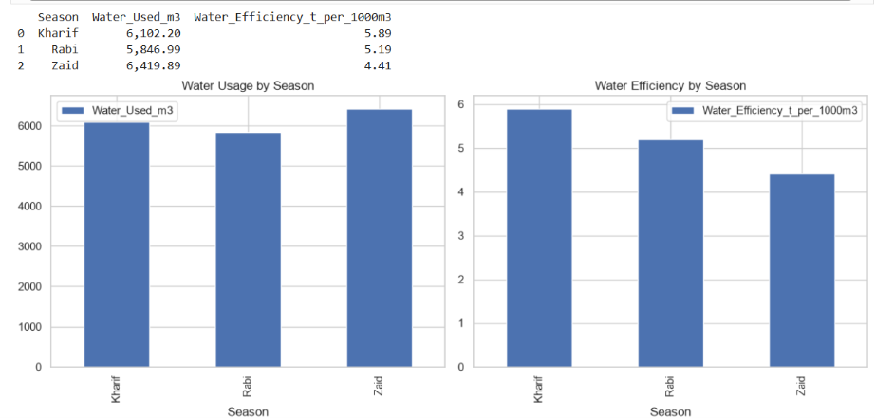
RESULTS
This will give you a summary table showing how much water is used and how efficient it is in each season.
A summary table of average water usage and efficiency per season.
Two bar charts side by side: one for water usage, one for efficiency.

Slide 10
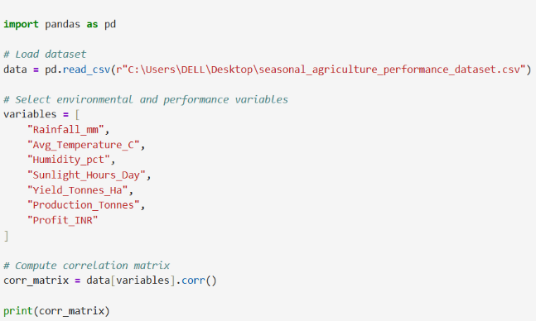
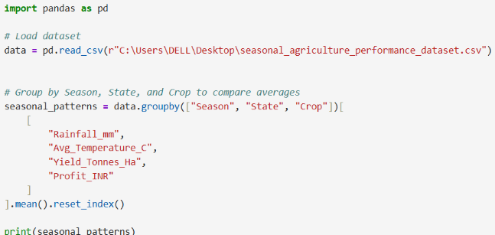
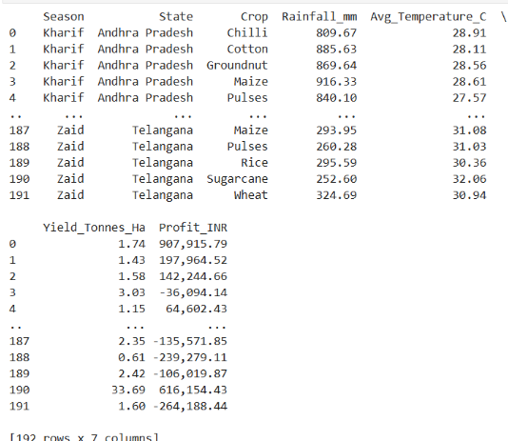
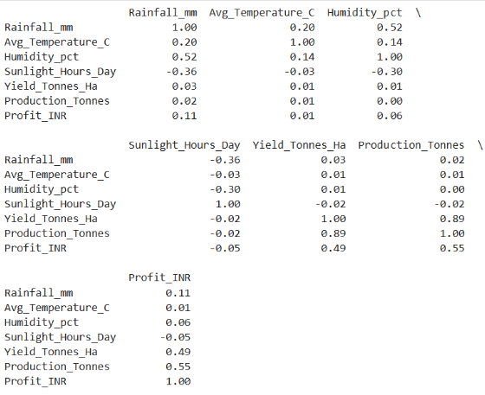
RESULTS
This will print a correlation table showing how environmental factors (rainfall, temperature, humidity, sunlight) relate to performance metrics (yield, production, profit).
This code aggregates your agricultural data to analyze performance metrics across different farming seasons, states, and crop types.

Slide 11
Future scope
1. Predicting Future Yields: Machine learning tools can be added to predict next season's crop harvest and market prices before they happen.
2. Live Interactive Dashboards: Static charts can be turned into simple interactive dashboards (using tools like Power BI or Streamlit) so non-technical users can click and view seasonal trends easily.
3. Real-Time Weather Integration: The project can connect with live weather apps and soil sensors to give farmers instant updates instead of looking only at past data.
4. Smart Farming Recommendations: An automated advice system can be built to directly send simple alerts to farmers about the best time to plant, water, or harvest based on seasonal patterns.
5. Long-Term Climate Studies: The analysis can be expanded across multiple years to see how global warming and changing weather patterns affect farming over time.

Slide 12
GitHub Link
https://github.com/Bhagyashri-Thakare/Seasonal-Agriculture-Performance-Analysis/upload/main

Slide 13
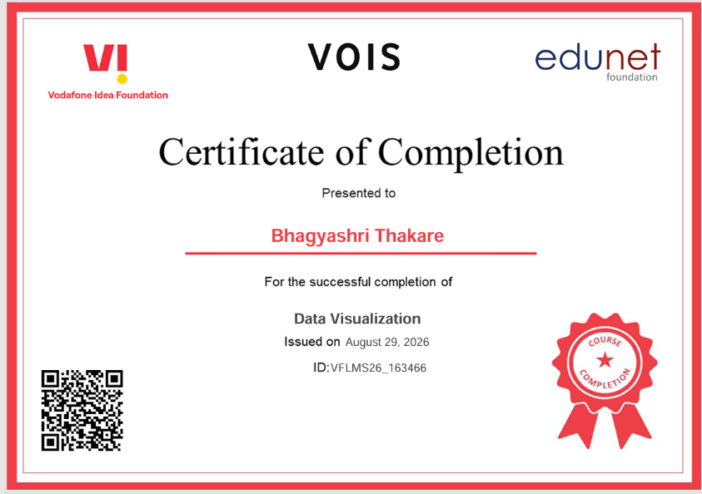
VOIS Course completion certificate - Course name- Data Visualization

Slide 14
Thank you
.
.

