Slide 1
Idea/Approach Details
Ministry/Organization Name: Government of Uttarakhand
Problem Statement: Lack of technological intervention in value addition of agriculture products produced by SHGs(Self Help Group) /FPGs(Farmer Producing Group)
Team Name: Connect_Tech
Team Leader Name: Bhagyashri Sangtani
College code:

Slide 2
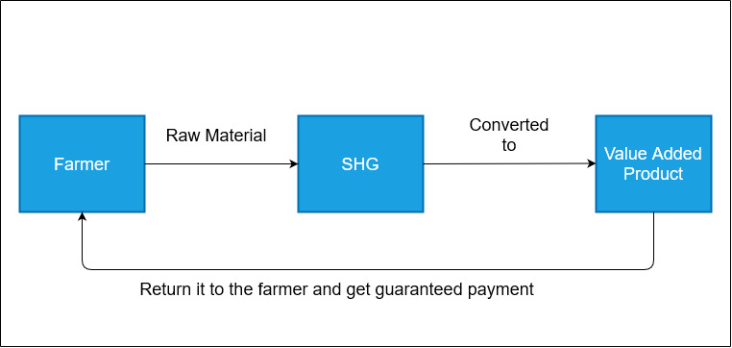
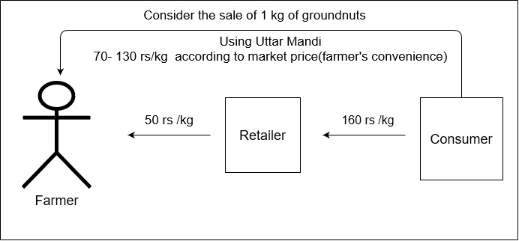
Idea/Approach Details
Main Idea: Providing Technological intervention in value added products produced by SHGs and FPGs through an e-commerce platform
Solution:
Direct link between farmers and SHG’s for the benefit of both.(Diagram)
Providing a platform for FPG formation which in turn provide better value for similar produce.
Value Addition: Selling value added products prepared with the help of SHGs and FPGs on the platform. Example – collectively preparing floor from wheat.
Technological Interventions: Chatbots for assisting farmers (in local language), route optimization for delivery of produce to consumers.
Promotion Avenues: Television / Radio, Social Media Sites, Promotion through NGOs, Newspaper Advertising, Reaching out to Gram Panchayats, School and College Campaigns
Technology Stack: HTML, CSS, JavaScript, PHP, SQL,
AI,ML,Blockchain

Slide 3
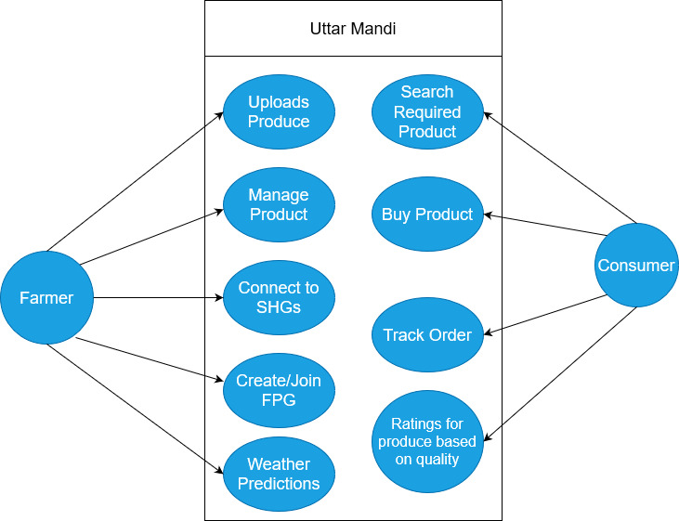
Idea/Approach Details
Dependencies
Farmer must upload produce details before any consumer can buy.
Produce should be delivered.
Farmer must receive a message after payment is completed.

