Slide 1
Defense Against Content-Sensitive Web Bots
Presented by
-Bhagyashri Thorat

Slide 2
Randomize the class name.
The page has totally 109 an elements but only one “Add to cart” button.
Libraries used:
Htmlparser2
htmlparser-to-html
Optional:
Cheerio

Slide 3
Link to my site

Slide 4
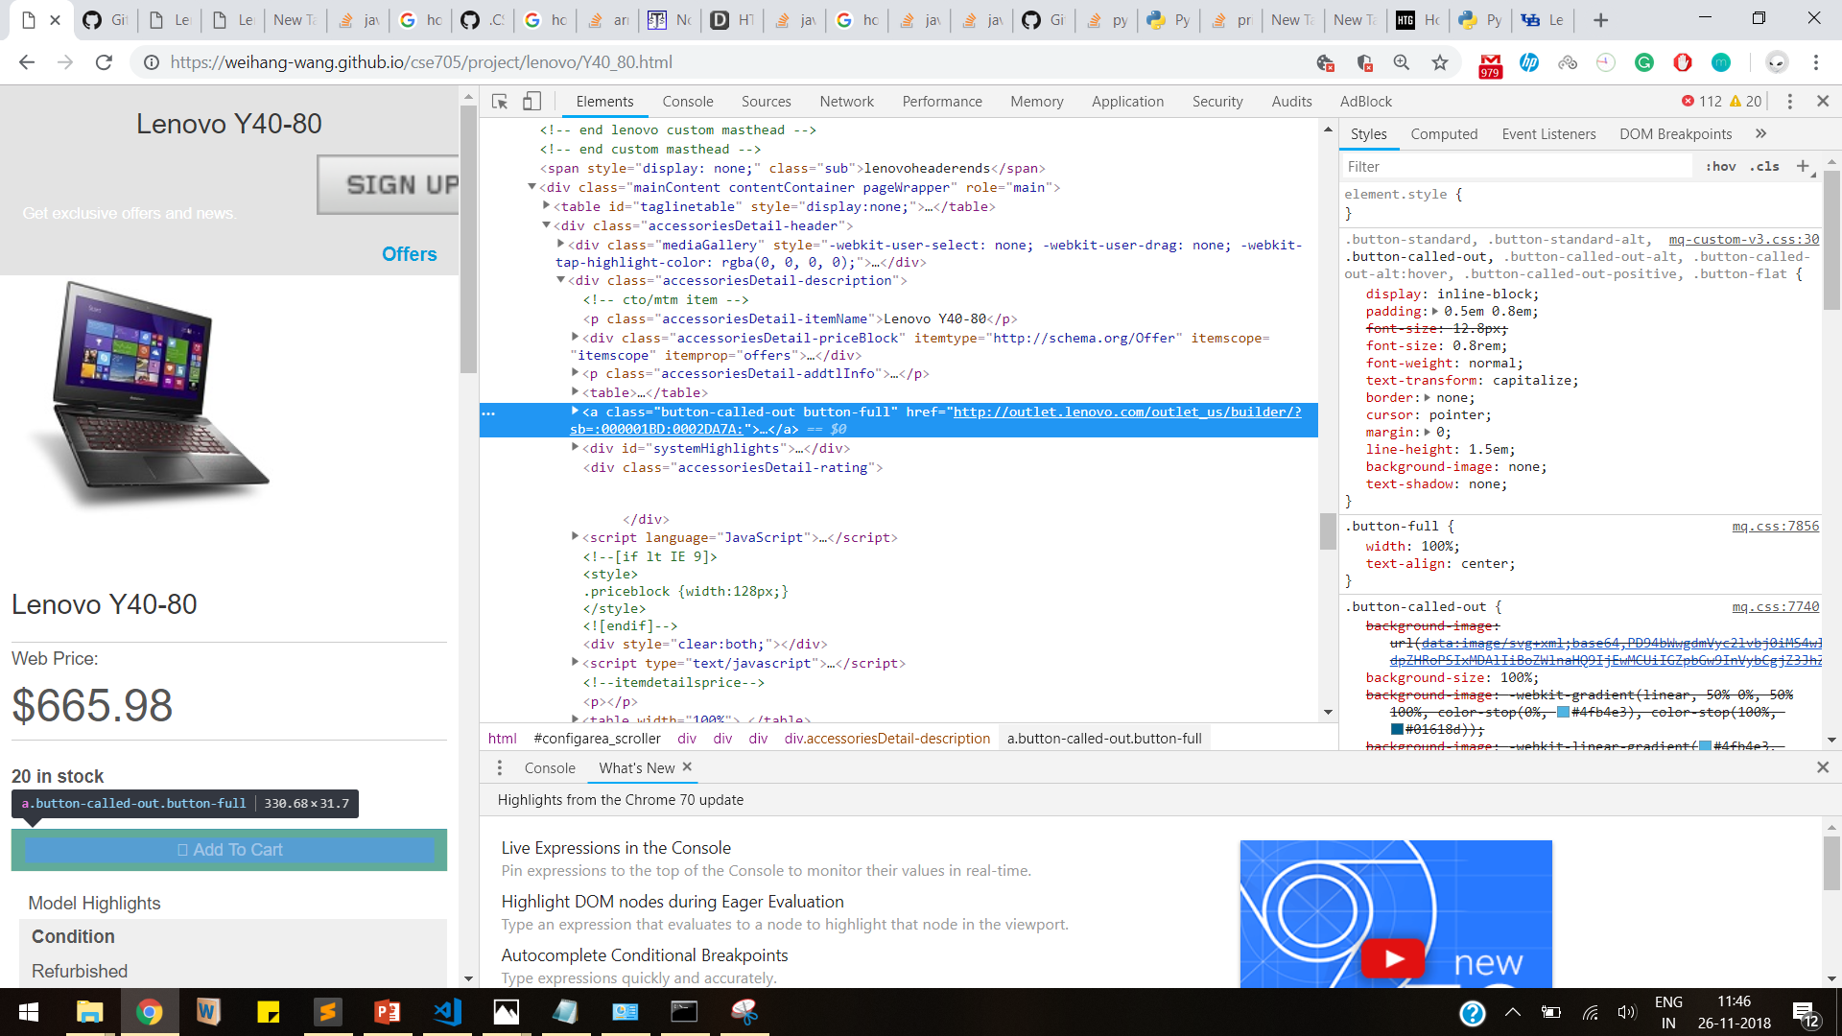

Slide 5
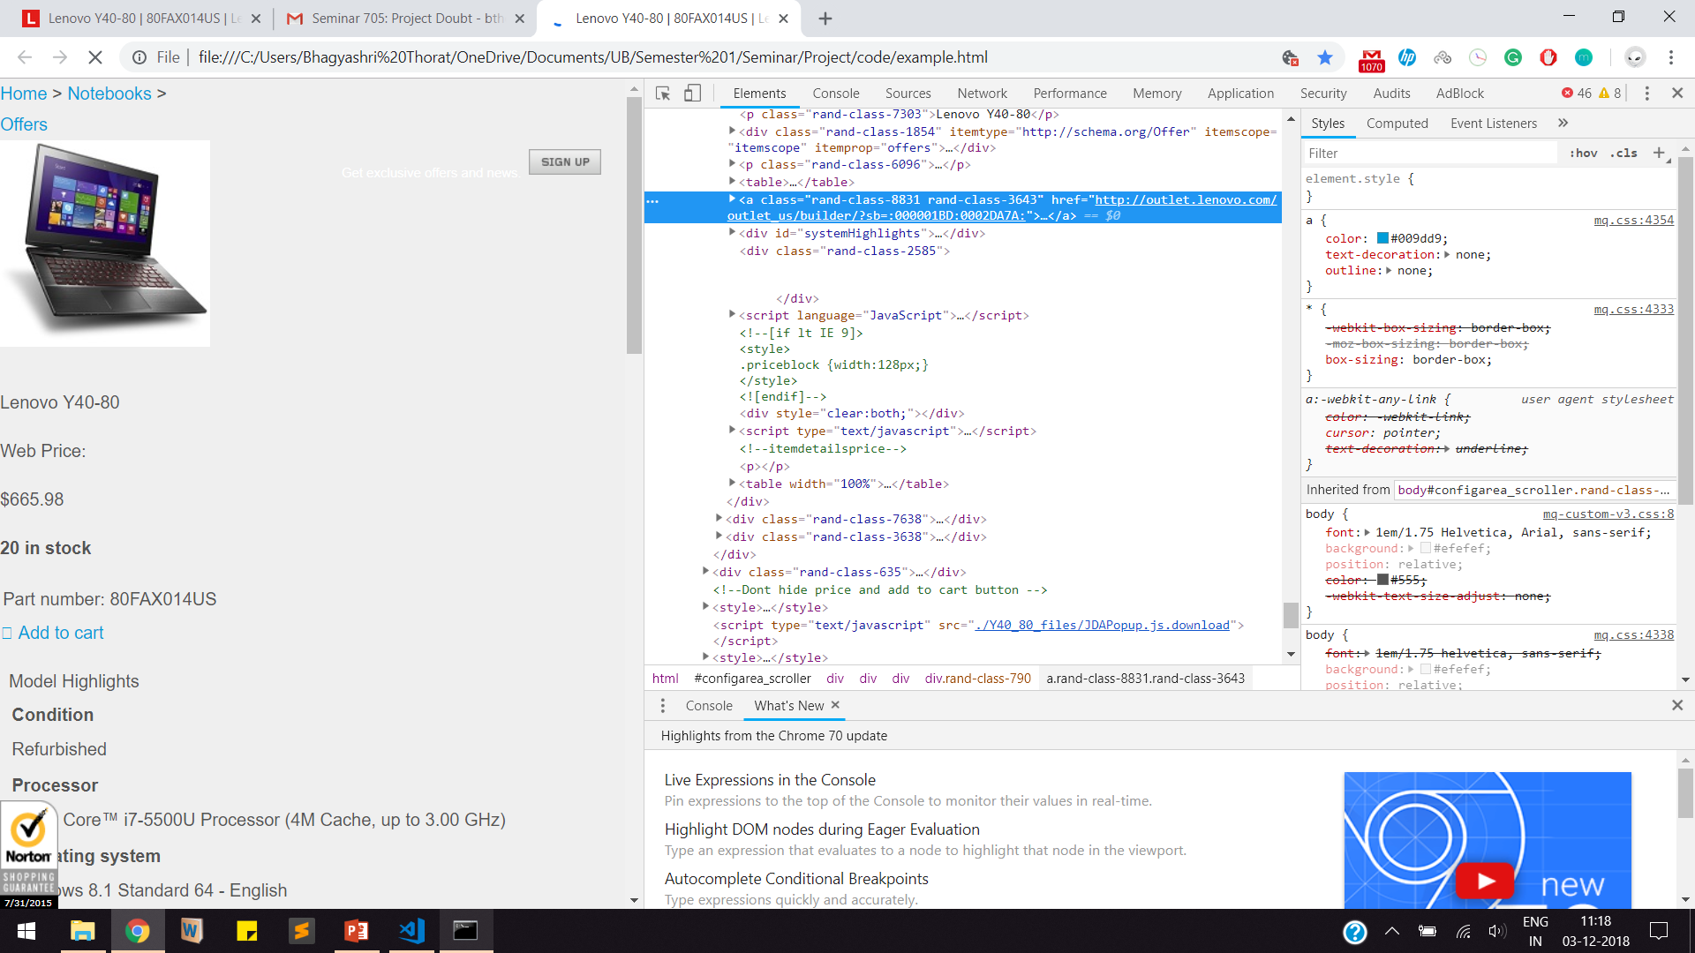

Slide 6
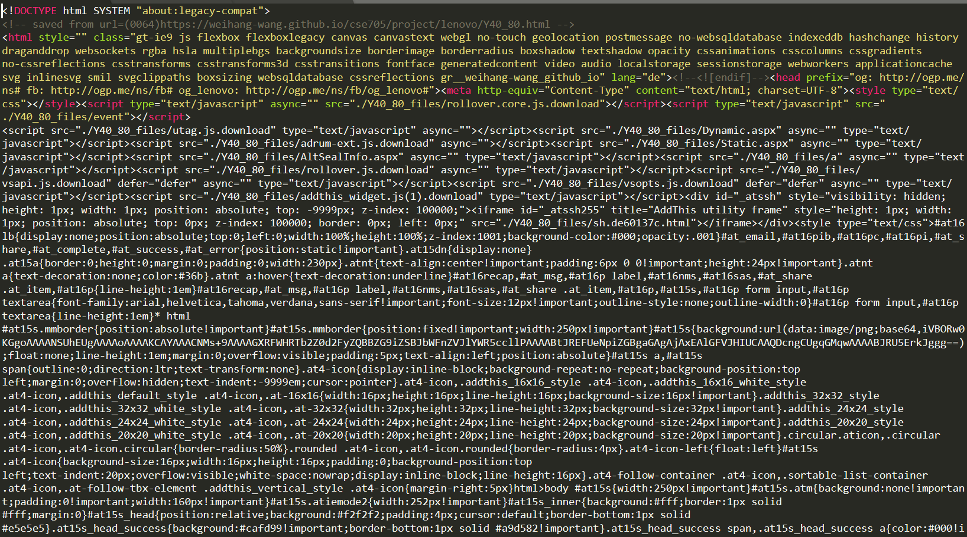

Slide 7
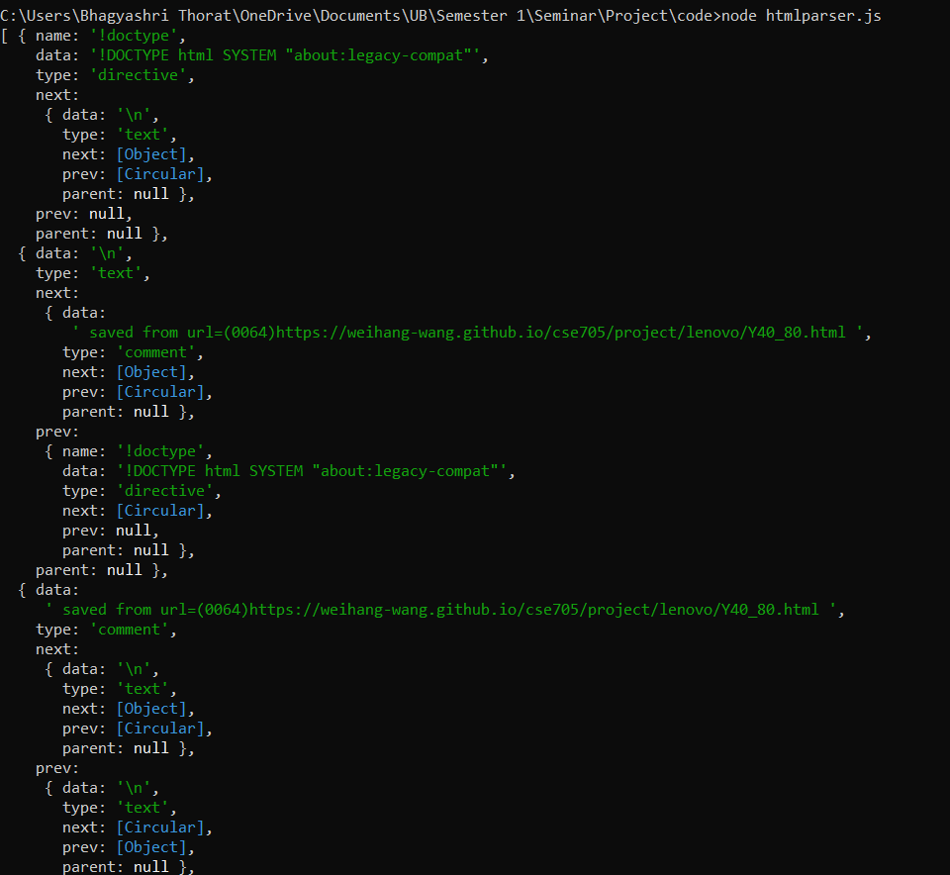

Slide 8
DOM Traversal Techniques
Recursive
Non recursive
DFT
BFT
I have used the DFS approach.

Slide 9
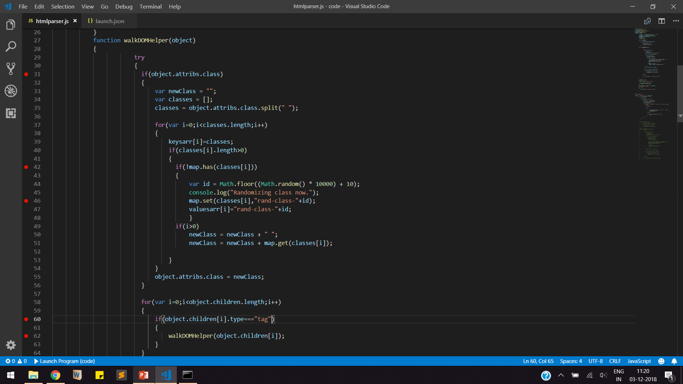

Slide 10
The Math.floor() function returns the largest integer less than or equal to a given number.
The Math.random() function returns a floating-point, pseudo-random number in the range 0–1 (inclusive of 0, but not 1) with approximately uniform distribution over that range — which you can then scale to your desired range.
The implementation selects the initial seed to the random number generation algorithm

Slide 11
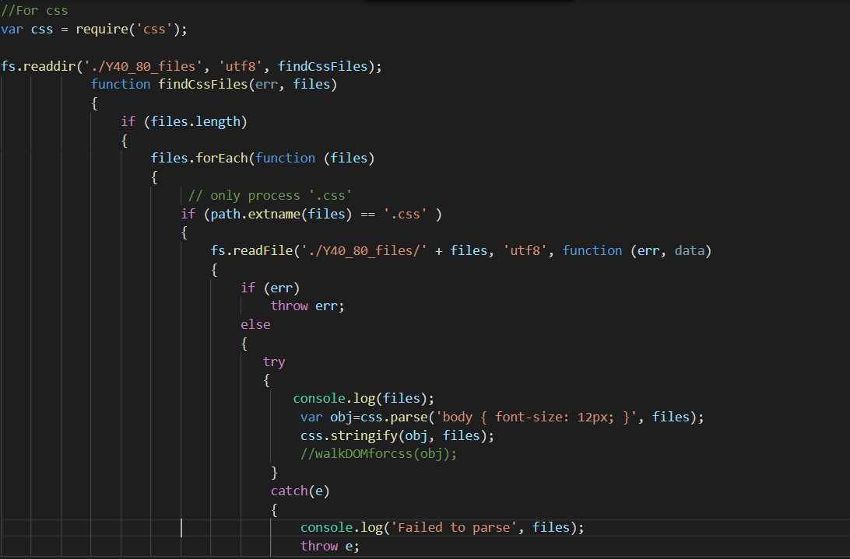

Slide 12
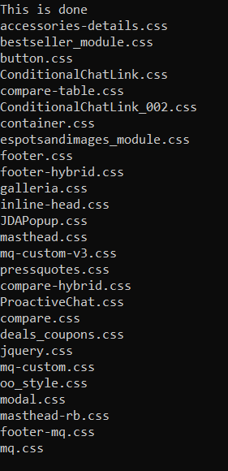

Slide 14
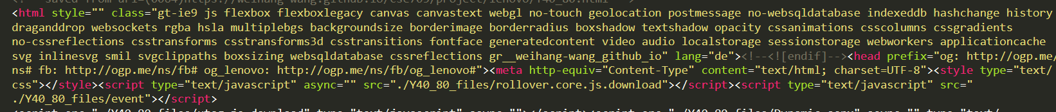

Slide 15
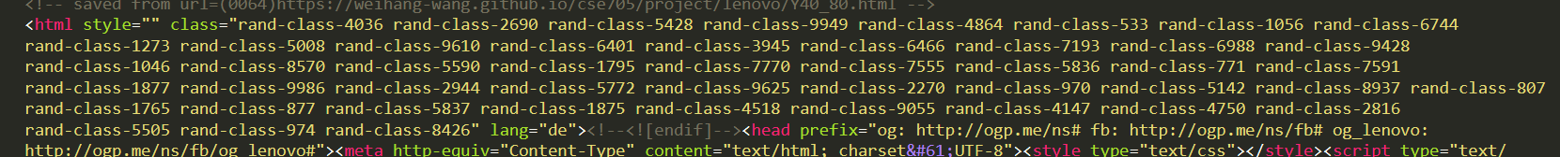

Slide 16
Method 2: Using cheerio
Cheerio operates over a DOM-like structure generated through string parsing only
This allows it to be much faster than jsDom at the cost of some fidelity.
Using cheerio (which provides jquery like access to html) + something to retrieve html like request.
The parsing options in cheerio are taken directly from htmlparser2, therefore any options that can be used in htmlparser are valid in cheerio as well.

Slide 17
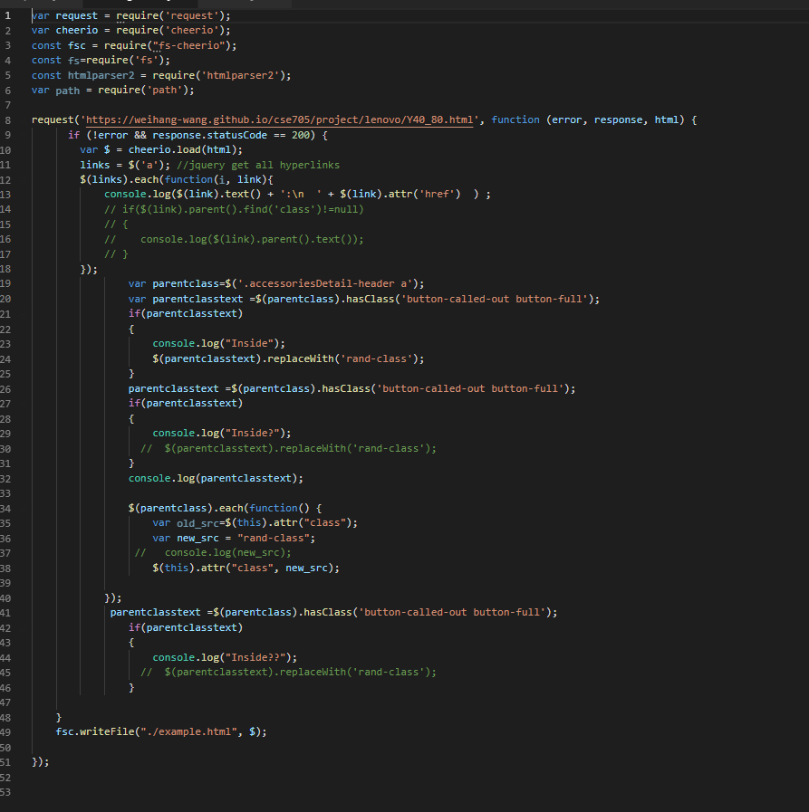

Slide 18
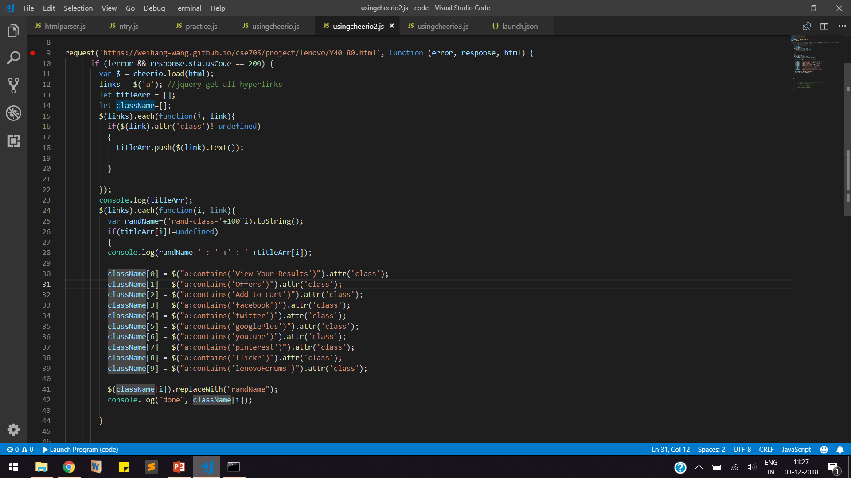

Slide 19
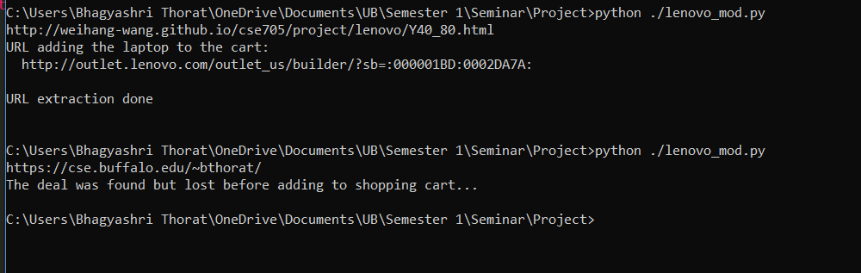

Slide 20
Demo:

Slide 21
Thank You!

