Slide 1
SENTIMENTAL ANALYSIS FOR CUSTOMER FEEDBACK
Bhagya Sree Bokka-1002145347 Kireeti Mattaparti-1002099884 Poorna Pallavi Tekkali-1002160637

Slide 2
INDEX
Introduction
Importing Dataset
Data Pre-processing Steps
Word2Vec Implementation
Model Implementation
Accuracy
Conclusion

Slide 3
INTRODUCTION
The goal of studying Natural Language Processing (NLP) is to enable computers to process spoken and written language in a manner that is similar to that of humans. This field combines machine learning, linguistics, and computer science.
Sentiment analysis is used to analyze raw text to drive objective quantitative results using natural language processing, machine learning, and other data analytics techniques. This involves instructing computers to recognize the sentiment conveyed in the text.
NLP's sentiment analysis heavily relies on data mining methods to categorize thoughts and segment text into primarily binary classifications, such as positive and negative.
Sentiment analysis can read beyond simple sentences and detect sarcasm, read common chat acronyms (LOL, ROFL, etc.), and correct common mistakes like misused and misspelled words.

Slide 4

DATA SET
A total of 1000 customer feedback reviews, in particular, for training and testing purposes, form part of the dataset.
A balanced mix of positive and adverse reviews is present in both training subsets as well as testing subsamples.
In addition, additional unlabeled data intended for supplementary use are included in the database.
In addition to this data can be categorized into different types like reviews, comments, ratings, etc.
SOURCE: https://www.kaggle.com/datasets/parve05/customer-review-dataset

Slide 5
DATA PRE-PROCESSING
It is important to perform data cleaning and processing before carrying out data analysis.
Cleaning involves not only enhancing and standardizing the dataset but also eliminating extraneous elements like noise and additional tags. Conversely, data transformation into a vector format, achieved through various preprocessing procedures, is a critical step.
In the field of Natural Language Processing (NLP), pre-processing involves crucial techniques such as Stemming and Lemmatization, with the order of these tasks being significant. The dataset is processed in a structured sequence of steps.

Slide 6

DATA PRE-PROCESSING STEPS
Data Modules
Reading Data Frames
Lower Casting
Contrast Expand
Noise Removal
Correcting Typo
Removing Stop words
Lemmatization

Slide 7
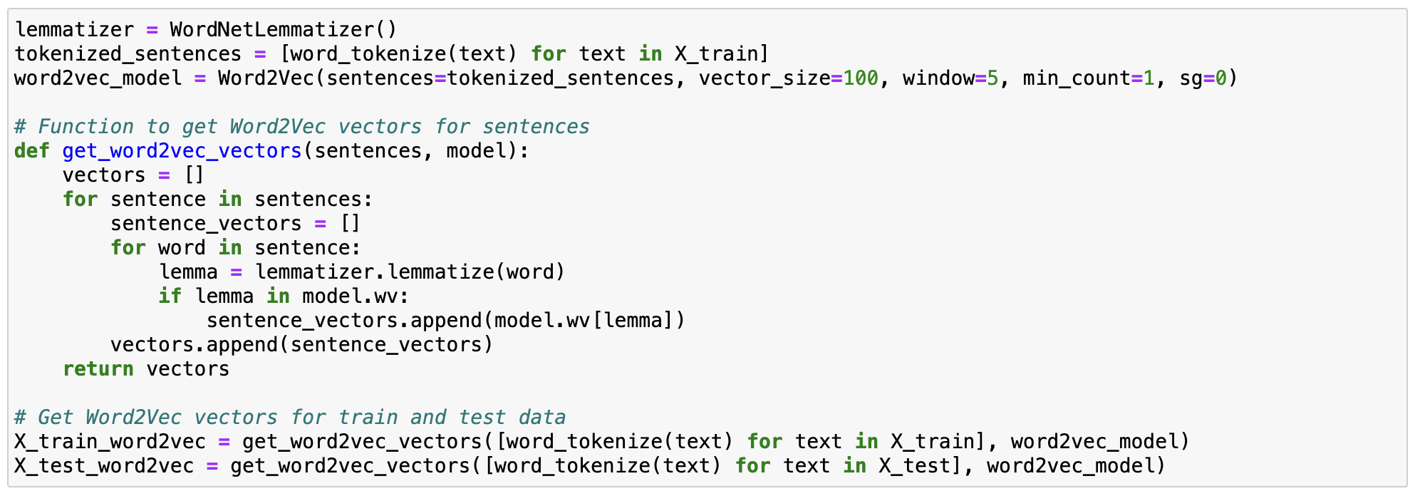
WORD2VEC IMPLEMENTATION
We then implemented an embedding technique to transfer vocabulary words to high-dimension vectors, and here in our project, we implemented the Word2Vec model.
We first initialized a WordNetLemmatizer and then tokenized the given training review data.
We have defined a method to retrieve a vector for each word.

Slide 8
MODEL IMPLEMENTATION
LSTM and GRU models can capture temporal dependencies and contextual information in sequential data, making them well-suited for modeling natural language.
They are capable of learning from both short-term and long-term dependencies in text data, enabling them to capture complex linguistic patterns and semantics.
By incorporating word embeddings and learning from large amounts of text data, LSTM and GRU models can achieve state-of-the-art performance on various NLP tasks.
They are often used in NLP and speech applications due to their powerful ability to capture complex dependencies.

Slide 9
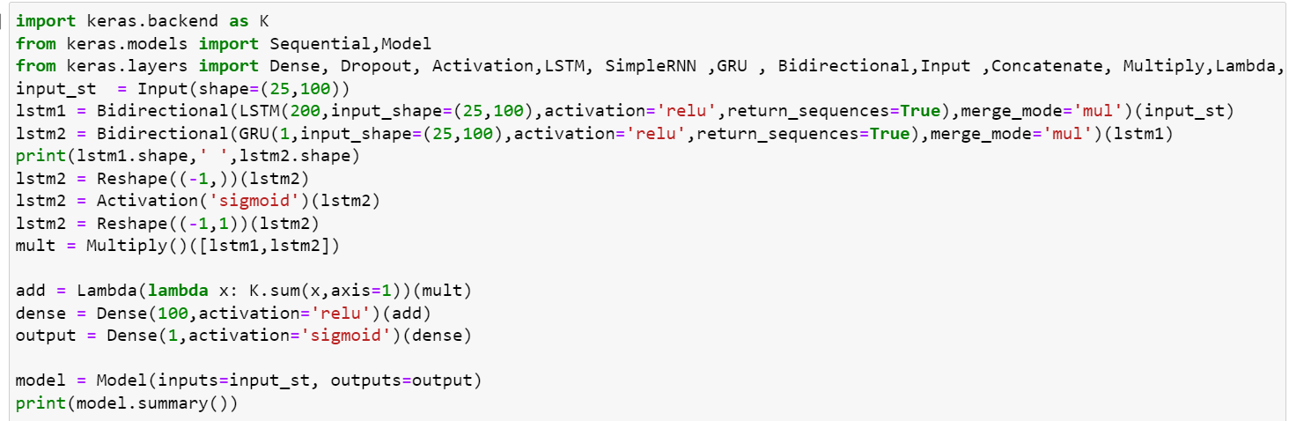
MODEL IMPLEMENTATION
We are implementing LSTM AND GRU directly from Keras module. We are experimenting with different layers of bidirectional LSTM and bi-direction GRU. We are combining those layers to train our model, in order to obtain enhanced accuracy.

Slide 10
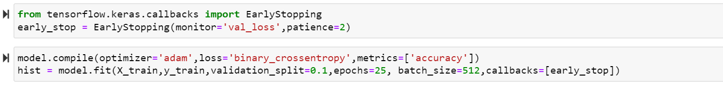
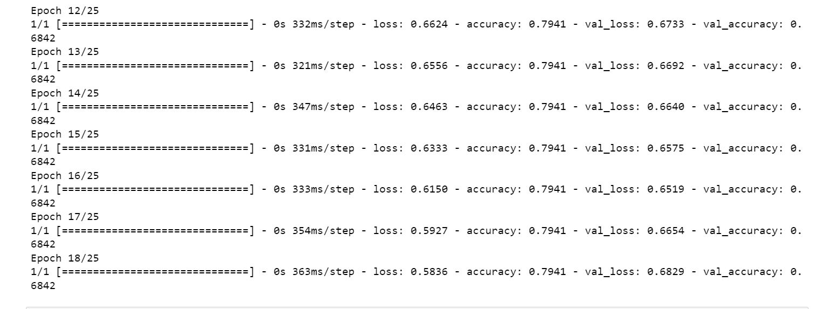

Slide 11
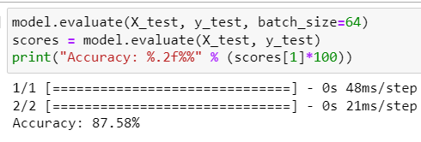
ACCURACY
Initially we got 85% accuracy, however, when we changed the model with 5 epochs, and by setting the batch size as 64, we got 87.58% as the accuracy.

Slide 12
CONCLUSION
Initially, we were able to improve the accuracy of the LSTM model compared to the reference paper which had an accuracy of around 80%.
LSTM is very effective in capturing the long-term dependencies in sequential data accounting for the higher performance over all other models.
Bi-directional LSTMs and GRUs are powerful tools for sequence-based tasks, when your data benefits from context in both directions and when you need a more efficient model with fewer parameters

Slide 13
THANK YOU

