Slide 1
Outcome-Centric API Design
A framework for lean, spec-driven, AI-enabled, observable, and integrity-preserving enterprise APIs
Conference presentation
Experience
Process
API layers as capability contracts
Spec-driven
Secure
Integrity
Lean
Observable
AI-enabled
Framework design → implementation approach → cap & grow adoption → hypothetical results
Enterprise API framework
Business outcomes
Capability contracts
MCP + A2A
NoSQL integrity
Health + observability
Bhagyeshkumar Chokhawala | Comcast Cable
Outcome-Centric API Design | Conference Presentation
01
Notes:
Greetings. Good Afternoon, and thank you for the opportunity to present this work on outcome-centric API design. This presentation summarizes a framework for designing lean, spec-driven, AI-enabled, observable, and integrity-preserving enterprise APIs. The core motivation is simple: in many enterprises, APIs have become the operational fabric for channels, workflows, data products, automation, and AI. Yet they are still too often designed as technical endpoints instead of governed business capability contracts. In the next fifteen minutes, I will walk through the framework design, the implementation approach, a cap-and-grow adoption model, and a set of hypothetical pilot results that illustrate how the framework could be evaluated in practice.

Slide 2
MOTIVATION
Why API architecture needs a stronger operating model
Enterprise API portfolios often grow faster than their governance, testing, observability, and transition practices.
Endpoint sprawl
Fragile processes
Screen-specific and database-wrapper APIs multiply across teams.
Partial failures leave mismatched states across business domains.
AI risk surface
NoSQL integrity gap
Agents and tools can invoke APIs without sufficient guardrails.
Denormalized entities and projections need explicit consistency controls.
Adoption friction
Teams need a practical path to cap legacy entropy and grow target capabilities.
Architecture question: How can APIs stay lean, secure, observable, AI-ready, and transaction-safe while spanning multiple domains and data stores?
Outcome-Centric API Design | Conference Presentation
02
Notes:
Motivation. Why is a stronger operating model needed for API architecture? Most organizations do not suffer from a lack of APIs. They suffer from API sprawl, inconsistent contracts, duplicated business logic, weak object-level authorization, limited failure-path testing, and fragmented observability. One team builds for a specific screen, another exposes database-shaped endpoints, another creates integration wrappers, and another adds AI access on top. The result is a portfolio that scales in count, but not in reliability or governance maturity. The central argument of this paper is that APIs should be designed and managed as durable business contracts aligned to outcomes and domain capabilities. That means the design must account not only for payloads and endpoints, but also for security, integrity, health, telemetry, AI control, and transition governance.

Slide 3
CONTRIBUTION
The paper’s contribution: a measurable API architecture framework
It connects design intent to implementation evidence, operational telemetry, and transition governance.
1. Design intent
Outcome, capability, resource, contract
2. Spec evidence
OpenAPI/AsyncAPI, policies, examples
3. Implementation
API layers, orchestration, data integrity
4. Runtime proof
Tests, observability, health, compliance
5. Adoption path
Cap legacy sprawl, grow target API products
Core contribution
API design is treated as a governance system: each API must provide value, contract clarity, authority control, test evidence, observability, and integrity status.
Talk flow: framework design → implementation approach → cap & grow transition → hypothetical evaluation
Outcome-Centric API Design | Conference Presentation
03
Notes:
Contribution. The paper contributes a measurable API architecture framework. It is not just a conceptual model. It ties design intent to evidence. In other words, for every important API concern, such as resource design, role-aware authorization, NoSQL integrity, observability, or AI tool exposure, the framework expects explicit design artifacts, implementation mechanisms, runtime telemetry, and compliance checks. This lets architects move from subjective review to measurable adherence. The contribution is valuable because many API programs have principles, but not a disciplined evidence model. The framework helps answer three questions: what should a good enterprise API look like, how should it be implemented, and how should the organization transition from today’s portfolio to the target state.

Slide 4
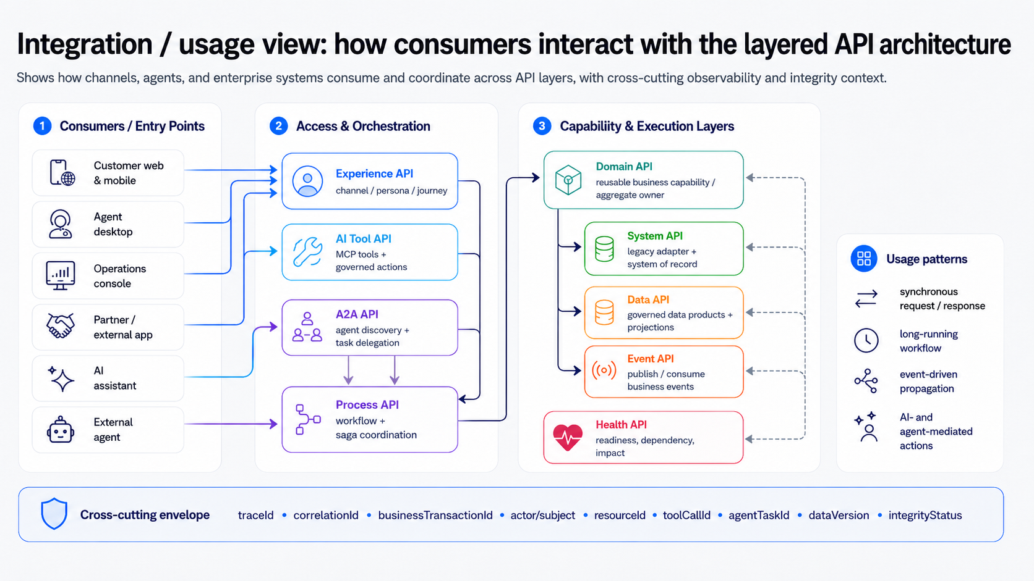
FRAMEWORK DESIGN
Layered API architecture: capability contracts, not endpoint inventory
Each layer has a distinct responsibility, ownership model, observability contract, and integrity obligation.
Experience API
Process API
Domain API
Channel, persona, journey
GET /agent-desktop/...
Workflow across domains
POST /customer-disconnect-requests
Reusable capability
GET /orders/{orderId}
System API
Data API
Event API
Legacy/system of record
GET /billing-system/...
Governed data products
GET /customer-profile/{id}
Publish/consume events
OrderSubmitted
AI Tool API
Health API
A2A API
Approved MCP tools
getOrderDetail
Readiness + impact
GET /health/capabilities
Agent discovery + tasks
delegateBillingReview
Cross-cutting envelope: traceId • correlationId • businessTransactionId • actor/subject • resourceId • toolCallId • agentTaskId • dataVersion
Outcome-Centric API Design | Conference Presentation
04
Notes:
Framework design: layered architecture. At the center of the framework is a layered API architecture. Experience APIs optimize for a user journey or channel. Process APIs coordinate multi-step business workflows. Domain APIs expose reusable business capabilities and own transactional boundaries. System APIs encapsulate systems of record and legacy dependencies. Data APIs expose governed data products and projections. Event APIs publish or consume business events. AI Tool APIs expose approved capabilities to AI through MCP tools. Health APIs expose readiness, dependency status, and business capability impact. Agent-to-Agent APIs support governed discovery, delegation, task exchange, and artifact sharing across agents. What makes this layered model different is the explicit cross-layer envelope: trace identifiers, correlation identifiers, business transaction identifiers, actor and subject context, tool call identifiers, agent task identifiers, and data version markers travel with the business transaction.

Slide 5
FRAMEWORK DESIGN
Capability contract dimensions: what every API must prove
The framework defines a minimum evidence set for design review, implementation, runtime, and compliance.
Outcome
Capability
Contract
Resource
Business value and measurable result
Owning domain and reusable behavior
Spec, schema, error model, examples
Collection/detail access patterns
Lean
Security
AI/MCP/A2A
Testing
Right-sized payloads and surface area
Actor, subject, resource, action, context
Tool access and agent collaboration
Contract, policy, mock, failure paths
Observability
Health
NoSQL Integrity
Compliance
Trace, metrics, logs, audit evidence
Readiness and business impact
Aggregate, version, saga, reconciliation
Framework adherence and release gate
Design rule: every API must demonstrate business value, right-sized design, explicit authority, traceable execution, test evidence, health impact, and integrity status.
Outcome-Centric API Design | Conference Presentation
05
Notes:
Framework design: capability contract dimensions. The second part of the framework is the capability contract model. Every API is expected to prove a minimum evidence set. That evidence spans business outcome alignment, domain capability ownership, contract quality, consumer experience fit, resource access patterns, lean surface area, security and authorization, observability, transactional and data integrity, AI and MCP governance, A2A governance, self-health, testing, and release compliance. This gives the architecture review board a consistent lens across very different APIs. Instead of reviewing only endpoint naming or payload examples, reviewers can ask whether the API has a single business purpose, whether it is right-sized for consumers, whether it is traceable across layers, whether integrity states are visible, and whether AI exposure is governed.

Slide 6
IMPLEMENTATION APPROACH
Spec-driven API factory: from intent to release gate
A repeatable delivery loop reduces ambiguity, accelerates development, and turns governance into automation.
1. Intent
outcome + capability + owner
2. Spec
OpenAPI/AsyncAPI + policies
3. Mock
scenario data + virtualization
4. Build
API + orchestration + data guardrails
5. Test
contract + auth + failure paths
6. Observe
traces + health + compliance evidence
Release gates
Spec linting and breaking-change detection
Policy-as-code for role and object-level authorization
Mock coverage for happy path, failure path, and edge cases
Telemetry contract present before production release
Outcome-Centric API Design | Conference Presentation
06
Notes:
Implementation approach: spec-driven API factory. To operationalize the framework, the paper proposes a spec-driven API factory. The delivery loop begins with intent: the target outcome, capability owner, and resource model. It then moves into specification: OpenAPI or AsyncAPI contracts, security schemes, and policy definitions. Next comes scenario-based mock data and service virtualization. Implementation follows, including orchestration, persistence, and data integrity guardrails. Then testing covers contracts, authorization, failure paths, and resiliency. Finally, observability and compliance evidence are added before release. The important point is that governance is not a document review at the end. It becomes part of the delivery pipeline. Release gates can validate linting, breaking changes, policy-as-code rules, test evidence, and telemetry contracts before an API goes live.

Slide 7
IMPLEMENTATION APPROACH
Reference implementation pattern: runtime components and responsibilities
Implementation converts framework dimensions into concrete runtime components.
Gateway
Policy Engine
Experience API
Process API
authn, rate limit, token validation
actor/subject/resource/action decisions
journey-oriented aggregation
saga, state, idempotency
Domain APIs
Data/Event APIs
MCP/A2A Gateway
Observability Plane
aggregate ownership, business rules
projections, outbox/inbox, freshness
tool and agent governance
traces, metrics, logs, audit, health
Implementation principle
Keep business authority and integrity in deterministic APIs. AI and A2A agents may assist, but execution remains tool-scoped, policy-controlled, idempotent, and fully audited.
Outcome-Centric API Design | Conference Presentation
07
Notes:
Implementation approach: runtime pattern. At runtime, the framework maps cleanly to a reference architecture. Consumers interact through channels, applications, or AI assistants. Those calls flow through experience or AI access layers into process APIs and domain APIs. Process APIs manage long-running workflows, sagas, and business transaction state. Domain APIs own aggregates and local integrity rules. System and data APIs wrap external systems and read models. Event APIs support asynchronous propagation. Health and observability services expose status and telemetry. Audit, policy, and outbox components provide cross-cutting controls. This reference pattern is especially useful because it turns high-level architecture into implementation responsibilities that teams can build, test, and observe.

Slide 8
IMPLEMENTATION APPROACH
Lean resource design: generic patterns before special endpoints
A lean API exposes only useful business surface area while preserving navigability, pagination, and evolvability.
Scoped collection
GET /{parent}/{id}/{resources}
Filtered collection
GET /{resources}?filter=...
Resource detail
GET /{resources}/{resourceId}
Example: order access as a generic pattern
Lean guardrails
GET /customers/{customerId}/orders
GET /accounts/{accountId}/orders
GET /orders/{orderId}
Summary list ≠ full detail payload
One internal query capability; multiple clear contracts
Avoid duplicate endpoint variants for the same purpose
Measure payload weight, reuse, defects, and consumer friction
Outcome-Centric API Design | Conference Presentation
08
Notes:
Lean resource design. A lean API is deliberately minimal without being underpowered. The goal is to expose only useful business surface area, reduce waste, and preserve reuse. A common anti-pattern is creating many special endpoints for each screen. Instead, the framework recommends generic resource access patterns that support collection, scoped collection, and resource detail retrieval. The paper uses orders by customer, orders by account, and order detail by order ID as an example, but the principle is generic. Lean design also favors summary versus detail payloads, pagination, filtering, stable identifiers, and evolvable contracts. The test for leanness is whether the API delivers consumer value with the minimum necessary surface area while remaining reusable across channels.

Slide 9
IMPLEMENTATION APPROACH
Role-aware authorization: same API, different authority modes
The same business API may be executed under different actor-subject relationships and policy controls.
User self-service
actor = subject
role + ownership + eligibility
Assisted / impersonated
actor ≠ subject
assist permission + subject entitlement
Operational override
elevated role
reason + approval + audit
System initiated
service identity
workflow state + event correlation
Policy decision inputs
actor
subject
resource
action
relationship
context
business state
risk
reason code
approval
Audit trail must preserve true actor, effective subject, acting mode, policy decision, and impacted resource.
Outcome-Centric API Design | Conference Presentation
09
Notes:
Role-aware authorization. Security is treated as a first-class design concern. The framework distinguishes actor and subject, so the same API can support different authority modes. In user self-service, the actor and subject are the same person. In assisted or delegated operation, such as an agent acting on behalf of a customer, the actor and subject differ and may require impersonation or delegation semantics. In operational override, policy may permit actions regardless of end-user permission, but only with stronger controls, reason codes, and audit. System-initiated execution is yet another mode. This means authorization is not just role-based access control on an endpoint. It is a policy decision that evaluates actor, subject, relationship, resource, action, context, and business state.

Slide 10
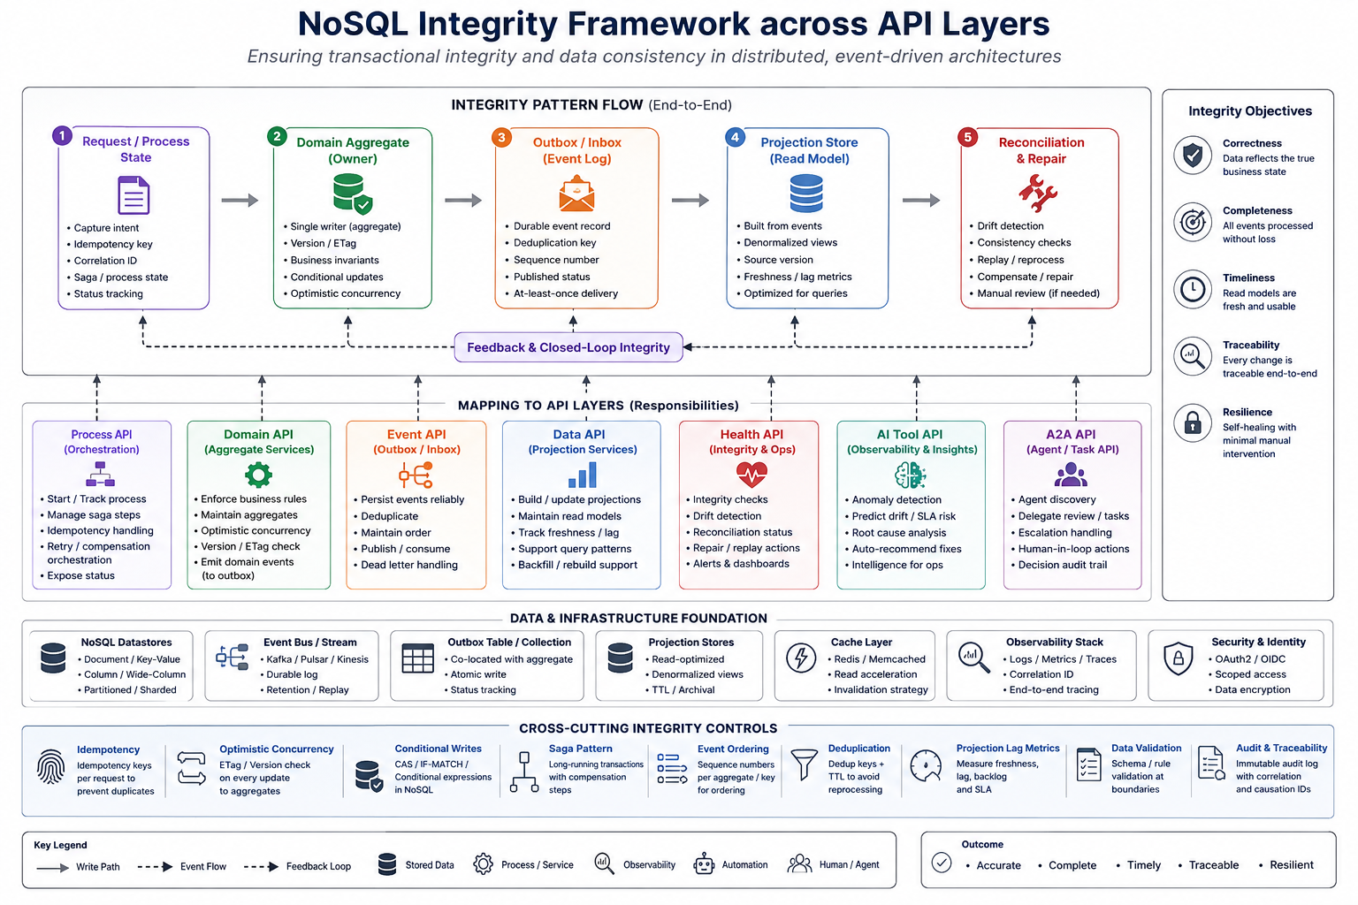
IMPLEMENTATION APPROACH
Transactional and NoSQL data integrity across API layers
NoSQL flexibility shifts integrity from hidden database assumptions to explicit API-layer ownership and reconciliation.
Process API
Domain API
durable state
saga step status
idempotency key
aggregate owner
single writer
version/ETag
System API
Data API
legacy consistency
retry contracts
fallback behavior
projection freshness
source version
lineage
Event API
Health API
outbox/inbox
deduplication
sequence/ordering
integrity status
lag + fallout
impact advice
Example pattern: `GET /{transactionRequests}/{requestId}/integrity` exposes entity versions, projection lag, event delivery status, reconciliation state, and manual-action flags.
Outcome-Centric API Design | Conference Presentation
10
Notes:
Transactional and NoSQL data integrity. A major extension in this work is the explicit treatment of transactional and data integrity across multiple NoSQL entities and across API layers. In distributed and NoSQL-heavy environments, integrity cannot rely on hidden relational assumptions. Process APIs maintain durable workflow state, idempotency keys, and saga progress. Domain APIs own aggregate boundaries, single-writer rules, and optimistic concurrency through versions or ETags. Event APIs use outbox and inbox patterns, deduplication, and sequencing. Data APIs expose projection freshness, lineage, and consistency metadata. Health APIs surface integrity lag, fallout, and manual-action flags. Reconciliation services detect drift and repair it. The disconnect workflow is used as an example: a single business transaction may affect account entities, service entities, device-return entities, settlement entities, and multiple read-model projections, all of which need visible integrity status.

Slide 11
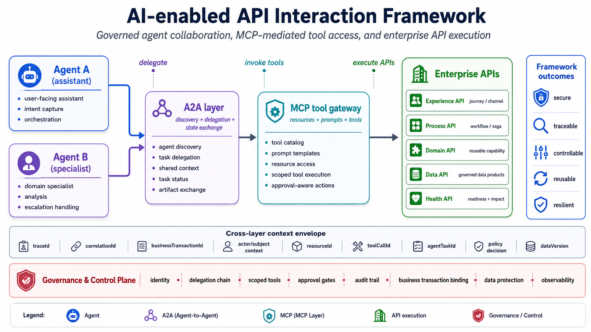
IMPLEMENTATION APPROACH
AI-enabled APIs: MCP for tools, A2A for agent collaboration
AI should interact through governed interfaces, not by bypassing API policy and transaction controls.
AI Assistant
user-facing reasoning
MCP Tool Gateway
agent → tool/API
Approved APIs
getOrderDetail • checkReadiness
A2A Collaboration
agent → agent tasks
Responsibility boundary
MCP: controlled access to APIs, tools, prompts, and resources
A2A: governed agent discovery, task delegation, state exchange, and artifacts
Process API: deterministic execution, idempotency, authorization, and audit
High-risk guardrails
Scoped tools and agent identity
Human approval for disconnect/refund/settlement
Tool-call and agent-task audit
No direct database or unrestricted execution
Outcome-Centric API Design | Conference Presentation
11
Notes:
AI-enabled APIs with MCP and A2A. AI is integrated, but in a governed way. MCP is used for tool and resource access so that an AI assistant can discover prompts, resources, and tools without bypassing enterprise API controls. A2A is used for agent-to-agent delegation, task exchange, artifact sharing, and state coordination. The boundary is important. MCP is primarily agent to tool or API. A2A is agent to agent. The deterministic business execution still belongs to process and domain APIs, where authorization, idempotency, and audit remain enforceable. This separation prevents a common failure mode where AI bypasses policy and operational integrity. The framework therefore supports AI enablement while keeping the business system authoritative.

Slide 12
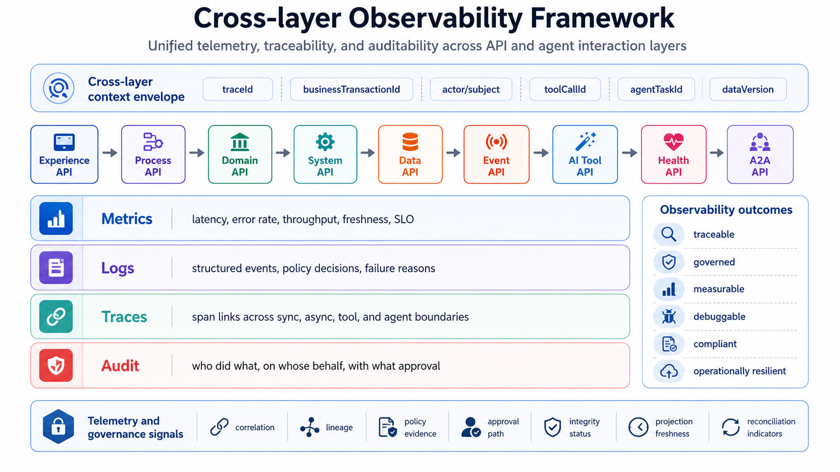
IMPLEMENTATION APPROACH
Observability and health: business trace across every API layer
Observability is the evidence system for policy, integrity, SLOs, health, and adoption.
Experience
Process
Domain
System
Data
Event
AI Tool
Health
A2A
Trace envelope
traceId
correlationId
businessTransactionId
actor/subject
resourceId
toolCallId
agentTaskId
projectionVersion
integrityStatus
Health as a consumer contract
/health/live
/health/ready
/health/dependencies
/health/capabilities
/health/impact
Outcome signal: “API is up” becomes “business transaction is progressing, authorized, consistent, observable, and recoverable.”
Outcome-Centric API Design | Conference Presentation
12
Notes:
Observability and health. Observability is the evidence system of the framework. The paper argues that telemetry should span every API layer, not just infrastructure monitoring. Metrics capture latency, throughput, freshness, and error rates. Logs capture policy decisions, failure reasons, and business state changes. Traces connect synchronous calls, asynchronous events, AI tool invocations, and A2A task transitions. Audit records show who did what, on whose behalf, under what approval path. Health APIs expose not only liveness and readiness, but dependency health, business capability status, and impact. In practice, this means you should be able to answer where a business transaction is, which API layers it crossed, what policy decisions were applied, what versions of data were observed, and whether integrity or projection lag is affecting the business outcome.

Slide 13
EVALUATION
Experimental design: 10 APIs, 4 workflows, 5 consumer types
Experimental results illustrate how the framework could be evaluated in a controlled enterprise pilot.
Scope
Consumers
10 APIs across order, account, billing, device, data, event, AI tool, A2A, and health layers
Agent desktop, workflow engine, AI assistant, operations console, integration service
Workflows
Measures
Order lookup, disconnect, billing review delegation, projection reconciliation
Reuse, contract defects, auth findings, fallout, MTTR, projection freshness, compliance score
Experimental setup
Baseline implementation compared to framework-applied implementation using the same functional scope and simulated transaction volume. Results are illustrative, not empirical.
Outcome-Centric API Design | Conference Presentation
13
Notes:
Evaluation design. The paper also proposes how the framework could be evaluated in a pilot. In the hypothetical pilot, ten APIs across four workflows and five consumer types are selected. The workflows include an end-to-end business transaction such as disconnect, an order retrieval scenario, an AI-assisted readiness scenario, and a cross-domain workflow with projections and events. The five consumer types cover self-service users, agents, operations, system consumers, and AI agents. The pilot looks at both build-time and run-time metrics. Build-time metrics include spec completeness, policy coverage, and test coverage. Run-time metrics include reuse, defect rate, fallout, recovery time, and framework adherence.

Slide 14
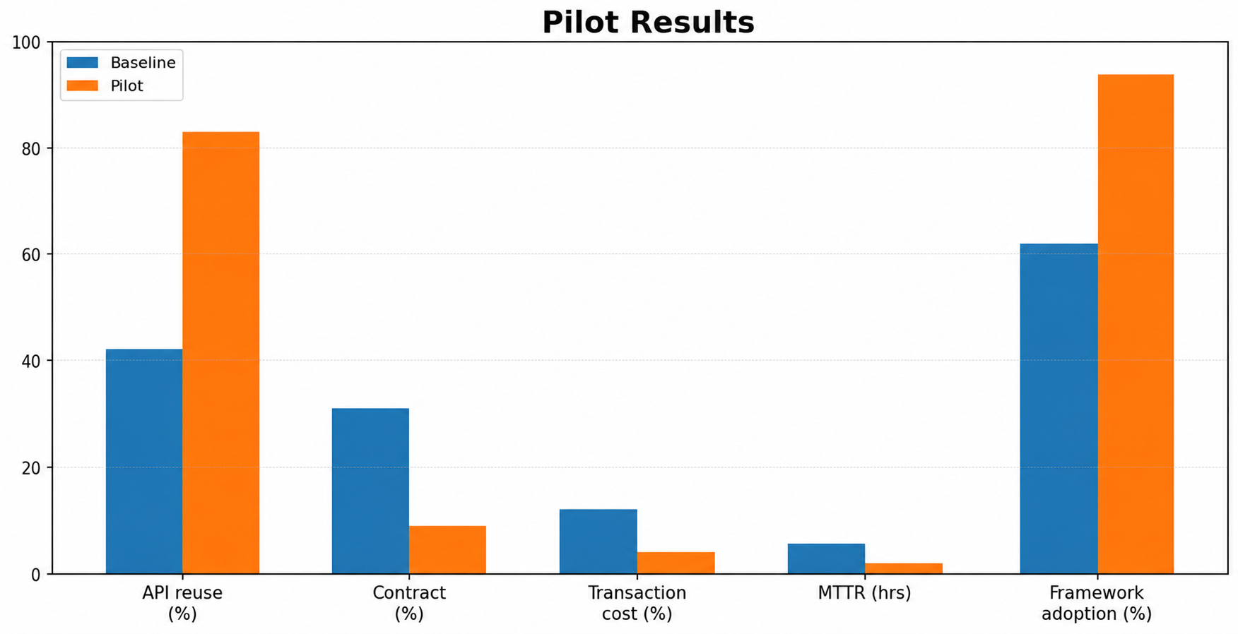
EXPERIMENTAL RESULTS
Experimental outcomes: quality improved without slowing delivery
Experimental pilot result: the largest gains came from spec-driven contracts, policy-as-code, failure-path tests, and cross-layer telemetry.
+41 pts
-71%
API reuse score
contract defects
baseline 42 → 83
31 → 9 defects
-67%
-63%
transaction fallout
MTTR
12% → 4%
5.4h → 2.0h
0
94%
high-risk AI bypasses
framework adherence
policy gate blocked all
release gate score
Interpretation
Framework adherence created measurable evidence: every API had a spec, test evidence, policy decision model, trace envelope, health impact, and integrity status.
Outcome-Centric API Design | Conference Presentation
14
Notes:
Pilot results. The illustrative results show how the framework could improve quality without slowing delivery. In this example, API reuse score increases from 42 to 83. Contract defects fall from 31 to 9, a 71 percent reduction. Transaction fallout drops from 12 percent to 4 percent, a 67 percent reduction. Mean time to recovery drops from 5.4 hours to 2.0 hours. High-risk AI bypasses are reduced to zero because policy gates block them. Framework adherence reaches 94 percent. These are hypothetical numbers, not empirical claims, but they demonstrate the kinds of measurable outcomes the framework is designed to influence. The main insight is that the biggest gains come from specification discipline, policy-as-code, failure-path tests, and cross-layer telemetry.

Slide 15
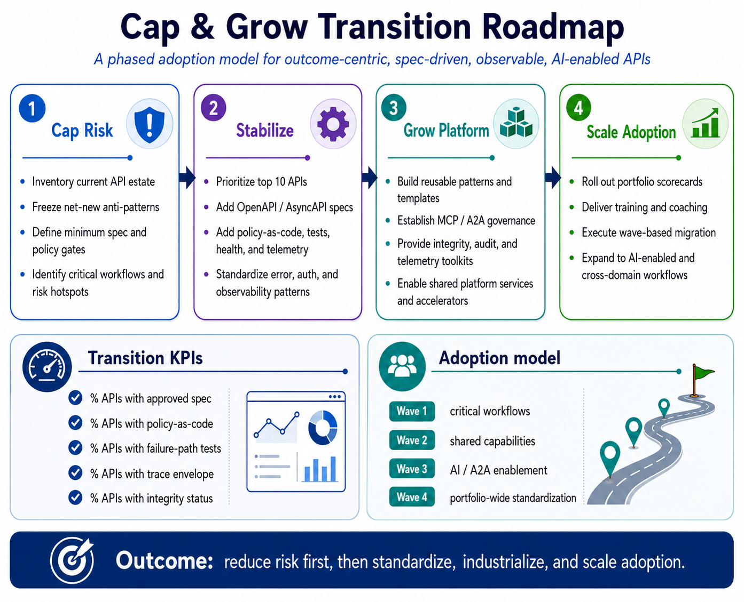
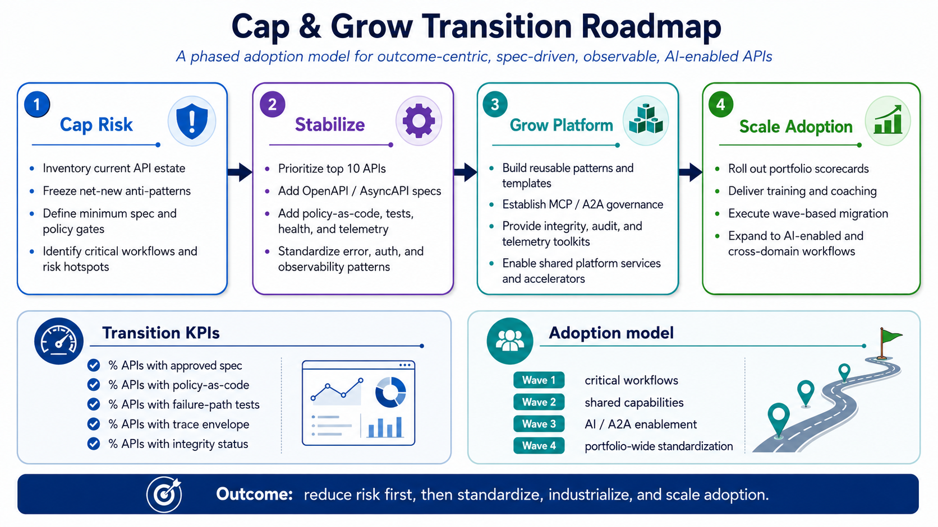
ADOPTION APPROACH
Cap & Grow: transition from API sprawl to governed capability contracts
Cap what creates risk today; grow the target architecture through measurable adoption waves.
CAP
GROW
1. Stop the entropy
4. Build API products
Freeze new screen-specific and database-wrapper endpoints unless exempted by architecture review.
Grow domain, process, data, event, health, MCP, and A2A APIs using the spec-driven factory.
2. Classify and score
5. Automate compliance
Tag existing APIs by layer, owner, consumer, risk, reuse, contract quality, observability, and integrity evidence.
Make framework adherence a CI/CD release gate: specs, tests, policy, health, trace, and integrity.
3. Wrap or retire
6. Scale by capability
Use facades/BFFs for unstable legacy access, then retire duplicate or low-value endpoints.
Expand wave-by-wave: order lookup → disconnect workflow → billing review → AI/A2A-assisted operations.
Closing thesis: APIs should be managed as business capability contracts — lean, spec-driven, secure, observable, AI-ready, and integrity-preserving.
Outcome-Centric API Design | Conference Presentation
15
Notes:
Adoption approach: cap and grow. The final part of the presentation is the transition model. Large organizations cannot replace an entire API portfolio at once. The proposed approach is cap and grow. First, cap risk by inventorying the current estate, identifying anti-patterns, and freezing risky net-new behavior. Second, stabilize a small set of critical APIs by adding specs, policies, tests, telemetry, and integrity status. Third, grow the target platform by building reusable patterns, templates, MCP and A2A governance assets, and integrity toolkits. Finally, scale adoption through scorecards, training, and wave-based migration. The success of the transition should be measured by portfolio-level indicators, such as the percentage of APIs with approved specs, policy-as-code, failure-path testing, trace envelopes, and integrity status. In closing, the paper’s main contribution is not just a better way to design one API. It is a practical framework for governing an API portfolio as a coherent, secure, AI-enabled, observable, and integrity-preserving enterprise capability system. Thank you.

Slide 16

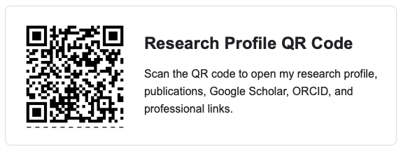
Q&A
Thank You
Outcome-Centric API Design | Conference Presentation
15

