Slide 1
WEB Technology PROJECT
Online Hostel Complaint Management System
BHAGYESH RASHINKAR
20CS3019

Slide 2
Project DESCRIPTION
Online Hostel Complaint Management System is a website through which we can register and manage hostel related complaints online. The website provides with a form through which students can register their complaints, it also provides with options to delete the complaints and update the complaint status(resolved or unresolved).
The project aims to make the complaint management process completely paper free and helps to handle the complaints with transparency and efficiency.
The project uses HTML, CSS for website design, MongoDB for database to store complaints and Node JS, Express JS to perform the CRUD(Create Read Update Delete) operations on the database.

Slide 3
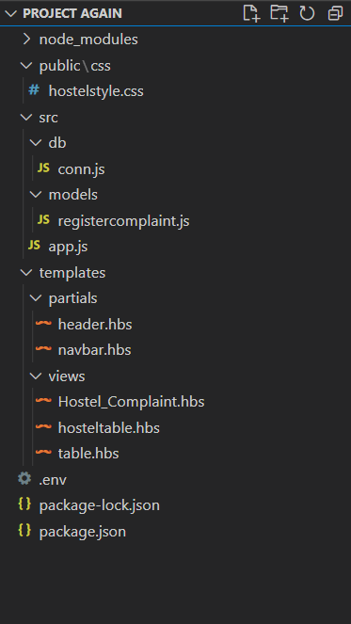
Project Folder Structure
The app.js has all the methods like get, post, update and delete, and paths which connect each element of the projects.
The db and models folders have the conn.js(connection to MongoDB) and registercomplaint.js(collection’s schema) files respectively.
The templates folder has all the .hbs files which contain the HTML codes for the webpages.
The hostelstyle.css in public/css directory has the css for the webpages.

Slide 4
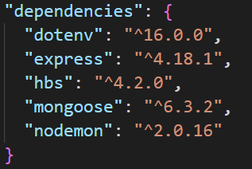
Modules Required
Open cmd in project directory and type npm install <package name> to install each module.
express: Node JS web application framework.
mongoose: MongoDB object modelling tool.
hbs: Express JS view engine to render .hbs files.
nodemon: Automatically starts server after changes in directory are detected.
dotenv: Loads environment variables from .env file.

Slide 5
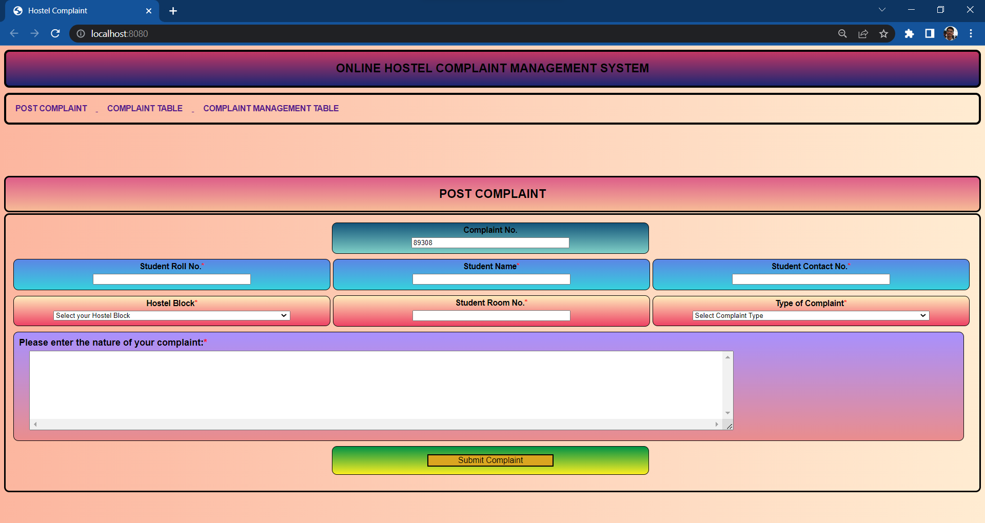
Front Page
The front page contains a form for students to post complaints.

Slide 6
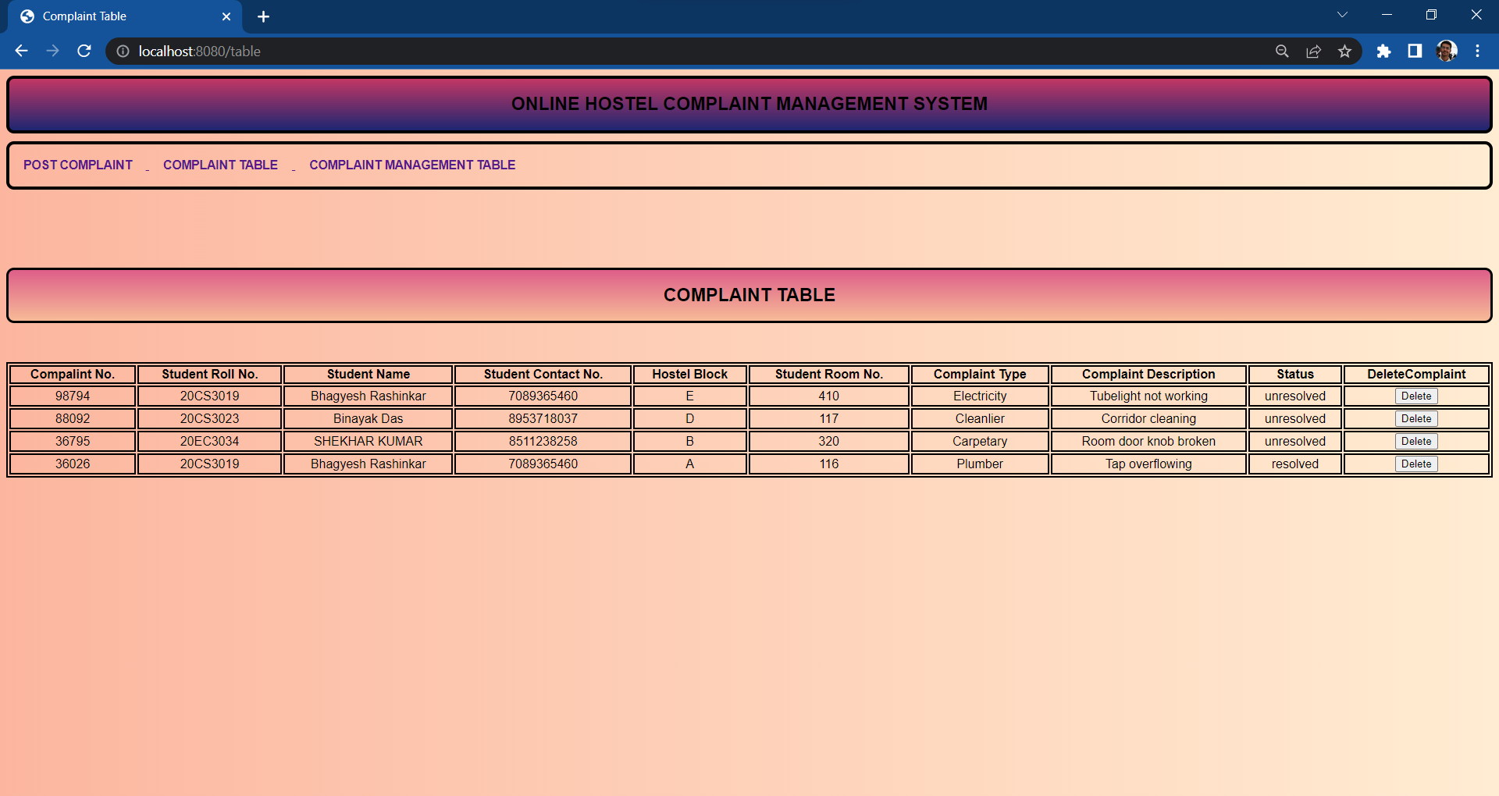
Complaint Table
This page has complaint table where students can see the status of their complaints and delete them if resolved.

Slide 7
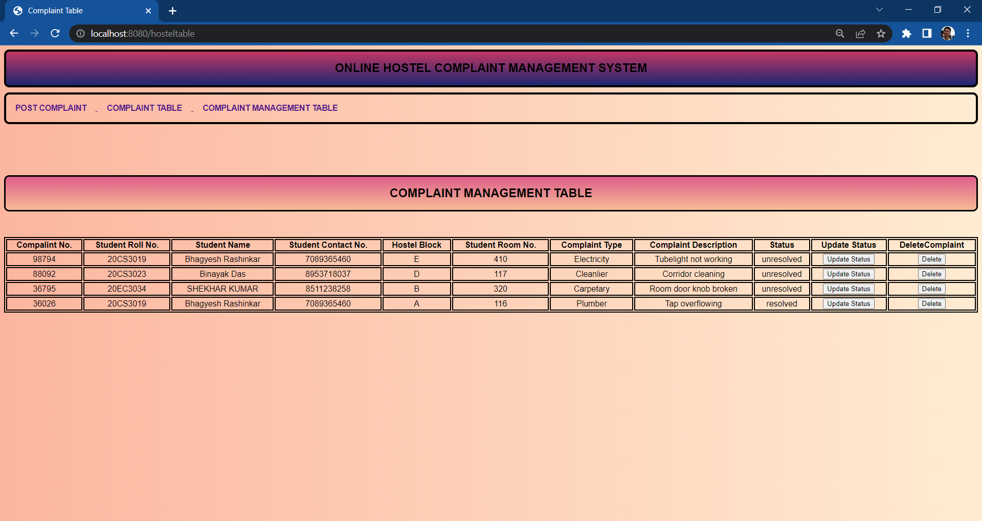
Complaint management table
This table is for hostel authorities where they can manage complaints and delete them if resolved.

Slide 8
Project Working flowchart
Fetch data to
complaint table
GET data from database
Complaint is registered via form
POST data to MongoDB database
DELETE method in POST request
DELETE data from both the tables and database
Get data from database
DELETE method in POST request
Fetch data to complaint management table
PUT method in POST request
Update status of complaint in both the tables and database

