Slide 1

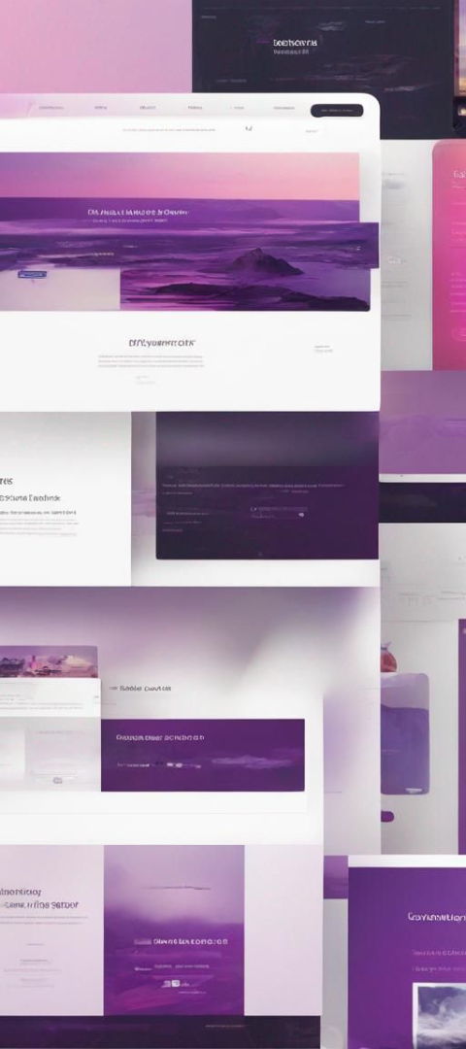
BLOG PLATFORM
Welcome to MY BLOG PLATFORM project. Our platform is designed to provide users with a modern, minimalist, and user-friendly interface for creating and managing their blogs. These messages often include a combination of text, images, and other media. Basically, a blog is a place where you can write posts and share your thoughts, experiences, and interests online.
by Bhairavi Kelwadkar

Slide 2
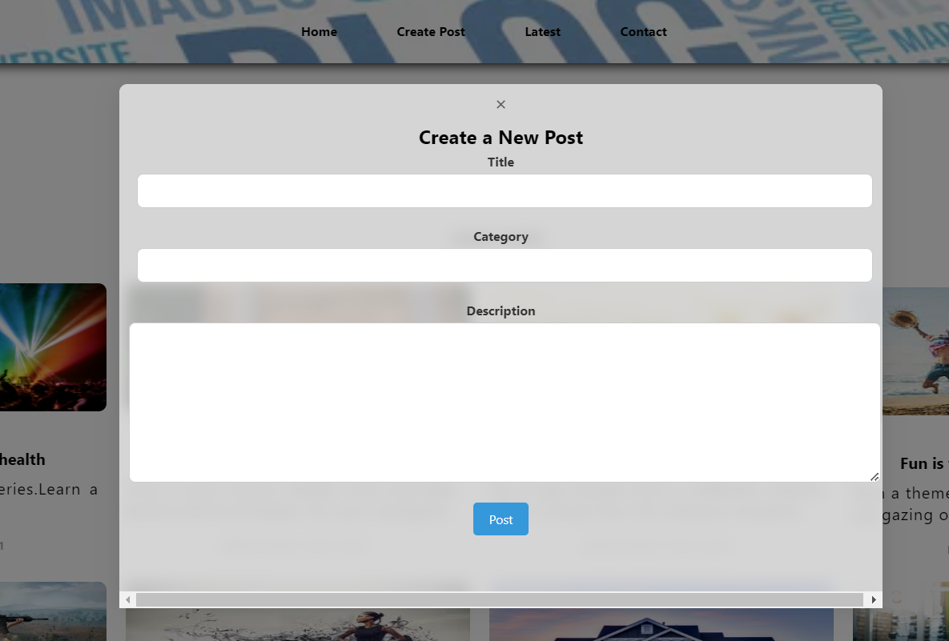
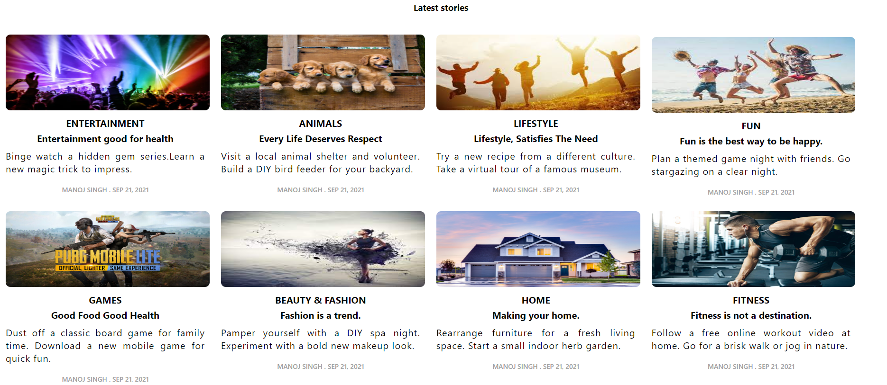
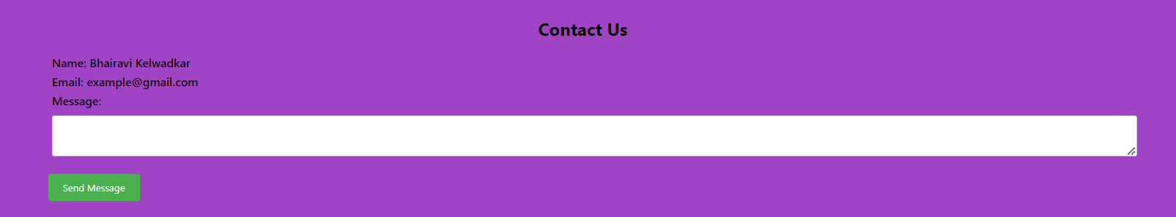
Working
Effortless Content Creation:
The "Create Post" button located in the top allows everyone to offer their voice with just one click, resulting in effortless content creation.
Curated Content Carousel :
Engaging users with new, readable information in the "Latest Stories" section.
Seamless Interaction:
The contact area encourages open dialogue and helps you gain
your audience's trust.

Slide 3




Uses
Independent Blogs
Through personal blogs, people can connect with others who share their interests by sharing their ideas, knowledge, and experiences.
Promotion of Business
The platform may be used by businesses to promote their brands, build thought leadership in their sector, and promote content.
Original Portfolios
In order to draw in clients and partners, artists, photographers, and designers can exhibit their work and portfolios.

Slide 4
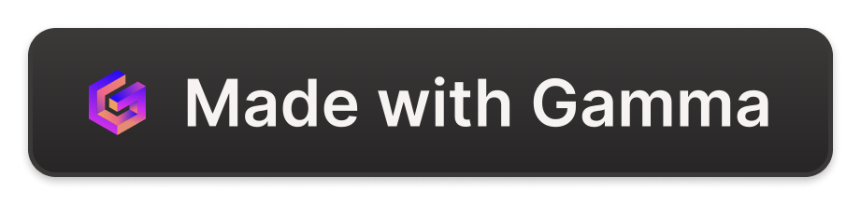
Advantages & Disadvantages
Advantages
Disadvantages
Showcase Your Skills
Update Yourself On The Latest
Reach a global audience
Creative freedom and brand building
Time commitment
Inconsistency and Lack of Self-Discipline
Disappointment
Technical challenges

Slide 5
Future scope
1
Enhanced User Experience
2
Advanced Integration
Continue to focus on improving the user interface and experience to meet changing blogging trends and user preferences.
Integrating with emerging technologies and social media platforms to enhance content distribution and engagement.
3
International Expansion
4
Monetization Opportunities
International expansion and multilingual to reach a global audience Explore support opportunities.
Designed to provide bloggers with new monetization features, including ad revenue, subscription models, and affiliate marketing.

