Slide 1
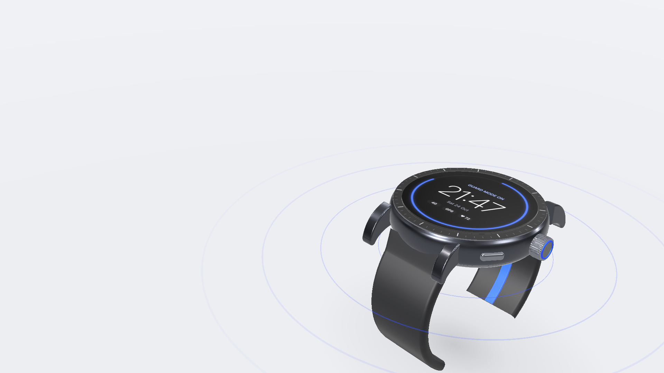
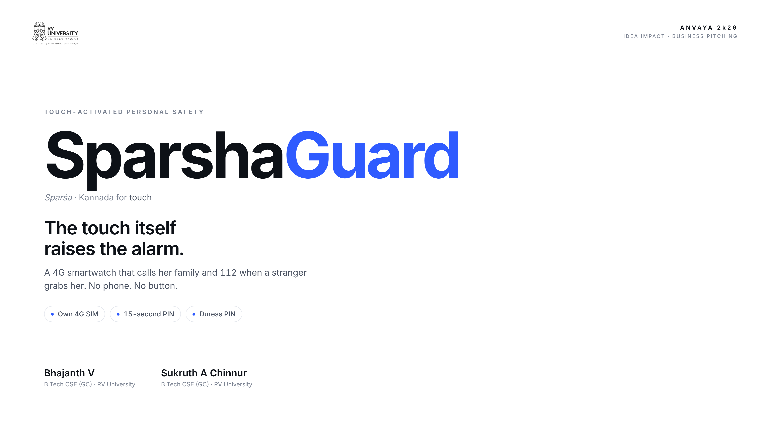
Notes:
Bhajanth · 0:00–0:15
Good morning. I'm Bhajanth V, and this is Sukruth A Chinnur, from RV University. This is SparshaGuard: a smartwatch where a stranger's touch itself raises the alarm.

Slide 2

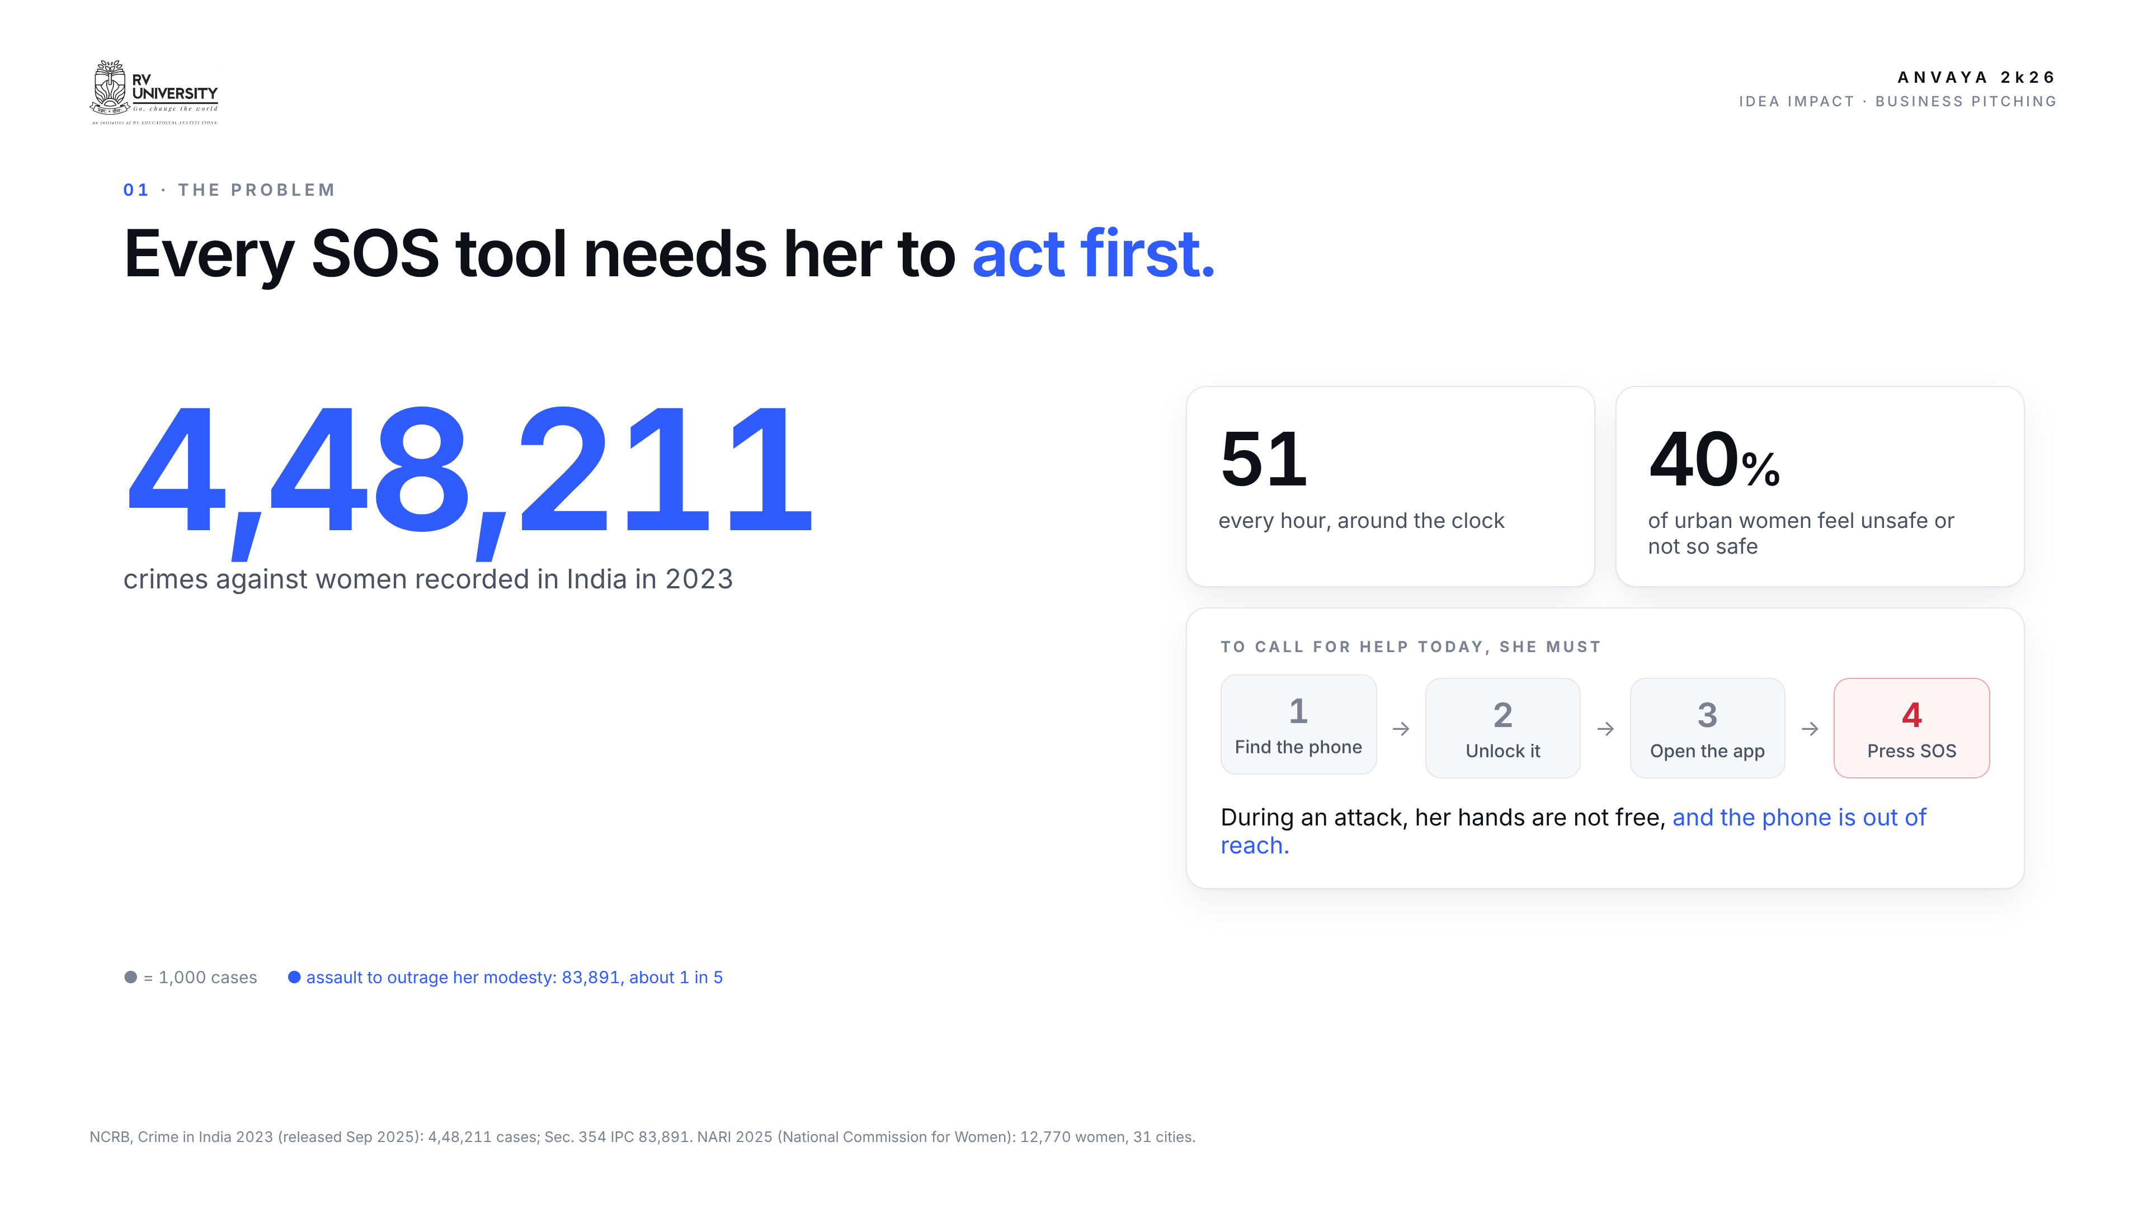
Notes:
Bhajanth · 0:15–0:47
In 2023, India recorded four lakh forty-eight thousand crimes against women: fifty-one every hour. About one in five was an assault on a woman's modesty: a grab, an unwanted touch. Forty percent of urban women say they feel unsafe. Yet every safety tool today needs her to find her phone, unlock it, open an app and press SOS. During an attack, there is no time for that.

Slide 3
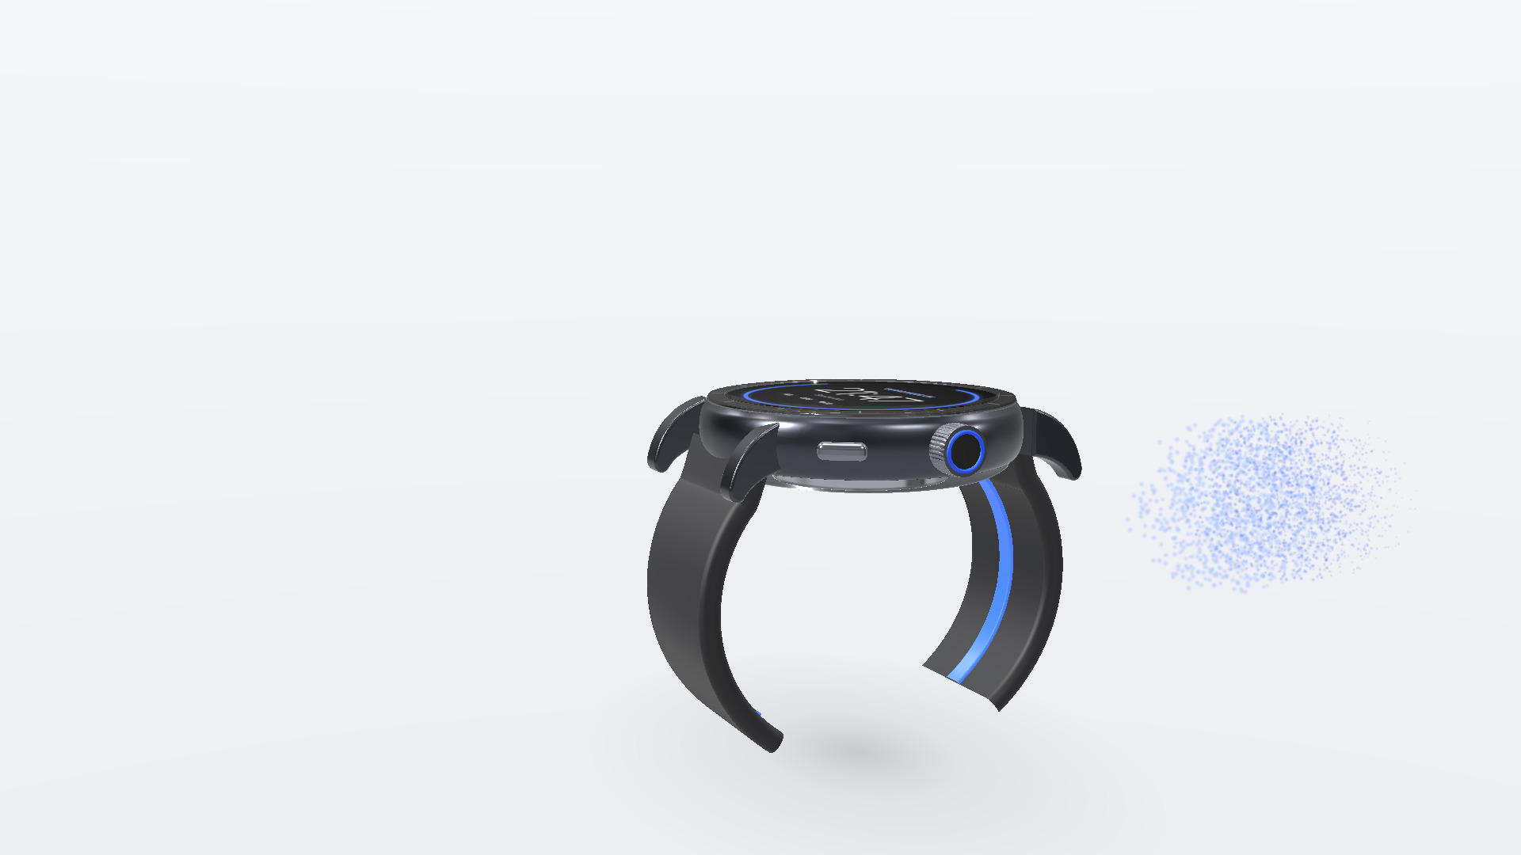
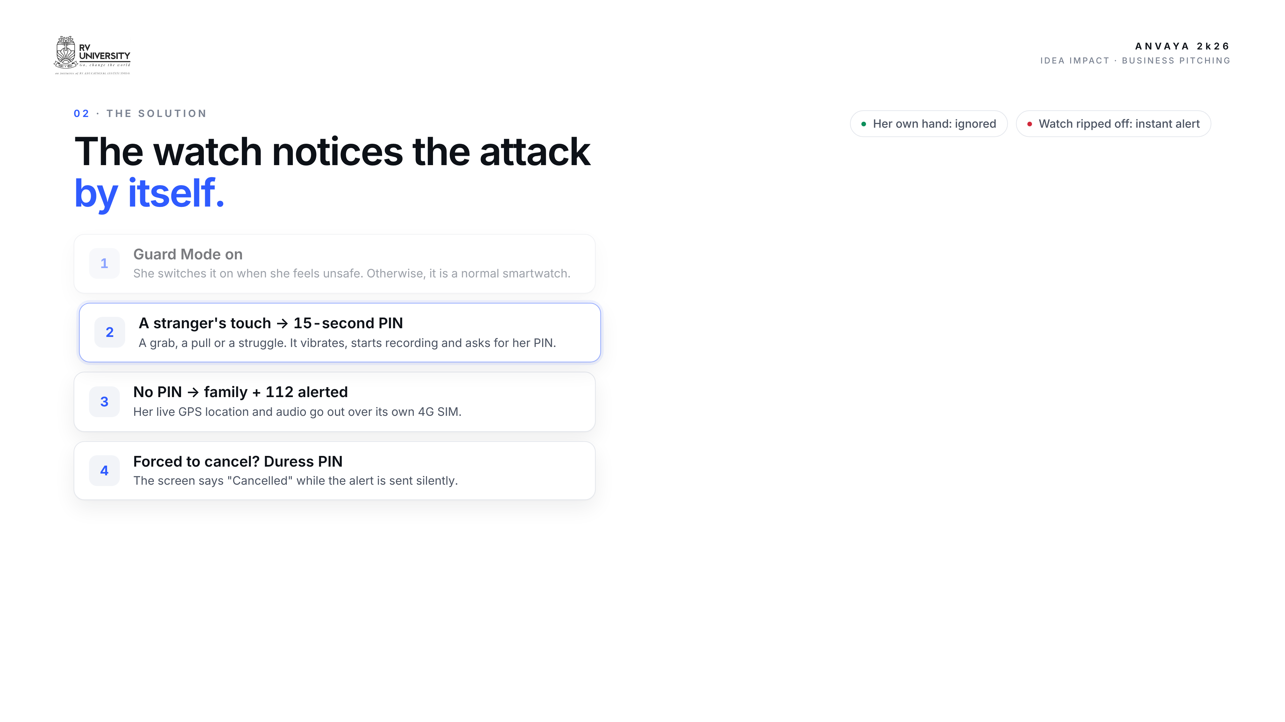
Notes:
Bhajanth · 0:47–1:25
SparshaGuard flips this: the watch notices the attack by itself. Day to day, it's a normal smartwatch. When she feels unsafe, she turns on Guard Mode. Now, if a stranger grabs her, or she struggles, the watch vibrates, starts recording, and asks for her PIN within fifteen seconds. Her PIN cancels it. No PIN, and her family and 112 get her live location and audio. And if she is forced to cancel, a duress PIN shows "Cancelled" but sends the alert silently.

Slide 4

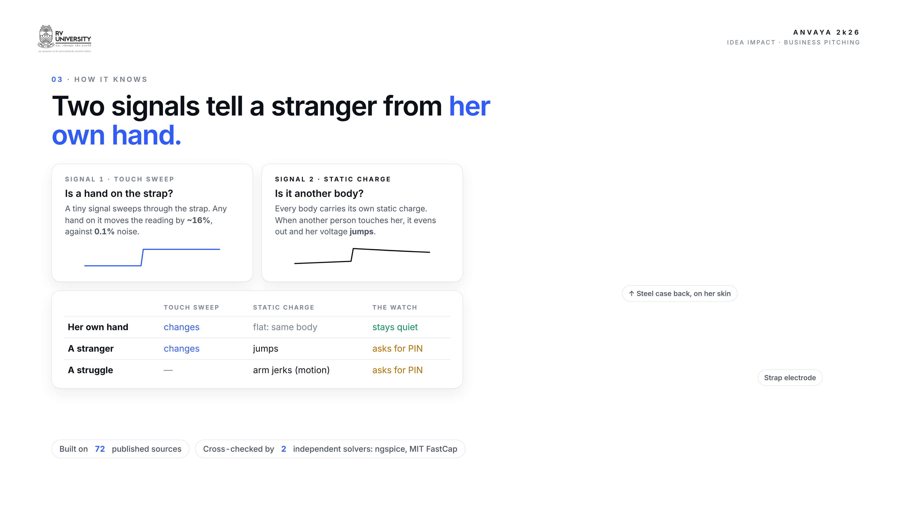
Notes:
Bhajanth · 1:25–1:57
How does a watch tell a stranger from her own hand? Two signals. First, a tiny signal runs through the strap, and any hand on it changes the reading. Second, every body carries its own static charge. When another person touches her, the charges even out and her voltage jumps. Her own hand can't do that: it's the same body. Both together mean another person.

Slide 5
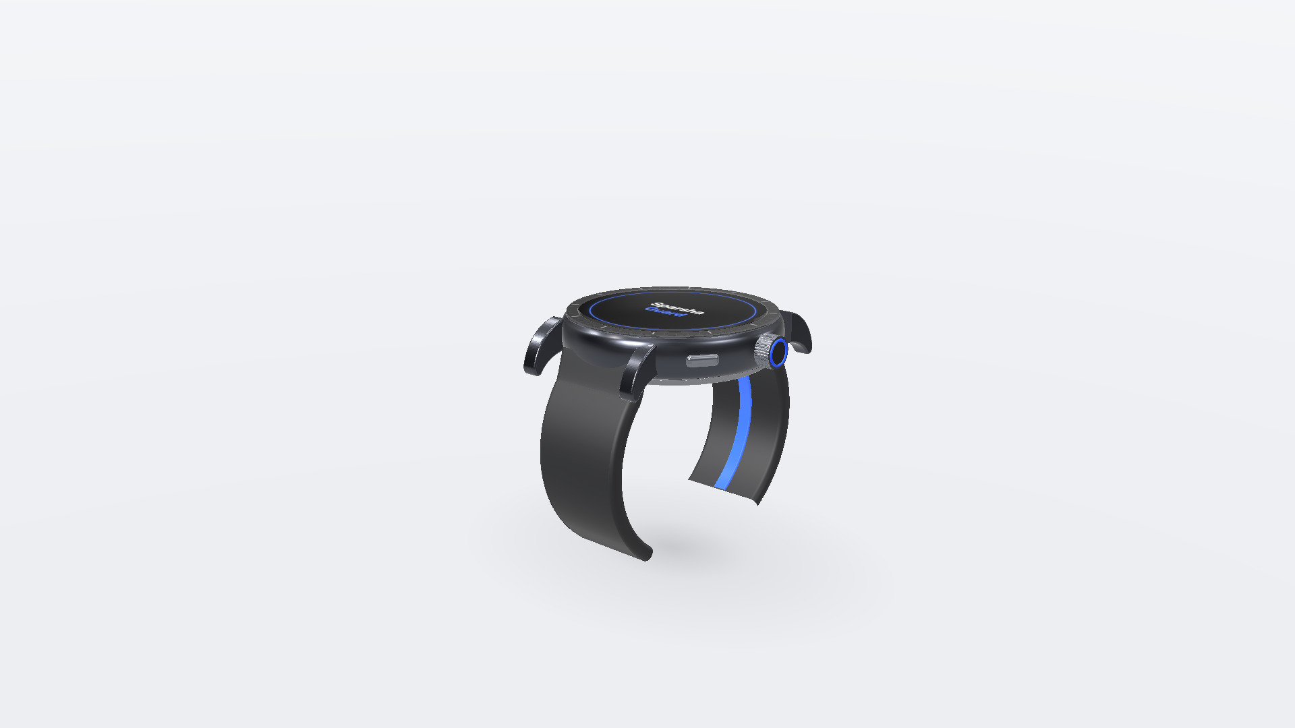
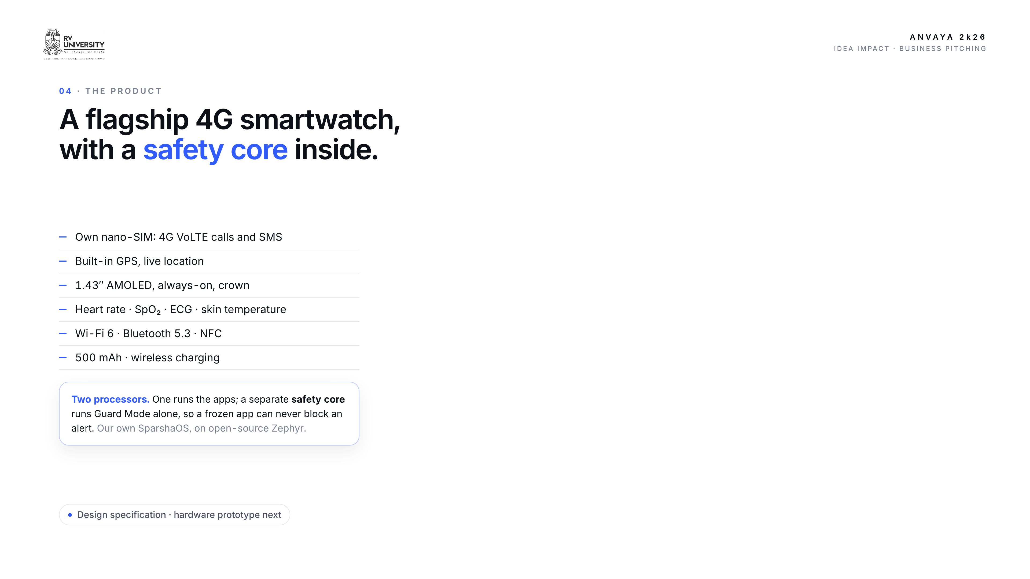
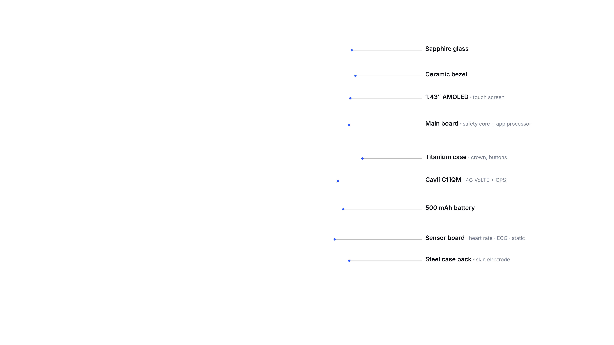
Notes:
Bhajanth · 1:57–2:25
And it's a full flagship 4G smartwatch: its own SIM for calls, GPS, an AMOLED screen, heart rate, ECG, Wi-Fi and Bluetooth, running our own operating system, SparshaOS. Inside, a separate safety processor runs Guard Mode on its own, so a frozen app can never block an alert. Sukruth will now show you the proof.

Slide 6
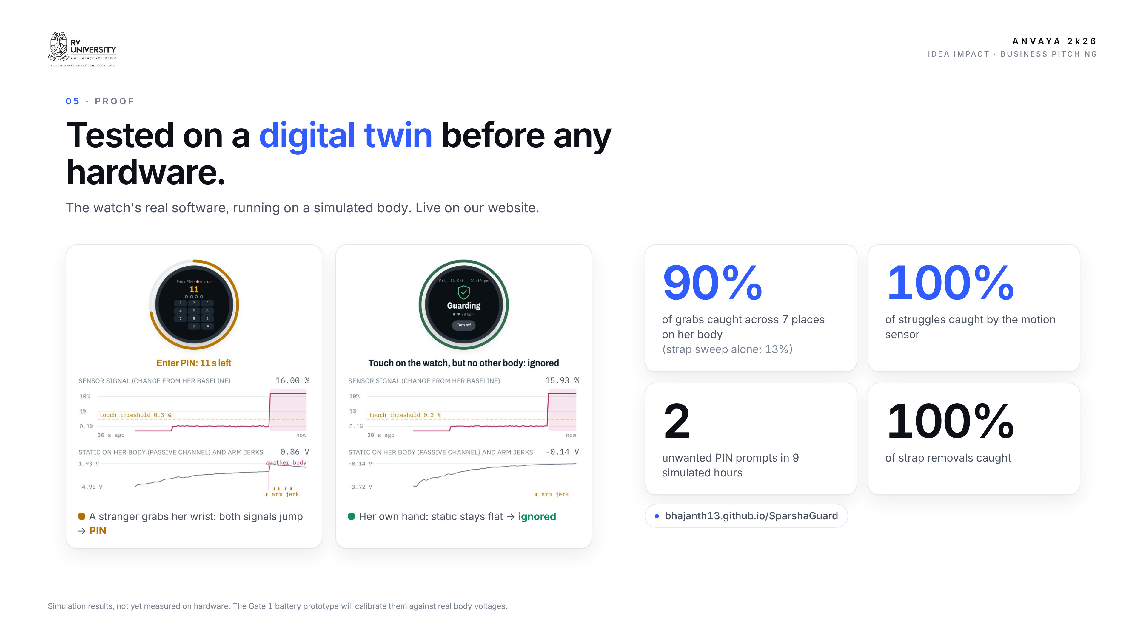
Notes:
Sukruth · 2:25–3:00
Thank you. Before building hardware, we built a digital twin: the watch's real software running on a simulated body, live on our website. When a stranger grabs her, both signals jump and the watch asks for her PIN. When she touches it herself, the static stays flat, and it stays quiet. Across seven places on her body, it catches ninety percent of grabs and every struggle, with two unwanted prompts in nine hours.

Slide 7
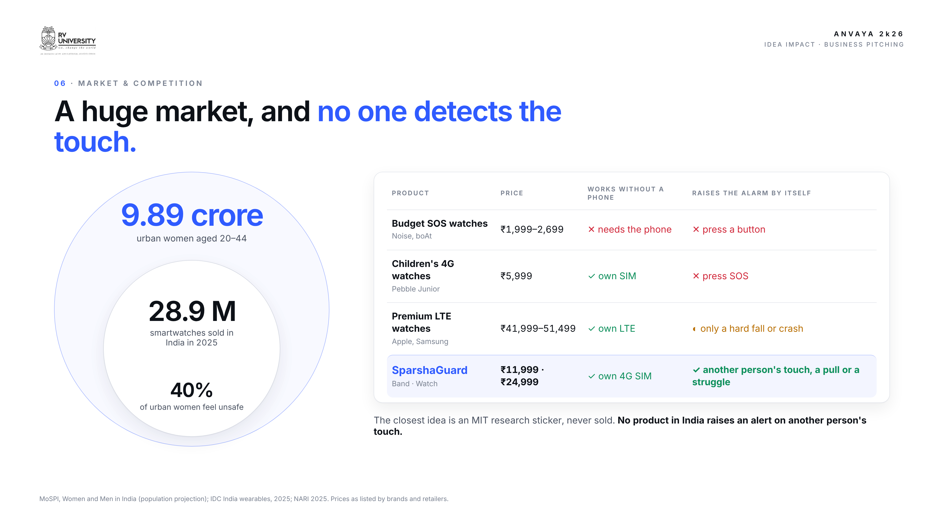
Notes:
Sukruth · 3:00–3:32
The market is huge: nine point eight nine crore urban women aged twenty to forty-four, and India buys twenty-nine million smartwatches a year. Yet budget SOS watches need a phone and a button. Children's 4G watches and premium LTE watches still wait for a button press, or a hard fall. No product sold in India raises an alert on another person's touch.

Slide 8
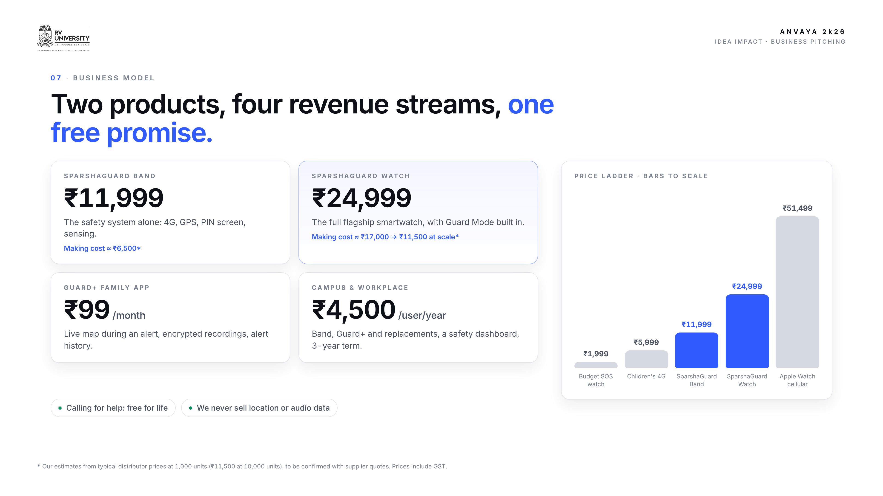
Notes:
Sukruth · 3:32–4:10
We offer two products: the SparshaGuard Band, the safety system alone, at eleven thousand nine hundred ninety-nine rupees, and the full SparshaGuard Watch at twenty-four thousand nine hundred ninety-nine, seventeen thousand rupees less than a cellular Apple Watch. Families can add Guard Plus, a live-map app, for ninety-nine rupees a month, and colleges and employers subscribe per user, per year. Calling for help stays free for life.

Slide 9
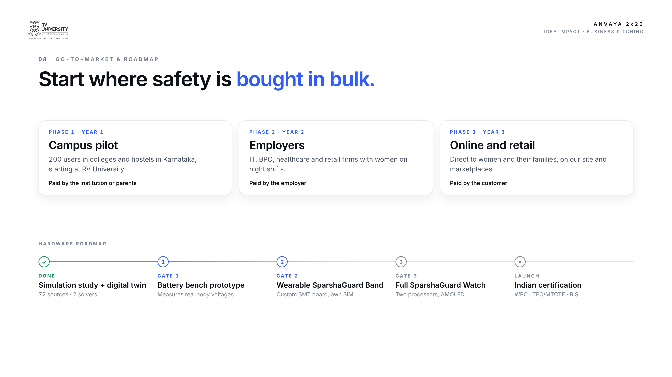
Notes:
Sukruth · 4:10–4:45
We'll start where safety is bought in bulk: a two-hundred-user campus pilot at RV University, then employers with women on night shifts, then online and retail. At each step, someone who wants her safe pays: the institution, the employer, the family. On hardware, our next step is a battery-powered bench prototype that measures real body voltages, then the wearable band, then the full watch and its Indian certifications.

Slide 10
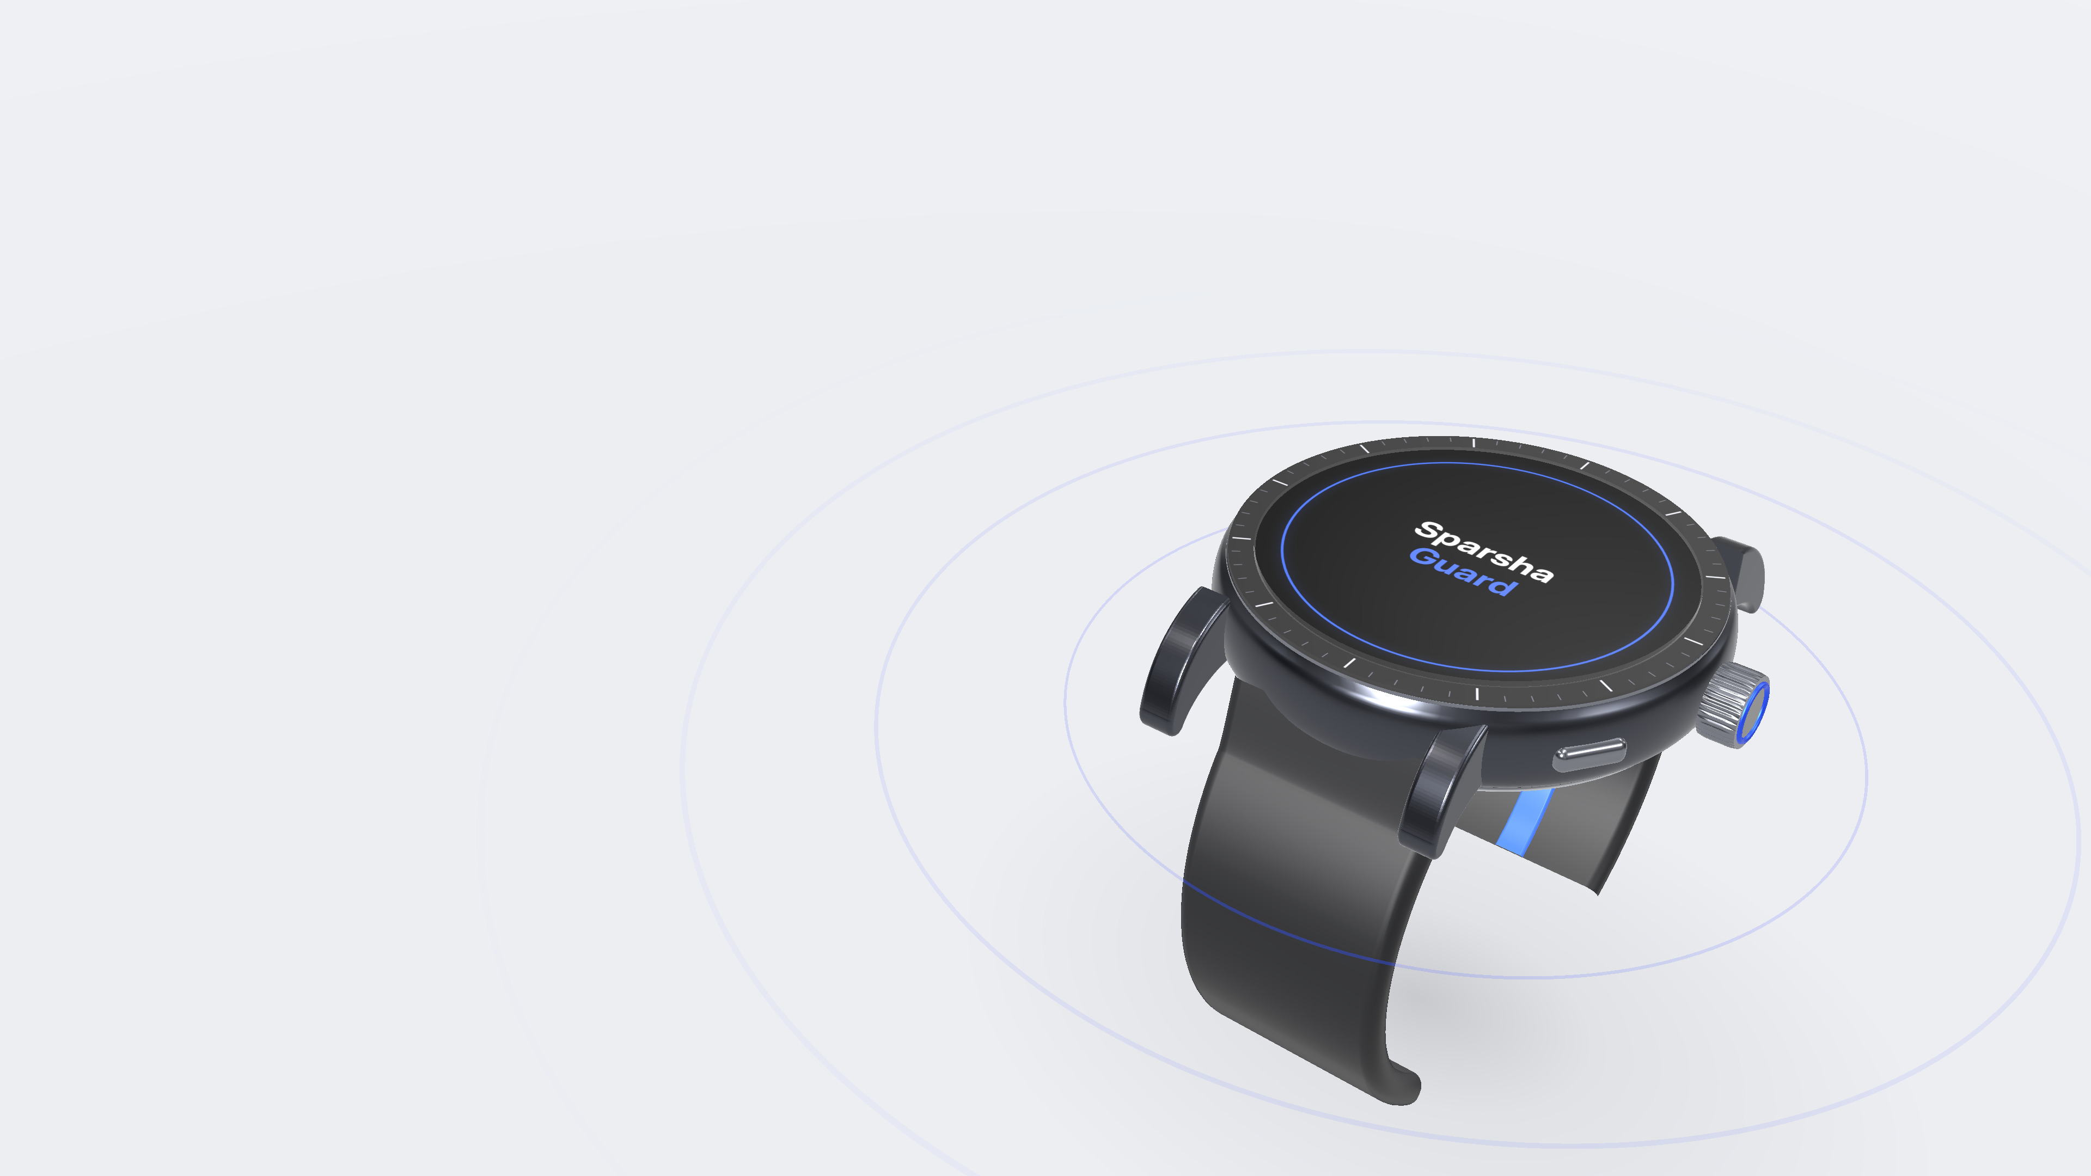
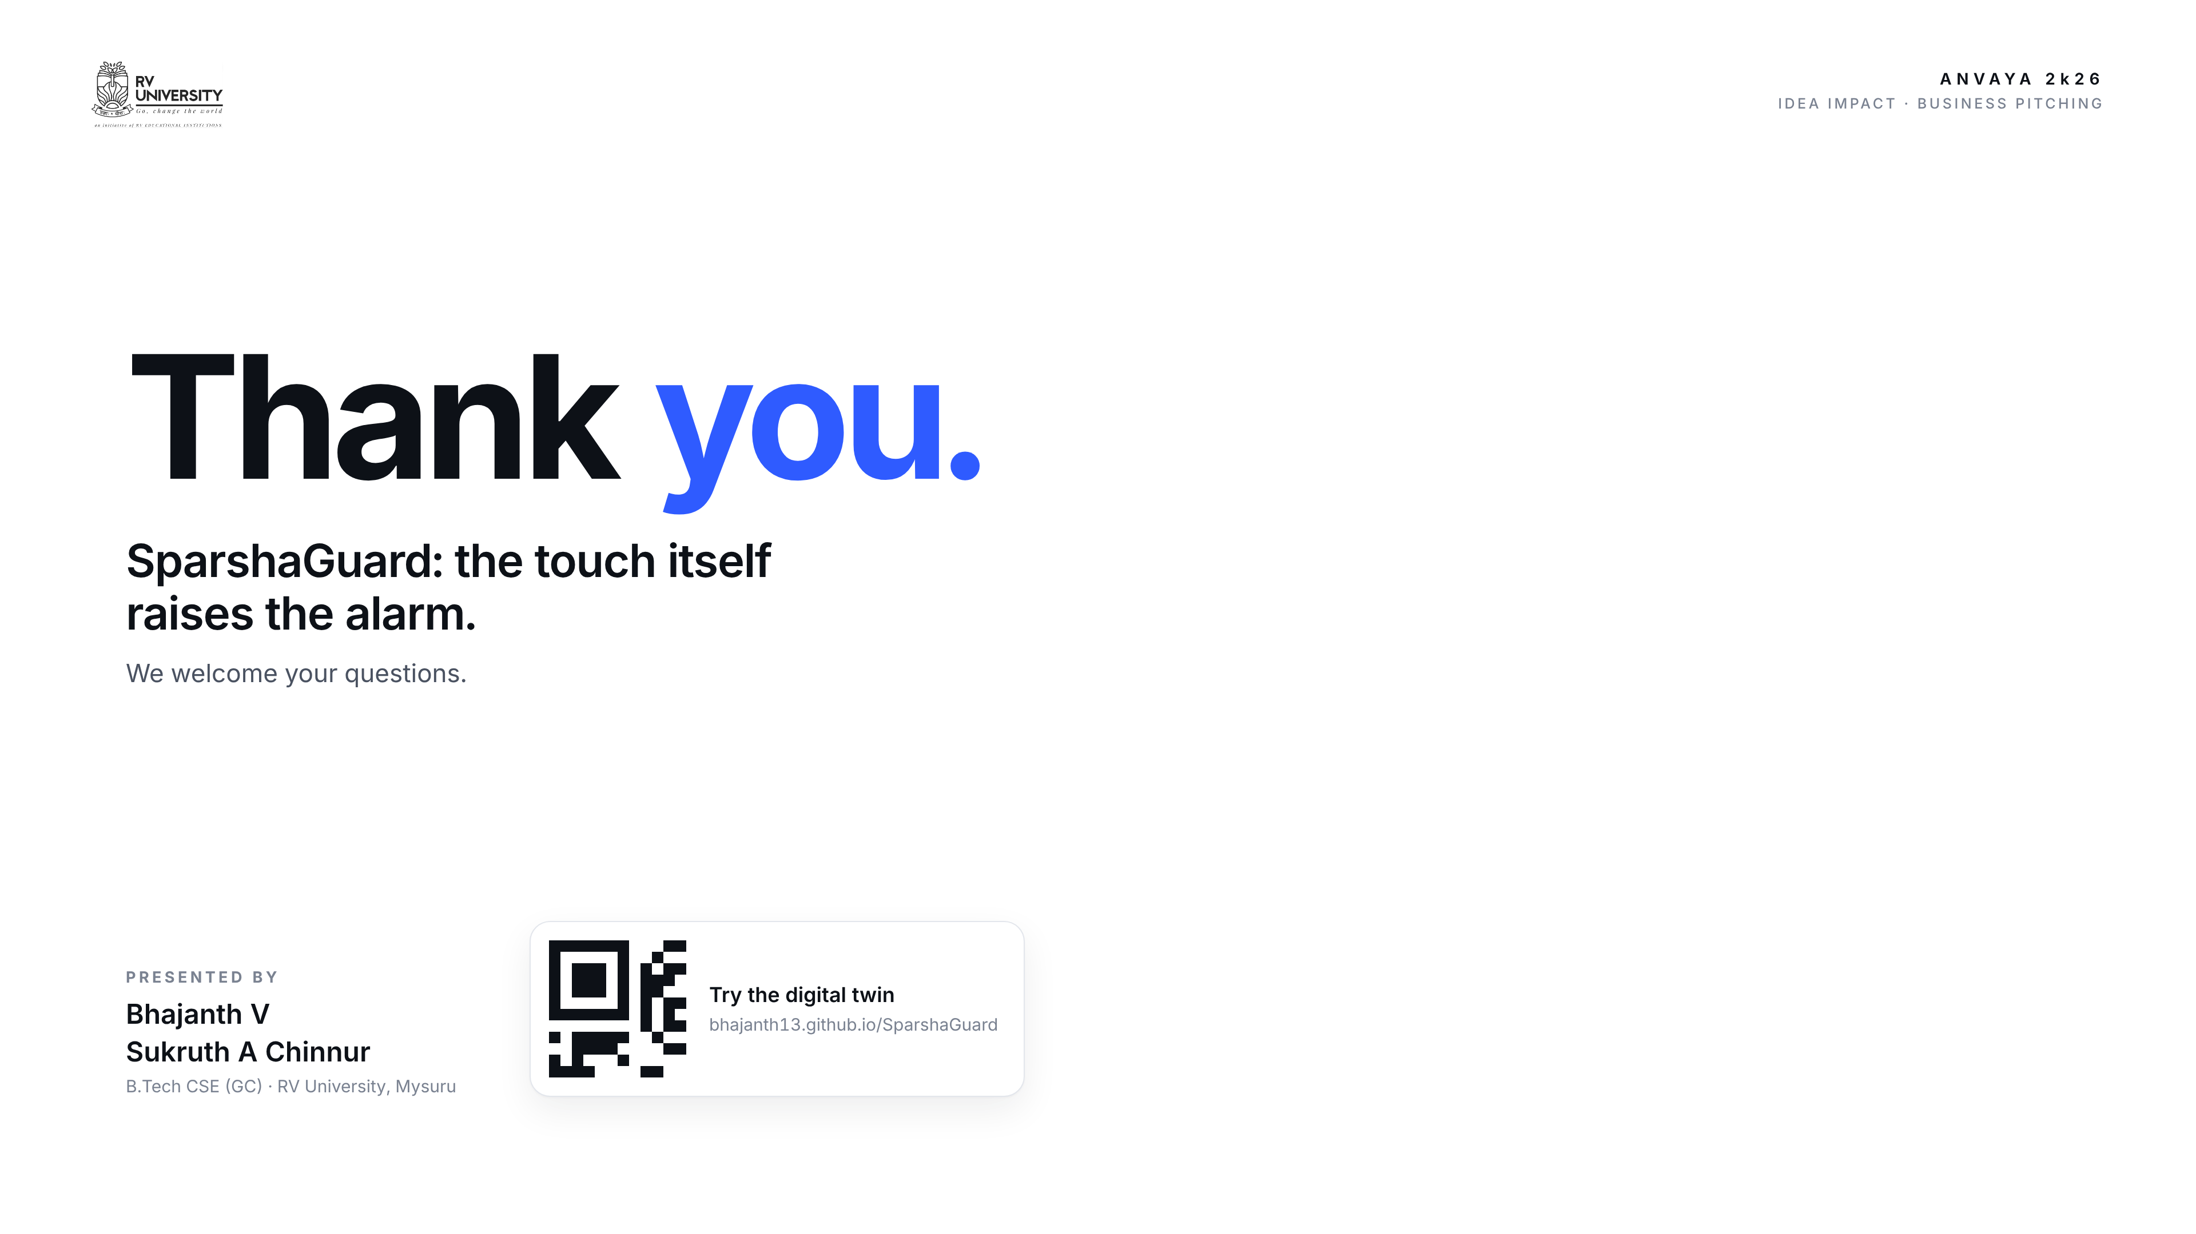
Notes:
Sukruth · 4:45–5:00
SparshaGuard: the touch itself raises the alarm. Scan the code to try our digital twin yourself. Thank you, we'd love your questions.

